Slide 1
Data Parallelism: How to Train Deep Learning Models on Multiple GPUs lab 1, part 2: More realistic networks

Slide 2
modern Neural Networks
How do they differ from our trivial example?
Not significantly!

Slide 3
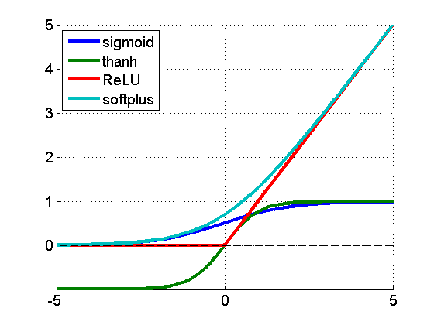
modern Neural Networks
How do they differ from our trivial example?
Nonlinearity
y = w·x + b
y = f(w·x + b)
y
y
w
b
w
b
x
1
x
1

Slide 4
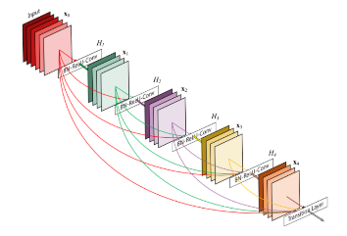
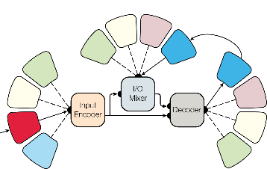
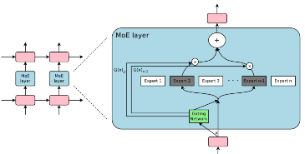
modern Neural Networks
How do they differ from our trivial example?
More complex interconnection and many more parameters
Kaiser, L., Gomez, A. N., Shazeer, N., Vaswani, A., Parmar, N., Jones, L., & Uszkoreit, J. (2017). One model to learn them all. arXiv preprint arXiv:1706.05137.
Iandola, F., Moskewicz, M., Karayev, S., Girshick, R., Darrell, T., & Keutzer, K. (2014). Densenet: Implementing efficient convnet descriptor pyramids. arXiv preprint arXiv:1404.1869.
Shazeer, N., Mirhoseini, A., Maziarz, K., Davis, A., Le, Q., Hinton, G., & Dean, J. (2017). Outrageously large neural networks: The sparsely-gated mixture-of-experts layer. arXiv preprint arXiv:1701.06538.

Slide 5
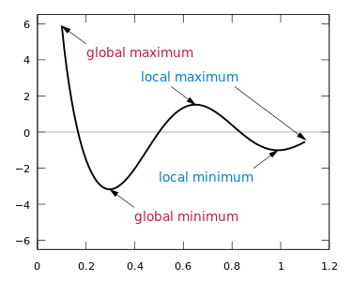
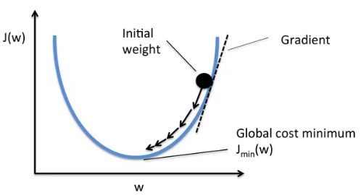
Non-convex LOss functions
Those differences make the optimization problem much more difficult

Slide 6
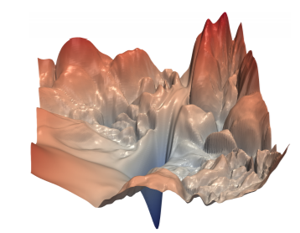
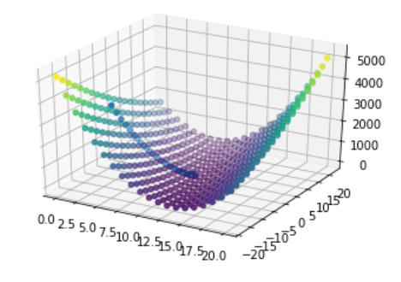
Non-convex loss functions
Those differences make the optimization problem much more difficult
Linear model loss function
ResNet-56 loss function projection to 3D – no skip connections
Li, H., Xu, Z., Taylor, G., & Goldstein, T. (2017). Visualizing the Loss Landscape of Neural Nets. arXiv:1712.09913.

Slide 7
Non-convex loss functions
Those differences make the optimization problem much more difficult
ResNet-56 loss function projection to 3D – no skip connections
Why do we succeed in finding good local minima?
Li, H., Xu, Z., Taylor, G., & Goldstein, T. (2017). Visualizing the Loss Landscape of Neural Nets. arXiv:1712.09913.
Notes:
Its not obvious that we should? Why don’t we converge to poor minima's all the time? The understanding of this problem is still very limited.

Slide 8
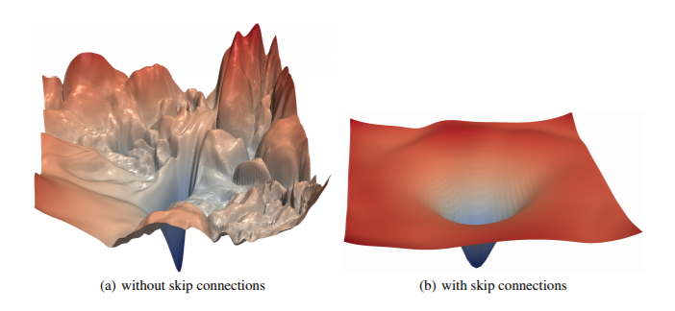
Non-convex loss functions
Recent advances such as residual connections simplify optimization
Li, H., Xu, Z., Taylor, G., & Goldstein, T. (2017). Visualizing the Loss Landscape of Neural Nets. arXiv:1712.09913.

