Slide 1
Generative AI with Diffusion Models
Part 3: Optimizations

Slide 2
Agenda
• | Part 1: From U-Nets to Diffusion
• | Part 2: Denoising Diffusion Probabilistic Models
• | Part 3: Optimizations
• | Part 4: Classifier-Free Diffusion Guidance
• | Part 5: CLIP
• | Part 6: Wrap-up & Assessment
Notes:
Our models are starting to make something recognizable, but they’re not quite there. In this section, we will look at various techniques to improve our model performance.

Slide 3
The Checkerboard Problem
Notes:
To begin, let’s talk about the checkerboard problem.

Slide 4
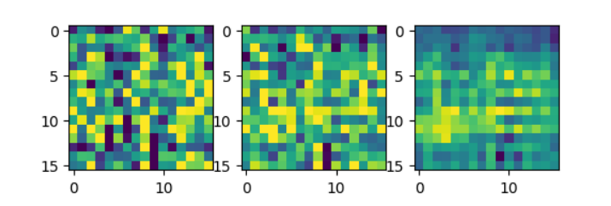
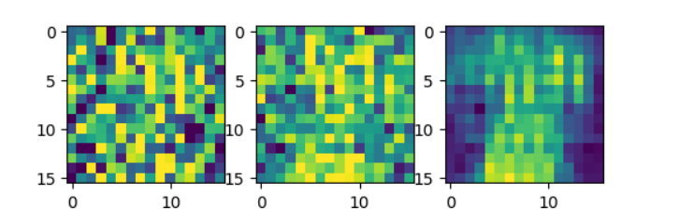
The Checkerboard Problem
Shoe?
Shirt?
Notes:
We might be able to make out what the model is trying to go for, but it has this sort of cross-stitch problem. This phenomenon is called the checkerboard problem.

Slide 5
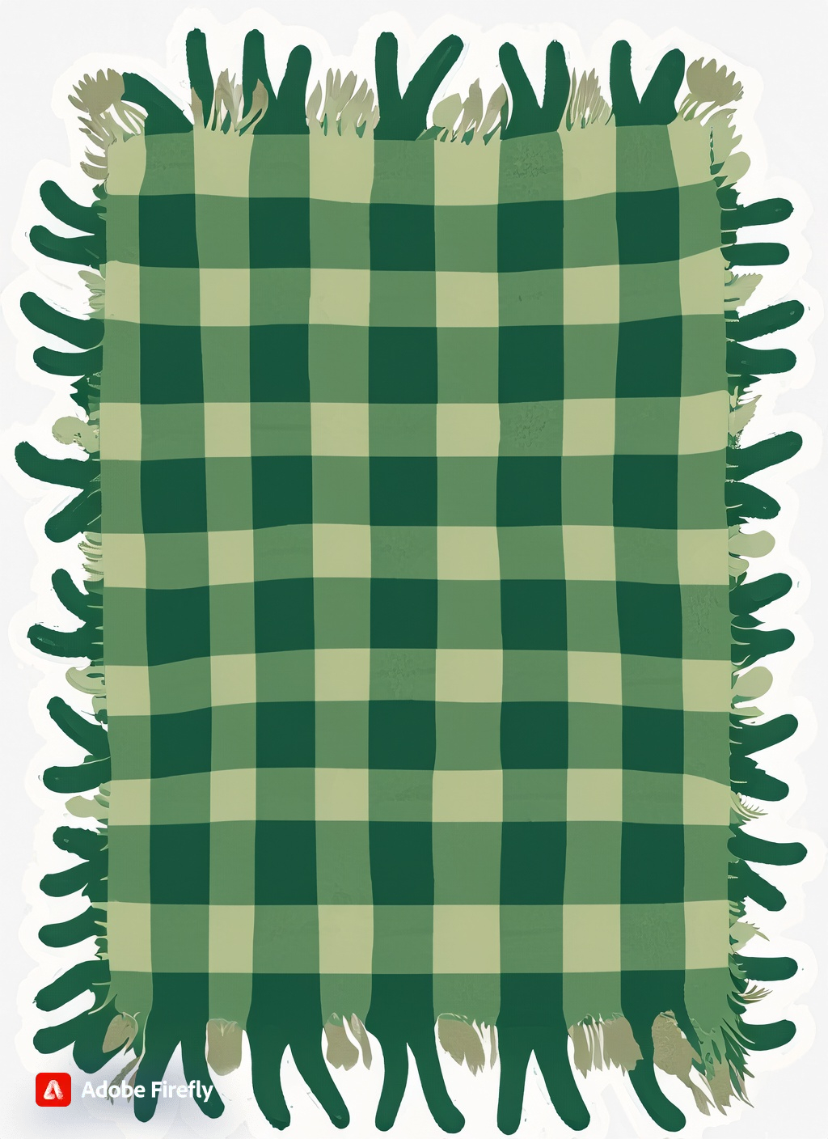
The Checkerboard Problem
The Impact of Stride
Stride = 2
Kernel Size = 3
A cozy green plaid blanket, fairy tale drawing
Notes:
Here’s the theory to what’s happening during transposed convolution. If the kernel size is larger than the stride…
We can end up using a pixel value for calculation multiple times, resulting in this cozy blanket pattern.

Slide 6
The Checkerboard Problem
The Impact of Stride
Stride = 2
Kernel Size = 2
Notes:
Even if the kernel and stride are not overlapping, the kernel can still output a pattern if it has trouble learning. In the next few slides, we will go over some model optimizations to help get a better output.

Slide 7
Group Normalization
Notes:
One technique is called group normalization.

Slide 8
Group Normalization
Batch Normalization Review
H, W
C
N
Notes:
Let’s say we have a batch of images. We could represent all the pixel values for every image with this cube here. To make things easier to visualize, we’ll combine the width and height into one dimension.

Slide 9
Group Normalization
Batch Normalization Review
H, W
C
N
Batch Normalization
Notes:
The goal of batch normalization is to convert the output of each neuron across a batch into a z-score, hence the word “normalization”. With convolutional neural networks, a kernel is equivalent to a neuron, so if the output of each neuron creates a channel, the outputs across the channel is normalized.
In practice, it is found that small batch sizes are effective, so the impact of batch normalization is minimized.

Slide 10
Group Normalization
Types of Group Normalization
H, W
H, W
C
C
N
N
Batch Normalization
Group Normalization
Notes:
With group normalization, we will normalize the output of each sample image across a group of channels. Each image in the batch does not influence each other.

Slide 11
Group Normalization
Types of Group Normalization
H, W
H, W
H, W
C
C
C
N
N
N
Instance Normalization
Group Normalization
Layer Normalization
Group Size = 1
Group Size = 2
Group Size = All
Notes:
When group size is 1, Group Normalization is equivalent to Instance Normalization. When group size equals the number of channels, Group Normalization is equal to Layer Normalization

Slide 12


Group Normalization
Types of Group Normalization
H, W
H, W
C
C
N
N
Group Normalization
Group Normalization
Group Size = 2
Group Size = 3
Notes:
The channels should be divisible by the group size. If not, there will be leftover channels that cannot be grouped.

Slide 13
Gaussian Error Linear Unit
(GELU)

Slide 14
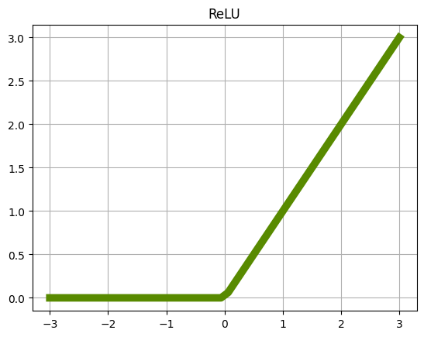
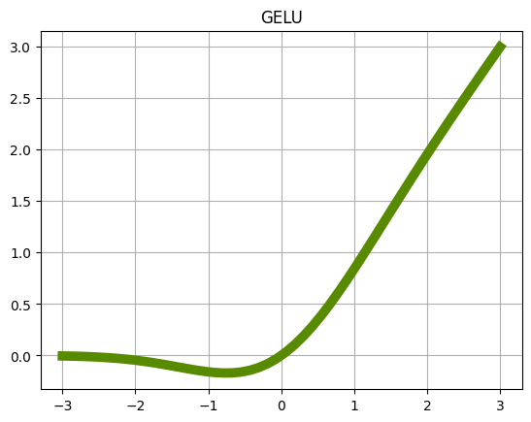
GELU
Gaussian Error Linear Unit
Notes:
When the constant term (b) in a ReLU gets too negative, all of the outputs are zero. Then the ReLU neuron is “dead” because its output is always zero, and the derivative of a flat line is zero.
GELU tries to fix this by creating a smoother function. When the sum of the inputs is largely negative, GELU will still have a small derivative.
The examples in our notebooks probably will not have any dead neurons, but we will get some practice with GELU anyway.

Slide 15
Rearrange Pooling

Slide 16
Pooling
Max Pooling Review
Image
Pooled Image
1 | 8 | 6 | 7
5 | 3 | 0 | 9
0 | 5 | 6 | 1
9 | 3 | 7 | 8
8 | 9
9 | 8
Information lost
Notes:
Max Pooling is an effective technique for reducing the size of our feature map, but it also drops a lot of information. What if some of that information is useful? Can we somehow let the neural network decide what information is useful?

Slide 17
Einops
Better Dimension Manipulation
Rearrange(
"c (h p1) (w p2) -> (c p1 p2) h w", p1=2, p2=2
)
1
2
3
4
Cut image into strips and stack
5
6
7
8
9
10
11
12
13
14
15
16
Notes:
What if instead of pooling the information, we stack the cells in such a way that it can be processed by a convolution kernel? Enter the Einops library. The goal of Einops is to provide tools that have more control over rearranging our feature maps.
Here’s an example to the right. p1 and p2 define the parts we would like to split our dimension. In this case, we’re requesting every other column get cut into strips and stacked along the channel dimension.
Then, cut every other row into strips and stack those along the channel dimension.
We can use parenthesis to identify which part variable should affect which dimension.

Slide 18
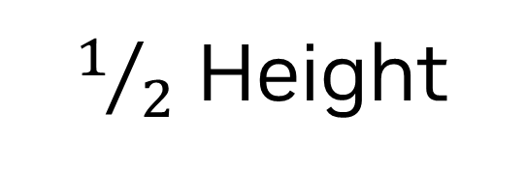
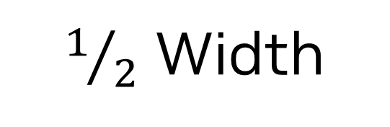
Einops
Better Dimension Manipulation
Rearrange(
"c (h p1) (w p2) -> (c p1 p2) h w", p1=2, p2=2
)
6
6
5
5
12
2
4
14
1
3
11
13
10
10
$1/2$ Height
Cut image into strips and stack
9
11
4 x new Channels
$1/2$ Width
Notes:
This will halve the width and height of our feature map, but in turn, quadruple the number of kernels. Then we can use our convolution kernels as normal.

Slide 19
Einops
Order Matters
Rearrange(
"c (h p1) w -> (c p1) h w", p1=2
)
Rearrange(
"c (p1 h) w -> (c p1) h w", p1=2
)
Notes:
By the way, the order is important here. If we put the part variable p1 after the height dimension h, it lets einops know that every p1th row should be grouped.
On the other hand, if we put p1 before h, it tells einops group the first p1 rows, then the next p1 rows, and so on.

Slide 20
Sinusoidal Position Embeddings

Slide 21
Time as a Sequence
How to Represent Time as Discrete Steps?
t
0 | 1 | 2 | 3 | 4 | 5 | 6 | 7 | 8 | 9 | …
As a one-hot encoding?
0 | 0 | 0 | 0 | 0 | 0 | 0 | 1 | 0 | 0 | …
t = 7
0 | 0 | 0 | 0 | 0 | 0 | 0 | 0 | 1 | 1 | …
0 | 0 | 0 | 0 | 1 | 1 | 1 | 1 | 0 | 0 | …
0 | 0 | 1 | 1 | 0 | 0 | 1 | 1 | 0 | 0 | …
0 | 1 | 0 | 1 | 0 | 1 | 0 | 1 | 0 | 1 | …
As binary?
Notes:
Currently, time is being passed into the model as a single float. In the real world, time is continuous, but with diffusion, time passes with more discrete timesteps. If we do not make it clear to the model that time is a sequence, it may learn to think that it can interpolate between the steps. For example, it might think that the amount of noise added at timestep 2 would be the average between timestep 1 and timestep 3.
That’s not always true, is it?
So we might consider treating time as a category. We could one-hot encode each timestep.
This would help the model better see time as discrete, but we also loose something valuable. We lose the ability to add timesteps. If we add 2 + 4 it should give us 6. If we one hot encode t, we can no longer do this.
How about we convert our time to binary?
This is getting closer. There is one weird property of representing time in this way. If we add 0001 to 0111, we get 1000. In terms of binary, that’s a small change. But to our model, all 4 digits changed. It will think “Must be a big change!” Maybe we can find a smoother way to express these values.

Slide 22

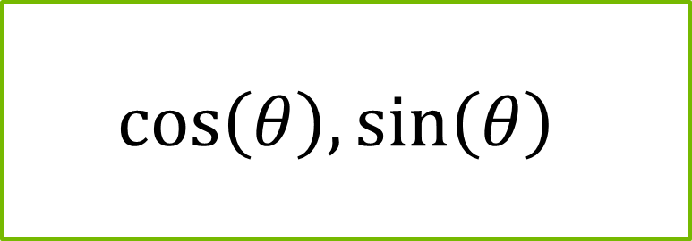

Time as a Sequence
As a Unit Circle?
1, 0
$$\frac{−\sqrt{2}}{2},\frac{\sqrt{2}}{2}$$
$$cos\left(θ\right), sin\left(θ\right)$$
$$θ$$
-1, 0
1, 0
0, -1
Notes:
Know what’s smooth? The edge of a circle. What if we put our time on a clock? We can use time as the angle of the hand of the clock. We can use this to get two numbers: the sine of the angle and the cosine of that angle.

Slide 23
Time as a Sequence
As Unit Circles?
12
11
t = 3
10
9
Notes:
Let’s say we have a good ole 12 hour clock. With that, we can get 24 values: the sine and cosine for each hour on the clock.
But why settle for one clock? Why not multiple clocks? If we use multiple clocks that count up to a different number of hours, we can represent many values with these clocks. For example, if we only use a 12 hour clock, 3 o’clock would look the same as 15 o’clock…

Slide 24
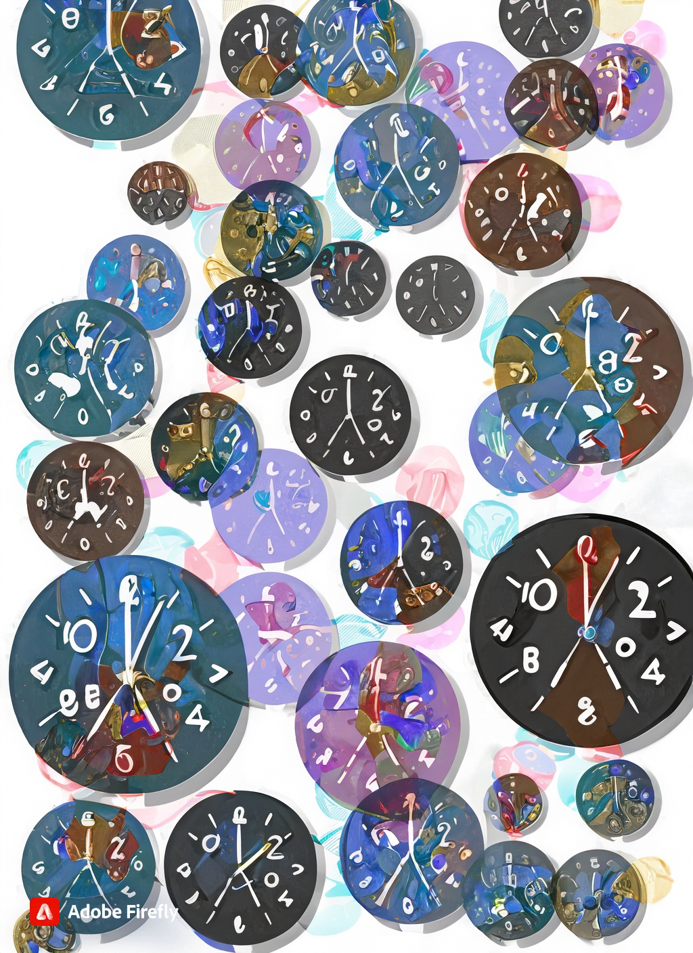
Time as a Sequence
As Unit Circles?
12
11
t = 15
10
9
A bunch of abstract clocks with different numbers on them
Notes:
But if we have an 10 hour clock, 3 o’clock would be 120 degrees, and 15 o'clock would be 180 degrees. The 12 hour clock and the 10 hour clock would only line up every 60 hours. With a few clocks, we can represent many timesteps!
If you would like to learn more about how this system came about, please check out the blog post by Jonathan Kernes linked in the presentation notes:
https://towardsdatascience.com/master-positional-encoding-part-i-63c05d90a0c3

Slide 25
Deeper Networks

Slide 26

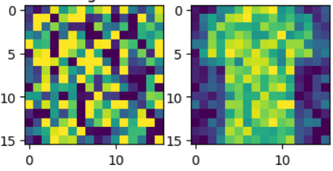

The U-Net Architecture
Adding Time
Time
Time Embed 2
Missing in previous labs
Feature Map
(Down0)
Down0
Copy
Feature Map
(Up2)
Time Embed 1
Feature Map
(Down1)
Down1 Copy
Feature Map
(Up1)
Feature Map
(Down2)
Down2 Copy
Feature Map
(Up0)
Latent Vector
Notes:
It’s time for me to come clean. Remember this diagram? Well, the lab does not perfectly replicate it. I purposely left out the top-level skip connection. Adding this back in will dramatically improve the pattern caused by the checkerboard problem.

Slide 27
Adding Depth
Normalization
Activation Function
Convolution
Normalization
Activation Function
Conv T
CT
Up
Block
Notes:
In general, adding more depth helps fight the checkerboard model. This is what our convolution blocks look like so far…

Slide 28
Adding Depth
Normalization
Activation Function
Convolution
Normalization
Activation Function
Convolution
Normalization
Activation Function
Convolution
Normalization
Activation Function
Convolution
Normalization
Activation Function
Conv T
CT
Up
Block
Notes:
And this is what we’ll change it to. We’ll add two more convolution layers per up block.

Slide 29
Let’s get started!
Notes:
Ready for the model to create something recognizable? Let’s get started!

