Slide 1
Generative AI with Diffusion Models
Part 4: Classifier-Free Diffusion Guidance

Slide 2
Agenda
• | Part 1: From U-Nets to Diffusion
• | Part 2: Denoising Diffusion Probabilistic Models
• | Part 3: Optimizations
• | Part 4: Classifier-Free Diffusion Guidance
• | Part 5: CLIP
• | Part 6: Wrap-up & Assessment
Notes:
Thus far, we have generated purely random images. We haven’t been able to tell the model what it should generate.

Slide 3
Adding Context
Notes:
So in this section, we’re going to learn how to add context.

Slide 4
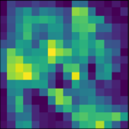
Adding Context
Shirt sleeve?
Shoe heel?
Notes:
Our models are now able to generate something recognizable, but since we are not giving it any categorical information, it doesn’t know how to tell the difference between a shoe and a shirt.

Slide 5

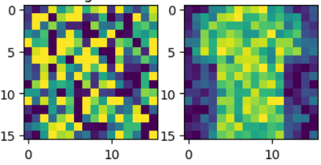

Adding Context
Time
Position Embed
Time Embed 2
Feature Map
(Down0)
Down0
Copy
Feature Map
(Up2)
Time Embed 1
Feature Map
(Down1)
Down1 Copy
Feature Map
(Up1)
Feature Map
(Down2)
Down2 Copy
Feature Map
(Up0)
Latent Vector
Notes:
So, we’re going to make a tiny change to our model. This is what we had before

Slide 6
Adding Context
Time
Position Embed
Time Embed 2
Feature Map
(Down0)
Down0
Copy
Feature Map
(Up2)
Time Embed 1
Context Embed 2
Feature Map
(Down1)
Down1 Copy
Feature Map
(Up1)
Context Embed 1
Feature Map
(Down2)
Down2 Copy
Feature Map
(Up0)
Latent Vector
Context
up2 = self.up2(c_emb2 * up1 + t_emb2, down1)
Notes:
And this is how we will add context. We will one-hot encode our clothing class, and then create an embedding. Unlike time which gets added into the feature map, the context will be multiplied. This is a technique to keep our model sizes smaller. The theory is, multiplication and addition are different enough operations the model will have an easier time learning how to treat the embeddings separately.

Slide 7
Classifier-Free Diffusion Guidance
Notes:
That’s it for model updates, but it’s not the only thing we will do to add context. We will also guide our context during diffusion.

Slide 8
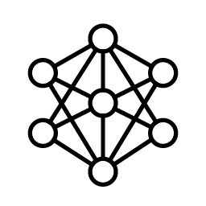
Make a Classifier Model?
Diffusion Model
Classifier Model
“Shoe”
Notes:
Here’s the dilemma. Even though we’ve added classifier information into the model, it’s not included in the loss function. Because of this, the classifier input will have a weak influence on the result.
Researchers thought about how to make this influence stronger? What if we made a classifier model, like a typical convolutional neural network? The classifier could guess what the category is, and how correct it was would be added to the loss function of the diffusion model.
This technique works, but researchers have since found a better way.

Slide 9
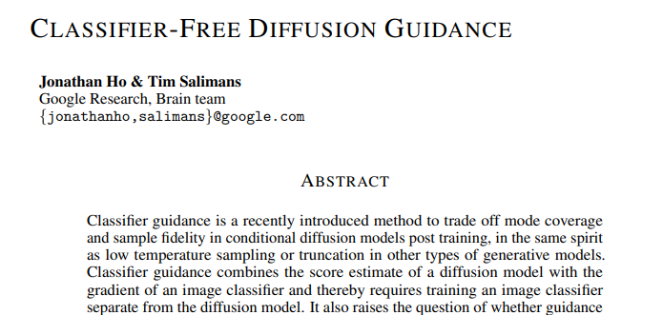
Classifier-Free Diffusion Guidance
Notes:
Jonathan Ho and Tim Salimans from the Google Brain team created a way to add contextual guidance without the need for a classifier model. Hence the name “Classifier-Free Diffusion Guidance”. Here’s how it works.
https://arxiv.org/pdf/2207.12598.pdf

Slide 10

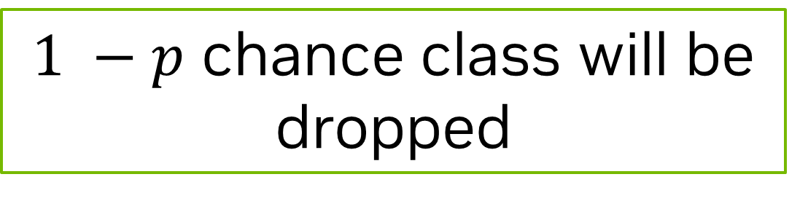
Classifier Free Diffusion Guidance
Bernoulli Masks
“sneaker”
one-hot encoding
0 | 0 | 0 | 0 | 0 | 0 | 0 | 1 | 0 | 0
Bernoulli mask
1 | 1 | 0 | 1 | 0 | 1 | 1 | 1 | 1 | 1
p = .9
0 | 0 | 0 | 0 | 0 | 0 | 0 | 1 | 0 | 0
$1 −p$ chance class will be dropped
A weighted coin flipping through the air like a cartoon
Notes:
We’re going to make an interesting change to how we change our model. We’ll still one-hot encode our clothing categories. However, we’re going to randomly drop values from that encoding.
We will use the Bernoulli distribution to do this. The Bernoulli distribution is much like flipping a weighted coin. Let’s say our coin has a 90% chance of landing heads. We’re going to take each category value represented in our one-hot encoding and flip our weighted coin. If it’s tails, we’ll set that encoding value to zero.
If you’re thinking “that seems like extra work. Why not flip only one coin for our one-hot encoding?”
And to that I say, “I like the way you think, and I will explain why later.”

Slide 11
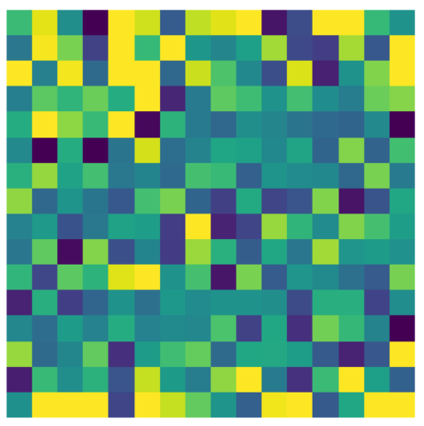
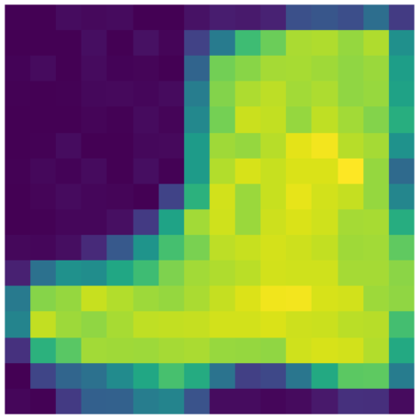
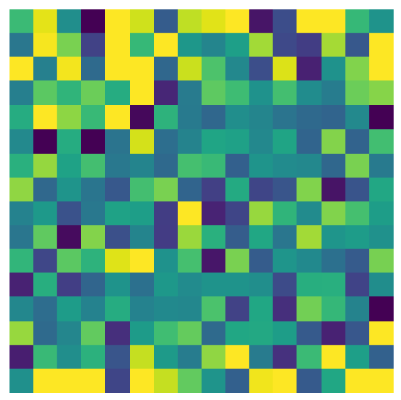
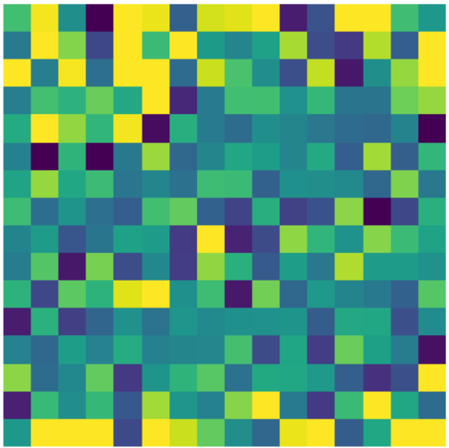
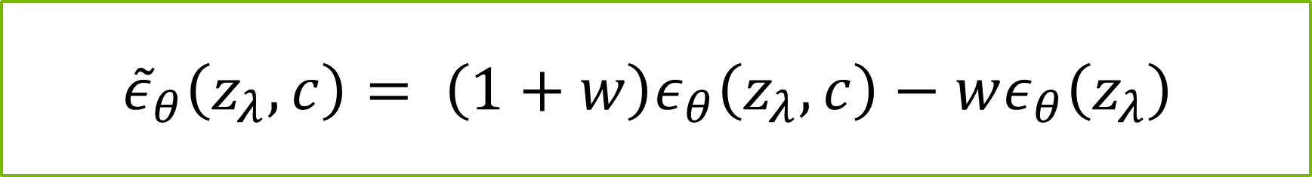



Classifier Free Diffusion Guidance
Weighted Reverse Diffusion
$${\tilde{ε}}_{θ}\left(z_{λ},c\right)= \left(1+w\right)ε_{θ}\left(z_{λ},c\right)−wε_{θ}\left(z_{λ}\right)$$
Keep Context
$$t=1$$
$$1+w$$
$$−w$$
Drop Context
Notes:
Another question could be, “Why would we drop the context encoding at all?”
Good question! We’re going to do something pretty clever. When we are generating our images by removing noise, we are going to predict two kinds of added noise. The first set of noise, we will keep the context information. The second set of noise, we will drop all context information.
Let’s call the first noise the context noise and the second noise the average noise. We will subtract the average noise from the context noise by weighting them both with w. Here, I’ve set w equal to 1. Do you see the difference? I sure don’t. It’s very subtle.

Slide 12

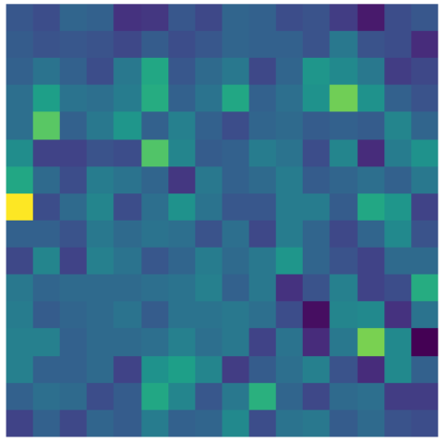
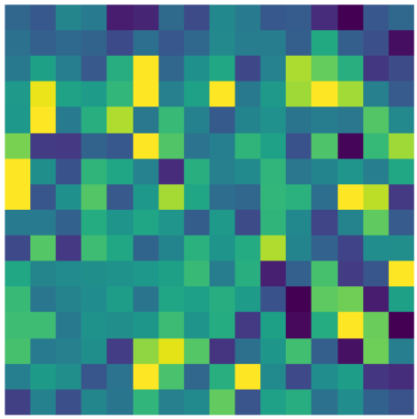
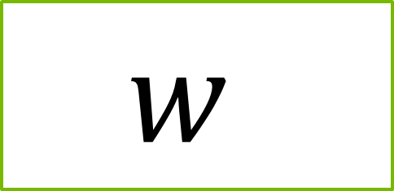

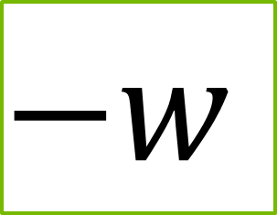
Classifier Free Diffusion Guidance
Weighted Reverse Diffusion
$$\left(1+w\right)ε_{θ}\left(z_{λ},c\right)−wε_{θ}\left(z_{λ}\right)$$
$$w$$
$$−w$$
w = 0
w = 1
w = 10
No context feature exaggeration
Some context feature exaggeration
Huge context feature exaggeration
Notes:
Let’s see what the new noise looks like if change 1 + w to only w for the context noise. When w is 0, nothing happens. Negative 0 is still 0, and 0 + 0 is zero.
When w is 1, we can start to see the difference, and when w is 10, it’s clear something is going on. The goal is to exaggerate the noise associated with the context by subtracting away what the “average case” would be, and we can use w to increase that exaggeration.

Slide 13
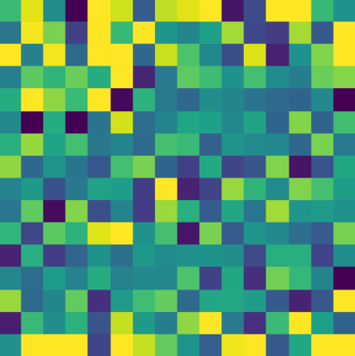
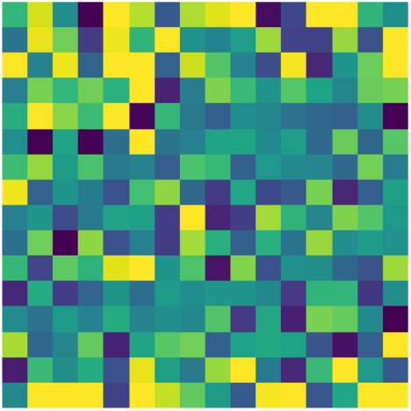
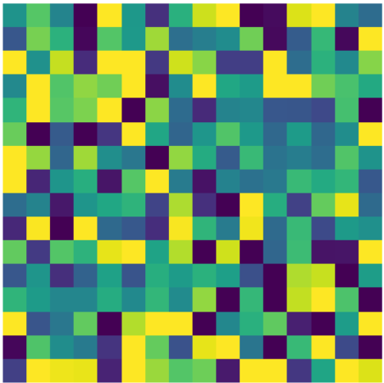
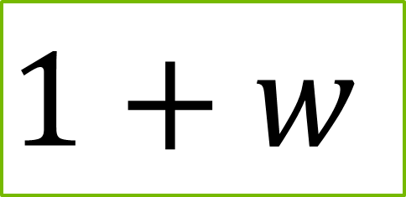
Classifier Free Diffusion Guidance
Weighted Reverse Diffusion
$$\left(1+w\right)ε_{θ}\left(z_{λ},c\right)−wε_{θ}\left(z_{λ}\right)$$
$$1+w$$
$$−w$$
w = 0
w = 1
w = 10
No context feature exaggeration
Some context feature exaggeration
Huge context feature exaggeration
Notes:
This is what new noise looks like when we add that 1 back into the context noise. If we flip between the two slides, it’s easier to see the impact of w.

Slide 14
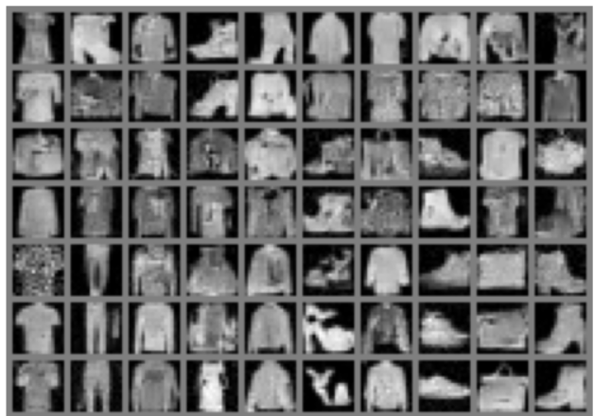
Classifier Free Diffusion Guidance
Weighted Reverse Diffusion
w = -2.0
w = -1.0
w = -0.5
w = 0.0
w = 0.5
w = 1.0
w = 2.0
Notes:
Here’s how different values of w impact the generation results. From left to right, we’re asking the model to generate a t-shirt, trousers, a pullover sweater, a dress, a coat, a sandal, a shirt, a sneaker, a bag, and an ankle boot. When w is largely positive, the images will be strongly tied to their category, but there will be less diversity in the generated images. When w is zero, it will still be influenced by the category because the context noise is weighted by 1 + w. When w is -.5, the categorical influence is very weak. It’s common to see the model generate images from other categories. When w is strongly negative, we’re saying “generate anything but this category”.

Slide 15
Modified TF Flowers
Notes:
Once we’ve added classifier-free guidance, we will have completely mastered FashionMNIST! Time to up the challenge. Let’s mo

Slide 16
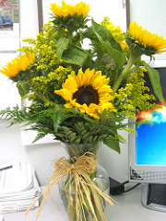

Modified TF Flowers
Modified for Image Generation
Photo by _e.t
Notes:
Why are we calling it Modified TF Flowers? We’ve cropped the photos to focus on the flower. If there was too much else going on in the image, our models would need much longer to conceptually understand the difference between a daisy, a sunflower, and a rose.
Images where it was difficult to see the flower were dropped, and images with people or insects were also removed. We also dropped images of dandelions and tulips for the sake of time.
It will take much longer to generate the color images, up to fifteen minutes. We will be sampling the results along the way, and we hope it is fun to watch the model learn!

Slide 17
Let’s get started!
Notes:
Ready to give it a try? Let’s get started!

