Slide 1
Generative AI with Diffusion Models
Part 5: CLIP

Slide 2
Agenda
• | Part 1: From U-Nets to Diffusion
• | Part 2: Denoising Diffusion Probabilistic Models
• | Part 3: Optimizations
• | Part 4: Classifier-Free Diffusion Guidance
• | Part 5: CLIP
• | Part 6: Wrap-up & Assessment
Notes:
We’ve made a ton of great progress today, but we have one more hands-lab left. We’re going to learn how to turn generate images from text!

Slide 3
Contrastive Language-Image Pre-Training (CLIP)
Notes:
We will be using a pre-trained model called CLIP in order to make this happen.

Slide 4
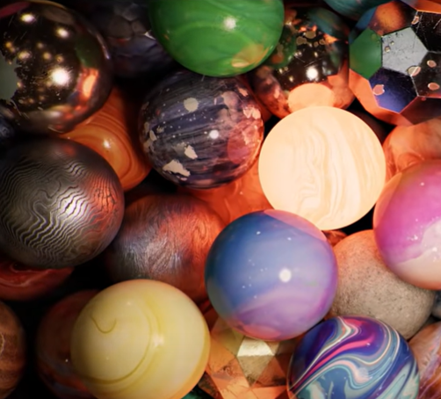
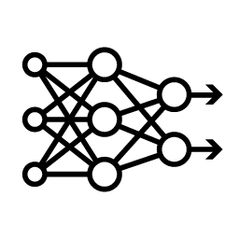
Matching Text to Image
Is it Possible?
[0.8, -0.6, 0.7]
“A bunch of different marbles”
Notes:
Here is the goal of CLIP.
Let’s say we have an image and a corresponding description of that image. Can we create a model such that it produces the same vector embedding for both the text and the image?

Slide 5
Cosine Similarity
[0.0, 1.0]
“A bunch of different marbles”
[1.0, 1.0]
Notes:
To see why this would be useful, let’s say this model gives our image an embedding of 0, 1. And, it gives the text an embedding of 1, 1.

Slide 6





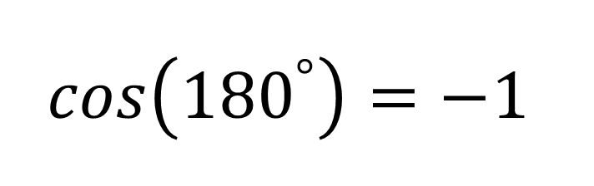
Cosine Similarity
[0.0, 1.0]
[1.0, 1.0]
“A bunch of different marbles”
$$cos\left({90}^{°}\right)=0$$
$$cos\left({270}^{°}\right)=0$$
$${45}^{°}$$
$$cos\left(0^{°}\right)=1$$
$$cos\left({180}^{°}\right)=−1$$
$$cos\left({45}^{°}\right)=\frac{\sqrt{2}}{2}$$
Notes:
We can check if the image is aligned with the text by using the cosine similarity. We can plot the vectors, find the angle between them, and use the cosine of the angle to see how well these vectors align.
Cosine of 0 is 1. That’s perfect! When the vectors are completely aligned, we get a value of 1. On the other hand, Cosign of 180 degrees is -1. This is also fine, we have an easy way to tell if vectors are opposites. Relatedly, cosine of 90 and 270 degrees is 0. The 0 here can be deceptive. It means there is no relationship, which is not the same as an opposite relationship.
This is great and all, but how are we going to calculate the angle between the vectors? Without a trusty protractor, we’d have to draw some extra lines and use SOHCAHTOA… that’s kind of a mess. There’s an easier way with the computer.

Slide 7
Dot Product
[0.0, 1.0]
[1.0, 1.0]
[0.0, 1.0]
[1.0, 1.0]
“A bunch of different marbles”
Notes:
First, we’re going to snap each vector to the unit circle. The vertical vector already has a length of 1, so we don’t have to do anything. For the other vector, we divide each component (in this case x and y), by the length or magnitude of the vector. We can use the good ole Pythagorean theorem to get the length. Thankfully, most matrix libraries like NumPy and PyTorch have this function built-in.

Slide 8


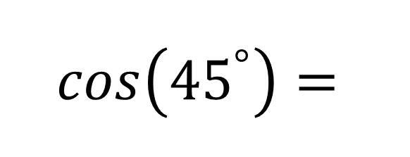
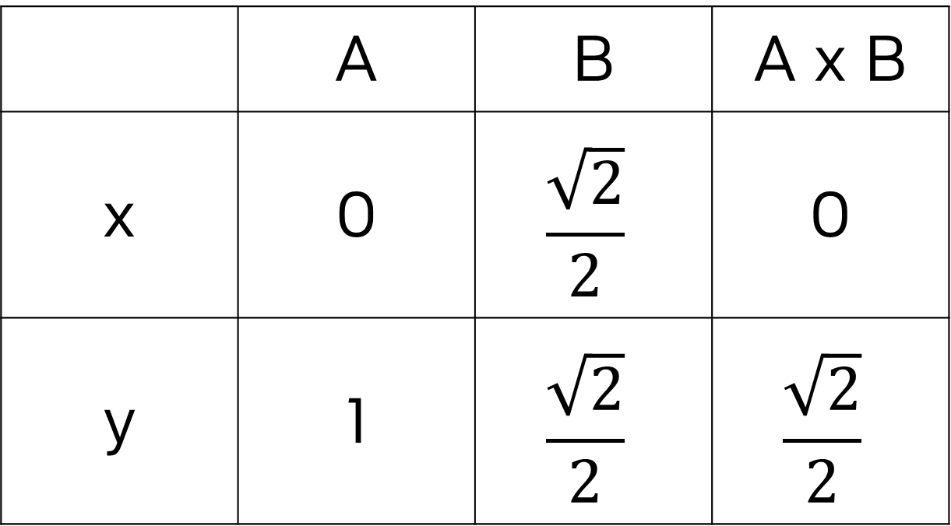
Dot Product
A
[0.0, 1.0]
B
[0.0, 1.0]
[1.0, 1.0]
$$\frac{\sqrt{2}}{2},\frac{\sqrt{2}}{2}$$
“A bunch of different marbles”
 | A | B | A x B
x | 0 | $$\frac{\sqrt{2}}{2}$$ | 0
y | 1 | $$\frac{\sqrt{2}}{2}$$ | $$\frac{\sqrt{2}}{2}$$
$$cos\left({45}^{°}\right)=$$
$$\frac{\sqrt{2}}{2}$$
Notes:
Nice, everything is aligned. Let’s call the vertical line A and the other B.
We can multiply both of the x values together, and both of the y values together. Add them up, and what do we get? Square root of two over two. The same as cosine of 45 degrees. Mathemagical!

Slide 9
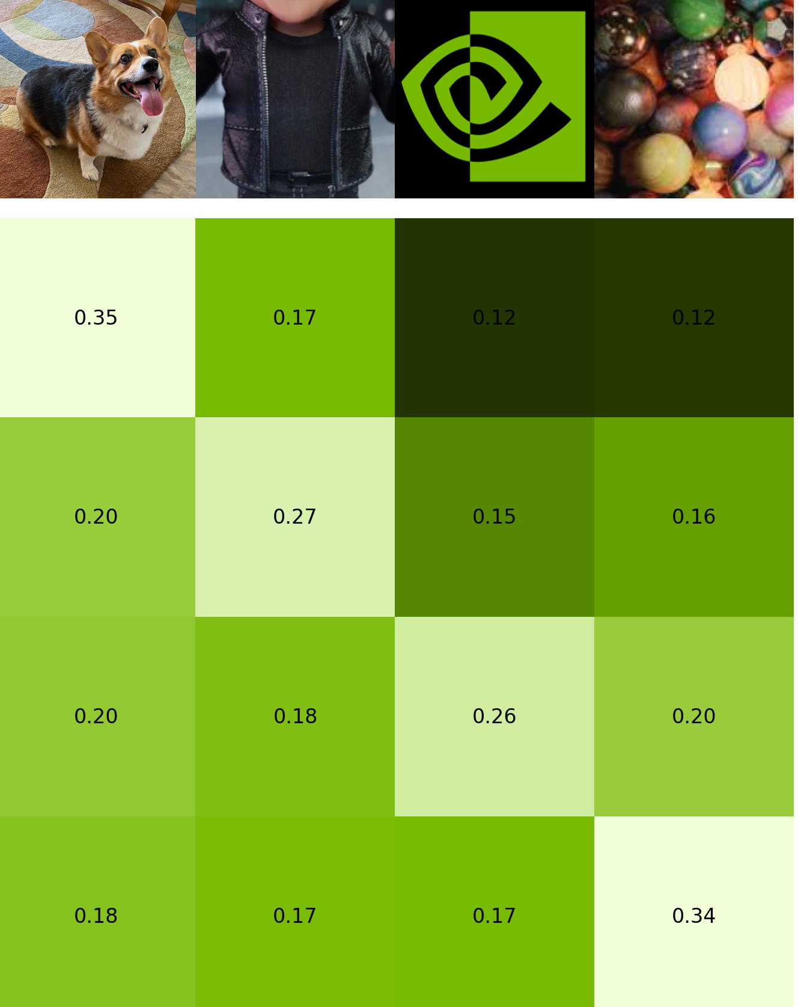
CLIP Training
Cosine similarity between encoding for “A happy corgi” and encoding for each image
A happy corgi
A leather jacket
Cosine similarity between encoding for the NVIDIA logo and encoding for each text
A green spiral
A bunch of different marbles
Notes:
CLIP uses the cosine similarity to train its neural network. Let’s say we have a batch of images with descriptions. During CLIP’s training, it will calculate the cosine similarity for each combination of image and text in the batch.

Slide 10
CLIP Training
A happy corgi
Minimize
A leather jacket
A green spiral
Minimize
A bunch of different marbles
Maximize
Notes:
The diagonal is the “correct” answer, so the loss function uses cross entropy to maximize the values along the diagonal. Everything else is the “wrong” answer, so the loss function will minimize those.

Slide 11
An Experiment
Notes:
With that in mind, let’s do an experiment.

Slide 12
If CLIP is a pretrained model, do we need text labels to make a text-to-image model?
Notes:
If CLIP is a pretrained model, do we need text labels to make a text-to-image model? We’re going to find out!

Slide 13

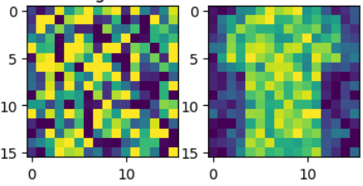

The Final Model
Time
Position Embed
Time Embed 2
Same as before
Feature Map
(Down0)
Down0
Copy
Feature Map
(Up2)
Time Embed 1
Context Embed 2
Feature Map
(Down1)
Down1 Copy
Feature Map
(Up1)
Context Embed 1
Feature Map
(Down2)
Down2 Copy
Feature Map
(Up0)
Latent Vector
Context
Notes:
The good news is, there are not changes to our neural network.

Slide 14
From Class to Context
“sneaker”
one-hot encoding
0 | 0 | 0 | 0 | 0 | 0 | 0 | 1 | 0 | 0
Bernoulli mask
1 | 1 | 0 | 1 | 0 | 1 | 1 | 1 | 1 | 1
p = .9
0 | 0 | 0 | 0 | 0 | 0 | 0 | 1 | 0 | 0
Notes:
We will make a slight change in our categorical one-hot encoding. Instead of using this to train the model, we will be using…

Slide 15
From Class to Context
“a snazzy sneaker”
512
features
CLIP Encoding
0.01 | -0.31 | 0.23 | -0.43 | 0.00 | 0.11 | 0.06 | -0.53 | … | -0.17
Bernoulli mask
1 | 1 | 0 | 1 | 0 | 1 | 1 | 1 | … | 1
p = .9
0.01 | -0.31 | 0 | -0.43 | 0 | 0.11 | 0.06 | -0.53 | … | -0.17
Notes:
A CLIP encoding. We will still use the Bernoulli function to train the model to handle an average case with no context.

Slide 16
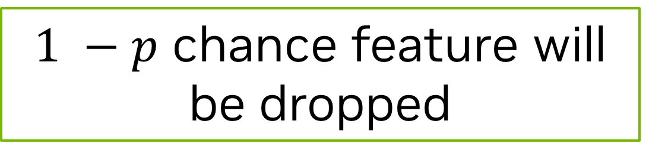
From Class to Context
“a snazzy sneaker”
512
features
CLIP Encoding
0.01 | -0.31 | 0.23 | -0.43 | 0.00 | 0.11 | 0.06 | -0.53 | … | -0.17
Bernoulli mask
1 | 1 | 0 | 1 | 0 | 1 | 1 | 1 | … | 1
p = .9
0.01 | -0.31 | 0 | -0.43 | 0 | 0.11 | 0.06 | -0.53 | … | -0.17
$1 −p$ chance feature will be dropped
Notes:
Each of CLIP’s 512 features would have a chance of being dropped.

Slide 17
Experimenting with CLIP
Training
[-0.13, …, 0.00]
CLIP
Prediction
“A bunch of different marbles”
[-0.17, …, -0.11]
CLIP
Notes:
We will use the CLIP encodings of our images to train the model. Then, during prediction, we will give it a text encoding. What do you think will happen?

Slide 18
Let’s get started!
Notes:
Ready to find out? Let’s get started!

