Slide 1
Pimp(l) your .NET code
Protect your code from decompilation
Zeb Mason, DotNetSheff Meetup, 4th June 2019
https://github.com/zebmason/PimplDotNet

Slide 2
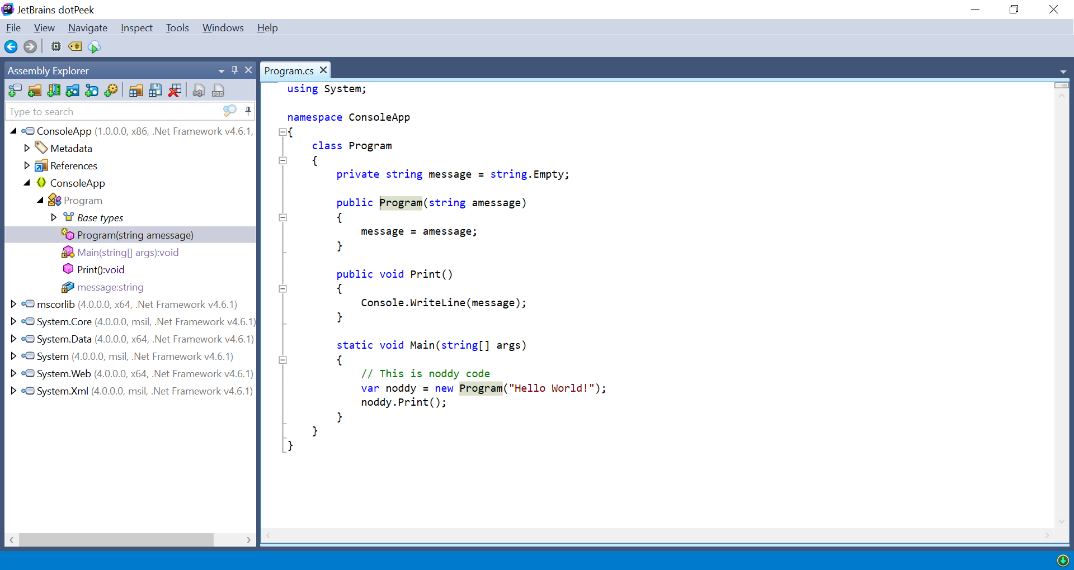
Pretty print your binaries

Slide 3
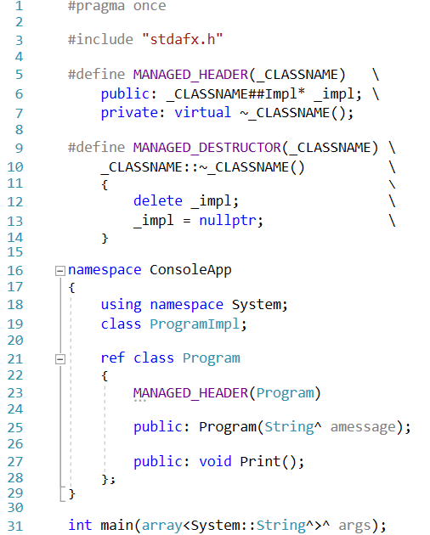
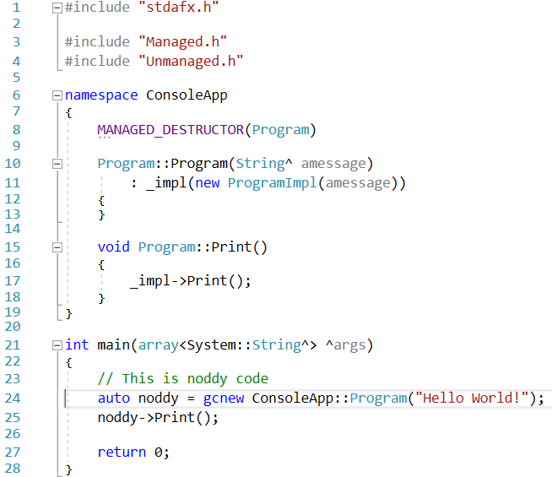
Create a public implementation

Slide 4
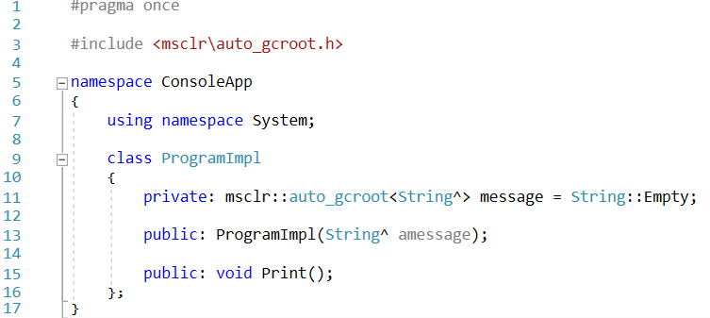
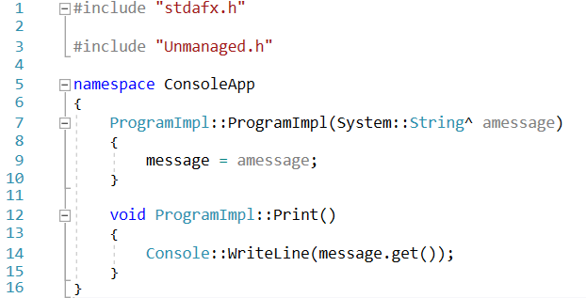
Create a private implementation

Slide 5
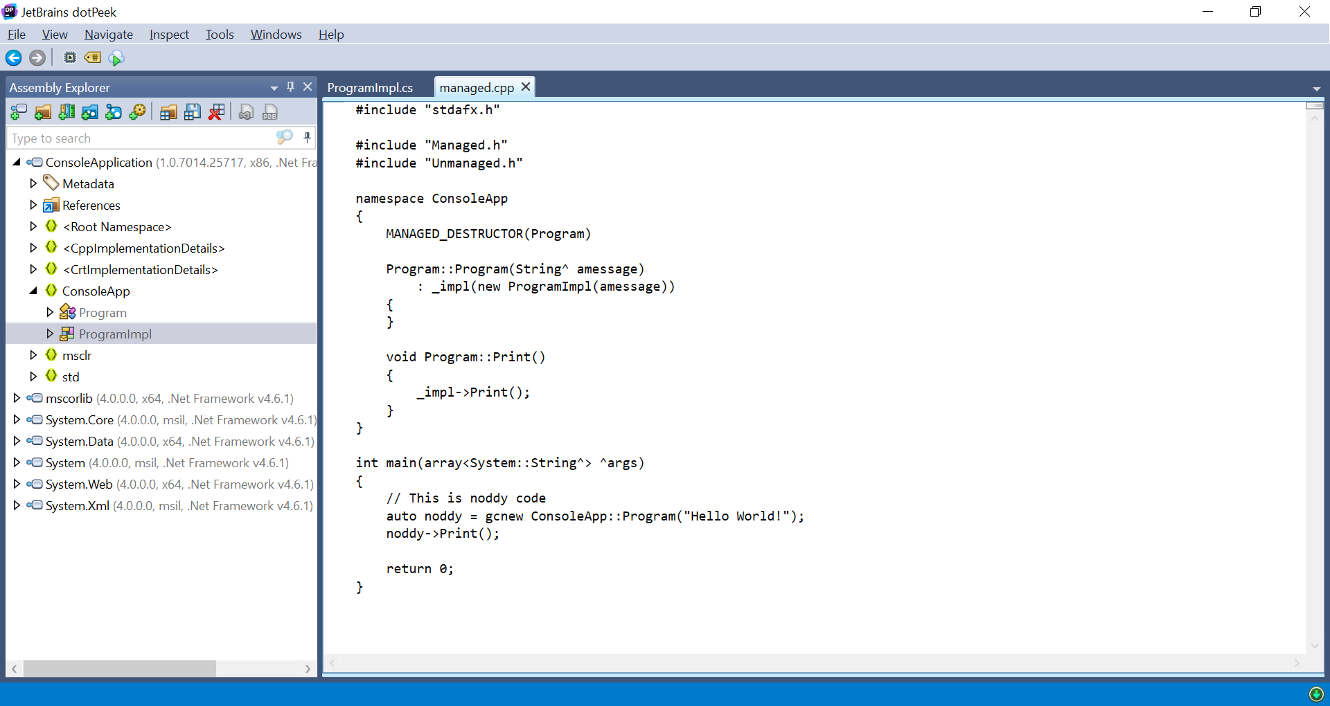
Pretty print the public

Slide 6
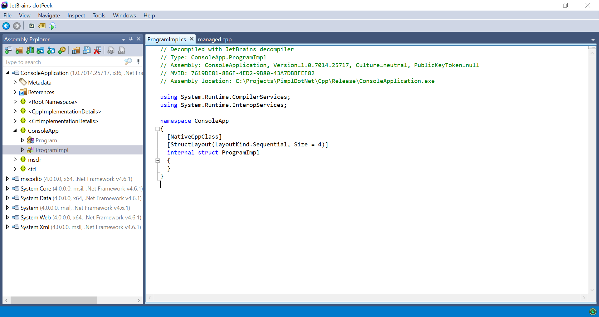
Pretty print the private

Slide 7
Finally the !finaliser
e.g. Program::!Program()
Called by the garbage collector which is run in a separate thread
If you try to delete unmanaged memory in the finaliser then expect random crashing

