Slide 1
Pimp(l) your .NET code
Protect your code from decompilation
Zeb Mason, DotNetSheff Meetup, 4th June 2019

Slide 2
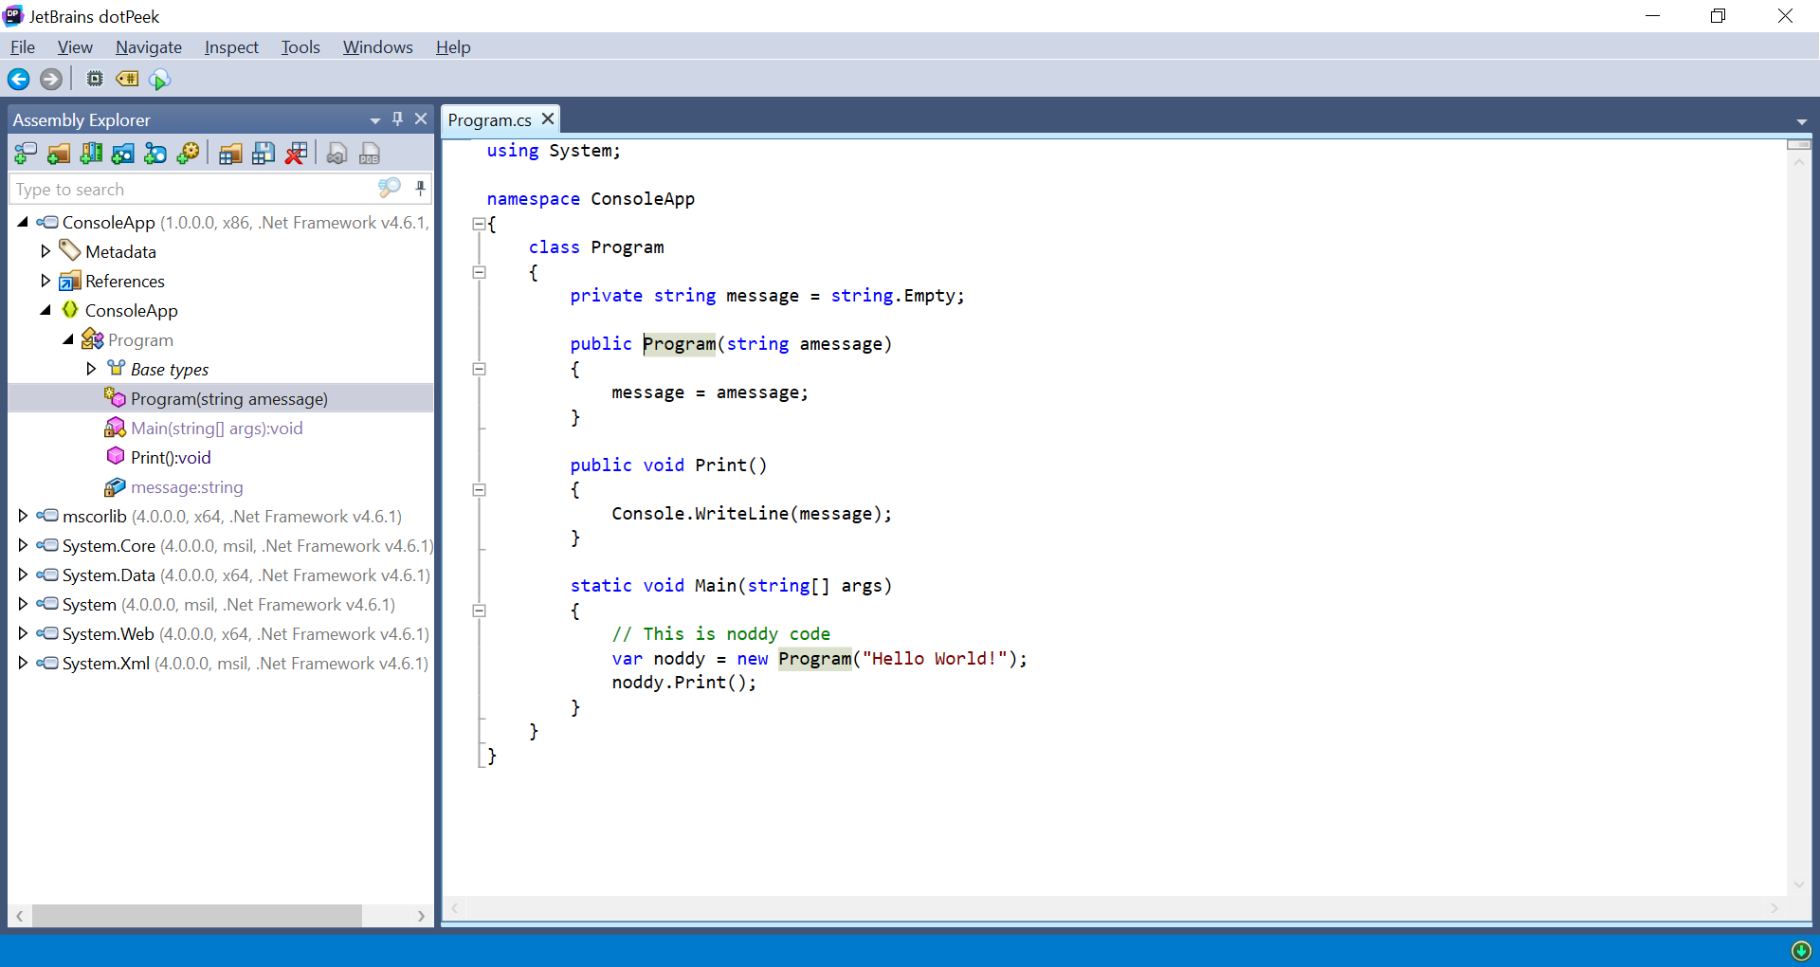
Pretty print your binaries

