Slide 1
Pimp(l) your .NET code
Protect your code from decompilation
Zeb Mason, DotNetSheff Meetup, 4th June 2019
https://github.com/zebmason/PimplDotNet

Slide 2
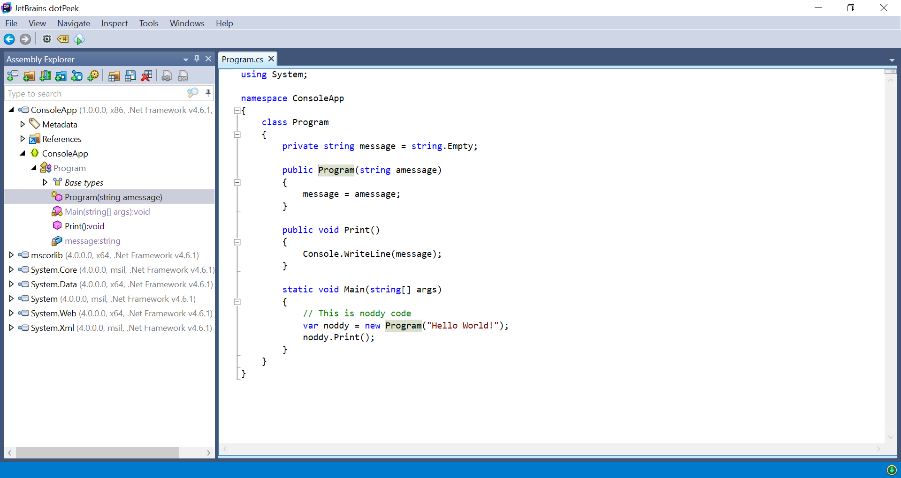
Pretty print a binary

Slide 3
Pretty print a binary
Even the comments

Slide 4
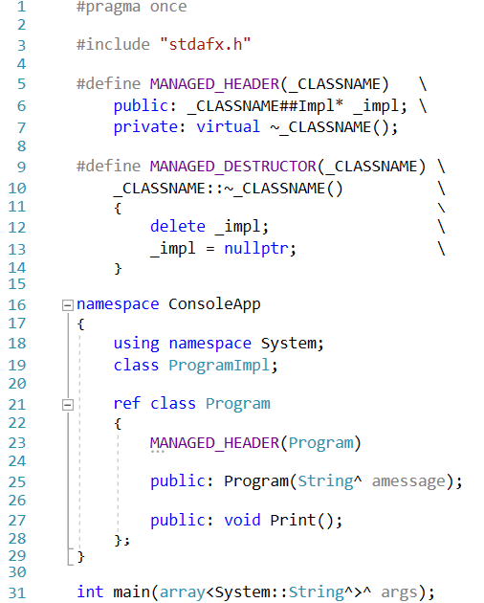
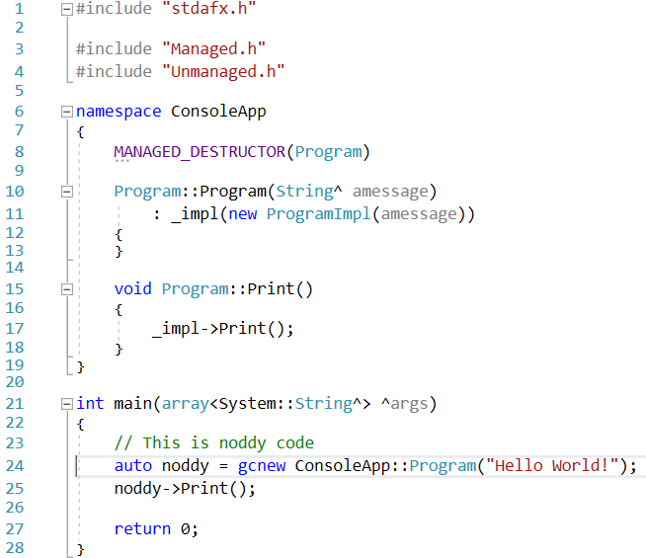
A public implementation

Slide 5
A public implementation
This is a managed class

Slide 6
A public implementation
The constructor creates a private implementation

Slide 7
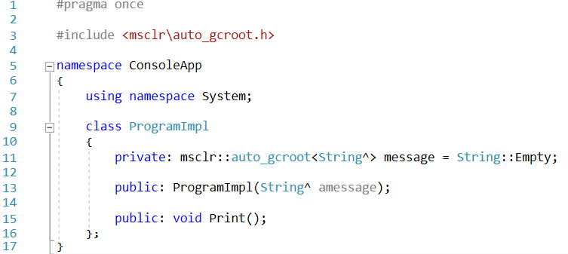
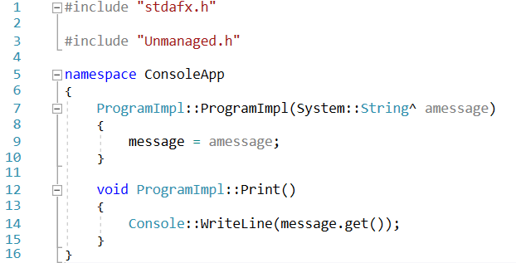
A private implementation

Slide 8
A private implementation
This is an unmanaged class

Slide 9
A private implementation
It stores a counted reference to a managed class

Slide 10
A private implementation
It calls a managed method

Slide 11
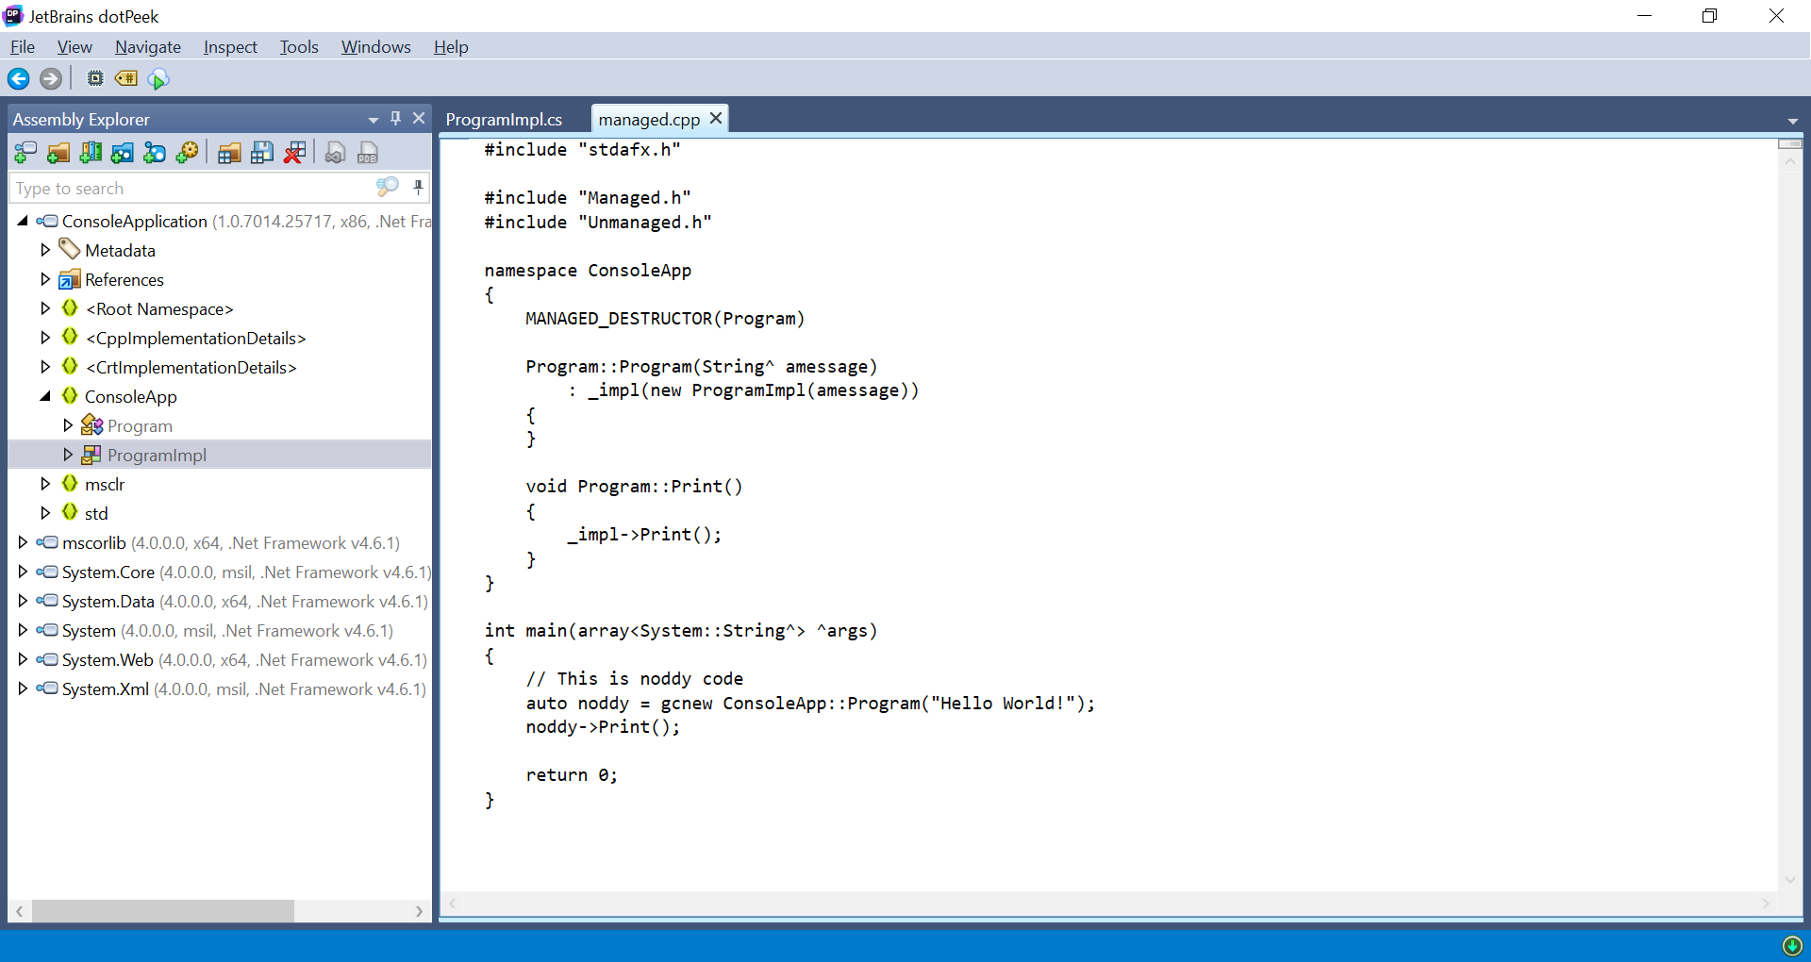
Pretty print the public implementation

Slide 12
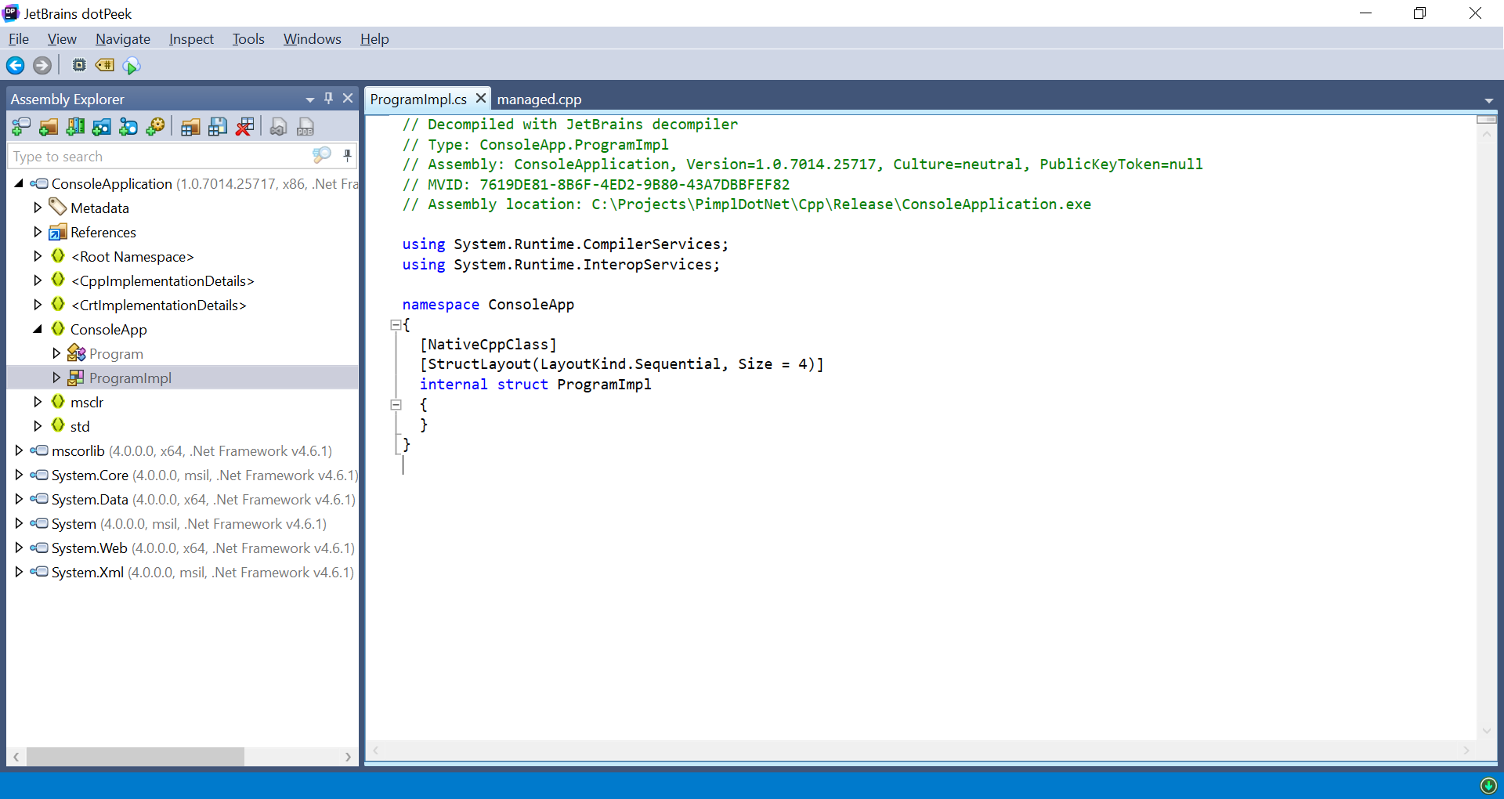
Pretty print the private implementation

Slide 13
Finally the !finaliser
e.g. Program::!Program() for a managed class

Slide 14
Finally the !finaliser
e.g. Program::!Program() for a managed class
Called by the garbage collector which is run in a separate thread

Slide 15
Finally the !finaliser
e.g. Program::!Program() for a managed class
Called by the garbage collector which is run in a separate thread
If you try to delete unmanaged memory in the finaliser then expect random crashing

