Slide 1
CSCE 636 HW1 Solution Keys
Yi Liu
10/2/2019

Slide 2
1. Data Preprocessing
(a). train_valid_split : The function divides the raw training dataset into two sub-sets, training set and validation set, with a certain rate. The validation set is used to estimate the out-of-sample error of a trained model, to help us tune hyper-parameters and choose the best model
(b). Yes. Firstly, more data is better. Secondly, validation set is originally part of the training set. When retrain the model before do testing, the whole training data is exposed, while the test data still keeps unseen.

Slide 3
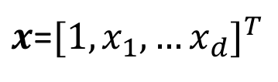
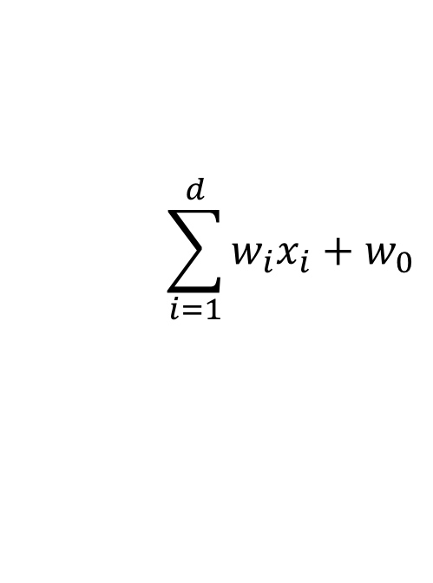
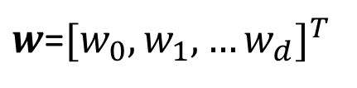
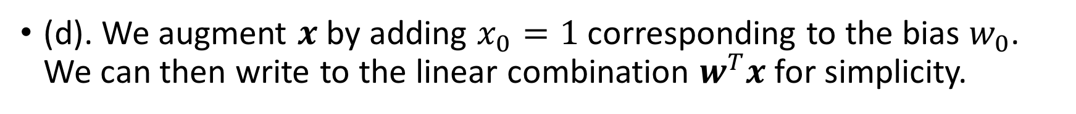

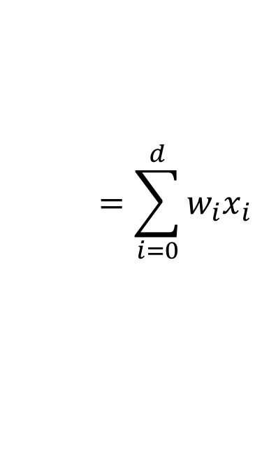
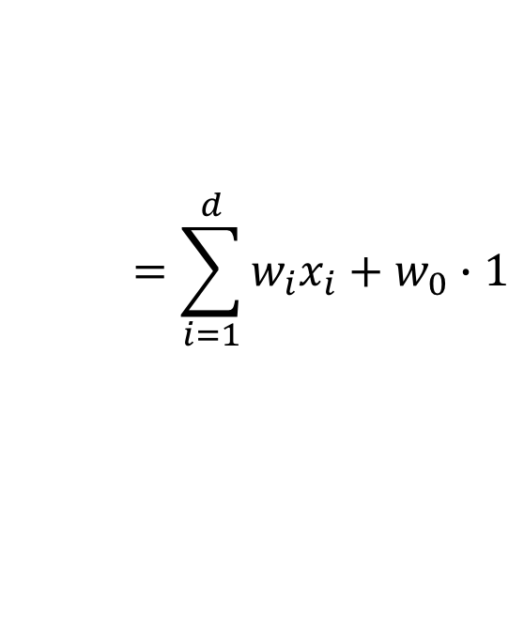
(d). We augment $x$ by adding $x_{0}=1$ corresponding to the bias $w_{0}$. We can then write to the linear combination $w^{T}x$ for simplicity.
$$\sum_{i=1}^{d}{w_{i}x_{i}+w_{0}}$$
$$=\sum_{i=1}^{d}{w_{i}x_{i}+w_{0}∙1}$$
$w$=${[w_{0},w_{1},…w_{d}]}^{T}$
$x$=${[1,x_{1},…x_{d}]}^{T}$
$$=\sum_{i=0}^{d}{w_{i}x_{i}}$$
$$=w^{T}x$$

Slide 4
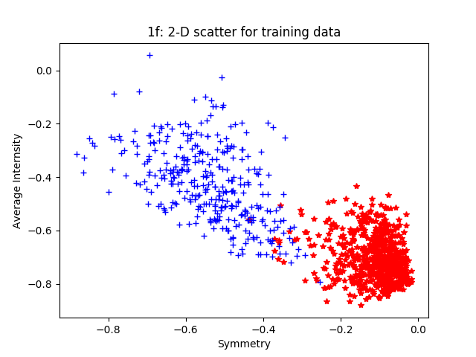
(f)

Slide 5
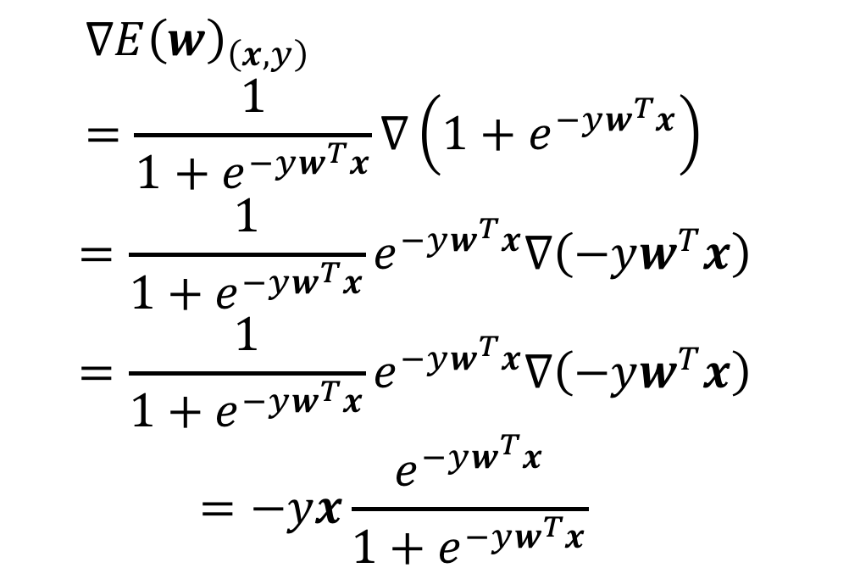
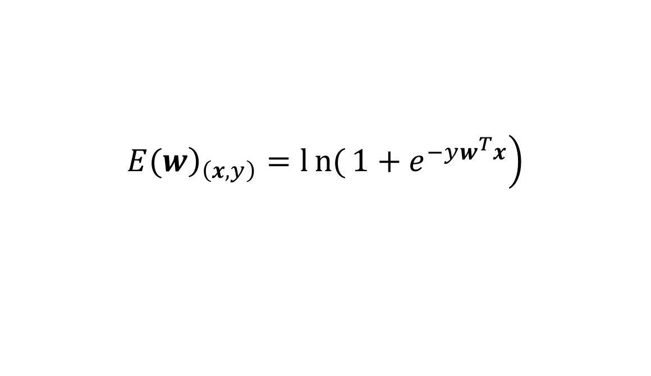
2. Cross-entropy loss for logistic regression
$$\left.{\left.E(w\right)}_{\left(x,y\right)}=ln{(}1+e^{−yw^{T}x}\right)$$
(a,b)
$${∇E\left(w\right)}_{\left(x,y\right)}=\frac{1}{1+e^{−yw^{T}x}}∇\left(1+e^{−yw^{T}x}\right)$$
$$=\frac{1}{1+e^{−yw^{T}x}}e^{−yw^{T}x}∇\left(−yw^{T}x\right)$$
$$=\frac{1}{1+e^{−yw^{T}x}}e^{−yw^{T}x}∇\left(−yw^{T}x\right)$$
$$=−yx\frac{e^{−yw^{T}x}}{1+e^{−yw^{T}x}}$$

Slide 6
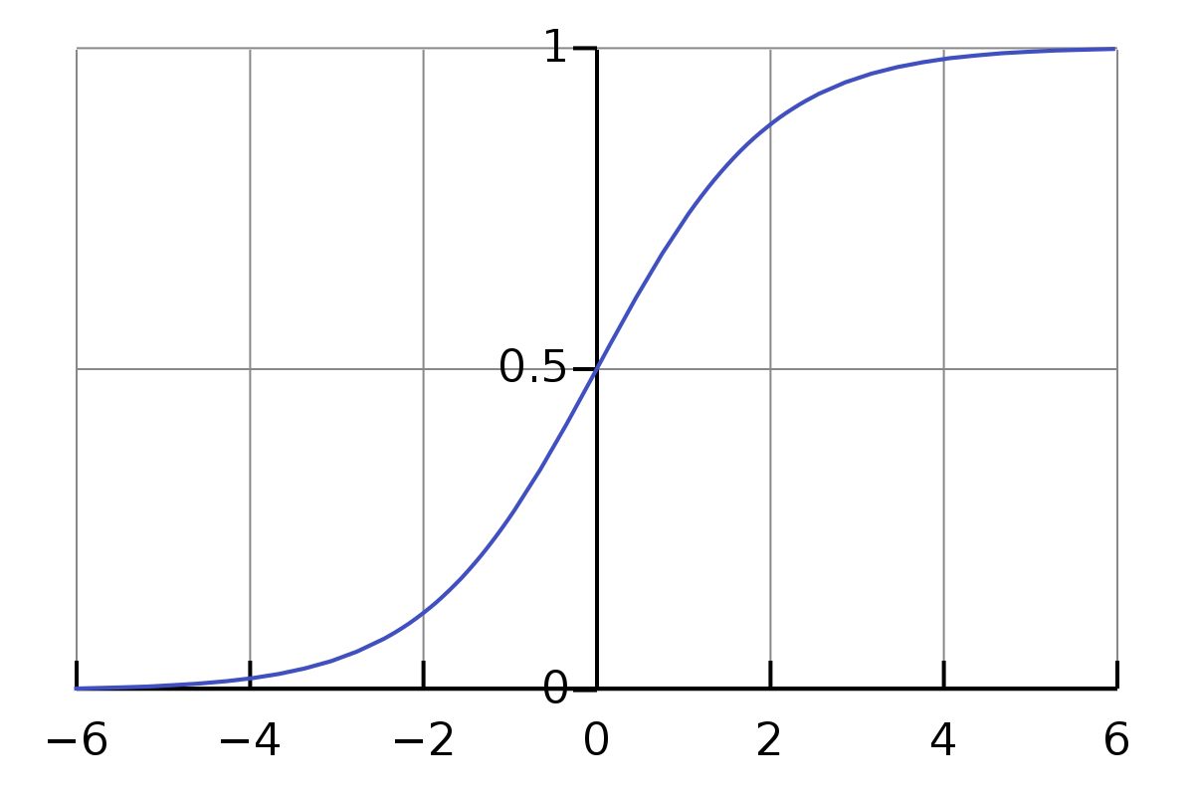
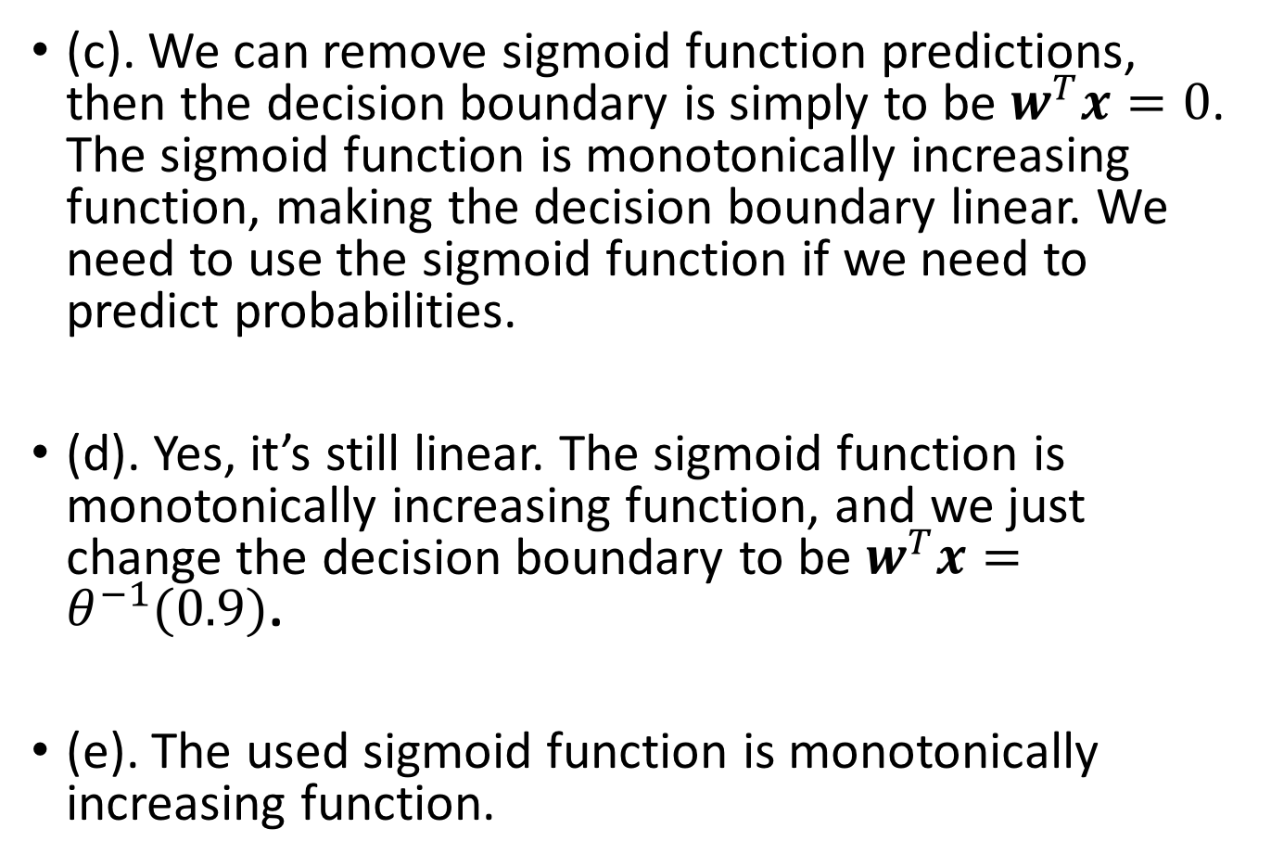
(c). We can remove sigmoid function predictions, then the decision boundary is simply to be $w^{T}x=0$. The sigmoid function is monotonically increasing function, making the decision boundary linear. We need to use the sigmoid function if we need to predict probabilities.
(d). Yes, it’s still linear. The sigmoid function is monotonically increasing function, and we just change the decision boundary to be $w^{T}x=θ^{−1}(0.9)$.
(e). The used sigmoid function is monotonically increasing function.
Notes:
Inverse sigmoid of 0.9, still a constant.

Slide 7
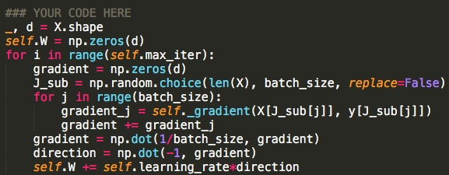
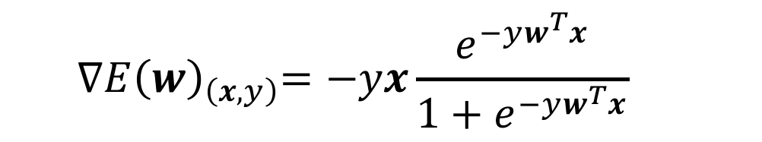
3. Sigmoid logistic regression
$${∇E\left(w\right)}_{\left(x,y\right)}=−yx\frac{e^{−yw^{T}x}}{1+e^{−yw^{T}x}}$$
(a).
(b). GD: One iter, update the whole data.
SGD: One iter, randomly choose one sample to update weights.
BGD: One iter, ‘randomly’ choose one batch of data to update weights.

Slide 8
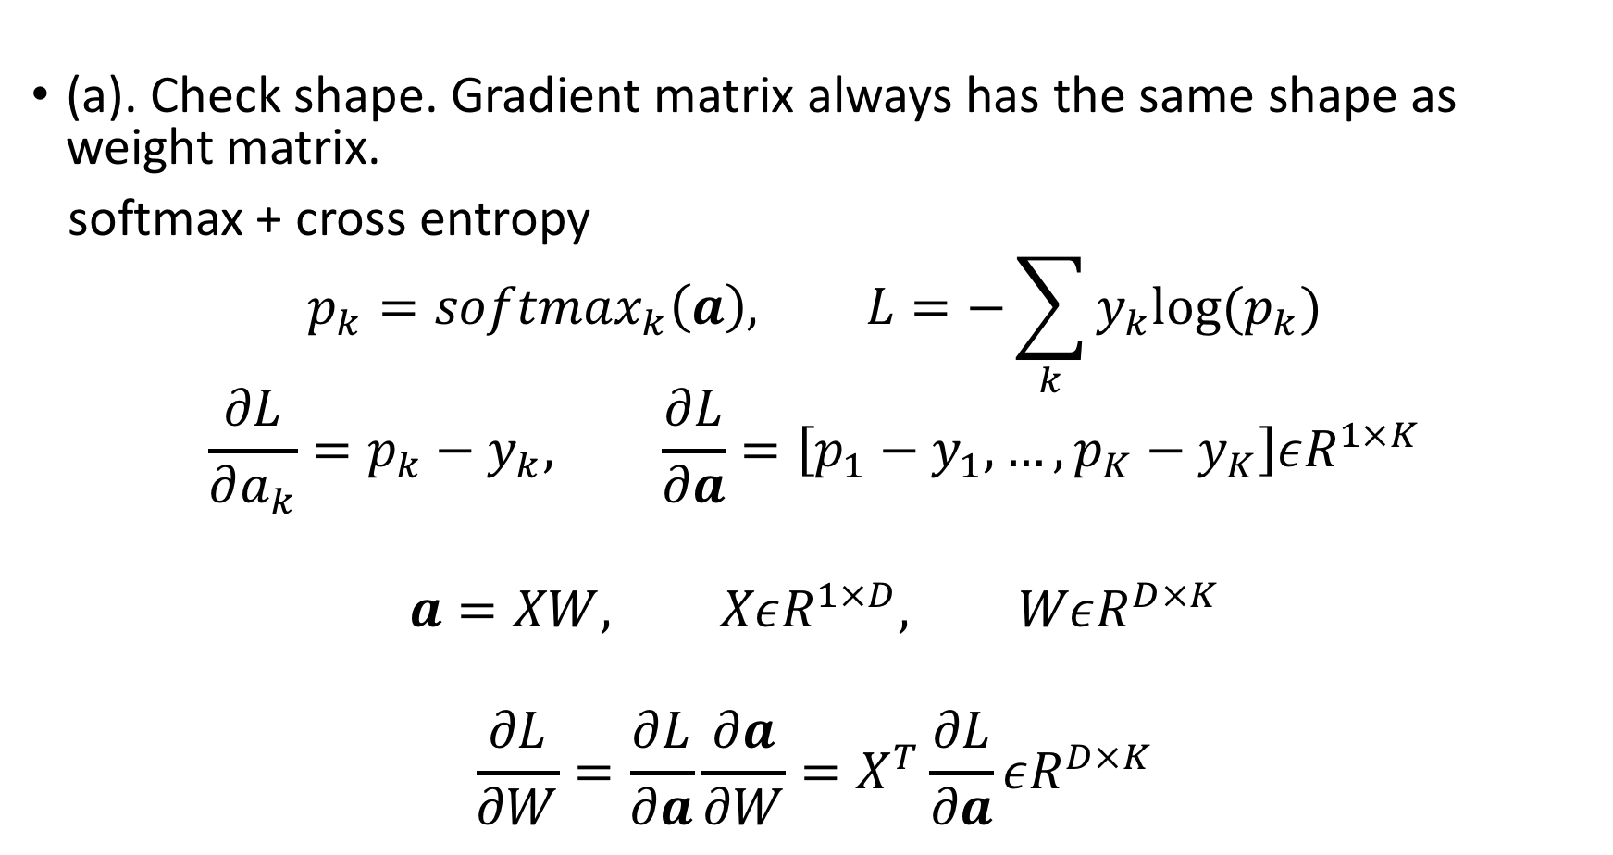
4. Softmax logistic regression
(a). Check shape. Gradient matrix always has the same shape as weight matrix.
softmax + cross entropy
$$p_{k}={softmax}_{k}\left(a\right), L=−\sum_{k}{y_{k}log⁡(p_{k})}$$
$$\frac{∂L}{∂a_{k}}=p_{k}−y_{k}, \frac{∂L}{∂a}=\left[p_{1}−y_{1},…,p_{K}−y_{K}\right]εR^{1×K}$$
$$a=XW, XεR^{1×D}, WεR^{D×K}$$
$$\frac{∂L}{∂W}=\frac{∂L}{∂a}\frac{∂a}{∂W}=X^{T}\frac{∂L}{∂a}εR^{D×K}$$

Slide 9
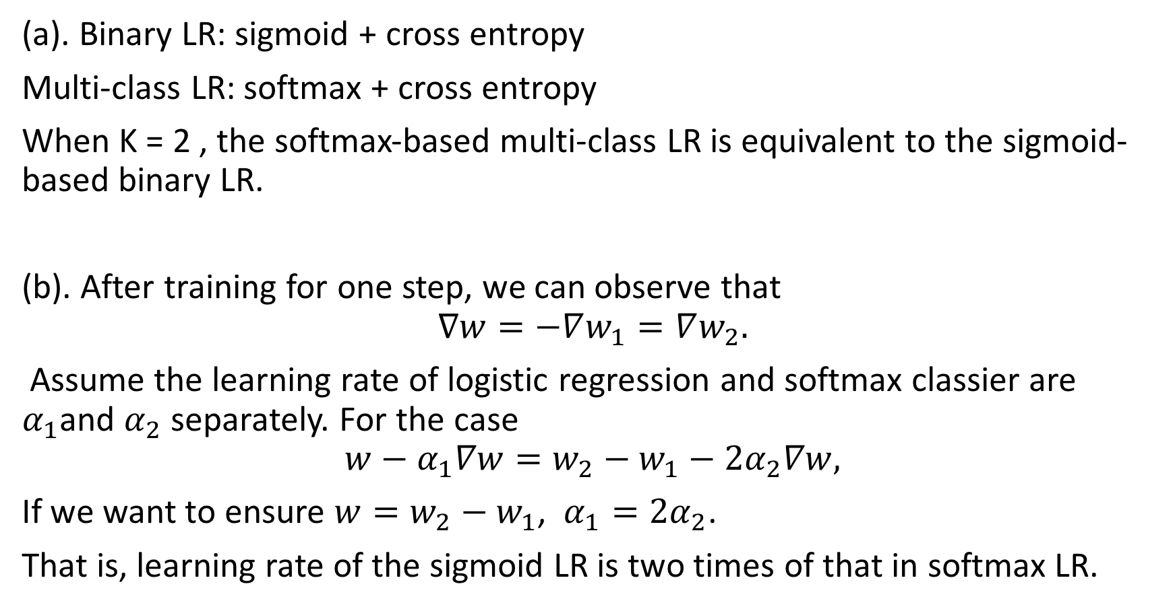
5. Sigmoid logistic vs Softmax logistic
(a). Binary LR: sigmoid + cross entropy
Multi-class LR: softmax + cross entropy
When K = 2 , the softmax-based multi-class LR is equivalent to the sigmoid-based binary LR.
(b). After training for one step, we can observe that
$$∇w=−∇w_{1}=∇w_{2}.$$
Assume the learning rate of logistic regression and softmax classier are $α_{1}$and $α_{2}$separately. For the case
$$w−α_{1}∇w=w_{2}−w_{1}−{2α}_{2}∇w,$$
If we want to ensure $w=w_{2}−w_{1}$, $α_{1}={2α}_{2}$.
That is, learning rate of the sigmoid LR is two times of that in softmax LR.
Notes:
Empirical study.

