Slide 1
Measuring Usability
Mueller, Komogortsev, & Tamir

Slide 2
Observations
Usability is inversely proportional to effort
User effort is related to manual effort – e.g., number of mouse clicks, number of key-board clicks, mouse path traversed.
A set of identical independent (“iid”) experiments on a single scenario can be used to measure learnability and operability
Eye tracking can be used to provide additional measures of physical and manual effort

Slide 3
Traditional Learning Curve
Content contributed by Texas State University
Notes:
P_{avg} – Performance Average. The average performance demonstrated by subjects in a study.
Power Law
Exponential trend
P_{ref} – Performance Reference. The minimum performance required to complete the tasks.
Asymptote

Slide 4
Tradition Learning Curve
Effort-based Usability Model
Average Effort of Test subjects
_{Learnability}
Learning Point
Expended Effort
Expected Effort
Productivity
Minimum Effort
Understandability gap
Time to learn
Operability
Repetitive Tasks
*Based on ISO/IEC 9126-1:2001 Standard
Notes:
1) Minimum Effort – An estimate of the minimum amount of effort required to complete the tasks. When the study is designed, we can determine a minimum effort.
2) Average Effort – The average of the effort expended by the test subjects on a given task.
3) Expert Effort – The effort expended by a trained user, someone that is familiar with the system and the tasks.
4) Time to learn - The time it takes for a test subject to become as proficient as a trained user in accomplishing a task.
5) Learning Point - is where the Expert Effort and the Average Effort intersect.
ISO –xyz defines
6) Operability is the minimum effort
7) Productivity is the average effort after the learning point
8) Understandability is the ratio of O and P

Slide 5
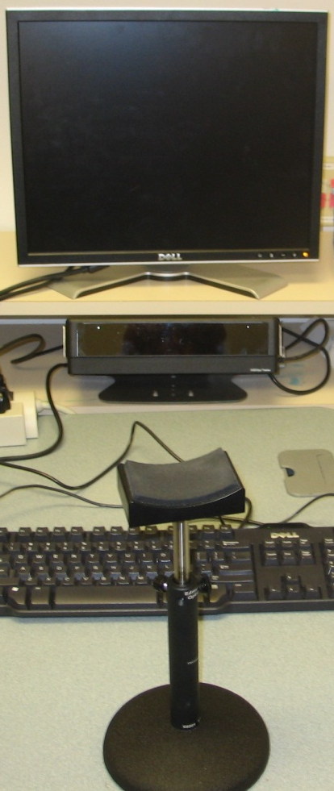
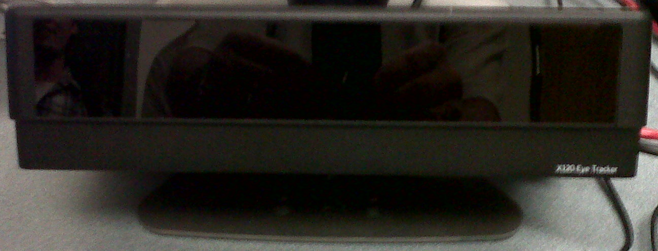
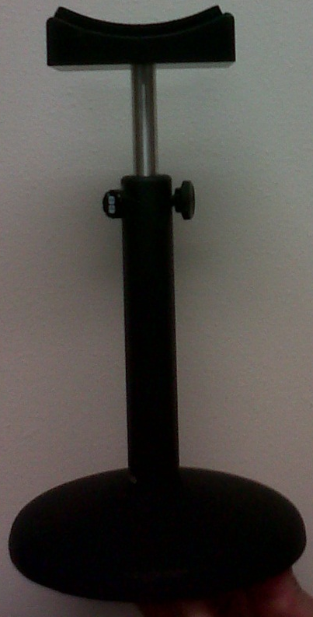
Eye Tracker Hardware
Eye tracker
Chin rest
Notes:
The measurement of eye movement is done with a device known as an eye tracker. It follows the subject’s eye movement by capturing infrared light reflected off of the eye to a camera. This technique is called Pupil Centre Corneal Reflection and it measures the difference between light reflected off the pupil and cornea to determine the position of the eyes.

Slide 6
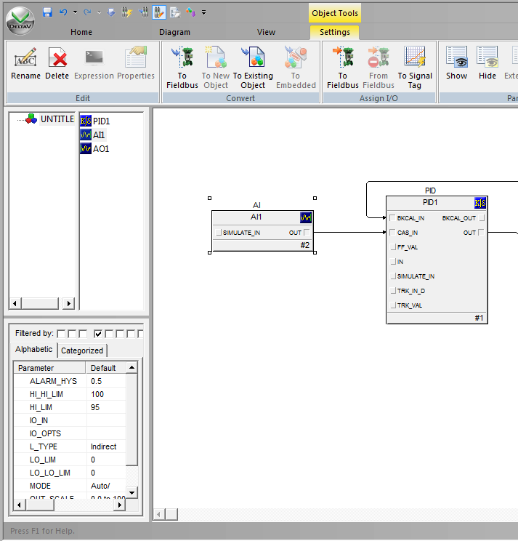
Fixations and Saccades
When performing a task, fixations and saccades can reflect effort expended.
Greater effort =
Longer fixation duration
More fixations
Longer saccade length
More saccades

Slide 7
Measurements
Time on Task
Number of Mouse/Keyboard clicks
Total mouse path traversed
Average fixation duration
Average pupil diameter
Number of fixations
Average saccade amplitude
Number of saccades
Total mouse path traversed

Slide 8
Travel Reservation Experiment Time on Task

Slide 9
Pilot Project
Mueller, Komogortsev, & Tamir

Slide 10
Emerson / TxState Usability Experiment
Purpose
Pilot Study to determine the usefulness of the Texas State University methodology in measuring aspects of Usability in Emerson products
Primary Goal
Compare the usability of a limited set of tasks in two versions of Control Studio referred to as System A and System B

Slide 11
Scenario-based Test Design
Our test consisted of 15 repetitive tasks.
Each task followed the same general workflow, but the function blocks, parameters, and properties being worked on were varied.
The task instructions were written in general terms such as “Add an AI block”, but did not specify how to carry out the work.

Slide 12
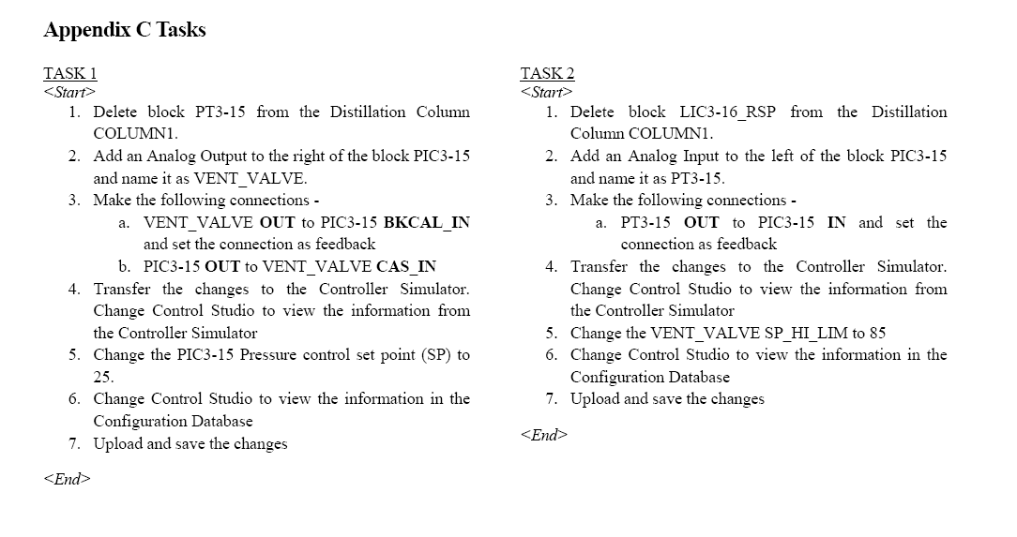
Scenario-based tasks used in Experiment
Content contributed by Texas State University

Slide 13
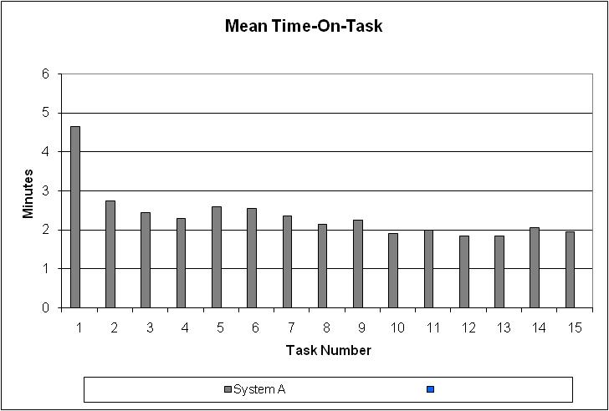
Mean Time to Complete a Task in System A

Slide 14
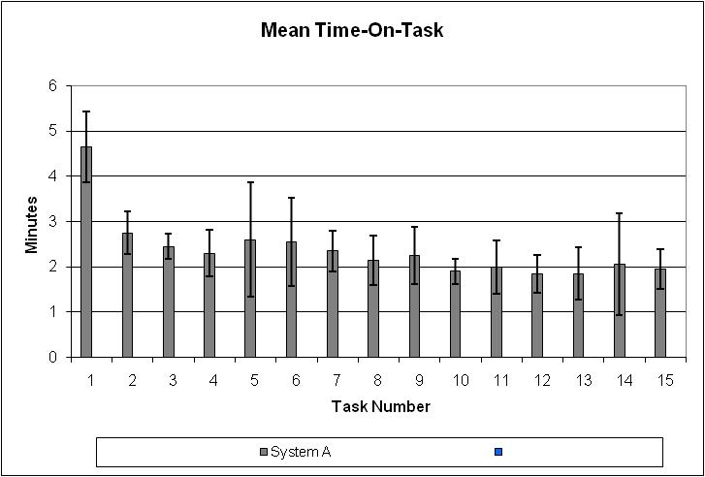
Standard Deviation for a Task in System A

Slide 15
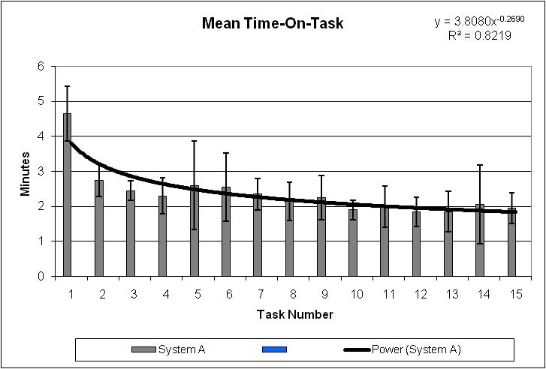
Power Curve Matching Tasks of System A
Notes:
This is the learning curve for the Scenario in System A.

Slide 16
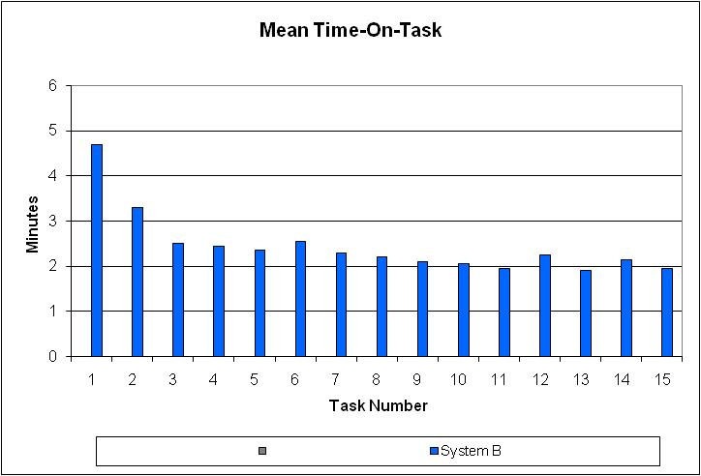
Mean Time to Complete a Task in System B

Slide 17
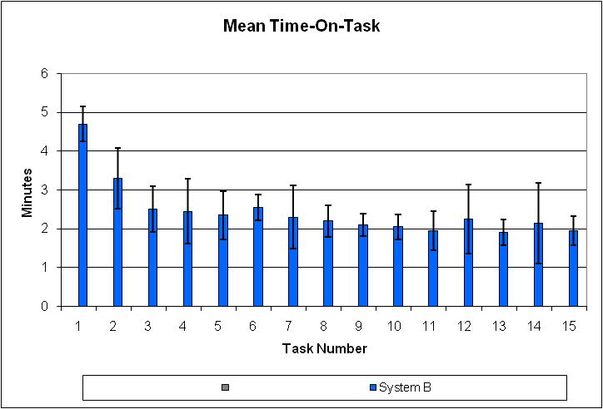
Standard Deviation for a Task in System B

Slide 18
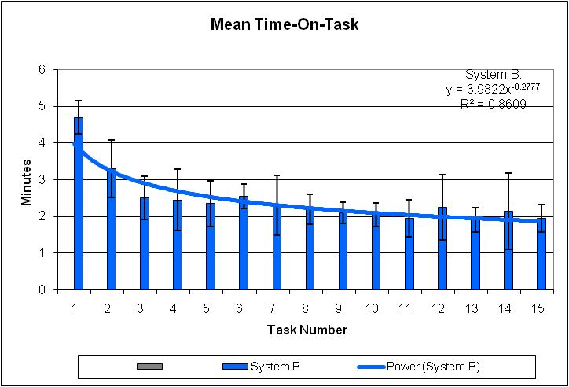
Power Curve Matching Tasks of System B
Notes:
This is the learning curve for System B.

Slide 19
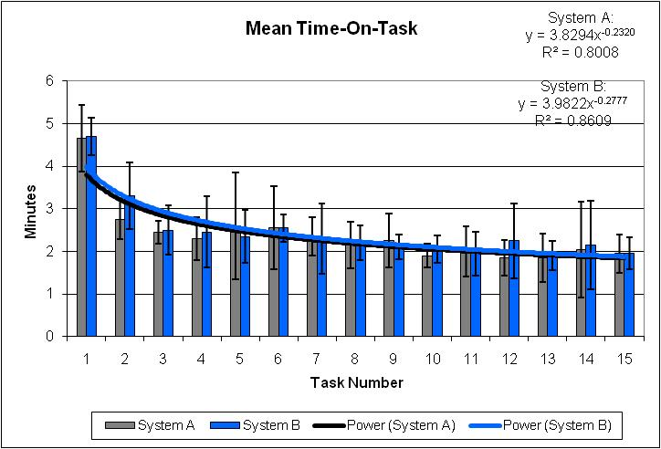
Overall Learnability
Content contributed by Texas State University

Slide 20
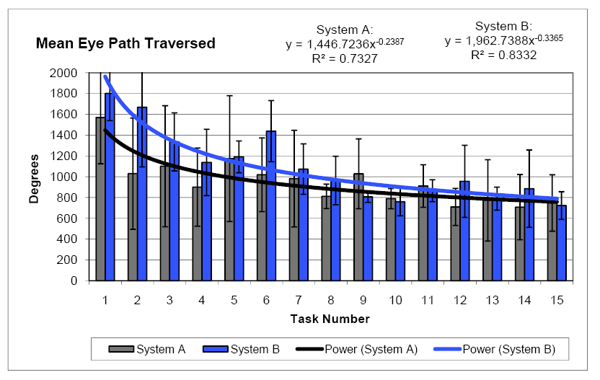
Physical Effort
Content contributed by Texas State University

Slide 21
Physical Effort
Content contributed by Texas State University

Slide 22
Experiment Conclusions
A methodology involving eye tracking is a viable tool for objectively measuring usability
After Learning point is reached, both System A and B have very similar usability characteristics
People are able to learn to use the application with the updated user interface
[After moderate training] student performance is close to “real user’s” performance

Slide 23
Current / Next Phases
Phase 2
Analysis of additional scenarios using current Emerson software and prototypes of “next generation software”.
Phase 3
Pinpoint analysis

Slide 24
Pinpoint Analysis

Slide 25
Current / Next Phases
Phase 2
Analysis of additional scenarios using current Emerson software and prototypes of “next generation software”.
Phase 3
Pinpoint analysis

Slide 26
Pinpoint analysis
Average Saccade Amplitude
Average Fixation duration
Total Time on Task

Slide 27
Pinpoint analysis
Segment the data
Use pattern recognition techniques to identify excessive- effort segments
Thresholding
Clustering (K-means)
Exhaustive feature selection
Principle component analysis
Video clips corresponding to identified excessive-effort segments are further analyzed to spot usability issues
MC
KC

Slide 28
Pinpoint Analysis Phases
The pinpoint analysis includes two phases
Training
Classification

Slide 29
Training
Set scenario
Define iid tasks
Determine the segmentation method
Supervised feature Selection (optional)
E.g., number of saccades per segment
Select participants for generating the training data
Produce training set (run tests and extract features for each segment)
Unsupervised feature selection (optional)
E.g., use the add-up technique
Set decision function per segment
E.g., a threshold on the average number of saccades per segment

Slide 30
Classification
Select participants for generating the classification data
For each participant
For each segment
Extract the selected feature
Measure the feature value
Compare to threshold
Make an Excessive (E) vs. Non-Excessive (NE) decision
Get an expert to check segments classified as excessive effort segments

Slide 31
Supervised feature Selection
An expert decided which feature[s] to use

Slide 32
Unsupervised feature Selection
Consider the training data
For each participant
For each segment
Use a nock-down or add up approach
Extract a subset of features
Measure the features value
Cluster the data
Check the within (W) and between (B) dispersion metrics
Choose the subset of features that produce best value for a given f(W)/f(B)

Slide 33
The nock down method
Consider single features
Per segment cluster
Check the within and between dispersion metrics
Choose the singleton features that produce best value for f(W)/f(B)
For each pair that contains the singleton chosen above
Per segment cluster
Check the within and between dispersion metrics
Choose the pair features that produce best value for f(W)/f(B)
For each triple that contains the singleton chosen above
Per segment cluster
Check the within and between dispersion metrics
Choose the triplet features that produce best value for f(W)/f(B)
Continue until reaching an upper limit on set cardinality

Slide 34
Illustration
MC
KC
$$U_{1}$$
MC
KC
$$U_{2}$$
MC
KC
$$U_{i}$$

Slide 35
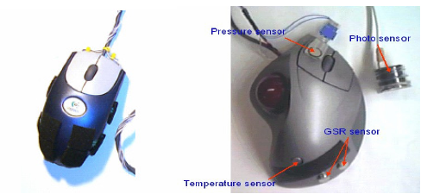
The Sentic Mouse
Physiological Emotion applications
MIT Affective Computing Lab’s Affective Tangibles Program
Mouse behaviors – number of mouse clicks, duration of mouse clicks

Slide 36
GOMS Research
Goals, Operators, Methods, and Selection Rules (GOMS).
A family of models to predict the usability of software for a task.
Natural GOMS Language (NGOMS)
Learning time and execution time are predicted based on a program-like representation.
Assumes methods are strictly sequential and hierarchical in form (?).

