Slide 1
Programming with OpenGL Part 2: Complete Programs
Ed Angel
Professor of Computer Science, Electrical and Computer Engineering, and Media Arts
University of New Mexico

Slide 2
Objectives
Refine the first program
Alter the default values
Introduce a standard program structure
Simple viewing was the unchanged default in viewing
Two-dimensional viewing as a special case of three-dimensional viewing
Fundamental OpenGL primitives
Attributes

Slide 3
Program Structure
Most OpenGL programs have a similar structure that consists of the following functions
main():
defines the callback functions
opens one or more windows with the required properties
enters event loop (last executable statement)
init(): sets the state variables
Viewing
Attributes
callbacks
Display function
Input and window functions

Slide 4
simple.c revisited
In this version, we shall see the same output, but we have defined all the relevant state values through function calls using the default values
In particular, we set
Colors
Viewing conditions
Window properties

Slide 5
main.c
includes gl.h
#include <GL/glut.h>
int main(int argc, char** argv)
{
glutInit(&argc,argv); move line parameters to GL
glutInitDisplayMode(GLUT_SINGLE|GLUT_RGB);
glutInitWindowSize(500,500);
glutInitWindowPosition(0,0);
glutCreateWindow("simple");
glutDisplayFunc(mydisplay);
init();
glutMainLoop();
}
define window properties
display callback
set OpenGL state
enter event loop

Slide 6
GLUT functions
glutInit allows application to get command line arguments and initializes system
gluInitDisplayMode requests properties for the window (the rendering context)
RGB color
Single buffering
Properties logically ORed together
glutWindowSize in pixels
glutWindowPosition from top-left corner of display
glutCreateWindow create window with title “simple”
glutDisplayFunc display callback
glutMainLoop enter infinite event loop

Slide 7
init.c
void init()
{
glClearColor (0.0, 0.0, 0.0, 1.0);
glColor3f(1.0, 1.0, 1.0);
glMatrixMode (GL_PROJECTION);
glLoadIdentity ();
glOrtho(-1.0, 1.0, -1.0, 1.0, -1.0, 1.0);
}
// DT Define the camera to be the default camera
// glOrtho(-2.0, 2.0, -2.0, 2.0, -2.0, 1.0);
Parallel projection
black clear color
opaque window
fill/draw with white
viewing volume

Slide 8
Coordinate Systems
The units in glVertex are determined by the application and are called object or problem coordinates
The viewing specifications are also in object coordinates and it is the size of the viewing volume that determines what will appear in the image
Internally, OpenGL will convert to camera (eye) coordinates and later to screen coordinates
OpenGL also uses some internal representations that usually are not visible to the application

Slide 9
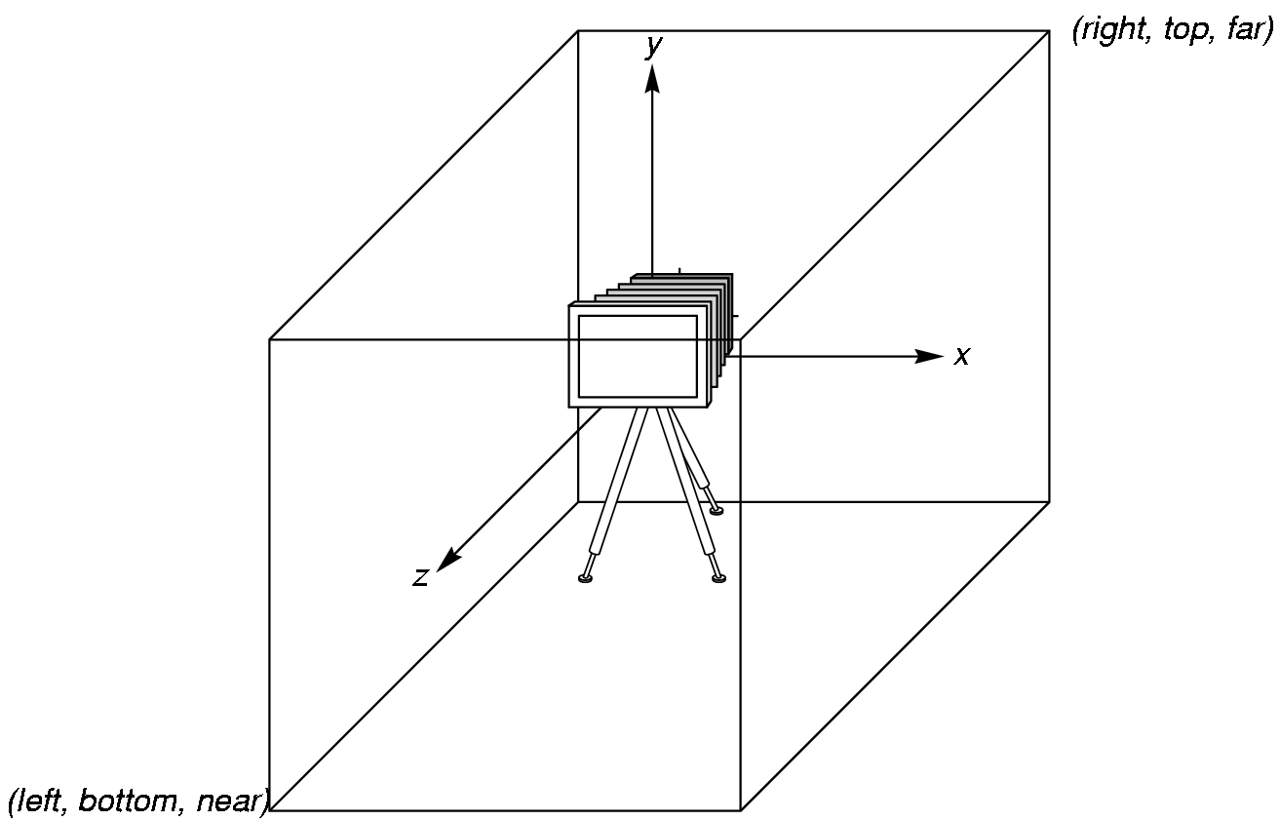
OpenGL Camera
OpenGL places a camera at the origin in object space pointing in the negative z direction
The default viewing volume
is a box centered at the
origin with a side of
length 2

Slide 10
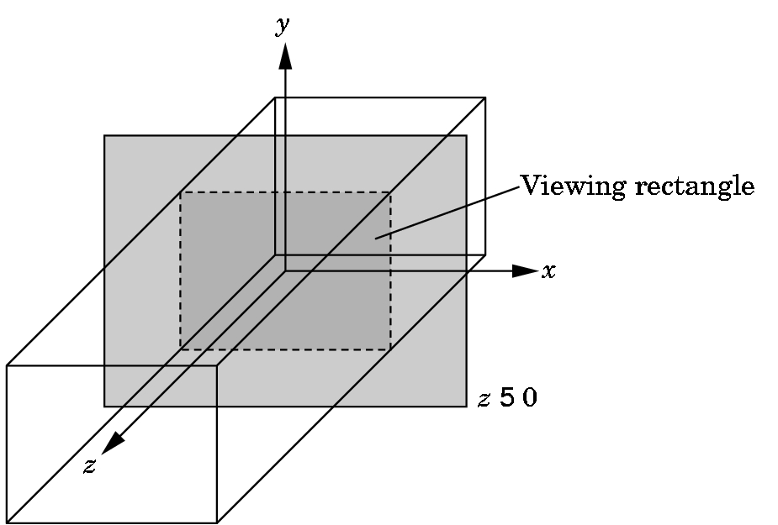
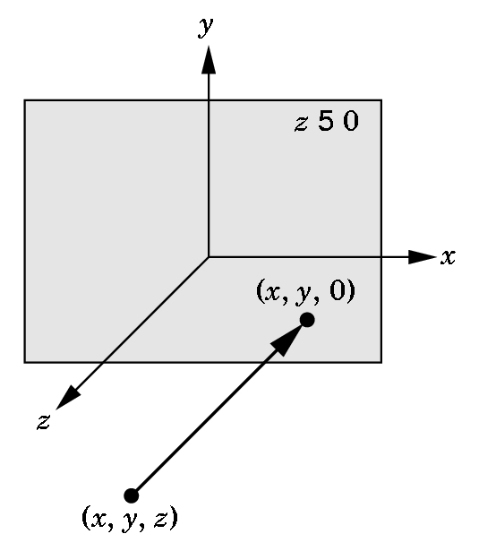
Orthographic Viewing
In the default orthographic view, points are
projected forward along the z axis onto the
plane z=0
z=0
z=0

Slide 11
Transformations and Viewing
In OpenGL, projection is carried out by a projection matrix (transformation)
There is only one set of transformation functions so we must set the matrix mode first
glMatrixMode (GL_PROJECTION)
Transformation functions are incremental so we start with an identity matrix and alter it with a projection matrix that gives the view volume
glLoadIdentity();
glOrtho(-1.0, 1.0, -1.0, 1.0, -1.0, 1.0);

Slide 12
Two- and three-dimensional viewing
In glOrtho(left, right, bottom, top, near, far) the near and far distances are measured from the camera
Two-dimensional vertex commands place all vertices in the plane z=0
If the application is in two dimensions, we can use the function
gluOrtho2D(left, right,bottom,top)
// Might not work
In two dimensions, the view or clipping volume becomes a clipping window

Slide 13
mydisplay.c
void mydisplay()
{
glClear(GL_COLOR_BUFFER_BIT);
glBegin(GL_POLYGON);
glVertex2f(-0.5, -0.5);
glVertex2f(-0.5, 0.5);
glVertex2f(0.5, 0.5);
glVertex2f(0.5, -0.5);
glEnd();
glFlush();
}

Slide 14
OpenGL Primitives
GL_POINTS
GL_POLYGON
GL_LINES
GL_LINE_STRIP
GL_LINE_LOOP
GL_TRIANGLES
GL_QUAD_STRIP
GL_TRIANGLE_STRIP
GL_TRIANGLE_FAN

Slide 15
Polygon Issues
OpenGL will only display polygons correctly that are
Simple: edges cannot cross
Convex: All points on line segment between two points in a polygon are also in the polygon
Flat: all vertices are in the same plane
User program can check if above true
OpenGL will produce output if these conditions are violated but it may not be what is desired
Triangles satisfy all conditions
nonconvex polygon
nonsimple polygon

Slide 16
Attributes
Attributes are part of the OpenGL state and determine the appearance of objects
Color (points, lines, polygons)
Size and width (points, lines)
Stipple pattern (lines, polygons)
Polygon mode
Display as filled: solid color or stipple pattern
Display edges
Display vertices

Slide 17
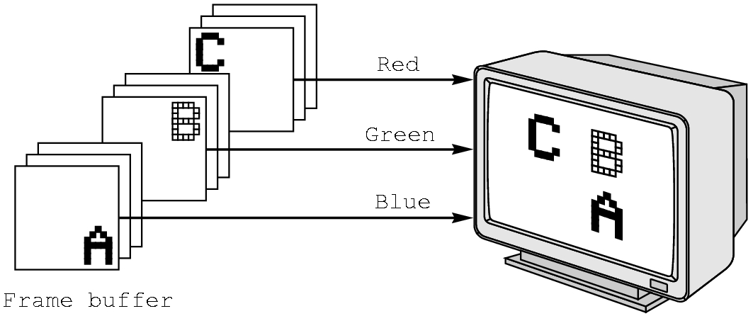
RGB color
Each color component is stored separately in the frame buffer
Usually 8 bits per component in buffer
Note in glColor3f the color values range from 0.0 (none) to 1.0 (all), whereas in glColor3ub the values range from 0 to 255

Slide 18
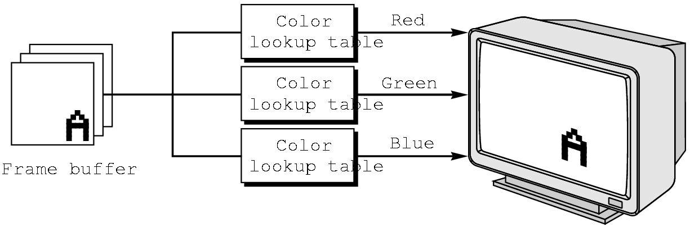
Indexed Color
Colors are indices into tables of RGB values
Requires less memory
indices usually 8 bits
not as important now
Memory inexpensive
Need more colors for shading

Slide 19
Color and State
The color as set by glColor becomes part of the state and will be used until changed
Colors and other attributes are not part of the object but are assigned when the object is rendered
We can create conceptual vertex colors by code such as
glColor
glVertex
glColor
glVertex

Slide 20
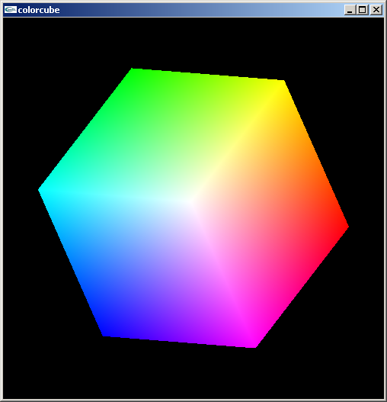
Smooth Color
Default is smooth shading
OpenGL interpolates vertex colors across visible polygons
Alternative is flat shading
Color of first vertex
determines fill color
glShadeModel
(GL_SMOOTH)
or GL_FLAT

Slide 21
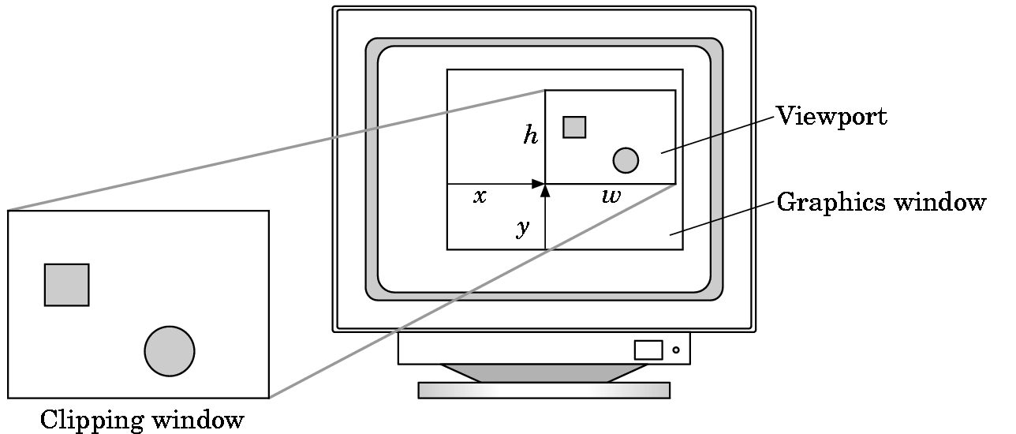
Viewports
Do not have use the entire window for the image: glViewport(x,y,w,h)
Values in pixels (screen coordinates)

