Slide 1
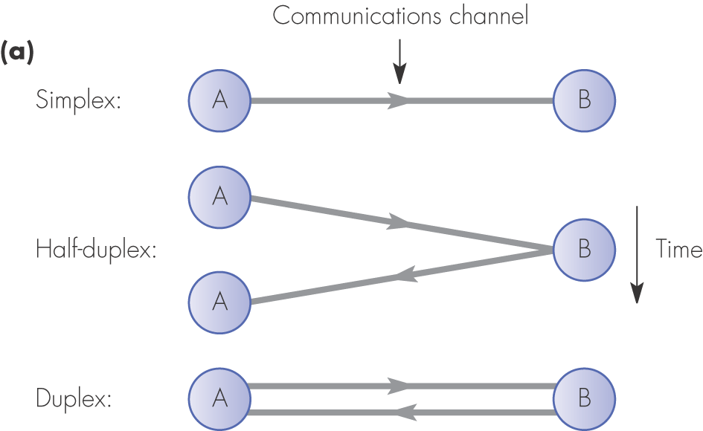
Figure 1.4 Communication modes: (a) unicast

Slide 2
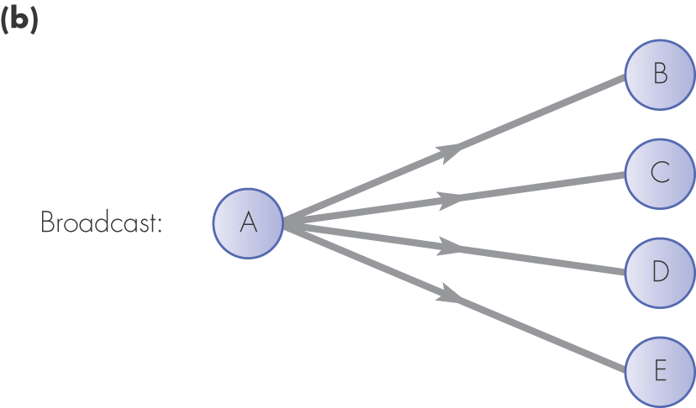
Figure 1.4 Communication modes: (b) broadcast

Slide 3
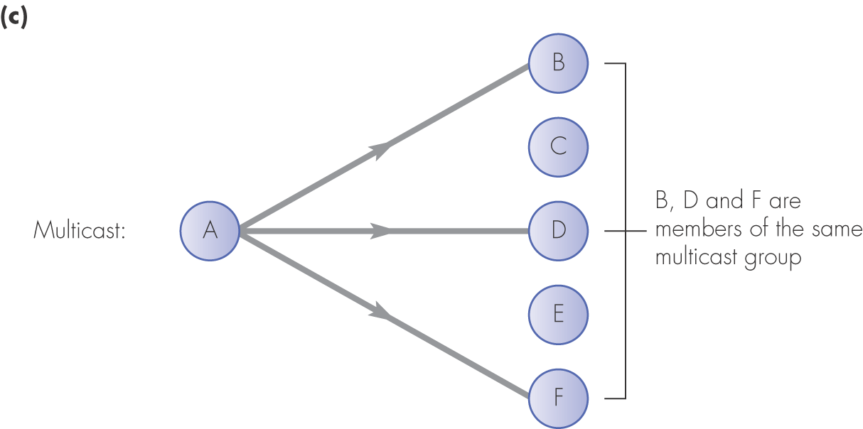
Figure 1.4 Communication modes: (c) multicast

Slide 4
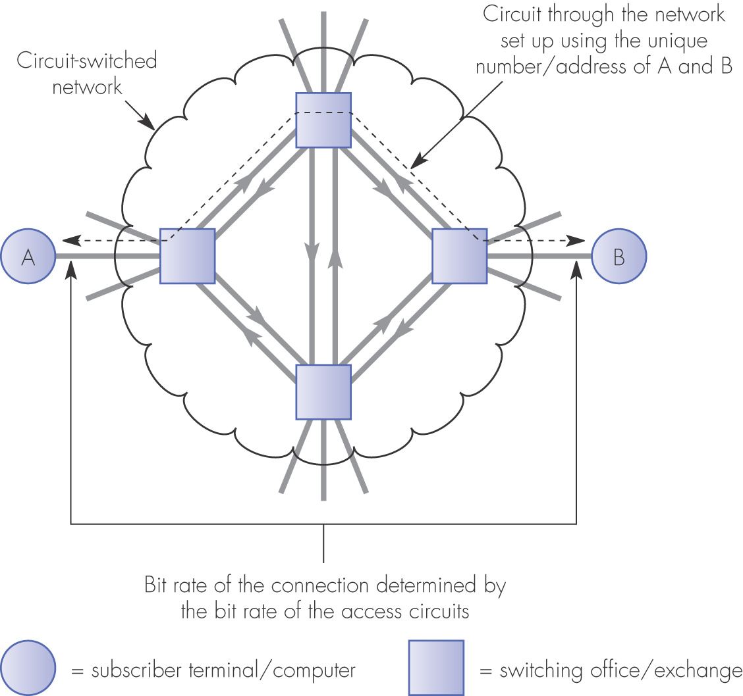
Figure 1.5 Circuit-switched network schematic

Slide 5
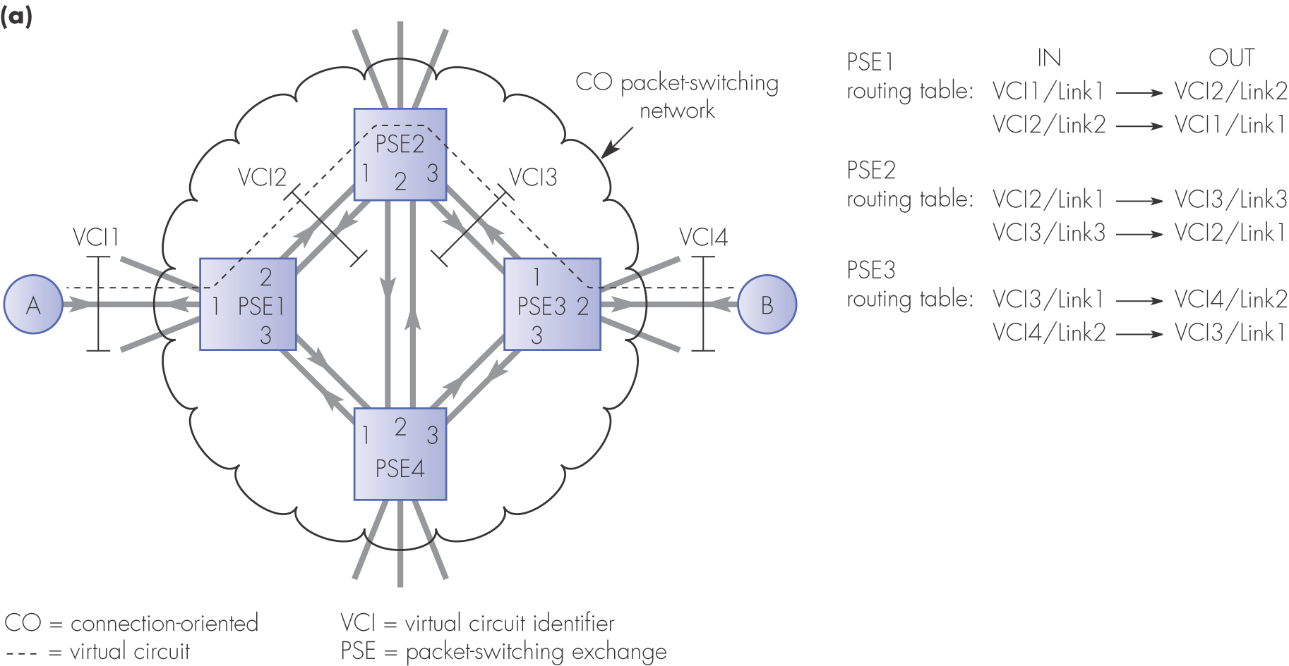
Figure 1.6 Packet-switching network principles: (a) connection-oriented

Slide 6
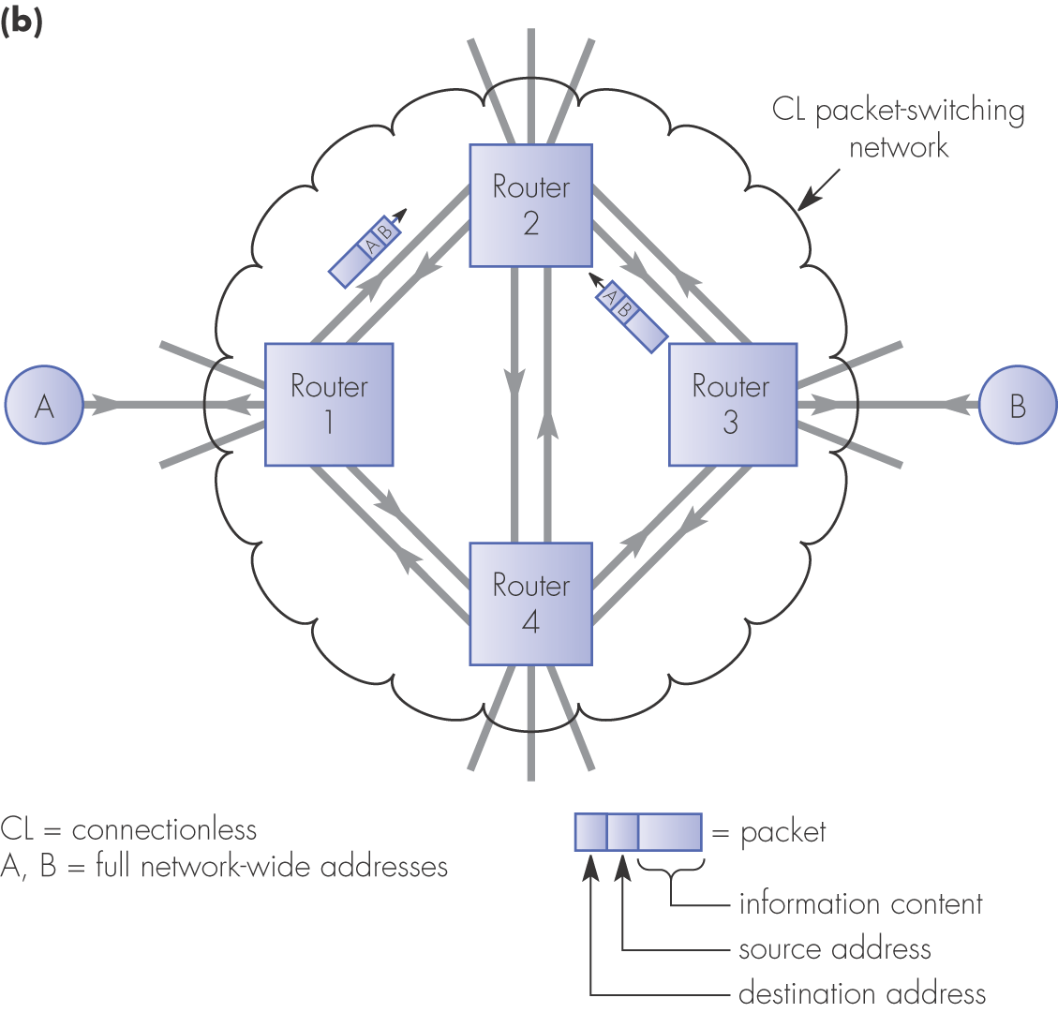
Figure 1.6 Packet-switching network principles: (b) connectionless

Slide 7
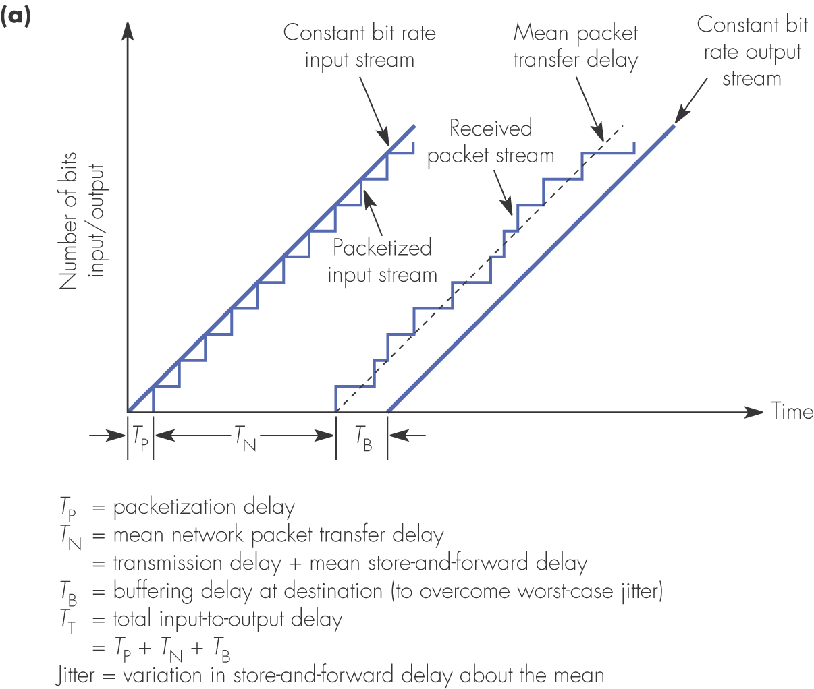
Figure 1.7 Transmission of a constant bit rate stream over a packet-switched network: (a) timing schematic

Slide 8
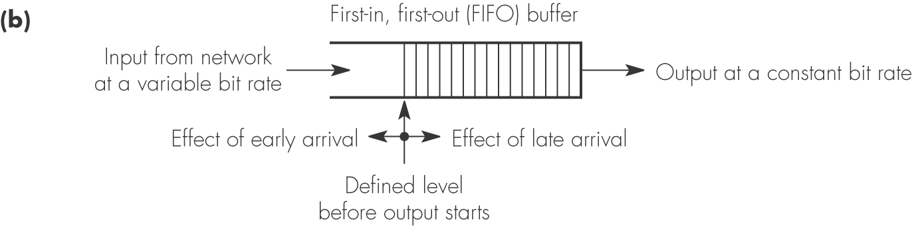
Figure 1.7 Transmission of a constant bit rate stream over a packet-switched network: (b) FIFO buffer operation

Slide 9
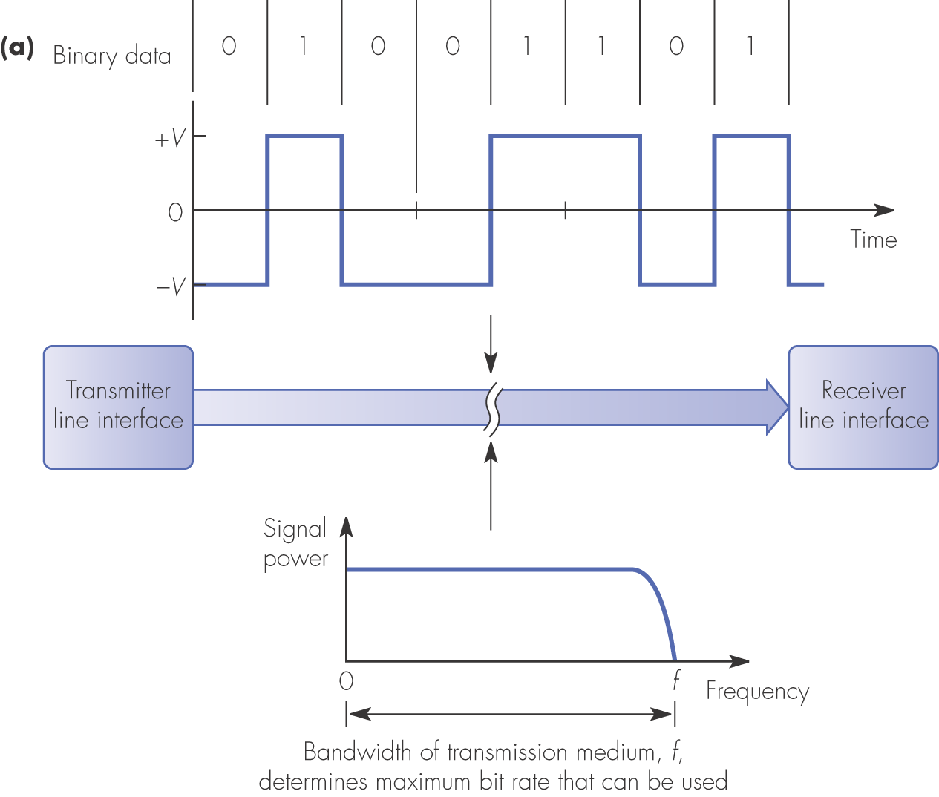
Figure 1.8 Modes of transmission: (a) baseband transmission

Slide 10
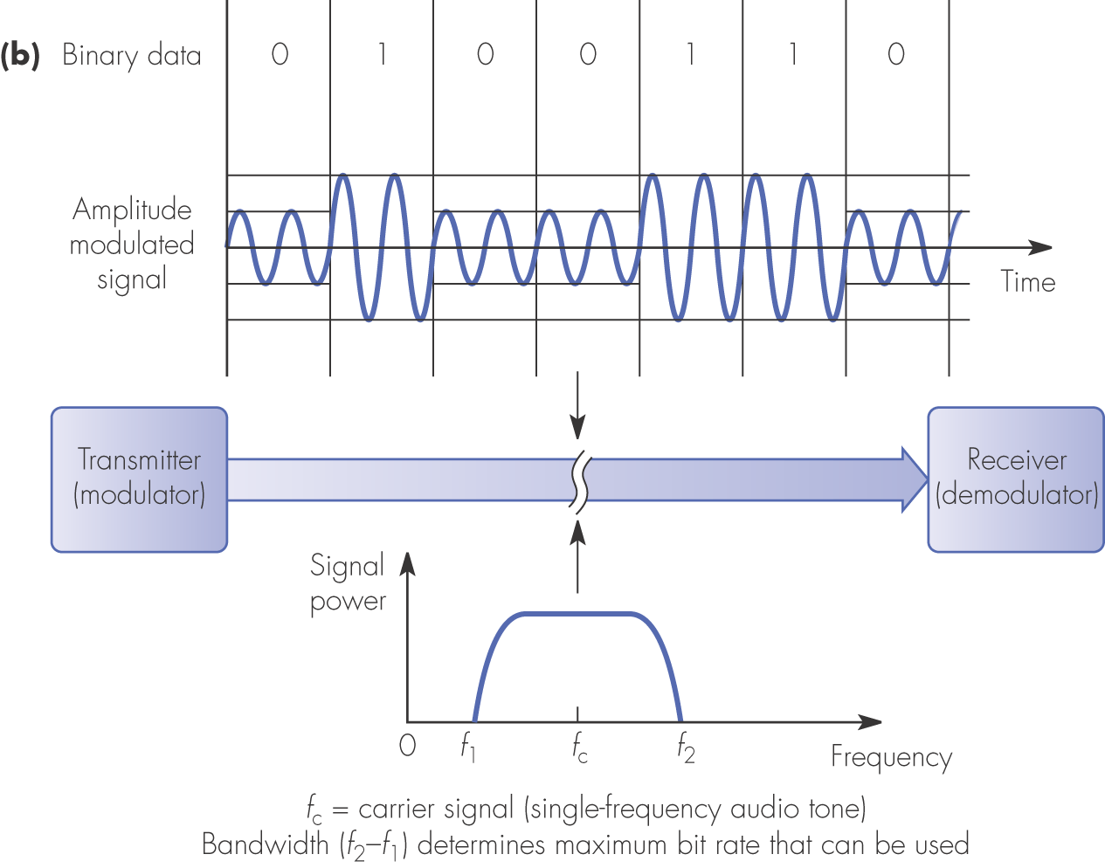
Figure 1.8 Modes of transmission: (b) modulated transmission

Slide 11
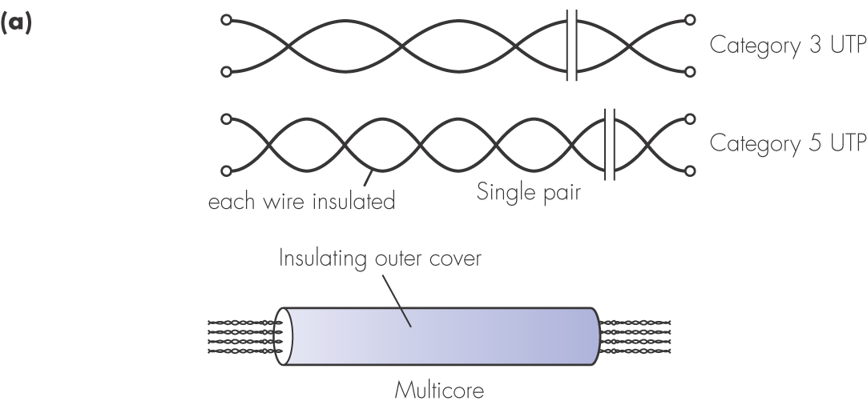
Figure 1.10 Copper wire transmission media: (a) unshielded twisted pair (UTP)

Slide 12
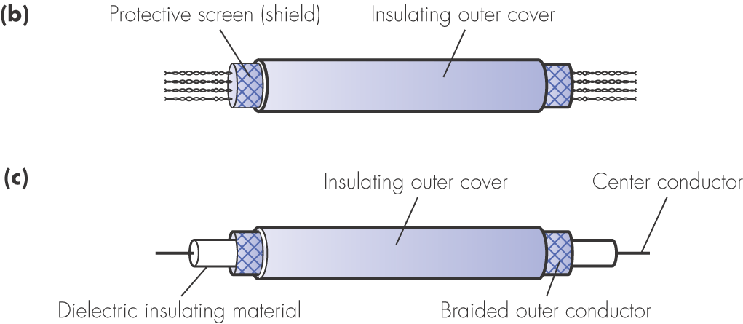
Figure 1.10 Copper wire transmission media: (b) shielded twisted pair (STP); (c) coaxial cable

Slide 13
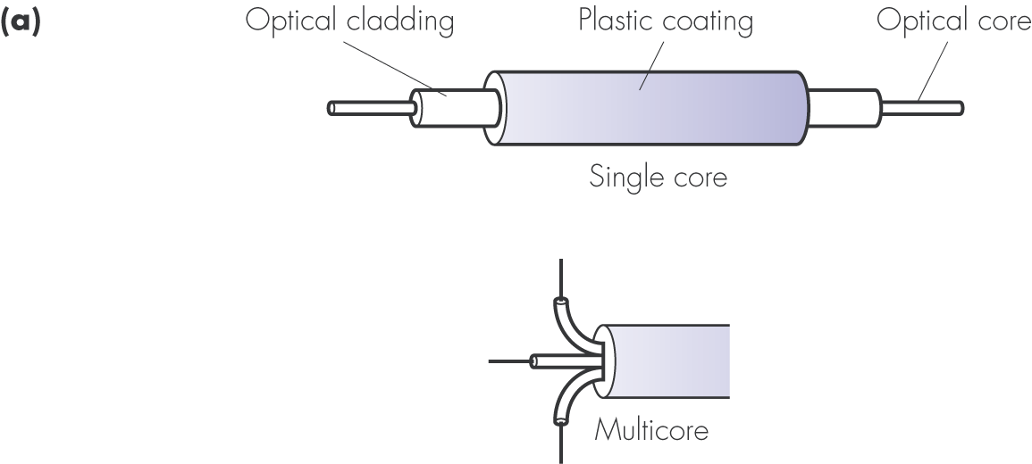
Figure 1.11 Optical fiber transmission media: (a) cable structures

Slide 14
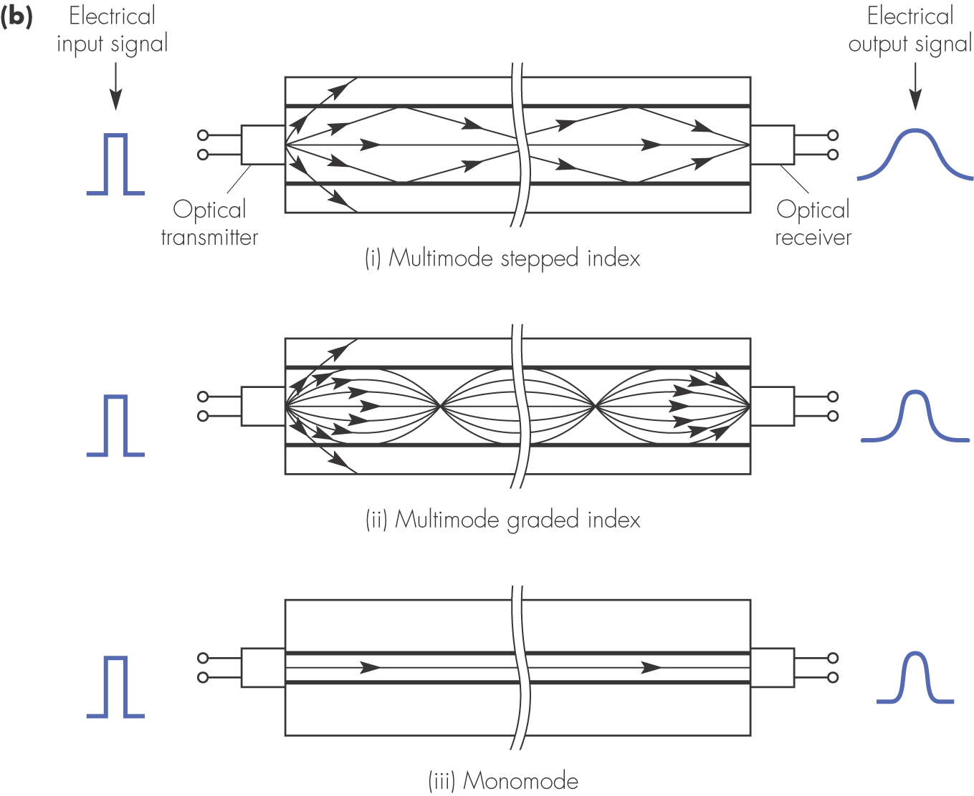
Figure 1.11 Optical fiber transmission media: (b) transmission modes

Slide 15
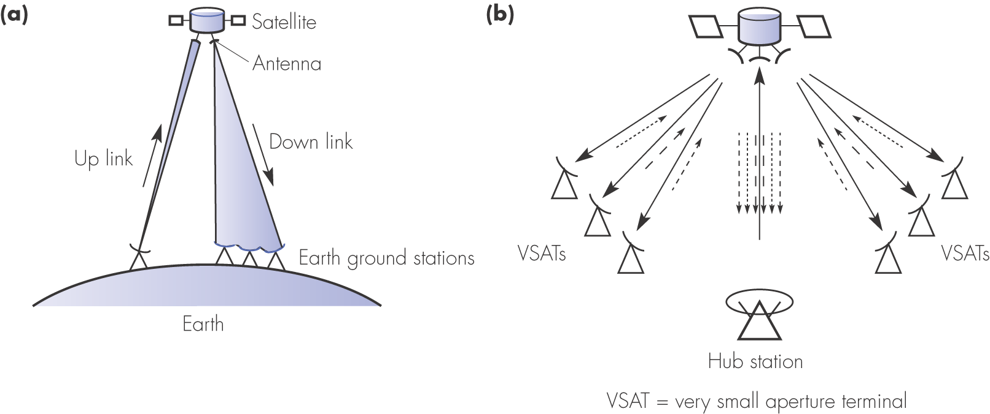
Figure 1.12 Satellite systems: (a) broadcast television; (b) data communications

Slide 16
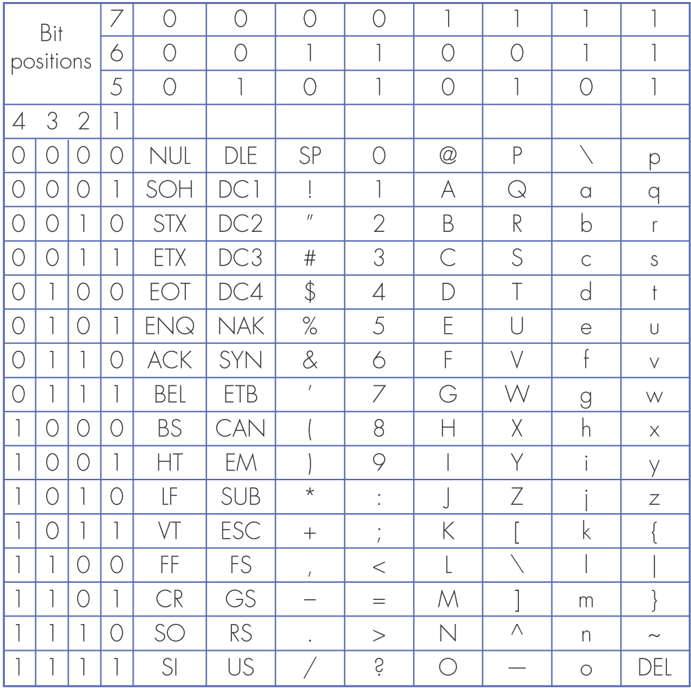
Figure 1.14 The ASCII character set

Slide 17
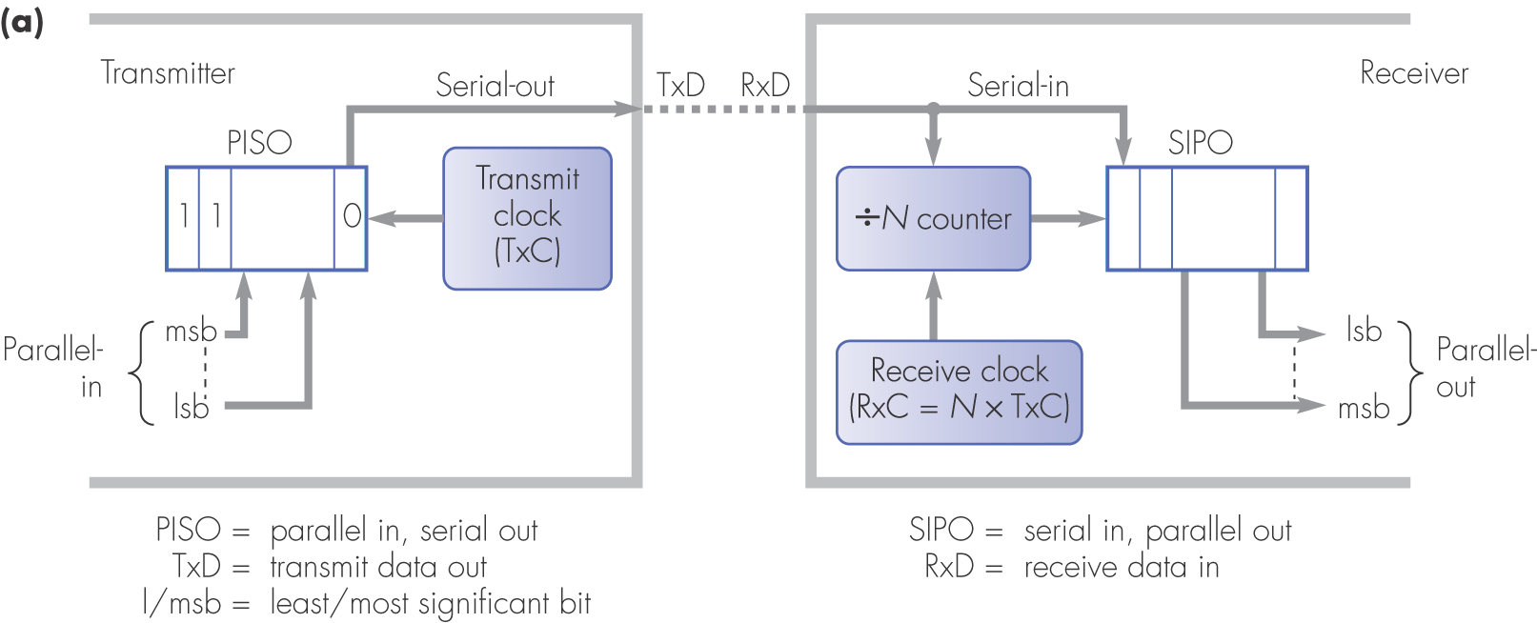
Figure 1.15 Asynchronous transmission: (a) principle of operation

Slide 18
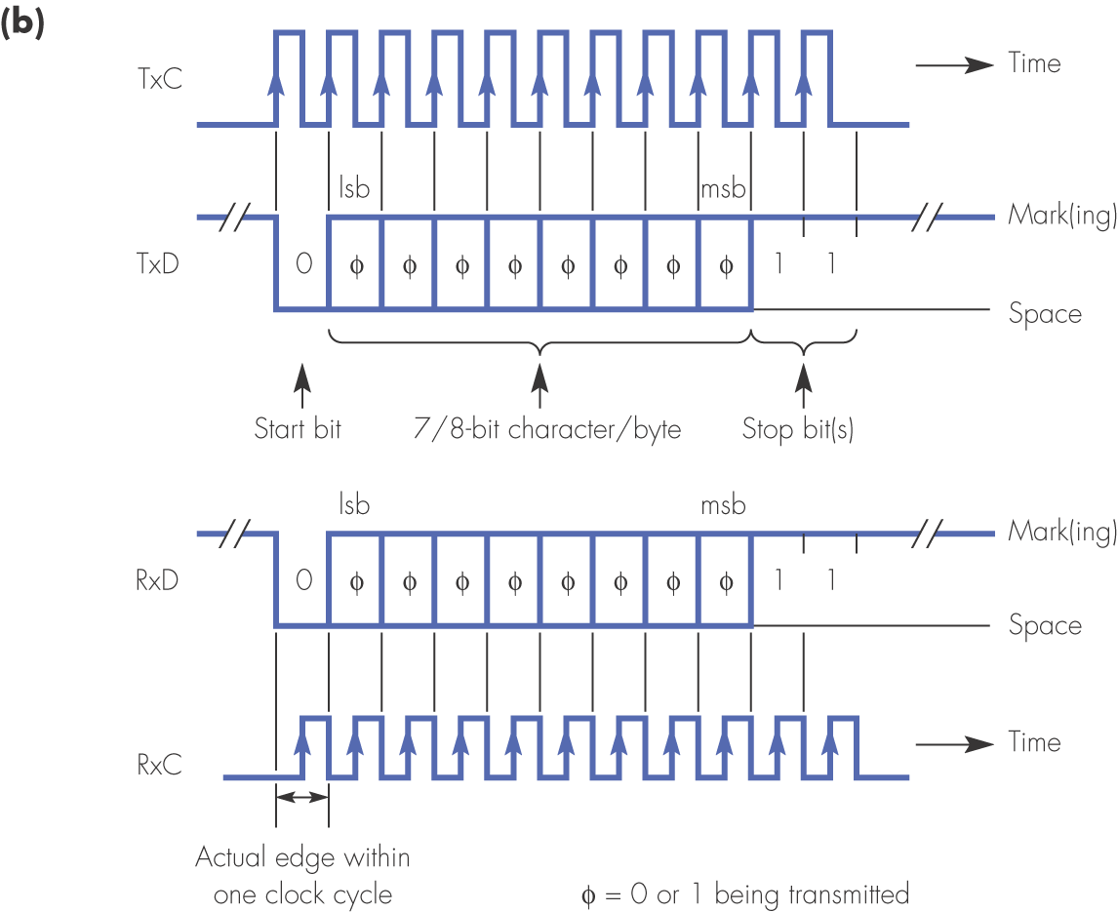
Figure 1.15 Asynchronous transmission: (b) timing principles

Slide 19
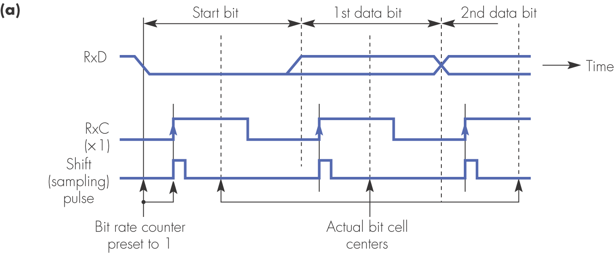
Figure 1.16 Examples of three different receiver clock rate ratios: (a) × 1

Slide 20
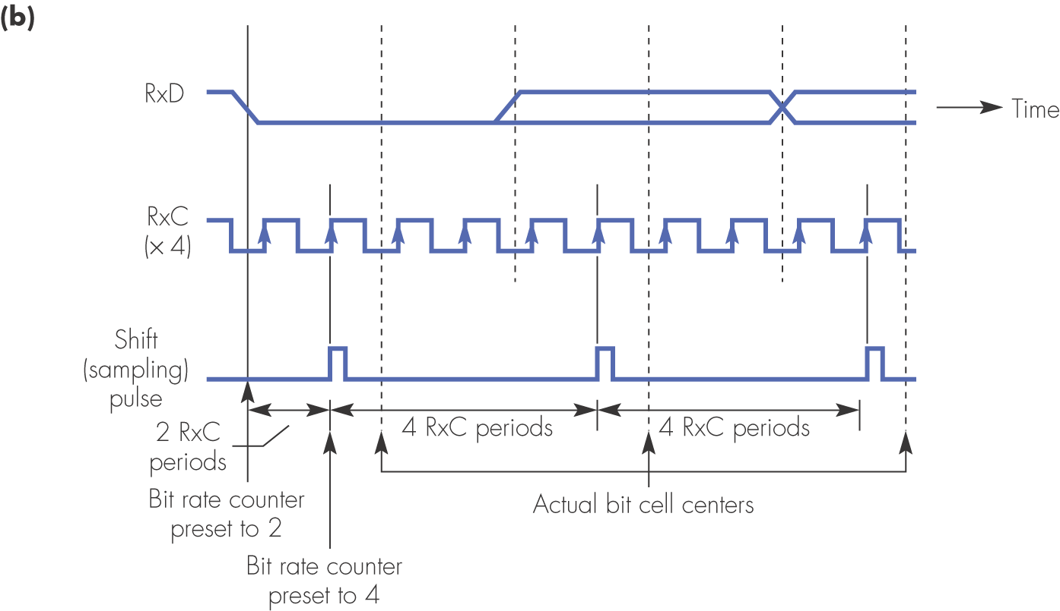
Figure 1.16 Examples of three different receiver clock rate ratios: (b) × 4

Slide 21
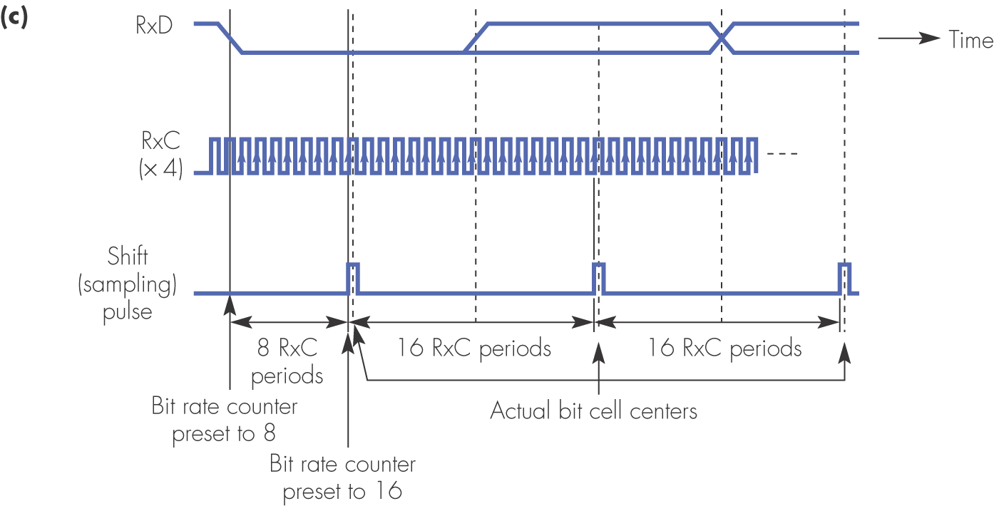
Figure 1.16 Examples of three different receiver clock rate ratios: (c) × 16

Slide 22
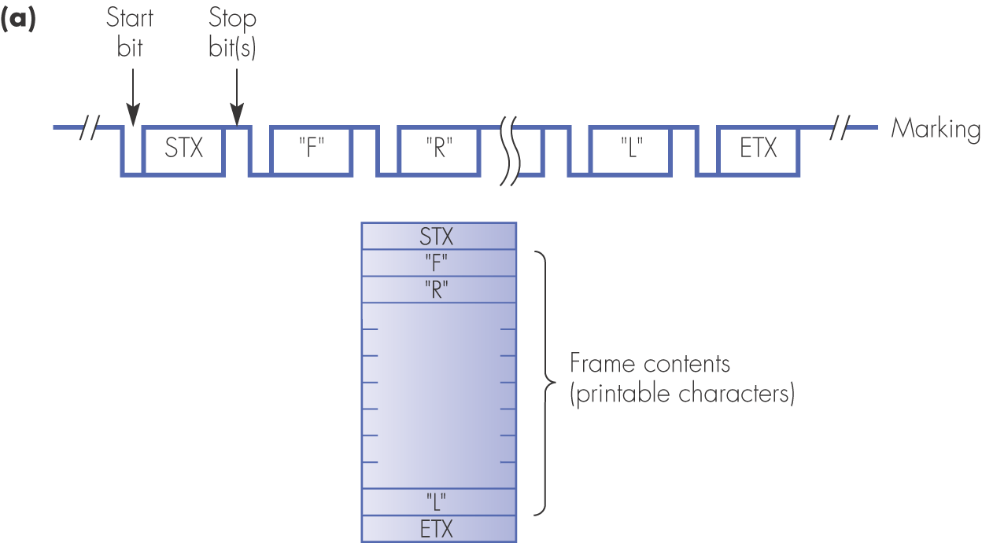
Figure 1.17 Frame synchronization with different frame contents: (a) printable characters

Slide 23
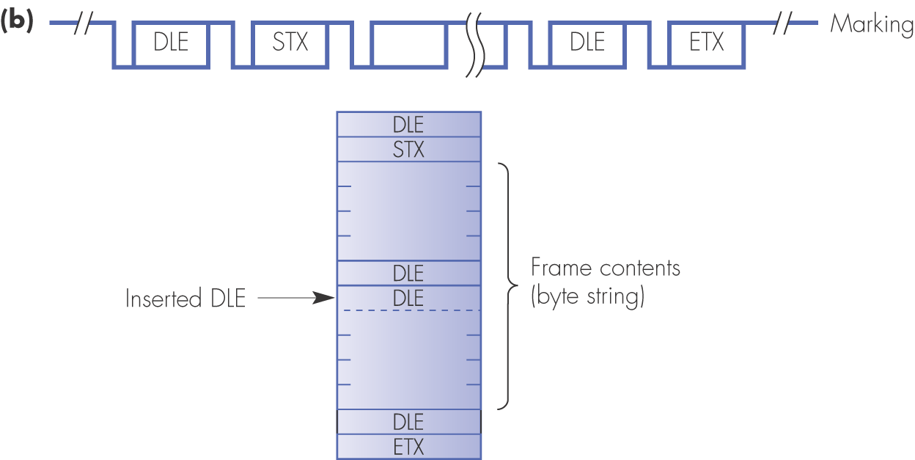
Figure 1.17 Frame synchronization with different frame contents: (b) string of bytes

Slide 24
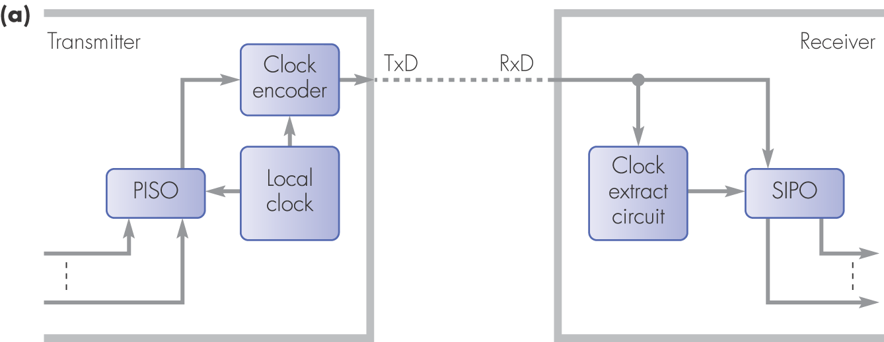
Figure 1.18 Alternative bit/clock synchronization methods with synchronous transmission: (a) clock encoding

Slide 25
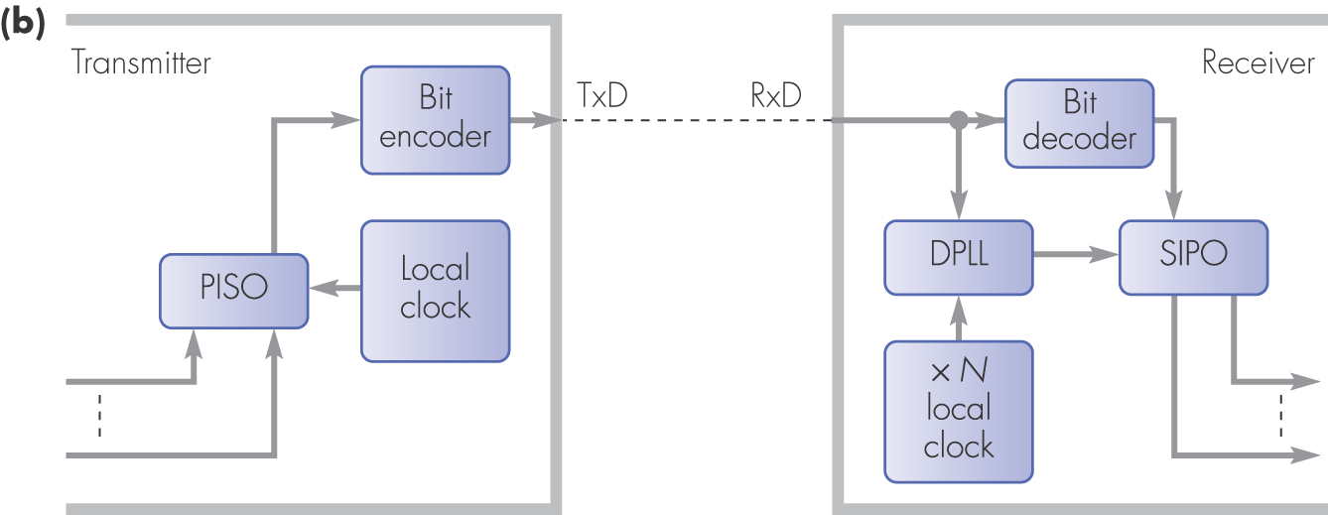
Figure 1.18 Alternative bit/clock synchronization methods with synchronous transmission: (b) digital phase-lock-loop (DPLL)

Slide 26
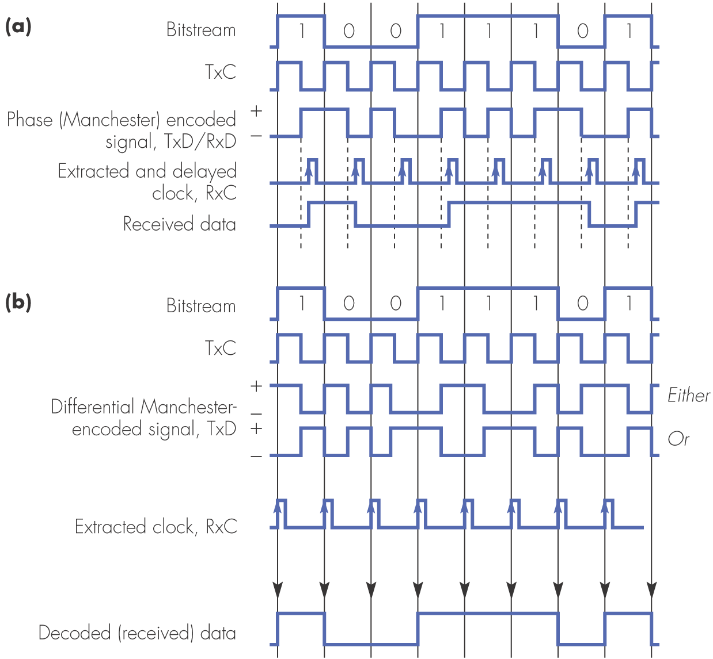
Figure 1.19 Synchronous transmission clock encoding methods: (a) Manchester; (b) differential Manchester

Slide 27
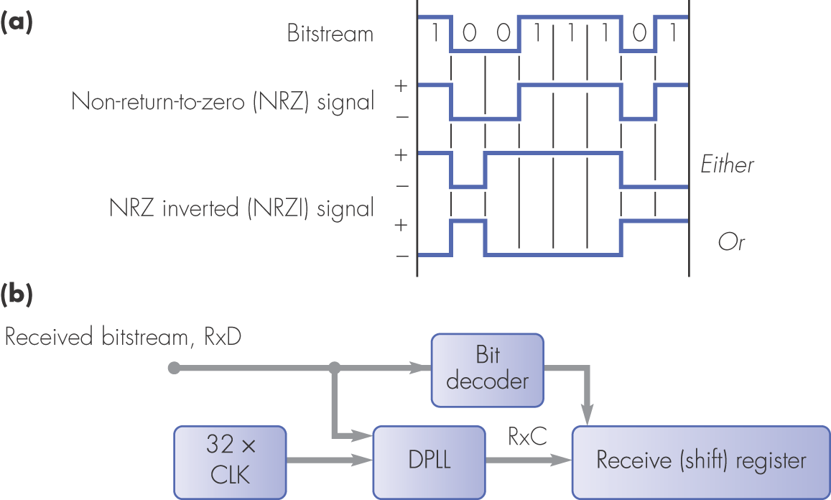
Figure 1.20 DPLL operation: (a) bit encoding; (b) circuit schematic

Slide 28
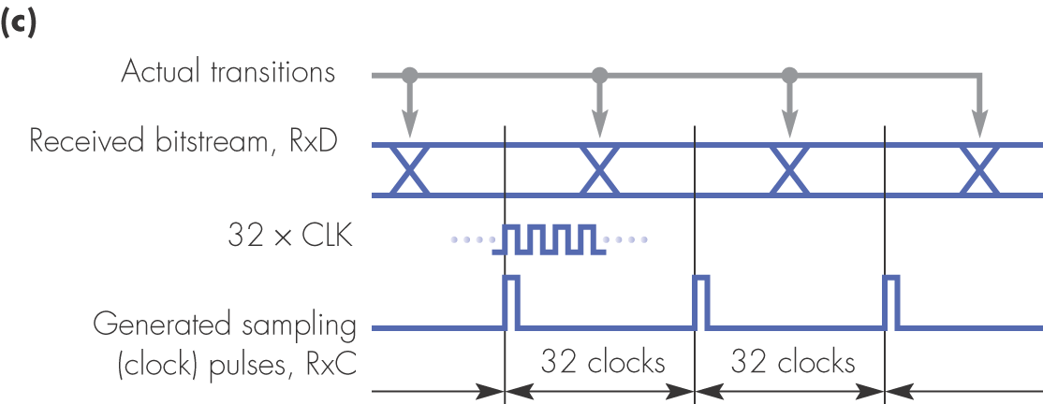
Figure 1.20 DPLL operation: (c) in phase

Slide 29
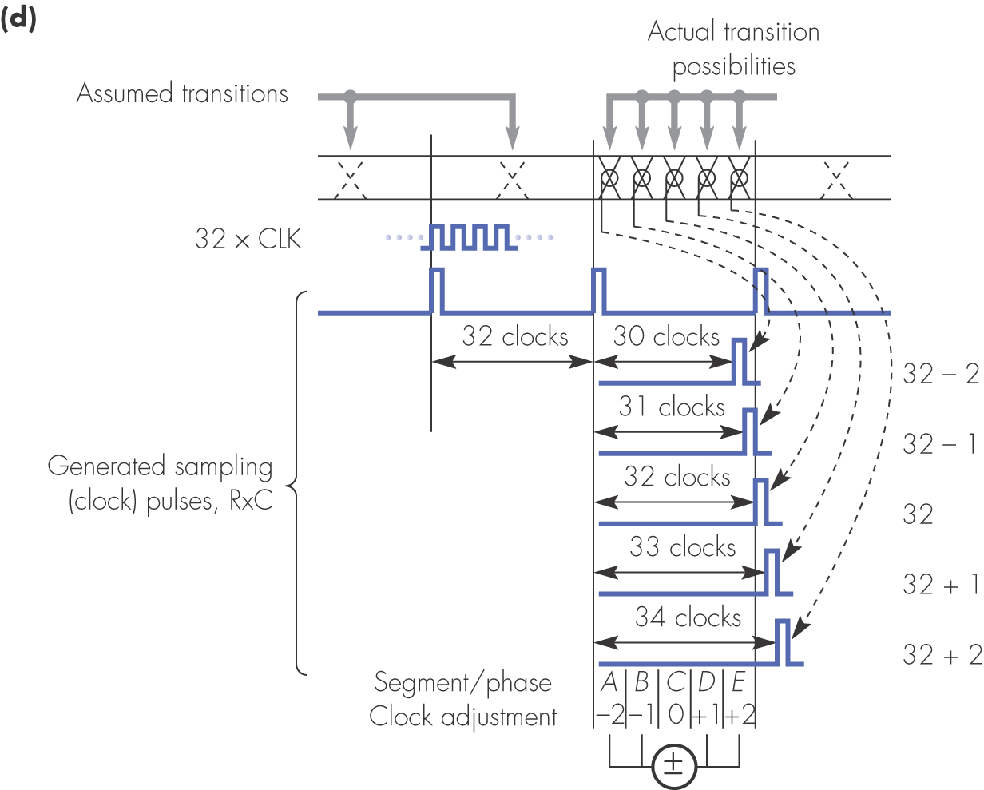
Figure 1.20 DPLL operation: (d) clock adjustment rules

Slide 30
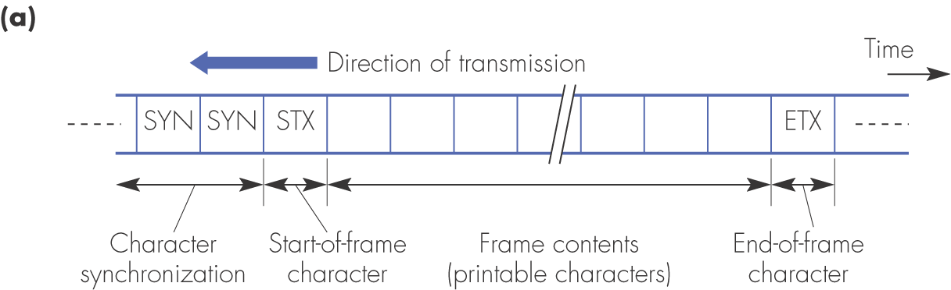
Figure 1.21 Character-oriented synchronous transmission: (a) frame format

Slide 31
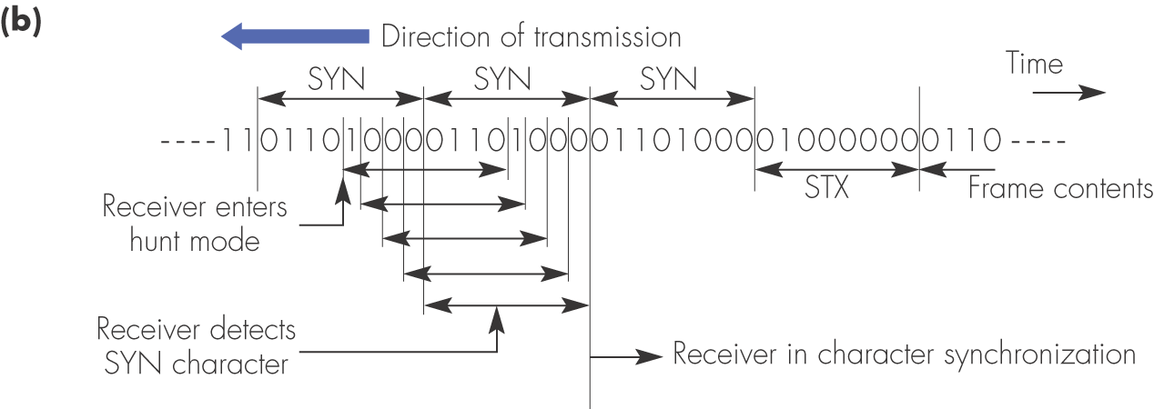
Figure 1.21 Character-oriented synchronous transmission: (b) character synchronization

Slide 32
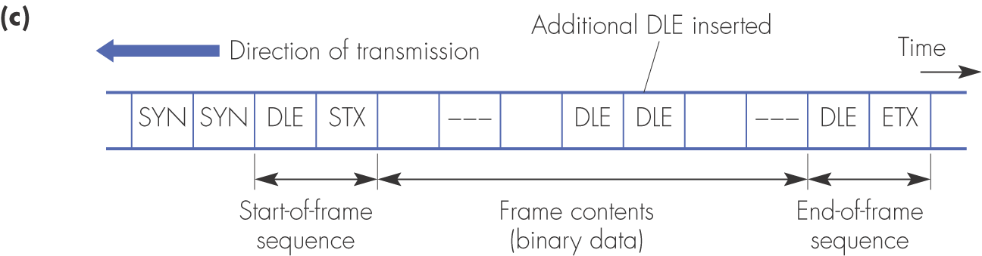
Figure 1.21 Character-oriented synchronous transmission: (c) data transparency (character stuffing)

Slide 33
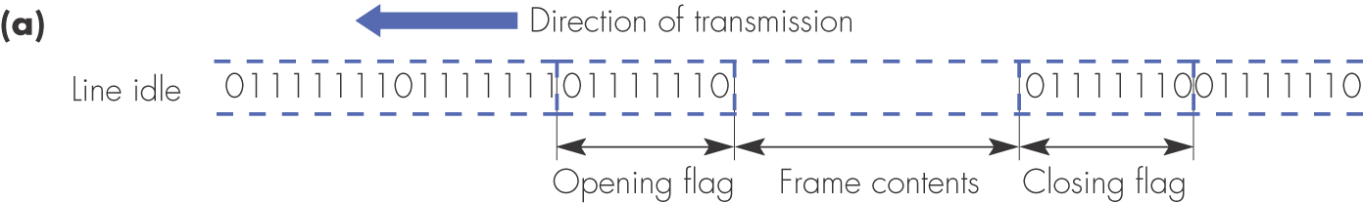
Figure 1.22 Bit-oriented synchronous transmission: (a) framing structure

Slide 34
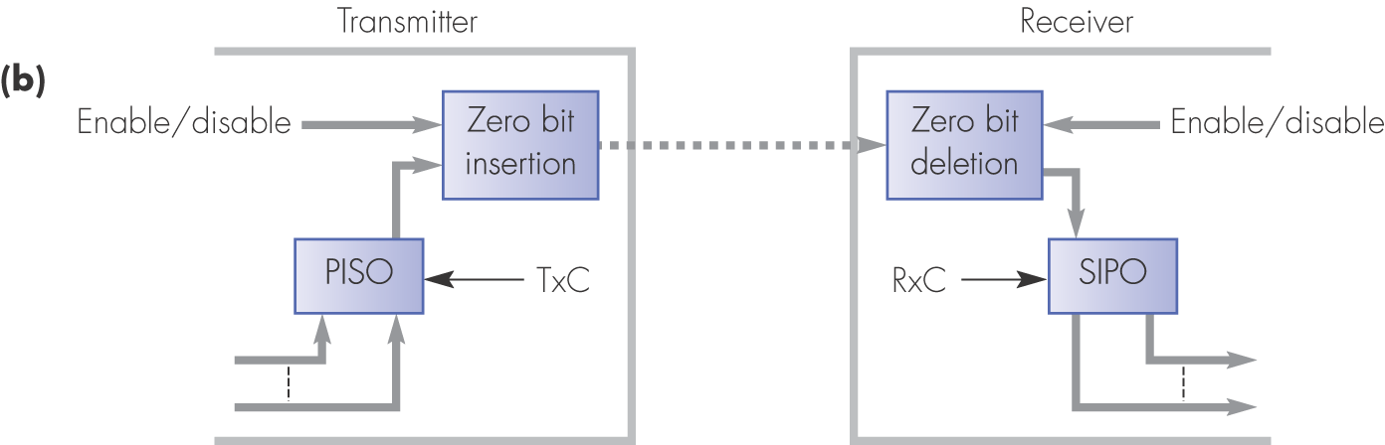
Figure 1.22 Bit-oriented synchronous transmission: (b) zero bit insertion circuit location

Slide 35
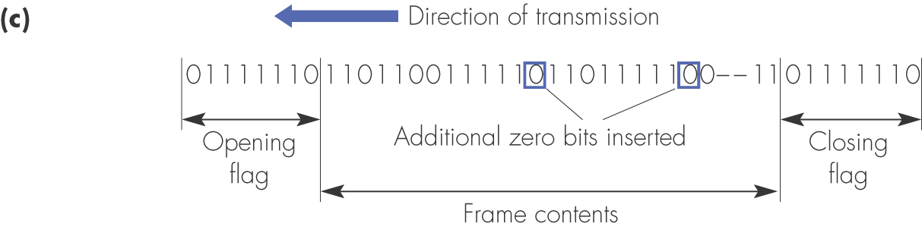
Figure 1.22 Bit-oriented synchronous transmission: (c) example transmitted frame contents

Slide 36
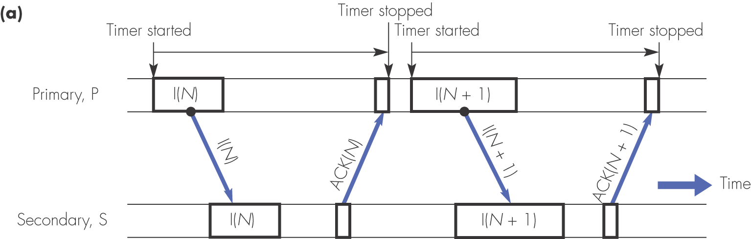
Figure 1.23 ARQ error control scheme: (a) error free

Slide 37
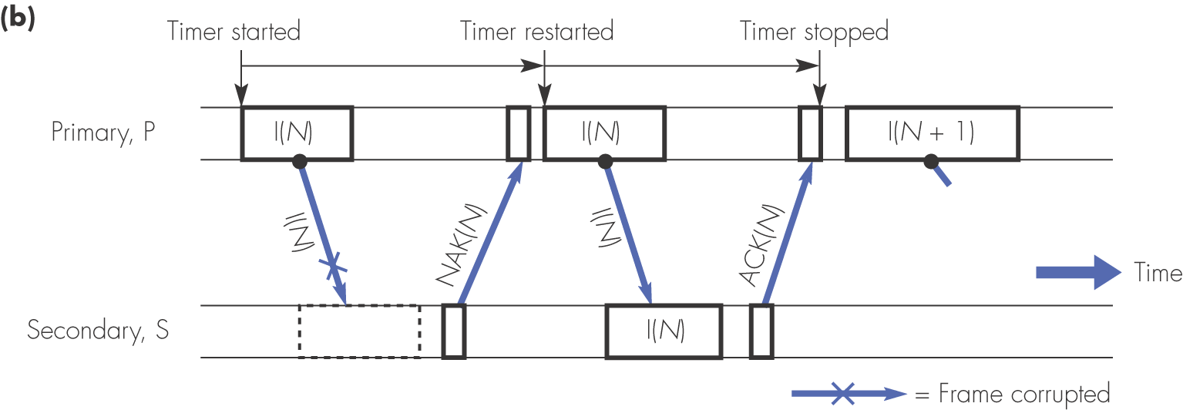
Figure 1.23 ARQ error control scheme: (b) corrupted I-frame

Slide 38
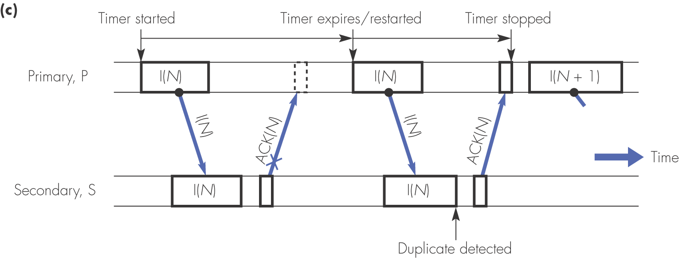
Figure 1.23 ARQ error control scheme: (c) corrupted ACK-frame

Slide 39
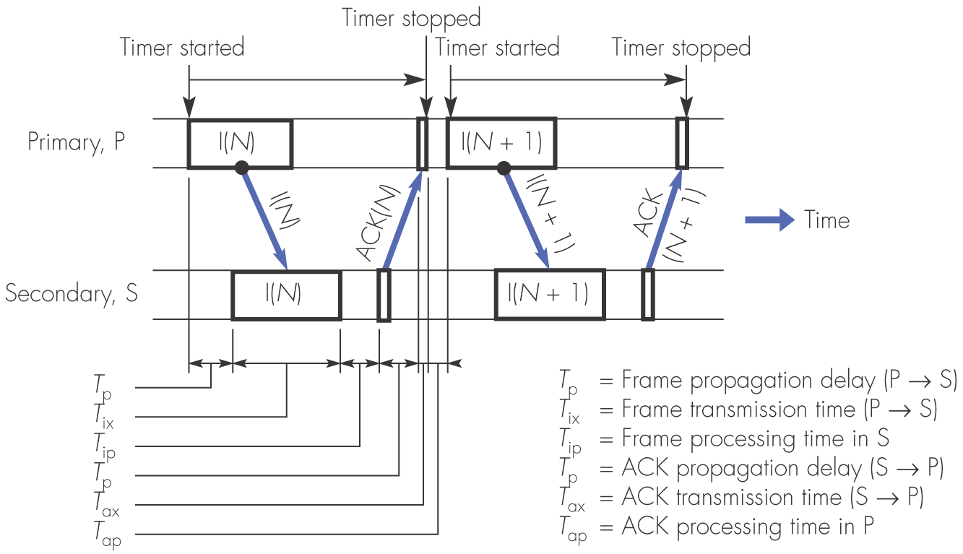
Figure 1.24 Idle RQ link utilization

Slide 40
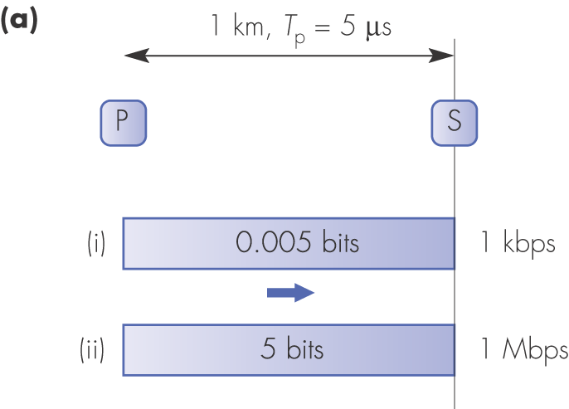
Figure 1.25 Effect of propagation delay as a function of data transmission rate; parts correspond to Example 1.6

Slide 41
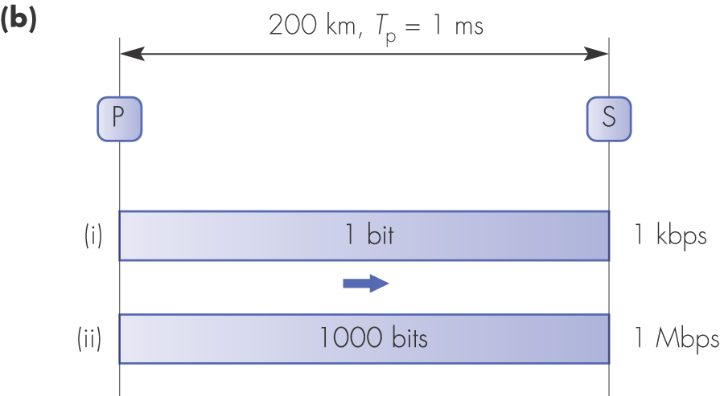
Figure 1.25 continued

Slide 42
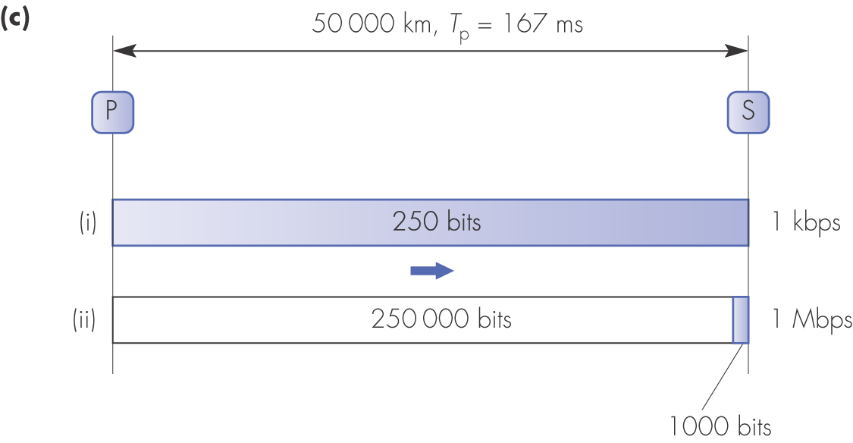
Figure 1.25 continued

Slide 43
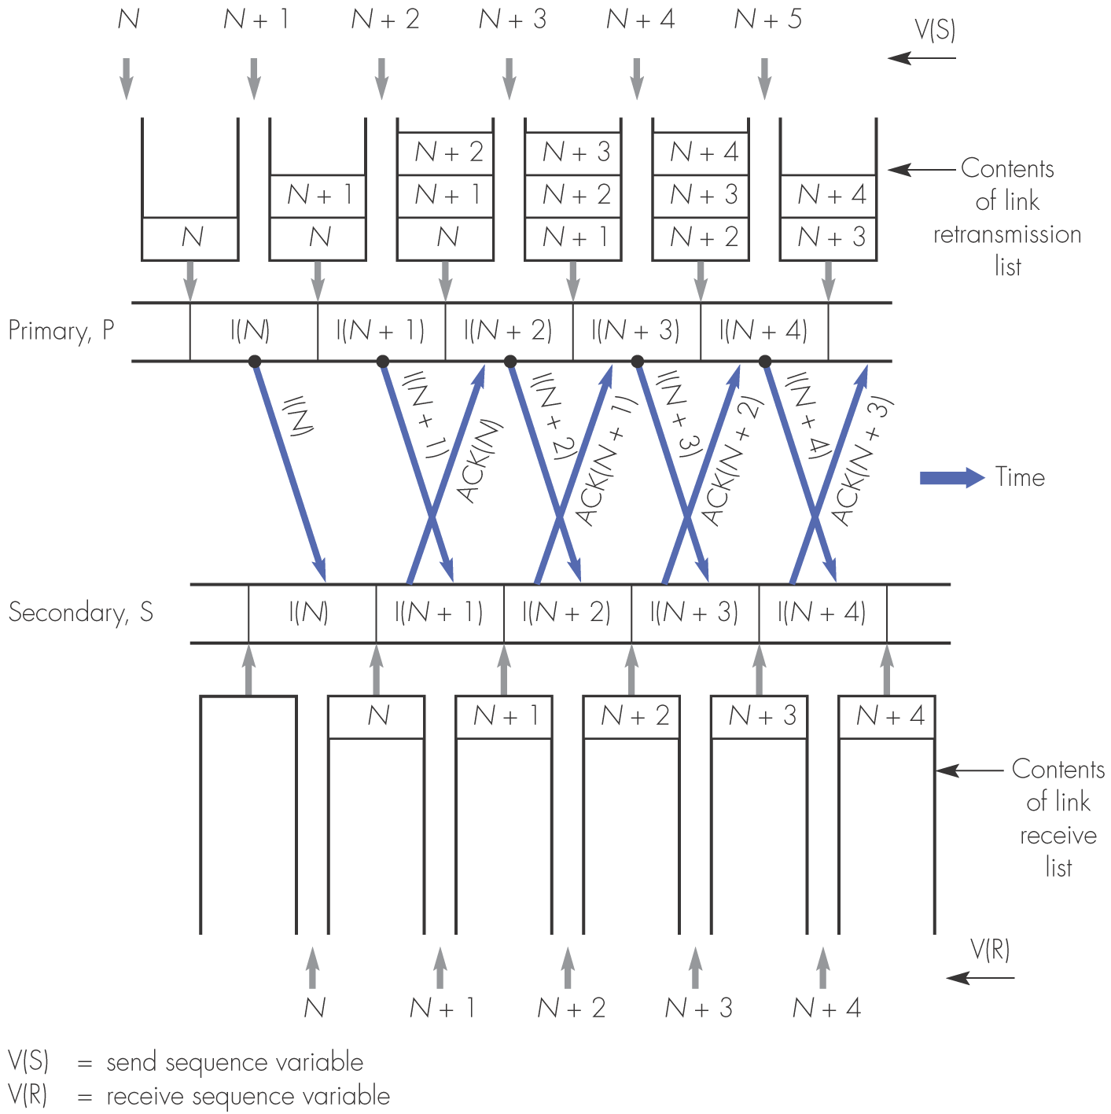
Figure 1.26 Continuous RQ frame sequence without transmission errors

Slide 44
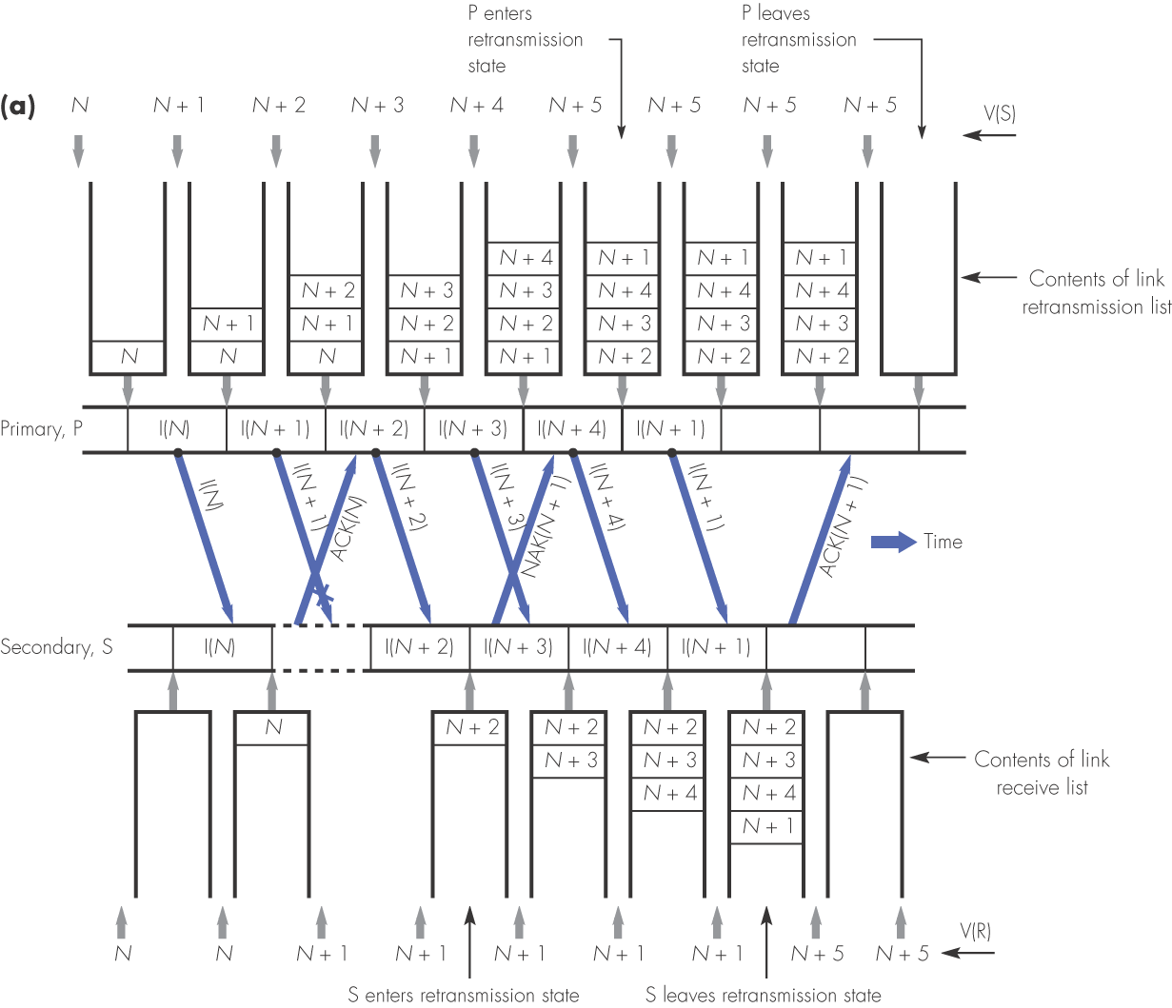
Figure 1.27 Selective repeat: (a) effect of corrupted I-frame

Slide 45
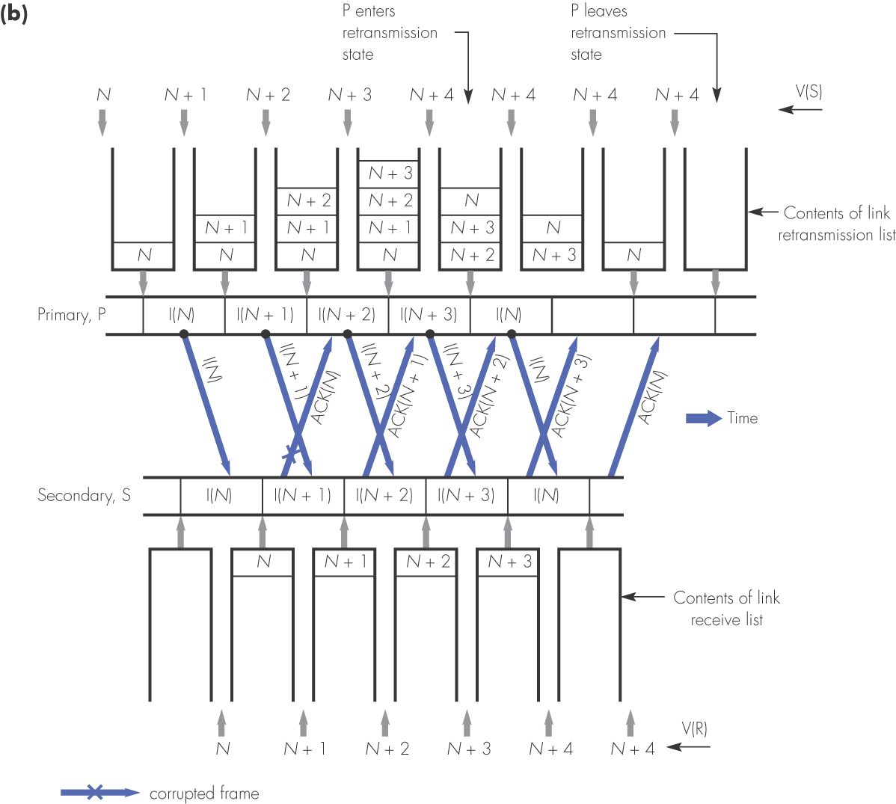
Figure 1.27 Selective repeat: (b) effect of corrupted ACK-frame

Slide 46
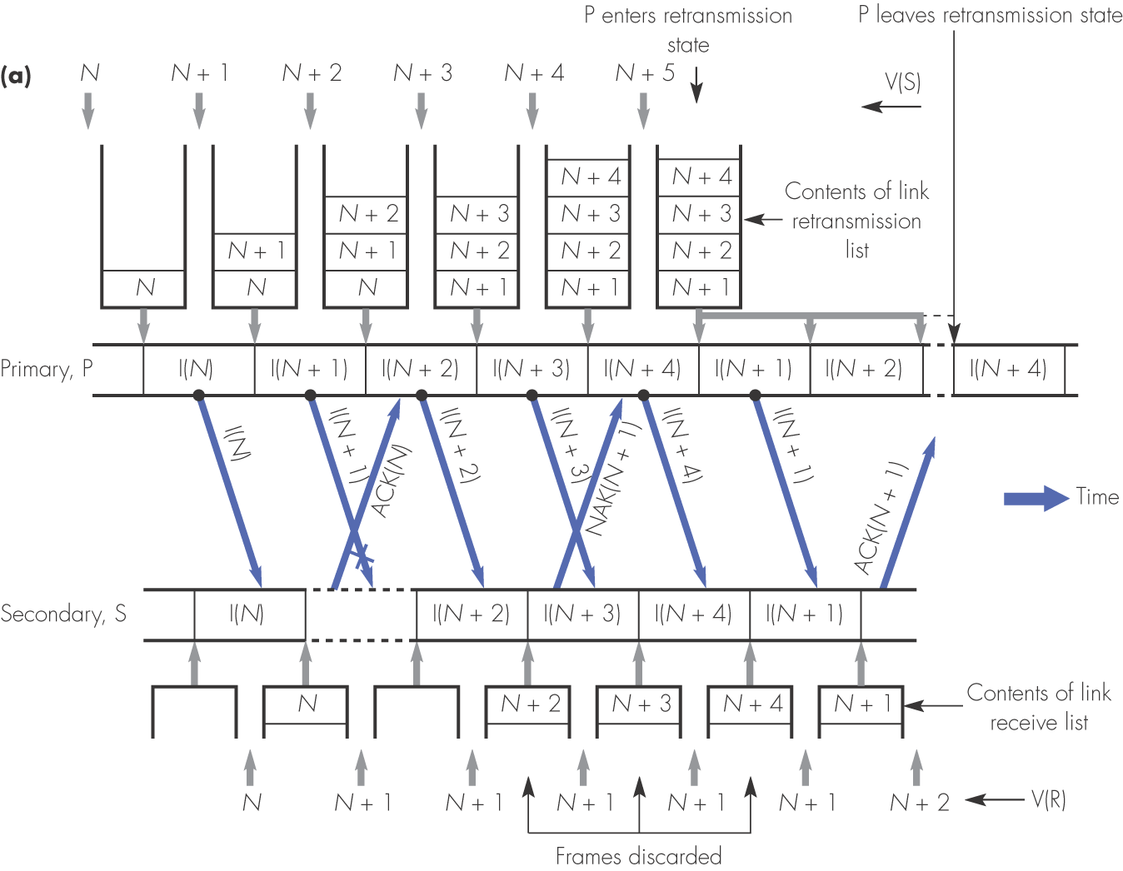
Figure 1.28 Go-back-N retransmission strategy: (a) corrupted I-frame

Slide 47
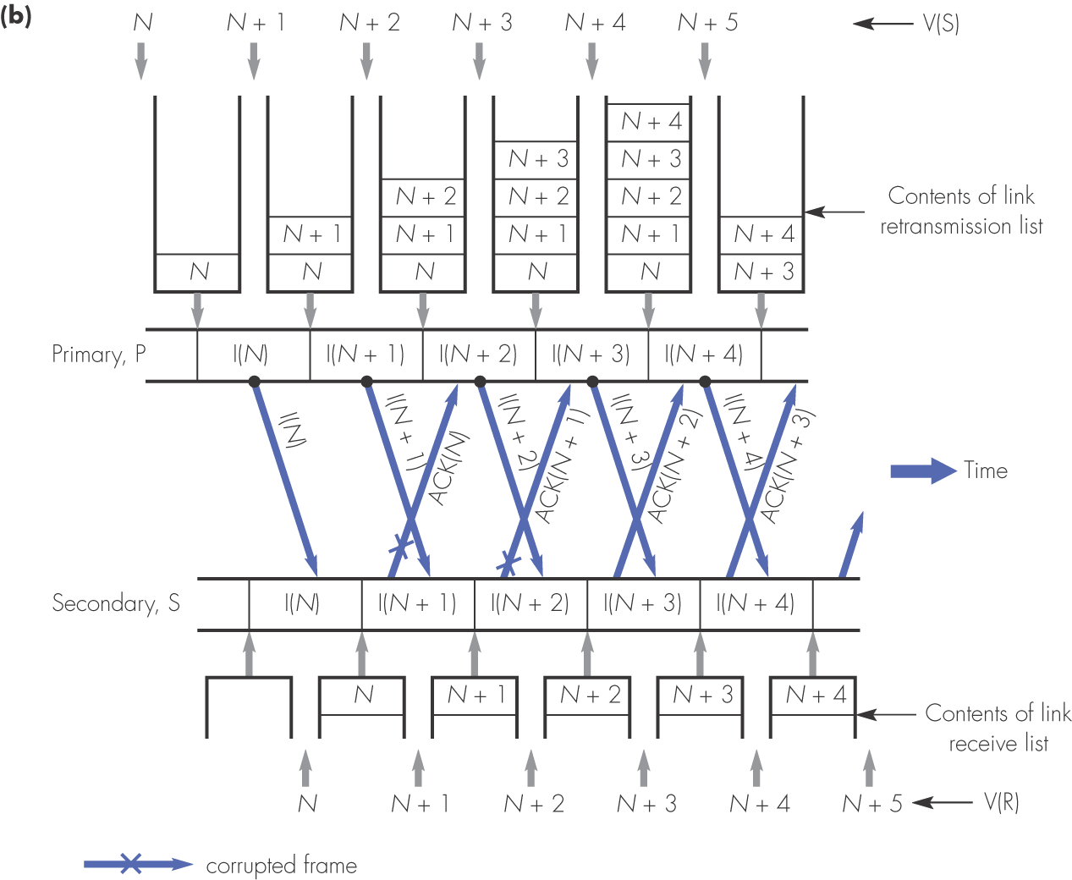
Figure 1.28 Go-back-N retransmission strategy: (b) corrupted ACK-frame

Slide 48
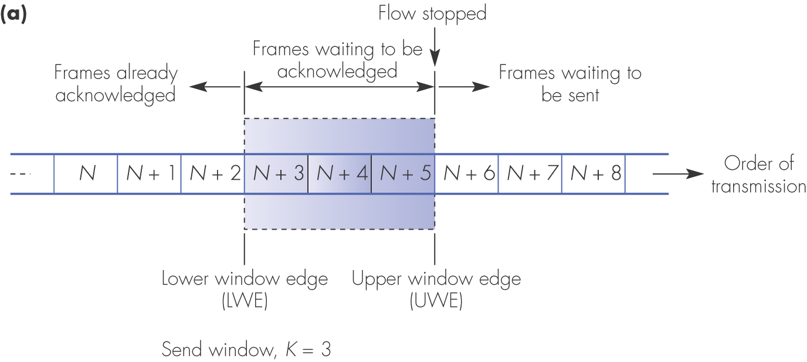
Figure 1.29 Flow control principle: (a) sliding window example

Slide 49
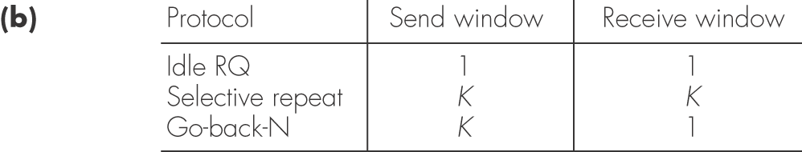
Figure 1.29 Flow control principle: (b) send and receive window limits

Slide 50
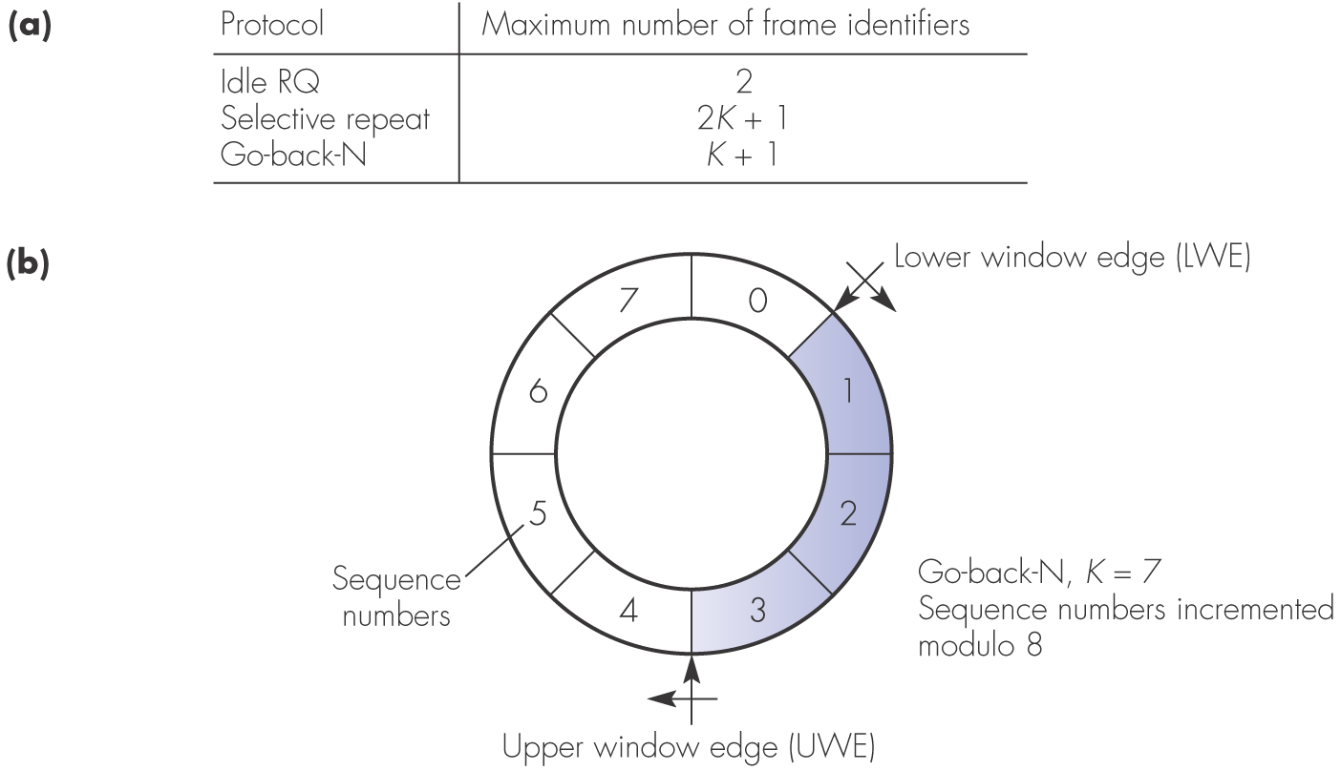
Figure 1.30 Sequence numbers: (a) maximum number for each protocol; (b) example assuming eight sequence numbers

Slide 51

Figure 1.31 Example layered architecture showing the layer and sublayer interfaces associated with the idle RQ protocol

Slide 52

Figure 1.32 Abbreviated names used in the specification of the idle RQ primary

Slide 53

Figure 1.33 Specification of idle RQ primary in the form of: (a) a state transition diagram

Slide 54

Figure 1.33 Specification of idle RQ primary in the form of: (b) an extended event–state table

Slide 55

Figure 1.33 Specification of idle RQ primary in the form of: (c) pseudocode

Slide 56

Figure 1.34 Specification of idle RQ secondary: (a) abbreviated names

Slide 57

Figure 1.34 Specification of idle RQ secondary: (b) state transition diagram; (c) extended event–state table

Slide 58

Figure 1.34 Specification of idle RQ secondary: (d) pseudocode

Slide 59

Figure 1.36 HDLC frame format and types: (a) standard/extended format

Slide 60

Figure 1.36 HDLC frame format and types: (b) standard control field bit definitions

Slide 61

Figure 1.36 HDLC frame format and types: (c) extended control field bit definitions

Slide 62

Figure 1.37 HDLC summary: (a) service primitives

Slide 63

Figure 1.37 HDLC summary: (b) state transition diagram (ABM)

Slide 64

Figure 1.38 Protocol stacks: (a) layer interactions and terminology

Slide 65

Figure 1.38 Protocol stacks: (b) the Internet protocol stack

Slide 66

Figure 1.39 Introduction and networking basics summary

Slide 67

Figure 1.39 continued

