Slide 1
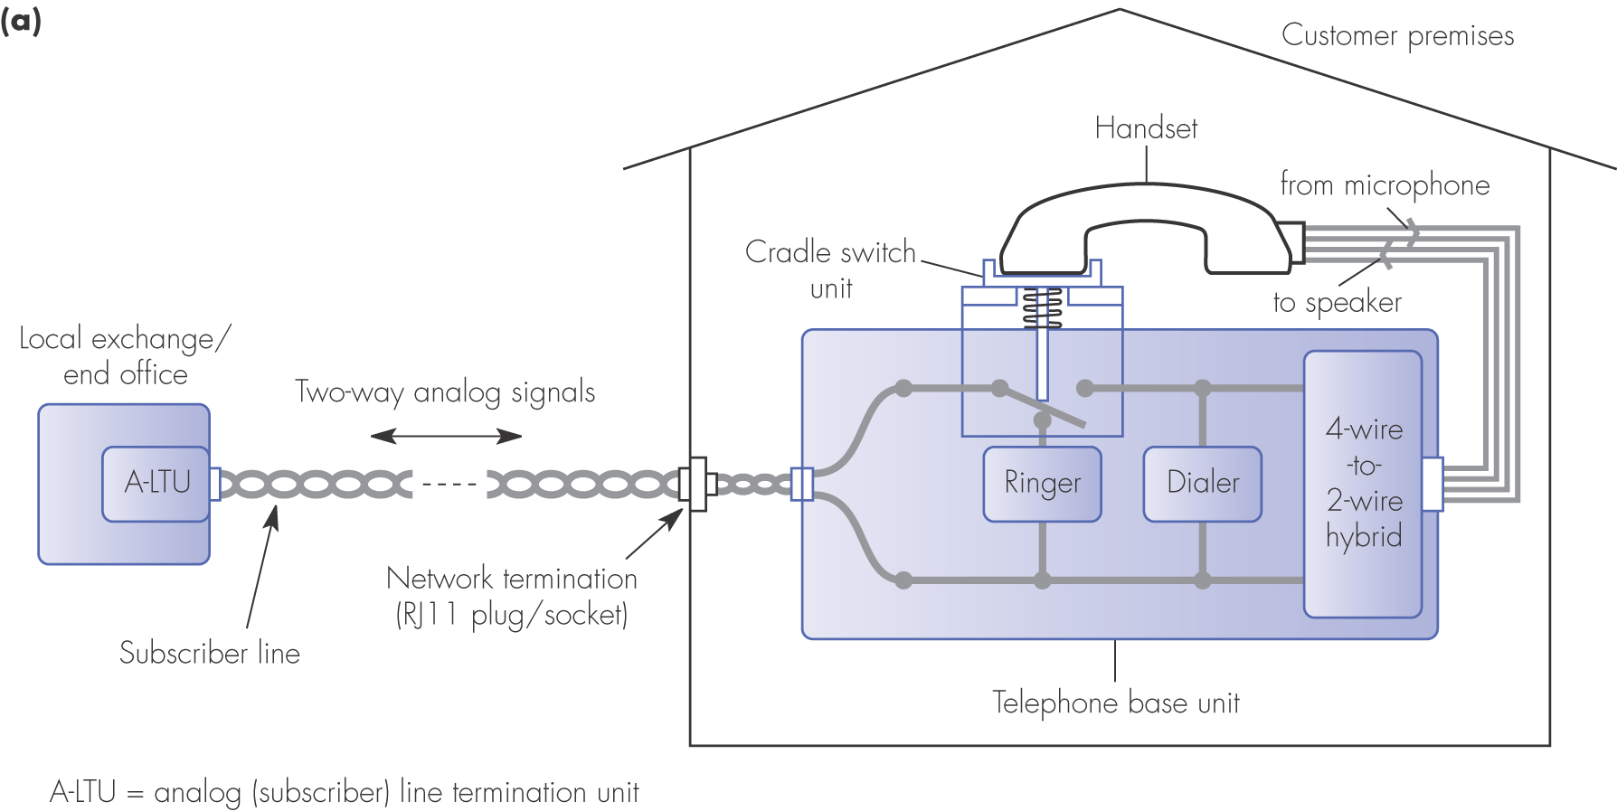
Figure 2.2 Analog subscriber line principles: (a) telephone components

Slide 2
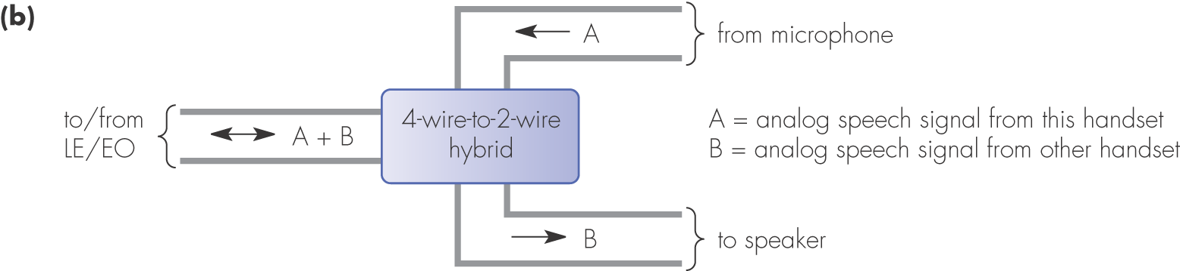
Figure 2.2 Analog subscriber line principles: (b) 4-wire to 2-wire hybrid

Slide 3
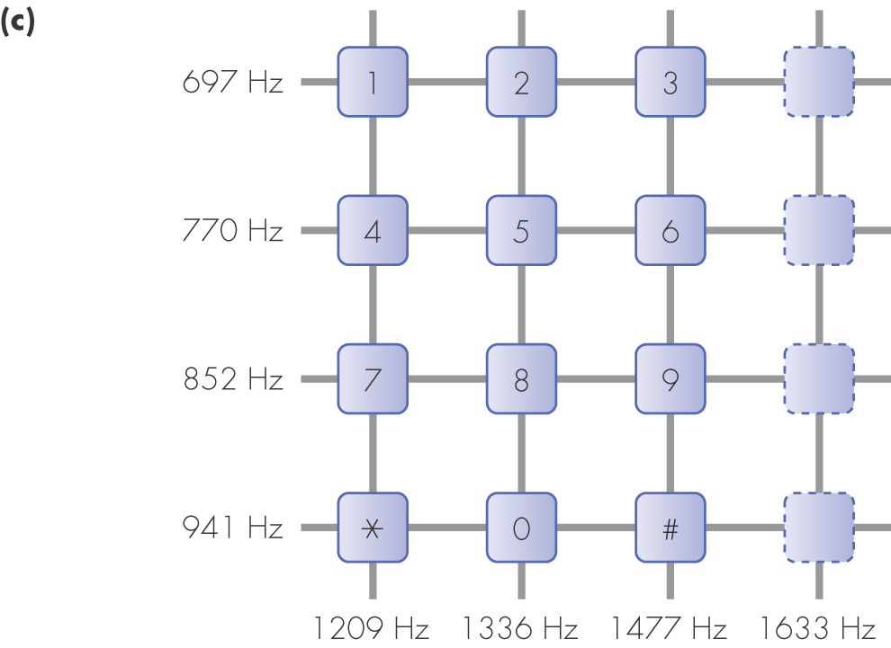
Figure 2.2 Analog subscriber line principles: (c) dual-tone multifrequency keypad

Slide 4
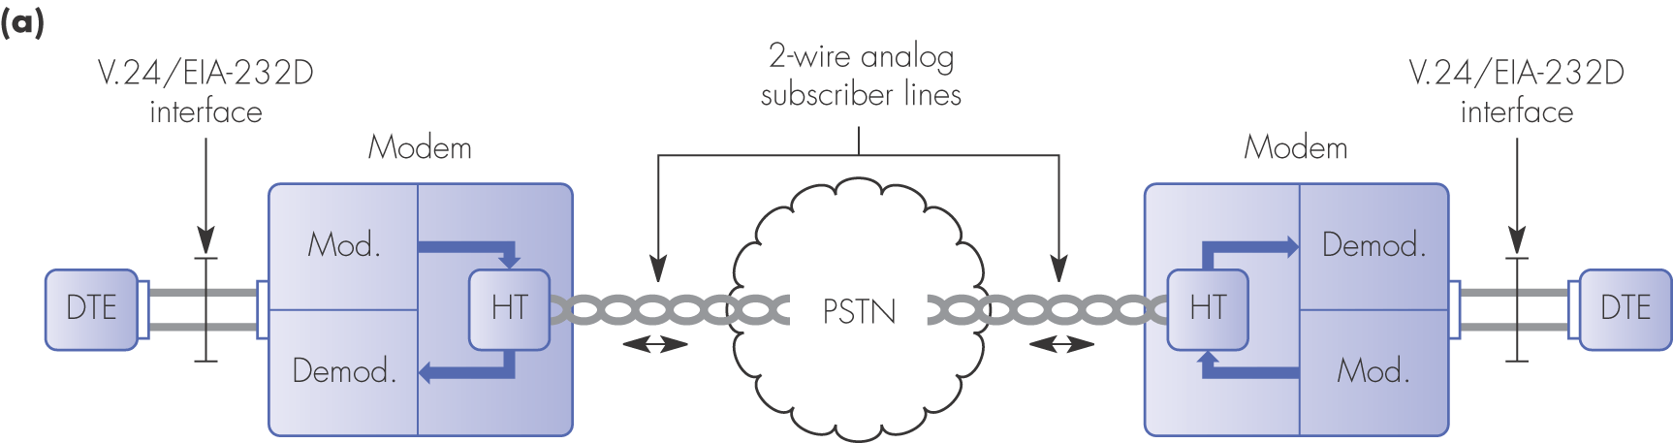
Figure 2.4 Modem operating alternatives: (a) 2-wire switched connections

Slide 5
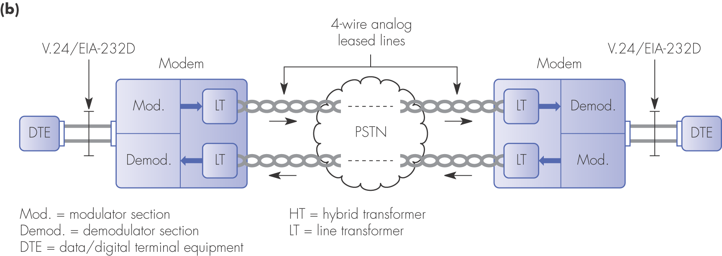
Figure 2.4 Modem operating alternatives: (b) 4-wire leased circuits

Slide 6
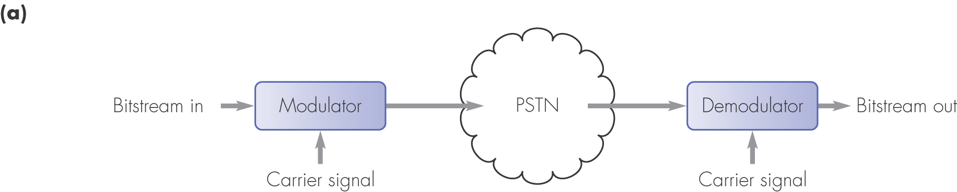
Figure 2.5 Modem principles: (a) modulator/demodulator schematic

Slide 7
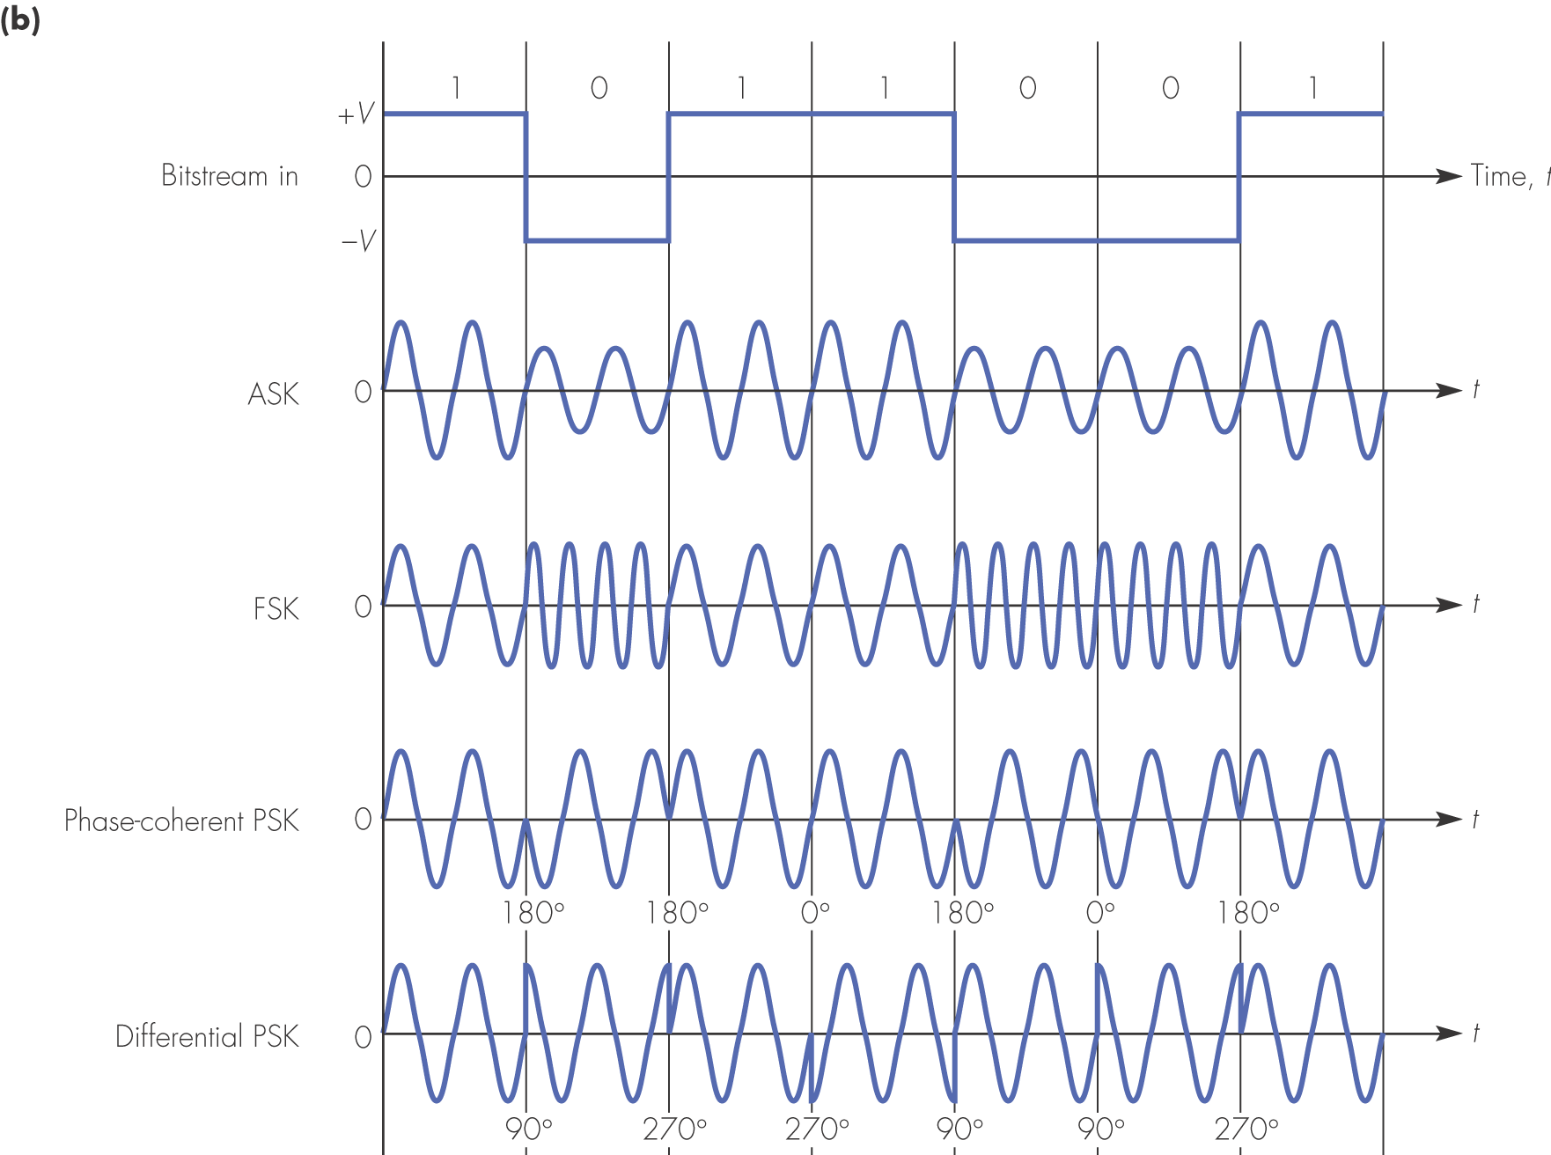
Figure 2.5 Modem principles: (b) waveforms of basic modulation methods

Slide 8
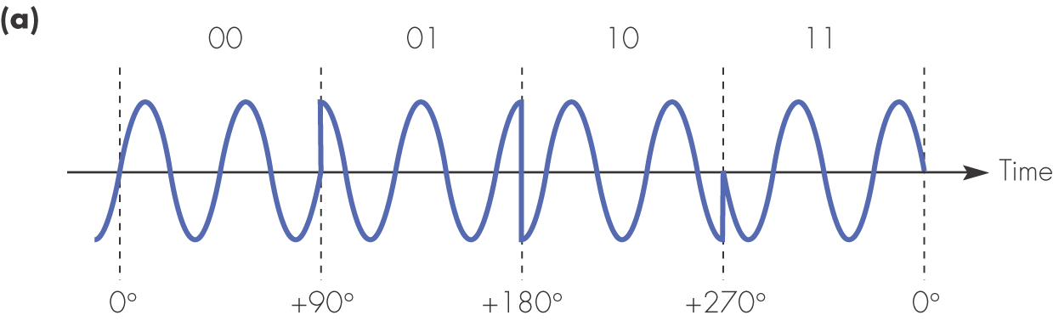
Figure 2.6 Multilevel modulation: (a) 4-PSK using a single carrier

Slide 9
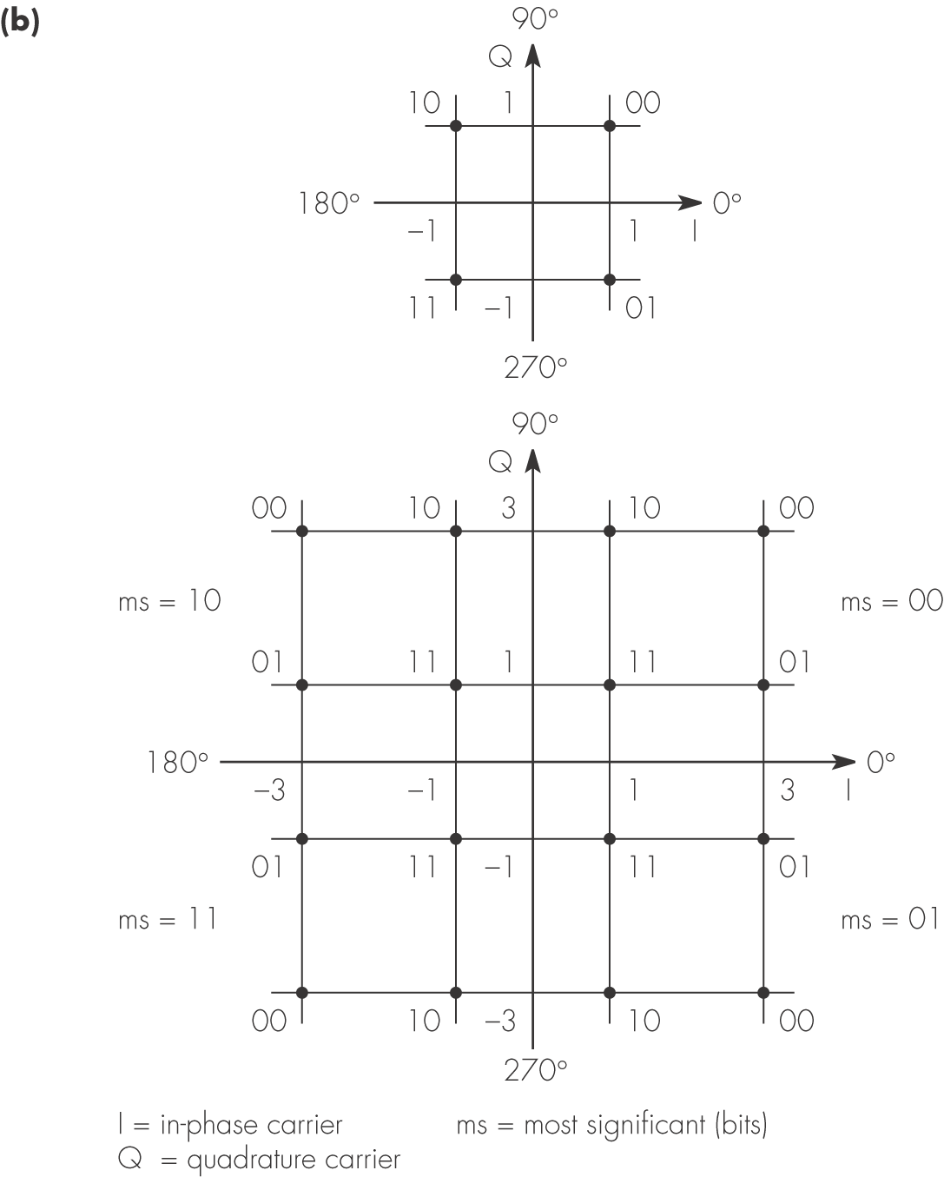
Figure 2.6 Multilevel modulation: (b) 4-QAM and 16-QAM using two carriers, one at 90° (Q) out of phase with the other (I)

Slide 10
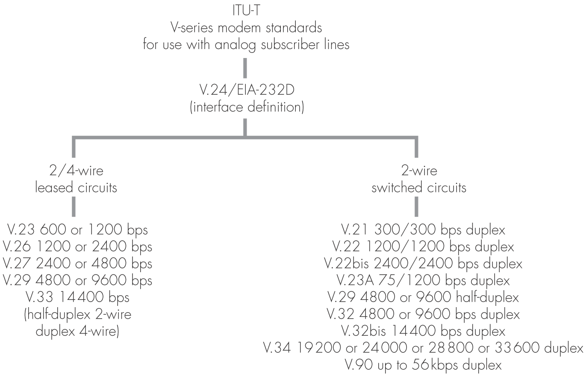
Figure 2.7 A selection of ITU-T V-series modem standards

Slide 11
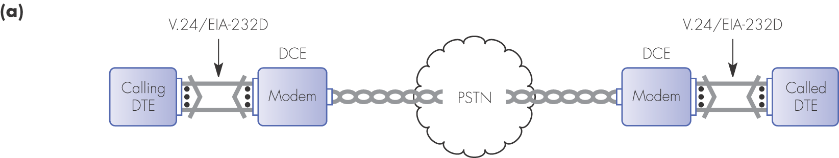
Figure 2.8 V.24/EIA-232D interface standards: (a) interface function

Slide 12
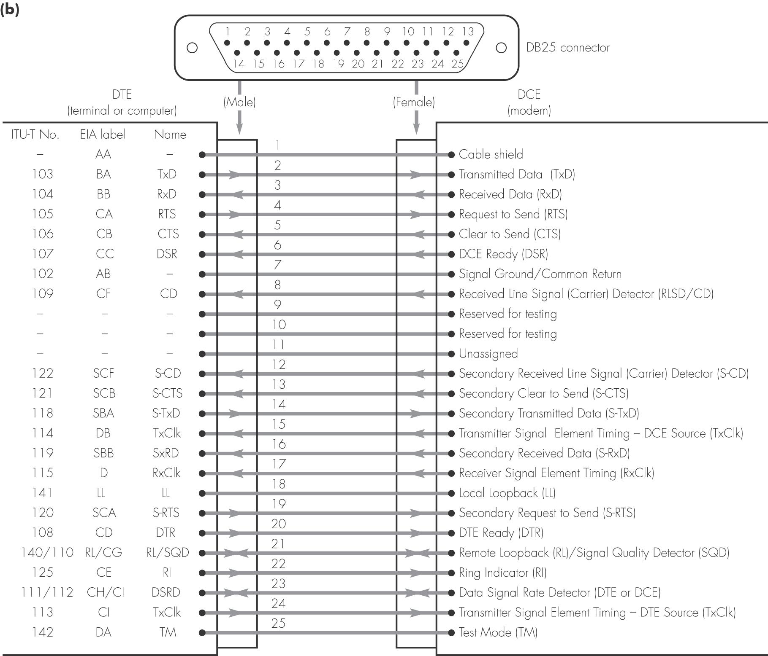
Figure 2.8 V.24/EIA-232D interface standards: (b) connector, pin, and signal definitions

Slide 13
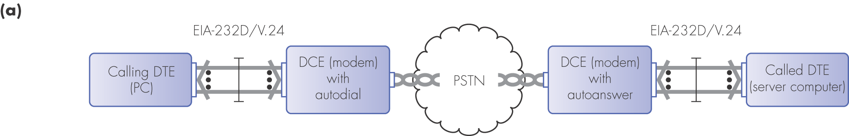
Figure 2.9 V.24/EIA-232D connection setup, two-way alternate data transfer and connection clearing sequences

Slide 14
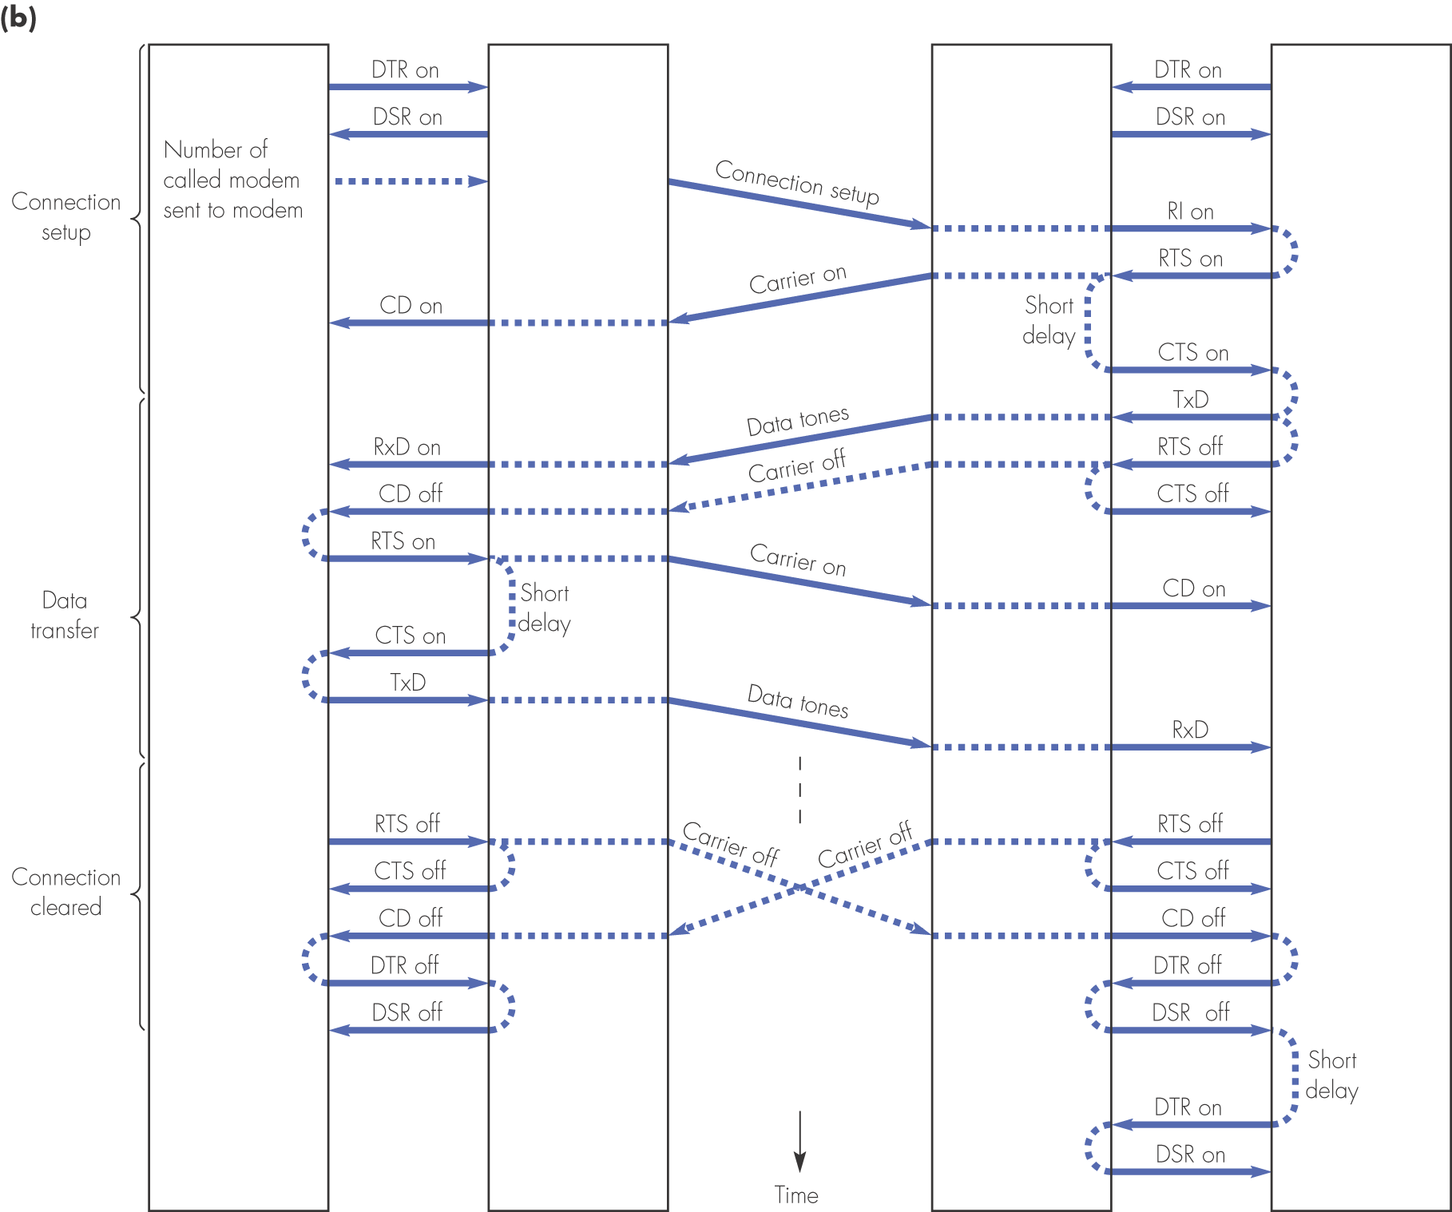
Figure 2.9 continued

Slide 15
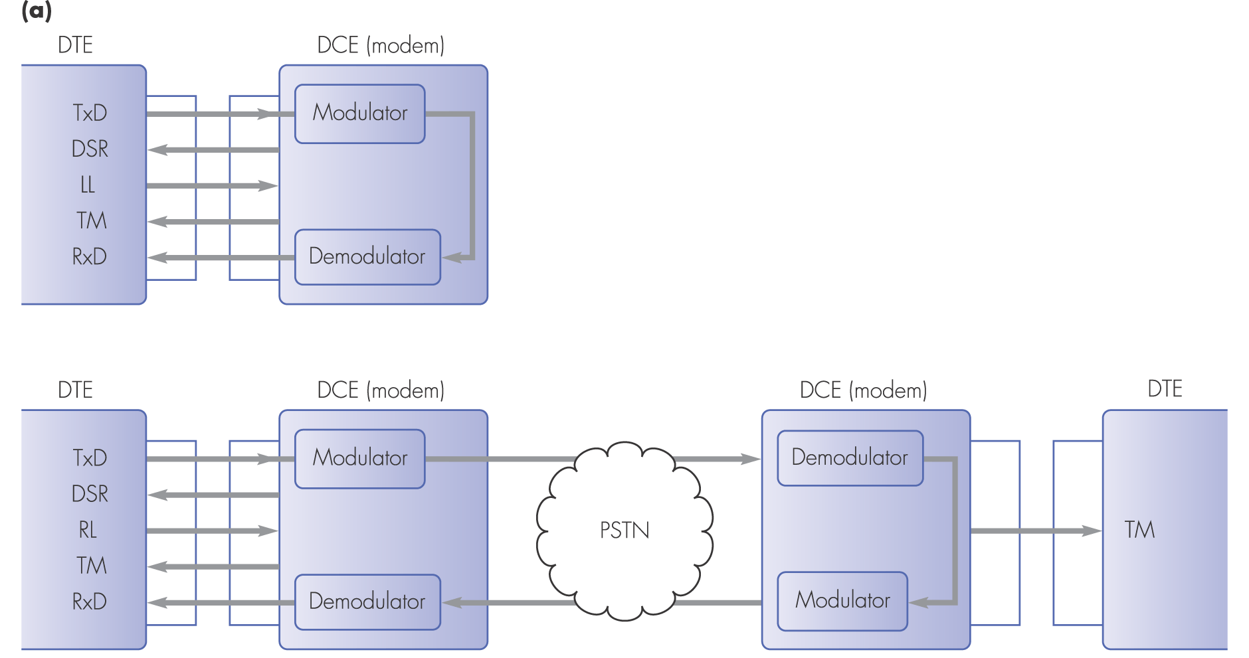
Figure 2.10 V.24/EIA-232D interface: (a) local and remote loopback tests

Slide 16
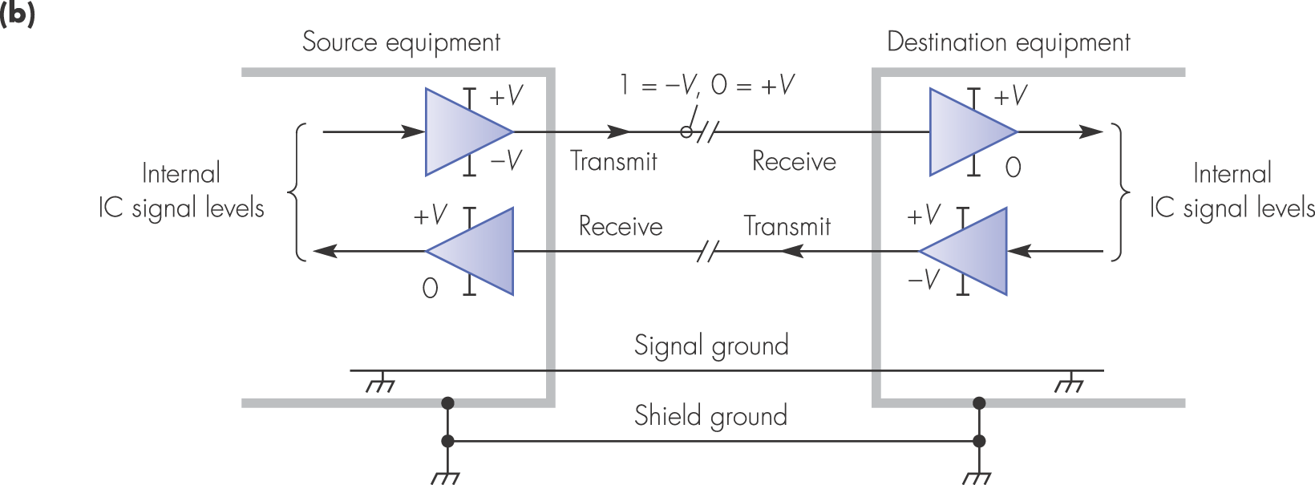
Figure 2.10 V.24/EIA-232D interface: (b) V.28/RS.232A signal levels

Slide 17
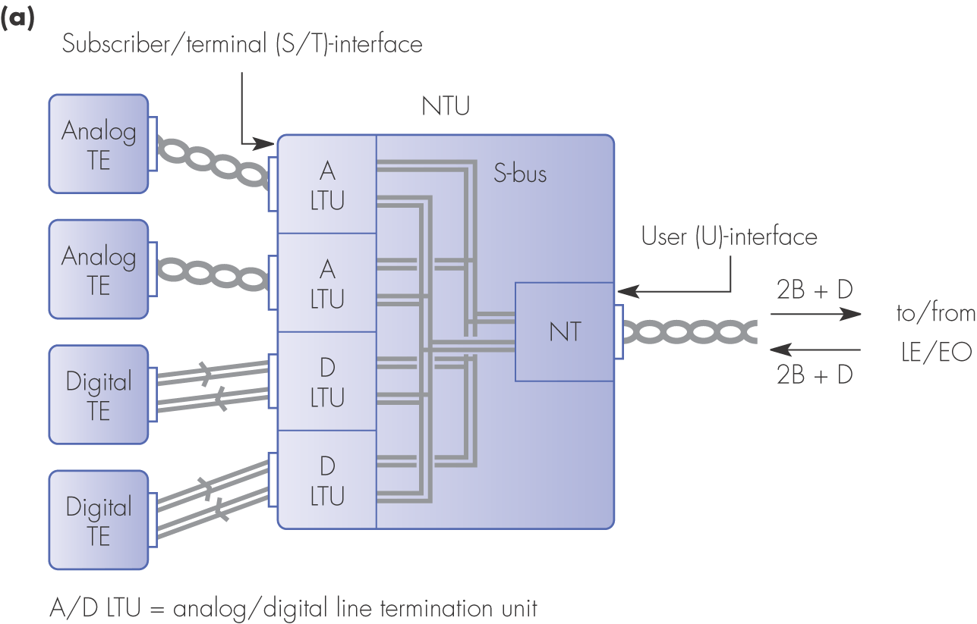
Figure 2.11 ISDN network termination alternatives: (a) 4-port NTU

Slide 18
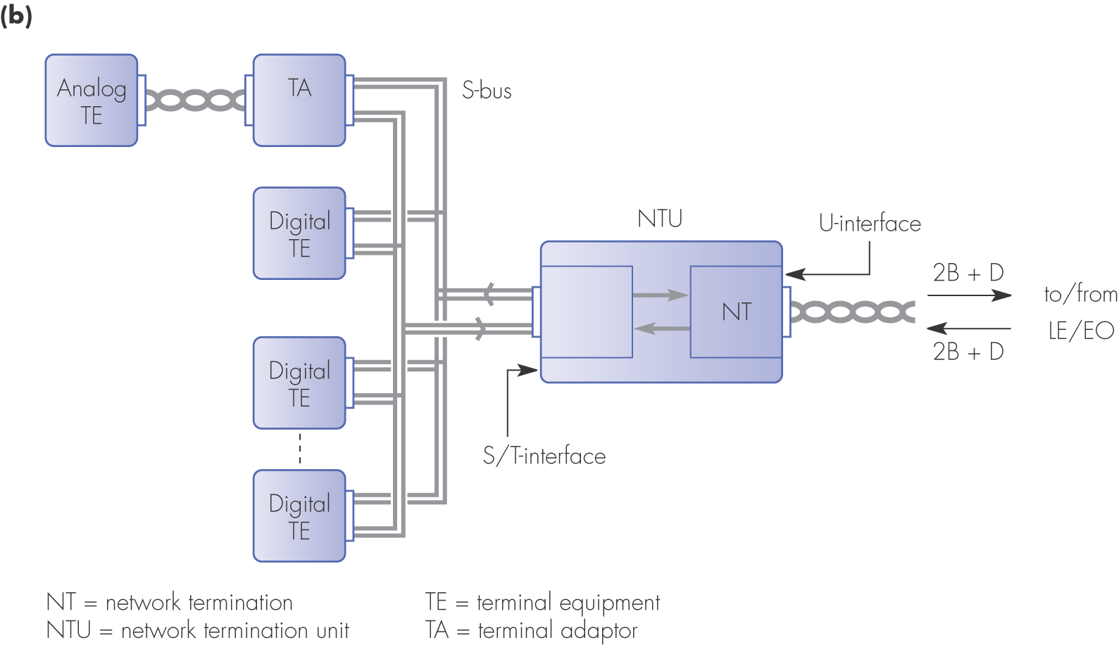
Figure 2.11 ISDN network termination alternatives: (b) S-bus NTU

Slide 19
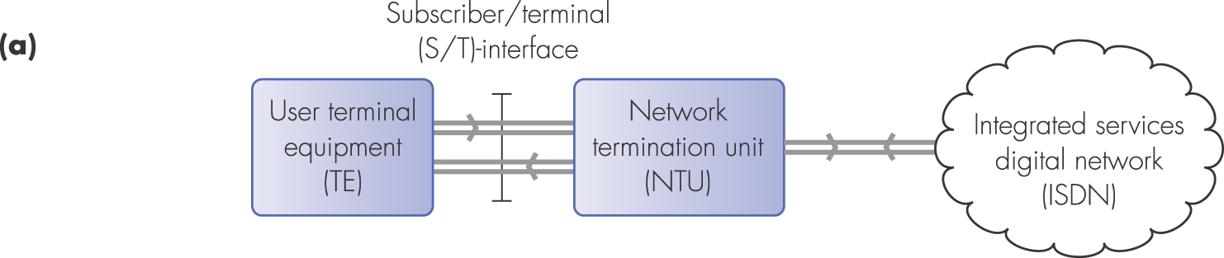
Figure 2.12 ISDN subscriber/terminal (S/T)-interface: (a) interface location

Slide 20
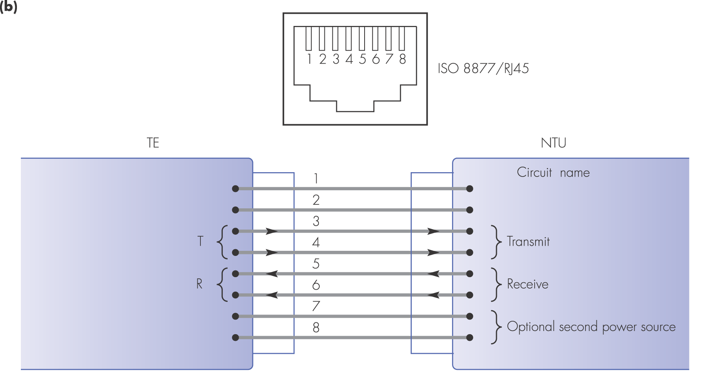
Figure 2.12 ISDN subscriber/terminal (S/T)-interface: (b) socket, pin, and signal definitions

Slide 21
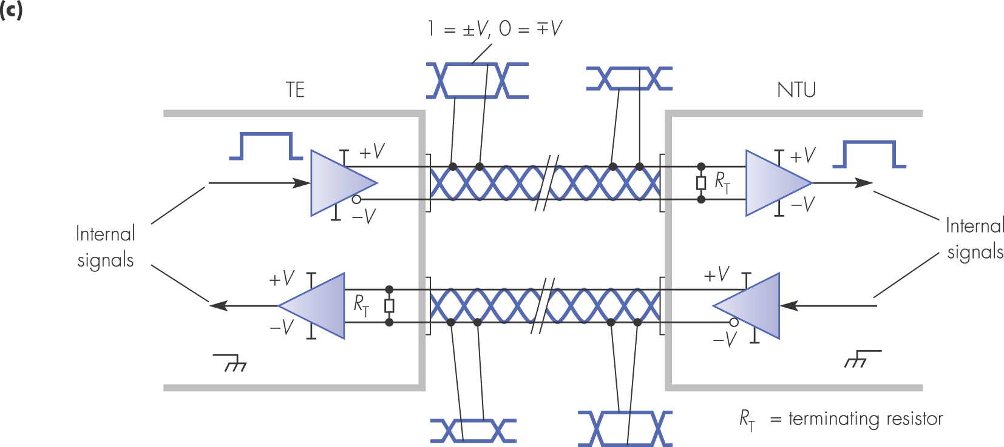
Figure 2.12 ISDN subscriber/terminal (S/T)-interface: (c) signal levels

Slide 22
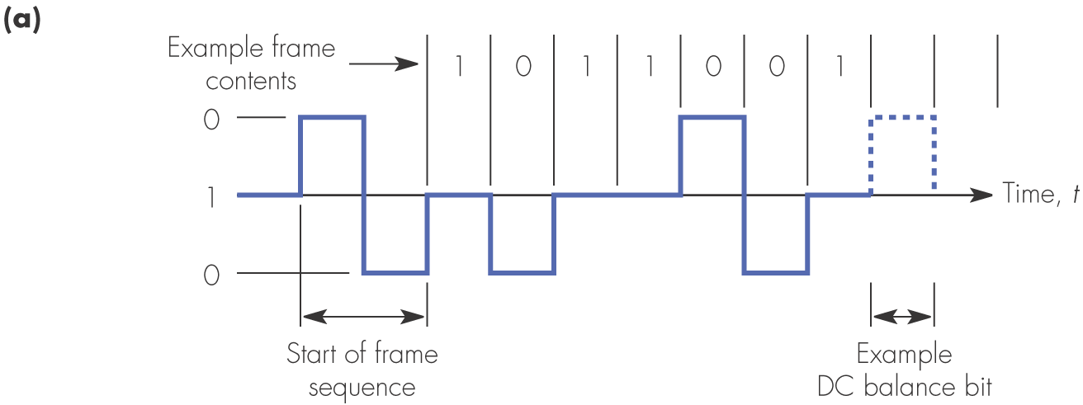
Figure 2.13 ISDN basic rate access S-bus line code principles: (a) alternate space inversion (ASI) line code

Slide 23
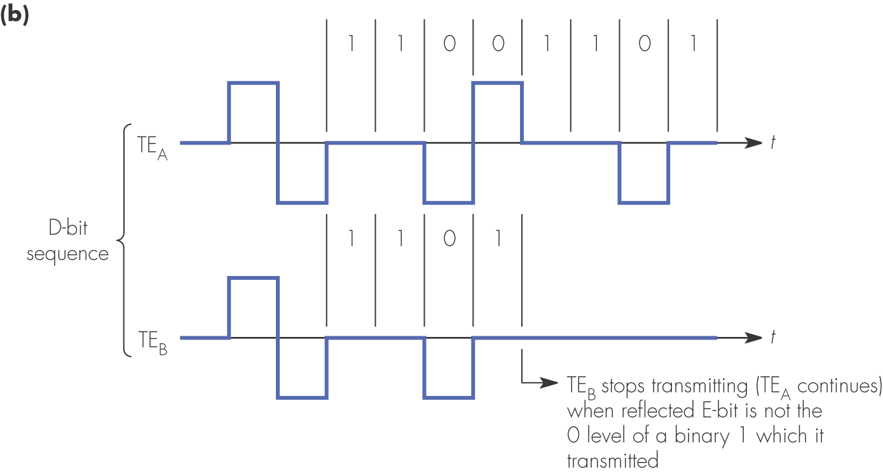
Figure 2.13 ISDN basic rate access S-bus line code principles: (b) example of contention resolution

Slide 24
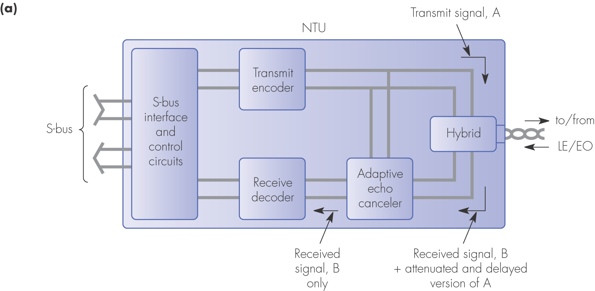
Figure 2.14 ISDN subscriber line principles: (a) NTU schematic

Slide 25
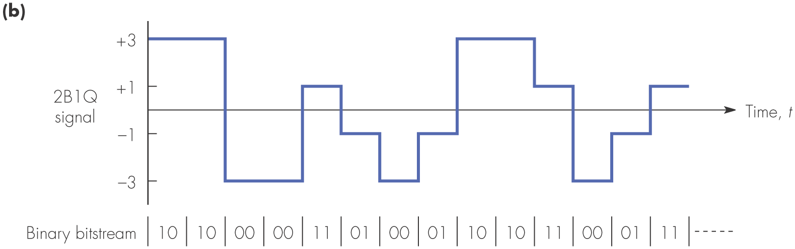
Figure 2.14 ISDN subscriber line principles: (b) 2B1Q line signal example

Slide 26
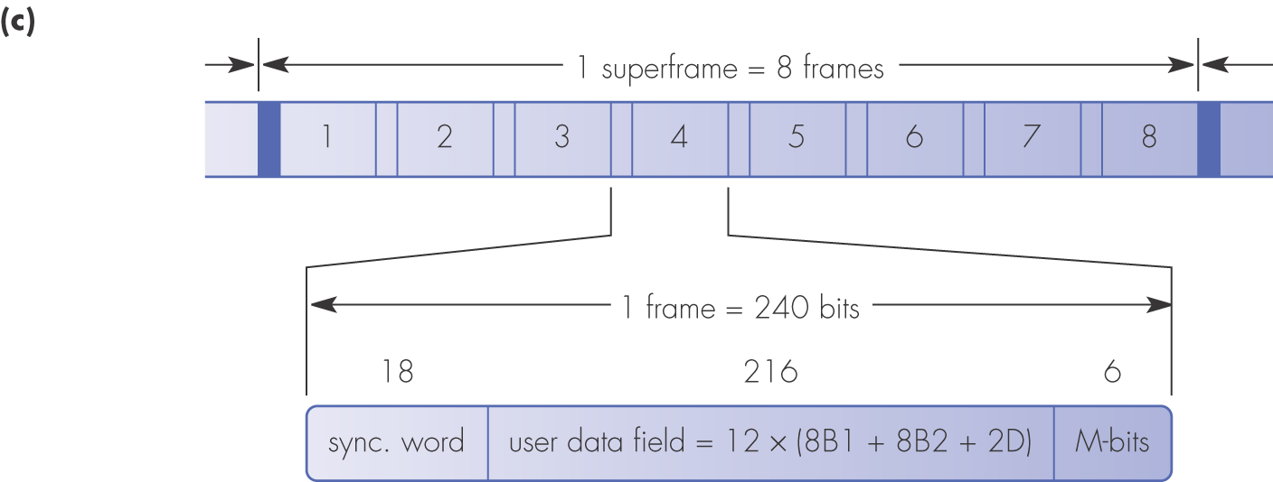
Figure 2.14 ISDN subscriber line principles: (c) frame and superframe format

Slide 27
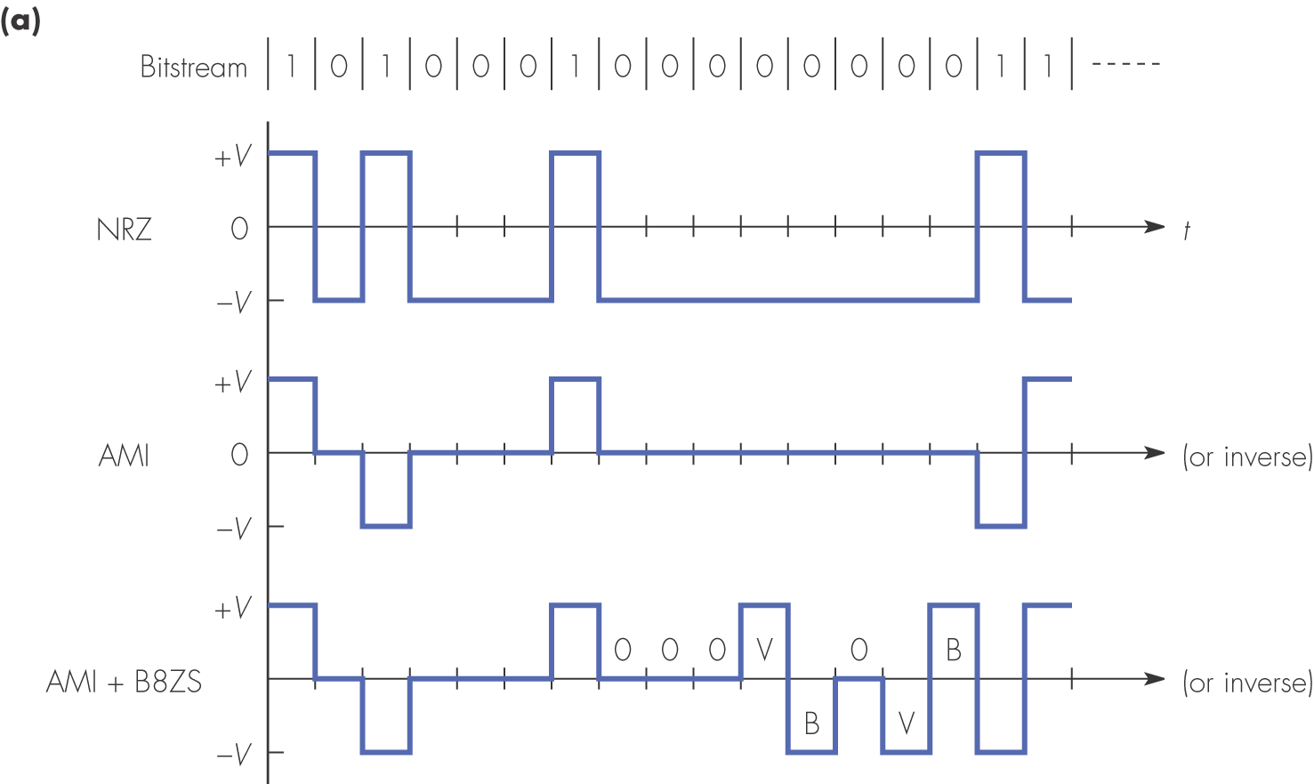
Figure 2.15 ISDN 1.544 Mbps primary rate interface principles: (a) line code

Slide 28
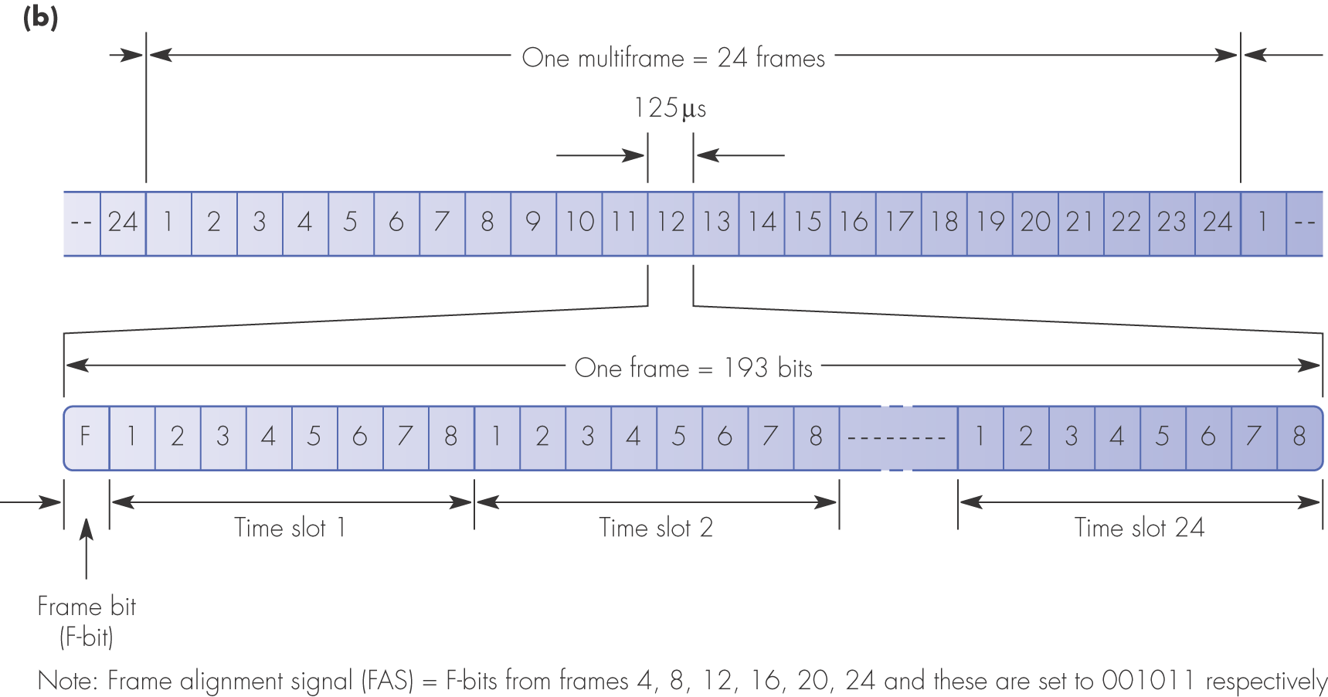
Figure 2.15 ISDN 1.544 Mbps primary rate interface principles: (b) frame and multiframe structure

Slide 29
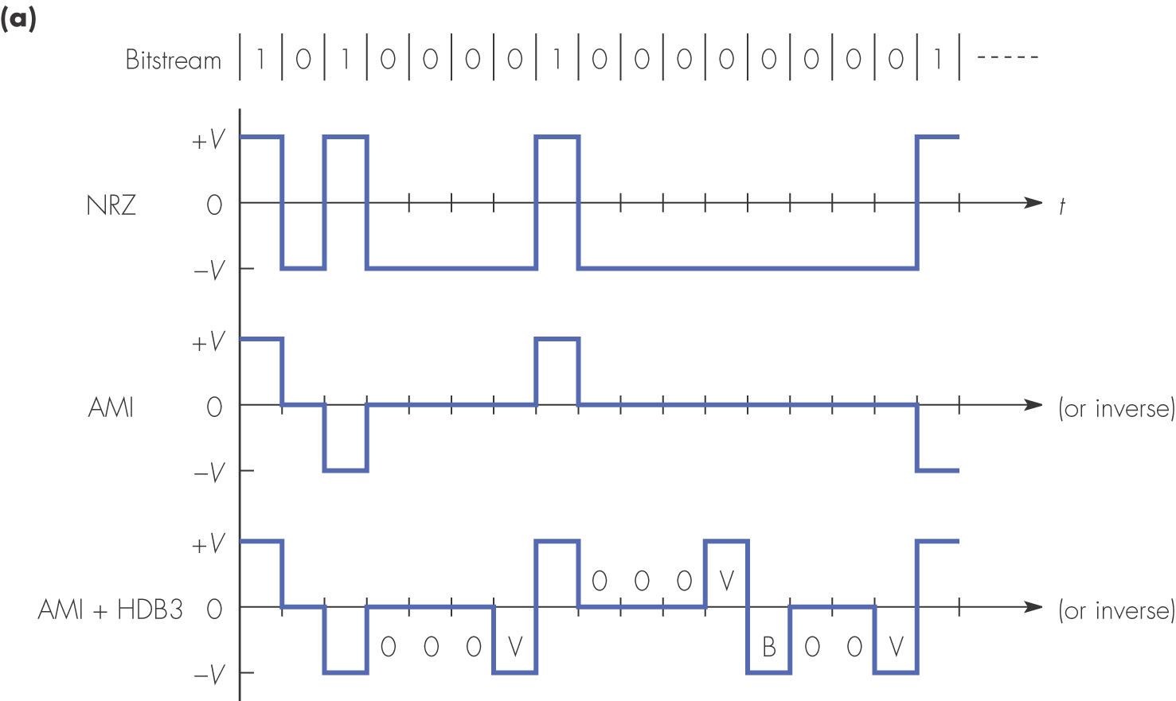
Figure 2.16 ISDN 2.048 Mbps primary rate interface: (a) line code

Slide 30
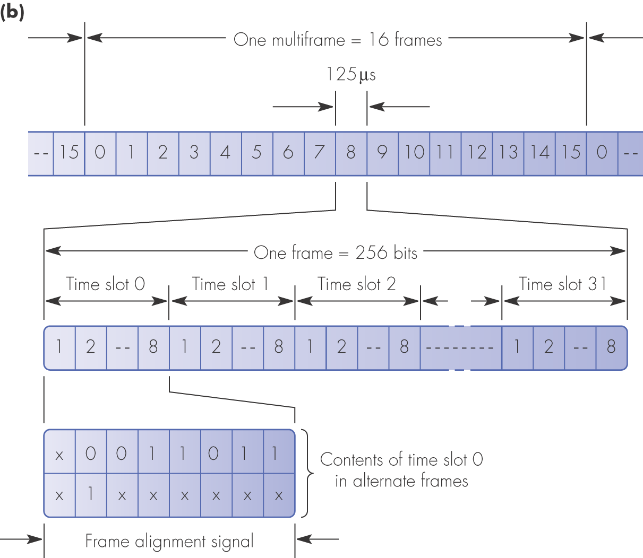
Figure 2.16 ISDN 2.048 Mbps primary rate interface: (b) frame and multiframe structure

Slide 31
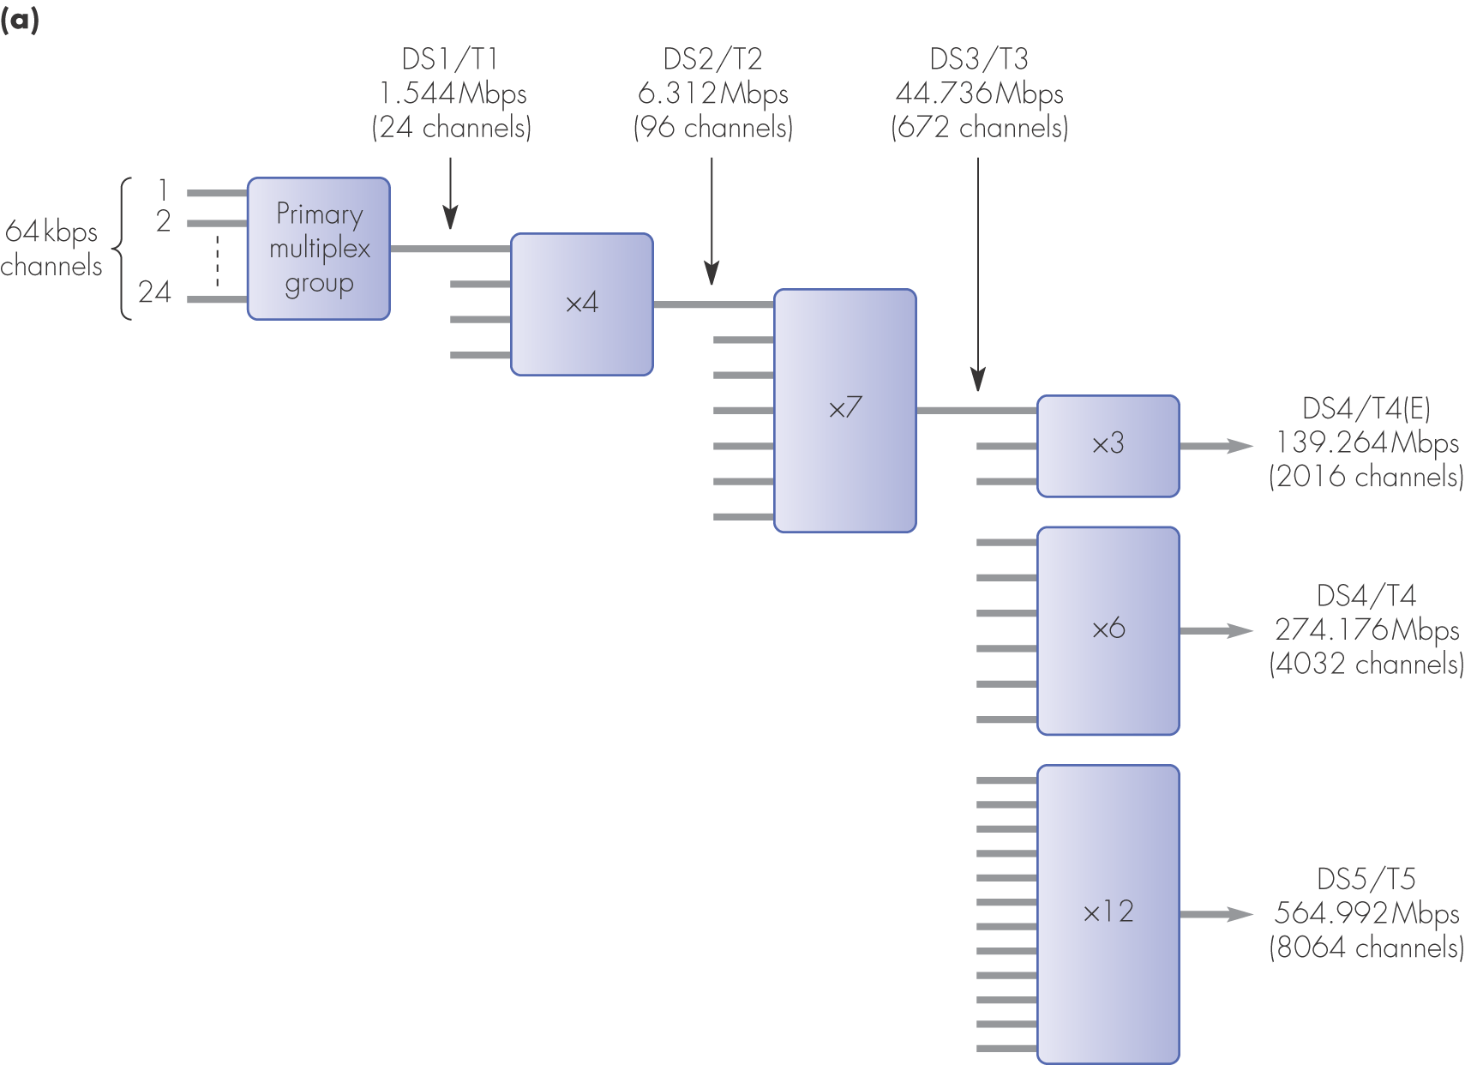
Figure 2.17 Plesiochronous digital hierarchies: (a) 1.544 Mbps derived multiplex hierarchy

Slide 32
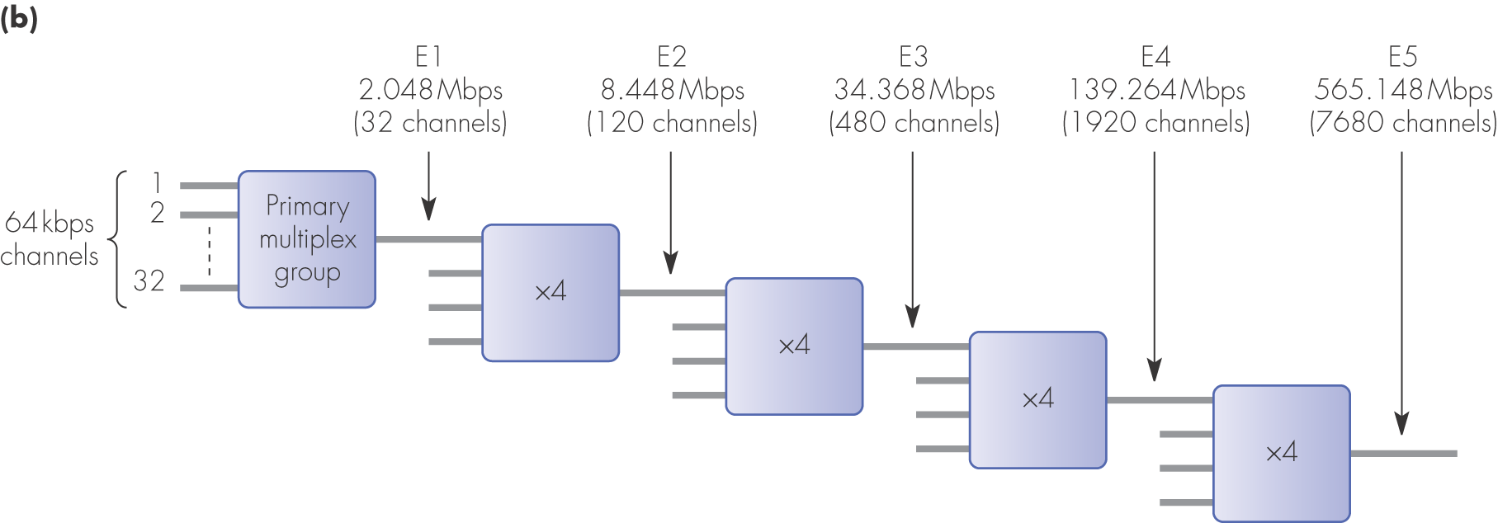
Figure 2.17 Plesiochronous digital hierarchies: (b) 2.048 Mbps derived multiplex hierarchy

Slide 33
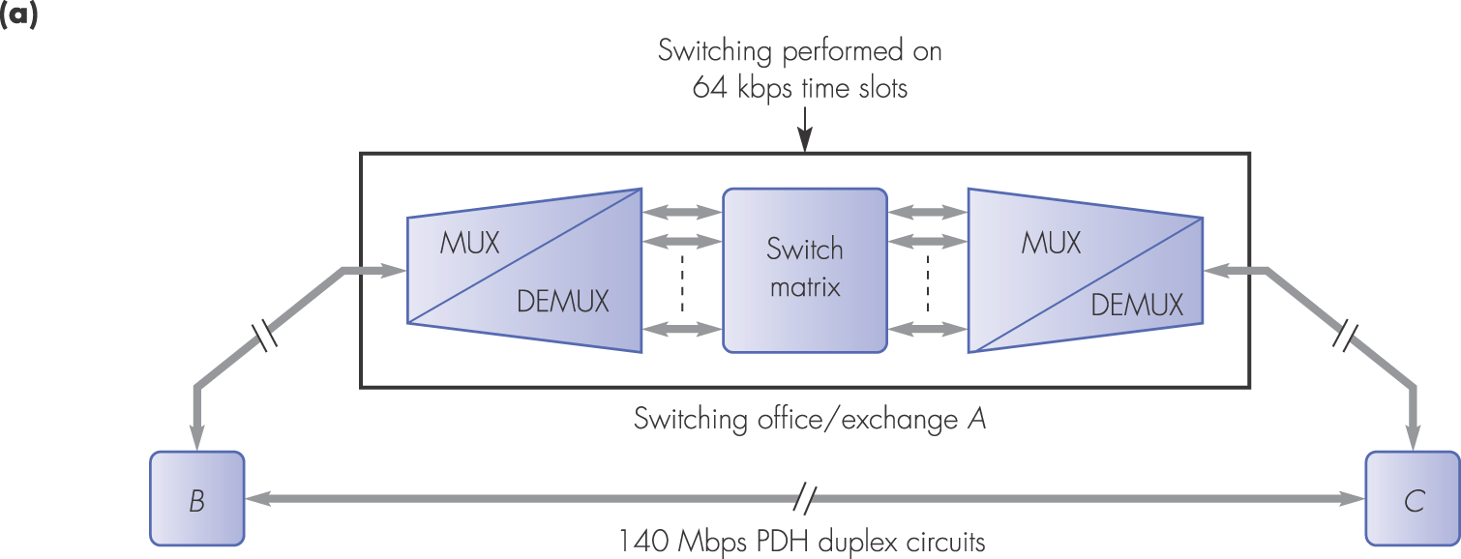
Figure 2.18 Private network provision with a PDH transmission network: (a) existing network

Slide 34
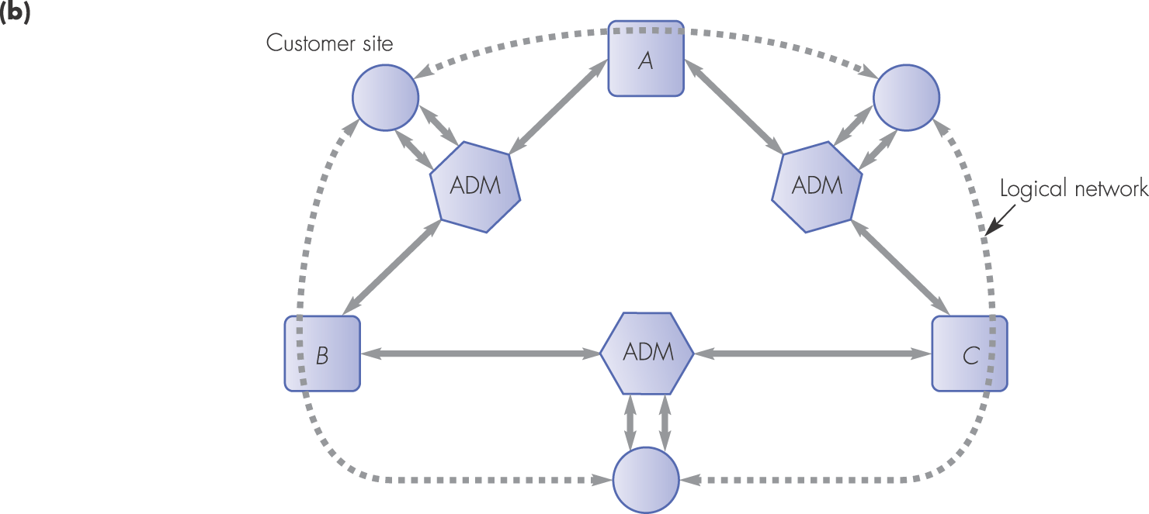
Figure 2.18 Private network provision with a PDH transmission network: (b) modified network

Slide 35
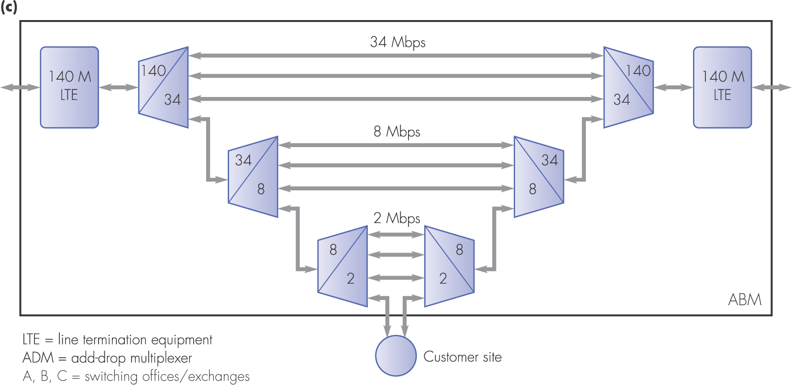
Figure 2.18 Private network provision with a PDH transmission network: (c) ADM principles

Slide 36
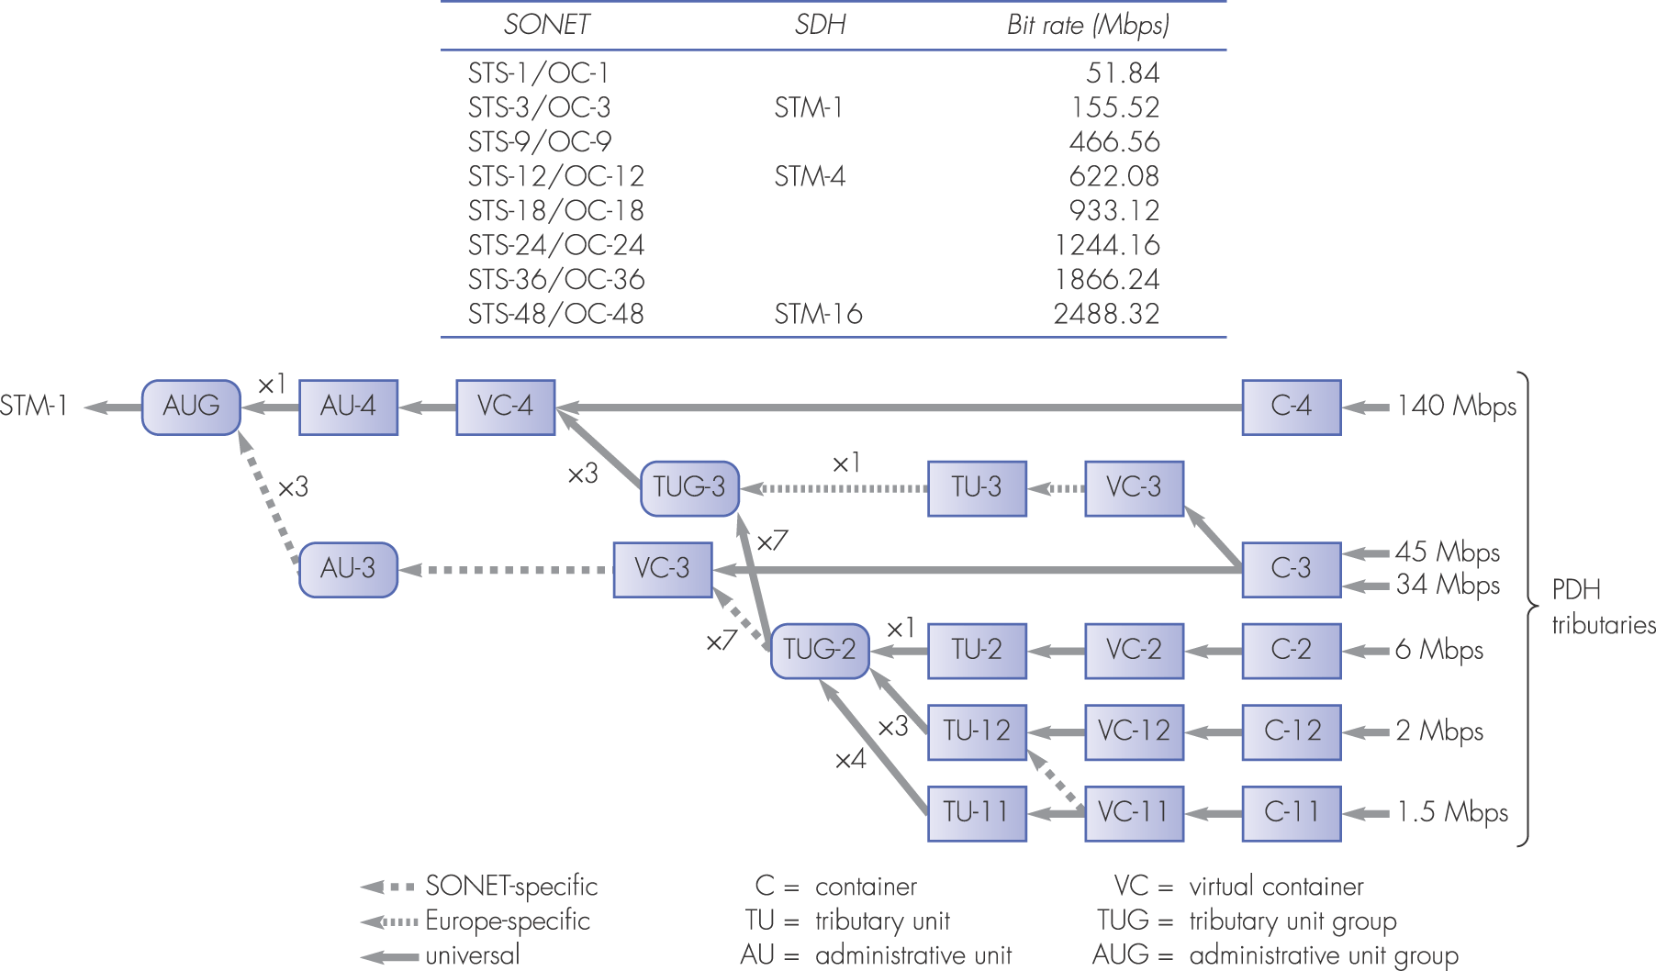
Figure 2.19 SDH/SONET multiplexing hierarchy and terminology

Slide 37
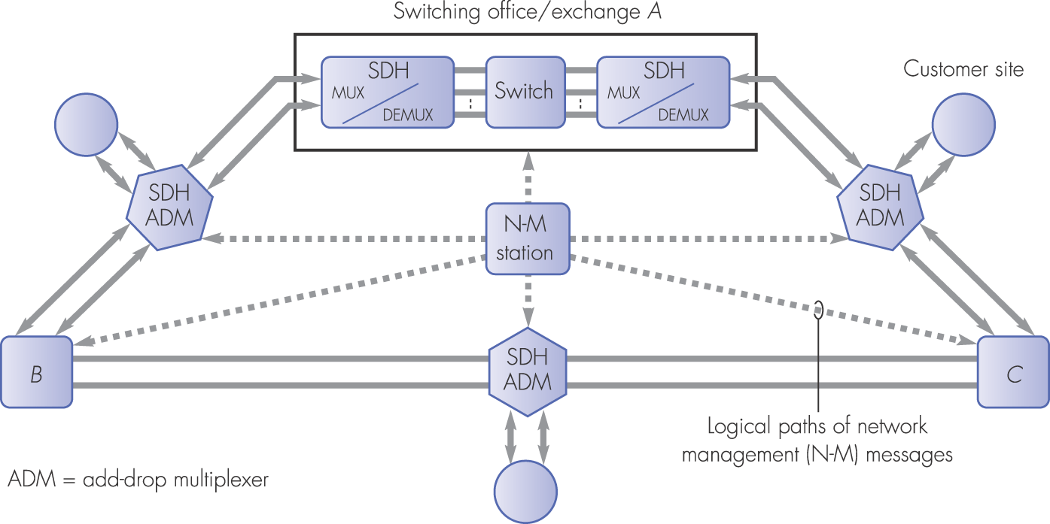
Figure 2.20 Service provision with SDH equipment using network management

Slide 38
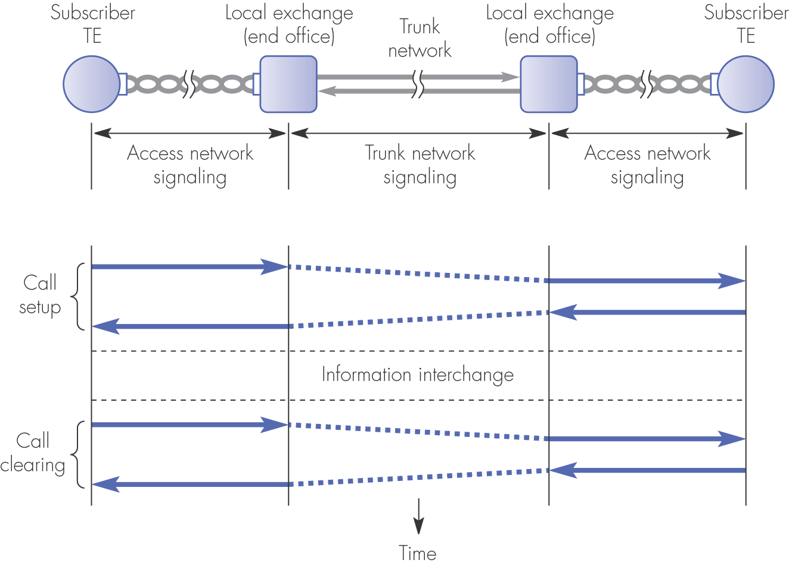
Figure 2.21 Signaling system components

Slide 39
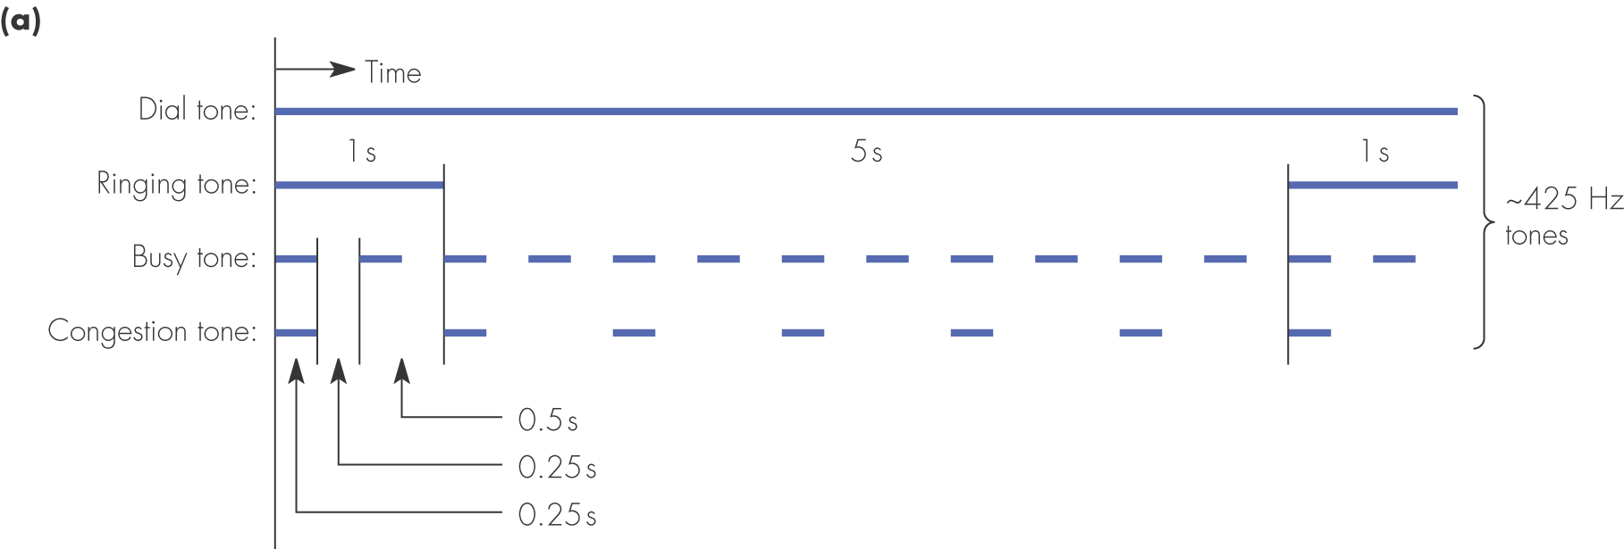
Figure 2.22 Analog access signaling: (a) a selection of the signals used

Slide 40
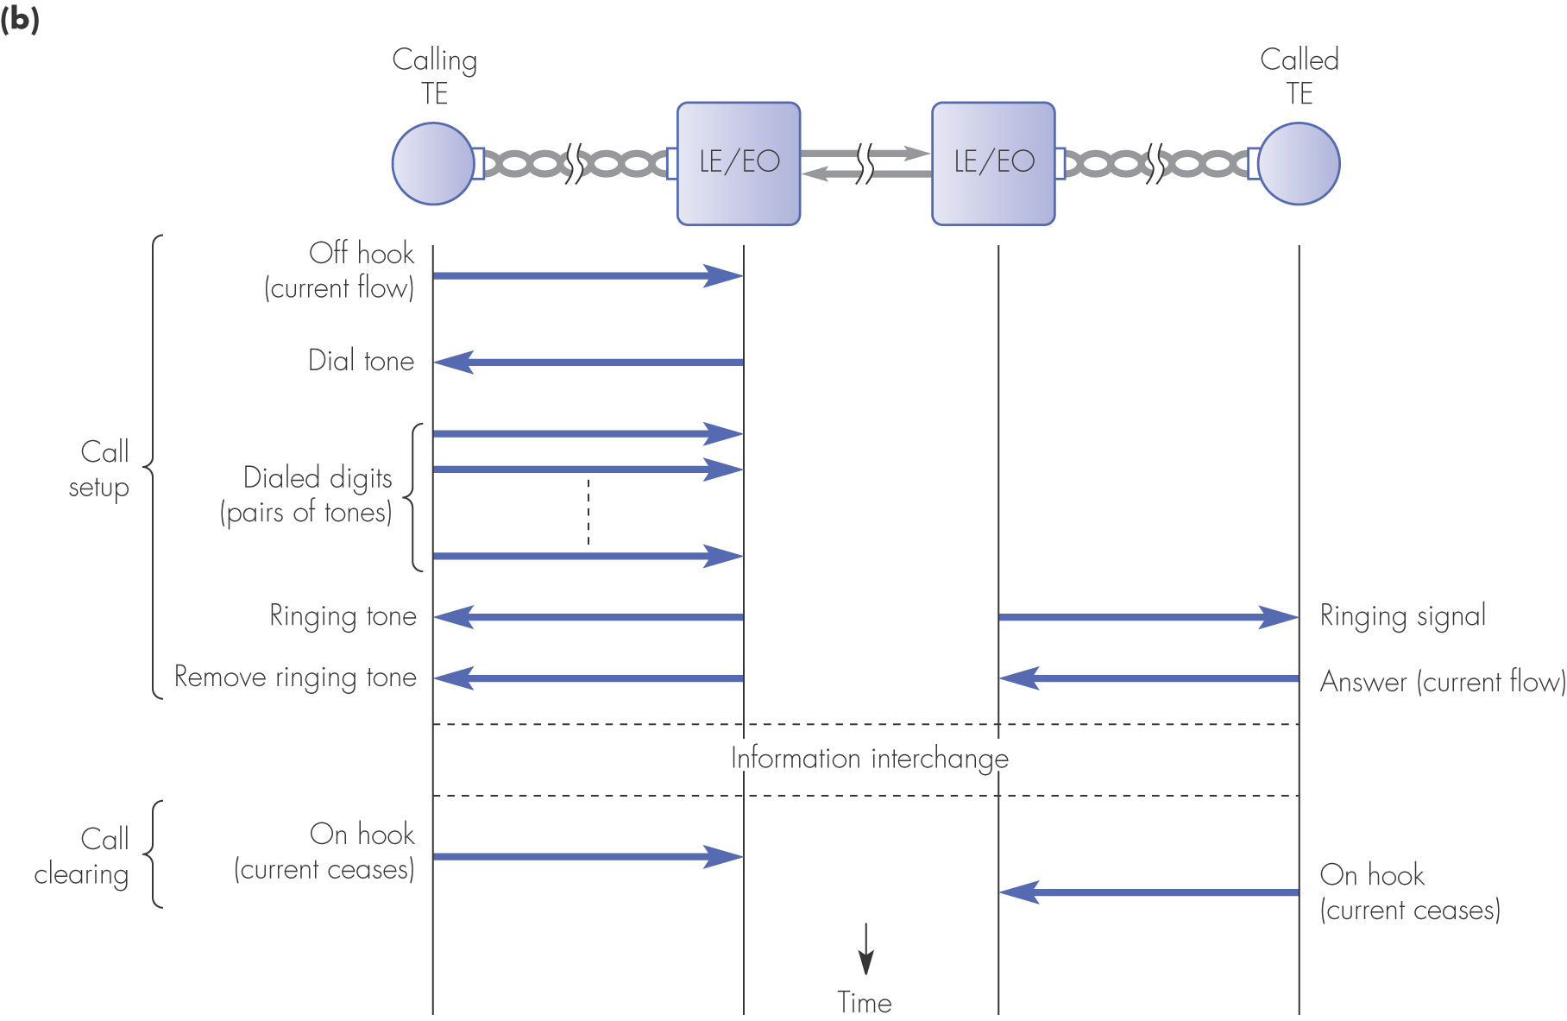
Figure 2.22 Analog access signaling: (b) sequence of signals exchanged to set up and clear a call

Slide 41
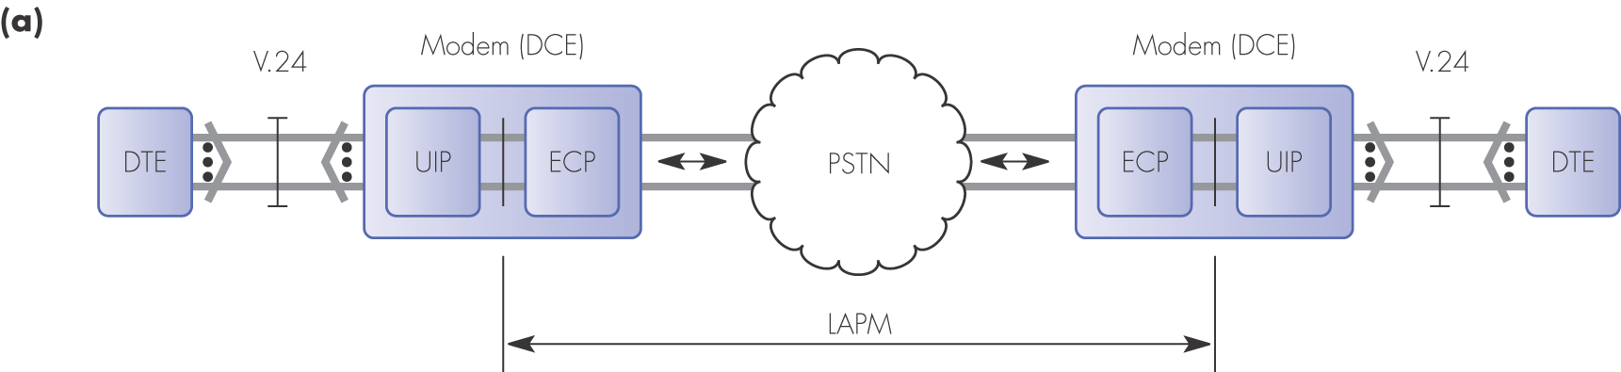
Figure 2.23 LAPM: (a) operational scope

Slide 42
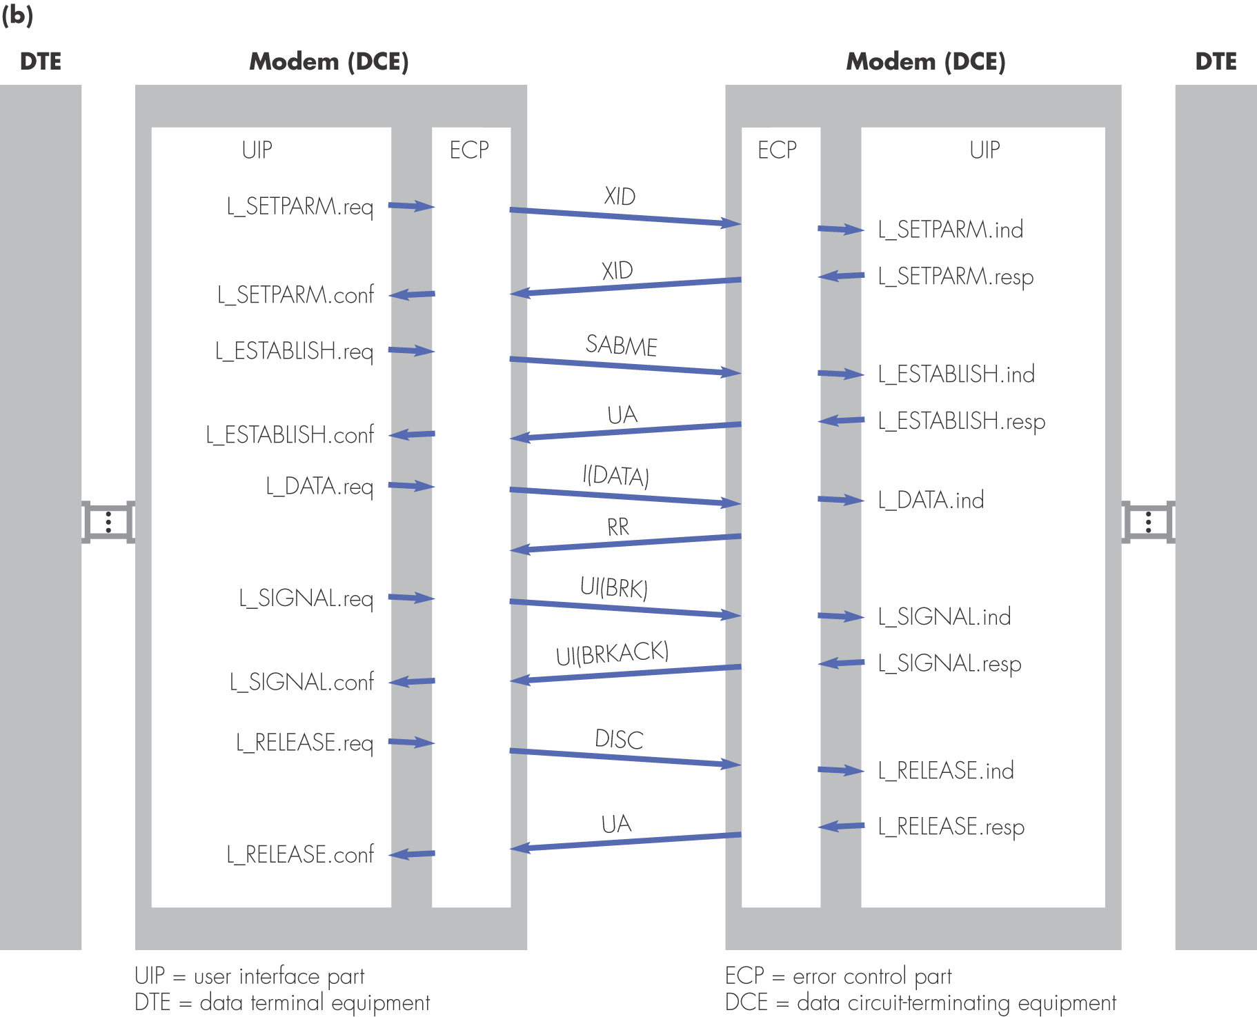
Figure 2.23 LAPM: (b) user service primitives and corresponding frame types

Slide 43
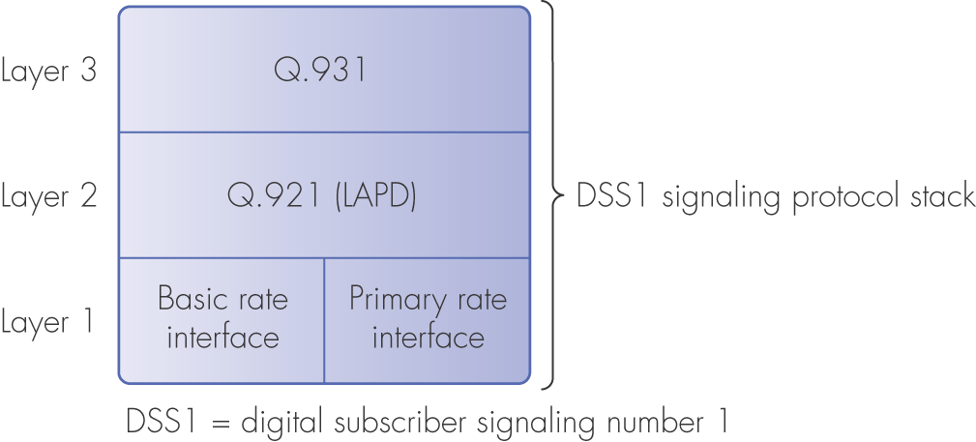
Figure 2.24 ISDN digital access signaling protocol set

Slide 44
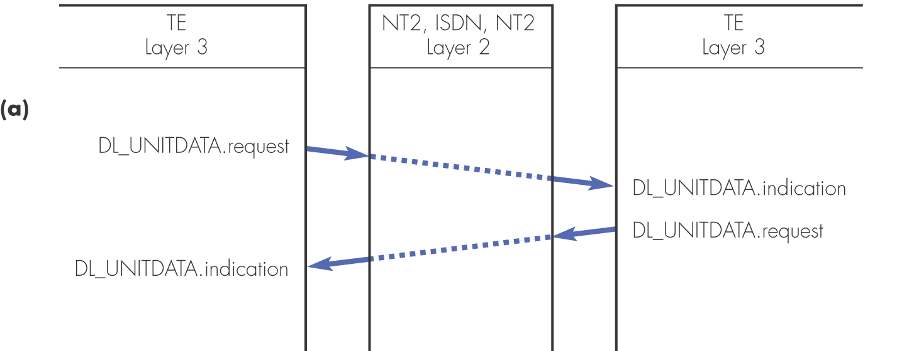
Figure 2.25 LAPD user service primitives: (a) connectionless

Slide 45
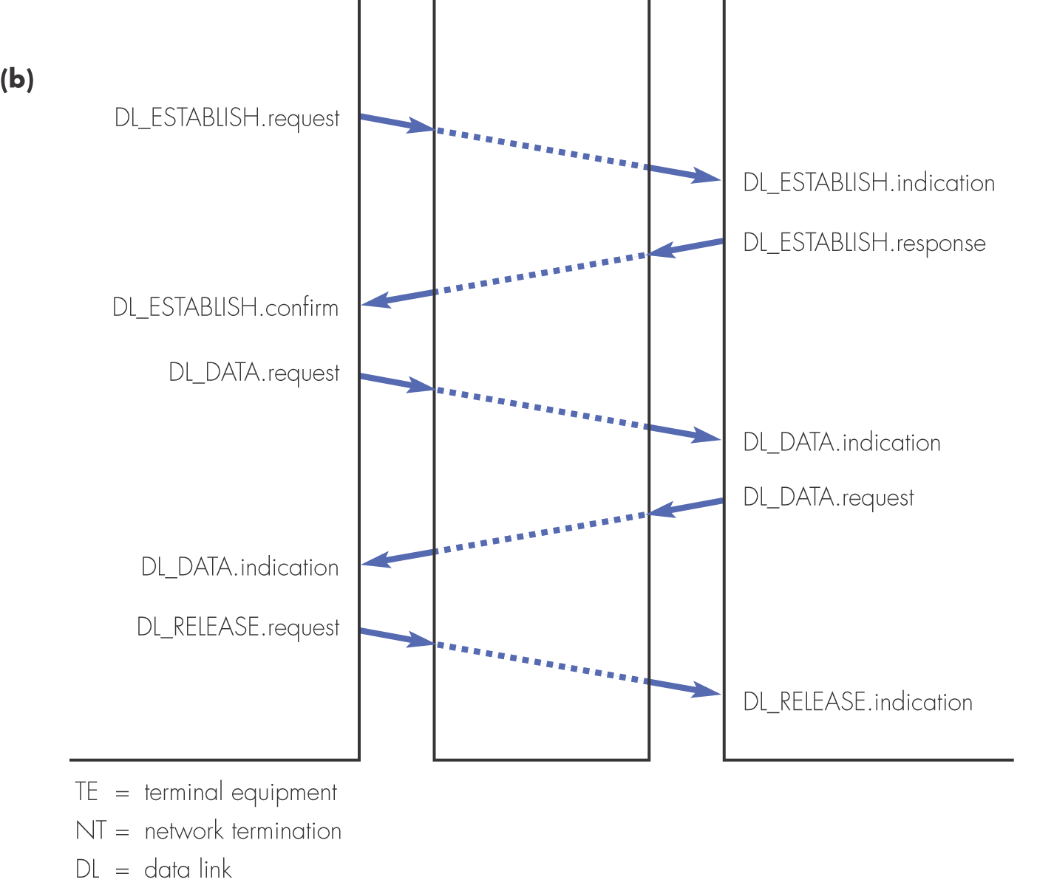
Figure 2.25 LAPD user service primitives: (b) connection-oriented

Slide 46
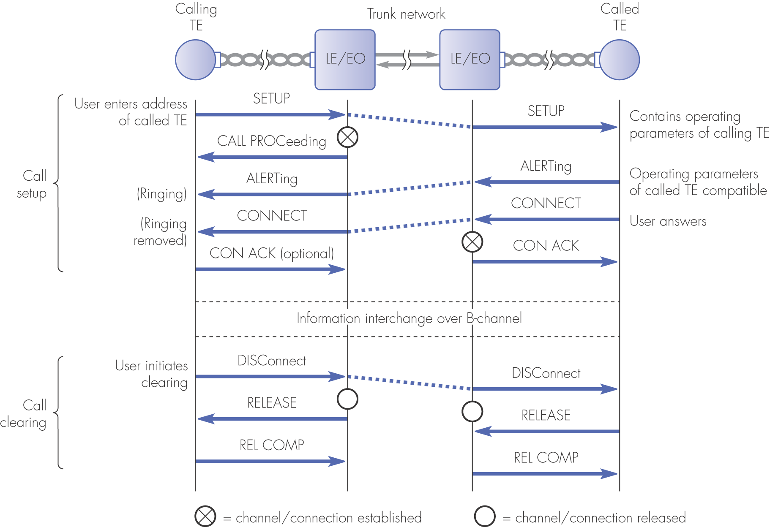
Figure 2.26 ISDN layer 3 signaling: example message sequence to set up a conventional telephone call

Slide 47
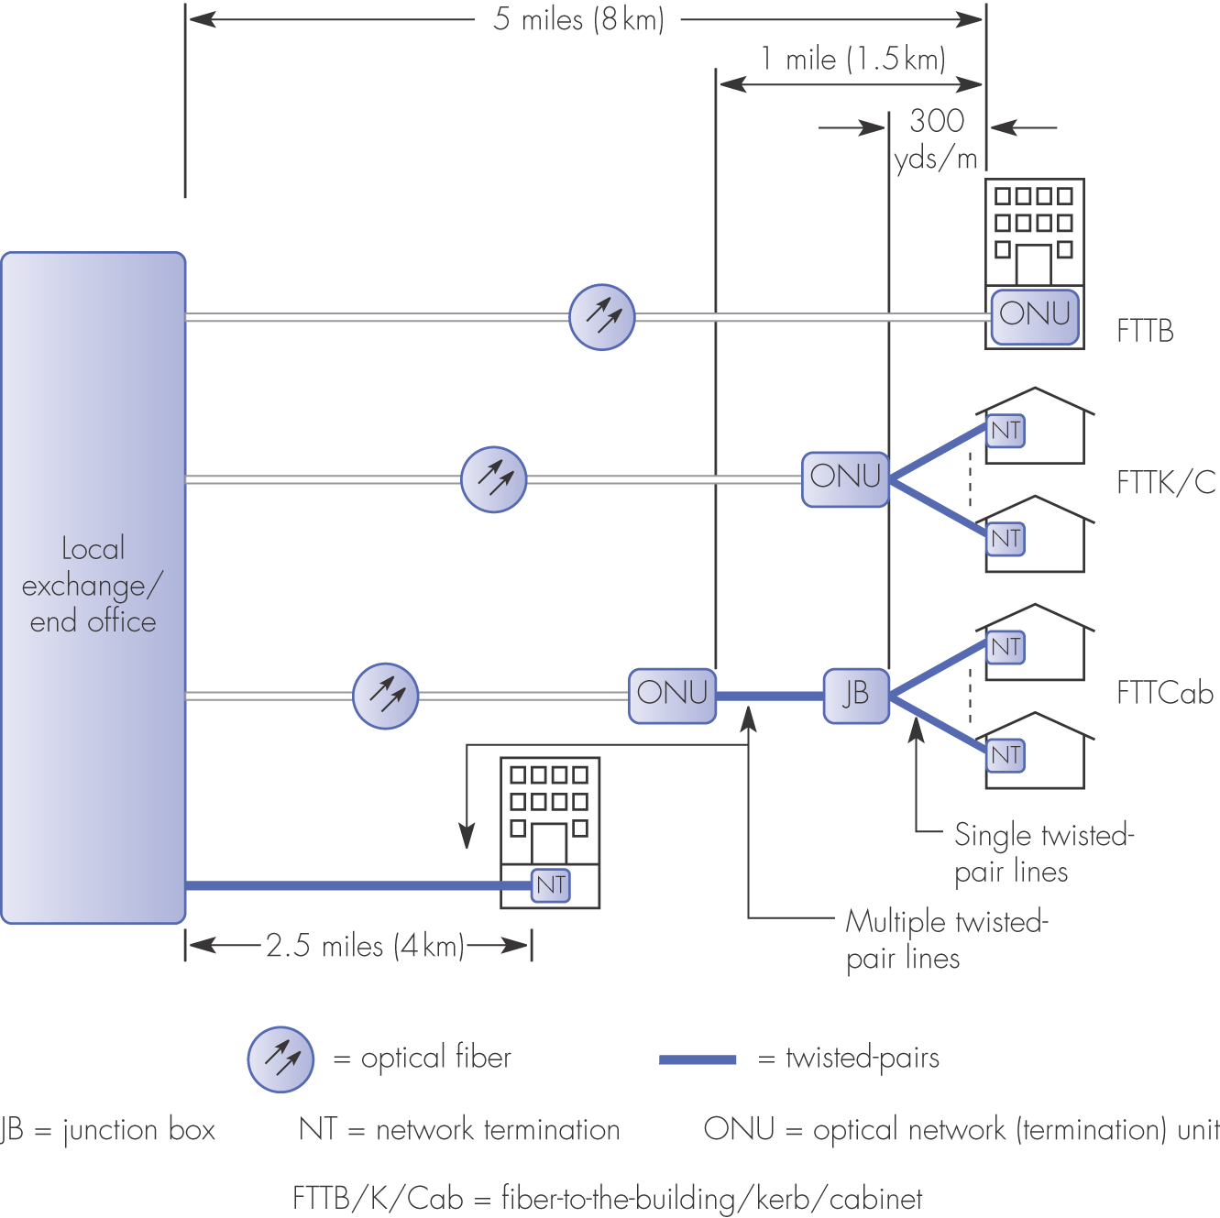
Figure 2.27 Typical modern access network architecture

Slide 48
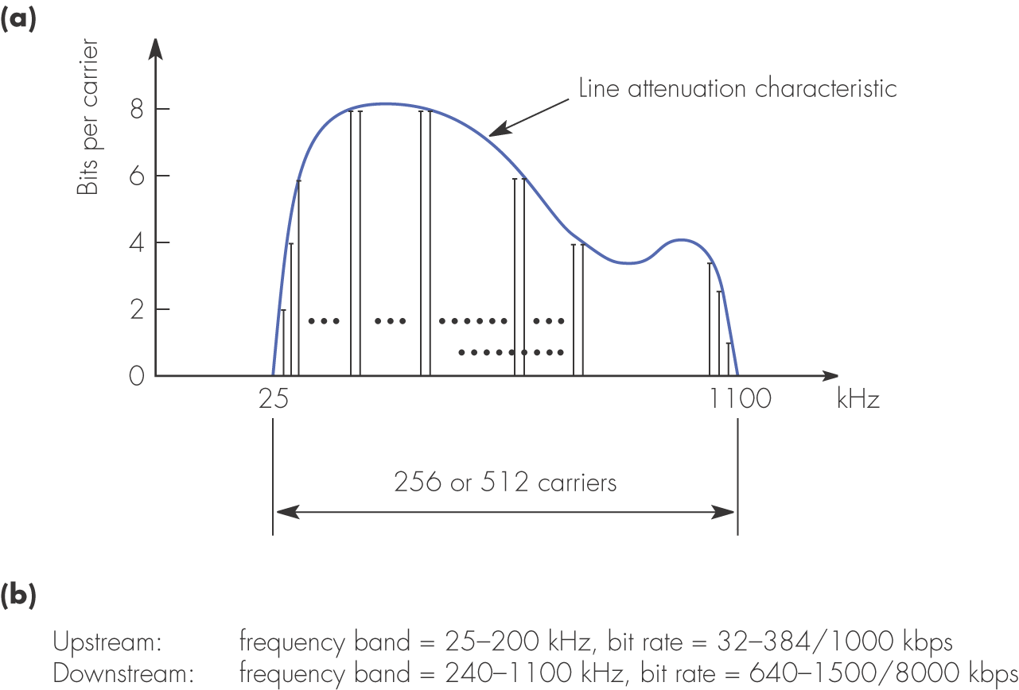
Figure 2.29 Example DMT frequency usage: (a) bits per carrier allocation; (b) duplex frequency usage.

Slide 49
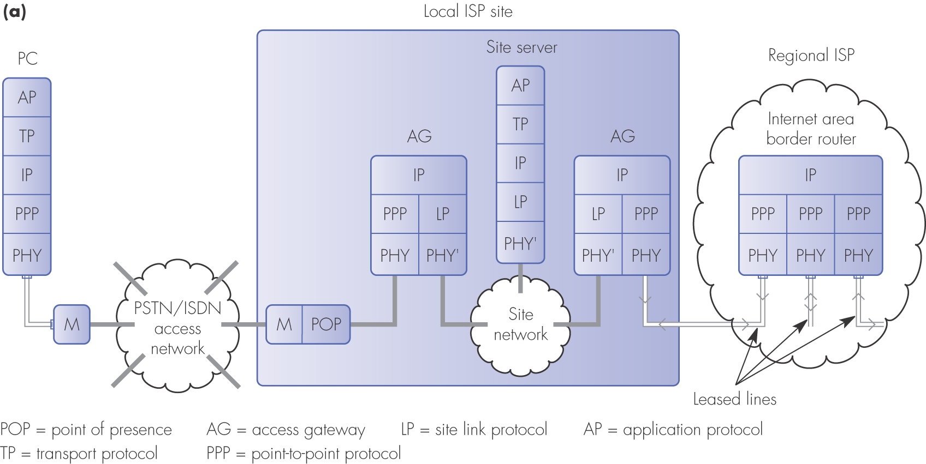
Figure 2.33 The PPP protocol: (a) the location of the PPP in relation to the other protocols

Slide 50
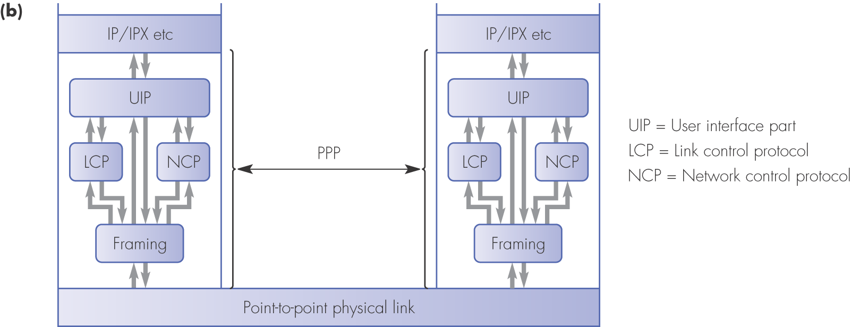
Figure 2.33 The PPP protocol: (b) the composition of the PPP

Slide 51

Figure 2.33 The PPP protocol: (c) a state transition diagram of the PPP

Slide 52

Figure 2.34 The point-to-point protocol (PPP): (a) frame format

Slide 53

Figure 2.34 The point-to-point protocol (PPP): (b) byte stuffing principle

Slide 54

Figure 2.35 The public Internet architecture

