Slide 1
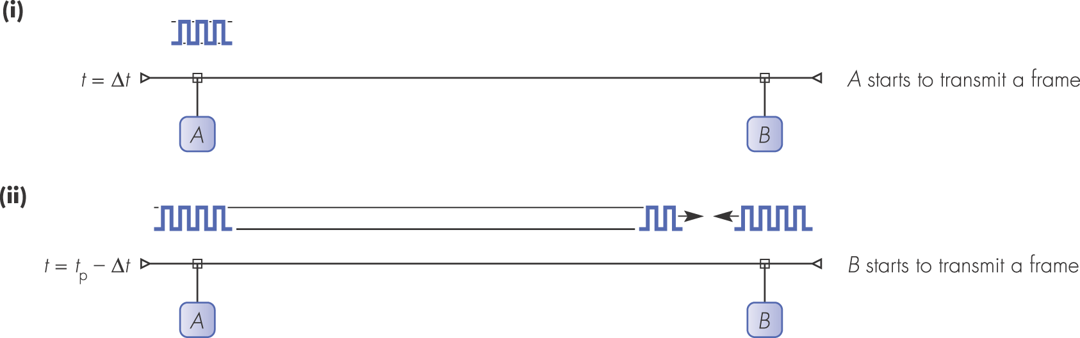
Figure 3.1 CSMA/CD worst-case collision detection

Slide 2
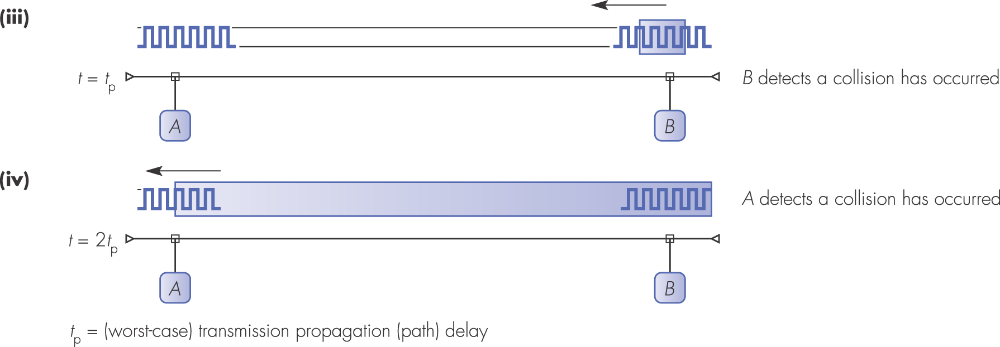
Figure 3.1 continued

Slide 3
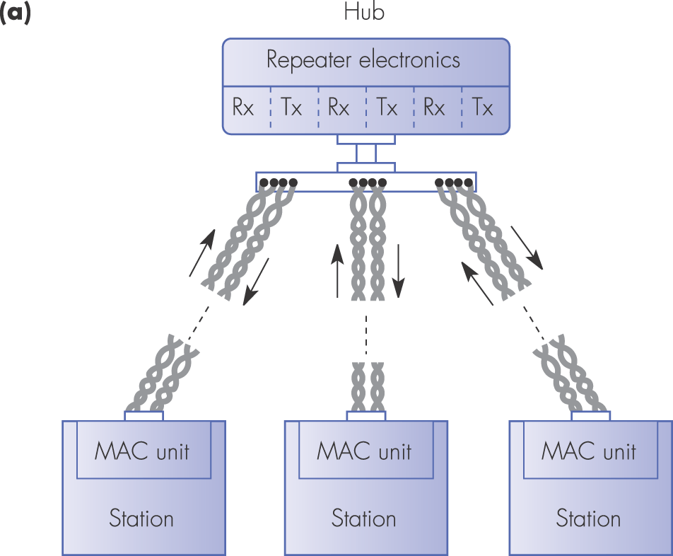
Figure 3.2 Hub configuration principles: (a) topology

Slide 4
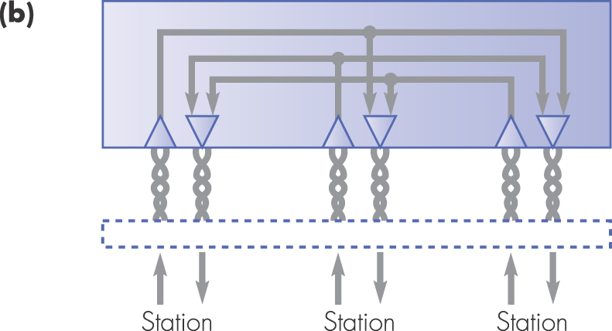
Figure 3.2 Hub configuration principles: (b) repeater schematic

Slide 5
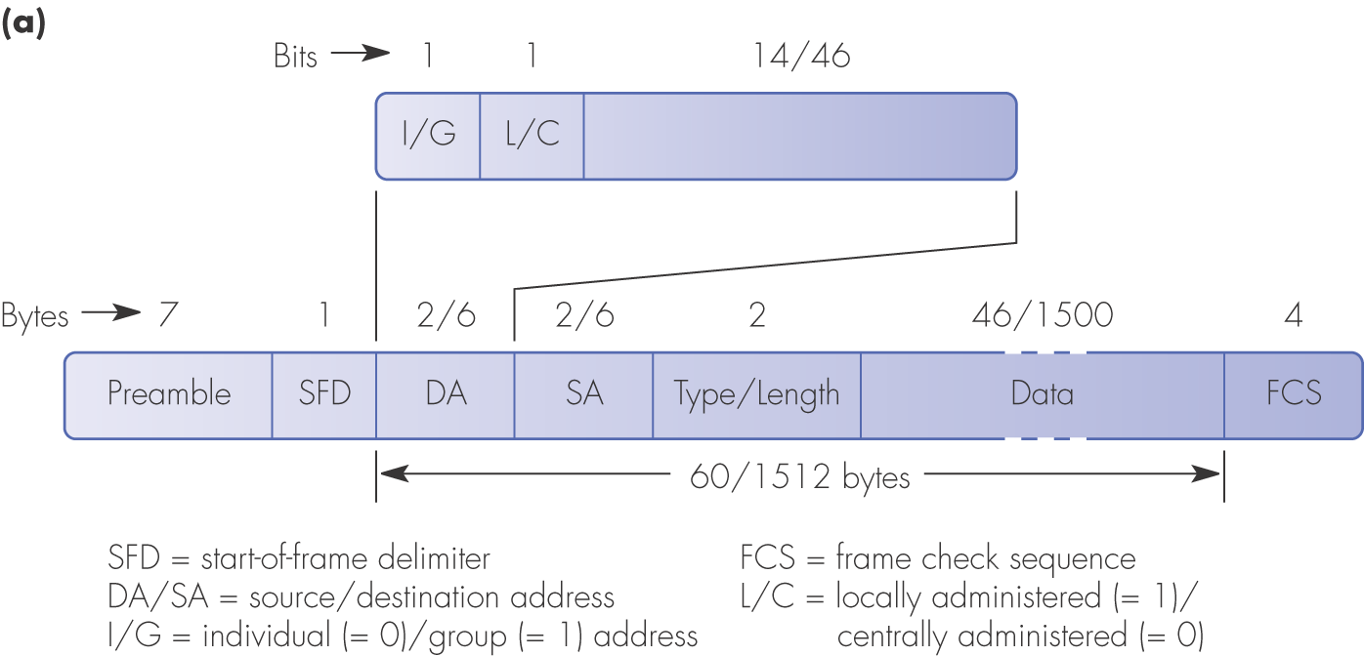
Figure 3.3 Ethernet/IEEE802.3 characteristics: (a) frame format

Slide 6
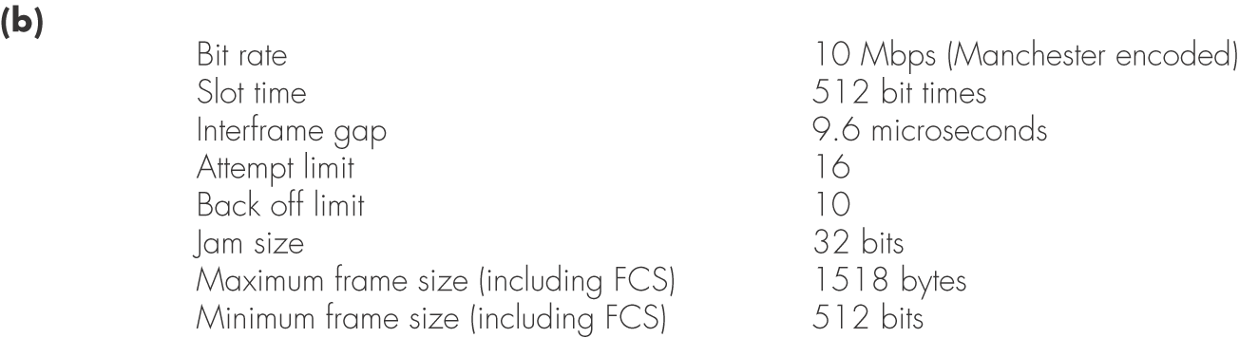
Figure 3.3 Ethernet/IEEE802.3 characteristics: (b) operational parameters

Slide 7
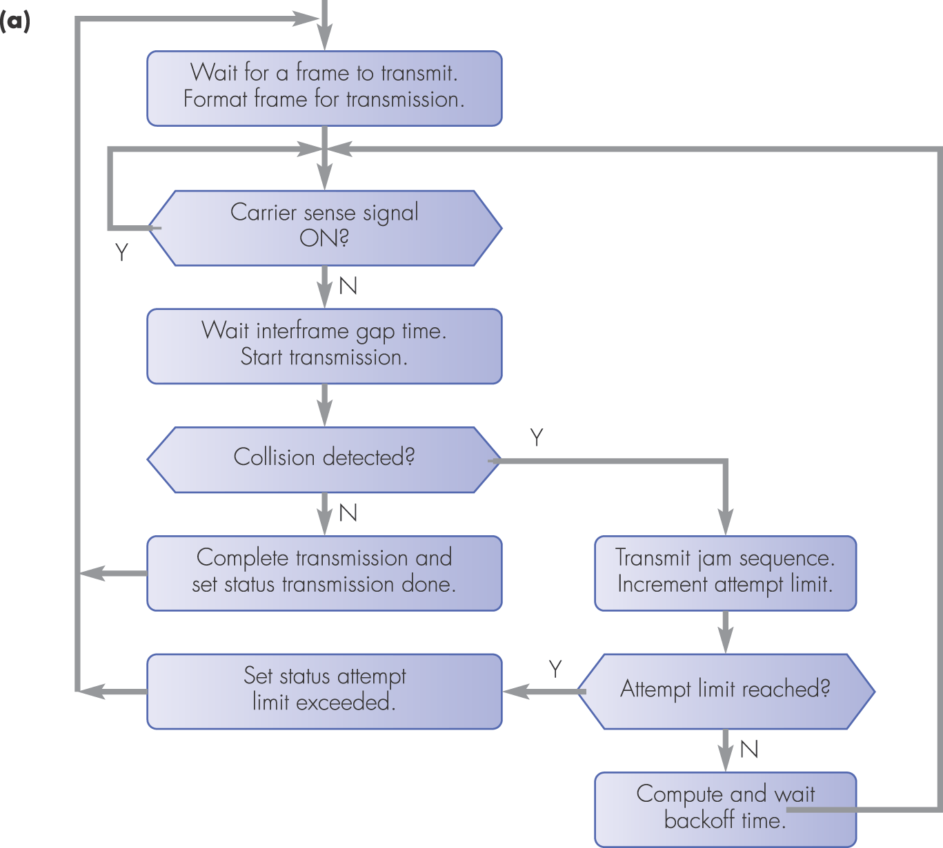
Figure 3.4 CSMA/CD MAC sublayer operation: (a) transmit

Slide 8
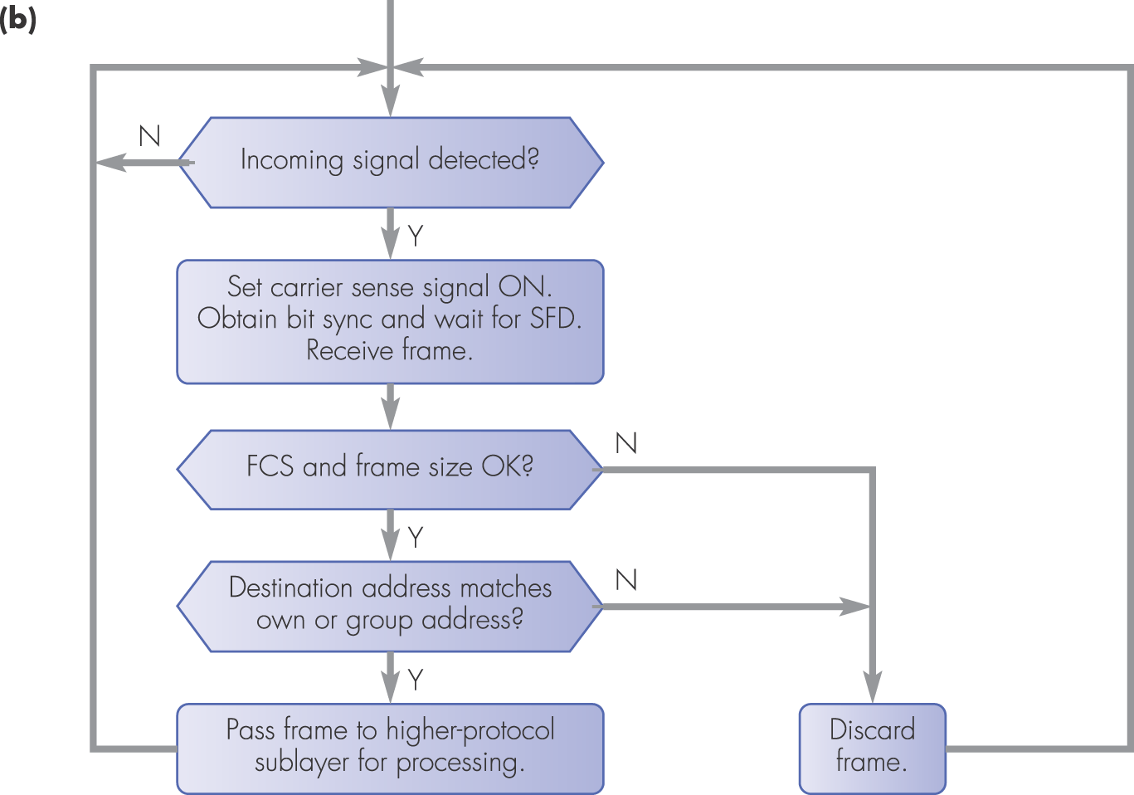
Figure 3.4 CSMA/CD MAC sublayer operation: (b) receive

Slide 9
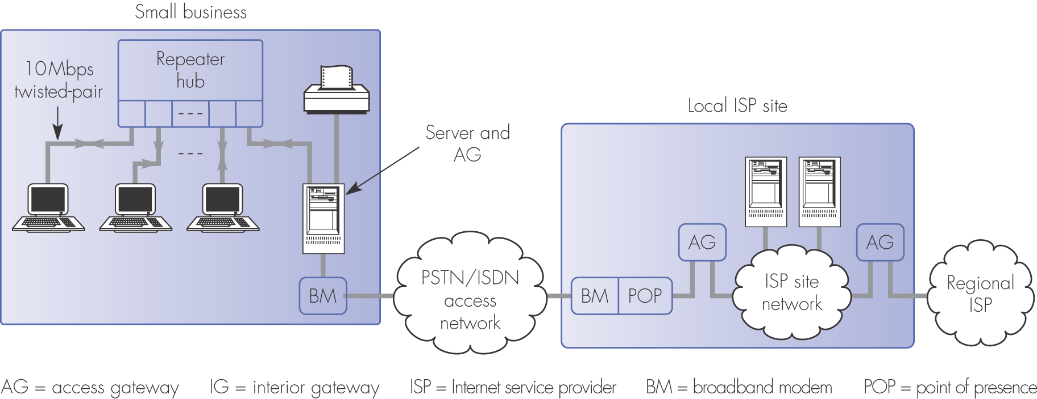
Figure 3.5 Access to the Internet for a small business

Slide 10
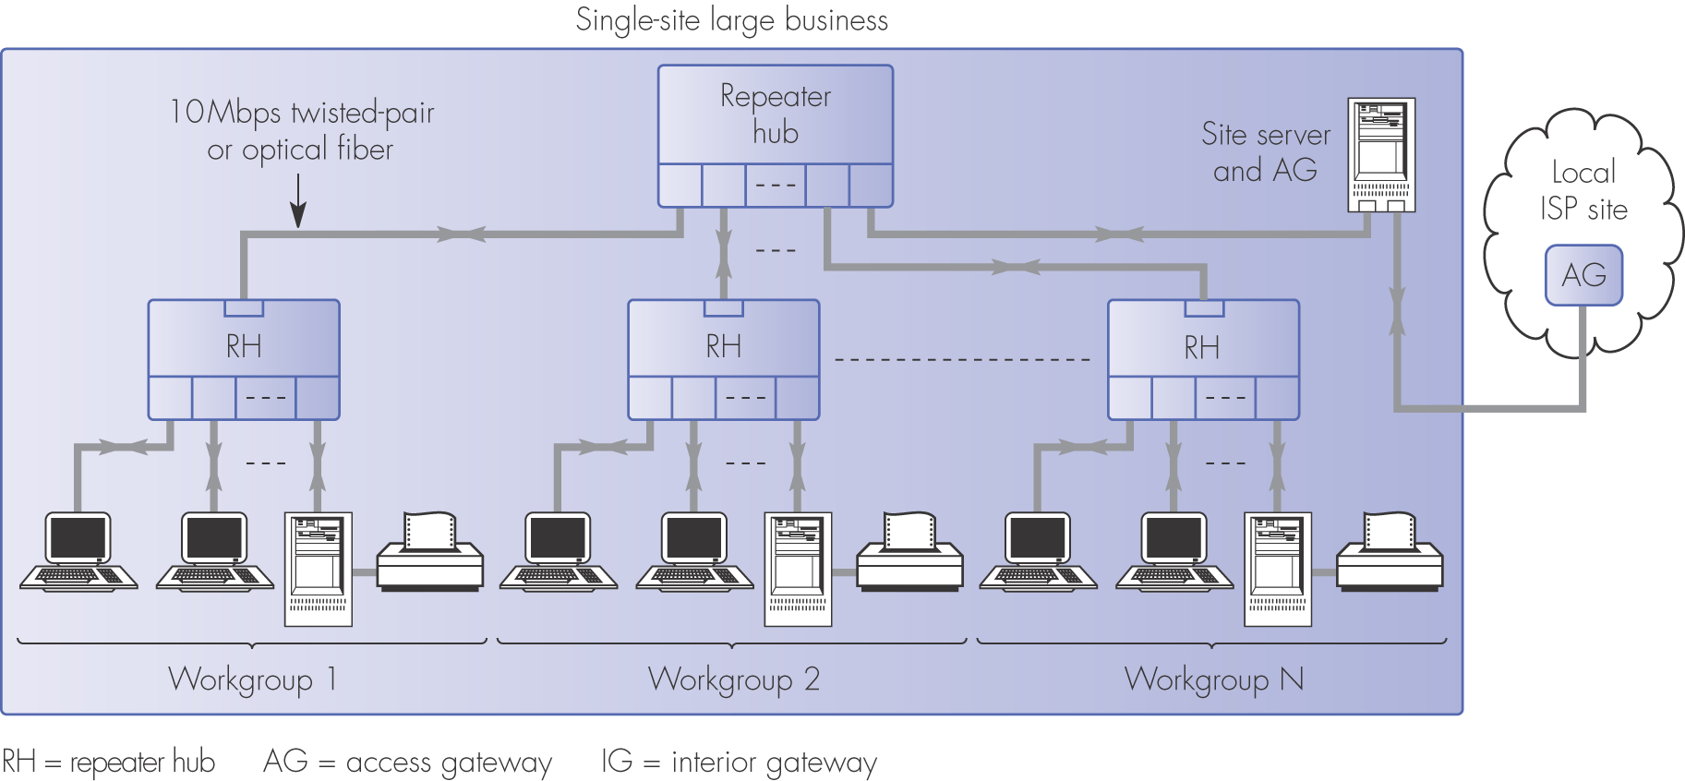
Figure 3.6 Access to the Internet for a single-site large business using repeater hubs only

Slide 11
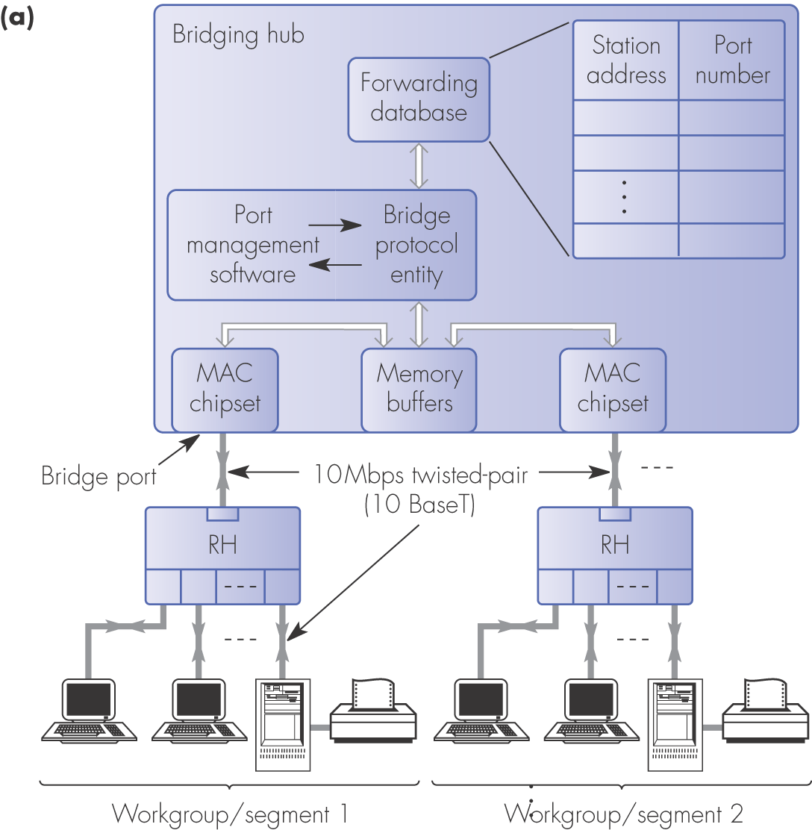
Figure 3.7 Transparent bridging hub schematic: (a) general topology

Slide 12
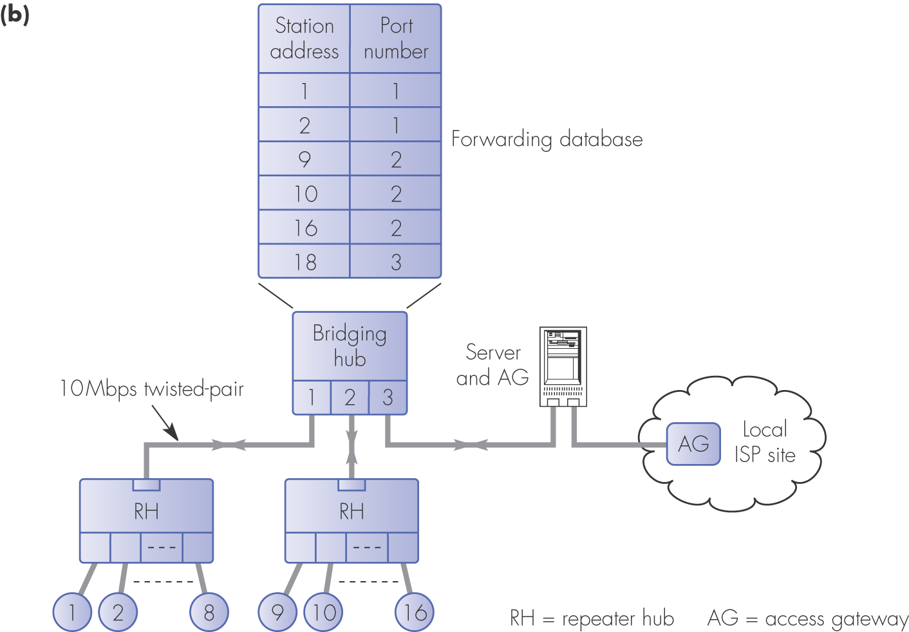
Figure 3.7 Transparent bridging hub schematic: (b) multiport bridge example

Slide 13
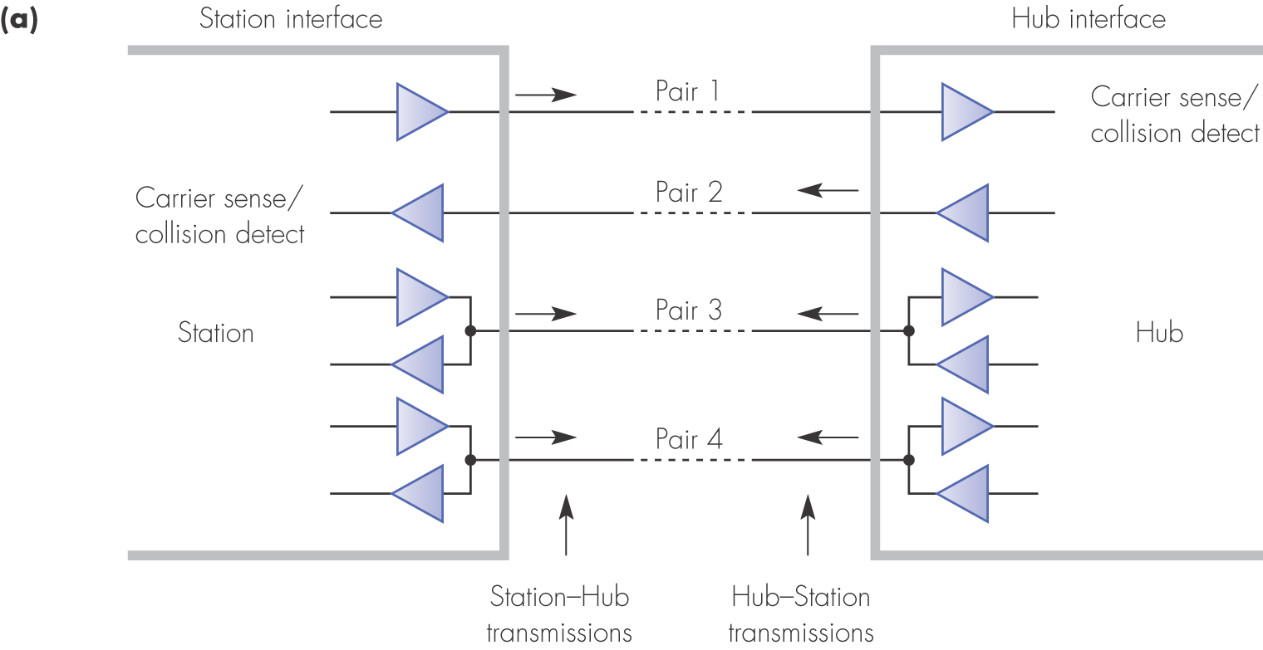
Figure 3.9 100Base4T: (a) use of wire pairs

Slide 14
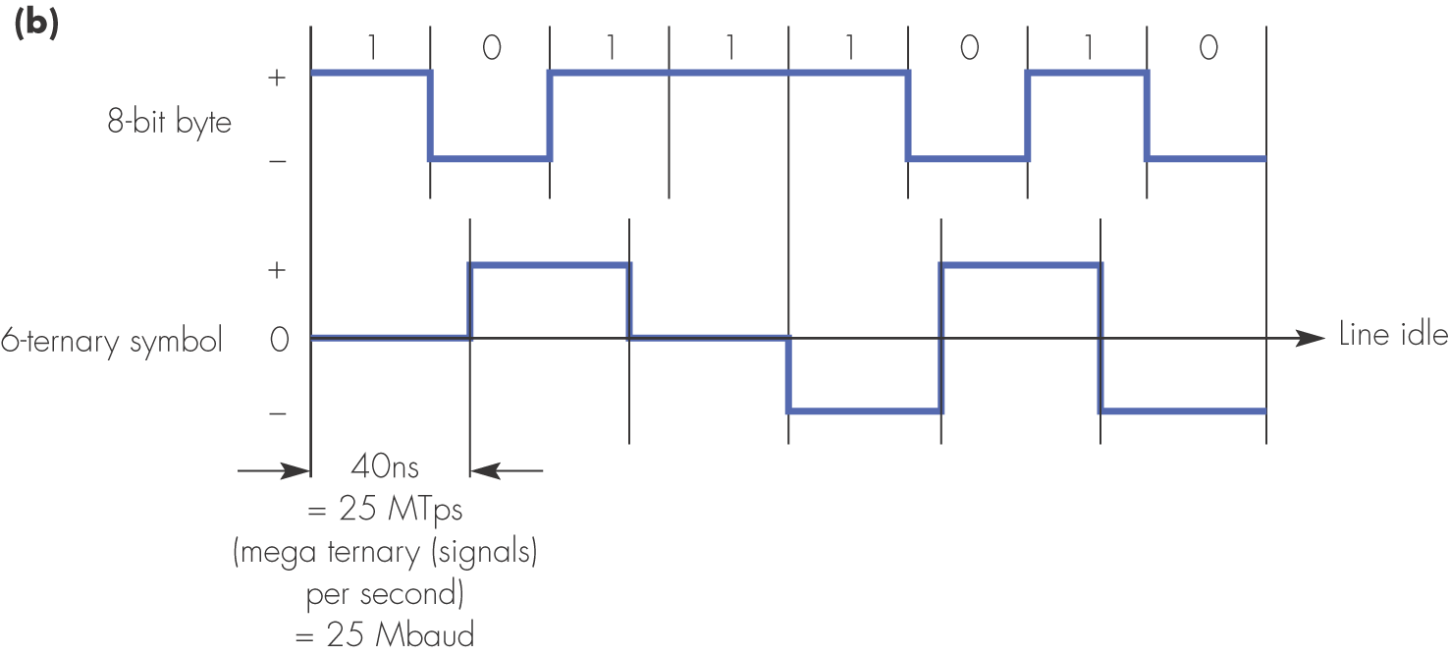
Figure 3.9 100Base4T: (b) 8B6T encoding

Slide 15
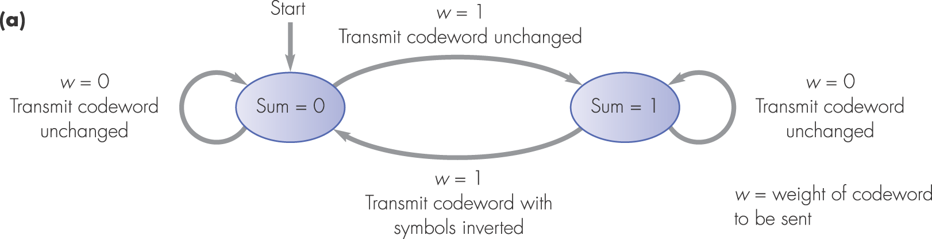
Figure 3.10 100Base4T transmission detail: (a) DC balance transmission rules

Slide 16
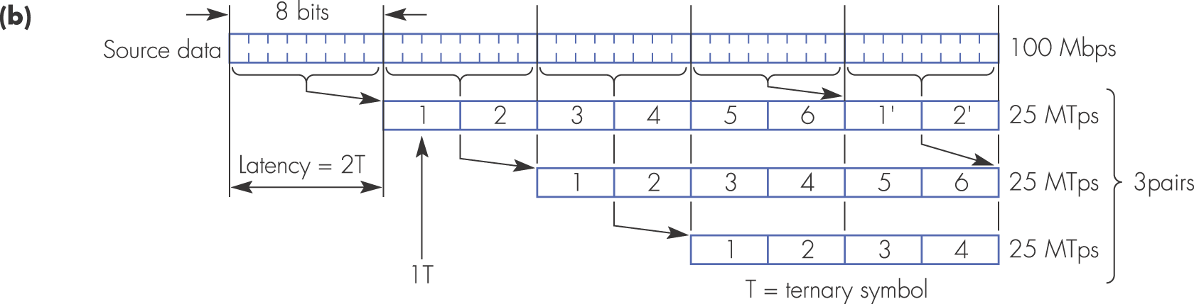
Figure 3.10 100Base4T transmission detail: (b) 8B6T encoding sequence

Slide 17
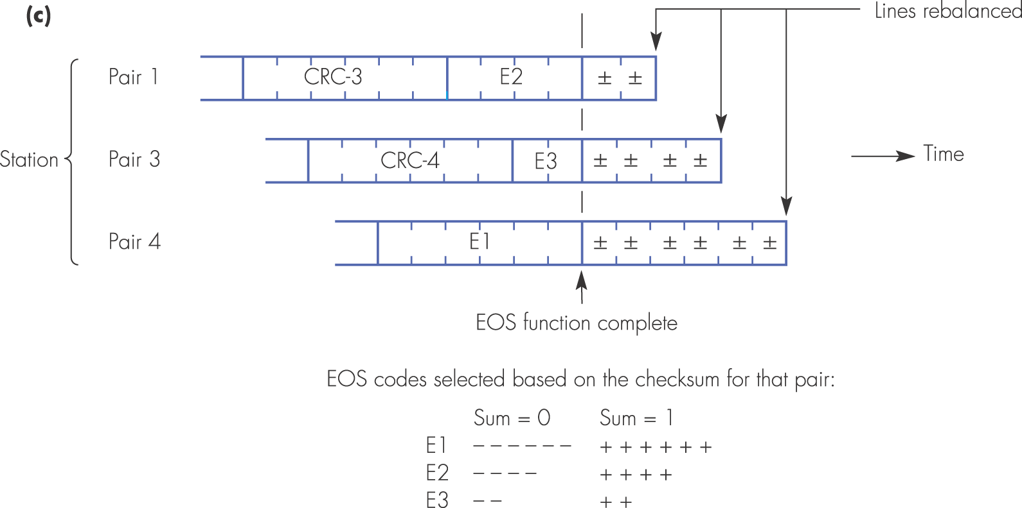
Figure 3.10 100Base4T transmission detail: (c) end of stream encoding

Slide 18
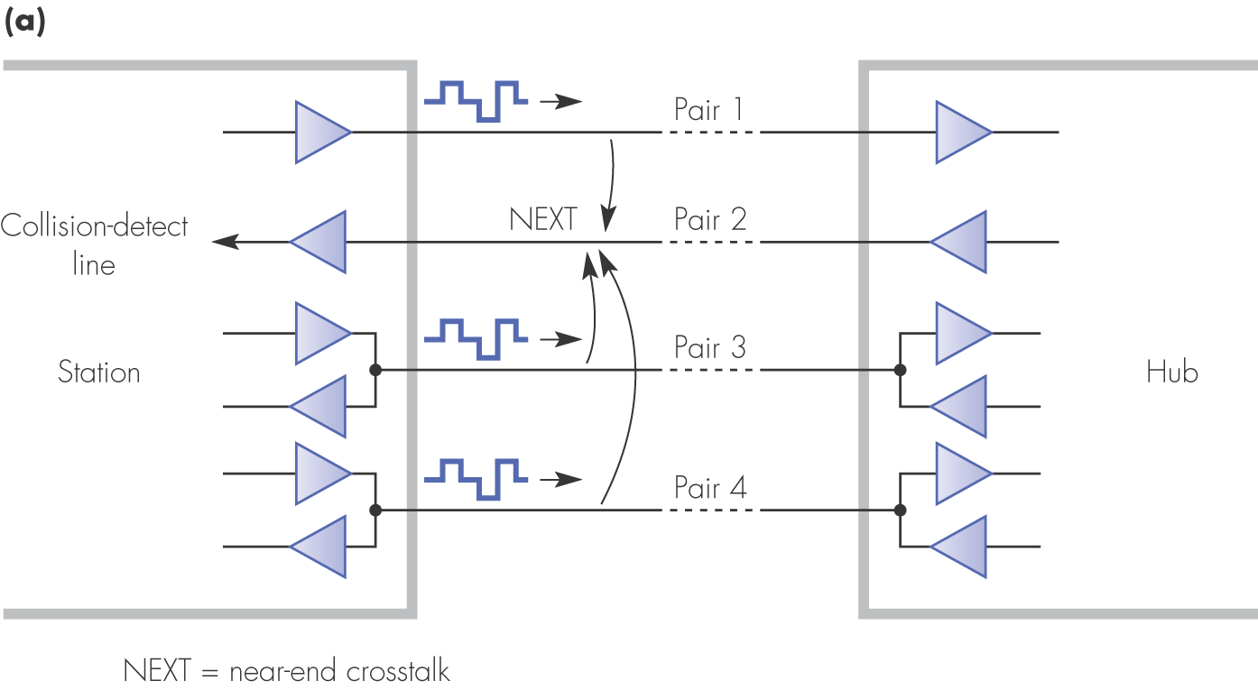
Figure 3.11 Start-of-frame detail: (a) effect of NEXT

Slide 19
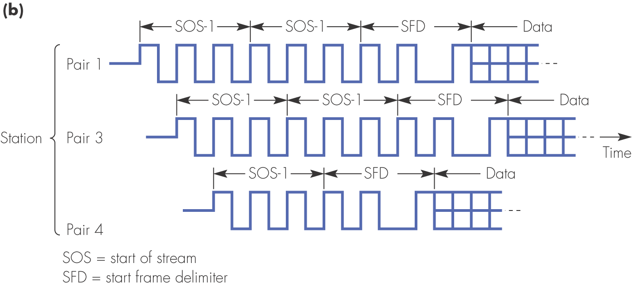
Figure 3.11 Start-of-frame detail: (b) preamble sequence

Slide 20
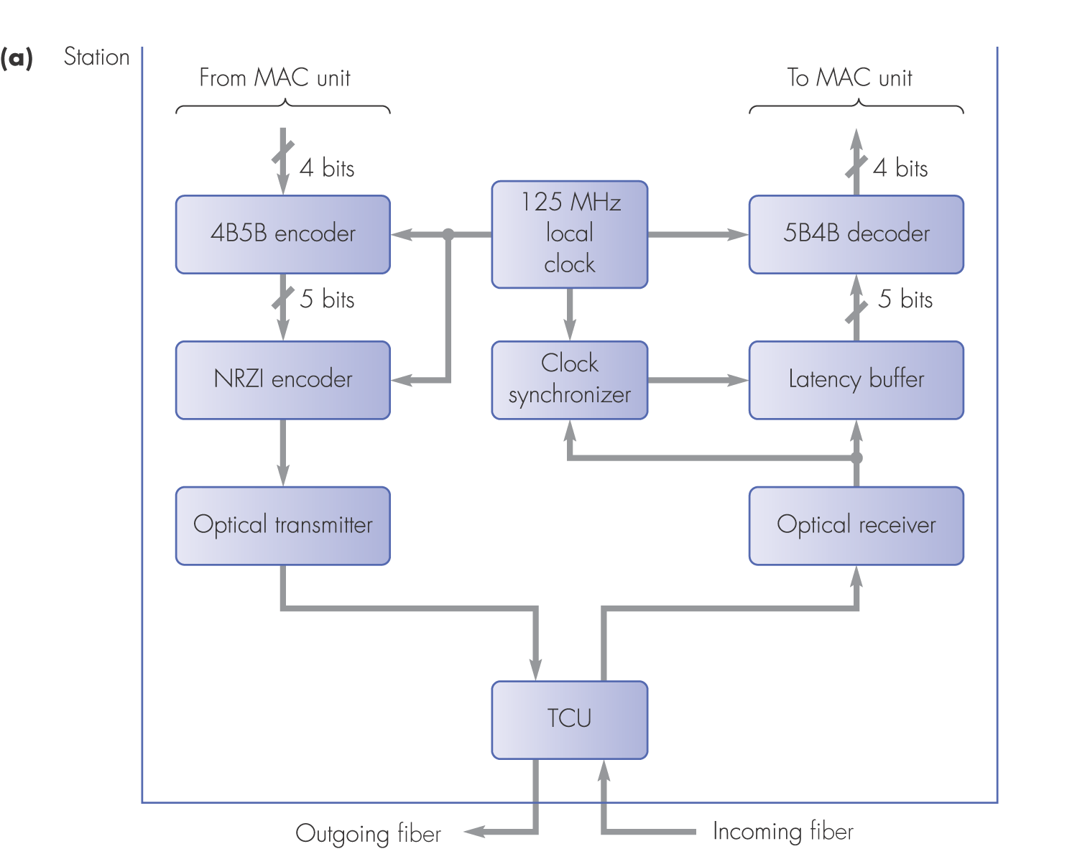
Figure 3.12 100BaseFX: (a) physical interface schematic

Slide 21
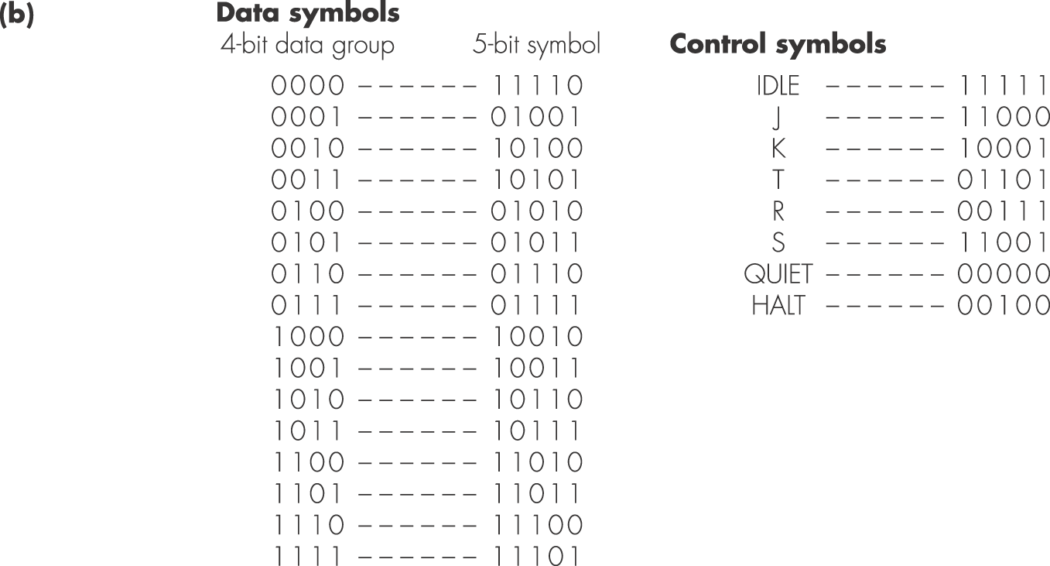
Figure 3.12 100BaseFX: (b) 4B/5B codes

Slide 22
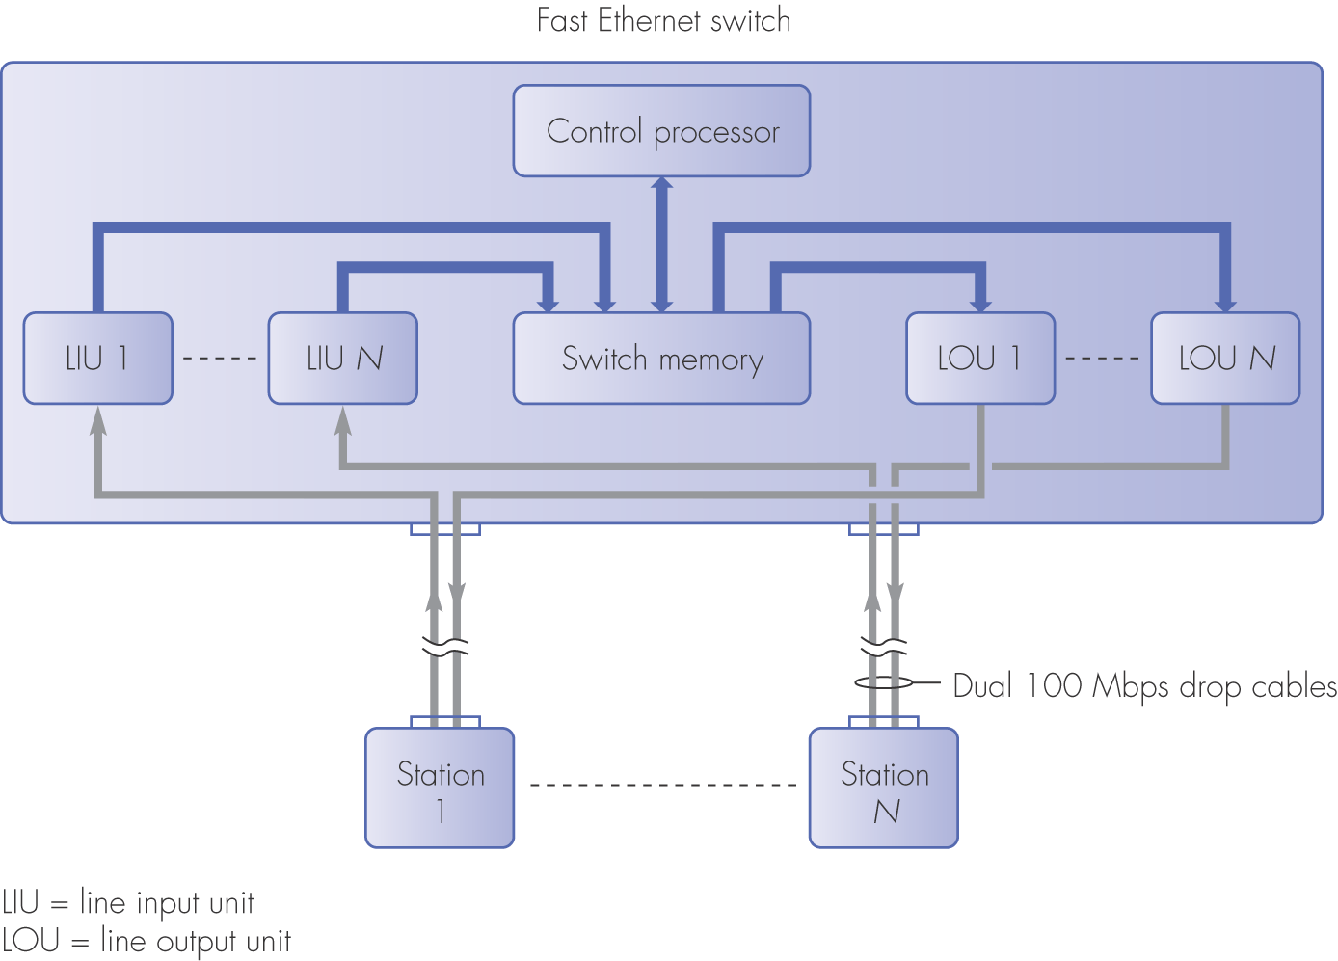
Figure 3.13 Fast Ethernet switch schematic

Slide 23
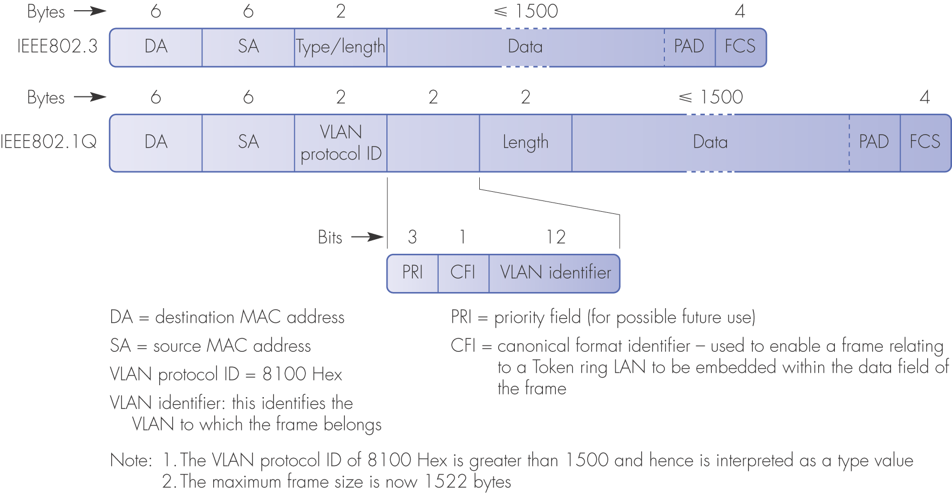
Figure 3.15 IEEE802.1Q frame format and field descriptions

Slide 24
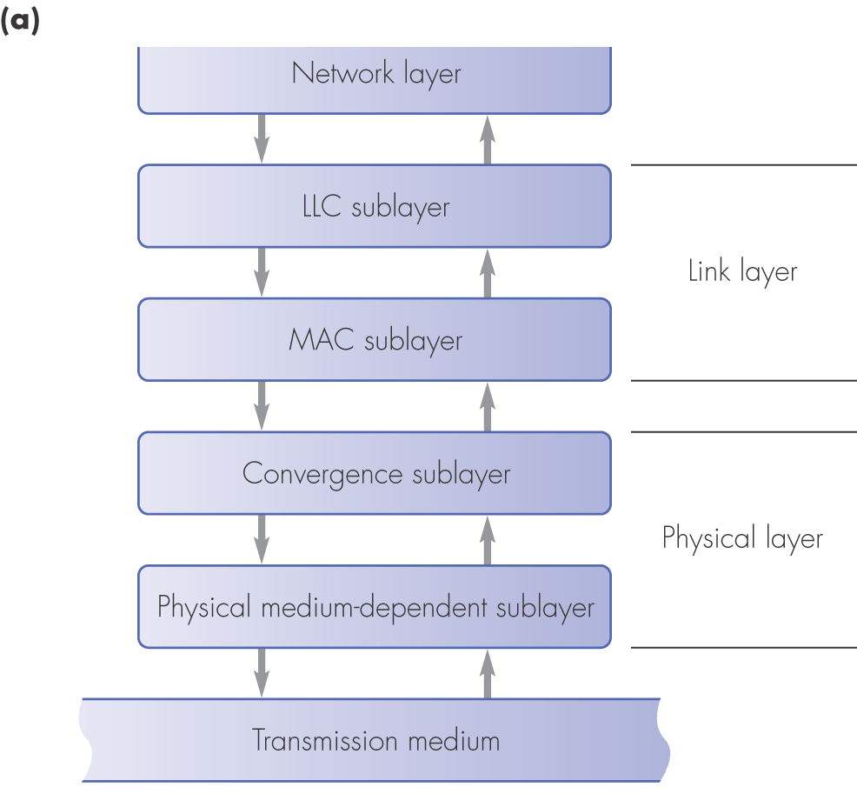
Figure 3.17 LAN protocols: (a) protocol framework

Slide 25
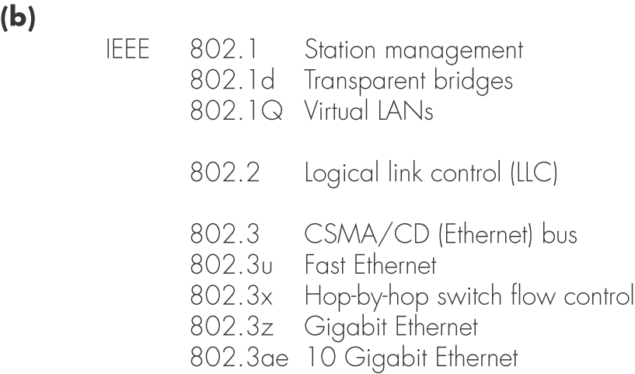
Figure 3.17 LAN protocols: (b) examples

Slide 26
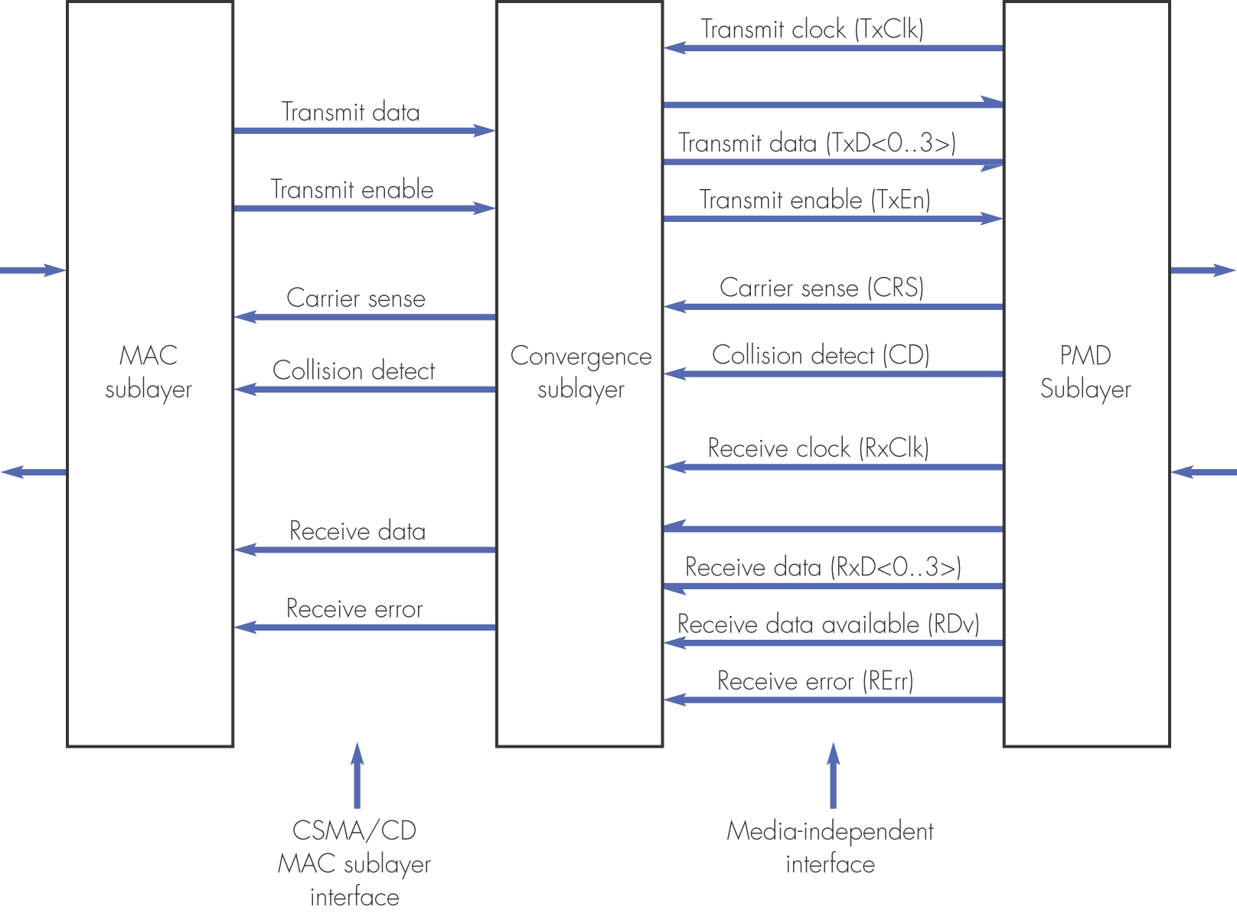
Figure 3.18 Fast Ethernet media-independent interface

Slide 27
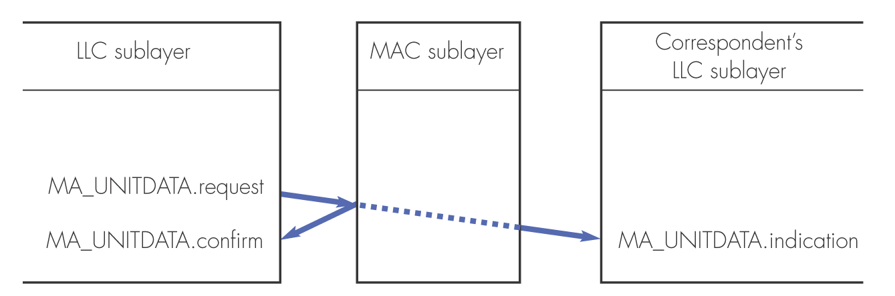
Figure 3.19 MAC user service primitives for CSMA/CD

Slide 28
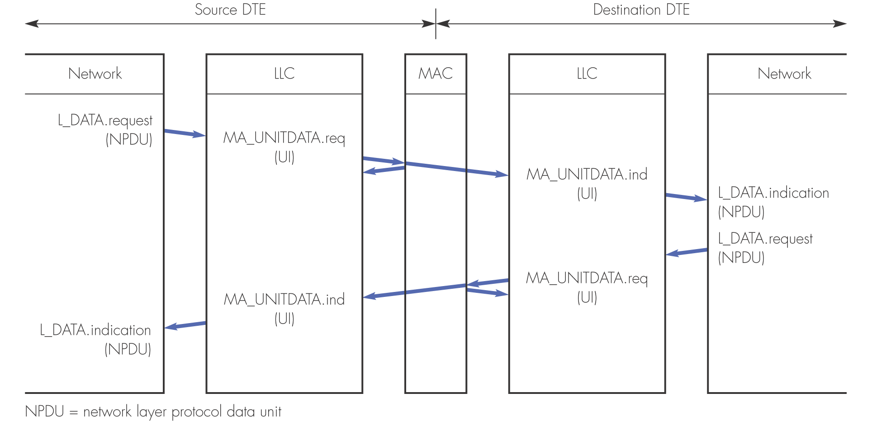
Figure 3.20 LLC/MAC sublayer interactions

Slide 29
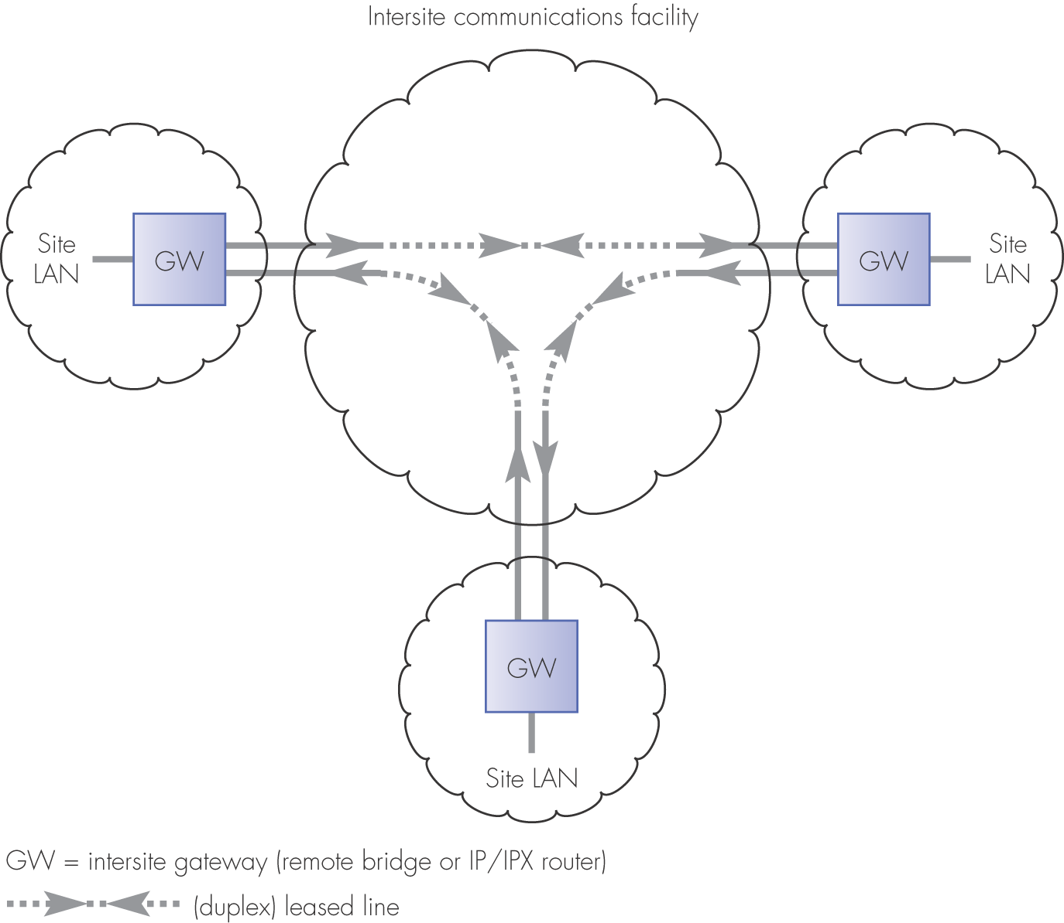
Figure 3.22 Example enterprise network architecture

Slide 30
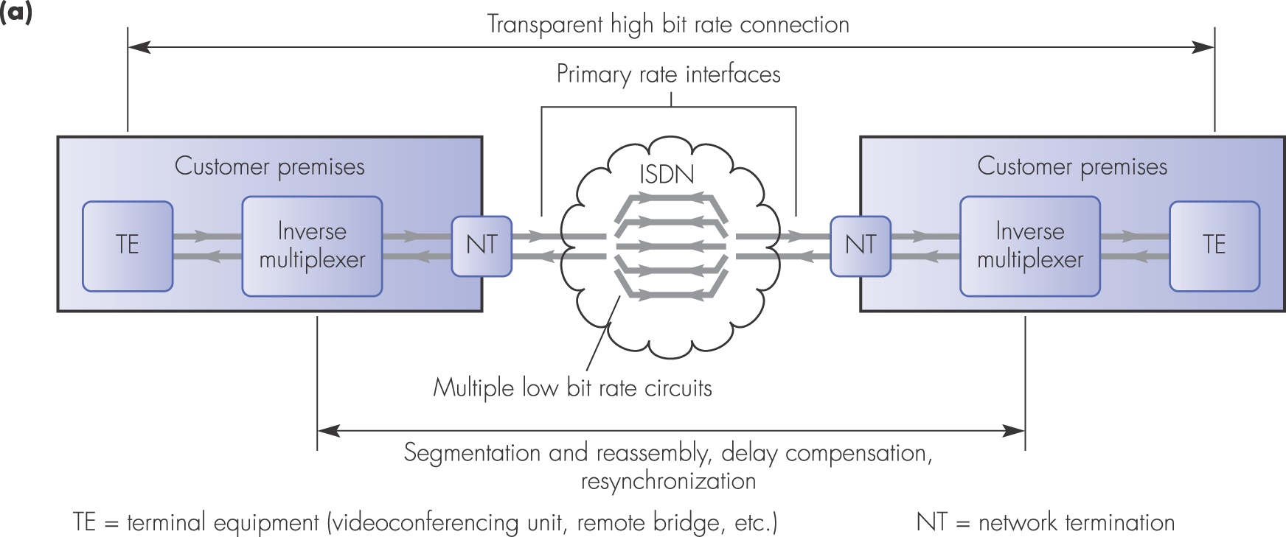
Figure 3.23 Inverse multiplexing: (a) principle of operation

Slide 31
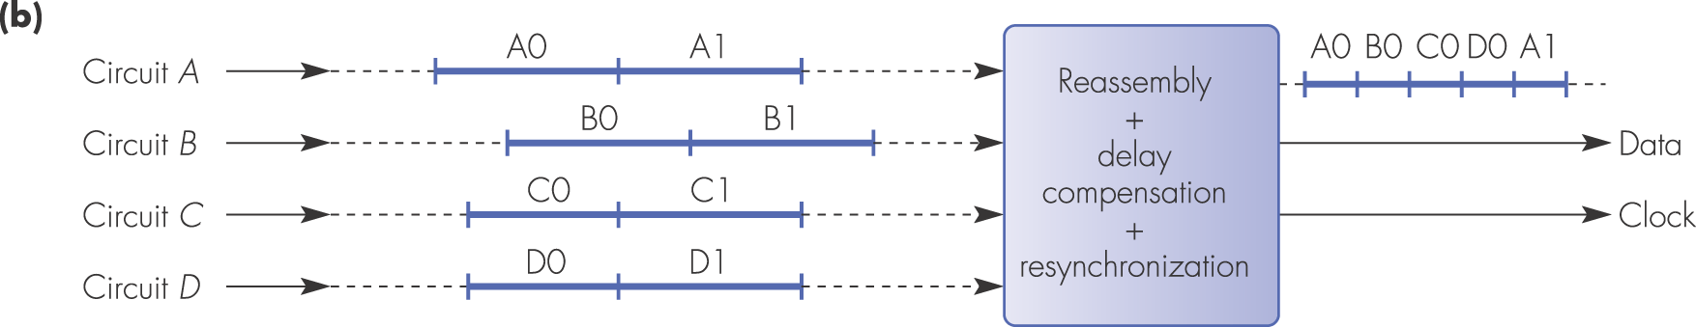
Figure 3.23 Inverse multiplexing: (b) reassembly schematic

Slide 32
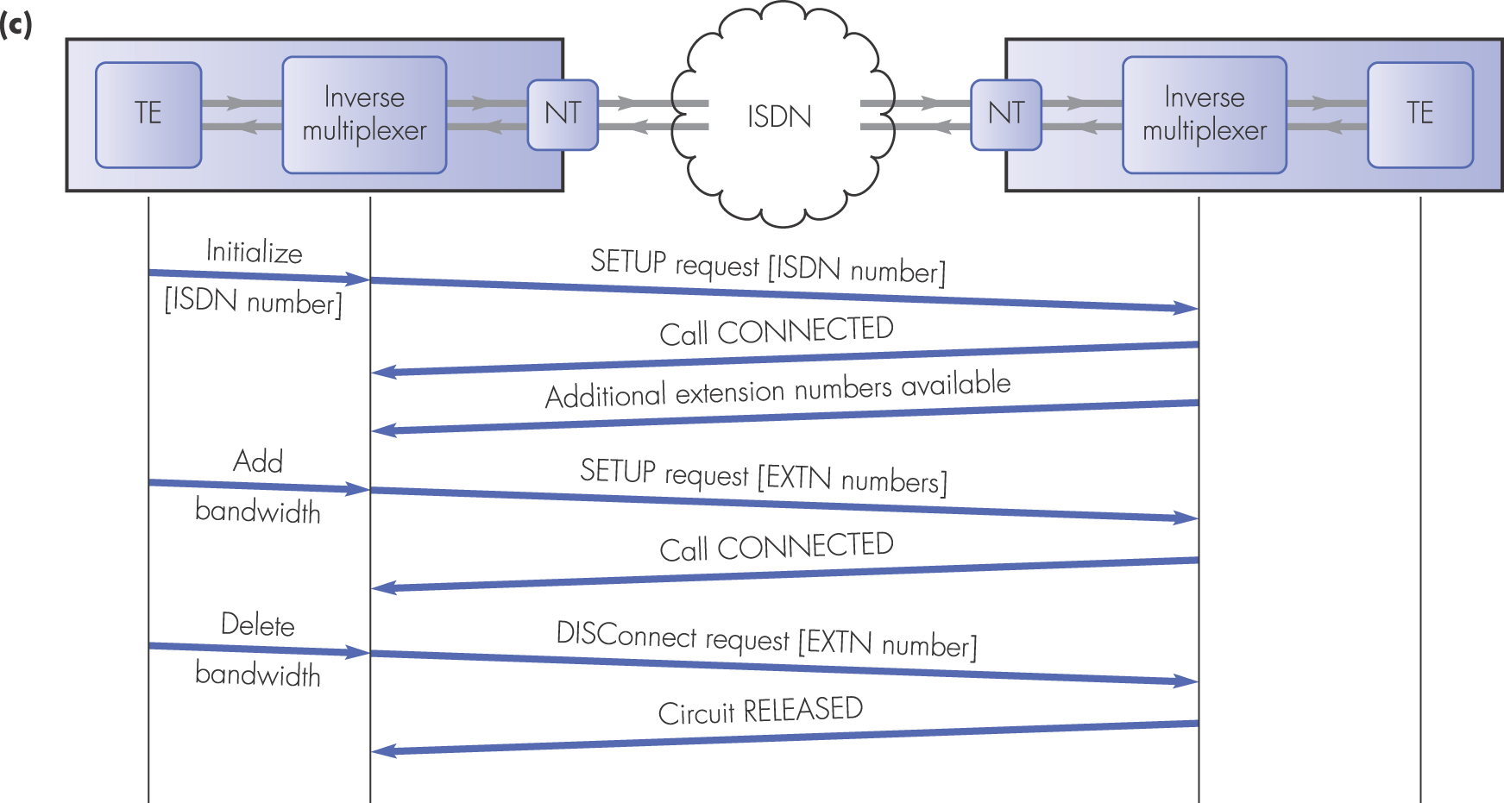
Figure 3.23 Inverse multiplexing: (c) bonding protocol

Slide 33
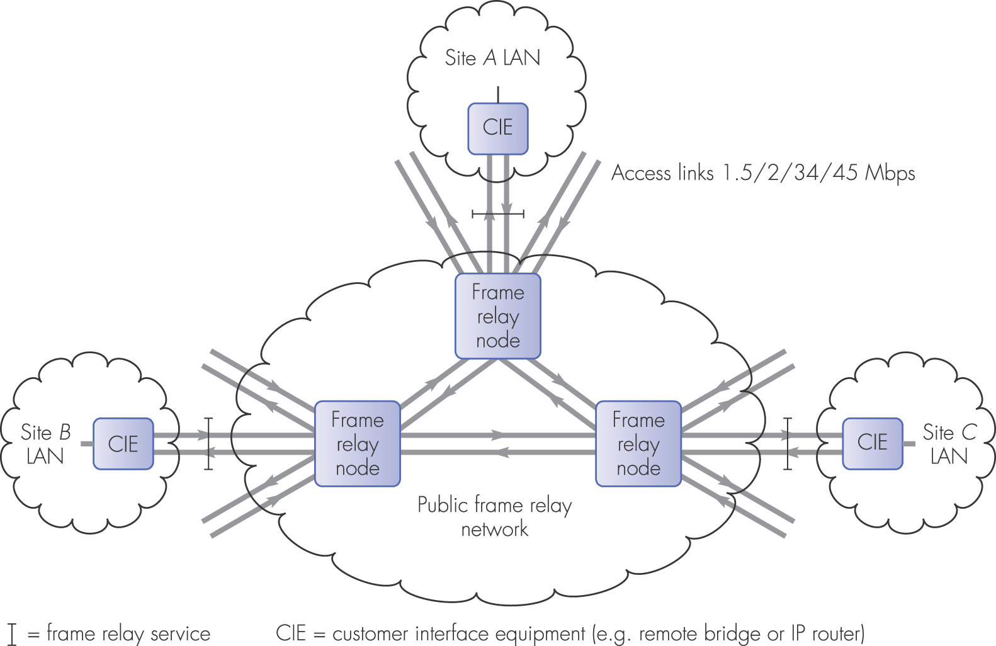
Figure 3.24 Public frame-relay network schematic

Slide 34
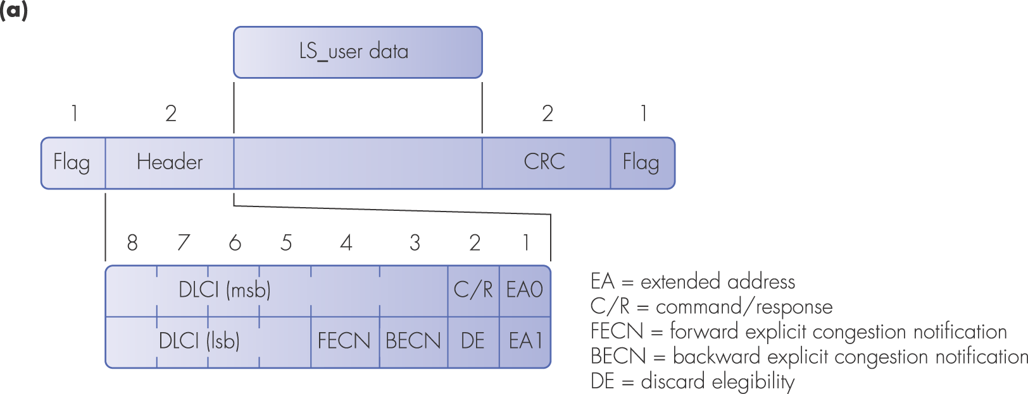
Figure 3.25 Frame relay principles: (a) frame format

Slide 35
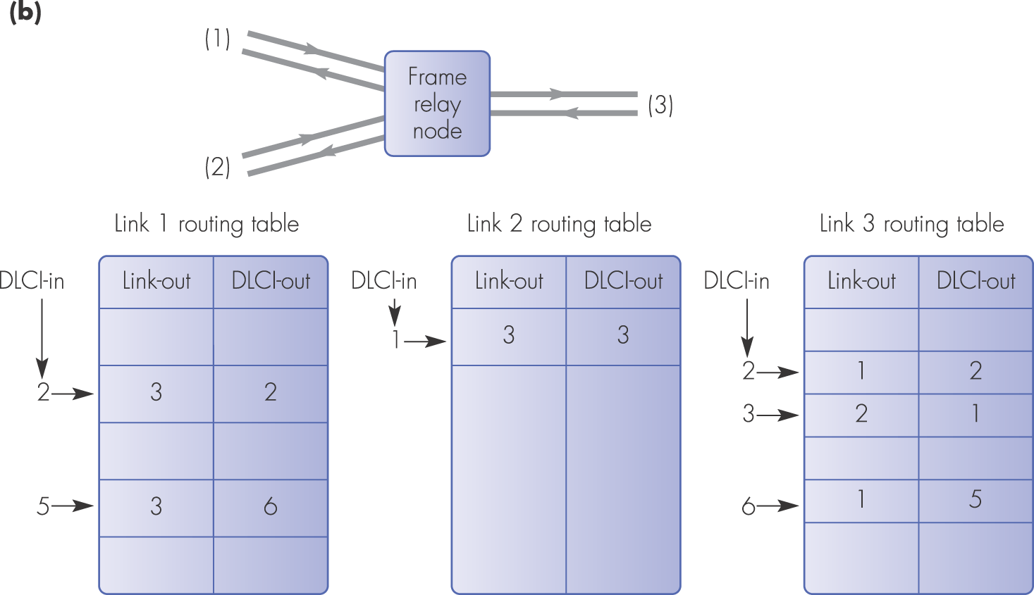
Figure 3.25 Frame relay principles: (b) frame routing

Slide 36
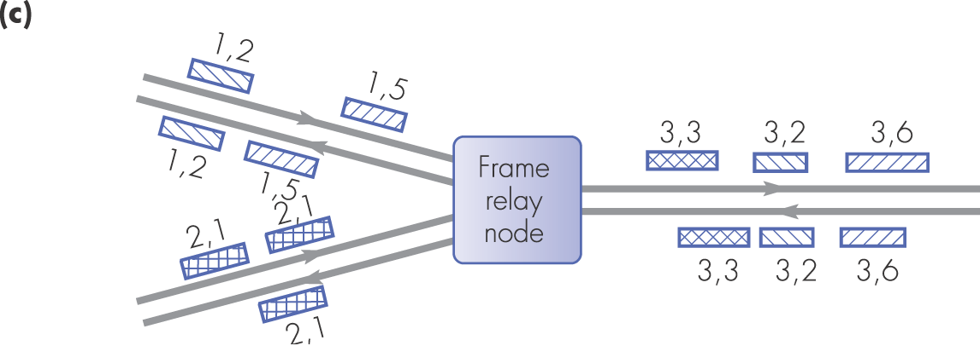
Figure 3.25 Frame relay principles: (c) frame relay schematic

Slide 37
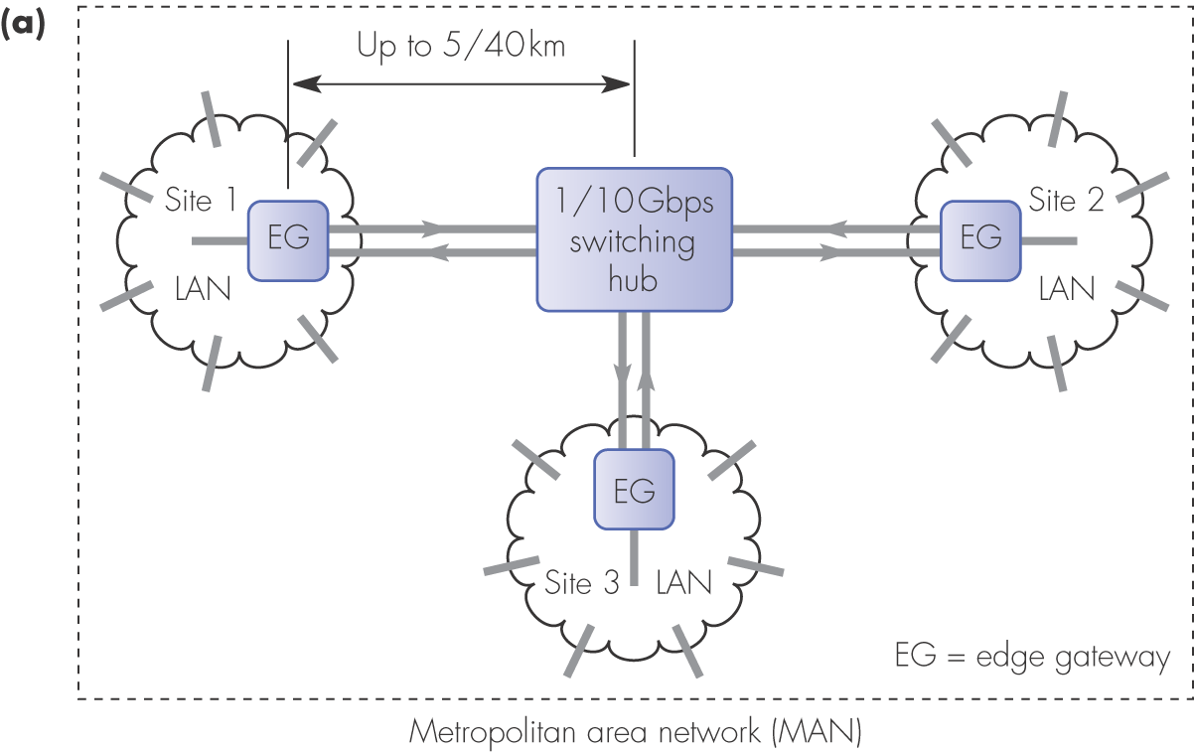
Figure 3.27 (a) Metropolitan area network schematic

Slide 38
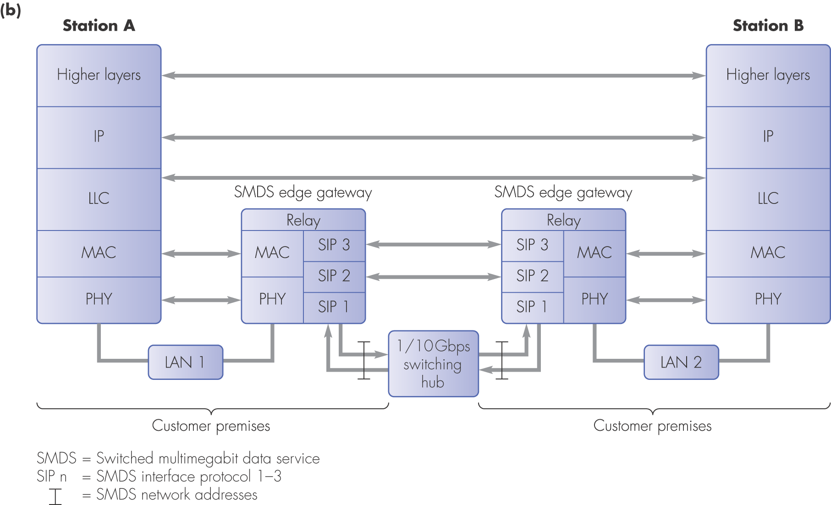
Figure 3.27 (b) SMDS internetworking protocol architecture

