Slide 1
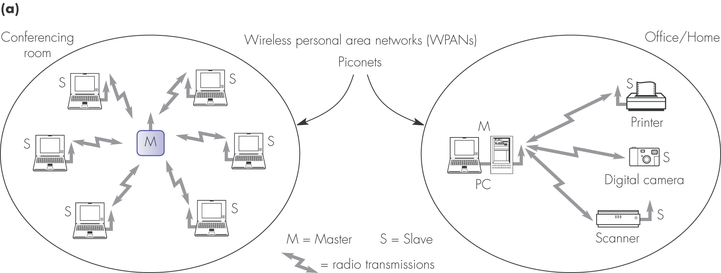
Figure 4.1 Wireless networks: (a) piconets/wireless PANs

Slide 2
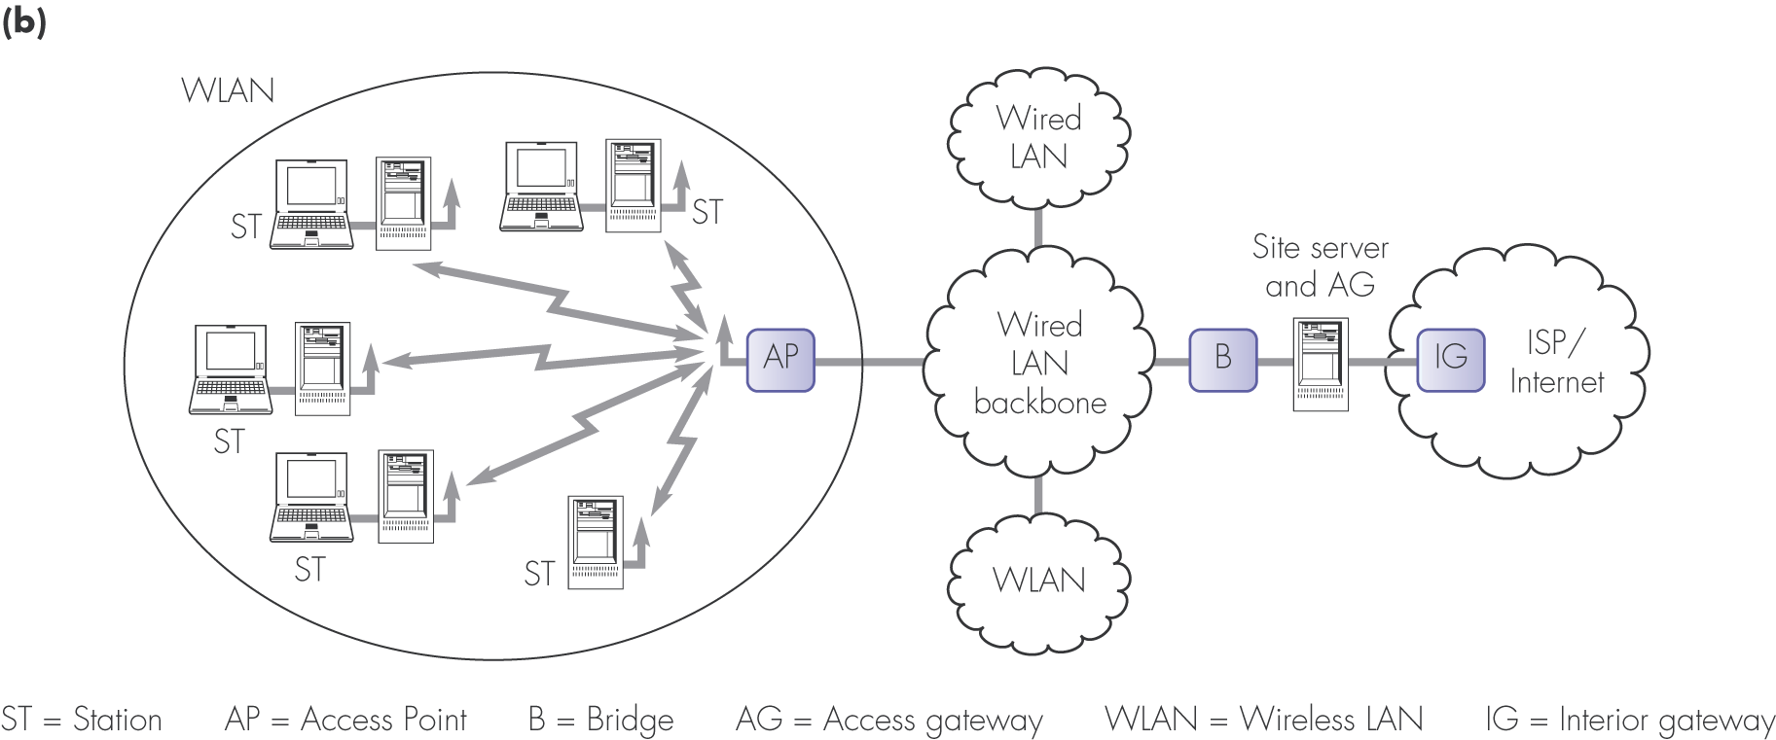
Figure 4.1 Wireless networks: (b) wireless LAN

Slide 3
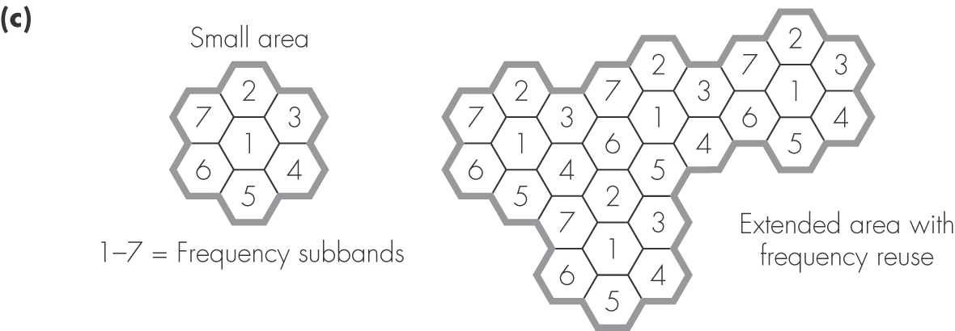
Figure 4.1 Wireless networks: (c) cellular/mobile radio networks

Slide 4
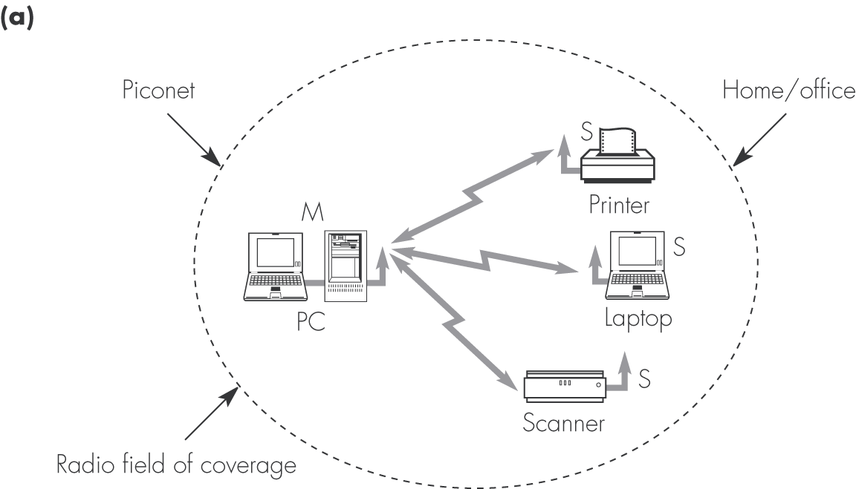
Figure 4.2 Bluetooth applications: (a) connection of peripheral devices to a computer

Slide 5
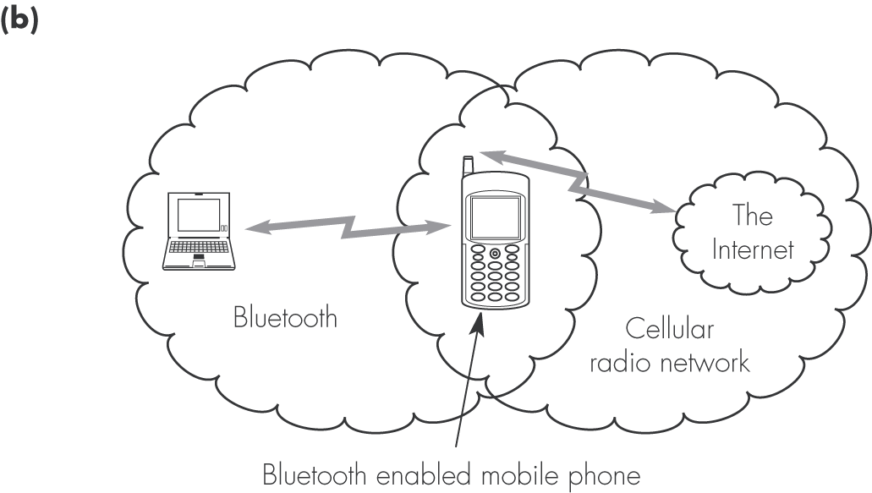
Figure 4.2 Bluetooth applications: (b) Internet access via a mobile phone

Slide 6
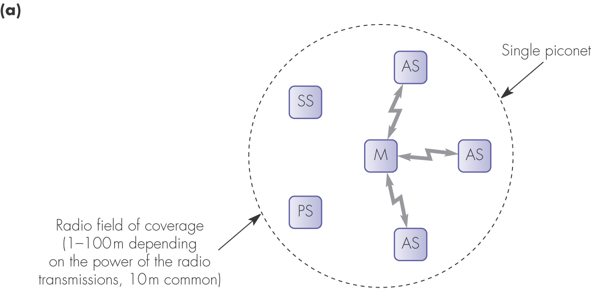
Figure 4.3 Bluetooth configurations and terminology: (a) single piconet

Slide 7
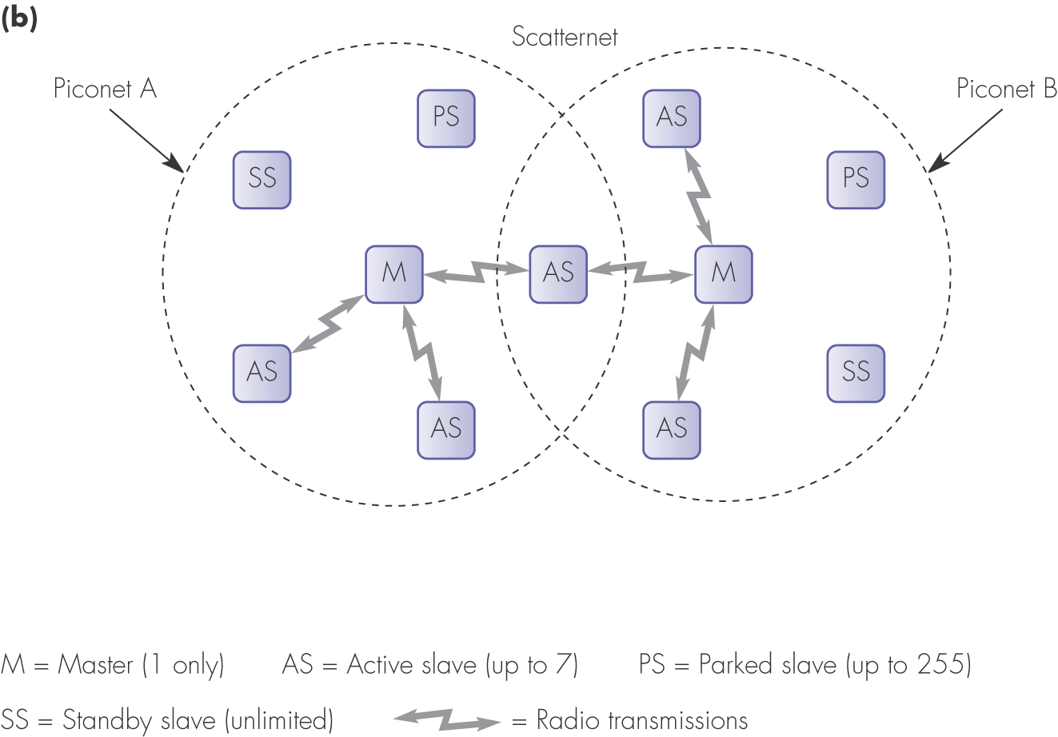
Figure 4.3 Bluetooth configurations and terminology: (b) scatternet

Slide 8
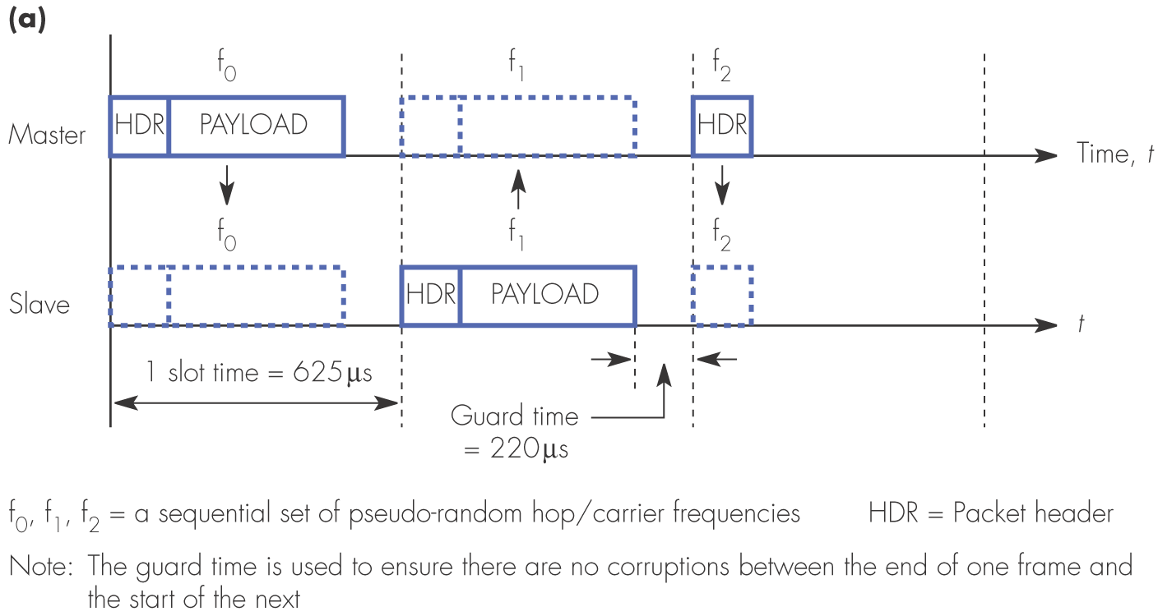
Figure 4.4 Piconet packet transmission examples: (a) one-slot packets

Slide 9
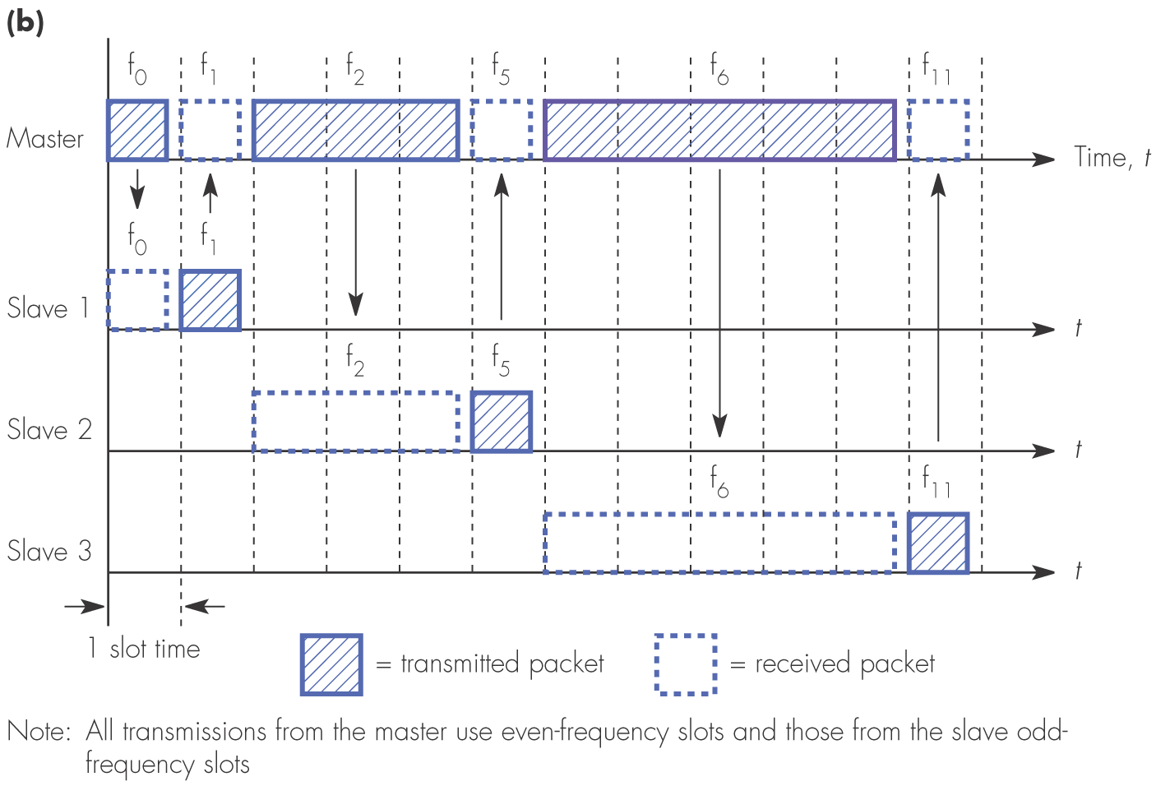
Figure 4.4 Piconet packet transmission examples: (b) one-,three- and five-slot packets

Slide 10
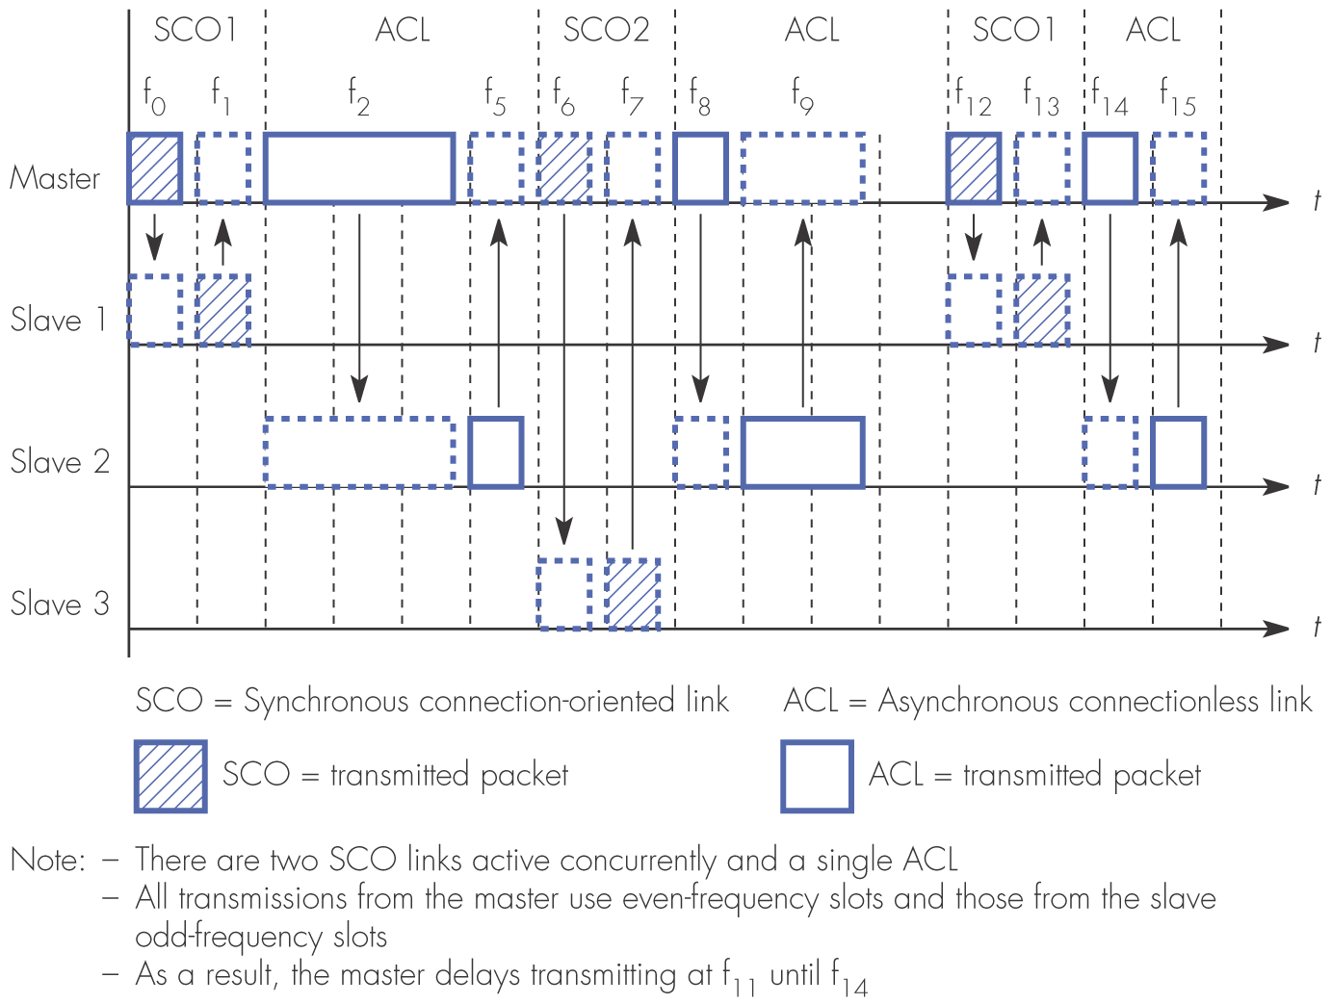
Figure 4.5 An example showing the transmission of mixed packet types

Slide 11
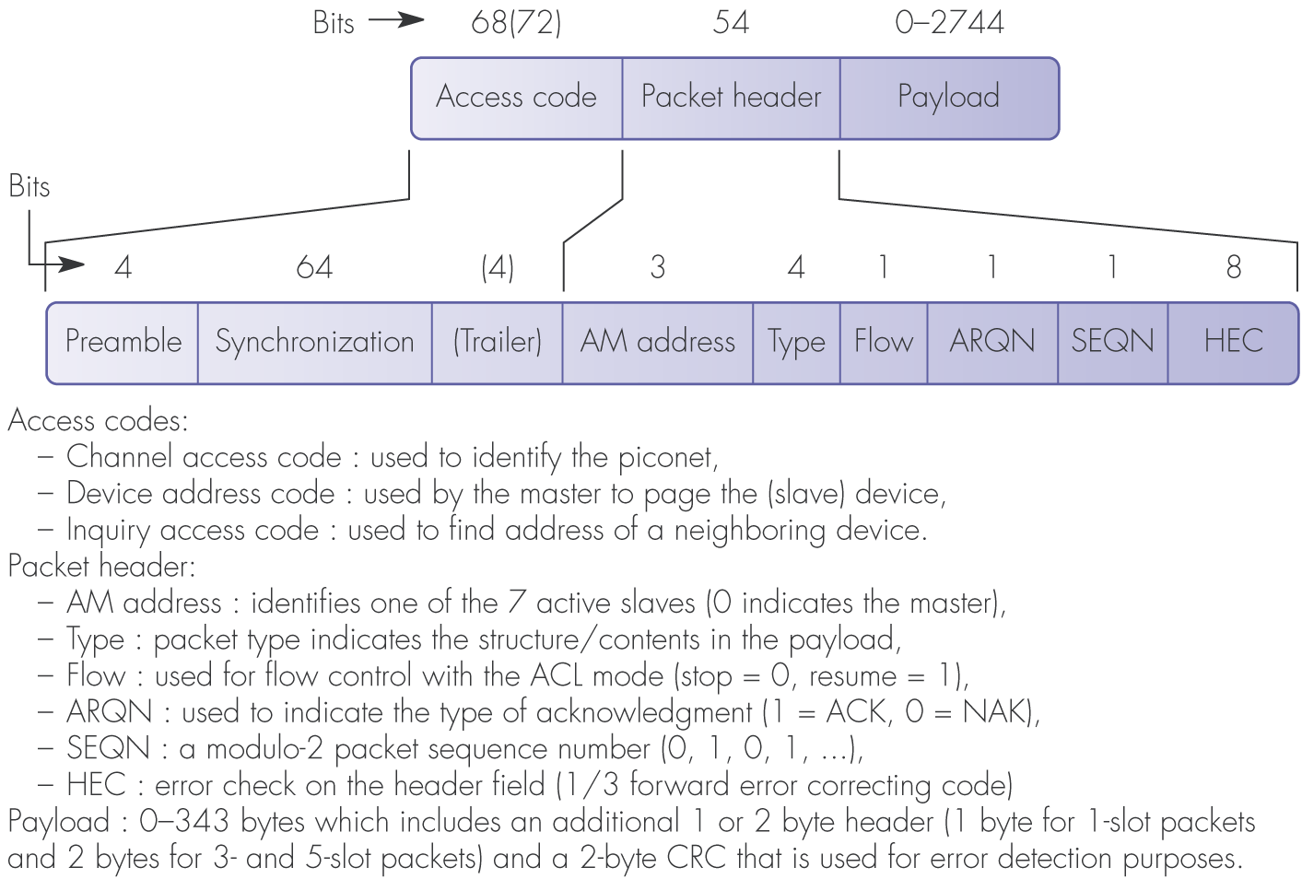
Figure 4.6 Bluetooth packet format and field descriptions

Slide 12
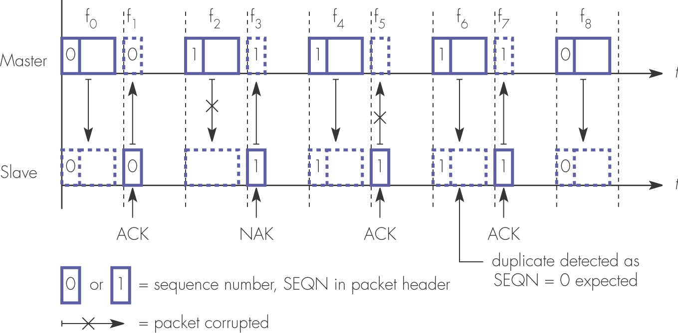
Figure 4.7 Example packet sequence with ARQ error control scheme

Slide 13
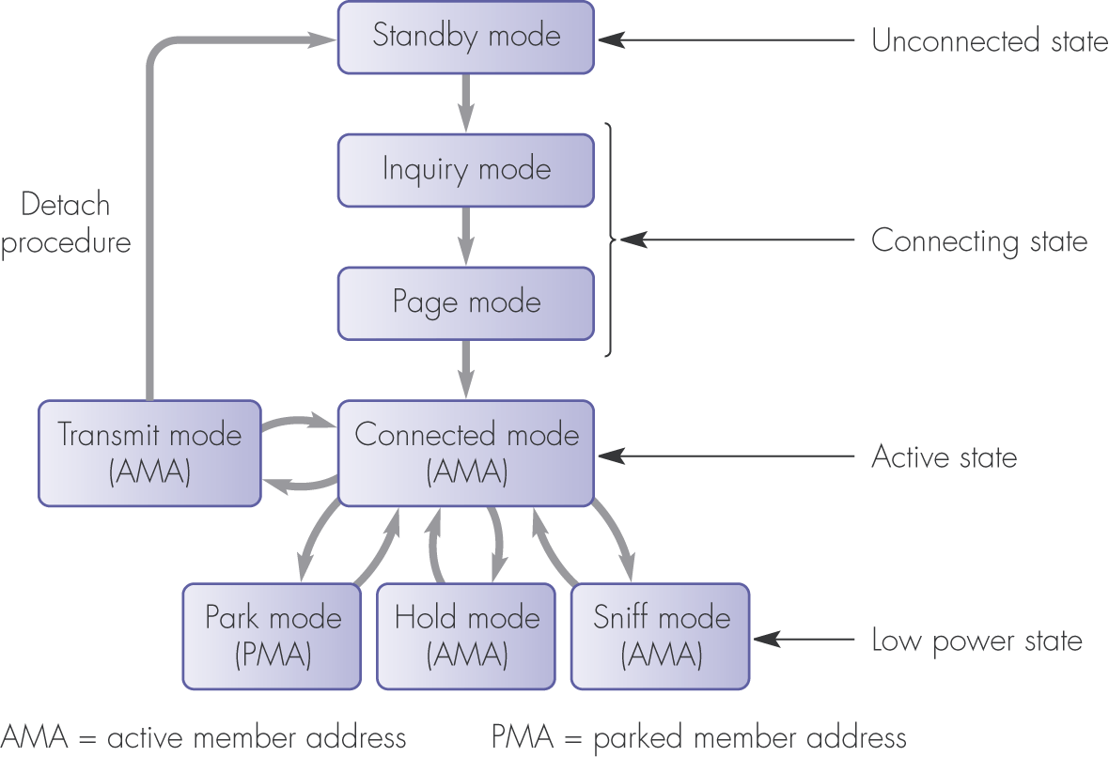
Figure 4.8 A simplified state transition diagram of a Bluetooth device

Slide 14
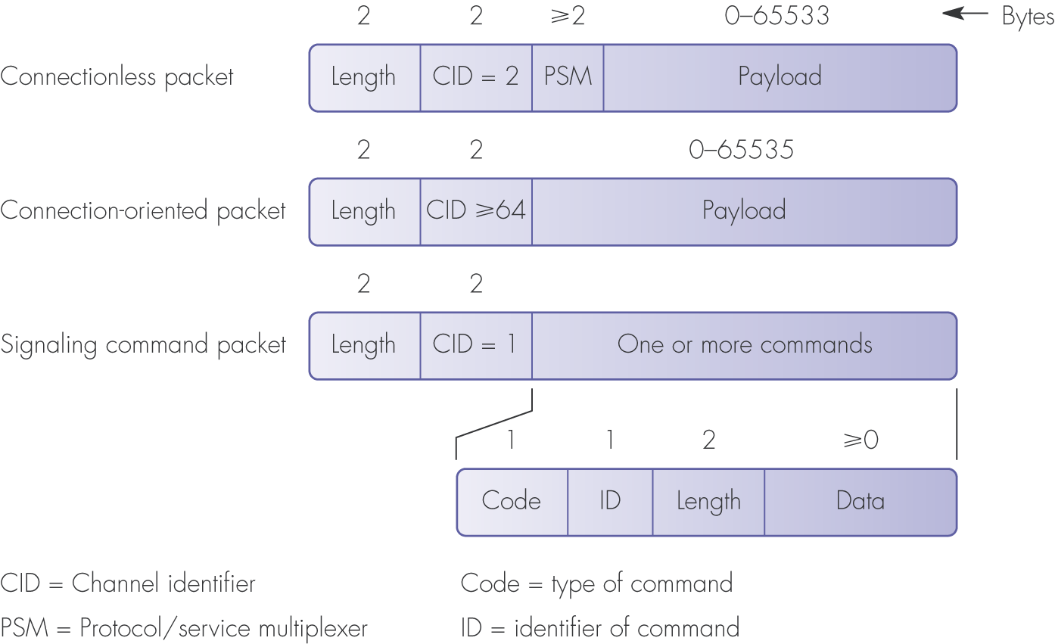
Figure 4.9 L2CAP packet types and their format

Slide 15
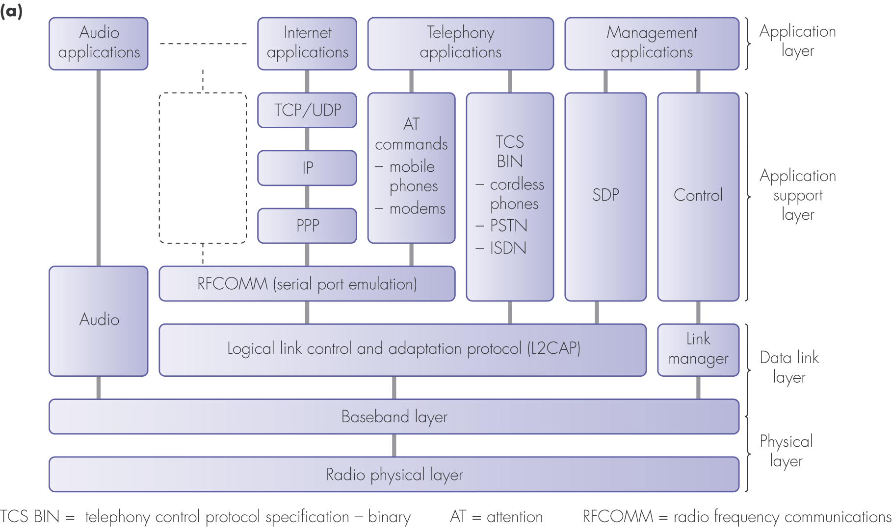
Figure 4.10 Bluetooth applications: (a) protocol stack

Slide 16
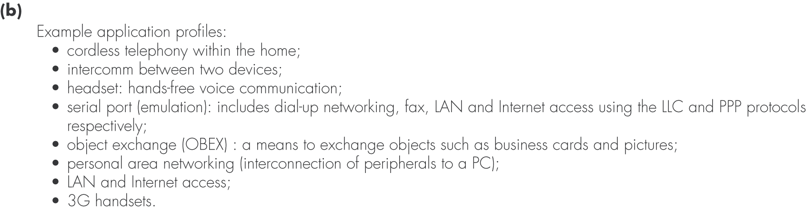
Figure 4.10 Bluetooth applications: (b) example profiles

Slide 17
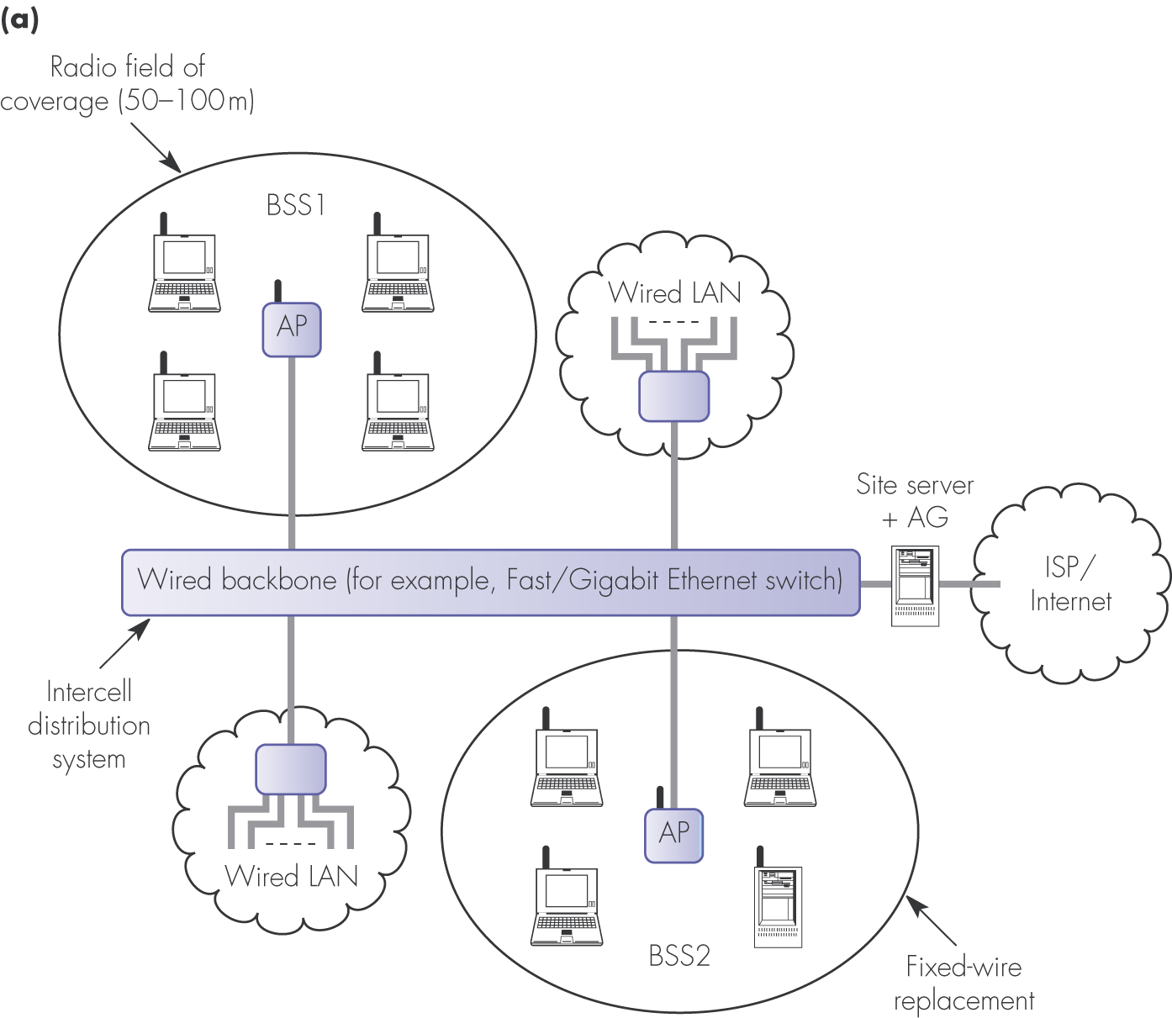
Figure 4.11 IEEE802.11 operational modes: (a) infrastructure

Slide 18
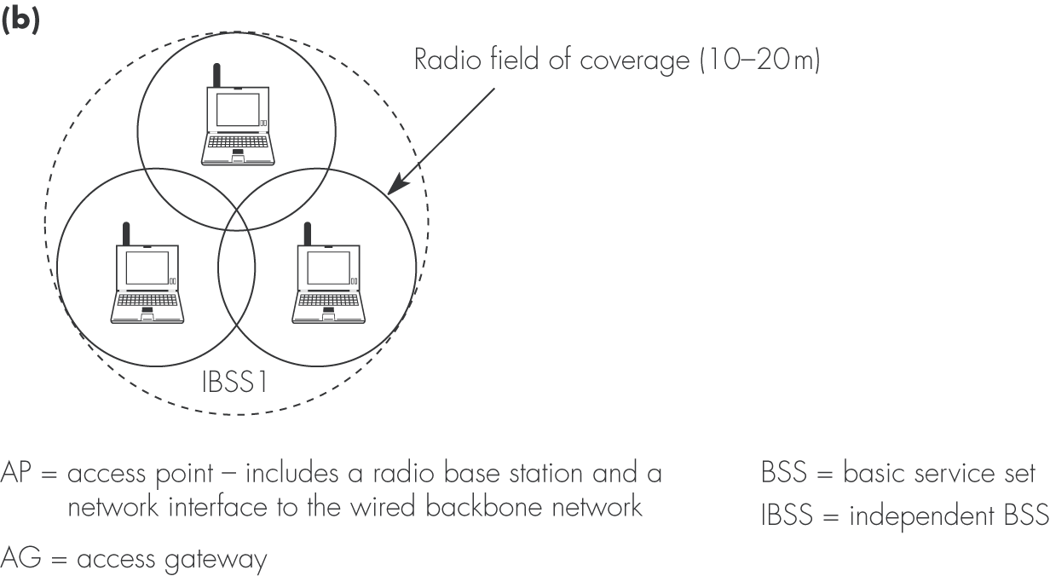
Figure 4.11 IEEE802.11 operational modes: (b) ad-hoc

Slide 19
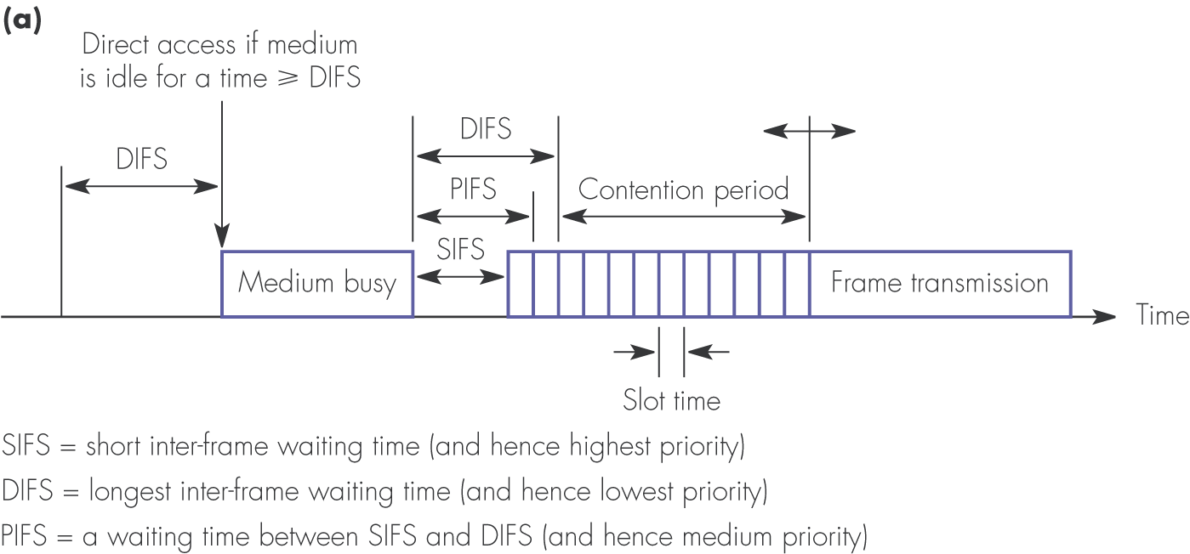
Figure 4.13 Operation of the basic DCF with CSMA/CA in the broadcast mode: (a) definition of the timing parameters

Slide 20
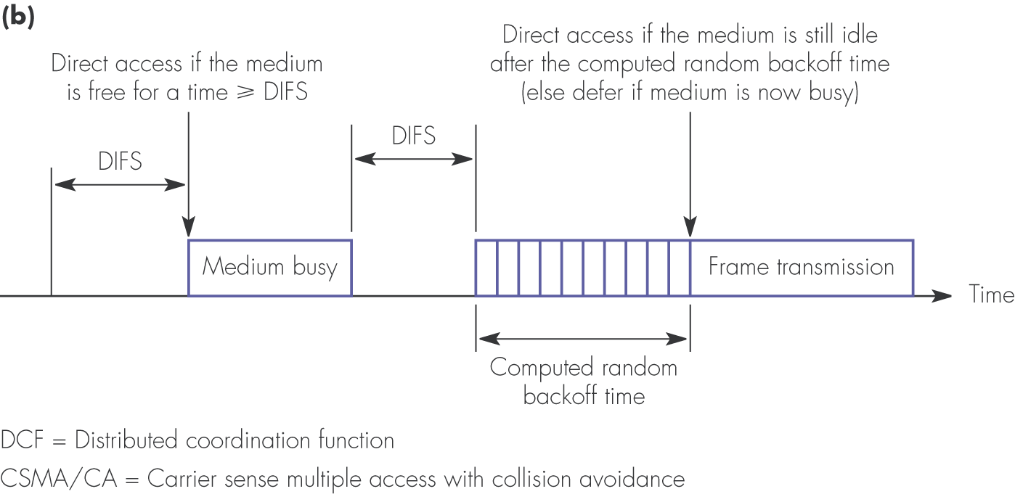
Figure 4.13 Operation of the basic DCF with CSMA/CA in the broadcast mode: (b) use of random backoff

Slide 21
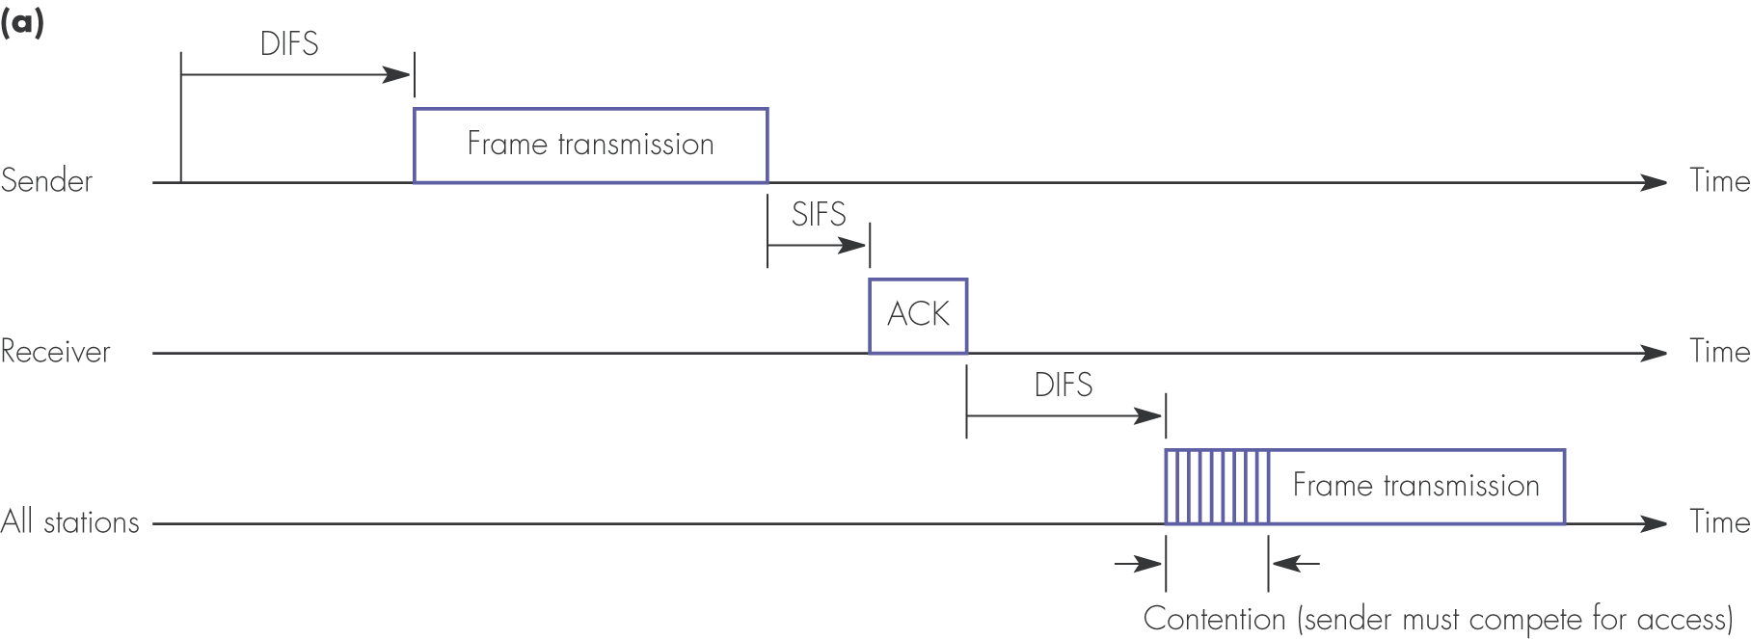
Figure 4.14 Operation of basic DCF with CSMA/CA in the unicast mode: (a) successful frame transmission

Slide 22
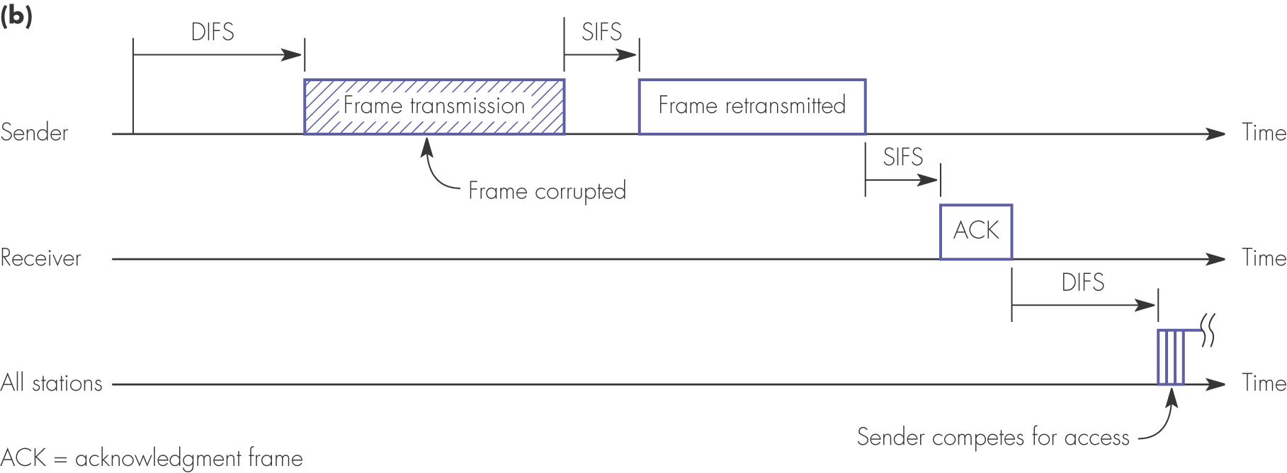
Figure 4.14 Operation of basic DCF with CSMA/CA in the unicast mode: (b) retransmission procedure

Slide 23
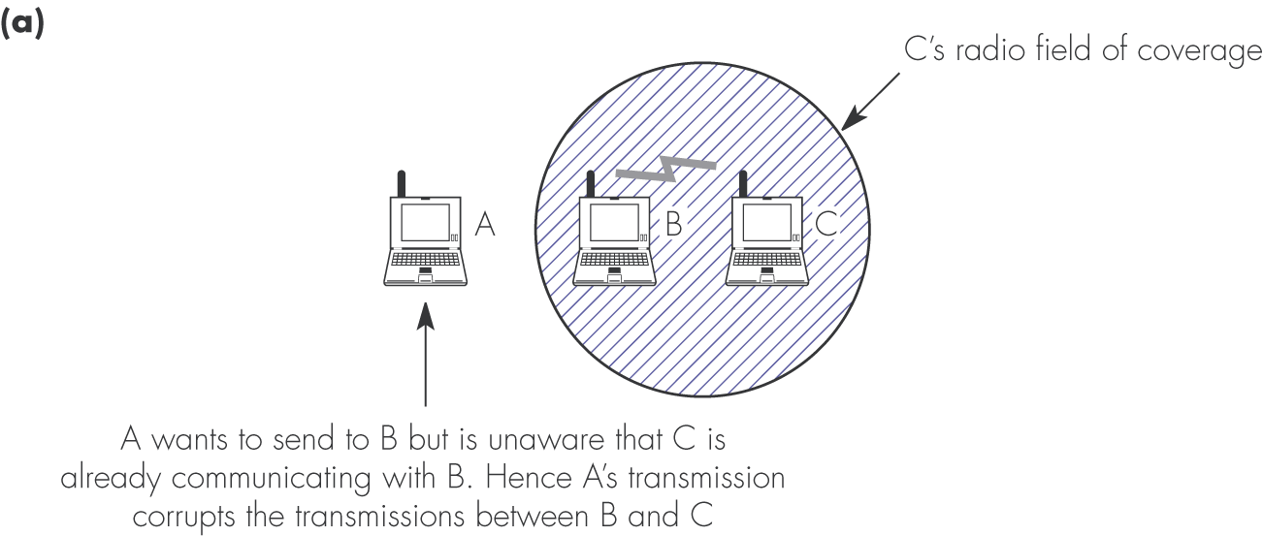
Figure 4.15 DCF with RTS/CTS extension: (a) hidden station problem

Slide 24
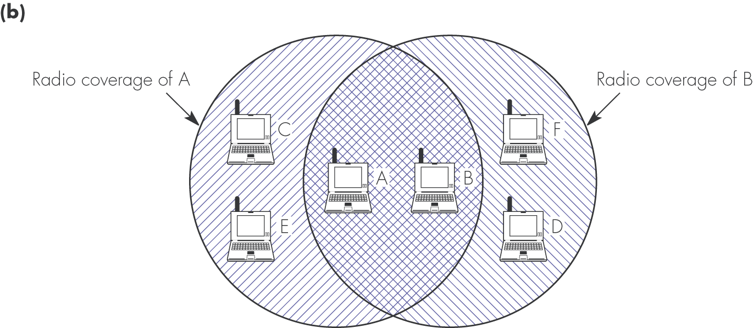
Figure 4.15 DCF with RTS/CTS extension: (b) example network configuration

Slide 25
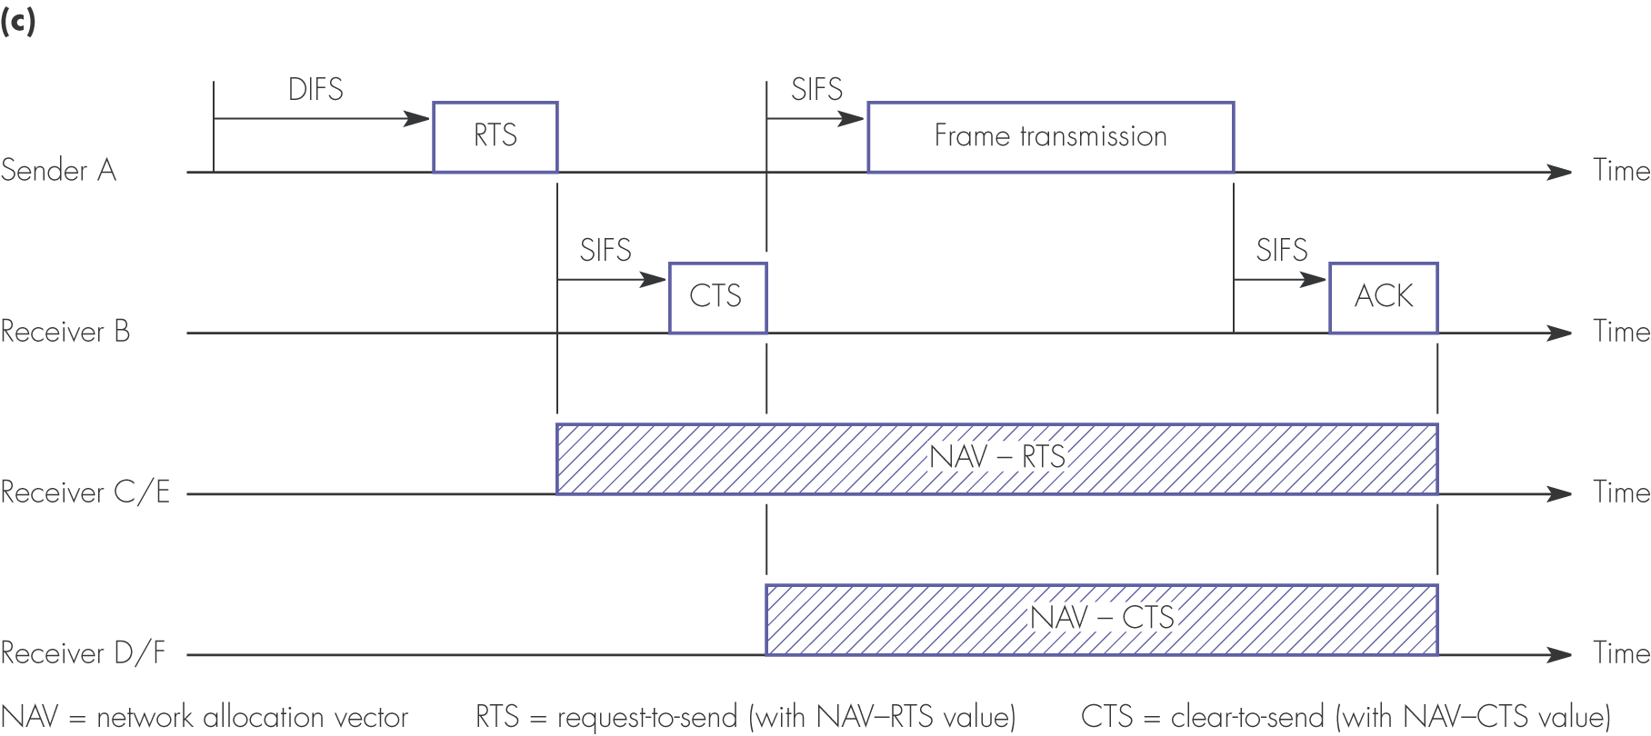
Figure 4.15 DCF with RTS/CTS extension: (c) associated timing diagram

Slide 26

Figure 4.16 DCF fragmentation example: (a) network configuration

Slide 27
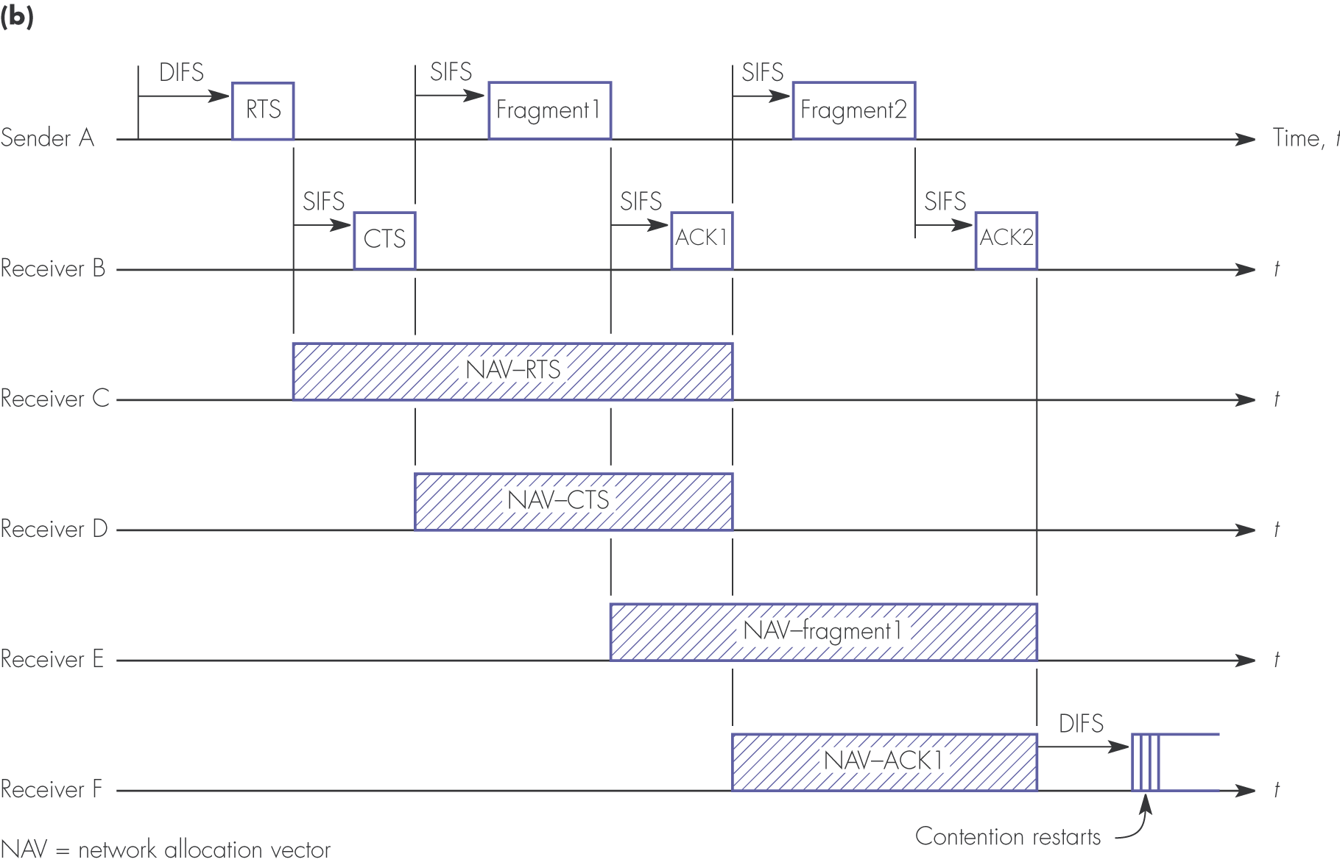
Figure 4.16 DCF fragmentation example: (b) associated timing diagram

Slide 28
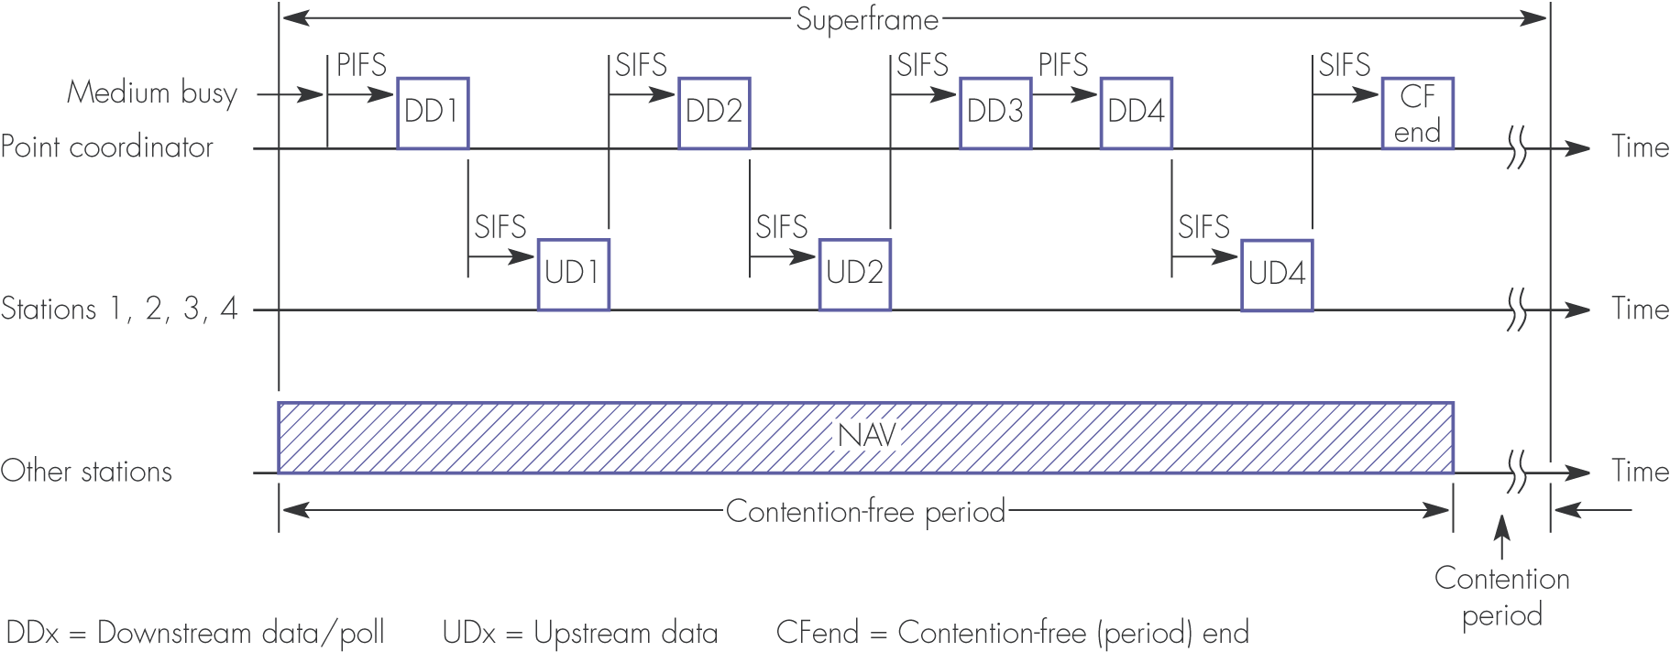
Figure 4.17 PCF with polling

Slide 29
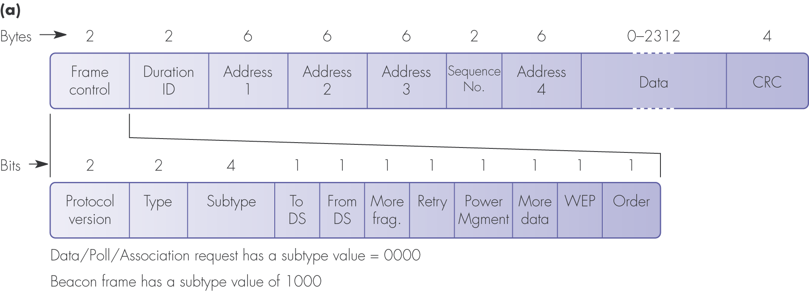
Figure 4.18 MAC frame formats: (a) data and management frames

Slide 30
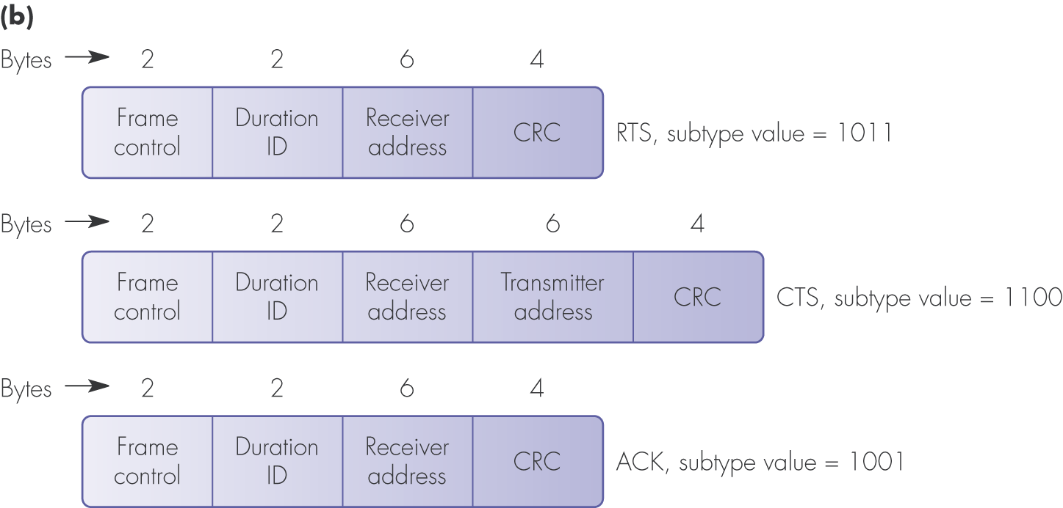
Figure 4.18 MAC frame formats: (b) control frames

Slide 31
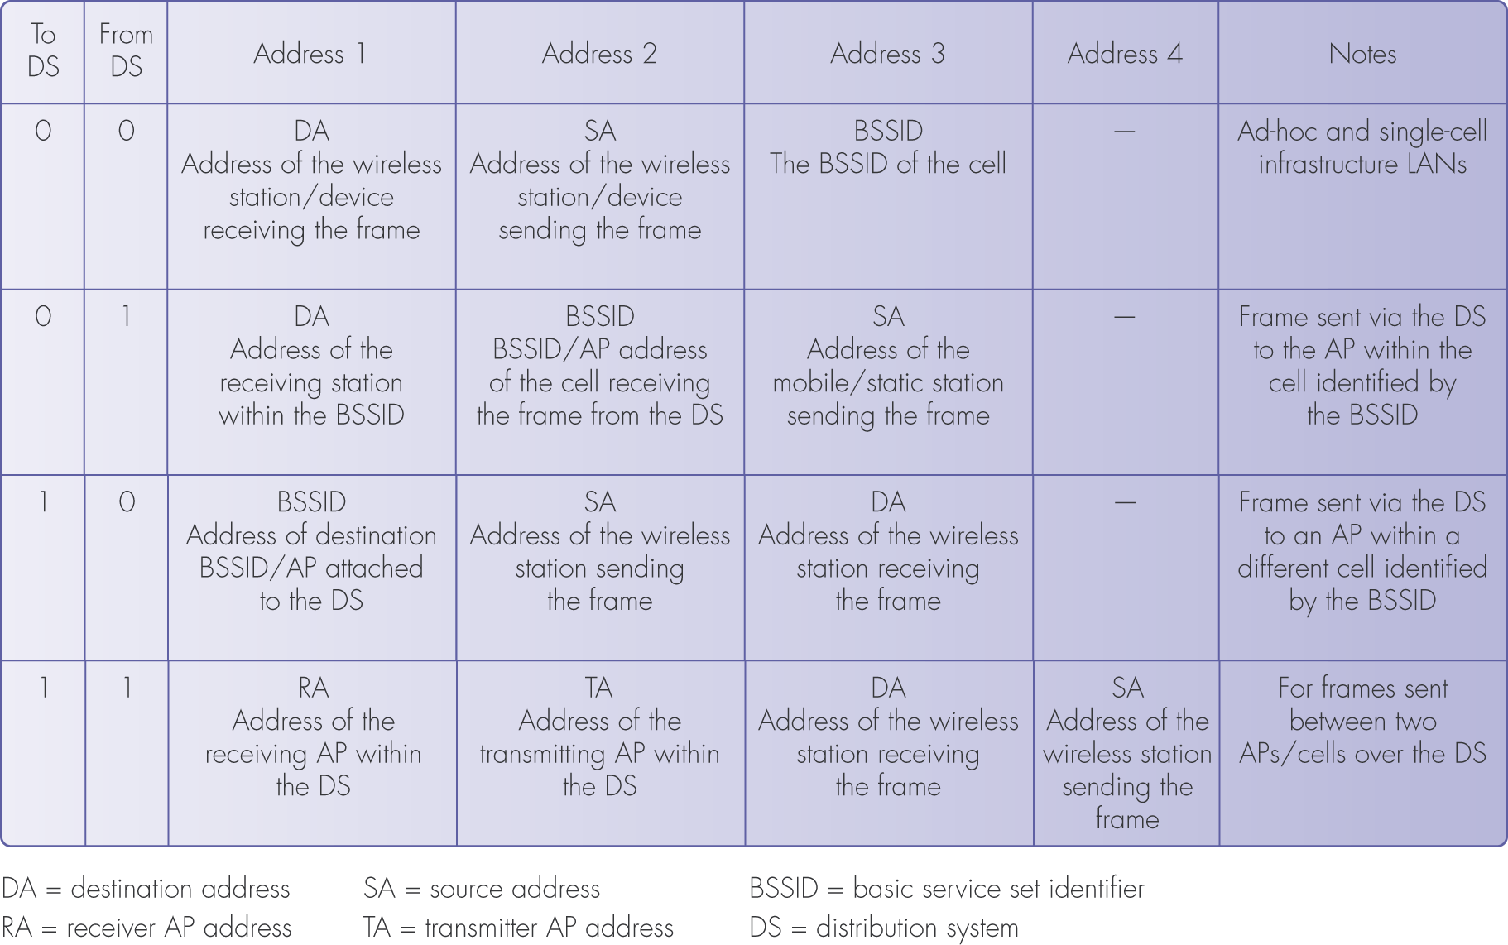
Figure 4.19 Address fields and their usage

