Slide 1
Buffers
Ed Angel
Professor of Computer Science, Electrical and Computer Engineering, and Media Arts
University of New Mexico

Slide 2
Objectives
Introduce additional OpenGL buffers
Learn to read and write buffers
Learn to use blending
Angel: Interactive Computer Graphics 5E © Addison-Wesley 2009

Slide 3
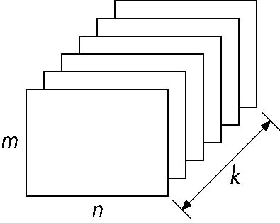
Buffer
Define a buffer by its spatial resolution (n x m) and its depth (or precision) k, the number of bits/pixel
pixel
Angel: Interactive Computer Graphics 5E © Addison-Wesley 2009

Slide 4
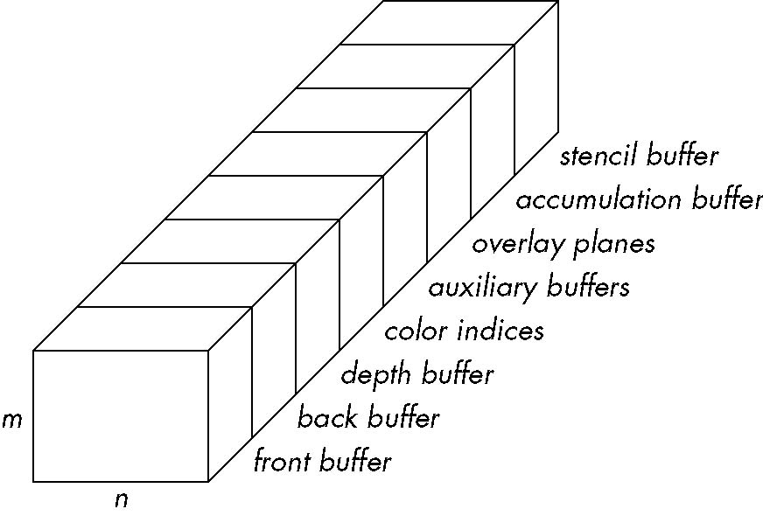
OpenGL Frame Buffer
Angel: Interactive Computer Graphics 5E © Addison-Wesley 2009

Slide 5
OpenGL Buffers
Color buffers can be displayed
  Front
  Back
  Auxiliary
  Overlay
Depth
Accumulation
  High resolution buffer
Stencil
  Holds masks
Angel: Interactive Computer Graphics 5E © Addison-Wesley 2009

Slide 6
Writing in Buffers
Conceptually, we can consider all of memory as a large two-dimensional array of pixels
We read and write rectangular block of pixels
  Bit block transfer (bitblt) operations
The frame buffer is part of this memory
memory
source
frame buffer
(destination)
writing into frame buffer
Angel: Interactive Computer Graphics 5E © Addison-Wesley 2009

Slide 7
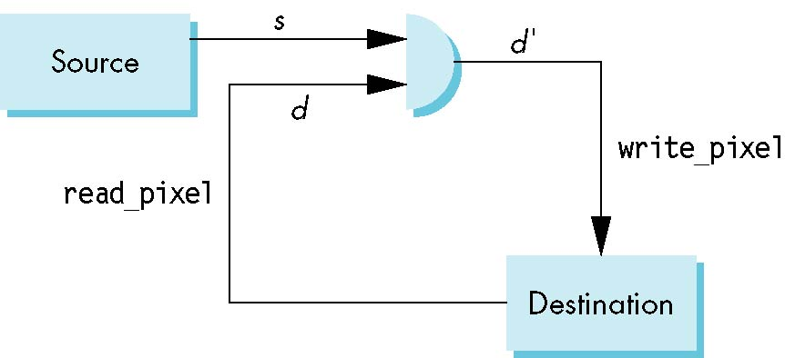
Writing Model
Read destination pixel before writing source
Angel: Interactive Computer Graphics 5E © Addison-Wesley 2009

Slide 8
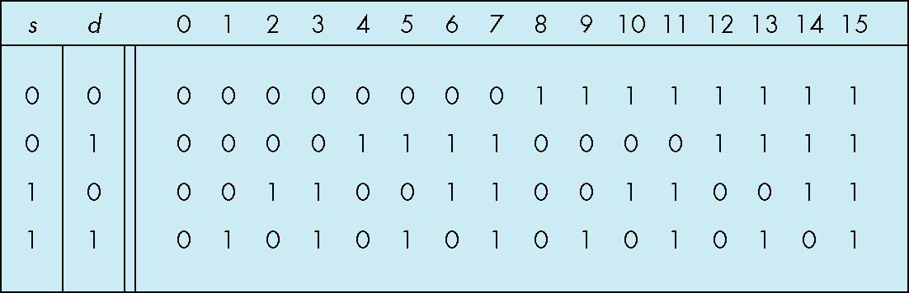
Bit Writing Modes
Source and destination bits are combined bitwise
16 possible functions (one per column in table)
replace
XOR
OR
Angel: Interactive Computer Graphics 5E © Addison-Wesley 2009

Slide 9
XOR mode
Recall from Chapter 3 that we can use XOR by enabling logic operations and selecting the XOR write mode
XOR is especially useful for swapping blocks of memory such as menus that are stored off screen
If S represents screen and M represents a menu
the sequence
S ← S ⊕ M
M ← S ⊕ M
S ← S ⊕ M
swaps the S and M
Angel: Interactive Computer Graphics 5E © Addison-Wesley 2009

Slide 10
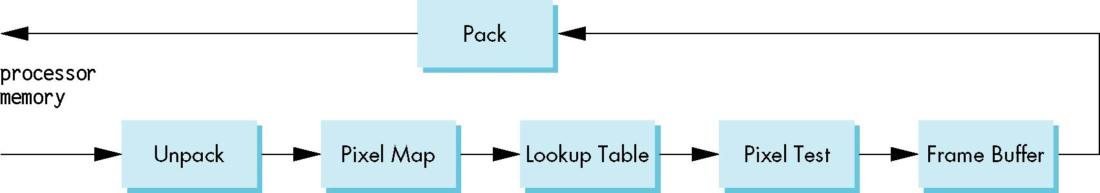
The Pixel Pipeline
OpenGL has a separate pipeline for pixels
  Writing pixels involves
    Moving pixels from processor memory to the frame buffer
    Format conversions
    Mapping, Lookups, Tests
  Reading pixels
    Format conversion
Angel: Interactive Computer Graphics 5E © Addison-Wesley 2009

Slide 11
Raster Position
OpenGL maintains a raster position as part of the state
Set by glRasterPos*()
  glRasterPos3f(x, y, z);
The raster position is a geometric entity
  Passes through geometric pipeline
  Eventually yields a 2D position in screen coordinates
  This position in the frame buffer is where the next raster primitive is drawn
Angel: Interactive Computer Graphics 5E © Addison-Wesley 2009

Slide 12
Buffer Selection
OpenGL can draw into or read from any of the color buffers (front, back, auxiliary)
Default to the back buffer
Change with glDrawBuffer and glReadBuffer
Note that format of the pixels in the frame buffer is different from that of processor memory and these two types of memory reside in different places
  Need packing and unpacking
  Drawing and reading can be slow
Angel: Interactive Computer Graphics 5E © Addison-Wesley 2009

Slide 13
Bitmaps
OpenGL treats 1-bit pixels (bitmaps) differently from multi-bit pixels (pixelmaps)
Bitmaps are masks that determine if the corresponding pixel in the frame buffer is drawn with the present raster color
  0 ⇒ color unchanged
  1 ⇒ color changed based on writing mode
Bitmaps are useful for raster text
  GLUT font: GLUT_BIT_MAP_8_BY_13
Angel: Interactive Computer Graphics 5E © Addison-Wesley 2009

Slide 14
Raster Color
Same as drawing color set by glColor*()
Fixed by last call to glRasterPos*()
Geometry drawn in blue
Ones in bitmap use a drawing color of red
glColor3f(1.0, 0.0, 0.0);
glRasterPos3f(x, y, z);
glColor3f(0.0, 0.0, 1.0);
glBitmap(…….
glBegin(GL_LINES);
glVertex3f(…..)
Angel: Interactive Computer Graphics 5E © Addison-Wesley 2009

Slide 15
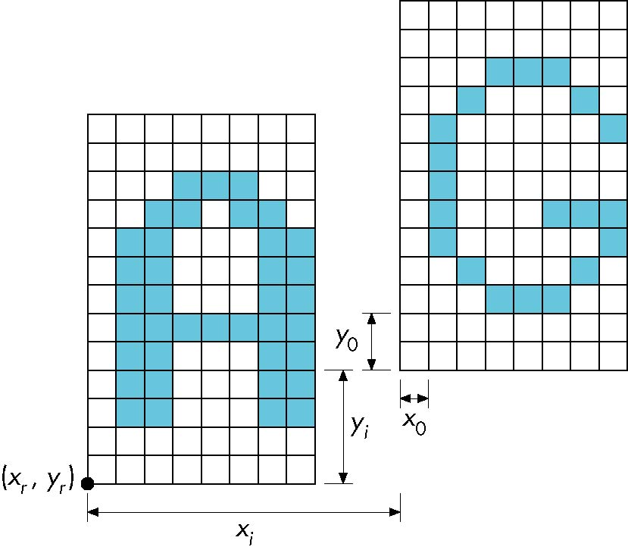
Drawing Bitmaps
glBitmap(width, height, x0, y0, xi, yi, bitmap)
offset from raster
position
increments in
raster
position after
bitmap drawn
first raster position
second raster position
Angel: Interactive Computer Graphics 5E © Addison-Wesley 2009

Slide 16

Example: Checker Board
GLubyte wb[2] = {0 x 00, 0 x ff};
GLubyte check[512];
int i, j;
for(i=0; i<64; i++) for (j=0; j<64, j++)
check[i*8+j] = wb[(i/8+j)%2];
glBitmap( 64, 64, 0.0, 0.0, 0.0, 0.0, check);
Angel: Interactive Computer Graphics 5E © Addison-Wesley 2009

Slide 17
Pixel Maps
OpenGL works with rectangular arrays of pixels called pixel maps or images
Pixels are in one byte ( 8 bit) chunks
  Luminance (gray scale) images 1 byte/pixel
  RGB 3 bytes/pixel
Three functions
  Draw pixels: processor memory to frame buffer
  Read pixels: frame buffer to processor memory
  Copy pixels: frame buffer to frame buffer
Angel: Interactive Computer Graphics 5E © Addison-Wesley 2009

Slide 18
OpenGL Pixel Functions
glReadPixels(x,y,width,height,format,type,myimage)
start pixel in frame buffer
size
type of pixels
type of image
pointer to processor
memory
GLubyte myimage[512][512][3];
glReadPixels(0,0, 512, 512, GL_RGB,
GL_UNSIGNED_BYTE, myimage);
glDrawPixels(width,height,format,type,myimage)
starts at raster position
Angel: Interactive Computer Graphics 5E © Addison-Wesley 2009

Slide 19
Image Formats
We often work with images in a standard format (JPEG, TIFF, GIF)
How do we read/write such images with OpenGL?
No support in OpenGL
  OpenGL knows nothing of image formats
  Some code available on Web
  Can write readers/writers for some simple formats in OpenGL
Angel: Interactive Computer Graphics 5E © Addison-Wesley 2009

Slide 20
Displaying a PPM Image
PPM is a very simple format
Each image file consists of a header followed by all the pixel data
Header
P3
# comment 1
# comment 2
.
#comment n
rows columns maxvalue
pixels
Angel: Interactive Computer Graphics 5E © Addison-Wesley 2009

Slide 21
Reading the Header
FILE *fd;
int k, nm;
char c;
int i;
char b[100];
float s;
int red, green, blue;
printf("enter file name\n");
scanf("%s", b);
fd = fopen(b, "r");
fscanf(fd,"%[^\n] ",b);
if(b[0]!='P'|| b[1] != '3'){
printf("%s is not a PPM file!\n", b);
exit(0);
}
printf("%s is a PPM file\n",b);
check for “P3”
in first line
Angel: Interactive Computer Graphics 5E © Addison-Wesley 2009

Slide 22
Reading the Header (cont)
fscanf(fd, "%c",&c);
while(c == '#')
{
fscanf(fd, "%[^\n] ", b);
printf("%s\n",b);
fscanf(fd, "%c",&c);
}
ungetc(c,fd);
skip over comments by
looking for # in first column
Angel: Interactive Computer Graphics 5E © Addison-Wesley 2009

Slide 23
Reading the Data
fscanf(fd, "%d %d %d", &n, &m, &k);
printf("%d rows %d columns max value= %d\n",n,m,k);
nm = n*m;
image=malloc(3*sizeof(GLuint)*nm);
s=255./k;
for(i=0;i<nm;i++)
{
fscanf(fd,"%d %d %d",&red, &green, &blue );
image[3*nm-3*i-3]=red;
image[3*nm-3*i-2]=green;
image[3*nm-3*i-1]=blue;
}
scale factor
Angel: Interactive Computer Graphics 5E © Addison-Wesley 2009

Slide 24
Scaling the Image Data
We can scale the image in the pipeline
glPixelTransferf(GL_RED_SCALE, s);
glPixelTransferf(GL_GREEN_SCALE, s);
glPixelTransferf(GL_BLUE_SCALE, s);
We may have to swap bytes when we go from processor memory to the frame buffer depending on the processor. If so, we can use
glPixelStorei(GL_UNPACK_SWAP_BYTES,GL_TRUE);
Angel: Interactive Computer Graphics 5E © Addison-Wesley 2009

Slide 25
The display callback
void display()
{
glClear(GL_COLOR_BUFFER_BIT);
glRasterPos2i(0,0);
glDrawPixels(n,m,GL_RGB,
GL_UNSIGNED_INT, image);
glFlush();
}
Angel: Interactive Computer Graphics 5E © Addison-Wesley 2009

