Slide 1
HEIGHT DATA ANALYSIS

Slide 2
HEIGHT DATA ANALYSIS
This analysis is done on a dataset of 163 families, collected by the students of K.R. MANGALAM UNIVERSITY who are currently taking the course: Using Data in Everyday Life & Careers
GitHub repository for this analysis: https://github.com/zeborg/Comparison-of-Heights-Between-Family-Members

Slide 3
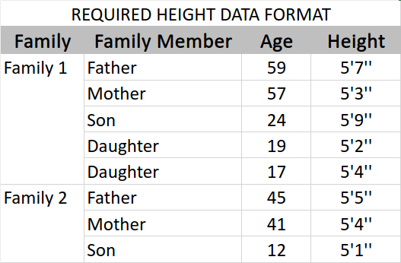
FORMAT OF COLLECTED DATA

Slide 4
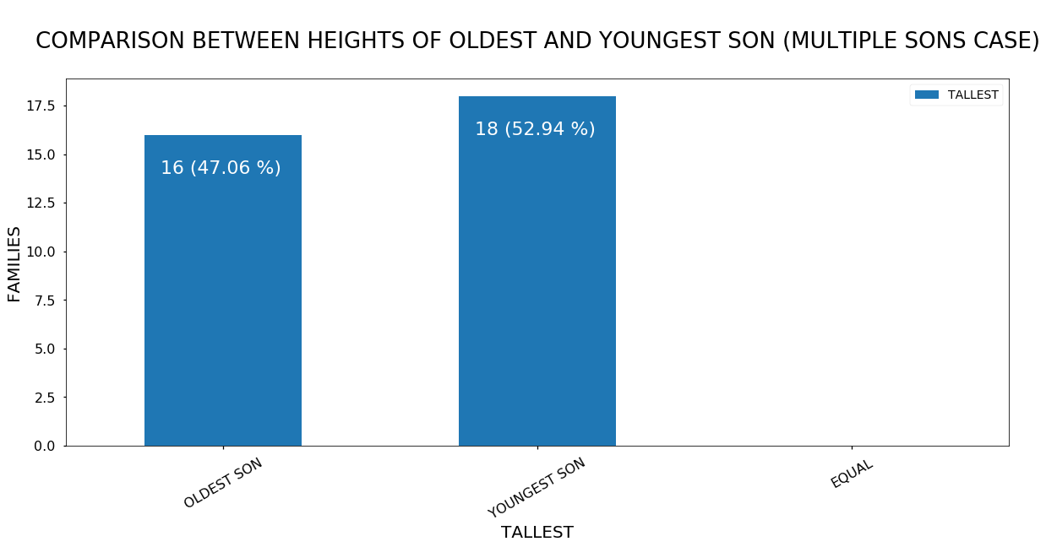

Slide 5
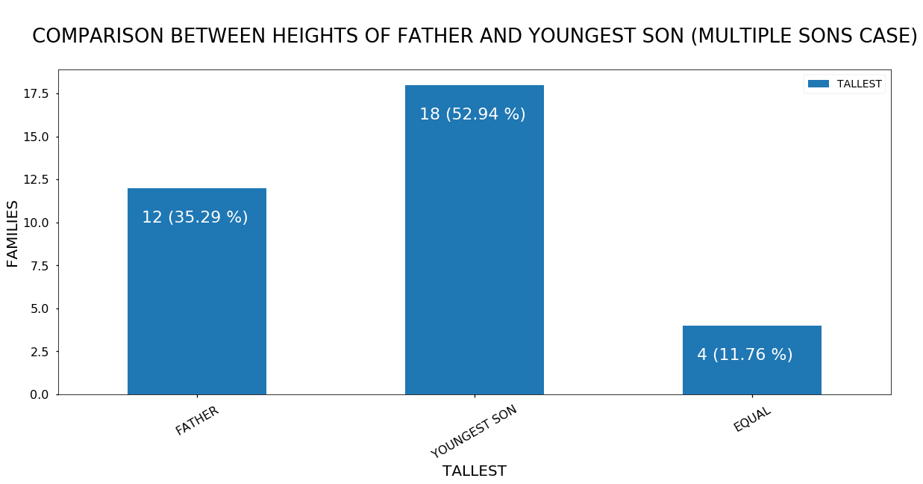

Slide 6
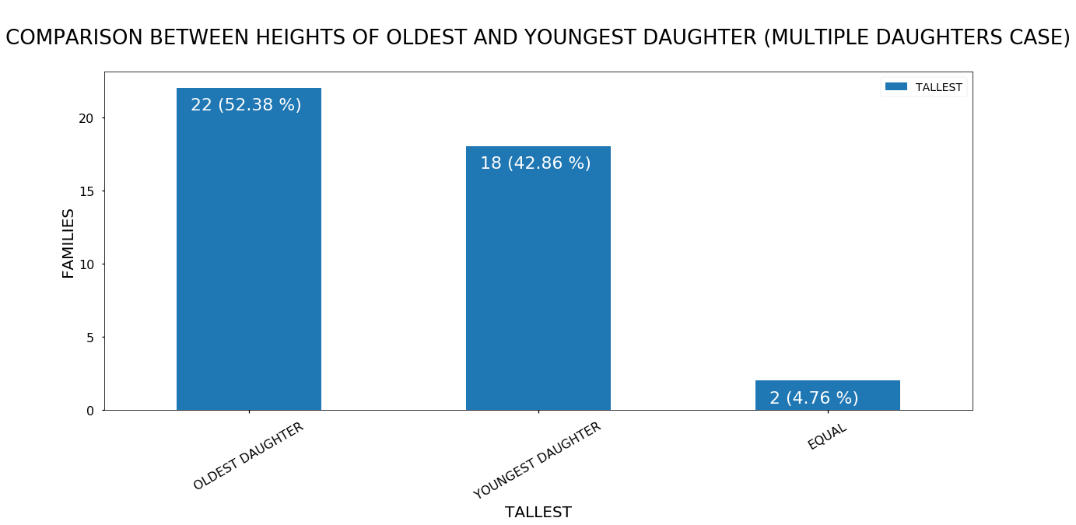

Slide 7
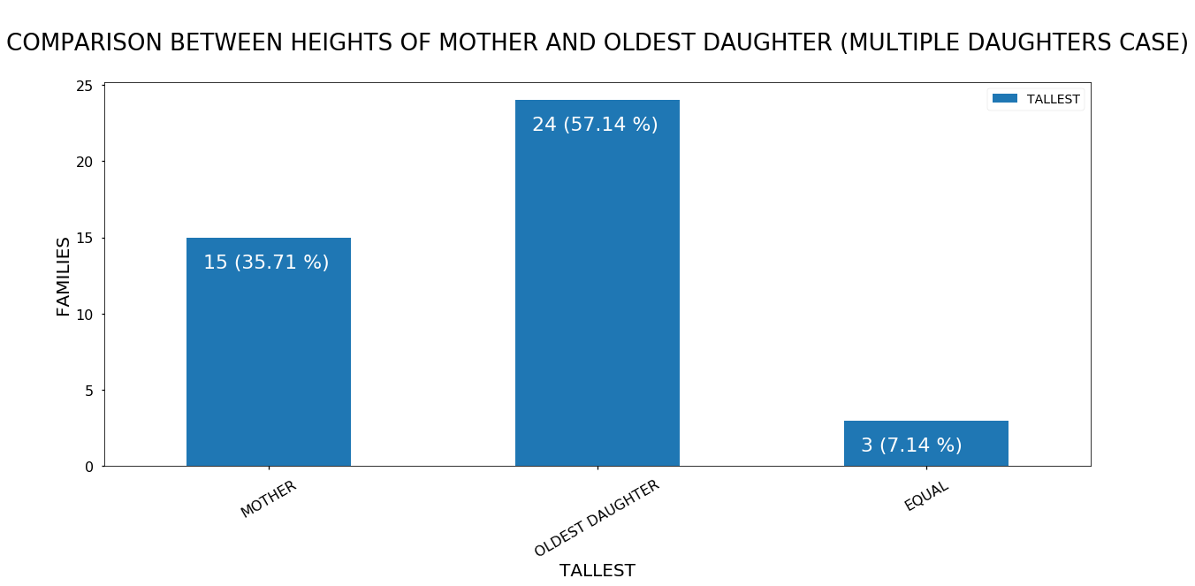

Slide 8
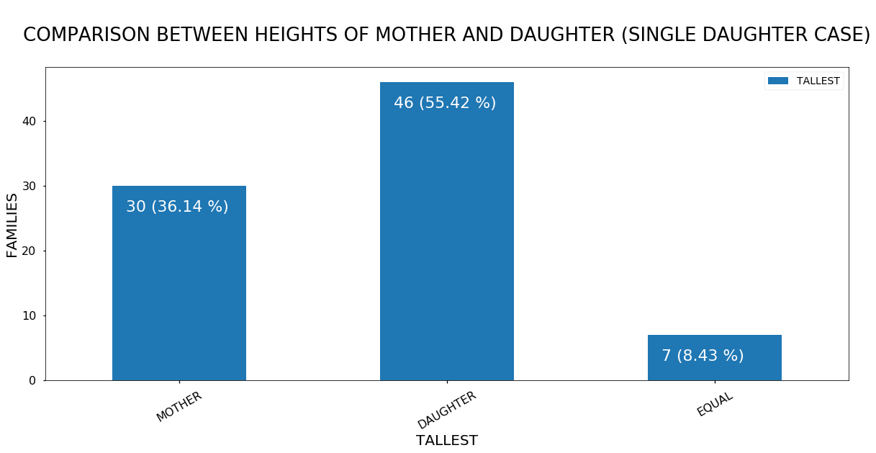

Slide 9
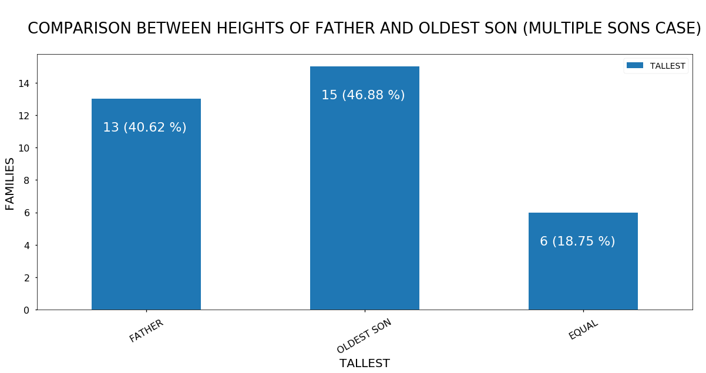

Slide 10
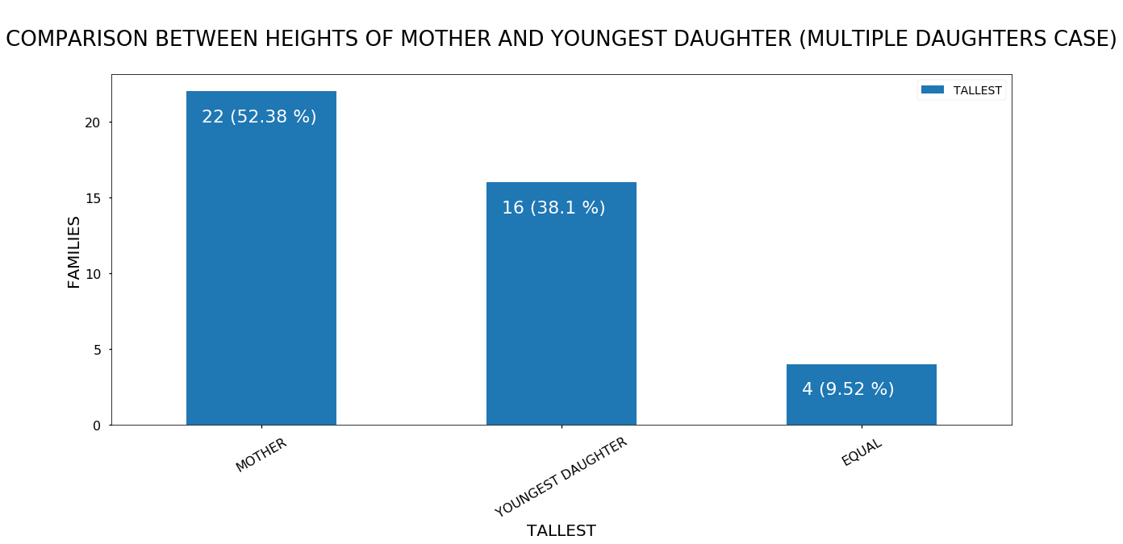

Slide 11
