Slide 1
Development guidelines applicable for TC501/701 TC201 ET401

Slide 2
Connection Modes
Two connection modes are supported.
RFID_ONLY mode
In RFID only mode cellular stack will not be available until RFID only mode is disconnected
Will not be able to receive any data/cellular call
RFID+WAN mode
In this mode data can co-exist with RFID operation.
User can receive cellular call. During cellular call RFID operation will not be available
Default connection API will initiate RFID_ONLY mode
Additional connect API provided to initiate connection in RFID+ WAN mode
void connect(ENUM_CONNECTION_MODE mode)

Slide 3
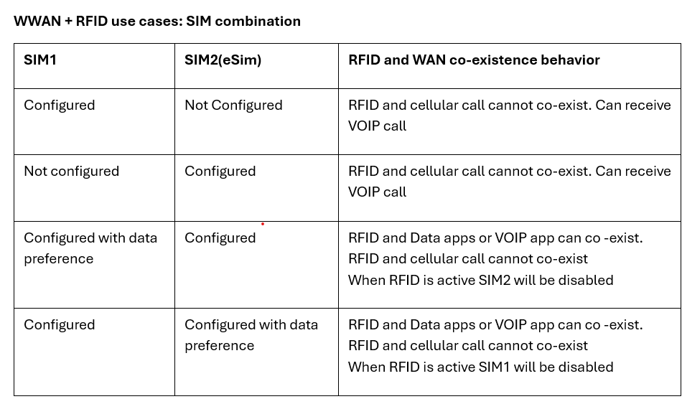

Slide 4
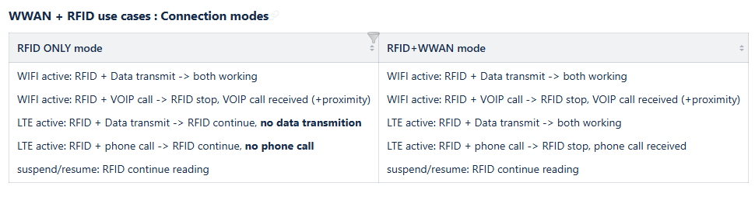
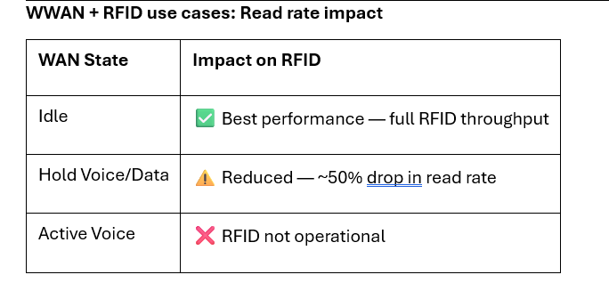

Slide 5
Conditions when RFID connections will fail
USB cable plugged
Low battery below 10%
Airplane mode
Will automatically disconnect if idle for more than 9 mins
Will automatically disconnect when user receives VOIP call and near body

Slide 6
Multi client support
Does not support multi client.
If second client attempts to connect while first client is connected. Client connection will fail
It’s the same reason you cannot have both Data wedge and 123RFID app connected at the same time

Slide 7
Features not Supported
AB flip configuration is not supported
No Firmware update
Periodic start/stop trigger not supported
CSP support is limited to factory reset and region configuration
Can get operation failure exceptions if we try to configure new regions that is supported from older 2.0.5.275 SDK
Data wedge by default always connects in RFID+WAN mode

Slide 8
Recommended settings by use cases
• inventory operations in small tags population
[ session: S0 or S1, link: PR-ASK M4 40KHz or PR-ASK M2 80KHz, Tx power 25 dBm]
• inventory operations in large tags population
[ session: S2, S3, link: PR-ASK M1 160KHz or PR-ASK M2 80KHz, Tx power 25 dBm]
• read/write operations on specific tags
[ session: S0, link: PR-ASK M4 40KHz or PR-ASK M4 40KHz, reduce Tx power]

