Slide 1
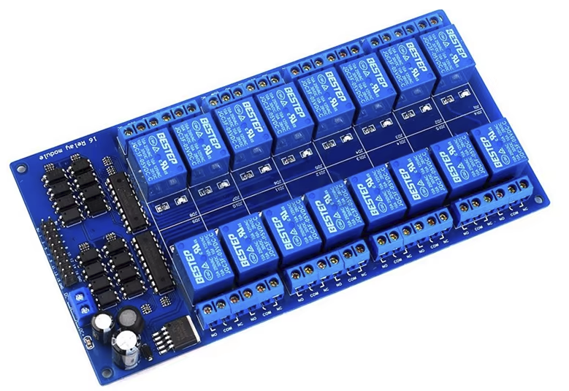
16 channel relay shield module
DC : 5V
Opto-coupler controler : LM2596S
Darlington 8channels-array : ULN2803APG
Relay : max AC250V, 10A or DC30V 10A

Slide 2
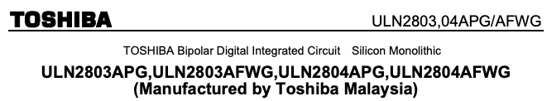
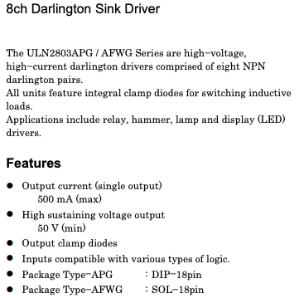
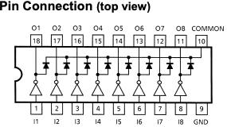


Slide 3
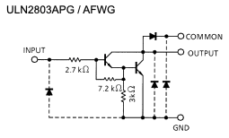
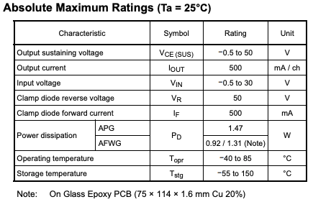
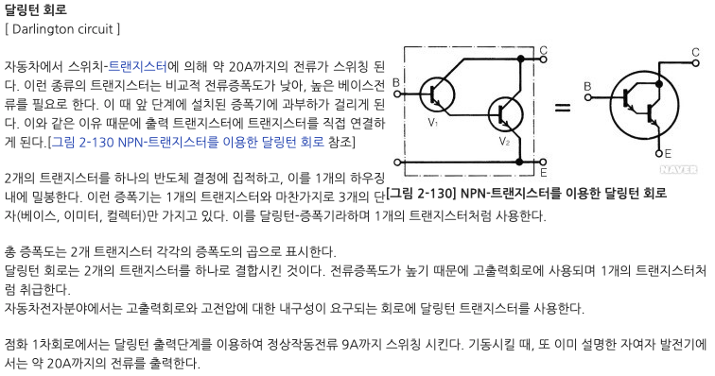
2003은 1채널, 2803은 8채널
2803은 sink output
2981은 source output
낮은 베이스 전류로 높은 출력 전류, 느린 속도

Slide 4

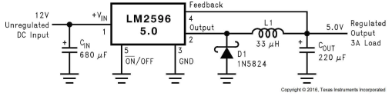

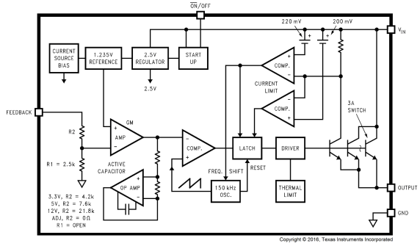

Slide 5
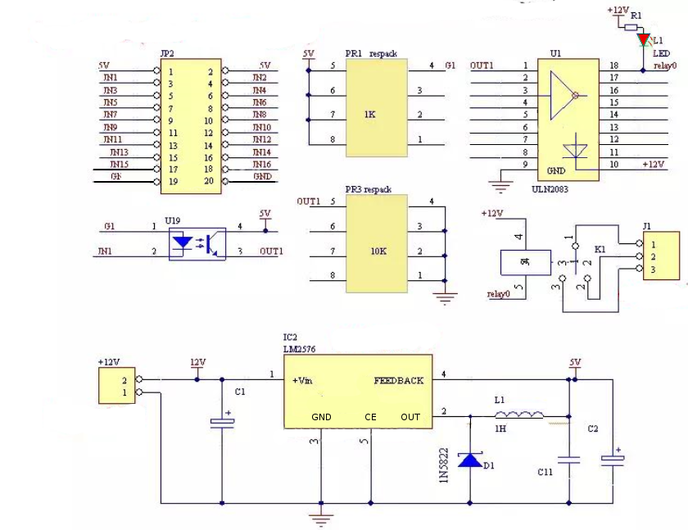

Slide 6
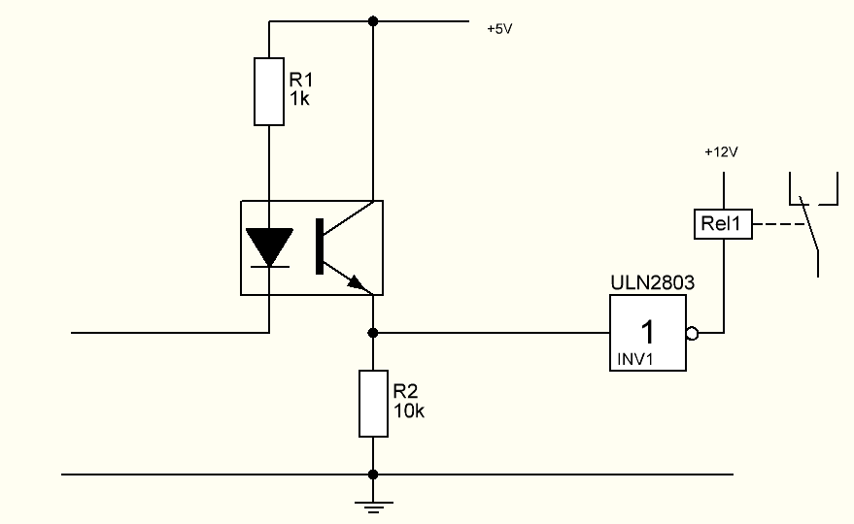
Control hierarchy : Opto-coupler → ULN2803 → relay modules
LOW to activate the relay.
Opto-coupler inverts the single.

Slide 7
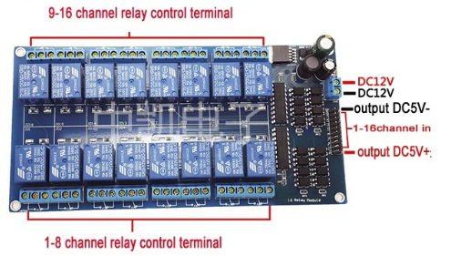

Slide 8
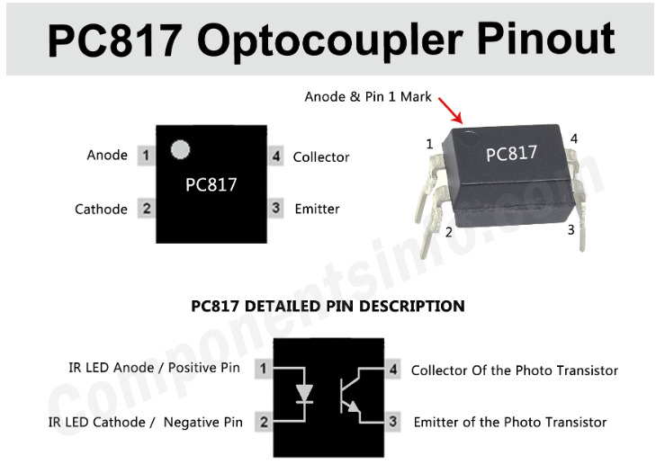

Slide 9
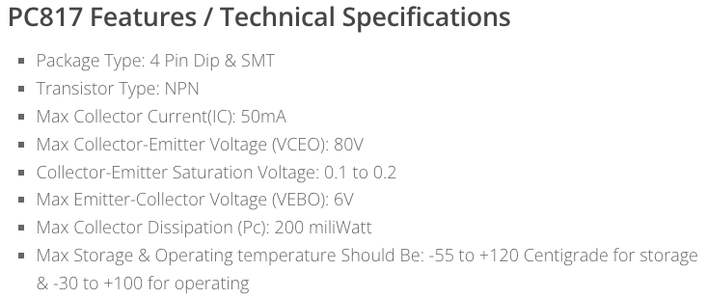

Slide 10
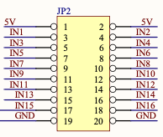
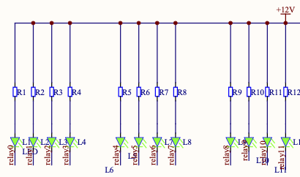
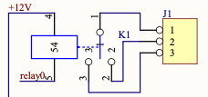
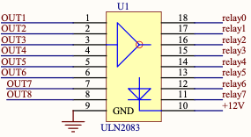
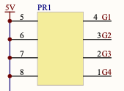
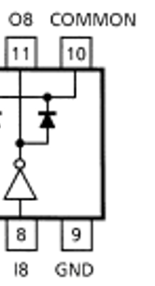

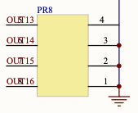
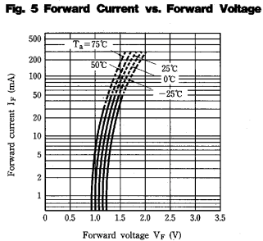
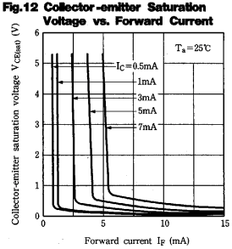
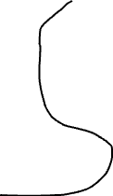

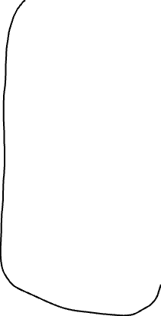
2.4KR
1kR array
From USB 5V
(max 50mA)
From USB 5V through the resistor array
GPIO input
5kR array
VCE max 80V
Vf 1.2V : enough 5mA

Slide 11
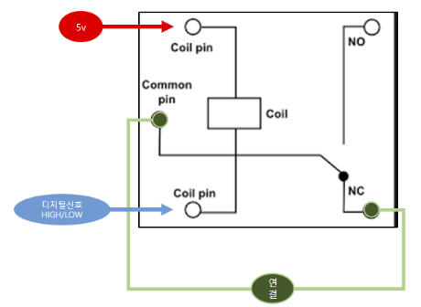
TTL GPIO = High
→ Opto-coupler LED ON
5V flows to output side
Turn on the darlington circuit
Output side is connected to GND
Turn the LED
Relay GND pin is connected to Emitter GND on darlington circuit

Slide 12
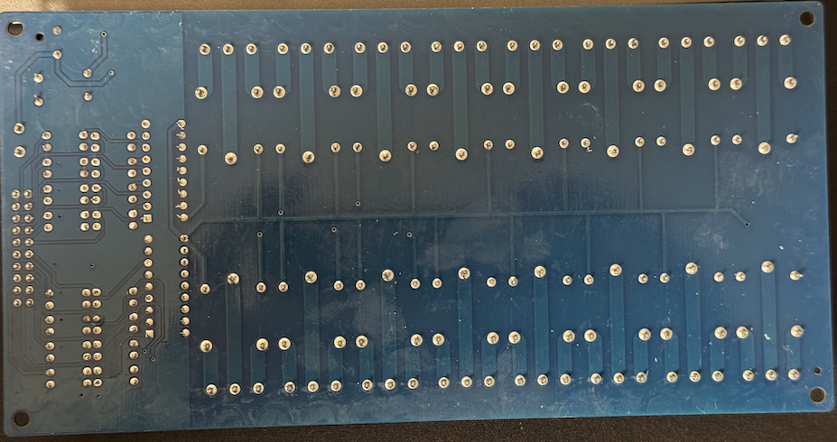
BOTTOM VIEW
DC +12V
N-O
Common
CH9
CH9
CH1
LED_C
CH8
Common
Common
CH1
N-O
N-O

