Slide 1

Storify
Presented to CodeJam 2019
By Christian Pickett, Philip Tam, Zedian Xiao, Danny Xie

Slide 2
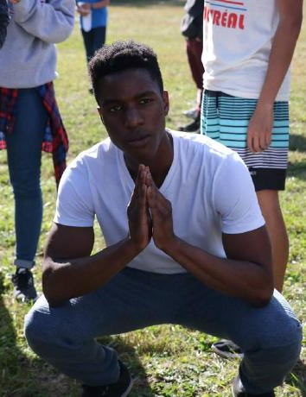
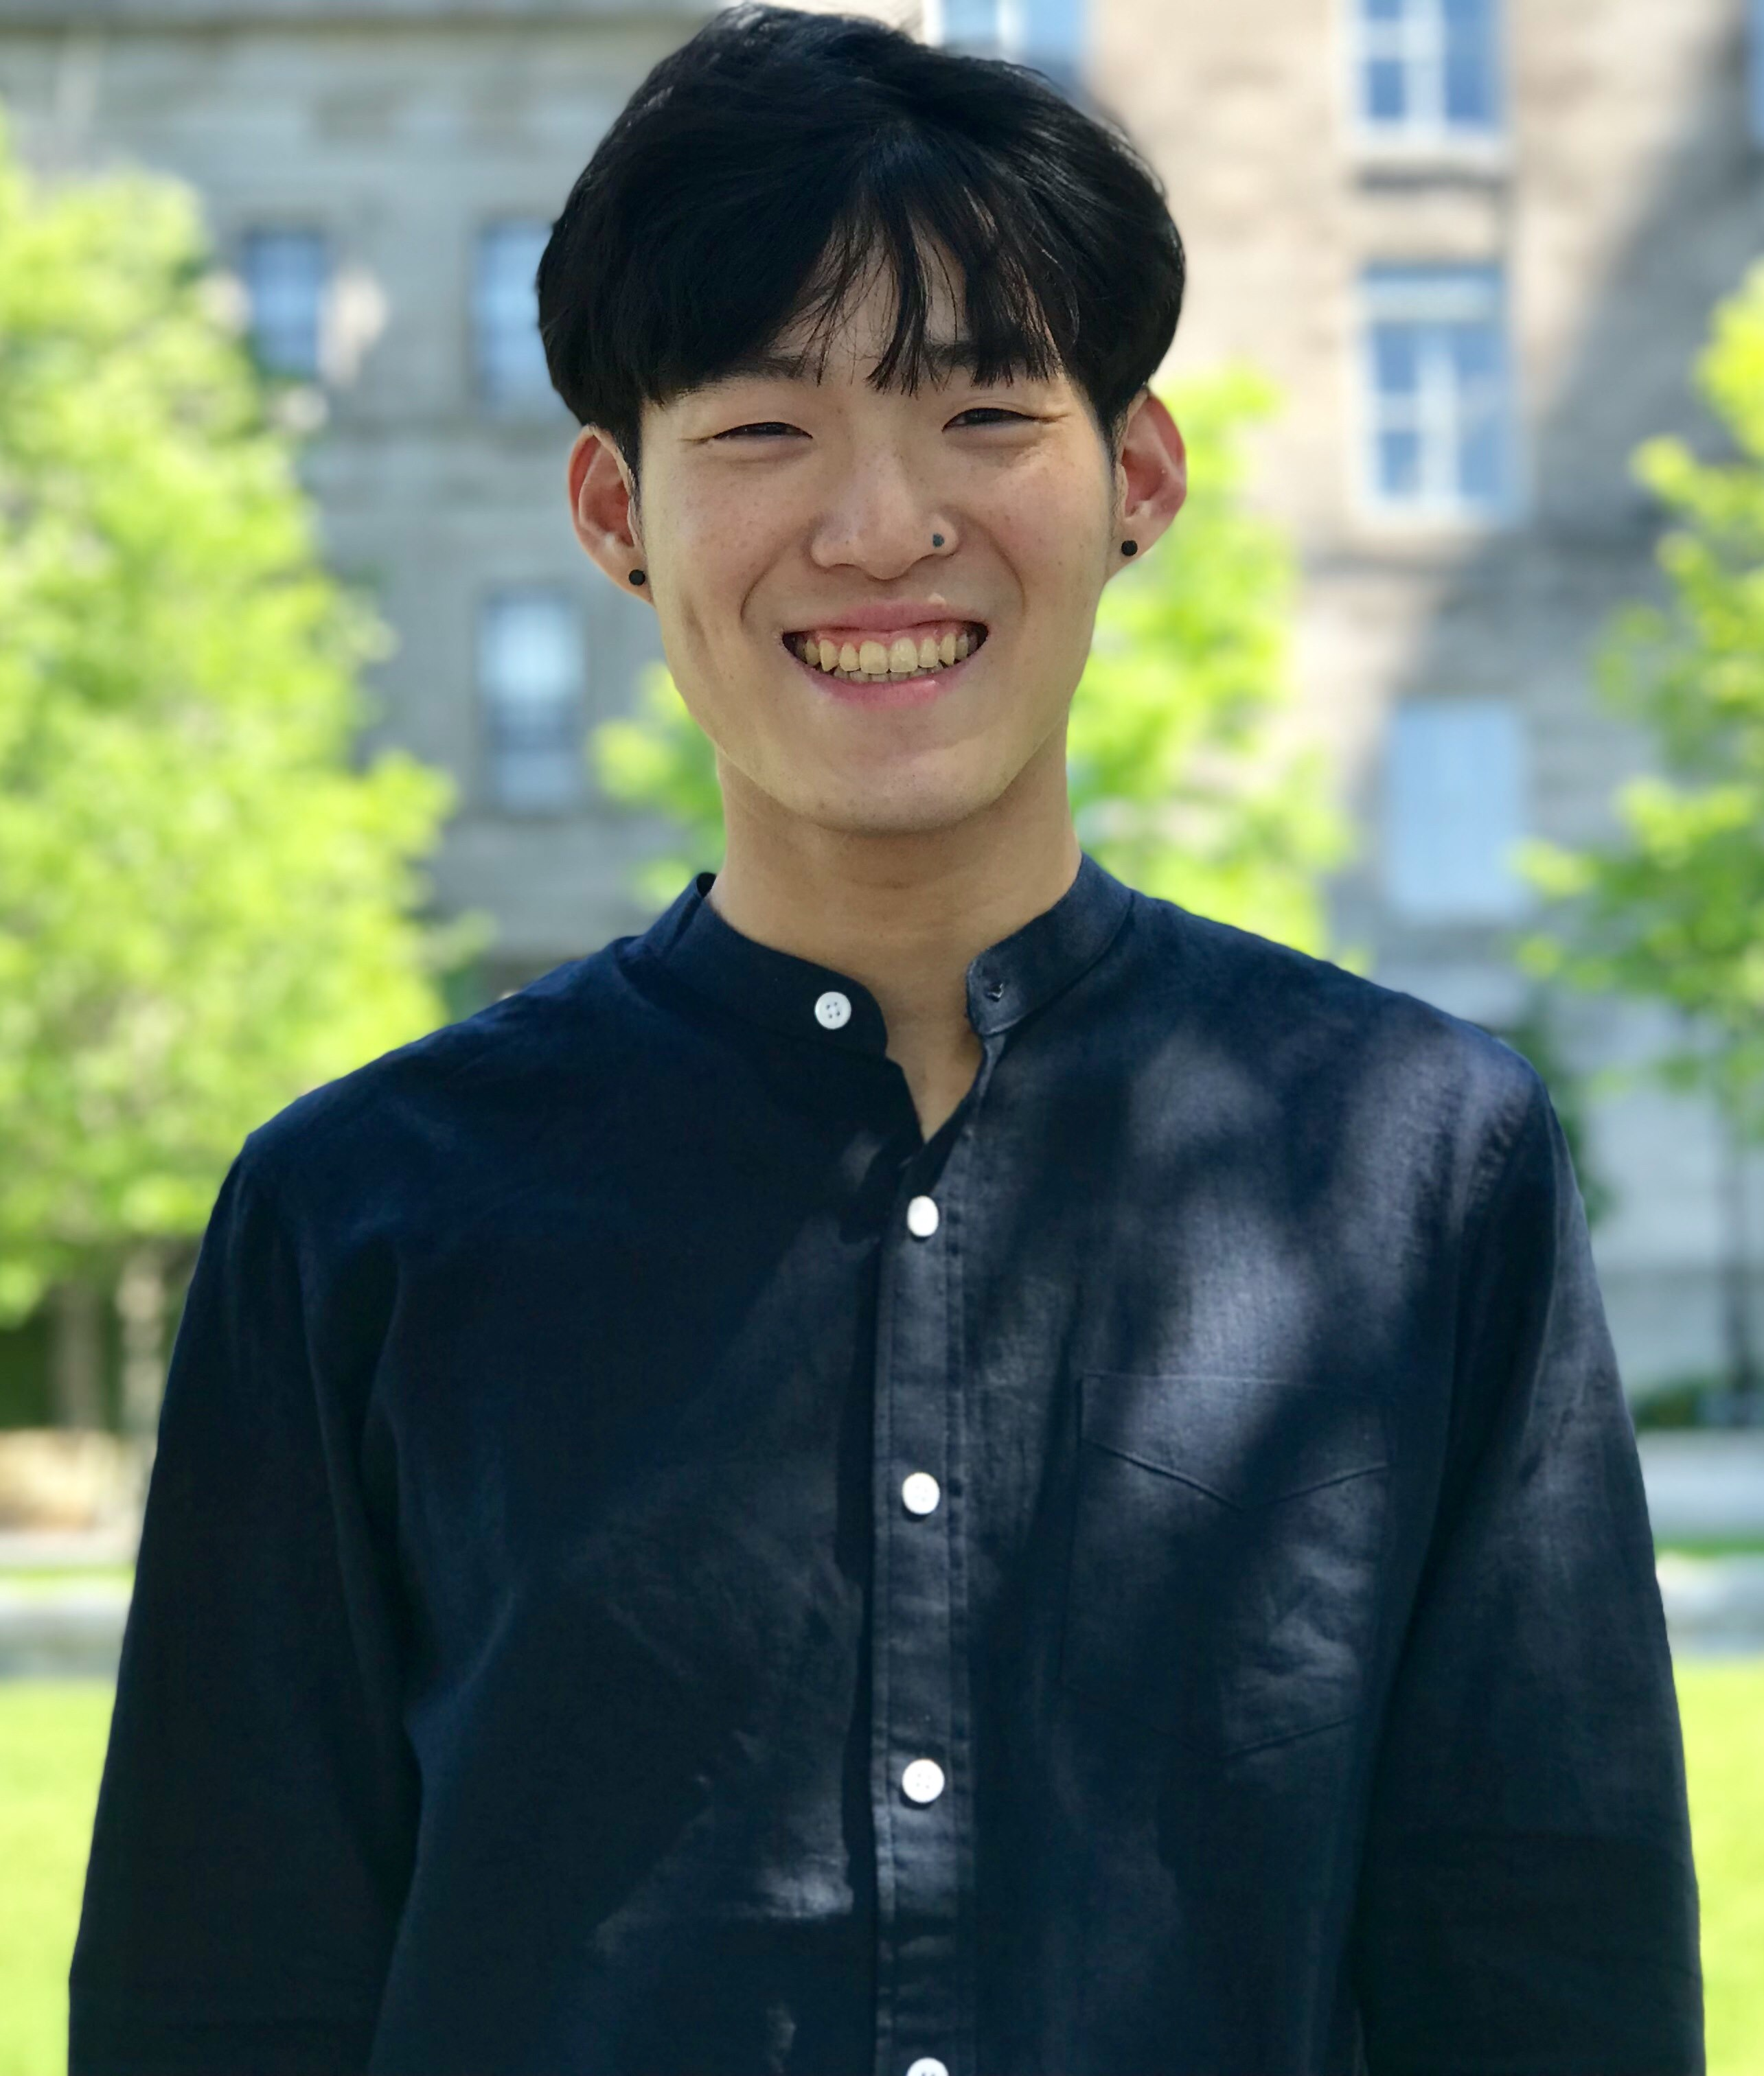

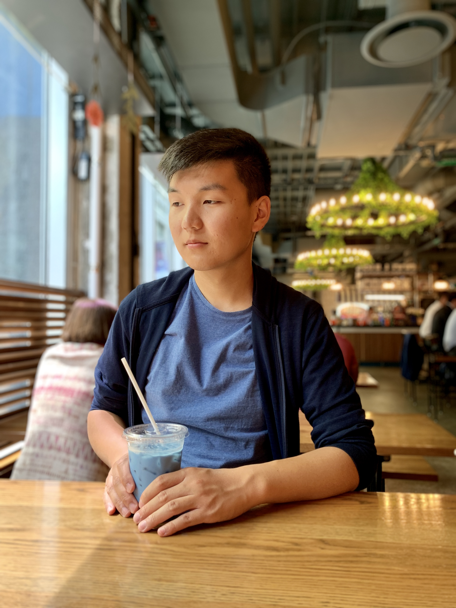
Meet the Team
Christian Pickett
U2 CS - McGill
Philip Tam
U2 CS - McGill
Zedian Xiao
U2 Math - McGill
Danny Xie
U2 CS - McGill

Slide 3
Origin
We know that:
Producing quality content is challenging
Inspiration can be challenging to find
What if an app could help this process?

Slide 4
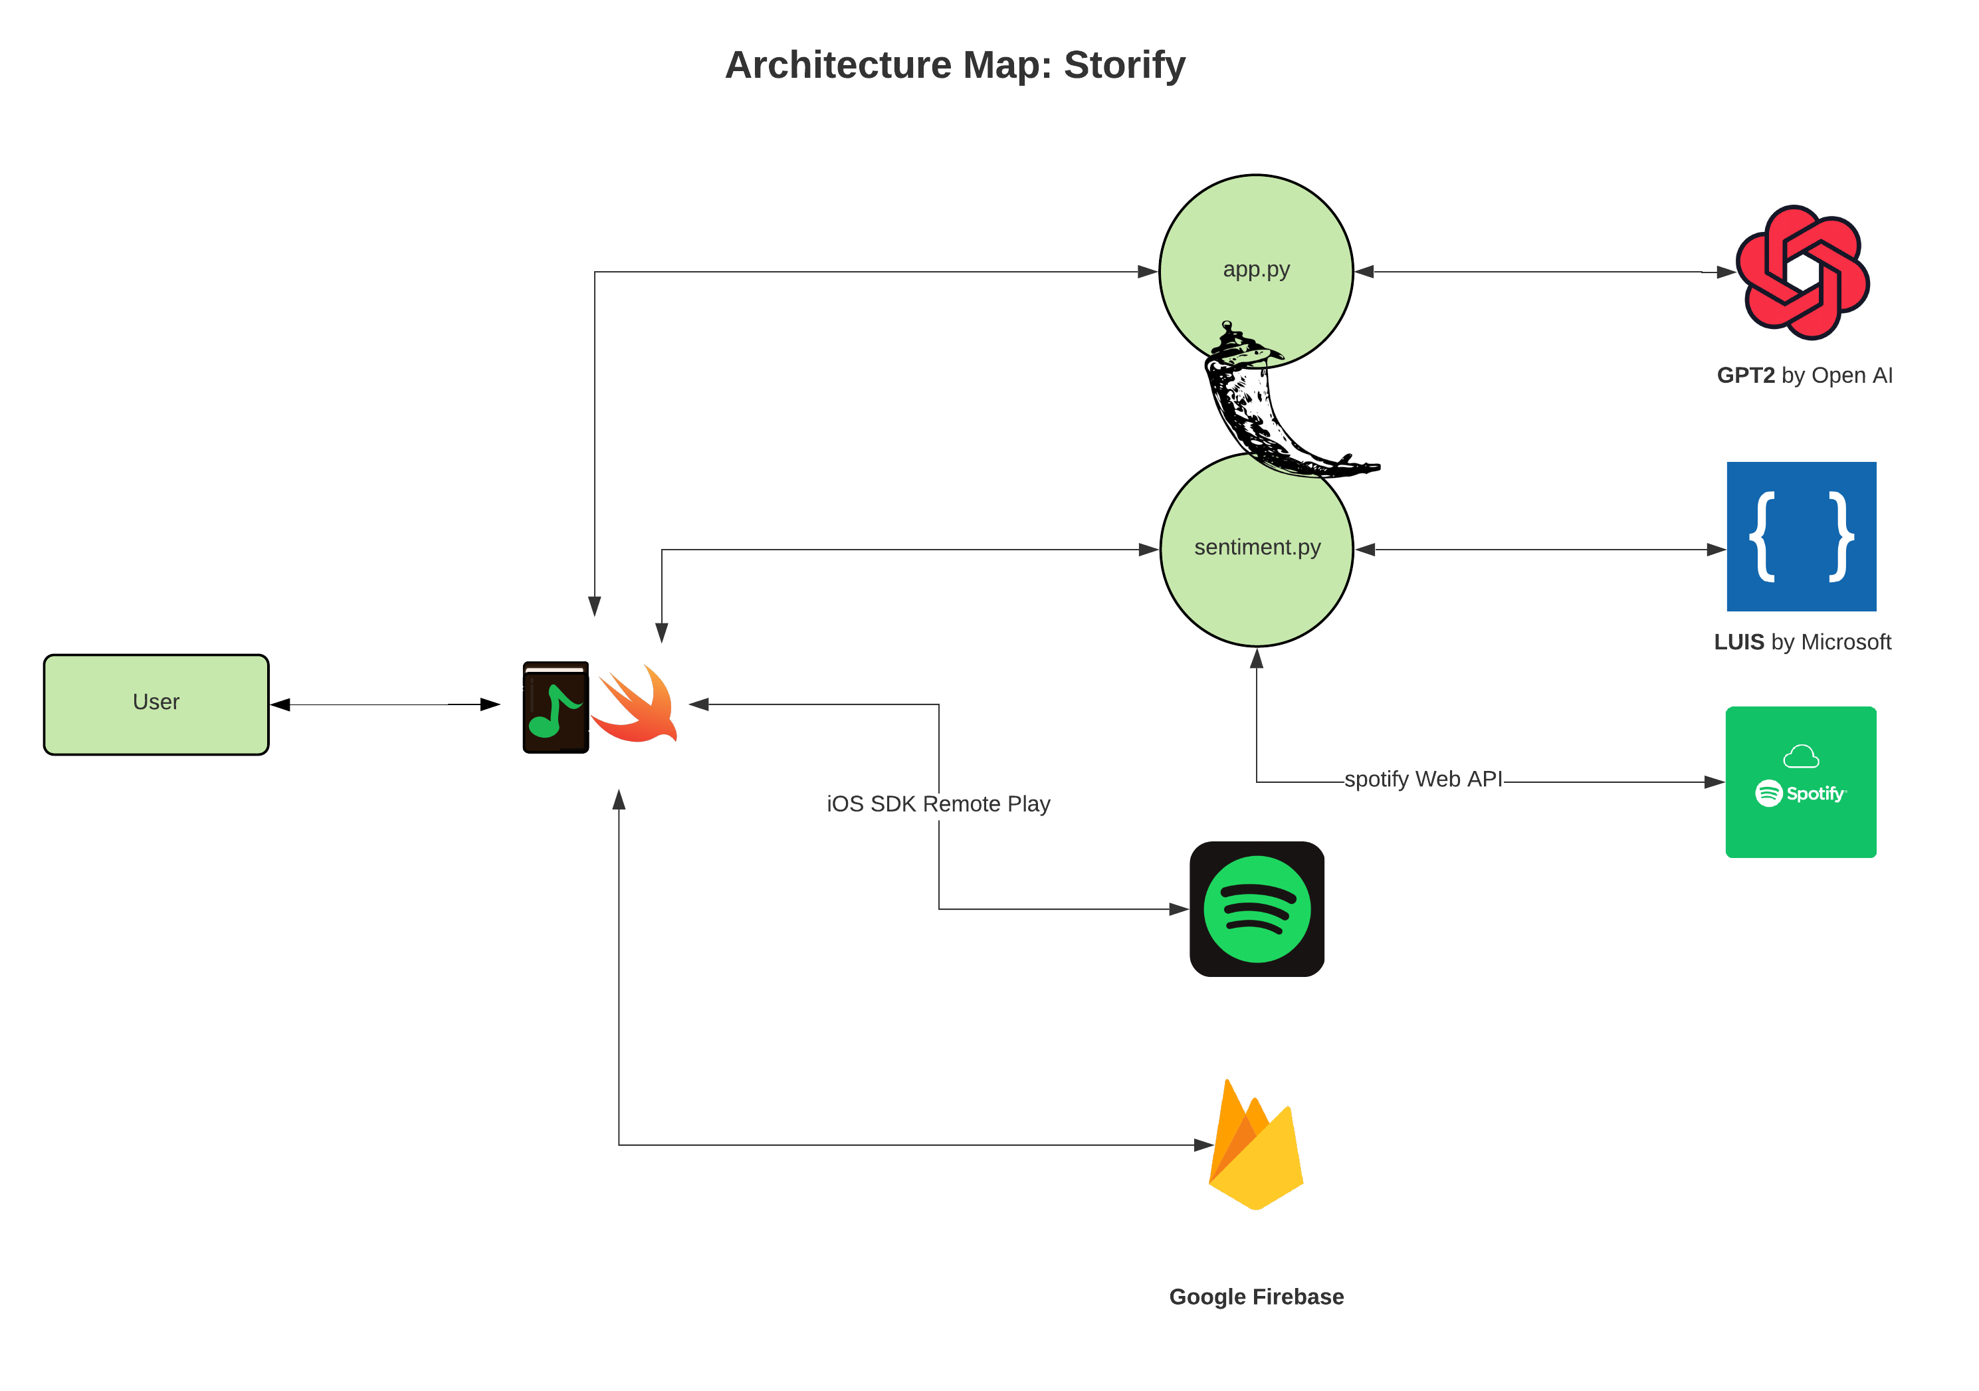

Slide 5
Accomplishments
Responsive UI
Collaborative Editing through Firebase
Interesting story recommendations

Slide 6
Challenges
Spotify SDK challenges
SwiftUI
Compatibility Issues Swift 5 and iOS 13

Slide 7
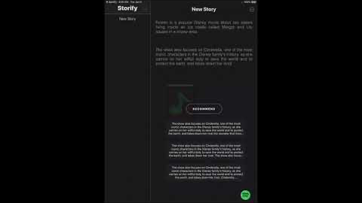
Demo

