Slide 1
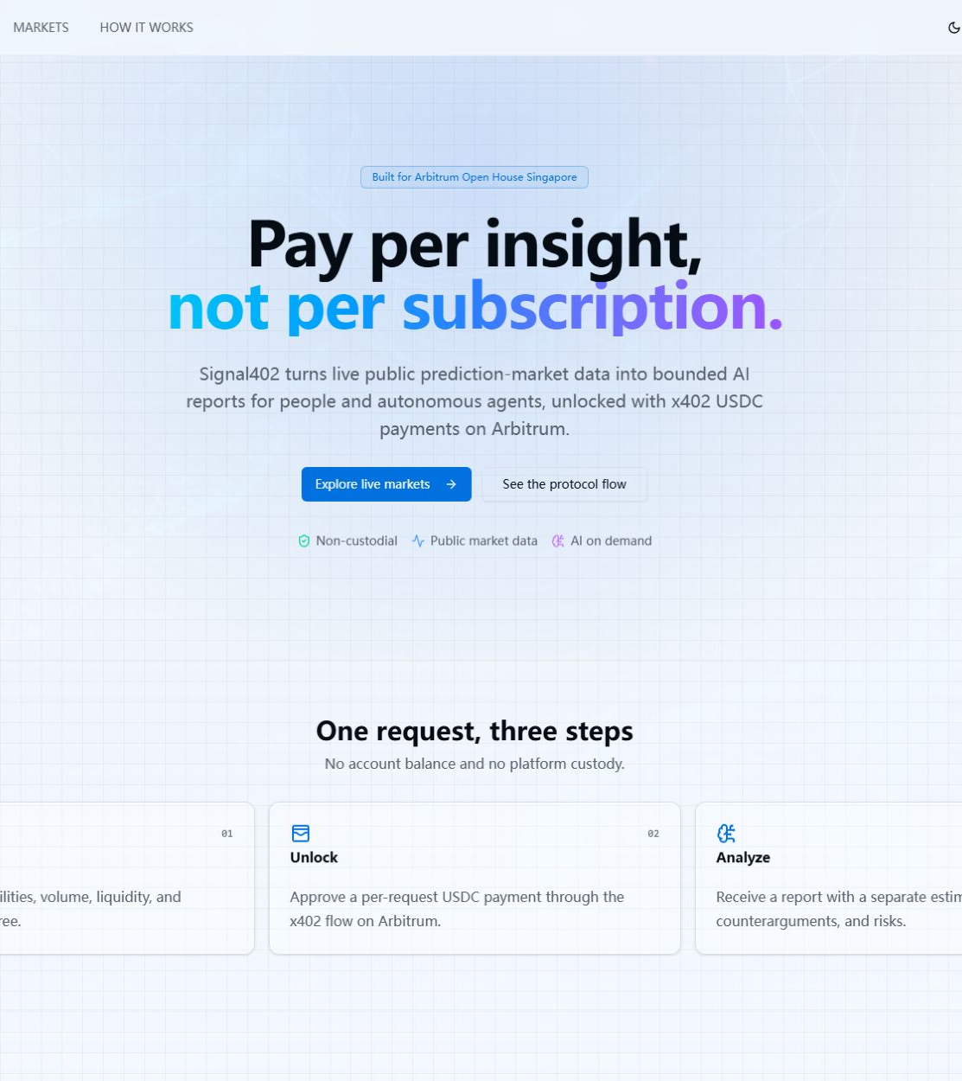
ARBITRUM OPEN HOUSE · SINGAPORE
Signal402
Pay per insight,
not per subscription.
Live prediction-market intelligence for people and autonomous agents.
BUILT ON ARBITRUM x402
Solo founder + AI development agents
Notes:
Opening: Signal402 makes one bounded market-intelligence report purchasable as one explicit transaction.
Do not lead with AI. Lead with the new transaction primitive: pay per successful report.
[Sources]
- Signal402 repository — https://github.com/zedili/X402AiPolyMarket
- Live preview screenshot — https://temporary-rushing-boron-2hytsda.vercel.app
[/Sources]

Slide 2
SIGNAL402
The missing transaction layer
Prediction markets publish probabilities in real time. The hard part is buying one trustworthy, bounded analysis without taking on another account, subscription, or opaque API contract.
TODAY
WITH SIGNAL402
Analysis is bundled
One report = one transaction
• Subscription walls
• Manual checkout
• No machine-readable payment boundary
A human or agent sees the exact price, authorizes payment, and receives a structured result—without custody or trade execution.
Opportunity
Turn intelligence into a composable API good.
02
Notes:
Explain the wedge: the probability itself is public, but contextual analysis is not easily purchased per request.
Signal402 does not claim to predict outcomes perfectly; it makes the purchase and delivery boundary explicit and auditable.
[Sources]
- Polymarket developer documentation — https://docs.polymarket.com/
- x402 protocol documentation — https://docs.x402.org/
[/Sources]

Slide 3
SIGNAL402
Inspect → Unlock → Analyze
01
02
03
INSPECT
UNLOCK
ANALYZE
Browse live markets
Approve 0.01 USDC
Receive structured intelligence
Normalized Polymarket snapshots, searchable and linked to source markets.
A wallet signs an x402 authorization on Arbitrum Sepolia—no deposit account.
Evidence, counterarguments, risks, assumptions, and an independent estimate.
No custody. No trade execution. Settle only after the report succeeds.
03
Notes:
Demo this exact loop: choose a market, open AI Analysis, connect a wallet, and show the 402 payment requirement.
For the live demo, stop before signing unless test USDC and wallet authorization have been explicitly approved.
[Sources]
- Signal402 implementation — https://github.com/zedili/X402AiPolyMarket
- x402 protocol documentation — https://docs.x402.org/
[/Sources]

Slide 4
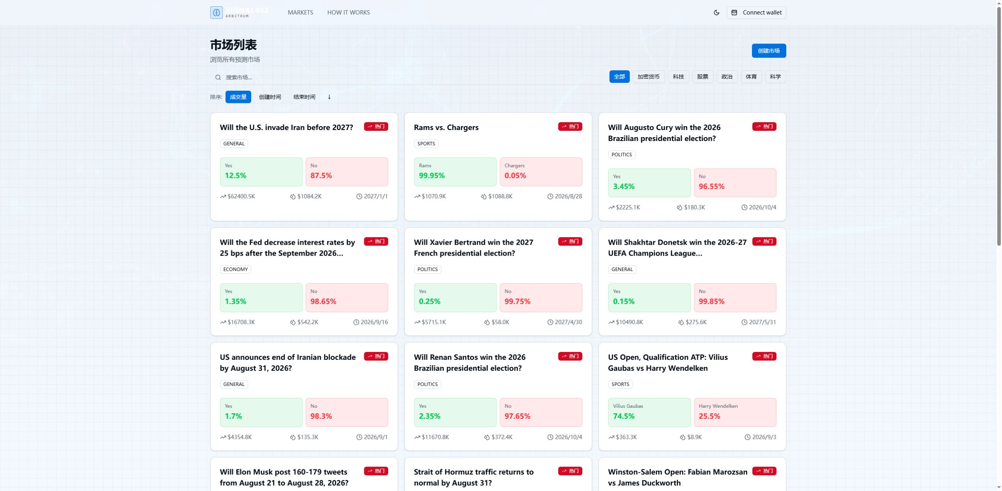
WORKING PRODUCT
Live markets, not demo fixtures
LIVE DATA
Polymarket Gamma API
Server-normalized market snapshots keep client code simple and protect upstream/API concerns.
LIVE PREVIEW VERIFIED
Homepage 200 · Markets API 200 · Analysis API 402
04
Notes:
Use this slide as proof that the product is already reading and rendering real market data.
The temporary preview was smoke-tested: homepage and markets endpoint returned 200; the protected analysis endpoint returned a valid 402 requirement.
[Sources]
- Live Signal402 preview screenshot — https://temporary-rushing-boron-2hytsda.vercel.app/markets
- Polymarket developer documentation — https://docs.polymarket.com/
[/Sources]

Slide 5
SIGNAL402
Payment is the trust boundary
The report is generated server-side, payment is verified before work, and settlement is committed only after a valid result exists.
01
02
03
04
05
Market snapshot
402 challenge
Verify
Generate
Settle + receipt
Polymarket Gamma
Exact price + terms
x402 facilitator
DeepSeek strict JSON
Only on success
NO CUSTODY
FAIL CLOSED
NO TRADING
Wallet signs; Signal402 never holds user funds.
Provider errors cancel settlement.
The product informs; it never places a bet.
05
Notes:
Walk left to right. The critical property is fail-closed settlement: model/provider failure must not become a successful paid response.
The app is non-custodial and does not place trades; it sells an information response.
[Sources]
- Signal402 x402 server and analysis route — https://github.com/zedili/X402AiPolyMarket
- x402 protocol documentation — https://docs.x402.org/
- Arbitrum documentation — https://docs.arbitrum.io/
[/Sources]

Slide 6
SIGNAL402
Built to be verified
No vanity metrics—only protocol configuration and reproducible engineering checks from the current build.
0.01
421614
3
USDC
EIP-155
GREEN
PER SUCCESSFUL REPORT
ARBITRUM SEPOLIA
CI JOBS
Transparent request price on Arbitrum Sepolia.
x402 v2 exact scheme, browser-wallet authorization.
Contracts, backend, and frontend checks in GitHub Actions.
Also passing: 2 x402 protocol tests · 2 smart-contract tests · production dependency audits clean
06
Notes:
These are not traction claims. They are reproducible properties of the submitted build.
Invite judges to inspect the repo and CI run rather than taking the slide on trust.
[Sources]
- Signal402 README and configuration — https://github.com/zedili/X402AiPolyMarket
- Signal402 GitHub Actions — https://github.com/zedili/X402AiPolyMarket/actions
[/Sources]

Slide 7
NEXT MILESTONE
Make market intelligence composable
Signal402 turns analysis into a permissionless, machine-readable transaction primitive.
TEAM
ROADMAP
Solo founder +
AI development agents
01 Permanent deployment + live testnet payment
02 Multi-provider analysis and evaluation harness
Product, full-stack implementation, protocol integration, testing, and demo delivery are owned end to end.
03 Agent-native API, receipts, and report marketplace
SIGNAL402 · PAY PER INSIGHT
07
Notes:
Close with the primitive, not the feature list: one analysis result can now be bought by a person or agent with the same payment contract.
Ask: judge the working boundary—live data, explicit 402 terms, server-side analysis, and fail-closed settlement.
[Sources]
- Signal402 repository — https://github.com/zedili/X402AiPolyMarket
[/Sources]

