Slide 1

Welcome to LibreChat
LibreChat is a free, open source AI chat platform you can use for everyday questions, work, and learning. It looks and feels similar to popular AI chat tools, but gives you more control and flexibility.
In this presentation, you will learn what LibreChat is, how it works, and how to use its main features. No technical background is required.

Slide 2
What You Will Learn
01
02
What LibreChat is and why people use it
How to start a chat, send messages, and get useful answers
03
04
How to use models, prompts, files, and presets in everyday scenarios
Basic settings, tips, and troubleshooting
Walk through the session roadmap so beginners know there is a clear structure. Reassure them that you will go step by step and that they do not need any programming skills.

Slide 3

LibreChat in One Sentence
LibreChat is an open source website style app where you can chat with different AI models in one place.
It helps you write, learn, summarize, brainstorm, and analyze information, all inside a familiar chat interface.

Slide 4
Why LibreChat Instead of a Single AI Website
Multiple AI Sites
LibreChat as One Central Hub
Jump between different websites
Use many AI providers in one interface instead of jumping between different websites
Multiple logins and tabs
Scattered conversation history
Keep more control over your data and how you connect to models (for example using your own keys or a company setup)
Inconsistent interfaces
Customize the experience for your personal or team workflows
Save time by reusing presets, shared prompts, and conversation history

Slide 5
Ways You Can Use LibreChat
Company
Public demo
Private setup
Use a hosted LibreChat instance from your company, school, or provider.
Try public demos if available, to explore the interface safely.
Ask your IT or tech friend to set it up locally or on a server if you want your own private instance.
Clarify that many beginners will not install LibreChat themselves. Often an organization or more technical person will handle installation. The important point is that once it is running, the user experience in the browser is straightforward.

Slide 6
Basic Requirements
A modern web browser (Chrome, Edge, Firefox, Safari, or similar)
A link (URL) to a LibreChat instance provided by your organization or host
Sometimes an account login, depending on how the system is configured
In some setups, a private key or token for an AI provider is needed, usually prepared by IT
Keep this simple. Explain that most beginners will just receive a link and possibly a username and password. Mention that "keys" or "tokens" are secret codes that connect LibreChat to AI services, but that these are often handled by admins.

Slide 7




First Time Login and Setup
Open the LibreChat URL in your browser
Sign in if you see a login page, using the credentials you received
After login, you will usually land on the main chat screen
If prompted to choose a default model, pick a friendly option suggested by your admin or the interface
Explain that the first time can feel confusing, but most screens will have clear calls to action like "New Chat" or "Start chatting." Encourage them to click around calmly and reassure them that they can always start a fresh chat if they get lost.

Slide 8
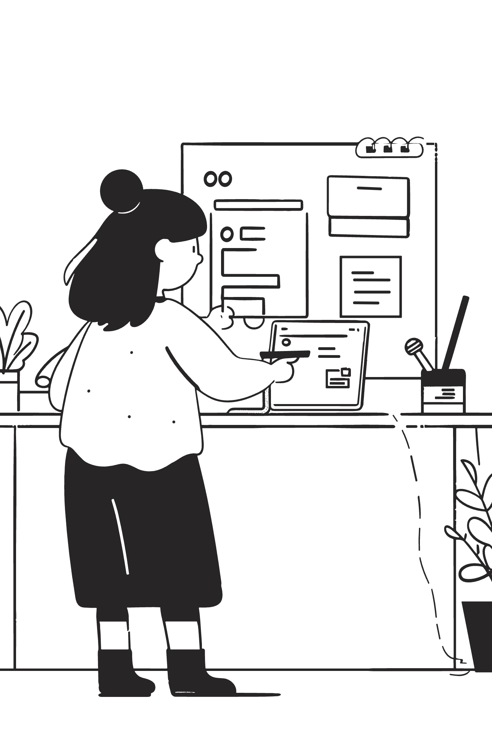
Main Screen Overview
Left side
Usually a sidebar with chats, folders, and often model or agent shortcuts.
Center
The main chat area where you see messages and type your questions.
Top or right
Model selector, settings menu, and sometimes extra tools.
Bottom
Input box to write your message and send it.
Slowly walk through each area of the screen so they can mentally map it. Encourage them to think of LibreChat as similar to a messaging app, but with AI on the other side.

Slide 9
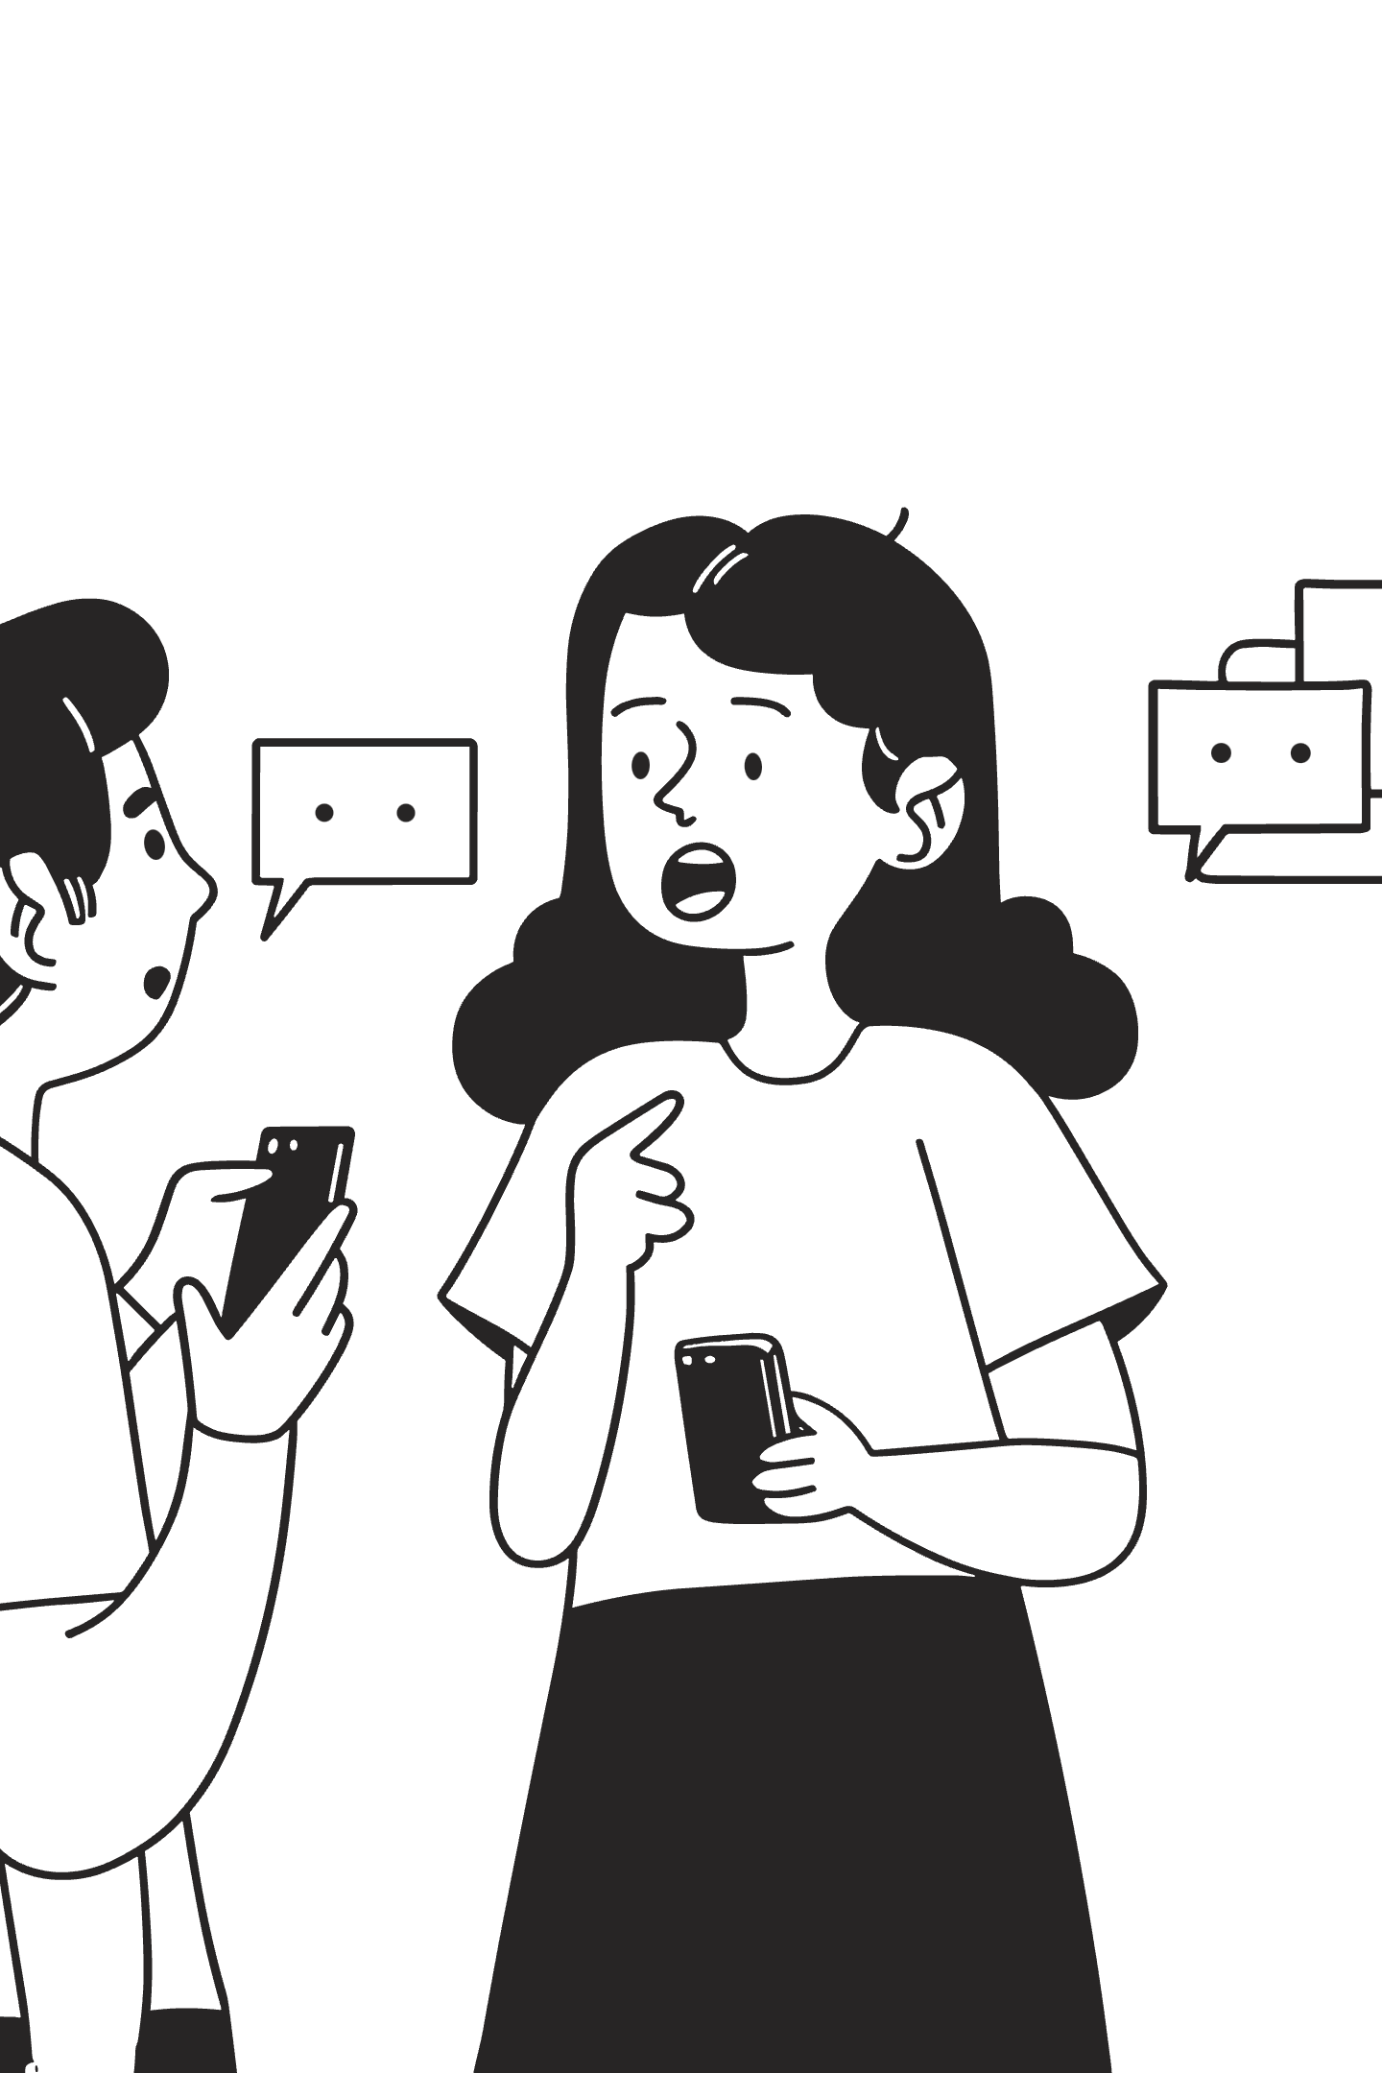
The Chat Area
Your messages are usually aligned on one side, often with a user icon
AI responses appear on the opposite side, often with a robot or logo icon
Messages may stream in gradually so you can see the answer being generated
You can scroll up to review previous parts of the conversation
Connect to familiar experiences, such as texting apps. Point out that long answers are normal and that scrolling is part of using LibreChat effectively.

Slide 10
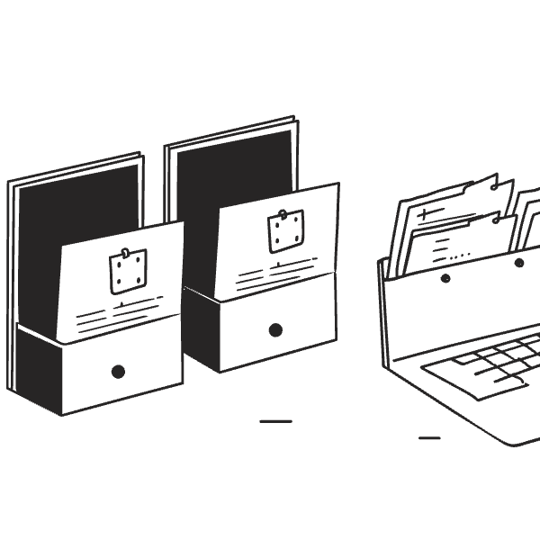
Sidebars, History, and Folders
The sidebar usually lists your recent conversations by title or first question.
You can click a conversation to reopen it and continue where you left off.
Some instances allow you to organize chats into folders or categories.
There may be a search box to quickly find old conversations.
Emphasize that LibreChat saves time by letting you reuse and revisit past conversations rather than starting from scratch every time. Mention that naming chats clearly helps when you come back later.

Slide 11

Starting Your First Chat
Make sure a model is selected at the top (the default is usually fine)
Click "New Chat" or the plus icon in the sidebar
Press Enter or click the send button to submit
Type a simple question, such as "Explain photosynthesis in simple terms."
Encourage them to start with something they know from school or daily life so they can easily judge the quality of the answer. Explain that there is no risk of "breaking" the system by asking simple questions.

Slide 12
Asking Better Questions (Prompts)
Vague Prompt
Clear Prompt
"Tell me about marketing"
"Give me three key points about digital marketing for small businesses. Use bullet points and explain for a busy manager."
Too broad, unclear what you want
Specific, with context and format
Tips for Better Prompts
Be clear about what you want, for example "Give me three key points about…"
Add context, such as your level: "Explain for a 12 year old," or "for a busy manager."
Ask for a format: "Use bullet points," or "Write a 200 word summary."
You can politely ask the AI to retry if the first answer is not what you need.
Explain that the word "prompt" just means "what you type into the chat." Show how small changes in wording can improve results significantly. Give one or two live examples if possible.

Slide 13


Following Up and Refining Answers
User: "Explain photosynthesis"
User: "Make that shorter"
User: "Add more detail about step 2"
AI: [Gives detailed answer]
AI: [Gives condensed version]
AI: [Expands on step 2]
Key Points
You do not need to repeat everything. You can say "Make that shorter" or "Add more detail about step 2."
Ask the AI to correct mistakes or update information.
Request alternatives: "Give me a different version focusing on students," for example.
Use this back and forth like you would talk to a helpful colleague.
Stress that LibreChat becomes more useful when you treat it as a conversation. Many beginners think they must ask the perfect question first time. Show that it is normal to iterate.

Slide 14
Editing, Branching, and Exporting
Editing
Branching
Exporting
Many LibreChat setups let you edit your last question and regenerate the answer.
Some allow "branches," which means trying different directions from the same message.
You can often export conversations as text, Markdown, or image for sharing.
Exports help you reuse work in documents, slides, or emails.
Explain branching using a tree analogy: one trunk (original question) and several branches (different follow up directions). Keep exports concrete with examples such as "attach to an email" or "paste into Word."

Slide 15
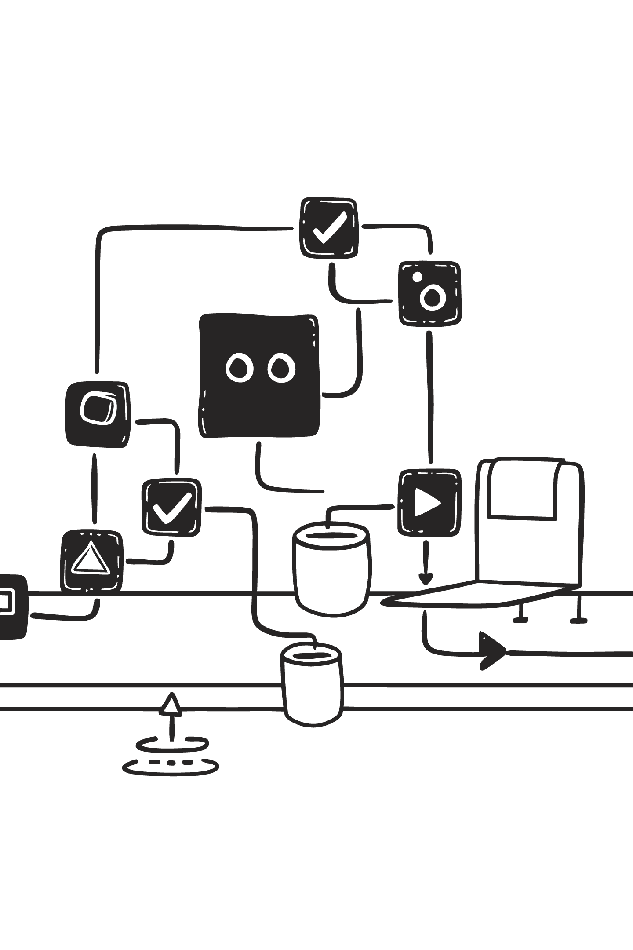
What Is a Model
A "model" is the brain behind the chat that reads your messages and writes answers
LibreChat can connect to many models from different providers, such as OpenAI, Anthropic, Google, and others
Different models may be stronger at coding, reasoning, language, or speed
You usually select a model from a drop down list at the top of the chat
Compare models to different "experts" you can invite into the conversation. Some are good at math, some at writing, some at images. Make clear that beginners can safely use the recommended or default model.

Slide 16
Choosing the Right Model
Model Type
Best For
Example Use
Advanced/Creative
Great for writing
Essays, stories, marketing copy
Code-focused
Code friendly
Programming help, debugging
Fast/Light
Fast and light
Quick questions, simple tasks
Tips for Choosing
If you are unsure, use the "recommended" or default model suggested by LibreChat or your admin.
For heavy writing tasks, pick models labeled as "advanced" or "creative."
For coding tasks, look for names that mention "code" or "developer."
If your organization limits which models you see, that is normal and usually set by policy.
Reassure users that picking the wrong model will not break anything, but that results may vary. Encourage them to try two different models on the same question to see the difference when allowed.

Slide 17

Connections, Keys, and Costs (Conceptual)
LibreChat usually connects to AI providers through secure keys or tokens set by admins.
These keys act like secret passwords that let LibreChat ask models for answers.
Costs are often pay per use and are usually handled by your organization or the person who set up LibreChat.
As a beginner user, you mostly do not need to manage keys yourself.
Keep this non technical. Emphasize security and privacy, noting that keys should never be shared publicly. If relevant, mention that some hosted LibreChat instances hide all of this from end users.

Slide 18

What Is a Prompt Template or Preset
A prompt template or preset is a saved starting message you can reuse many times.
It can include role, style, and instructions, for example "Act as a language tutor."
Presets help you get consistent results without rewriting long instructions.
Many LibreChat setups allow saving and naming your favorite prompts.
Explain presets like "email templates" in Outlook or Gmail. Show how they save time and reduce mistakes. Mention that teams can agree on shared presets for common tasks.

Slide 19
Creating Your First Preset
Start a new chat and write a detailed instruction, such as "You are my study coach. Ask me questions and explain concepts simply."
1
Test it with a sample question and adjust the wording until you are happy.
2
Use the "Save as preset" or similar button in the interface.
3
Give it a clear name, for example "Study Coach (School)."
4
Show the full text of a simple but effective preset. Explain that they can refine the preset over time and resave it. Encourage them to keep names short but descriptive, since names appear in lists and menus.

Slide 20
Example Presets for Everyday Use
"Email Assistant"
"Study Buddy"
Draft polite business emails from bullet points.
Explain textbook pages in simple words and quiz you.
"Meeting Note Helper"
"Idea Generator"
Turn rough notes into structured meeting minutes.
Brainstorm headlines, content ideas, or product names.
Encourage users to start with one or two presets that match their everyday work or study. Emphasize that they can always open the preset and tweak it instead of making new ones from scratch.

Slide 21

Uploading Files and Images
LibreChat often allows you to attach files such as PDFs, Word documents, or images.
You usually drag and drop files into the chat or use an "Upload" button.
The AI can then summarize, explain, or extract information from the file.
Image support can include describing pictures or analyzing diagrams.
Clarify that the exact file types supported depend on how the system is configured. Suggest simple starter tasks like "Summarize this PDF in 5 bullet points." Emphasize that large or sensitive files should follow your organization's data rules.

Slide 22


Chatting With Your Documents
Ask questions like "What are the main conclusions of this report" after uploading.
Request comparisons, for example "Compare section 2 and section 4 and list key differences."
Use it to prepare presentations: "Turn this document into a slide outline."
For images, ask "Explain what this chart shows in simple terms."
Use real world examples such as school reports, policy documents, or research papers. Make sure beginners see that they can ask very natural follow up questions, not just "summarize."

Slide 23

Sharing and Collaboration Options
Many setups allow you to copy links to chats or export them as files.
You can paste exported text into shared documents, wikis, or project tools.
Some organizations enable shared presets so teams can reuse the same instructions.
Always check internal policies before sharing data outside your team.
Emphasize that LibreChat is often one piece of a bigger workflow that includes tools like email, office suites, or project trackers. Show how sharing reduces duplicate work, for example sharing a preset "Client Brief Writer" among colleagues.

Slide 24



Building Simple Workflows
Input
LibreChat Process
Output
Notes, files, or raw ideas
Organize and transform
Paste into tools or share
Example Workflows
Start with a prompt template, then feed it notes or files, and finally export the result.
Example: notes → LibreChat summary → paste into project management tool.
Example: raw ideas → LibreChat structure → paste into slide deck.
Example: long article → LibreChat summary → personal checklist of actions.
Encourage users to think in terms of "input, process, output." LibreChat is strongest in the "process" part, organizing and transforming information. Help them design one or two personal workflows they can start using today.

Slide 25


Personalizing the Look and Feel
Light Mode
Dark Mode
Customization Options
Switch between light and dark themes for comfortable reading.
Choose language preferences if your LibreChat instance supports multiple languages.
Adjust font size or compact mode if available for easier reading on your screen.
Small visual changes can make long sessions more pleasant.
Demonstrate theme switching live if possible. Remind users that comfort matters, especially for long research or writing sessions. Mention that these settings usually affect only their account, not everyone.

Slide 26
Default Model and Behavior Settings
Default Model
You can often set a default model so new chats always start with your preferred choice.
Conversation Retention
Some instances let you control how long conversations are kept or when they expire.
Safety Settings
Safety related settings may limit what the AI can answer, to follow company rules.
For beginners, sticking to recommended defaults is usually best.
Explain that these settings are a way to "tune" the assistant to your habits, but that many are set by administrators to protect privacy and safety. Encourage them to ask an admin before changing anything they do not understand.

Slide 27

Account and Access Management
Your LibreChat account may be tied to your work or school login.
Use profile or account menus to log out when using shared devices.
Some setups allow changing your password or connecting single sign on providers.
If you lose access, contact your internal support or admin rather than trying to fix it alone.
Emphasize security basics, especially logging out on shared computers. Clarify that access changes are often a policy issue, not something you can fix in settings.

Slide 28

Getting Better Answers
Better Prompts Checklist
Be specific about the outcome you want, not just the topic.
Provide context, such as audience, length, and tone.
Use follow up questions to refine, correct, and improve answers.
Review results critically and cross check important facts.
Underline that AI is powerful but not perfect. Encourage a mindset of "assistant, not oracle." Remind them to double check critical information, especially for legal, medical, or financial topics, using trusted human or official sources.

Slide 29
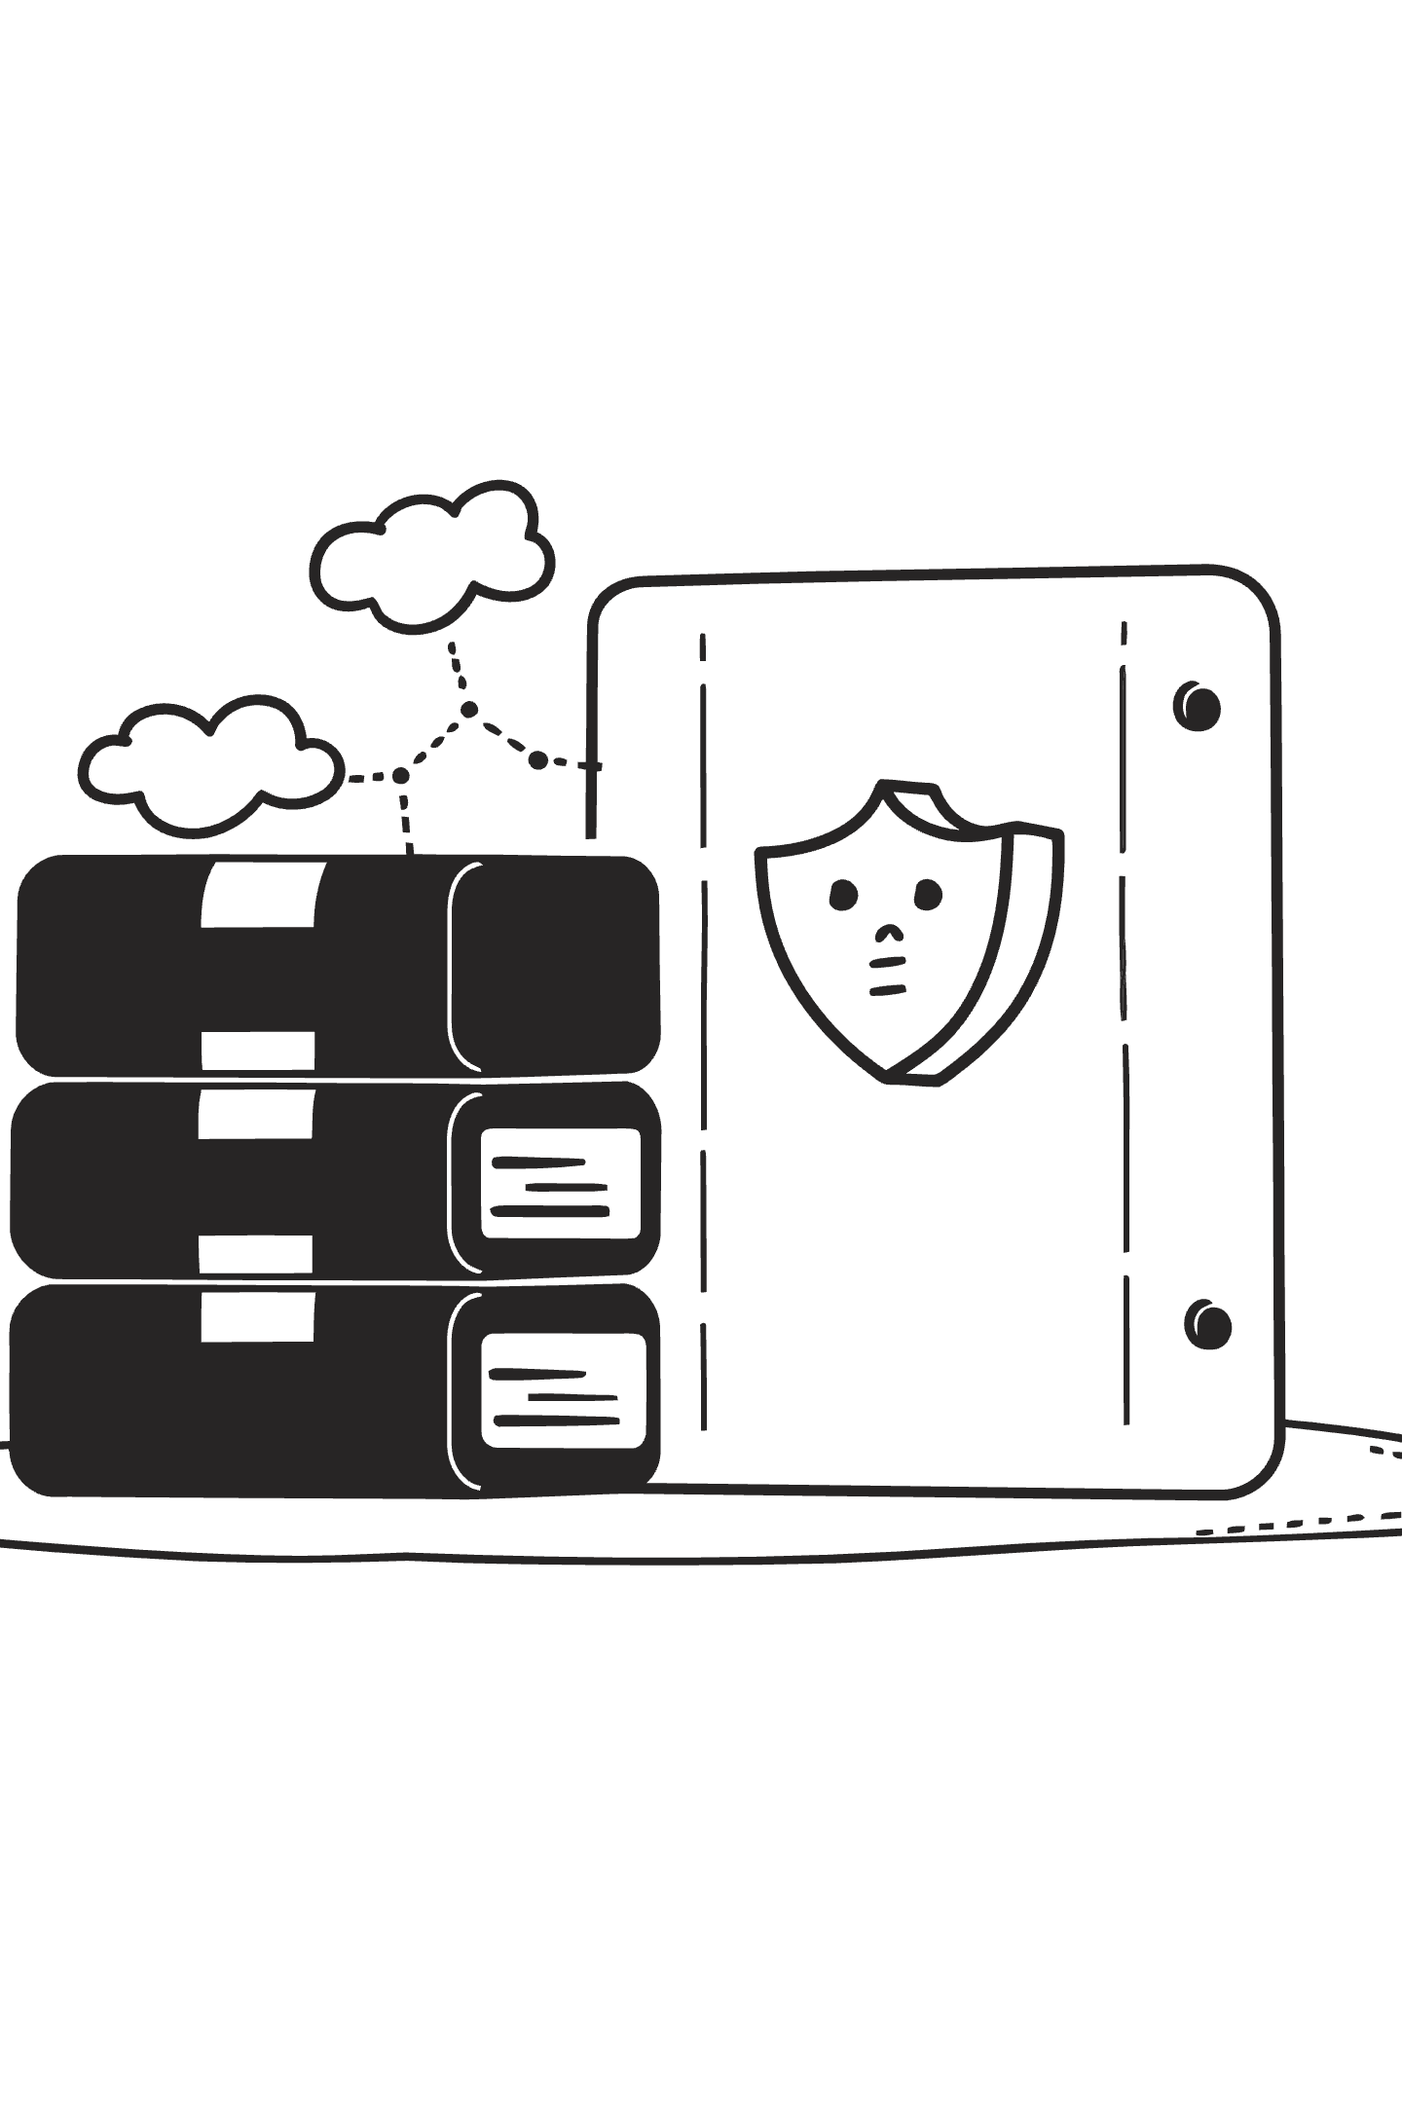
Staying Safe and Handling Data Carefully
Do
Do Not
Follow your organization's internal guidelines for AI usage
Paste highly sensitive personal or company information unless your policy allows it
Treat AI answers as drafts that you review, not final truths
Share confidential health records or financial details
Ask a manager or data protection officer when in doubt
Assume all AI answers are completely accurate
Use LibreChat for appropriate work and learning tasks
Ignore your organization's data protection rules
Use clear examples of sensitive data, such as health records or financial details. Explain that even with self hosted solutions, policies matter. Encourage a "safety first" mindset.

Slide 30
Study and Learning Scenarios
Simplify Complex Topics
Create Study Materials
Turn complex textbook chapters into simple explanations and summaries.
Create quizzes and flashcards from your notes or lectures.
Language Practice
Step-by-Step Help
Practice languages by chatting with LibreChat as a tutor.
Ask for step by step explanations of math or science problems.
Make the connection between everyday student struggles and LibreChat capabilities. Stress that it should support learning, not replace thinking or lead to plagiarism. Suggest using the AI to understand material, then writing in their own words.

Slide 31
Work and Productivity Scenarios
Draft Communications
Meeting Summaries
Draft emails, reports, and proposals from bullet points or rough notes.
Turn meeting transcripts into clear action lists and summaries.
Brainstorming
Documentation
Brainstorm ideas for campaigns, features, or process improvements.
Prepare slide outlines, FAQs, or documentation from scattered information.
Use realistic examples, such as preparing a client update or summarizing a long policy. Emphasize time savings and the value of having a "first draft machine" that you then polish.

Slide 32

Personal Life and Creativity Scenarios
Travel Planning
Plan trips, weekend activities, or personal projects with checklists.
Recipe Ideas
Get recipe ideas based on ingredients you have at home.
Gift Brainstorming
Brainstorm gift ideas or event themes.
Creative Writing
Explore creative writing prompts, stories, or journaling support.
Remind the audience that LibreChat can be fun and helpful beyond work and study. This makes the tool feel less intimidating and encourages experimentation.

Slide 33
Common Problems You Might See
⚠️ Connection or API Errors
⏱️ Slow Responses
"Connection" or "API" errors when the AI provider is down or misconfigured.
Slow responses during busy times or when using very advanced models.
🚫 Access Denied
📎 Attachment Issues
Access denied messages if your account lacks permission for certain models.
Attachments not working if file types or sizes are restricted.
Explain that many issues are not the user's fault. Encourage them to note the error message and contact support if simple retrying does not help. Suggest trying a different model or a smaller request when things are slow.

Slide 34
Simple Troubleshooting Steps
If something goes wrong
Try a shorter question or a different model if available
Refresh the page or reopen the browser tab
If problems continue, capture a screenshot and contact your admin or support
Check your internet connection and log in again if needed
Encourage users not to panic. Show that most issues can be quickly tested with a few simple steps. Emphasize that sharing screenshots or exact error messages speeds up support.

Slide 35
Recap of Key Ideas
LibreChat is an open source hub for many AI models in one familiar chat interface.
You interact with it through simple conversations, prompts, and follow up questions.
Features like presets, files, and exports help you build powerful workflows.
Safe, thoughtful use and basic troubleshooting make it a reliable daily tool.
Briefly revisit each bullet, connecting back to the sections of the presentation. Ask the audience to think of one concrete scenario where they will try LibreChat this week.

Slide 36
Your Next Steps
Start now
1
Log in to your LibreChat instance and start one simple chat today.
2
Create one preset that matches your main daily task, such as "Email helper."
3
Try one file upload task, for example "Summarize this PDF in 5 bullets."
4
Note any questions or issues and share them with your team or support.
Turn the recap into action. Encourage users not to wait, because familiarity comes from use. Suggest that teams share their favorite prompts and presets with each other to accelerate learning.

