Slide 1

输入/输出系统

Slide 2
Input/Output
3.1 Principles of I/O hardware
3.2 Principles of I/O software
3.3 I/O software layers
3.4 Deadlocks
3.5 Disks
3.6 Clocks
3.7 Character-oriented terminals
3.8 Graphical user interfaces
3.9 Network terminals
3.10 Power management

Slide 3

I/O硬件原理
block devices
  fix-sized, addressable blocks
  512-32768bytes/block
  disks, tapes
character devices
  deliver or accept a stream of characters
  printers, network interfaces, mice, rats

Slide 4
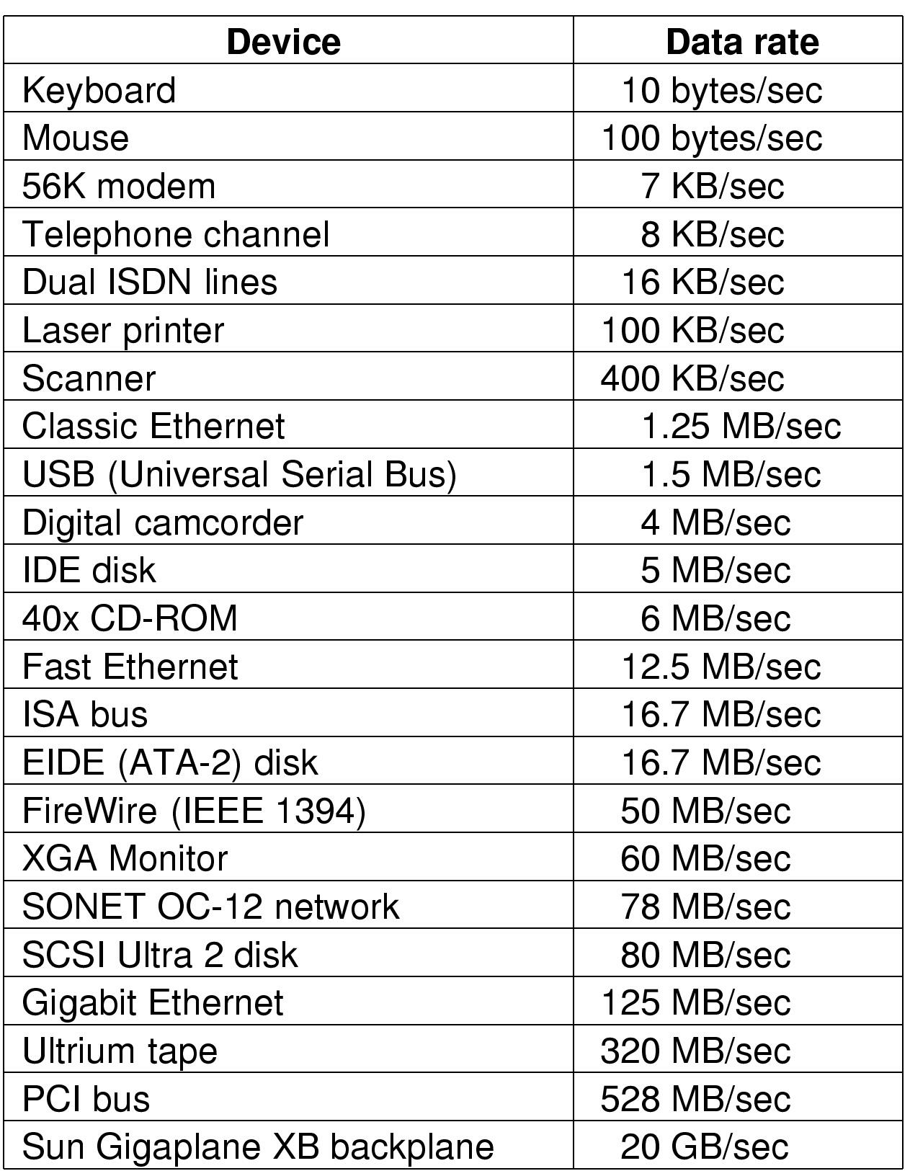
I/O硬件原理
常见设备的速率

Slide 5

I/O硬件原理
设备控制器(device controllers)
  device controllers (adapters)
  devices
Bus

Slide 6
I/O硬件原理
Interface between the controller and the device
  low-level interface
  can conform to some standards
two examples
  disk controller - disks
  CRT controller – CRT

Slide 7
I/O硬件原理
device controller
  addresses
  interrupt
  interrupt vector

Slide 8
I/O硬件原理
device controllers
  control registers
  device data buffer
addresses
  I/O port number
  memory-mapped I/O

Slide 9
I/O硬件原理
I/O port
  I/O port number: an 8- or 16-bit integer
  special I/O instruction
e.g.
  IN REG, PORT
  OUT PORT, REG
  IN R0, 4 v.s. MOV R0, 4
early mainframes, IBM 360 etc.

Slide 10
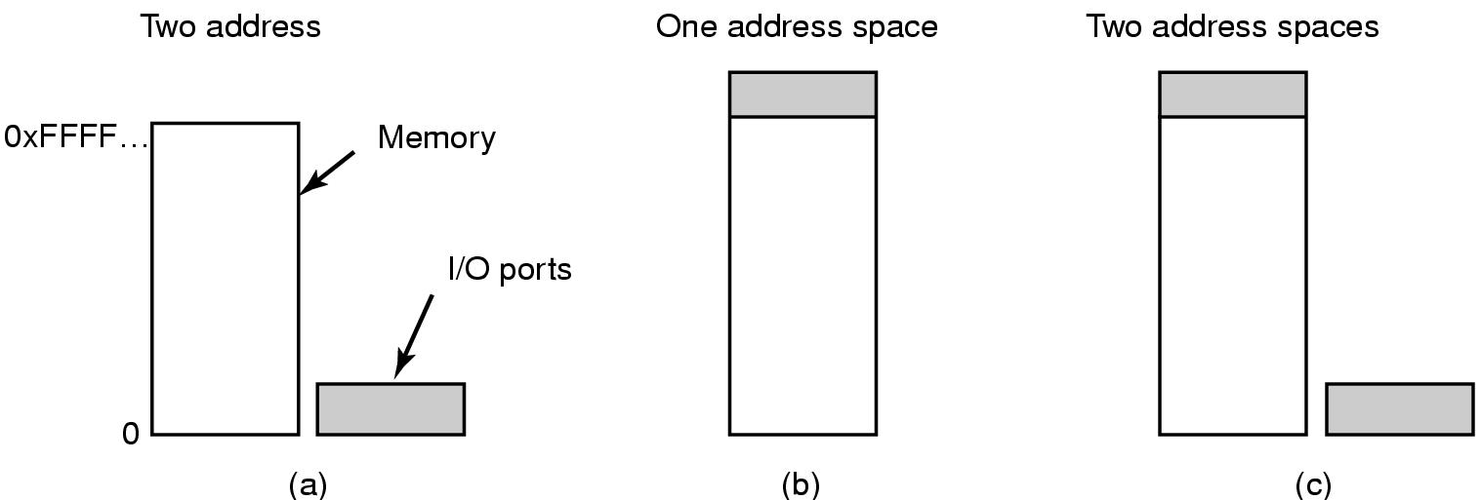
I/O硬件原理
(a) Separate I/O and memory space
(b) Memory-mapped I/O
(c) Hybrid

Slide 11
I/O硬件原理
Memory-mapped I/O (e.g.PDP11)
Hybrid (e.g. Pentium)
  reserved 640K-1M for device data buffers
  0-64K for I/O ports
working procedure:

Slide 12
I/O硬件原理
Advantages of memory-mapped I/O
  device driver can be written in C, no assembly code needed
  no special protection needed
  no extra machine instructions

Slide 13
I/O硬件原理
LOOP: TEST PORT_4 //check if port 4 is 0
BEQ READY // if it is 0, go to ready
BRANCH LOOP //otherwise, continue testing
READY:

Slide 14
I/O硬件原理
Disadvantages of memory-mapped I/O
  caching of memory words
    solution: selectively disabling caching
  memory address examining

Slide 15
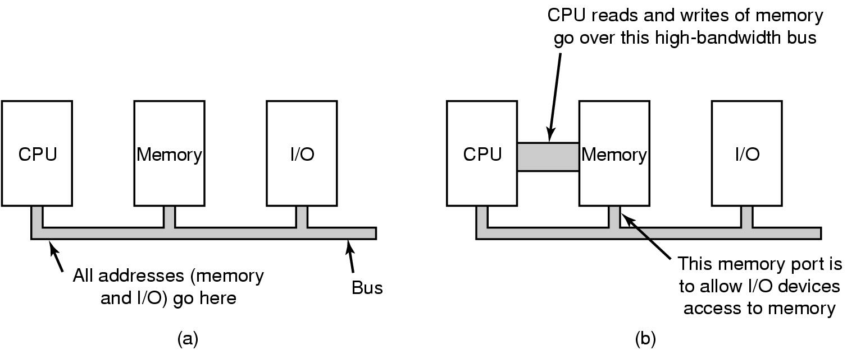
I/O硬件原理
(a) A single-bus architecture
(b) A dual-bus memory architecture

Slide 16
I/O硬件原理
measures for memory-mapped I/O on multiple-bused system
  first send all to memory, then other buses if fail
  put a snooping device on the memory bus
  Pentium: PCI bridge – range registers: nonmemory range(640K-1M)

Slide 17

I/O硬件原理
DMA(Direct Memory Access)
Operation of a DMA transfer

Slide 18
I/O硬件原理
DMA controllers
  simple controllers: one transfer at a time
  complex ones: multiple transfers
    multiple sets of registers
    some algorithms to schedule
    different acknowledgement lines on the bus

Slide 19
I/O硬件原理
Bus or DMA controller working modes:
  cycle stealing
  burst mode
fly-by mode: device controller directly transfer data to main memory
transfer data through DMA controller

Slide 20
I/O硬件原理
Physical memory address for transferring
  DMA controller’s address register:
    physical address: OS does the converting
    virtual address: MMU does the converting
Why is an internal buffer needed?

Slide 21

I/O硬件原理
How interrupts happens. Connections between devices and interrupt controller actually use interrupt lines on the bus rather than dedicated wires

Slide 22
I/O硬件原理
What information is saved?
  program counter
  all visible registers and most internal registers
Where is it saved?
  in internal registers
  on the stack (user process stack v. s. kernel stack)

Slide 23
I/O硬件原理
Modern CPUs are pipelined and superscalar
  boundary between executed instructions and nonexecuted instructions
  precise interrupt:
    PC is saved in a known place
    All instructions before PC have fully executed
    No instructions beyond PC has been executed
    The execution state of the PC instruction is known

Slide 24
I/O硬件原理
imprecise interrupt
  OS has to figure out the machine state
both kinds of interrupt are allowed, e.g.
  precise I/O interrupts
  imprecise traps

Slide 25

I/O软件原理——I/O软件目标
Device independence
  programs can access any I/O device
  without specifying device in advance
    (floppy, hard drive, or CD-ROM)
Uniform naming
  name of a file or device a string or an integer
  not depending on which machine
Error handling
  handle as close to the hardware as possible

Slide 26
I/O软件原理——I/O软件目标
Synchronous vs. asynchronous transfers
  blocked transfers vs. interrupt-driven
Buffering
  data coming off a device cannot be stored in final destination
Sharable vs. dedicated devices
  disks are sharable
  tape drives would not be

Slide 27
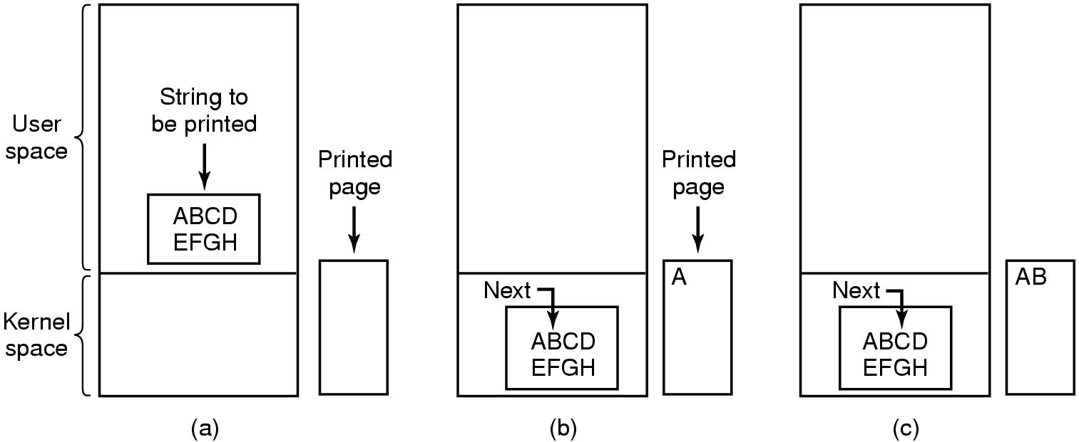
Programmed I/O (1)
Steps in printing a string

Slide 28
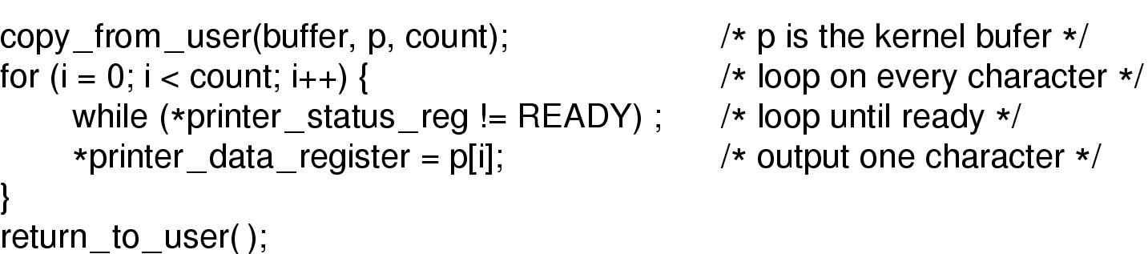
Programmed I/O (2)
Writing a string to the printer using programmed I/O

Slide 29
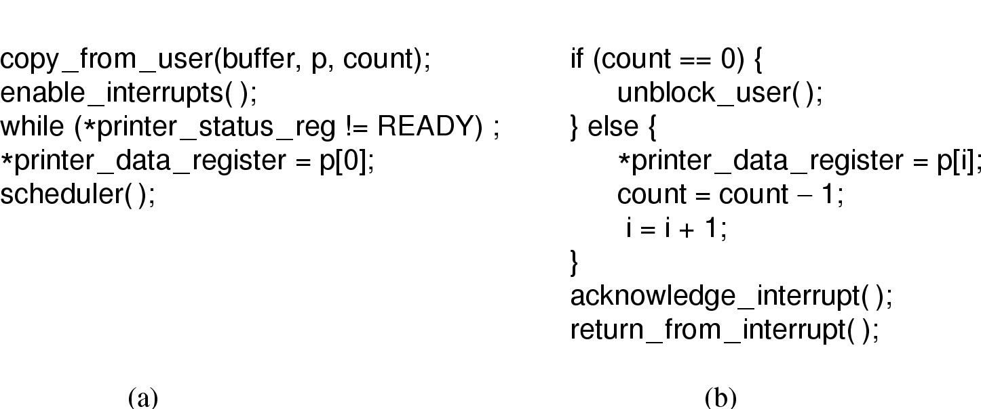
Interrupt-Driven I/O
Writing a string to the printer using interrupt-driven I/O
  (a) Code executed when print system call is made
  (b) Interrupt service procedure

Slide 30
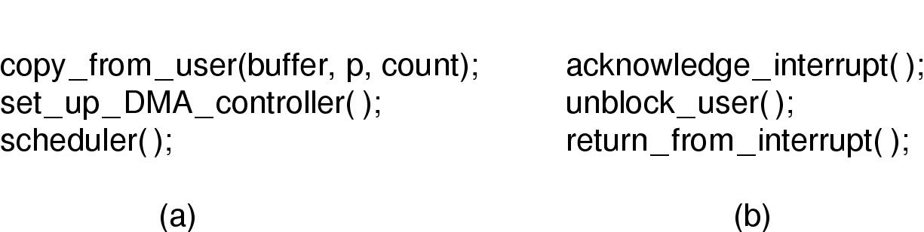
I/O Using DMA
Printing a string using DMA
  (a) code executed when the print system call is made
  (b) interrupt service procedure

Slide 31
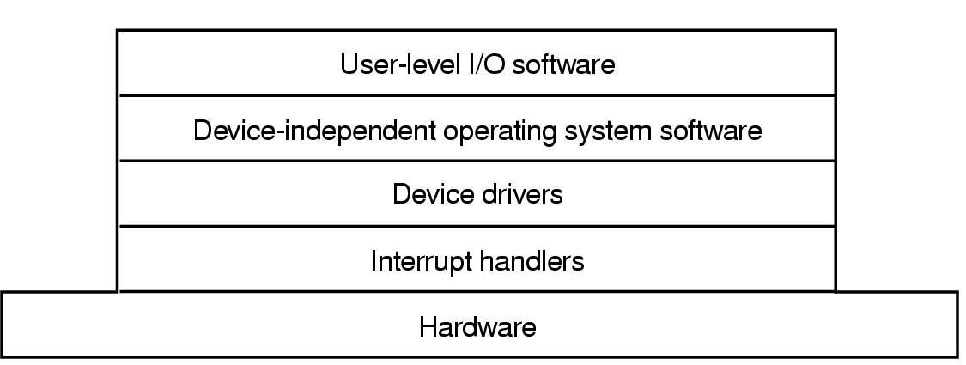
I/O Software Layers
Layers of the I/O Software System

Slide 32
Interrupt Handlers (1)
Interrupt handlers are best hidden
  have driver starting an I/O operation block until interrupt notifies of completion
Interrupt procedure does its task
  then unblocks driver that started it
Steps must be performed in software after interrupt completed
  Save regs not already saved by interrupt hardware
  Set up context for interrupt service procedure

Slide 33
Interrupt Handlers (2)
  Set up stack for interrupt service procedure
  Ack interrupt controller, reenable interrupts
  Copy registers from where saved
  Run service procedure
  Choose process to run next
  Set up MMU context for process to run next
  Load new process' registers
  Start running the new process

Slide 34
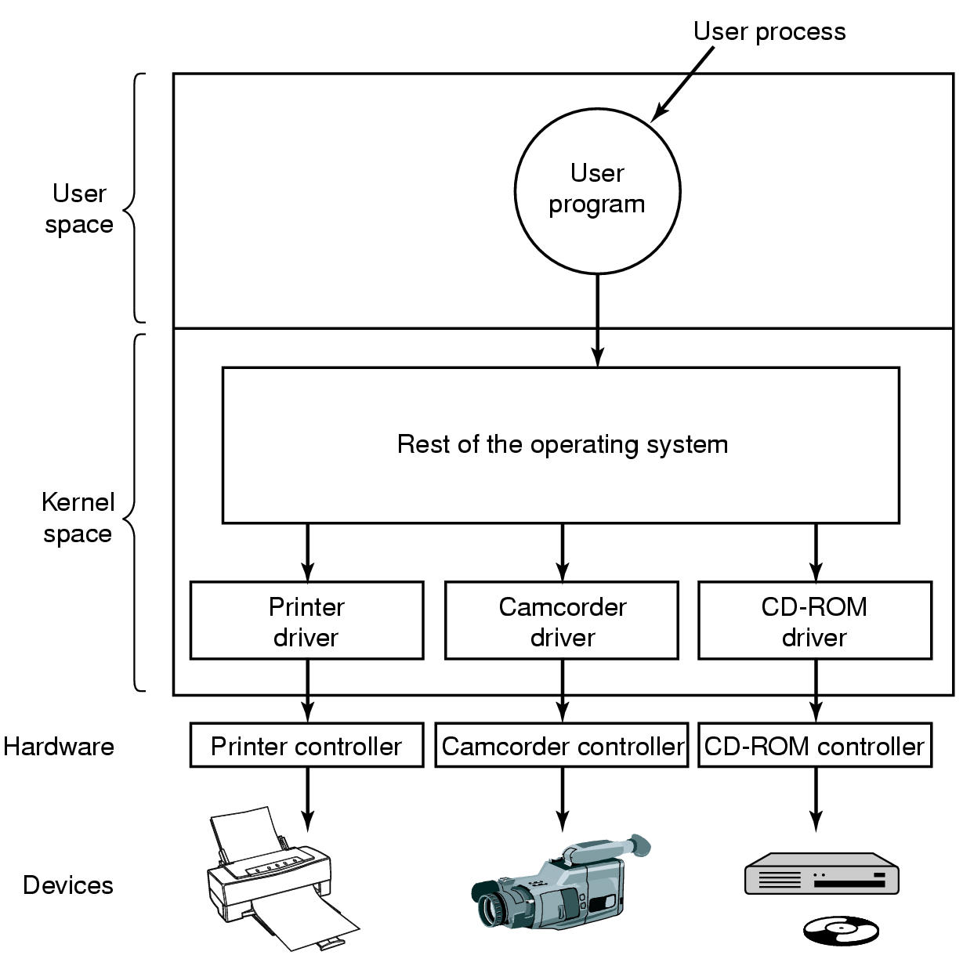
Device Drivers
Logical position of device drivers is shown here
Communications between drivers and device controllers goes over the bus

Slide 35
Device Drivers
device-specific codes controlling different devices
part of operating system kernel
functions
  support standard interfaces to upper layers
  device initialization, power management, log events

Slide 36
Device Drivers
working structure:
  checking parameters
  translating abstract terms to device-specific terms
  queue the request or examine device to get ready
  controlling the device
    determining the commands sequence
    writing each command to the controller
    blocking or finishing
    checking for errors
    passing data to the device-independent software
    returning status for error reporting to its caller
    next queued request or blocking

Slide 37
Device Drivers
some other issues:
  drivers have to be reentrant – a running driver can be called a second time before the first call has been completed
  in hot pluggable system
  not allowed to make system calls; can call certain kernel procedures

Slide 38
Device-Independent I/O Software (1)
Uniform interfacing for device drivers
Buffering
Error reporting
Allocating and releasing dedicate devices
Providing a deice-independent block size
Functions of the device-independent I/O software

Slide 39
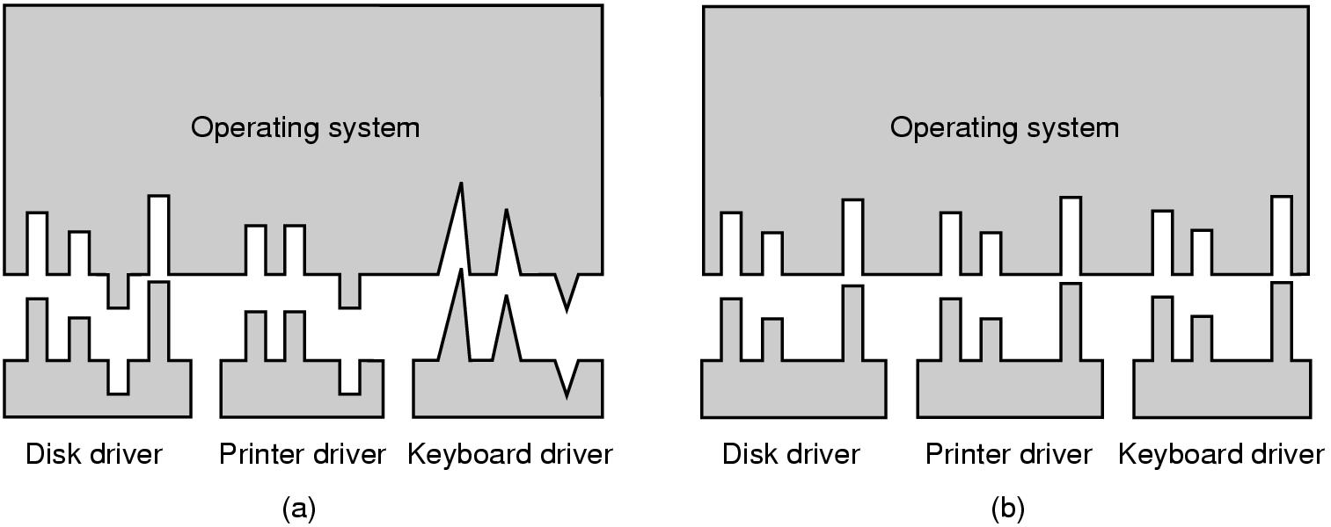
Device-Independent I/O Software (2)
(a) Without a standard driver interface
(b) With a standard driver interface

Slide 40
Device-Independent I/O Software (3)
naming devices – mapping symbolic device names onto the proper driver
  e.g Unix device name: /dev/disk0
  major device number: used to locate driver
  minor device number: passed as a parameter to the driver
protection

Slide 41
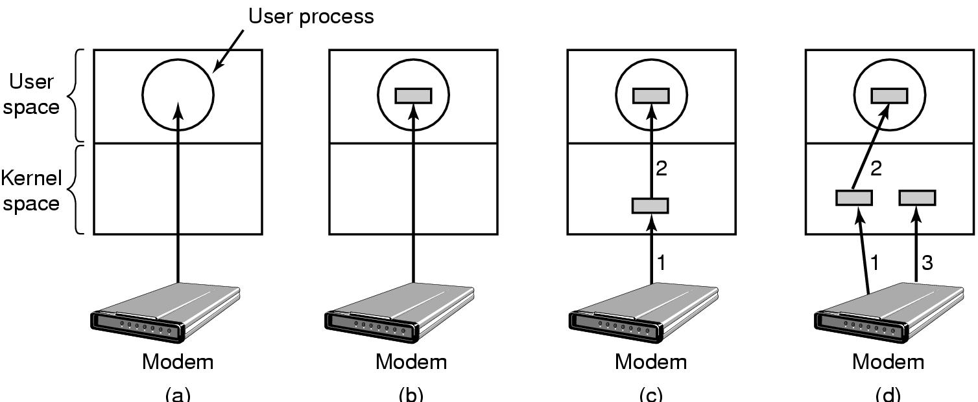
Device-Independent I/O Software (4)
(a) Unbuffered input
(b) Buffering in user space
(c) Buffering in the kernel followed by copying to user space
(d) Double buffering in the kernel

Slide 42
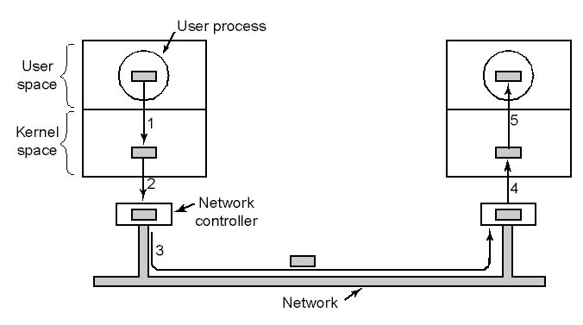
Device-Independent I/O Software (5)
Networking may involve many copies

Slide 43
Device-Independent I/O Software (6)
error reporting
  device-specific errors v.s. device-independent error handling
  programming errors – report back error code
  actual I/O errors – driver or device-independent software (interactive user decide or fail on system call)

Slide 44
Device-Independent I/O Software (7)
Allocating and releasing dedicated devices
device-independent block size
  uniform block size to upper layers
  uniform delivery character unit

Slide 45
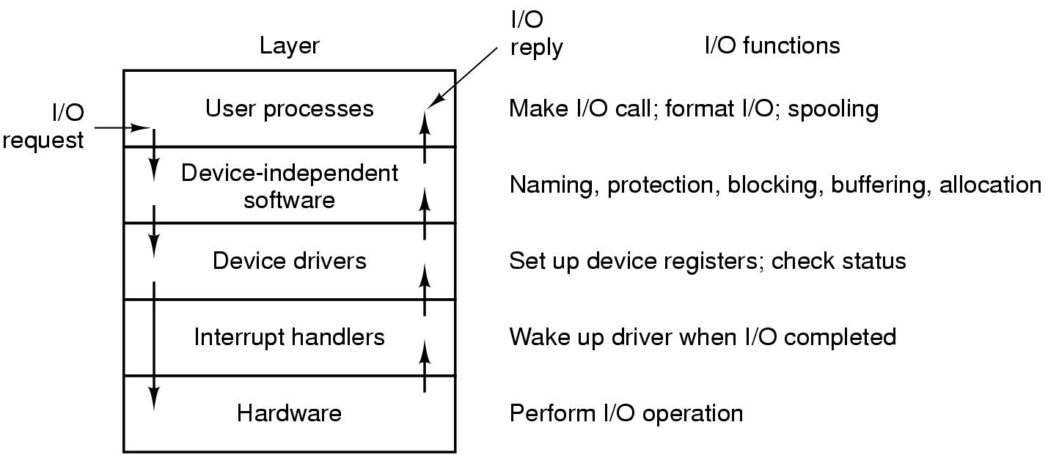
User-Space I/O Software
Layers of the I/O system and the main functions of each layer

Slide 46
Deadlocks
Resource
Introduction to deadlocks
The ostrich algorithm
Deadlock detection and recovery
Deadlock avoidance
Deadlock prevention
Other issues

Slide 47
Deadlocks - Resources
Examples of computer resources
  printers
  tape drives
  tables
Processes need access to resources in reasonable order
Suppose a process holds resource A and requests resource B
  at same time another process holds B and requests A
  both are blocked and remain so

Slide 48
Deadlocks - Resources
Deadlocks occur when …
  processes are granted exclusive access to devices
  we refer to these devices generally as resources
Preemptable resources
  can be taken away from a process with no ill effects
Nonpreemptable resources
  will cause the process to fail if taken away

Slide 49
Deadlocks - Resources
Sequence of events required to use a resource
  request the resource
  use the resource
  release the resource
Must wait if request is denied
  requesting process may be blocked
  may fail with error code

Slide 50
Deadlocks - Introduction
Formal definition :
A set of processes is deadlocked if each process in the set is waiting for an event that only another process in the set can cause
Usually the event is release of a currently held resource
None of the processes can …
  run
  release resources
  be awakened

Slide 51
Deadlocks – Four Conditions
Mutual exclusion condition
  each resource assigned to 1 process or is available
Hold and wait condition
  process holding resources can request additional
No preemption condition
  previously granted resources cannot forcibly taken away
Circular wait condition
  must be a circular chain of 2 or more processes
  each is waiting for resource held by next member of the chain

Slide 52
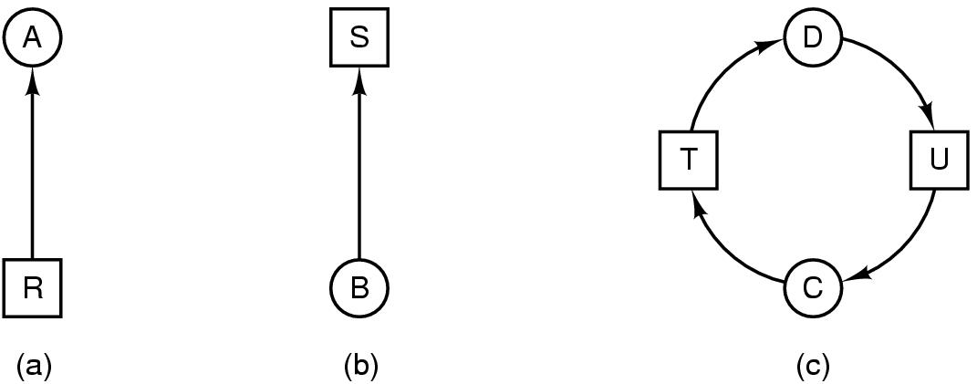
Deadlock Modeling (1)
Modeled with directed graphs
  (a) resource R assigned to process A
  (b) process B is requesting/waiting for resource S
  (c) process C and D are in deadlock over resources T and U

Slide 53
Deadlock Modeling (2)
Strategies for dealing with Deadlocks
  just ignore the problem altogether
  detection and recovery
  dynamic avoidance
    careful resource allocation
  prevention
    negating one of the four necessary conditions

Slide 54
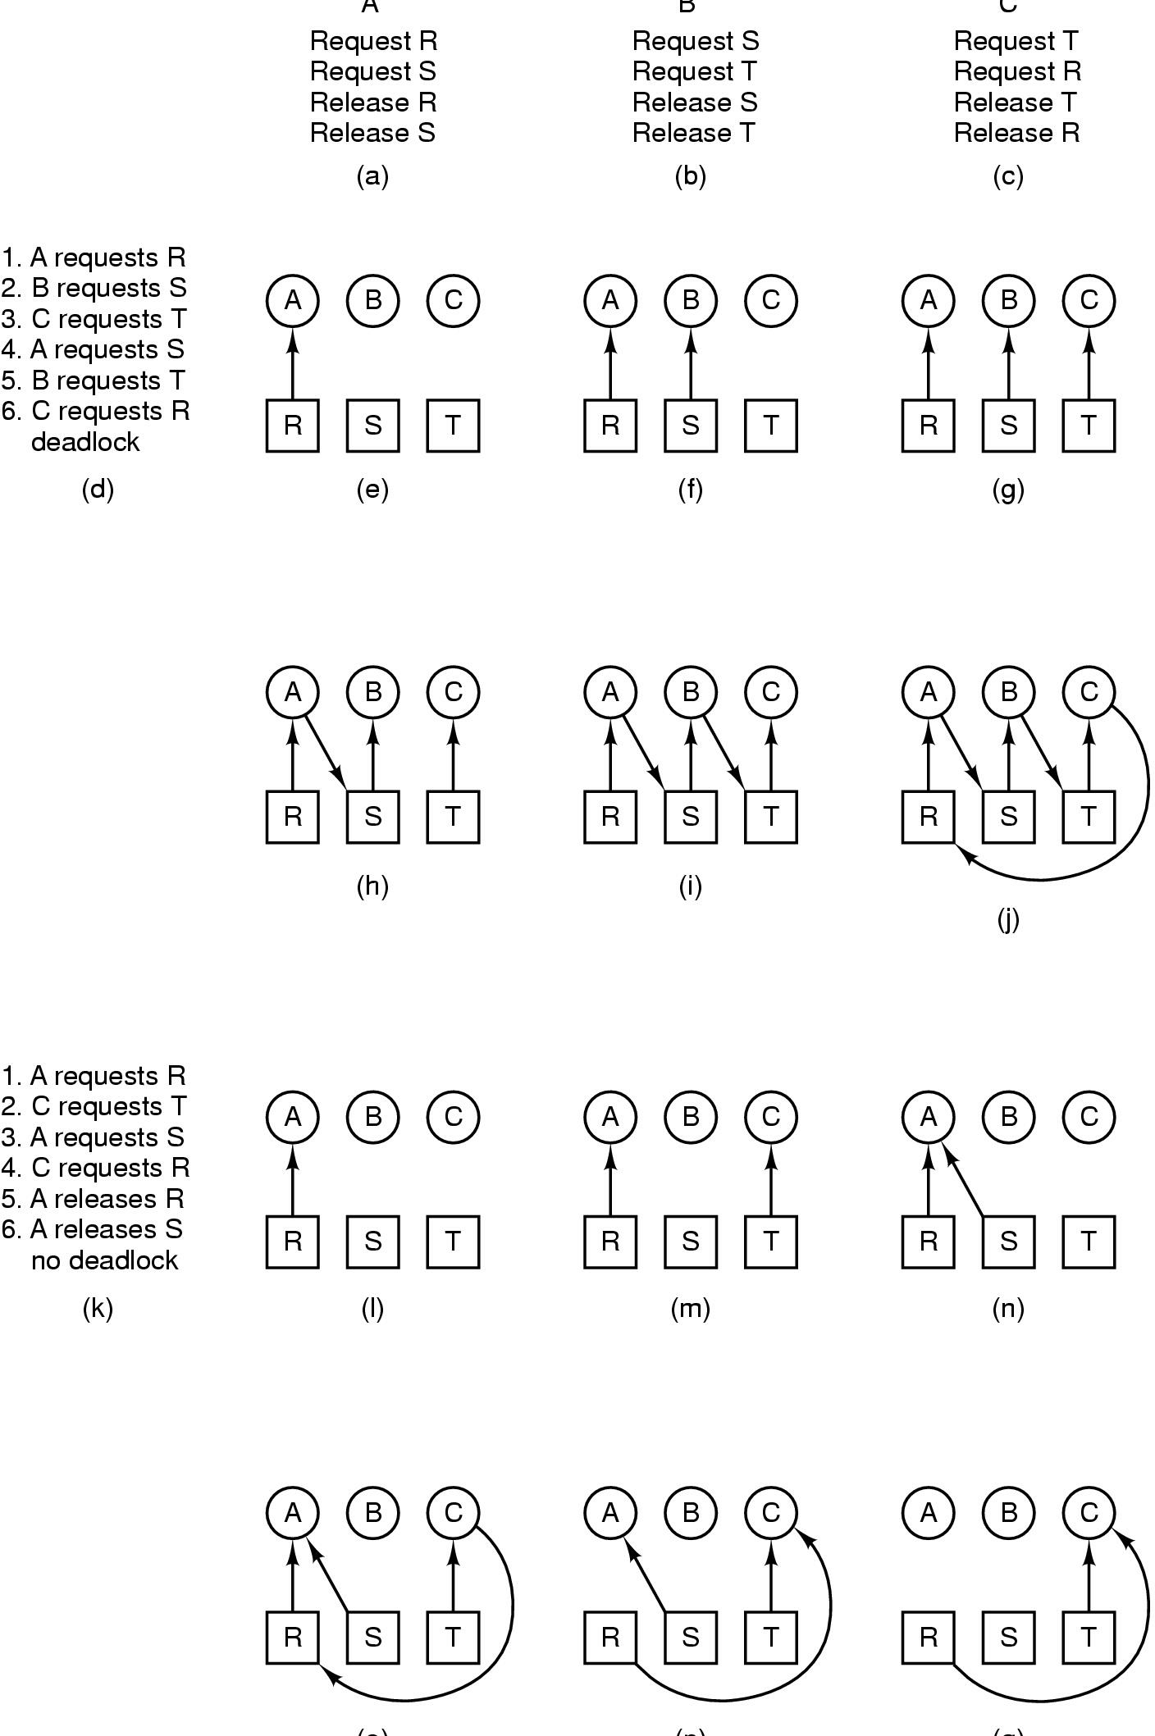
Deadlock Modeling (3)
How deadlock occurs

Slide 55
Deadlock Modeling (4)
How deadlock can be avoided

Slide 56
The Ostrich Algorithm
Pretend there is no problem
Reasonable if
  deadlocks occur very rarely
  cost of prevention is high
UNIX and Windows takes this approach
It is a trade off between
  convenience
  correctness

Slide 57

Detection with One Resource of Each Type
Note the resource ownership and requests
A cycle can be found within the graph, denoting deadlock

Slide 58
Algorithm for detecting cycles in directed graph
(1) for each node N in the graph, performing the following 5 steps with N as the starting node
  (2) initialize L to the empty list, all arcs as unmarked
  (3) add current node to L; check to see if it appears two times;if so,terminates
  (4) if the current node has any unmarked outgoing arcs, go to (5); else go to (6)
  (5) pick an unmarked arc randomly and mark it; get the new current node; go to (3)
  (6) reach a dead end; remove it and go back to previous one

Slide 59
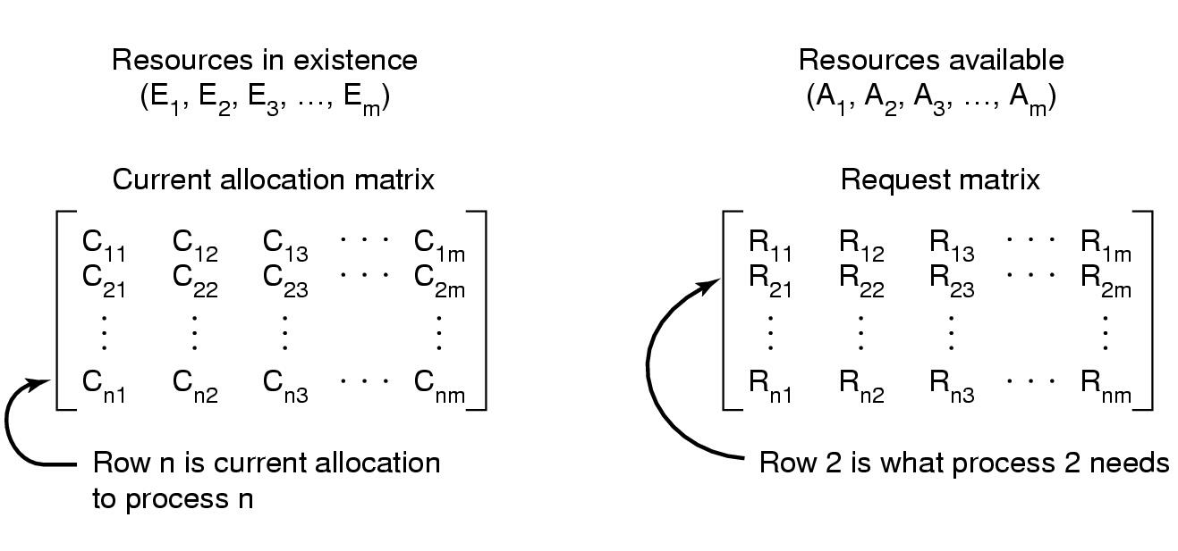
Detection with Multiple Resources of Each Type(1)
Data structures needed by deadlock detection algorithm

Slide 60
Dead lock detection based on comparing vectors
(1) look for an unmarked process, Pi, for which the i-th row of R is <= A
(2) if such a process is found, add the i-th row of C to A, mark the process, and go back to (1)
(3) if no such process exists,terminates

Slide 61

Detection with Multiple Resources of Each Type(2)
An example for the deadlock detection algorithm

Slide 62
Recovery from Deadlock (1)
Recovery through preemption
  take a resource from some other process
  depends on nature of the resource
Recovery through rollback
  checkpoint a process periodically
  use this saved state
  rollback the process if it is found deadlocked

Slide 63
Recovery from Deadlock (2)
Recovery through killing processes
  crudest but simplest way to break a deadlock
  kill one of the processes in the deadlock cycle
  the other processes get its resources
  choose process that can be rerun from the beginning

Slide 64
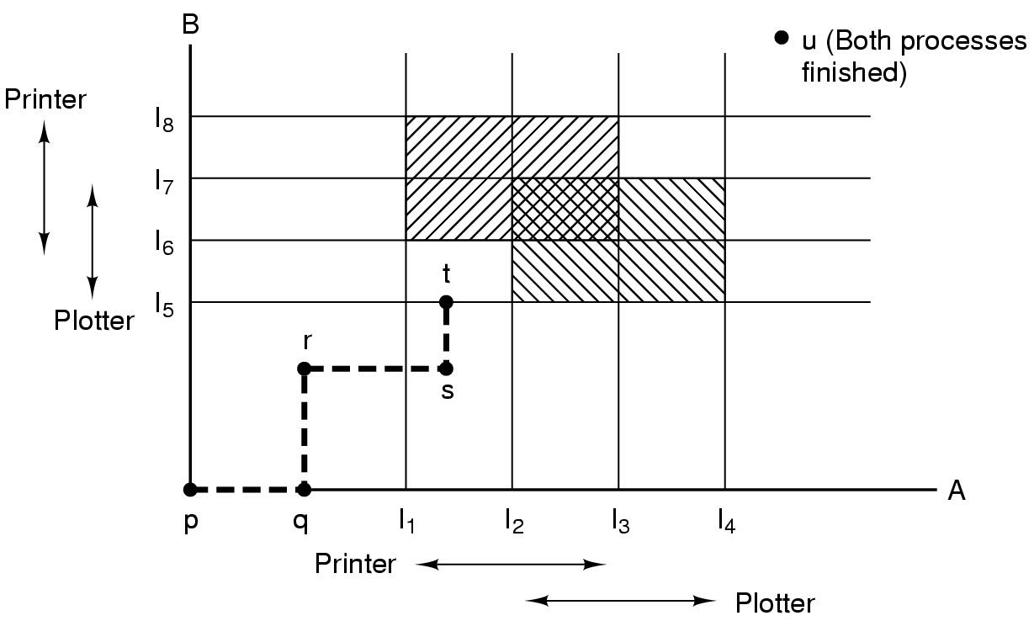
Deadlock Avoidance
Resource Trajectories
Two process resource trajectories

Slide 65
Safe and Unsafe States (1)
a safe state:
  it is not deadlocked, and there is some scheduling order in which every process can run to complete
  it is guaranteed

Slide 66
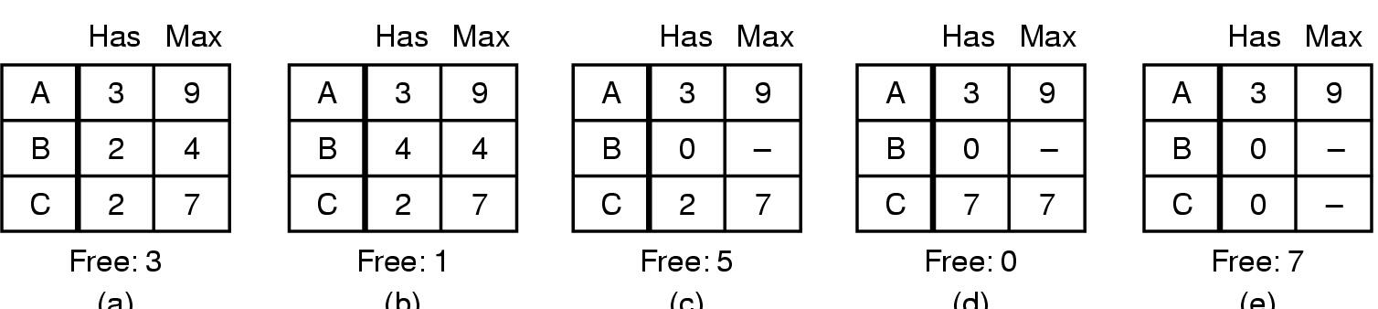
Safe and Unsafe States (2)
Demonstration that the state in (a) is safe

Slide 67
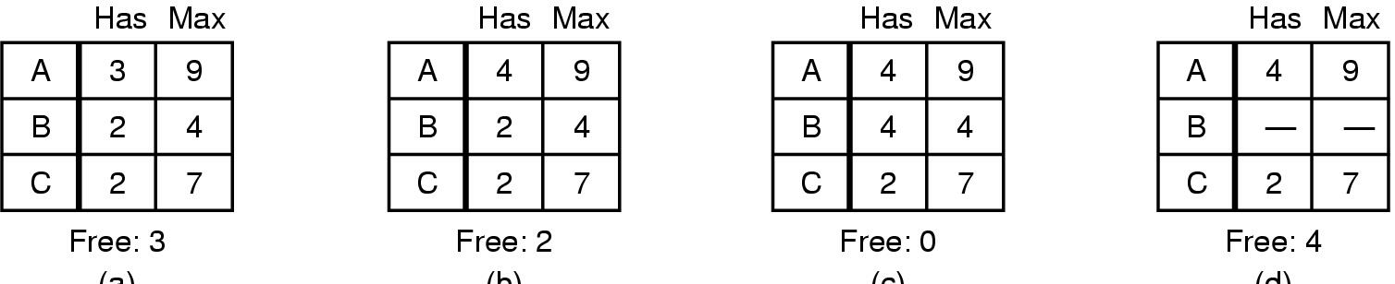
Safe and Unsafe States (3)
Demonstration that the sate in b is not safe

Slide 68
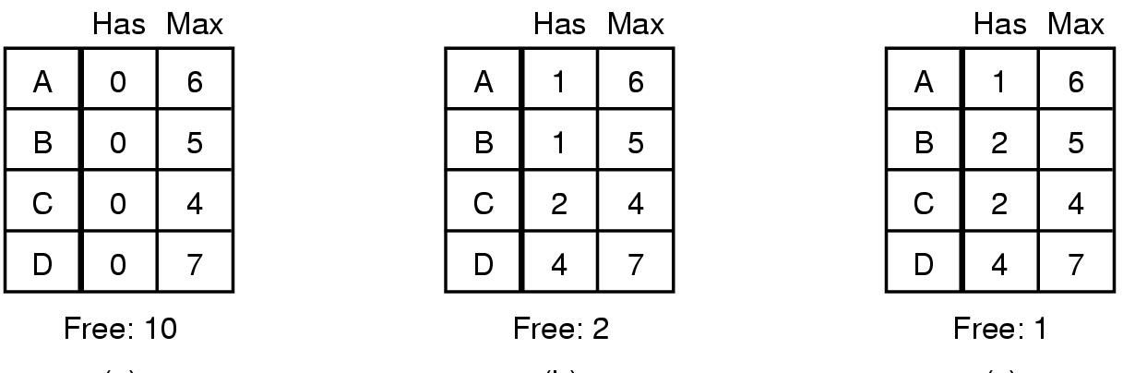
The Banker's Algorithm for a Single Resource
Three resource allocation states
  safe
  safe
  unsafe

Slide 69
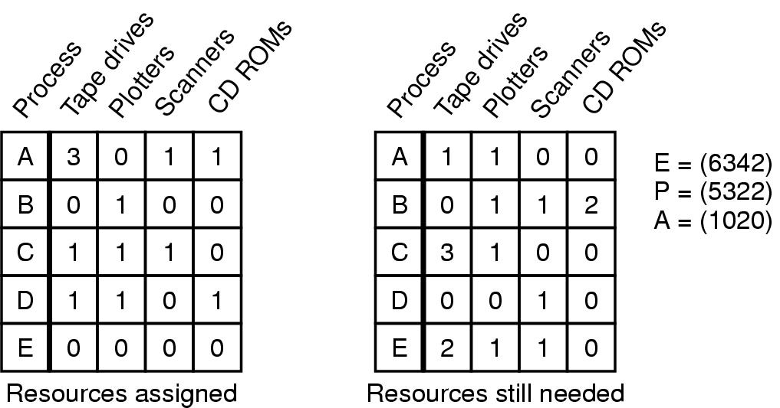
Banker's Algorithm for Multiple Resources
Example of banker's algorithm with multiple resources

Slide 70
Banker's Algorithm for Multiple Resources
algorithm for checking if a state is safe:
  look for a row, R, whose unmet needs <= A; if no such row, the system will eventually deadlock
  Assume the process chosen run to complete, and mark that process and add all its resources to A
  repeat step 1 and 2, until either all processes are marked terminated, thus the state was safe, or until a deadlock occurs, in which case it was not safe.

Slide 71
Deadlock Prevention
Attacking the Mutual Exclusion Condition
Some devices (such as printer) can be spooled
  only the printer daemon uses printer resource
  thus deadlock for printer eliminated
Not all devices can be spooled
Principle:
  avoid assigning resource when not absolutely necessary
  as few processes as possible actually claim the resource

Slide 72
Attacking the Hold and Wait Condition
Require processes to request resources before starting
  a process never has to wait for what it needs
Problems
  may not know required resources at start of run
  also ties up resources other processes could be using
Variation:
  process must give up all resources
  then request all immediately needed

Slide 73
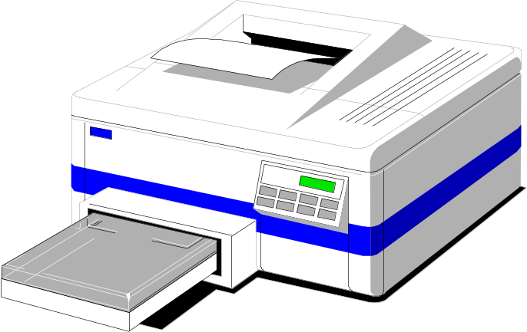
Attacking the No Preemption Condition
This is not a viable option
Consider a process given the printer
  halfway through its job
  now forcibly take away printer
  !!??

Slide 74
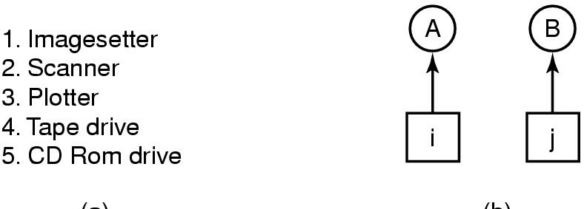
Attacking the Circular Wait Condition (1)
Normally ordered resources
A resource graph

Slide 75
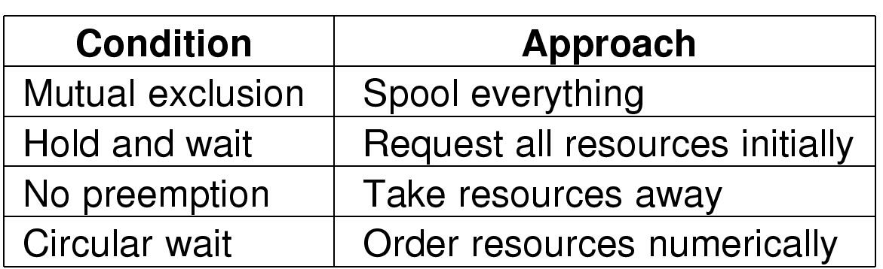
Deadlock prevention
Summary of approaches to deadlock prevention

Slide 76
Other Issues
Two-Phase Locking
Phase One
  process tries to lock all records it needs, one at a time
  if needed record found locked, start over
  (no real work done in phase one)
If phase one succeeds, it starts second phase,
  performing updates
  releasing locks
Note similarity to requesting all resources at once
Algorithm works where programmer can arrange
  program can be stopped, restarted

Slide 77
Nonresource Deadlocks
Possible for two processes to deadlock
  each is waiting for the other to do some task
Can happen with semaphores
  each process required to do a down() on two semaphores (mutex and another)
  if done in wrong order, deadlock results

Slide 78
Starvation
Algorithm to allocate a resource
  may be to give to shortest job first
Works great for multiple short jobs in a system
May cause long job to be postponed indefinitely
  even though not blocked
Solution:
  First-come, first-serve policy

Slide 79
Disks
Disk Hardware (1)
magnetic disks(hard disk or floppy disk)
optical disks(CD-ROMs, CD-Recordables, DVDs)

Slide 80
Disks
Disk Hardware (2)
magnetic disks: 磁盘
  cylinders：柱面
  tracks: 1-16/cylinder：磁道
  sectors: 扇区(8-12/track on floppy disks,
  several hundred on hard disks)

Slide 81
Disks
Disk Hardware (3)
The disk drive may have a microcontroller that does some work for disk controller.
overlapped seek：重叠寻道
  a device feature of the controller to seek on more drives simultaneously
  a floppy disk controller CANNOT do so
  BUT only one transfer between the controller and the main memory is possible at a time.

Slide 82
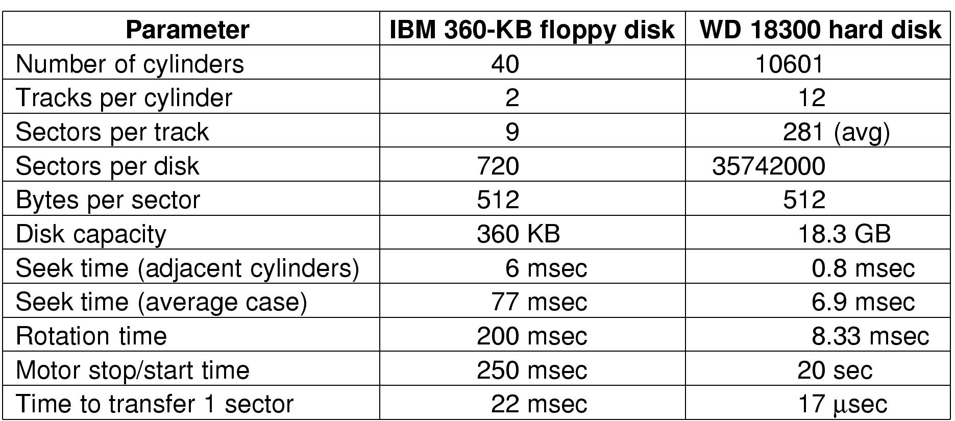
Disks
Disk Hardware (4)
Disk parameters for the original IBM PC floppy disk and a Western Digital WD 18300 hard disk

Slide 83
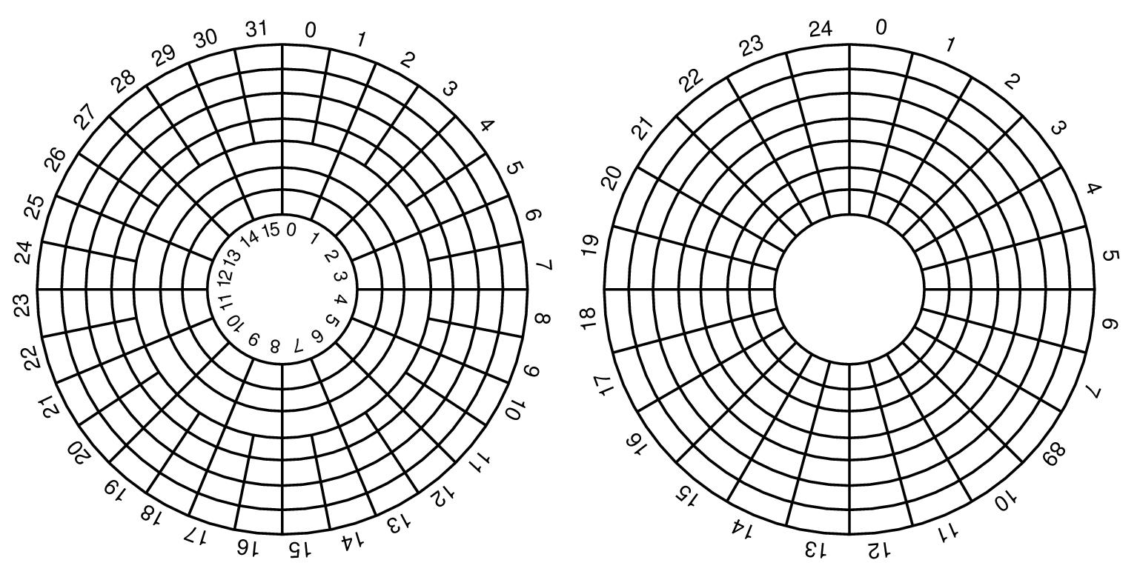
Disks
Disk Hardware (5)
Physical geometry of a disk with two zones
A possible virtual geometry for this disk

Slide 84
Disks
Disk Hardware (6)
real disks with the number of the zones up to 16(WD 18300), increasing radially outward by about 4% in number or sectors per track
a virtual geometry for disks
  (x,y,z) real cylinder, head, sector
  controllers remapps
  Pentium conputers:
  (65536, 16, 63) * 512B/sector = 31.5GB
  logical block addressing: no (x, y, z), with sectors numbered consecutively

Slide 85
Disks
Disk Hardware (7)
RAID
  Patterson et al. 1988
  Redundant Array of Inexpensive Disks
  Redundant Array of Independent Disks
  SLED: Single Large Expensive Disk

Slide 86
Disks
Disk Hardware (8)
RAID
  hardware: often RAID SCSI controller and a box of SCSI disks
  data: distributed over multiple drives
  present to operating system:
    appearance like a single large disk, no software changes
    high performance and reliability

Slide 87
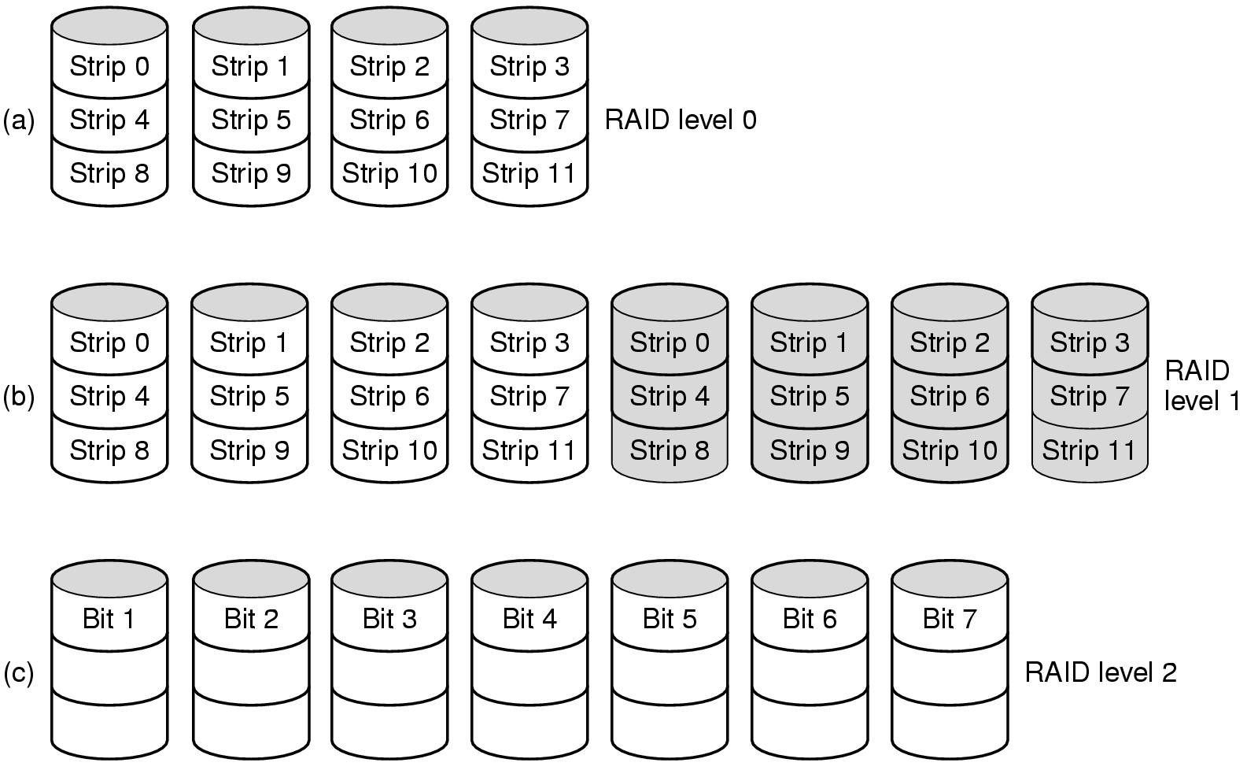
Disks
Disk Hardware (9)
Raid levels 0 through 2
Backup and parity drives are shaded

Slide 88
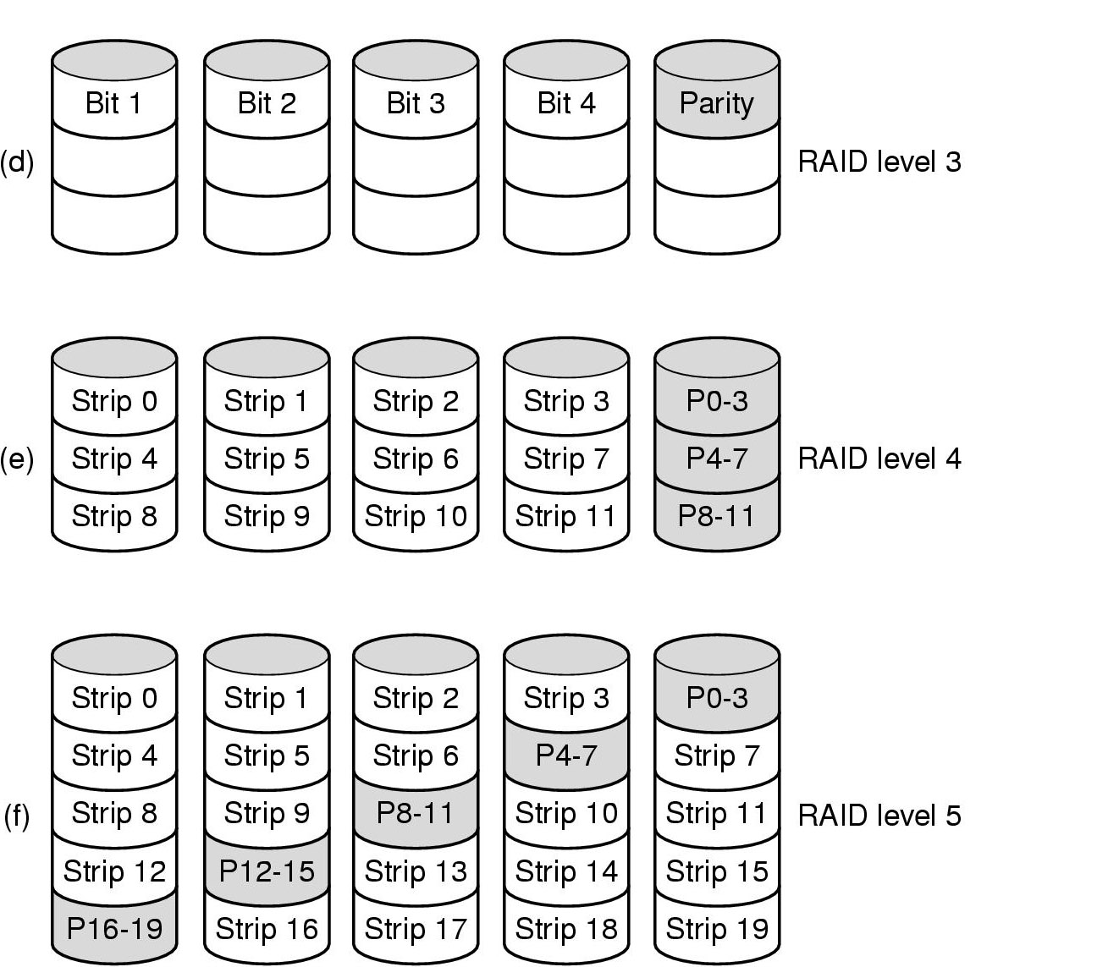
Disks
Disk Hardware (10)
Raid levels 3 through 5
Backup and parity drives are shaded

Slide 89
Disks
Disk Hardware (11)
CD-ROMs
  第一代 LaserVision, Philips, 30cm across
  1980, Philips and Sony, CD,
    IS 10149, the Red Book
    120mm across, 1.2 mm thick, 15mm-hole

Slide 90
Disks
Disk Hardware (12)
CD制作
  在玻璃表面的主盘(master disk)上，高功率的红外激光(infrared laser)烧制出直径为0.8微米的洞
  依照主盘制作模具(mold)，模具上有突起(bumps)对应主盘上激光烧制的洞
  向模具中浇入熔化的有机树脂材料
  其上是具有反光性的一层薄铝
  再上是一层保护性的漆面和标签(label)层

Slide 91
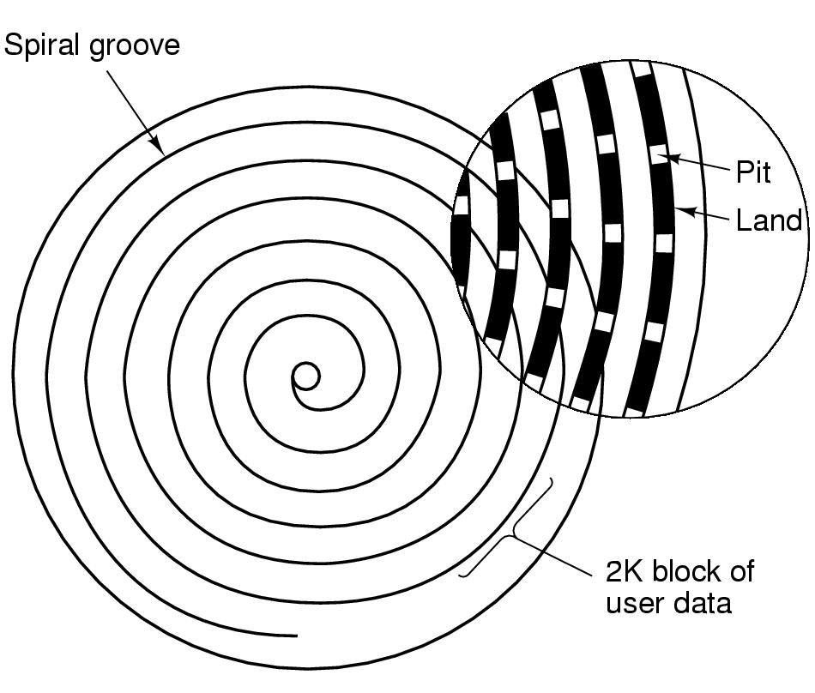
Disks
Disk Hardware (13)
Recording structure of a CD or CD-ROM

Slide 92
Disks
Disk Hardware (14)
CD回放：
  低功率激光二极管以波长为0.78微米的红外激光顺次照射pits和lands
  pits的高度是激光波长的1/4，pit反射的光与周围的land反射光可相互消减，播放器的photodetector可由此区别出pit v.s. land
  通常：pit/land 或者 land/pit表示1
  no such transitions 表示0

Slide 93
Disks
Disk Hardware (15)
constant linear velocity v.s. reduced CD rotation rate
  inside：530 rpm -> 120cm/sec
  outside: 200 rpm -> 120cm/sec

Slide 94
Disks
Disk Hardware (16)
1984, Philips & Sony, CD-ROMs
  Yellow Book
  定义了计算机数据的格式：
    a symbol: 14bits
    a frame: 42 consecutive symbols
    a CD-ROM sector: 98 frames

Slide 95
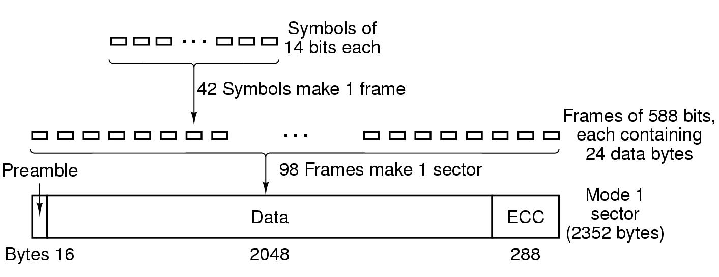
Disks
Disk Hardware (17)
Logical data layout on a CD-ROM

Slide 96
Disks
Disk Hardware (18)
preamble: 16 bytes
  first 12 bytes: 便于player识别CD-ROM 扇区的开始
  next 3 bytes: 扇区号
  the last byte: 模式(mode)
    mode 1
    mode 2: combine the data and ECC fields into a 2336-byte data field

Slide 97
Disks
Disk Hardware (19)
error-correcting v.s. space efficiency
single-speed CD-ROM drives:
  75 sectors/sec
  153600bytes/sec (mode1); 175200 bytes/sec (mode2)
An audio CD: 74 minutes of music, 681,984,000 bytes(mode1) approx. 650MB
性能低于磁盘

Slide 98
Disks
Disk Hardware (20)
1986, Philips, the Green Book
  增加图形特性
  在一个CD-ROM扇区中，交错存入视频(video)、音频(audio)和数据(data)

Slide 99
Disks
Disk Hardware (21)
CD-ROM file system
  IS 9660
  3 levels
    level 1 - filenames of up to 8 characters, optionally an extension of up to 3 characters(MS-DOS file naming convention)
    level 1 – only upper case letters, digits, and underscores in filenames; directories nested up to 8 deep; all files contguous

Slide 100
Disks
Disk Hardware (22)
IS 9660 level 2: names up to 32 characters
IS 9660 level 3: noncontiguous files
Rock Ridge extension: very long names, UIDs, GIDs, symbolic links

Slide 101
Disks
Disk Hardware (23)
CD-Recordables
  like CD-ROMs
  but with a 0.6-mm wide groove to guide the laser for writing
  gold colored
  add a layer of dye to simulate the reflectivity of the pits and lands on CDs

Slide 102
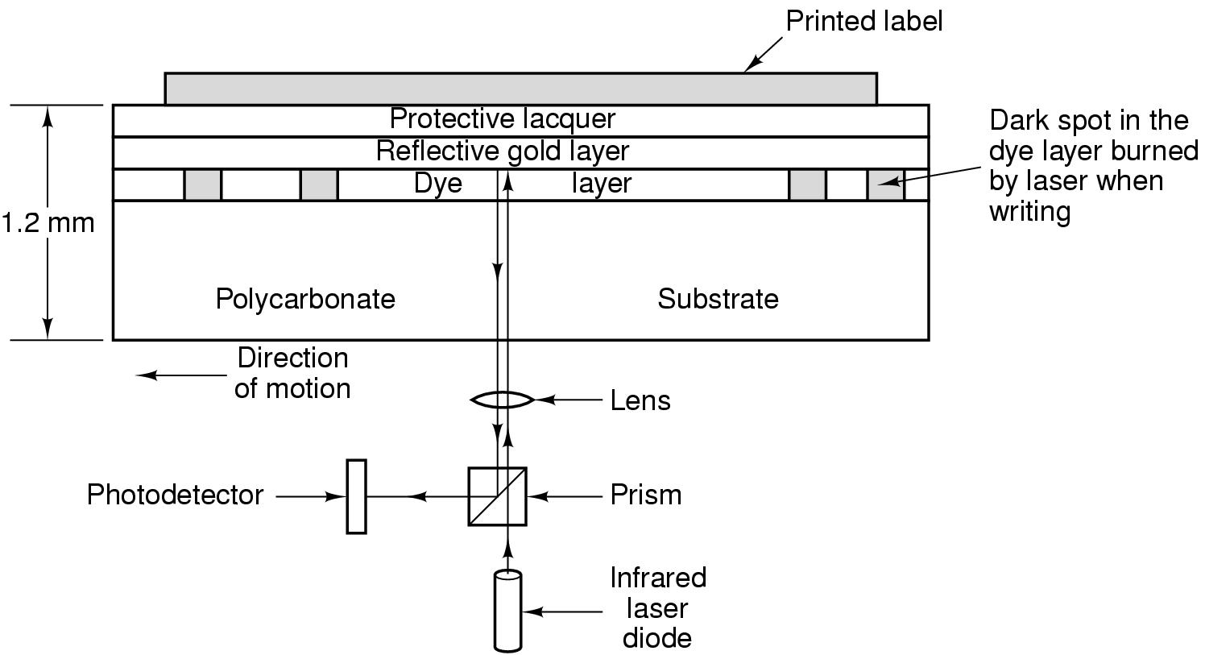
8－16 mW v.s.
0.5 mW
Cross section of a CD-R disk and laser
  not to scale
Silver CD-ROM has similar structure
  without dye layer
  with pitted aluminum layer instead of gold

Slide 103
Disks
Disk Hardware (24)
1989, Orange Book
  CD-R
  CD-ROM XA
    allow incrementally write to CD-Rs
    CD-ROM track: a group of consecutive sectors written at once
    VTOC(Volume table of Contents): one per track

Slide 104
Disks
Disk Hardware (25)
possible violation of the publisher’s copyright
  使CD-ROM只能用出版商的软件读解
    CD-ROM文件长度改为多GB级，使标准拷贝软件无法拷贝；真正的文件长度在软件中或加密后存于CD-ROM 的某个地方。
    某些扇区中故意使用错误的ECC码，一般CD拷贝软件会更正错误，真正的软件在检查ECC时，发现无错误就拒绝工作。
    tracks之间非标准的间距，或一些有意的物理漏洞

Slide 105
Disks
Disk Hardware (26)
CD-ReWritables
  CD-R中的dye层，替换为银(silver)、铟(indium)、锑(antimony)、碲(tellurium)的合金->CD-RW中的Recording 层
  合金的两个稳定状态
    crystalline: 晶体状态
    amorphous: 非结晶状态

Slide 106
Disks
Disk Hardware (27)
CD-RW drive 使用三种不同功率的激光
  high power: melt the alloy, converting it from the high-reflectivity crystalline state to low-reflectivity amorphous state(a pit)
  medium power: melts the alloy, and reform to its natural crystalline state(a land again)
  low power: sense the state of the alloy, no transitions

Slide 107
Disks
Disk Hardware (28)
DVD (Digital Video Disk, Digital Versatile Disk)
use the same general design as CDs (120mm, injection-molded, pits and lands etc.)
new
  Smaller pits (0.4 microns v.s. 0.8 microns for CDs)
  A tighter spiral (0.74 microns between tracks v.s. 1.6 microns)
  A red laser(0.65 microns v.s. 0.78 microns for CDs)
capacity raised to 4.7G

Slide 108
Disks
Disk Hardware (29)
单倍速DVD光驱数据传送率：1.4MB/sec
4.7GB DVD using MPEG-2 compression can
  133 minutes of full-screen, full-motion video at high resolution(720 * 480)
  soundtracks in up to 8 languages
  subtitles in 32 more

Slide 109
Disks
Disk Hardware (30)
四个格式
  single-sided, single-layer(4.7GB)
  single-sided, dual-layer(8.5GB)
  double-sided, single-layer(9.4GB)
  double-sided, dual-layer(17GB)

Slide 110
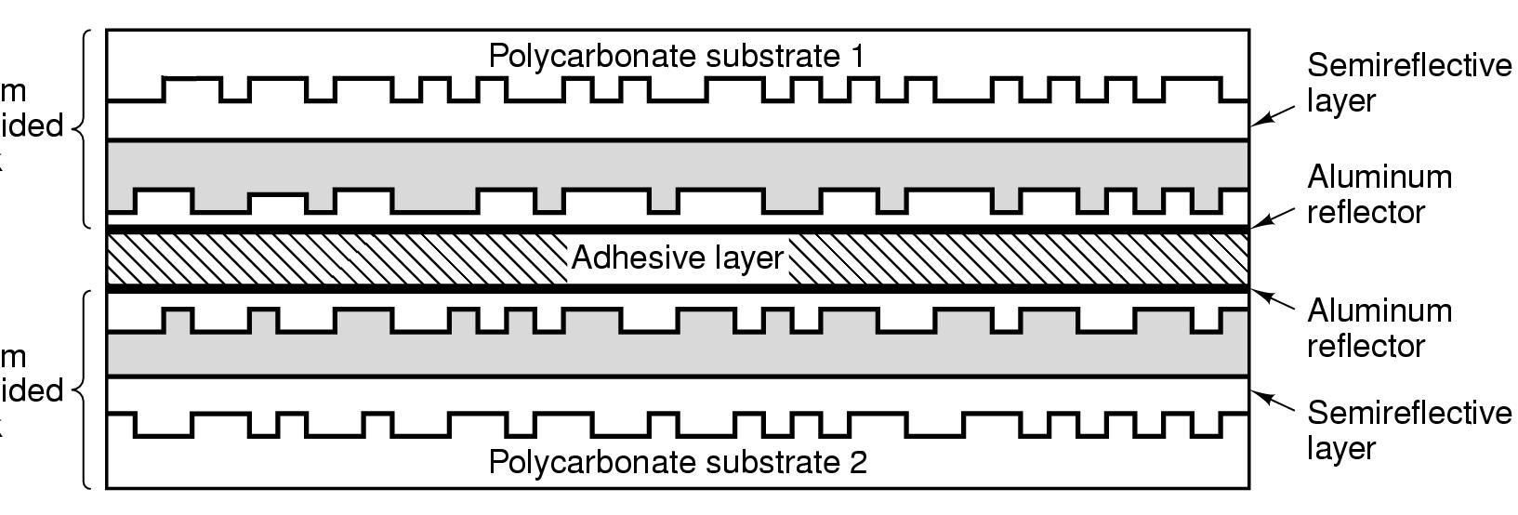
Disks
Disk Hardware (31)
0.6 mm single-sided disk
0.6 mm single-sided disk
A double sided, dual layer DVD disk

Slide 111
Disk Formatting (1)
低级格式化(low-level format)
  一系列同心圆的磁道(concentric tracks)
  每个磁道有若干扇区(sectors)，扇区之间有间隙(gaps)
A disk sector

Slide 112
Disk Formatting (2)
导言(preamble)
  位模式(bit pattern)
  柱面号、扇区号、扇区大小、其他信息
  在低级格式化时写入
数据部分
  大小由低级格式化程序决定
  一般512bytes

Slide 113
Disk Formatting (3)
纠错码(ECC)
  冗余信息，用于恢复读入错误
  长度和内容随生产厂商而定，一般16 bytes
一些空闲扇区，用于替换故障扇区

Slide 114
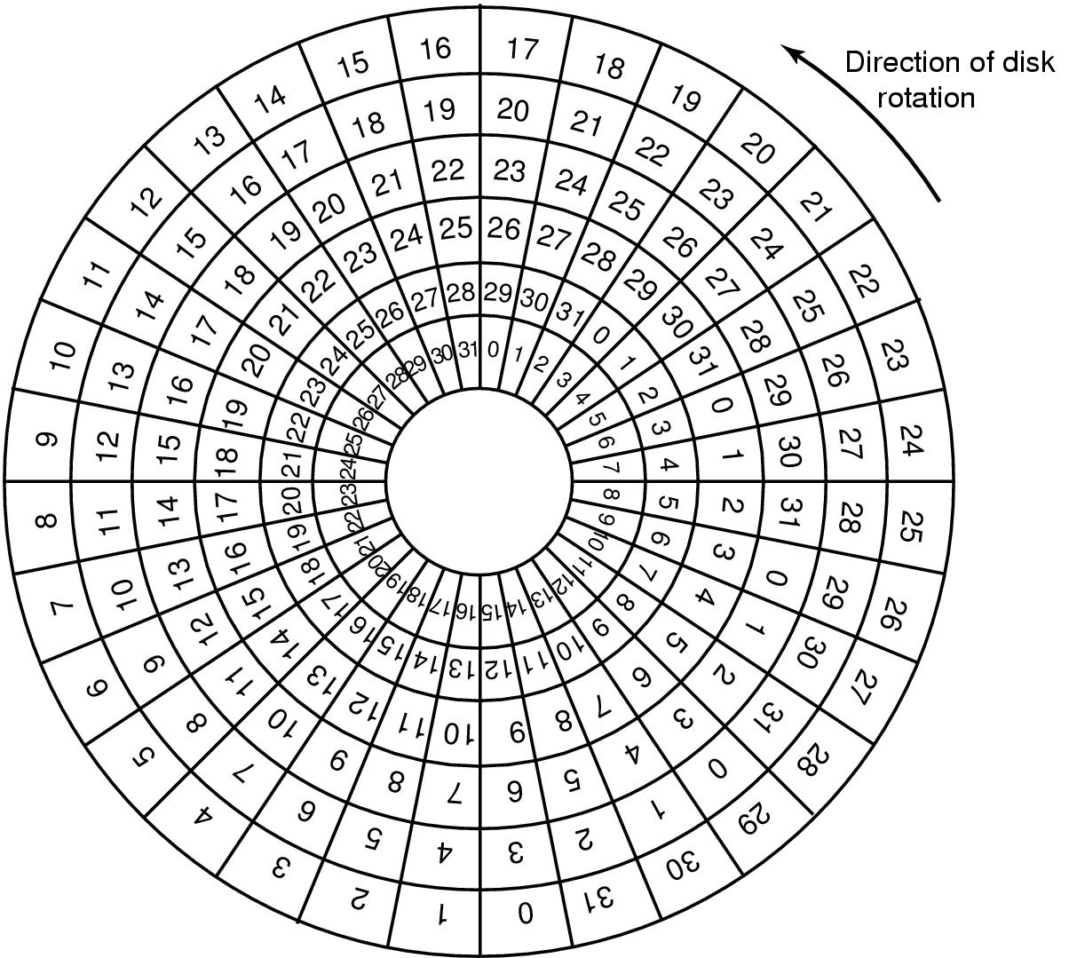
Disk Formatting (4)
An illustration of cylinder skew

Slide 115
Disk Formatting (5)
低级格式化的一些后果
  磁盘空间变小(Often the formatted capacity is 20% lower than the unformatted capacity.)
    2 * 10⁹B(as 20GB) – 2³⁴B(17.2 * 10⁹ byte) – 16.0GB
  性能
    10,000-rpm disk, 300 sectors per track of 512 bytes each
    data rate: 25,600,000 bytes/sec (24.4 MB/sec)

Slide 116
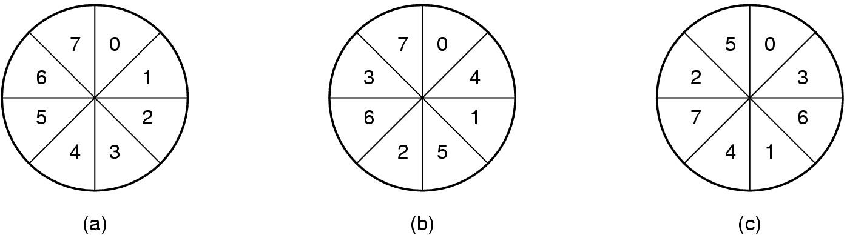
Disk Formatting (6)
No interleaving
Single interleaving
Double interleaving

Slide 117
Disk Formatting (7)
分区(partitions)
sector 0: master boot record
  boot program
  partition table: the starting sector and size of each partition; mark one active partition

Slide 118
Disk Formatting (8)
每个分区分别高级格式化(high-level format)
  a boot block
  free storage management(free list or bitmap)
  root directory
  an empty file system

Slide 119

Disk Arm Scheduling Algorithms (1)
Time required to read or write a disk block determined by 3 factors
  Seek time
  Rotational delay
  Actual transfer time
Seek time dominates

Slide 120
Disk Arm Scheduling Algorithms (2)
先来先服务(First-Come, First-Served)
  The driver accepts request one at a time
  Little can be done to optimize seek time.

Slide 121
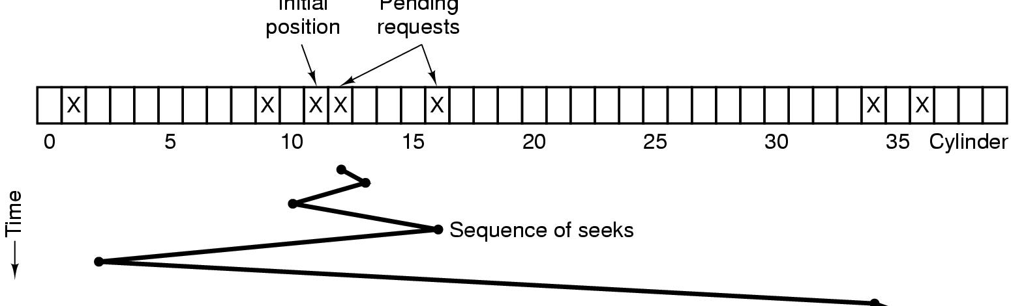
Disk Arm Scheduling Algorithms (3)
最短寻道算法(Shortest Seek First)
  不同柱面的请求到达顺序: 11(, 1, 36, 16, 34, 9, 12)
Shortest Seek First (SSF) disk scheduling algorithm

Slide 122
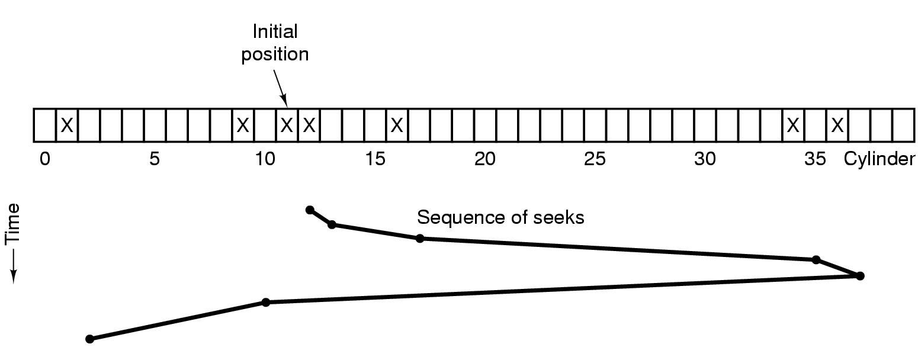
Disk Arm Scheduling Algorithms (4)
电梯算法(Elevator algorithm)
The elevator algorithm for scheduling disk requests

Slide 123
Disk Arm Scheduling Algorithms (5)
在同一个柱面上的多个请求的优化
  如果控制器提供让软件检测当前扇区号的手段，先经过磁头的扇区优先
  如果同一柱面有多个磁道，不同磁道的请求可无需优化

Slide 124
Disk Arm Scheduling Algorithms (6)
如果寻道的时间比旋转延迟快
  请求表应按扇区号排序
  当下一个扇区将通过磁头时，将磁臂移到相应的磁道进行读写

Slide 125
Disk Arm Scheduling Algorithms (7)
磁盘控制器上的cache存储
  例如：2M – 4MB
  cache的使用由控制器动态决定
  常分为两个区域：读区/写区

Slide 126
Disk Arm Scheduling Algorithms (8)
若一个控制器有多个驱动器，且支持重叠寻道
  驱动程序为每个驱动器维护一个请求表
  寻道操作和数据的传送可以同时完成
以上算法假定
  the real disk geometry is the same as the virtual geometry
  控制器一次处理一个请求

