Slide 1


出错处理(Error Handling)
常见错误
  程序错误(programming errors)
  暂时检查和错误(transient checksum errors)
  永久检查和错误(permanent checksum errors)
  寻道错误(seek errors)
  控制器错误(controller errors)

Slide 2
出错处理(Error Handling)
bad sectors
  ECC corrects the errors
  deal with in the controller
  deal with in the operating system

Slide 3
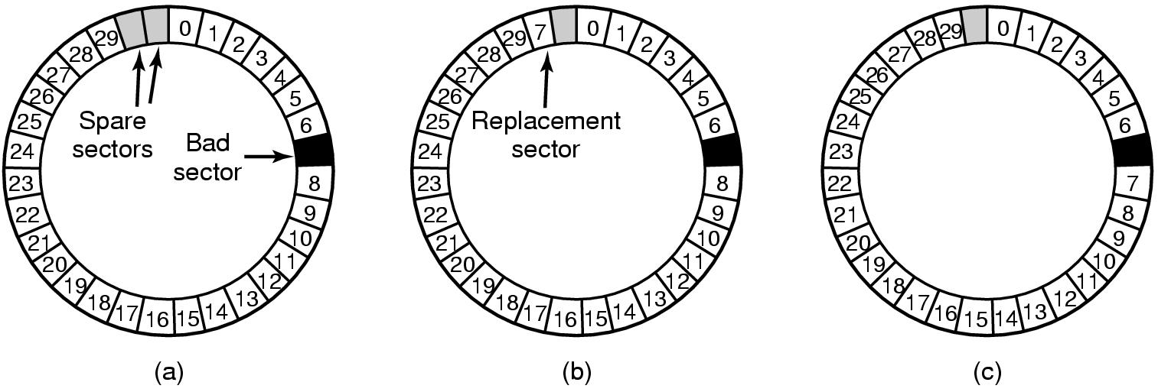
出错处理(Error Handling)
A disk track with a bad sector
Substituting a spare for the bad sector
Shifting all the sectors to bypass the bad one

Slide 4
出错处理(Error Handling)
substituting spare sectors for bad ones
  控制器需要记录信息
    内部表(one per track)
    导言重写(rewriting preambles)

Slide 5
出错处理(Error Handling)
deal with bad sectors in the operating system
  acquire a list of bad sectors
  build remapping tables
  can also use the former two ways

Slide 6
出错处理(Error Handling)
deal with bad sectors in the operating system
  bad sectors are not in any files
  nor in the free list
  create a secret file containing all the bad sectors, keeping it out of the file system

Slide 7
出错处理(Error Handling)
deal with bad sectors in the operating system
  backups:
    file by file: hide the bad block file
    sector by sector: smart backup utility program

Slide 8
出错处理(Error Handling)
寻道错误(seek errors)
  hard disks controllers can handle automatically
  floppy controllers set an error bit and leave it to the driver
    the driver: 发送校准命令(recalibrate command)，重置控制器的0号柱面信息

Slide 9
出错处理(Error Handling)
控制器错误(controller errors)
  controller bugs
  need some hardware in design to reset itself
  the disk driver sets a bit to invoke the signal and reset the controller
  the disk driver print a message and give up

Slide 10
Clocks - Clock Hardware
时钟硬件(PC机中)
    实时时钟（Real Time Clock，RTC）
    可编程间隔定时器（Programmable Interval Timer，PIT）
    时间戳计数器（Time Stamp Counter，TSC）。

Slide 11
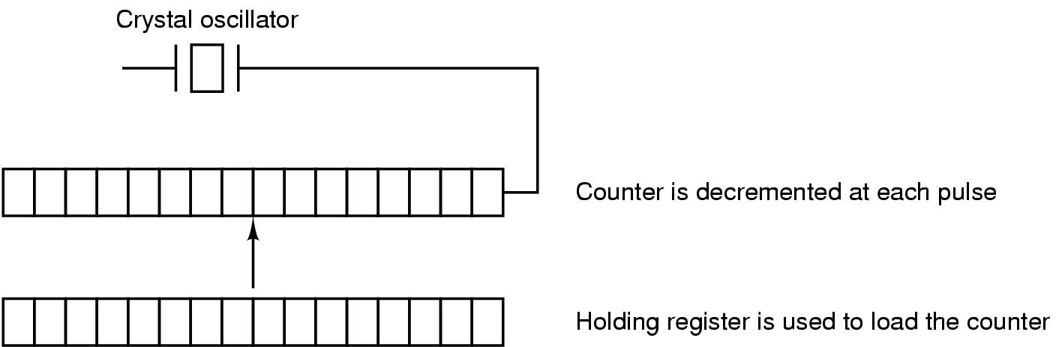
Clocks - Clock Hardware
A programmable interval clock

Slide 12
Clocks - Clock Hardware
Programmable interval clock的工作模式
  One-shot mode
  Square-wave mode
时钟滴答(Clock tick)

Slide 13
Clocks - Clock Hardware
Programmable interval clock
  周期性地发生时钟中断
  e.g. 晶体振荡频率500MHz, 32位寄存器, 则时钟中断的间隔为2nsec – 8.6sec

Slide 14
Clocks - Clock Hardware
实时时钟RTC
  在PC机断电后仍能保存时间
  通过主板上的电池供电；通常与CMOS RAM集成到一块芯片上
  也称为 CMOS Timer

Slide 15
Clocks - Clock Hardware
实时时钟RTC
  可在系统初启时读入
  并转换为相对于某一基准时间的时钟滴答数
操作系统提供实用程序可以设置系统时钟和RTC并在二者之间同步

Slide 16
Clocks - Clock Hardware
时间戳记数器TSC
  Pentium之后的CPU中包含的64位的寄存器
  在每一个振荡信号到达时，该计数器递增
  可为操作系统提供更准确的时间度量

Slide 17
Clock Software (1)
Common duties of the clock driver
  maintaining the time of day
  preventing processes from running longer than they are allowed to
  accounting for CPU usage
  handling alarm system call by user processes
  providing watchdog timers for part of the system itself
  doing profiling, monitoring and statistics gathering

Slide 18
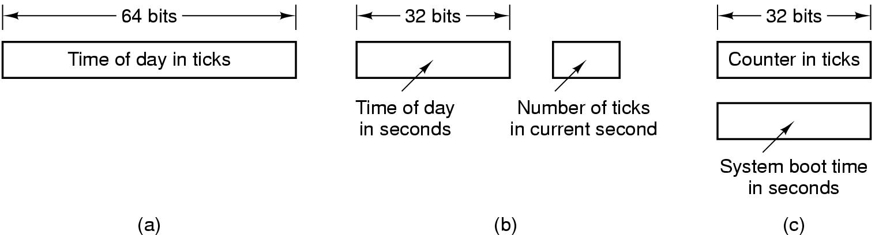
Clock Software (2)
maintaining the time of day(real time)
  problem: clock rate – 60Hz, 32-bit counter
Three ways to maintain the time of day

Slide 19
Clock Software (3)
preventing processes from running longer than they are allowed to
  Process started, the scheduler initializes a counter to the process’ quantum in clock ticks.
  At every clock interrupt, the clock driver decrements the counter by 1.
  When it gets to 0, the clock driver calls the scheduler to start up another process

Slide 20
Clock Software (4)
accounting for CPU usage
  method 1: start a second timer
  method 2: charging clock ticks to the current process

Slide 21
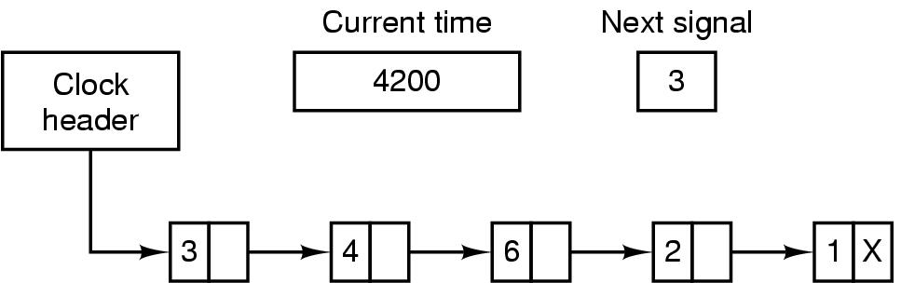
Clock Software (5)
handling alarm system call by user processes
Simulating multiple timers with a single clock

Slide 22
Clock Software (6)
the clock driver does in a clock interrupt:
  increment the real time
  decrement the quantum and check for 0
  do CPU accounting
  decrement the alarm counter

Slide 23
Clock Software (7)
watch-dog timer
  used by other parts of the operating system
  e.g. floppy disks
    floppy disk driver starts the motor at requests and sets a watch-dog timer
  the clock driver calls a procedure provided by the caller, instead of causing a signal

Slide 24
Character-oriented terminal
RS-232 terminals
graphical user interface
network terminals

Slide 25
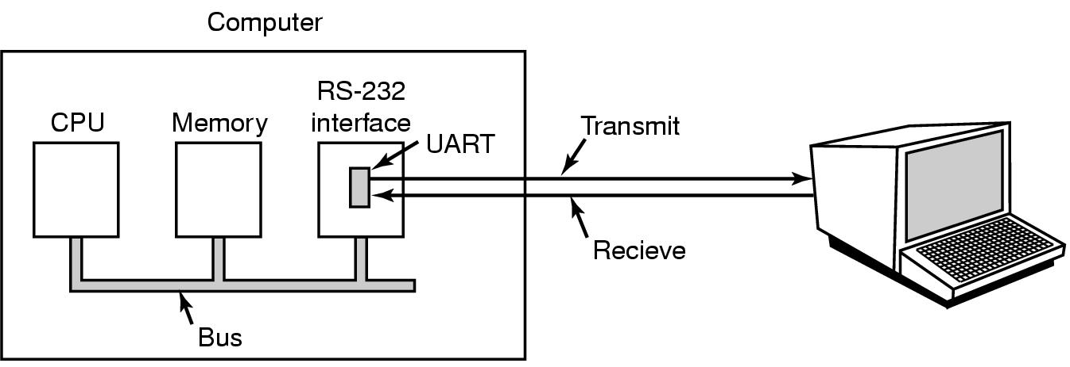
Character-oriented terminal
RS-232 Terminal Hardware
An RS-232 terminal communicates with computer 1 bit at a time
Called a serial line – bits go out in series, 1 bit at a time
Unix: /dev/tty1, /dev/tty2…;Windows: COM1 and COM2
Computer and terminal are completely independent

Slide 26
Character-oriented terminal
UART(Universal Asynchronous Receiver Transmitters)
  hardware doing the character-to-serial and serial-to-character conversions
  e.g. a modem operating at 56000bps, it takes 179microseconds to send a character
  can send and receive characters simultaneously

Slide 27
Character-oriented terminal
RS-232 terminals can be subdivided into categories
  hardcopy terminals
  dumb terminals
  intelligent CRT terminals

Slide 28
Terminal – Input software
The keyboard driver works in two modes:
  character-oriented: raw mode, noncanonical mode
  line-oriented: cooked mode, canonical mode

Slide 29
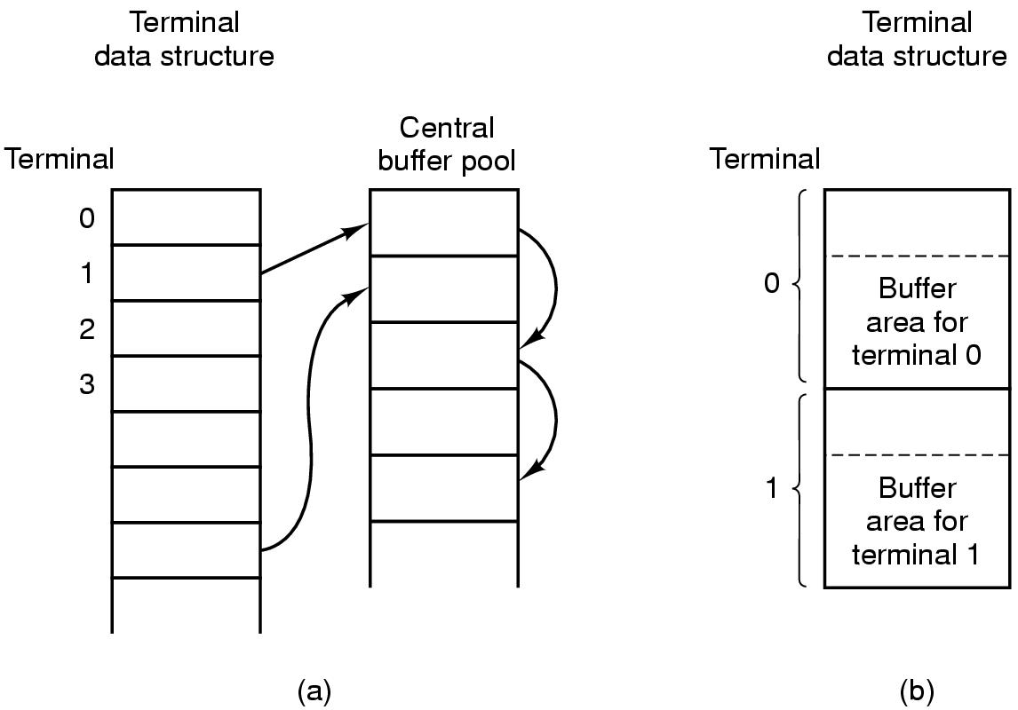
Terminal – Input software
character collecting
character buffering
Central buffer pool
Dedicated buffer for each terminal

Slide 30
Terminal – Input software
echoing
  to keep new input
  line wrapping or truncating
  tab handling
  device equivalence

Slide 31
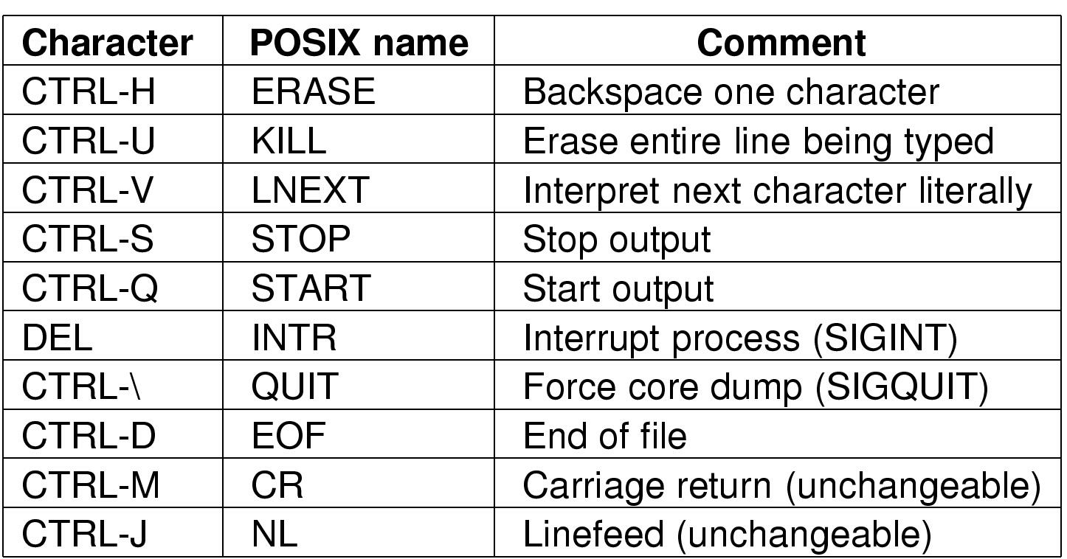
Terminal – Input software
Characters handled specially in canonical mode

Slide 32
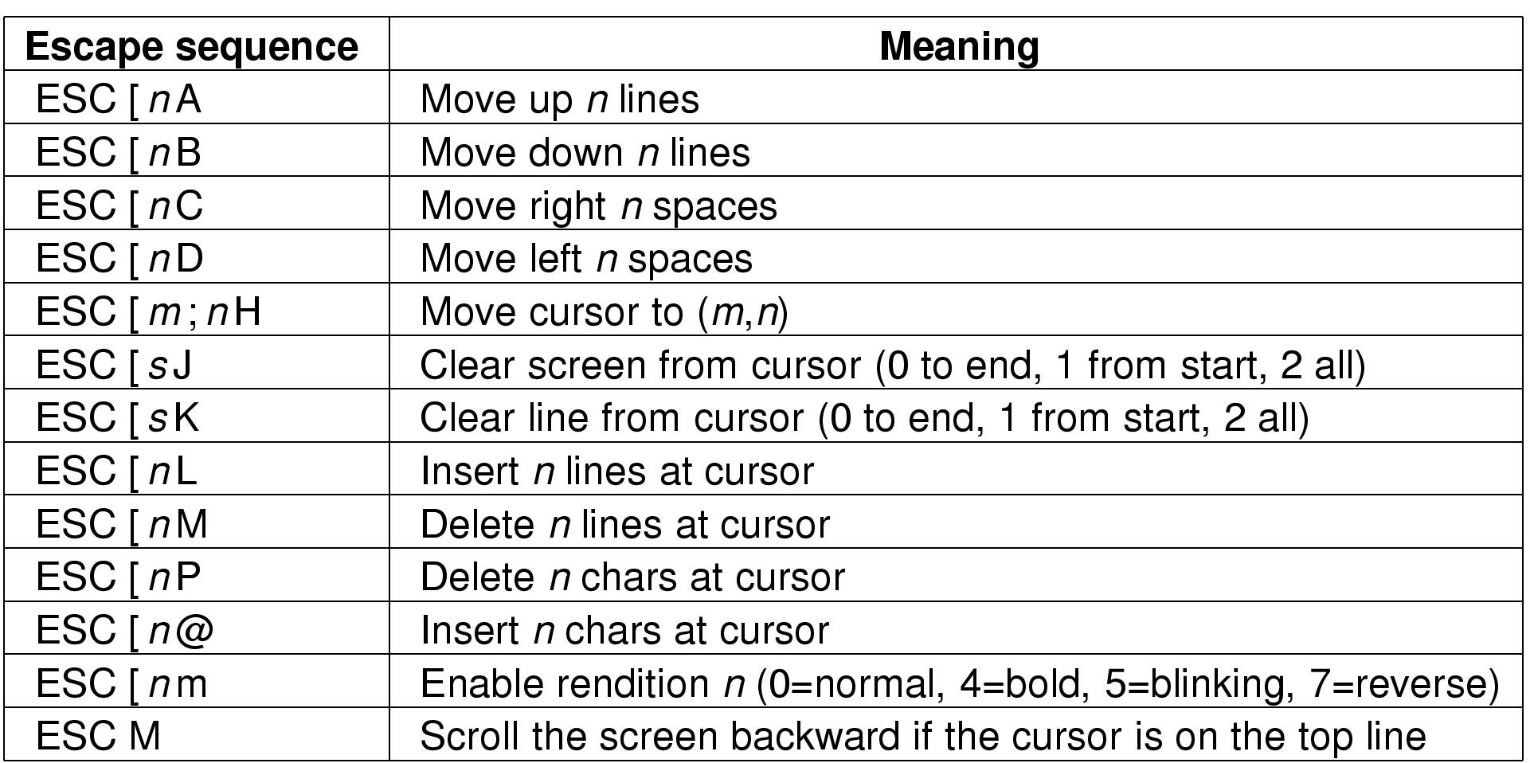
Terminal – Output software
The ANSI escape sequences
accepted by terminal driver on output
ESC is ASCII character (0x1B)
n,m, and s are optional numeric parameters

Slide 33
Terminal – Output software
e.g.在编辑器中删除第三行
  ESC [ 3; 1 H ESC [ 0 K ESC [ 1 M

Slide 34
Graphical User Interface
RS-232 terminals
graphical user interface
network terminals

Slide 35
Graphical User Interface
A GUI has four essential elements: WIMP
  W: windows
  I: icons
  M: menus
  P: a pointing device

Slide 36
Graphical User Interface
Hardware
  Keyboard
  Mouse
  Display hardware

Slide 37
Graphical User Interface
Keyboard
  Keyboard interface: a serial port, a parallel port, or a USB port
  CPU is interrupted at every key action
  The keyboard driver extracts the character typed by reading an I/O port A

Slide 38

Graphical User Interface
Mouse
  As the mouse moves, two orthogonal shafts rotate
  A certain minimum distance moved, any button depressed or released, can cause a message sent.
    mickey (about 0.1 mm, can be set in software)
    The message contains x, y, buttons
  Most mice report back 40times/sec at most.
  Some GUIs distinguish single click v.s. double click.

Slide 39
Graphical User Interface
Display devices can be divided into:
  vector graphics
  raster graphics (bitmap graphics)

Slide 40
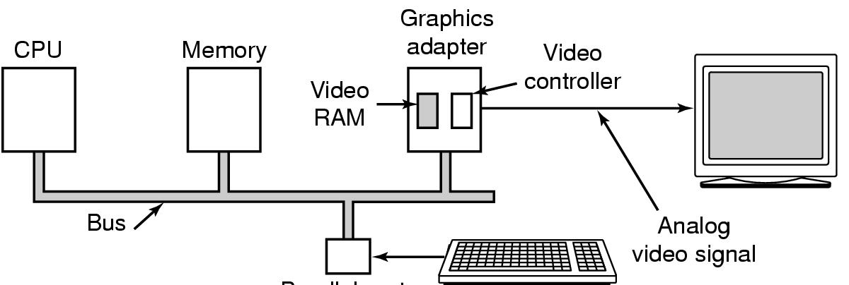
Display Hardware
Memory-mapped displays
driver writes directly into display's video RAM

Slide 41
Display Hardware
Video controller
  pulls characters or bits out of the video RAM and generates the video signal used to drive the monitor.
  The monitor generates a beam or beams of electrons that scan horizontally across the screen.

Slide 42
Display Hardware
Video controllers have two modes
  character mode
  bit mode

Slide 43
Display Hardware
Video controllers in character mode, e.g.
  each character might be 9 pixels wide by 14 pixels high
  25 lines of 80 characters
  redrawn 60 – 100 times/sec
  video controller ROM:
    keeps 9-by-14 bit patterns
    addressed by a 12- bit address

Slide 44
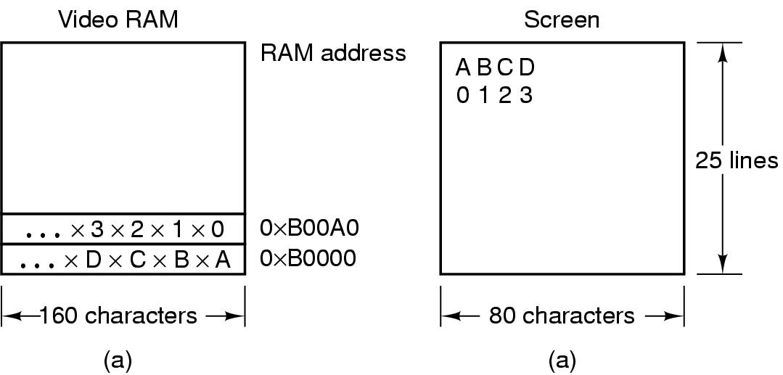
Display Hardware
A video RAM image
  simple monochrome display
  character mode
Corresponding screen
  the xs are attribute bytes

Slide 45
Display Hardware
Video controller in bitmap mode:
  each pixel on the screen is individually controlled and represented in the video RAM.
  color
  size: 640 * 480(VGA), 800 * 600(SVGA), 1024 * 768(XGA), 1280 * 1024, 1600 * 1200
  e.g. 1024 * 768 with 24 bits per pixel, refreshing frequency 75 times/sec( 2.25 MB of RAM to hold the image, deliver rate at 169MB/sec)

Slide 46
Display Hardware
Video controller in bitmap mode:
  color palette: a table, called color palette, of 256 entries, each holding a 24-bit value
  or
  use 16-bit color by storing the RGB values as three 5-bit numbers

Slide 47
Input Software
Keyboard delivers a number
  driver converts to characters
  uses a ASCII table
Exceptions, adaptations needed for other languages
  many OS provide for loadable keymaps or code pages

Slide 48
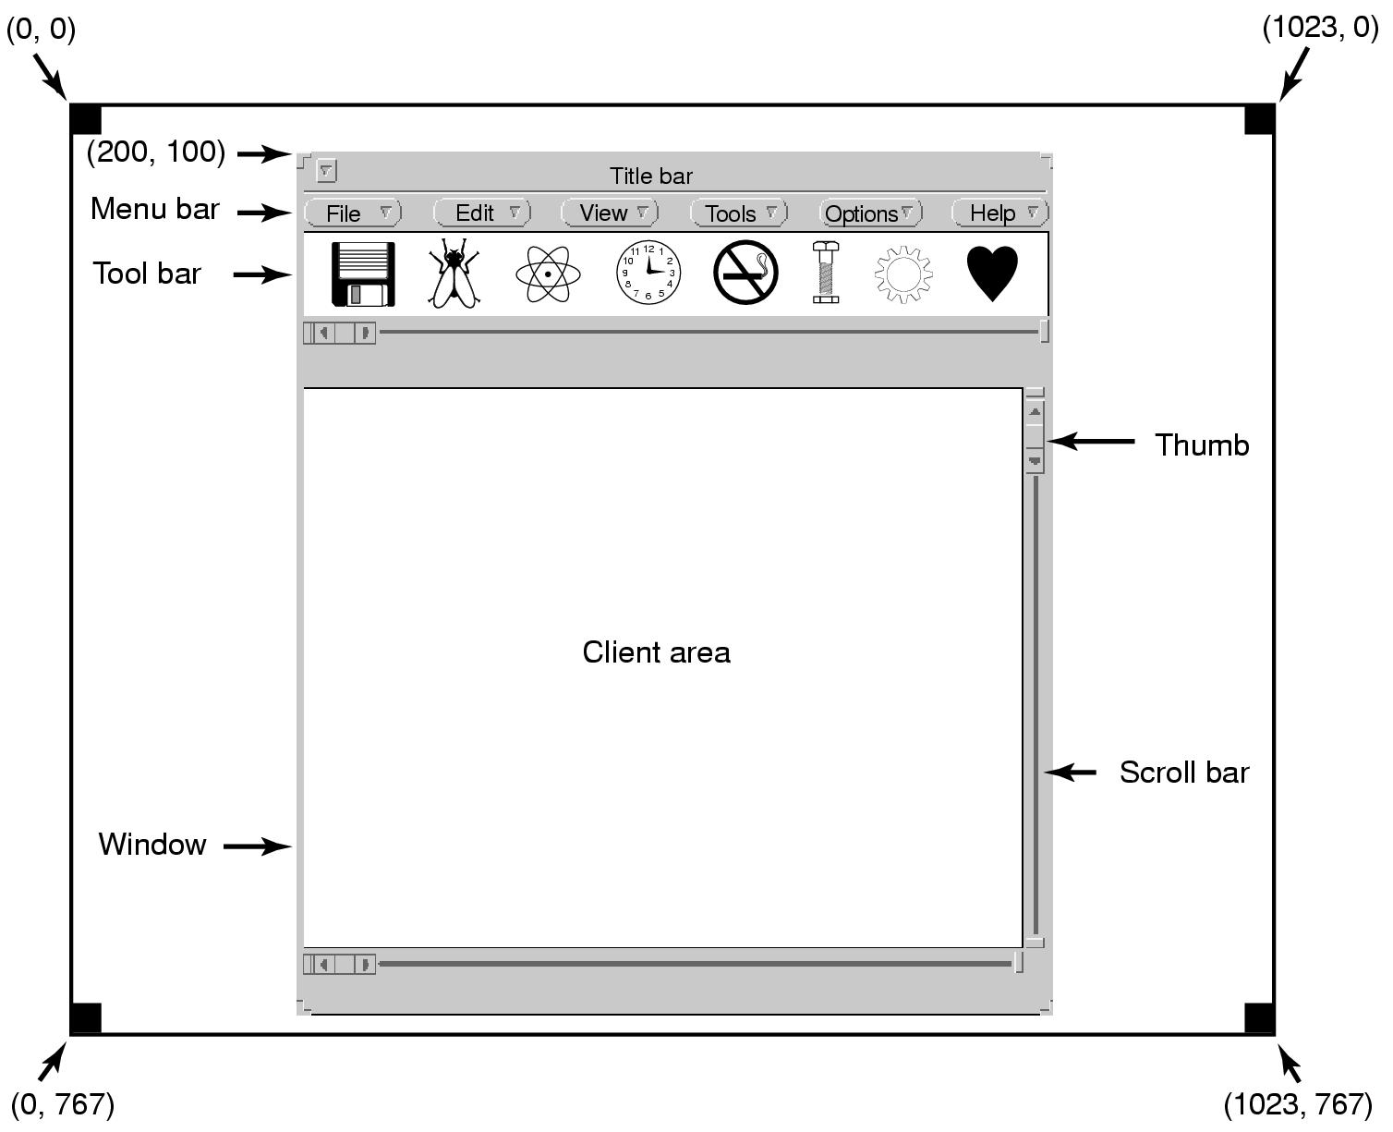
Output Software for Windows (1)
Sample window located at (200,100) on XGA display

Slide 49
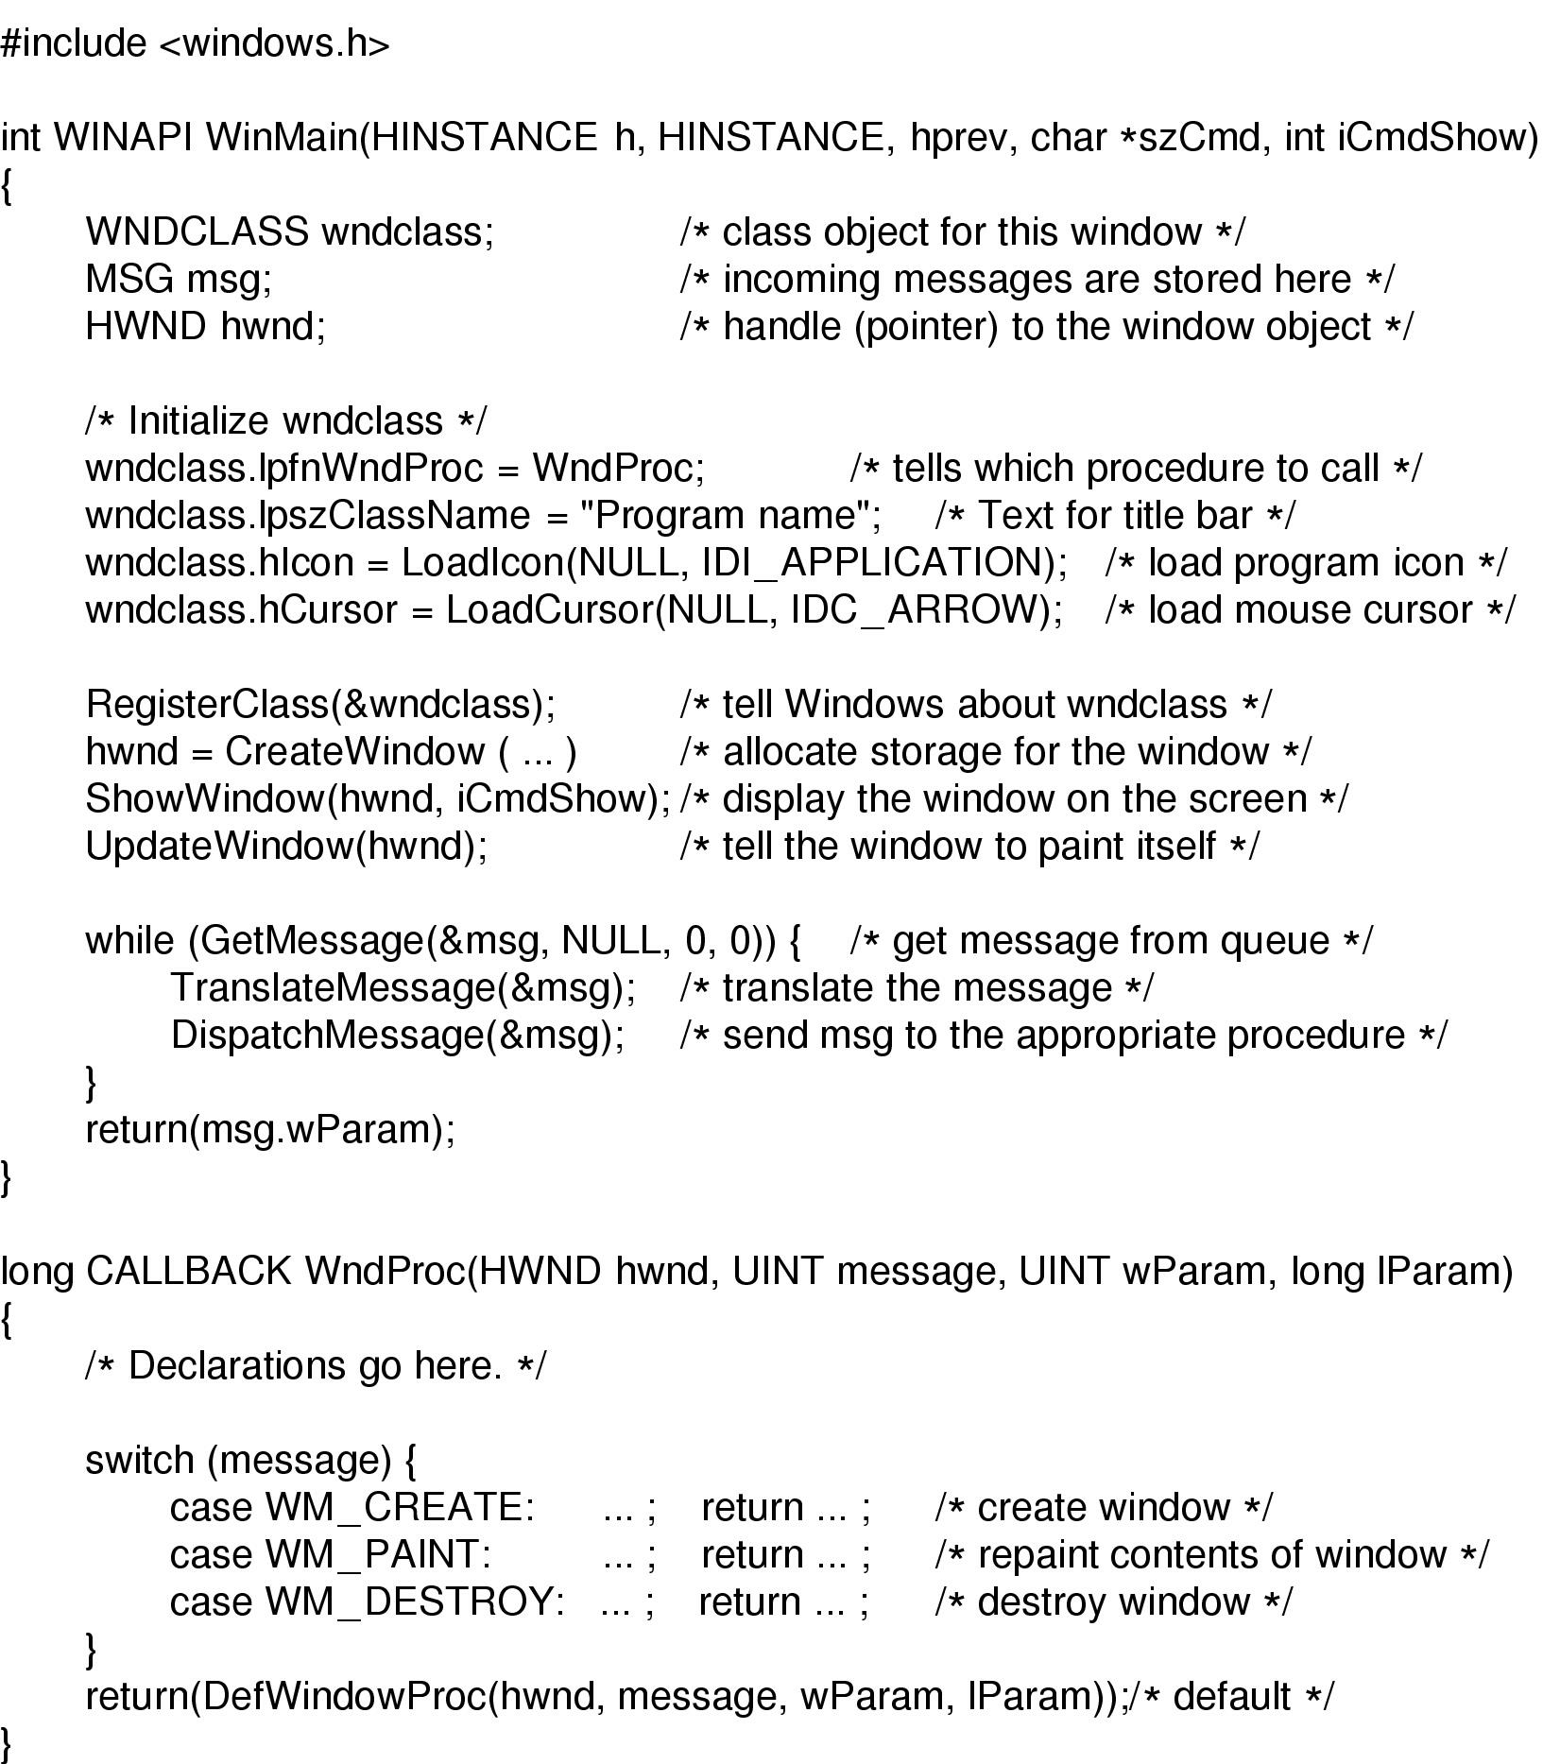
Output Software for Windows (2)
Skeleton of a Windows main program (part 1)

Slide 50
Output Software for Windows (3)
Skeleton of a Windows main program (part 2)

Slide 51
Output Software for Windows (4)
GDI(Graphics Device Interface)
  handles the actual drawing to the screen
  a package consisting of hundreds of procedures
  a device context
    an internal data structure containing the properties of the window
    a program needs to acquire a device context before drawing

Slide 52
Output Software for Windows (5)
drawing procedures
  drawing lines and curves
  drawing filled areas
  managing bitmaps
  displaying text, e.g.
    hdc = GetDC(hwnd);
    TextOut(hdc, x, y, pcText, iLength);
    Release(hdc);

Slide 53
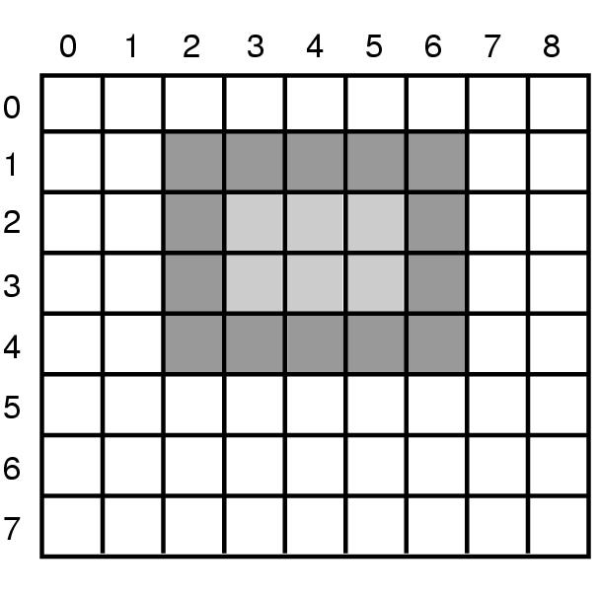
Output Software for Windows (6)
An example rectangle drawn using
Rectangle(hdc, 2, 1, 6, 4)

Slide 54
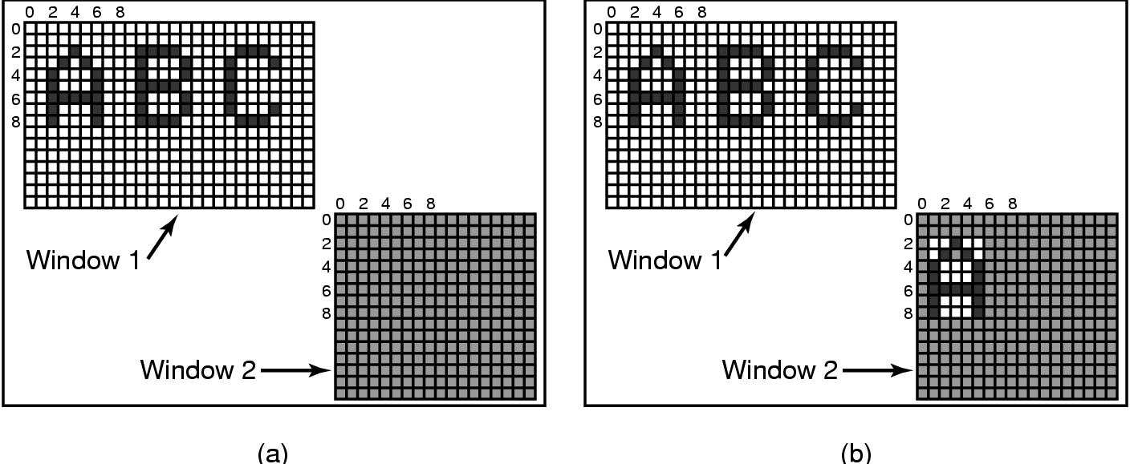
Output Software for Windows (7)
Copying bitmaps using BitBlt(hdc2,1,2,5,7,hdc1,2,2,SRCCOPY).
  before
  after

Slide 55
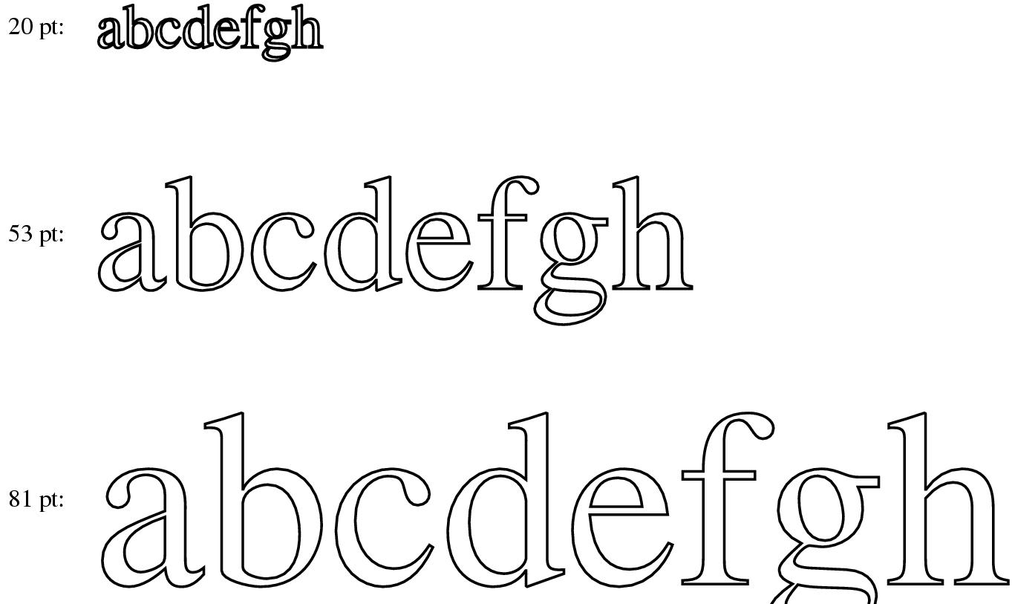
Output Software for Windows (8)
Examples of character outlines at different point sizes

Slide 56
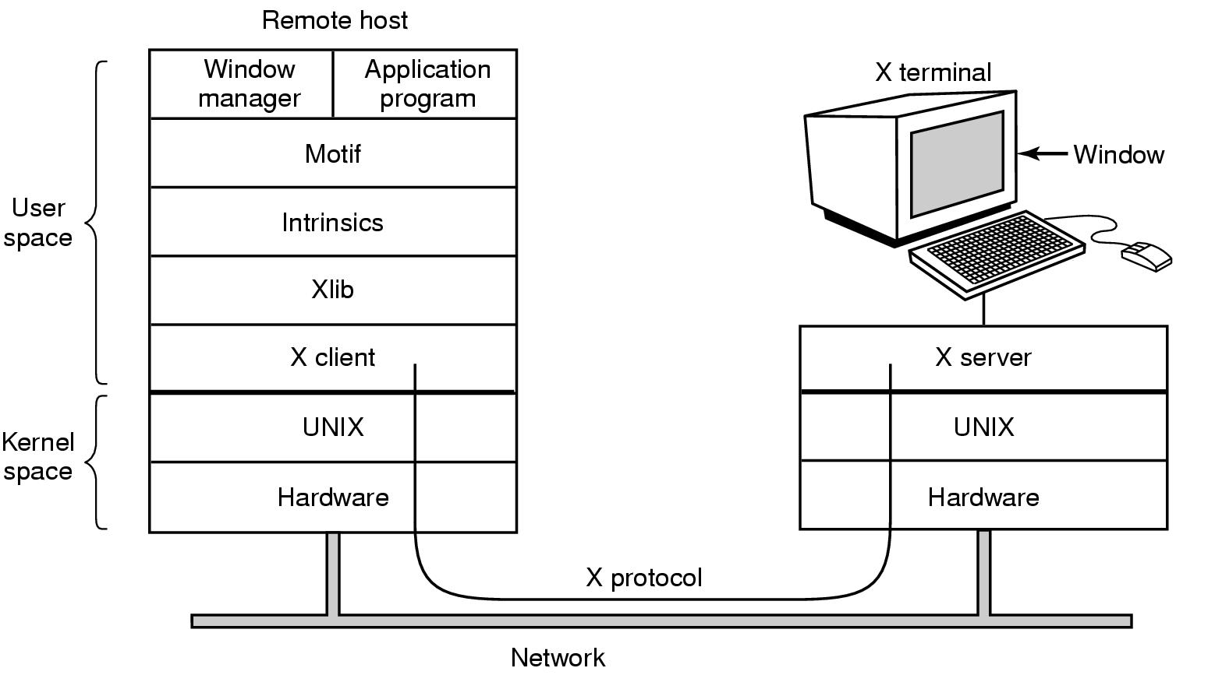
Network Terminals
X Window (1)
Clients and servers in the M.I.T. X Window System

Slide 57
Network Terminals
X Window (2)
Xlib level
  four kinds of messages go over the connection
    drawing commands from the program to the workstation
    replies by the workstation to program queries
    keyboard, mouse, and other event announcements
    error messages
  X is highly event driven, as Windows

Slide 58
Network Terminals
X Window (3)
resource
  a key concept in X
  a data structure that holds certain information
  application programs creates resources on workstations
  can be shared, short lived
  typical resources: windows, fonts, color palette, bitmaps, cursors, graphics contexts

Slide 59
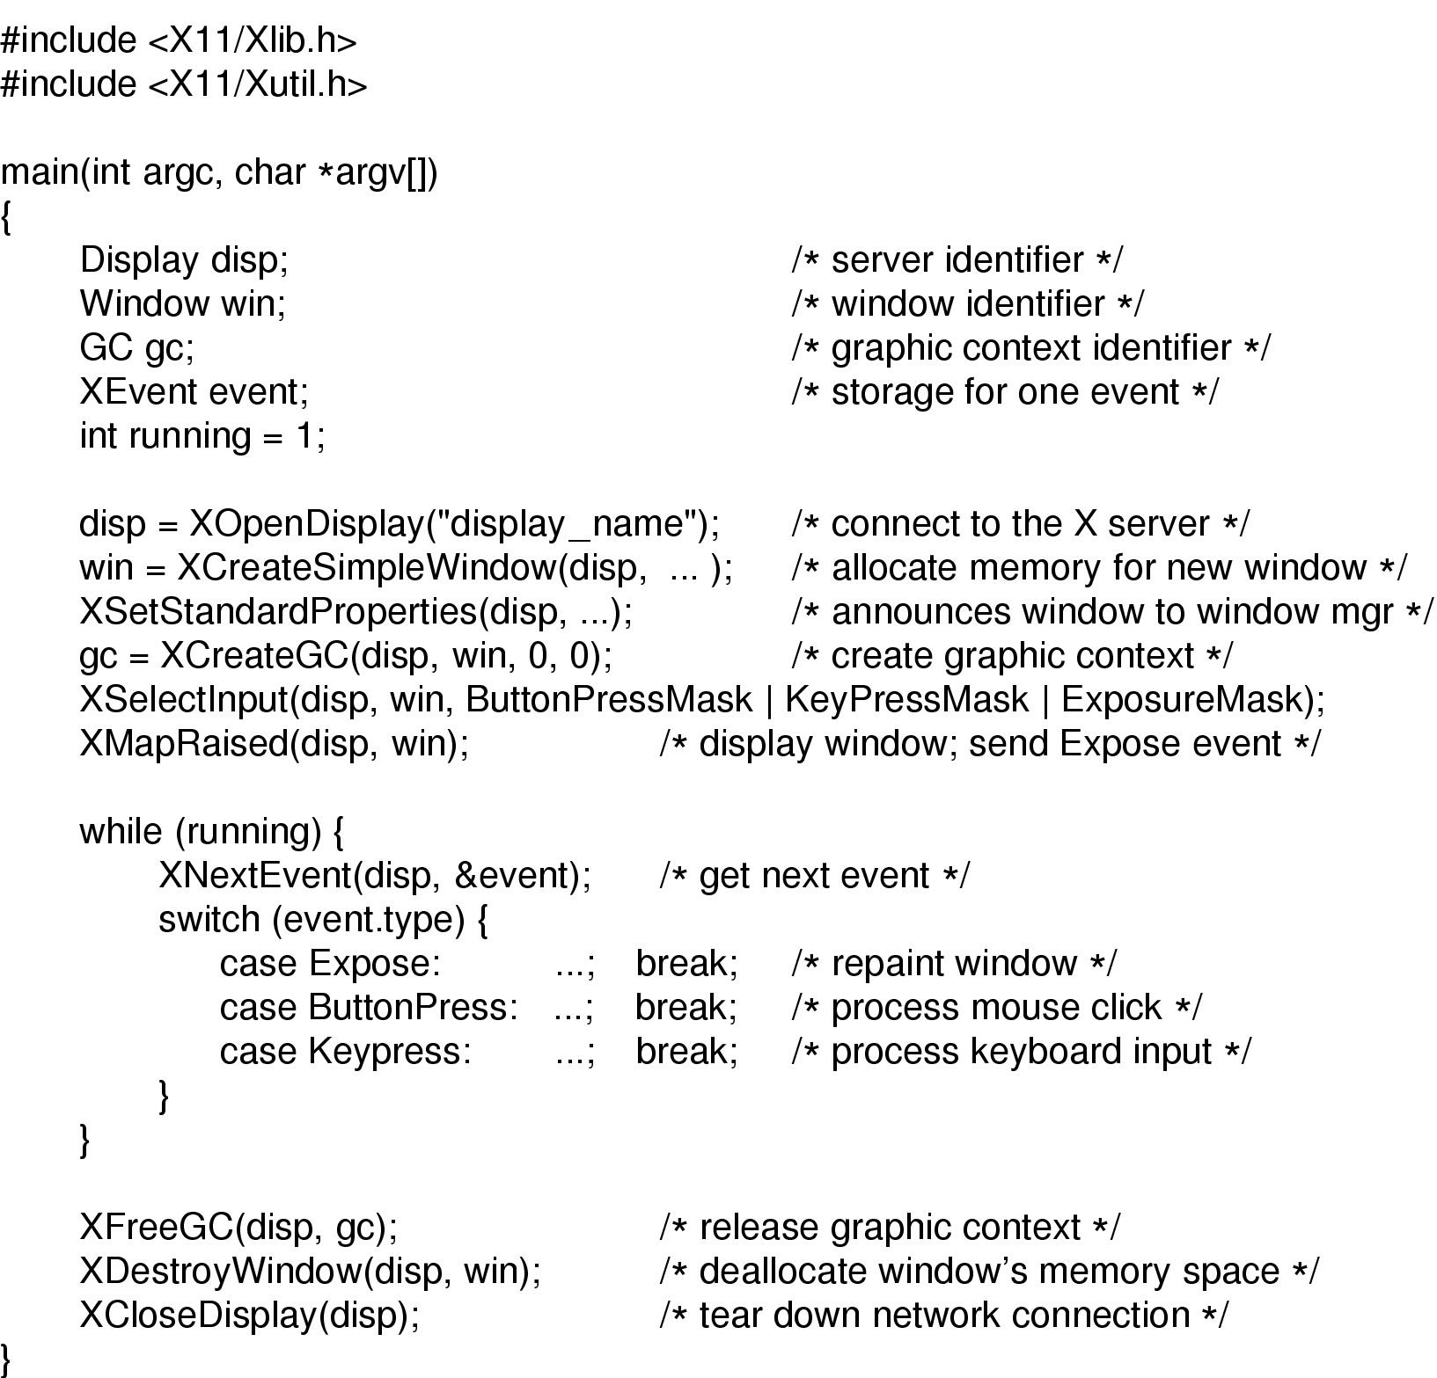
X Window (4)
Skeleton of an X Windows application program

Slide 60
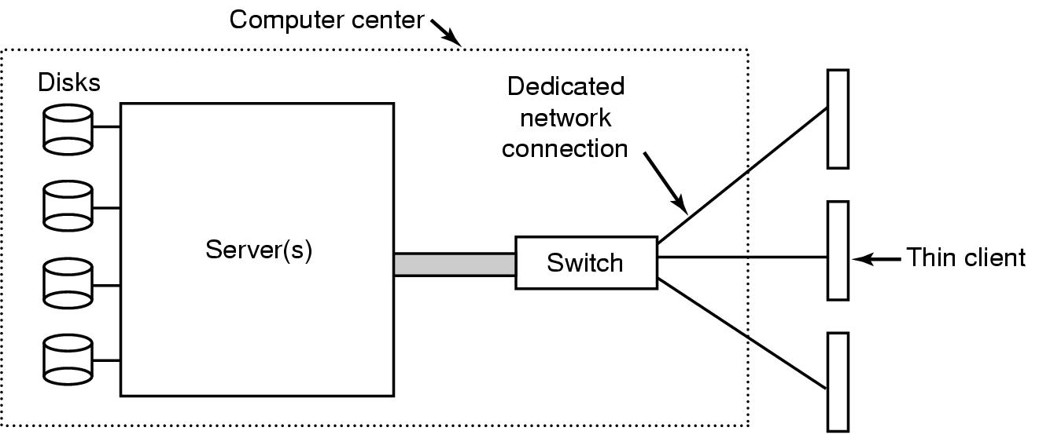
The SLIM Network Terminal (1)
SLIM(Stateless Low-level Interface Machine)
The architecture of the SLIM terminal system

Slide 61
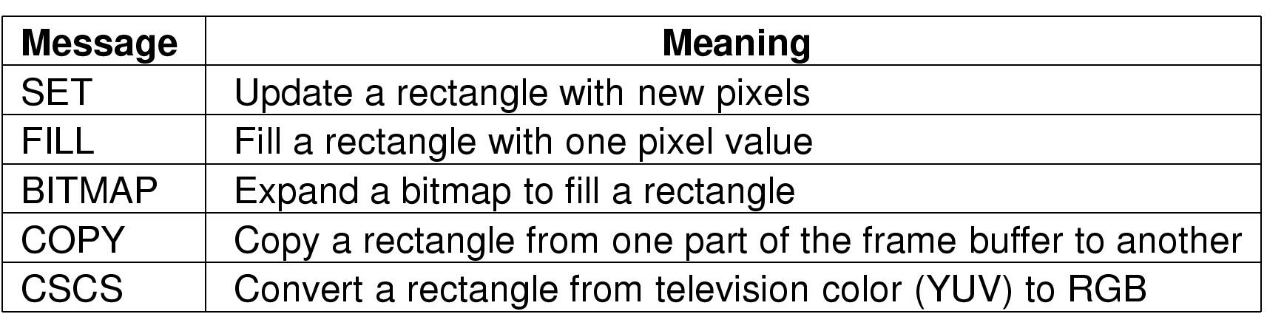
The SLIM Network Terminal (2)
Messages used in the SLIM protocol from the server to the terminals

Slide 62
Power Management (1)
multiple states for CPU, memory or I/O devices
  on
  sleep
  hibernation
  off

Slide 63
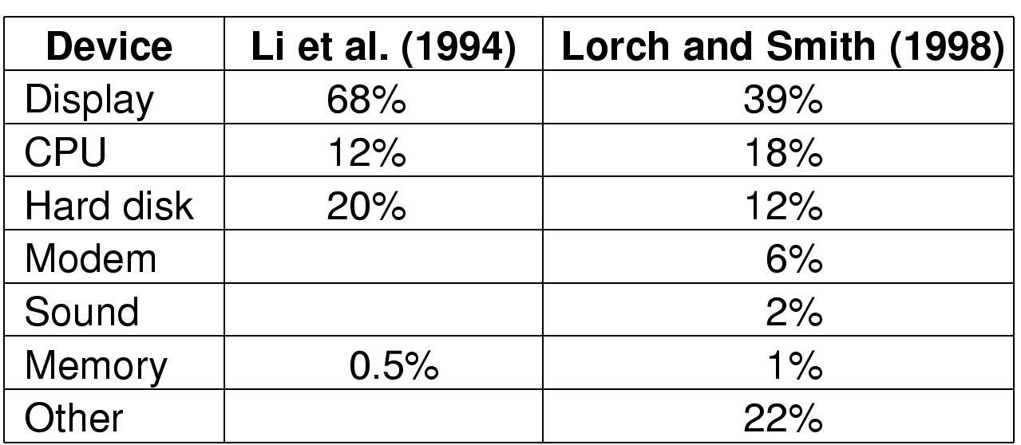
Power Management (2)
Power consumption of various parts of a laptop computer

Slide 64
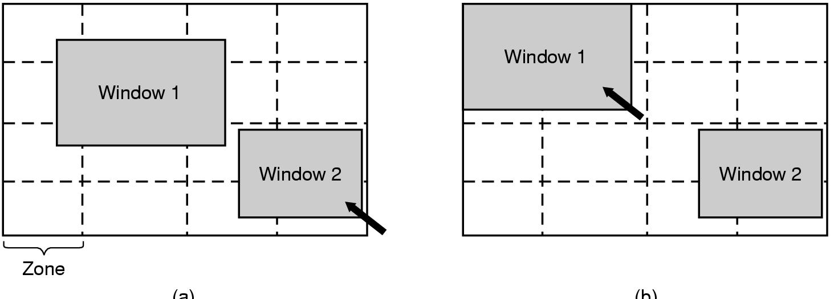
Power management (3)
The use of zones for backlighting the display

Slide 65
Power Management (4)
the hard disk
  a stopped disk is hibernating
  a characteristic time T_{d} for every disk
    if t < T_{d}, keep the disk spinning
    if t> T_{d}, spin the disk down and up again much later
  have a disk cache in RAM
  inform the running program of the disk state

Slide 66
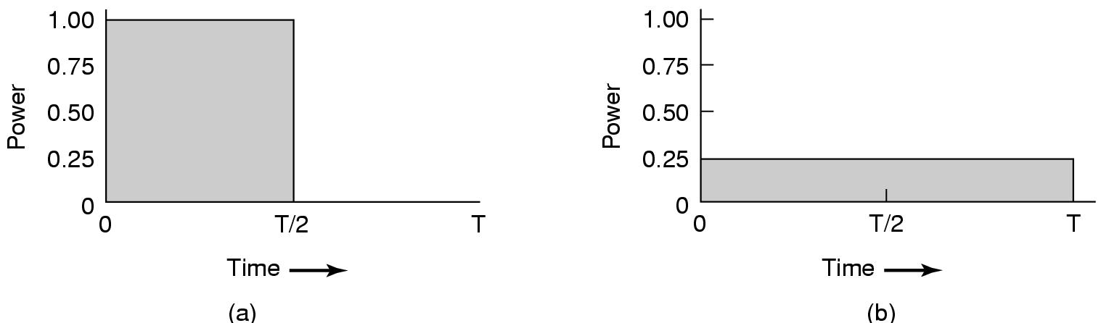
Power Management (5)
Running at full clock speed
Cutting voltage by two
  cuts clock speed by two,
  cuts power by four

Slide 67
Power Management (6)
Telling the programs to use less energy
  may mean poorer user experience
Examples
  change from color output to black and white, etc.
  speech recognition reduces vocabulary, and a simpler acoustic model
  less resolution or detail in an image

Slide 68
小结
I/O 工作方式
I/O 软件层次
Disk
clock
character-oriented terminals
GUI
network terminals
power management

Slide 69
习题

