Slide 1
Memory Management

Slide 2
Memory Management
4.1 Basic memory management
4.2 Swapping
4.3 Virtual memory
4.4 Page replacement algorithms
4.5 Design issues for paging systems
4.6 Segmentation
4.7 Implementation issues

Slide 3
Memory Management
Ideally programmers want memory that is
  large
  fast
  non volatile
Memory hierarchy
  small amount of fast, expensive memory – cache
  some medium-speed, medium price main memory
  gigabytes of slow, cheap disk storage
Memory manager handles the memory hierarchy

Slide 4

Basic Memory Management
Monoprogramming without Swapping or Paging
Three simple ways of organizing memory
- an operating system with one user process

Slide 5
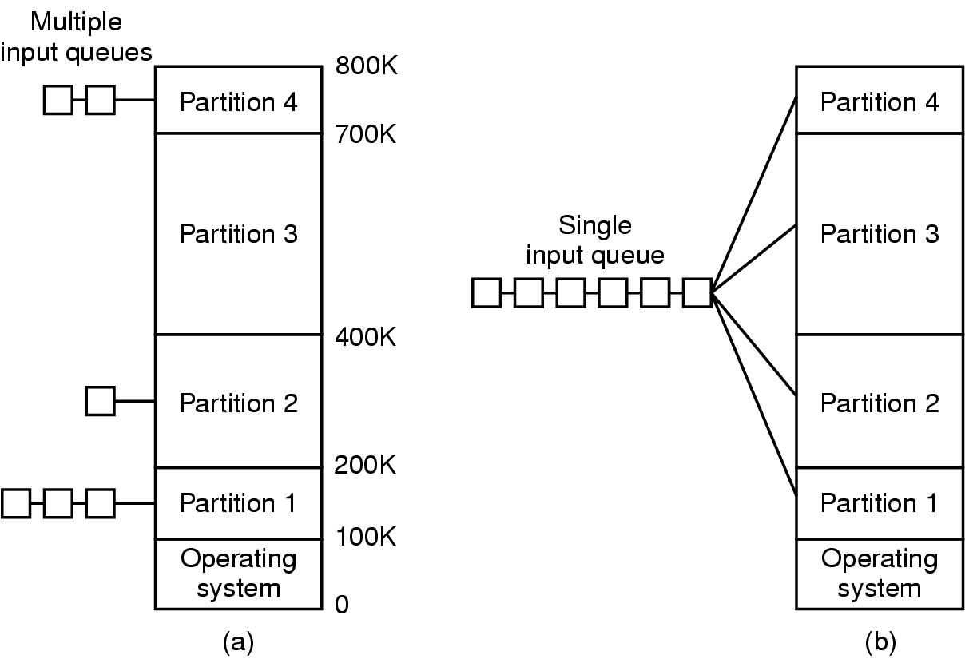
Multiprogramming with Fixed Partitions
Fixed memory partitions
  separate input queues for each partition
  single input queue

Slide 6
Multiprogramming with Fixed Partitions
some alternative approach
  first fit
  best fit
  one small partition at least
  k threshold
Fixed partitions were used by OS/360(MFT), now rarely used

Slide 7
Relocation and Protection
Cannot be sure where program will be loaded in memory
  address locations of variables, code routines cannot be absolute
  must keep a program out of other processes’ partitions
relocation during loading(OS/MFT)
comparison of memory block protection code to the PSW 4-bit key, either changeable only by OS. (OS/360)
Use base and limit values(CDC 6600)
  address locations added to base value to map to physical addr
  address locations larger than limit value is an error

Slide 8
Swapping and virtual memory
There is not enough main memory to hold all the currently active processes.
Excess processes must be kept on disk and brought in to run dynamically.
swapping
  each process in its entirety is swapped
virtual memory
  active processes can be partially in main memory

Slide 9

Swapping (1)
Memory allocation changes as
  processes come into memory
  leave memory
Shaded regions are unused memory

Slide 10
Swapping (2)
memory compaction(存储紧缩)
  combine multiple holes into a big one by moving processes downward as far as possible.
  time consuming

Slide 11

Swapping (3)
Allocating space for growing data segment
Allocating space for growing stack & data segment

Slide 12

Memory Management with Bit Maps
Part of memory with 5 processes, 3 holes
  tick marks show allocation units
  shaded regions are free
Corresponding bit map
Same information as a list

Slide 13
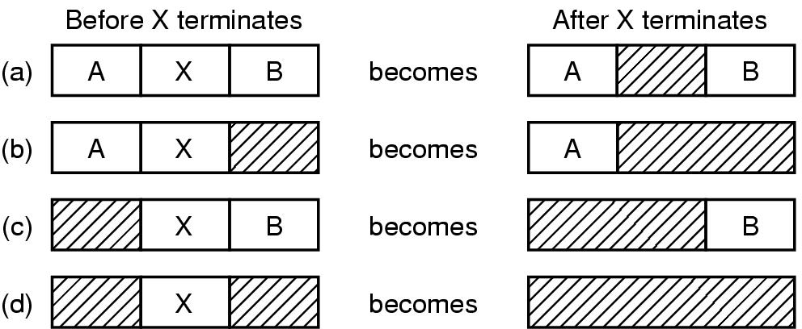
Memory Management with Linked Lists
Four neighbor combinations for the terminating process X

Slide 14
Memory Management with Linked Lists
allocation of holes in linked list sorted by address
  first fit
  next fit
  best fit
  worst fit
distinct lists for processes and holes
  sorted by size for holes’ list
  holes themselves can be used to maintain information
  quick fit

Slide 15
Virtual Memory
Paging (1)
Virtual memory
  the combined size of the program, data, and stack may exceed the physical memory available.
virtual address & virtual address space

Slide 16

Virtual Memory
Paging (2)
The position and function of the MMU

Slide 17
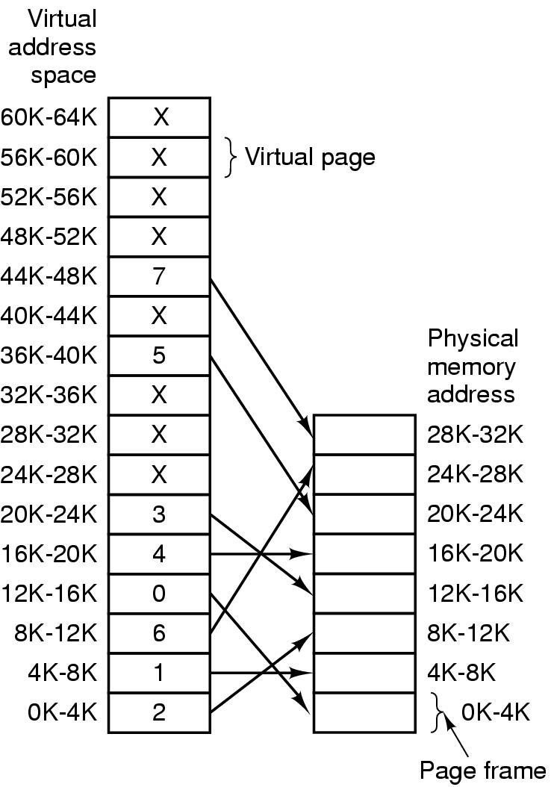
Virtual Memory
Paging (3)
The relation between
virtual addresses
and physical
memory addres-
ses given by
page table
examples
present/absent bit

Slide 18
Virtual Memory
Paging (4)
page fault
  coming across an unmapped page
  The operating system
    picks a little-used page frame and write back to the disk,
    fetches the referenced page into the page frame
    changes the map, restart the trapped instruction.

Slide 19

Virtual Memory
Page Tables (1)
Internal operation of MMU with 16 4 KB pages

Slide 20
Virtual Memory
Page Tables (2)
the size of page table
  large virtual address space
  each process needs its own page table
page table lookups
  needs virtual-to-physical mapping on every memory reference

Slide 21
Virtual Memory
Page Tables (3)
To solve those problems, page table can
  consist of an array of registers
  or be in main memory, and with one register pointing to the start of the page table.

Slide 22

Virtual Memory
Page Tables (4)
32 bit address with 2 page table fields
Two-level page tables

Slide 23

Virtual Memory
Page Tables (5)
Typical page table entry

Slide 24
TLBs – Translation Lookaside Buffers
Memory references for page tables access reduce performance.
A small device mapping virtual addresses to physical addresses without going through the page table.
TLB-inside MMU, consists of a small number of entries.

Slide 25
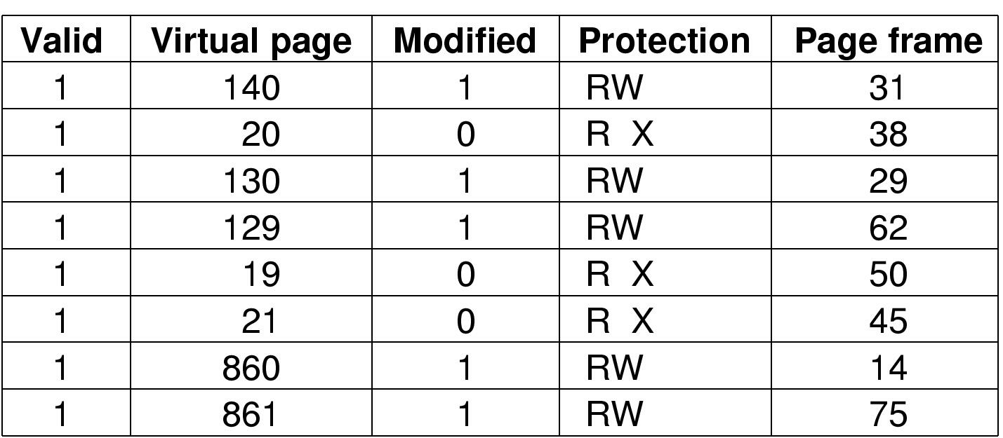
TLBs – Translation Lookaside Buffers
A TLB to speed up paging

Slide 26
TLBs – Translation Lookaside Buffers
How does the MMU work with a TLB
  Upon a virtual address, the hardware first check in the TLB in parallel on all entries.
  TLB hit
  TLB miss
    MMU does an ordinary page table lookup
    update the TLB against the page table

Slide 27
TLBs – Translation Lookaside Buffers
software TLB management
  TLB entries are explicitly loaded by the operating system.
  TLB fault generated to the operating system upon TLB misses.
why?
  can free up hardware areas on CPU chip to improve performance.

Slide 28
TLBs – Translation Lookaside Buffers
to improve performance by reducing TLB misses and reducing the cost of a TLB miss.
  the operating system predicts the pages to be used and preload them into TLB.
  reducing additional TLB faults for page table by maintaining a large software cache of TLB entries in a fixed location whose page is always kept in TLB.

Slide 29
Inverted Page Tables
to save memory space
entries in inverted page tables keep track of which (process, virtual page) is located in the page frame.
virtual-to-physical translation is harder
  using the TLB.
  using a hash table to handle a TLB miss.

Slide 30

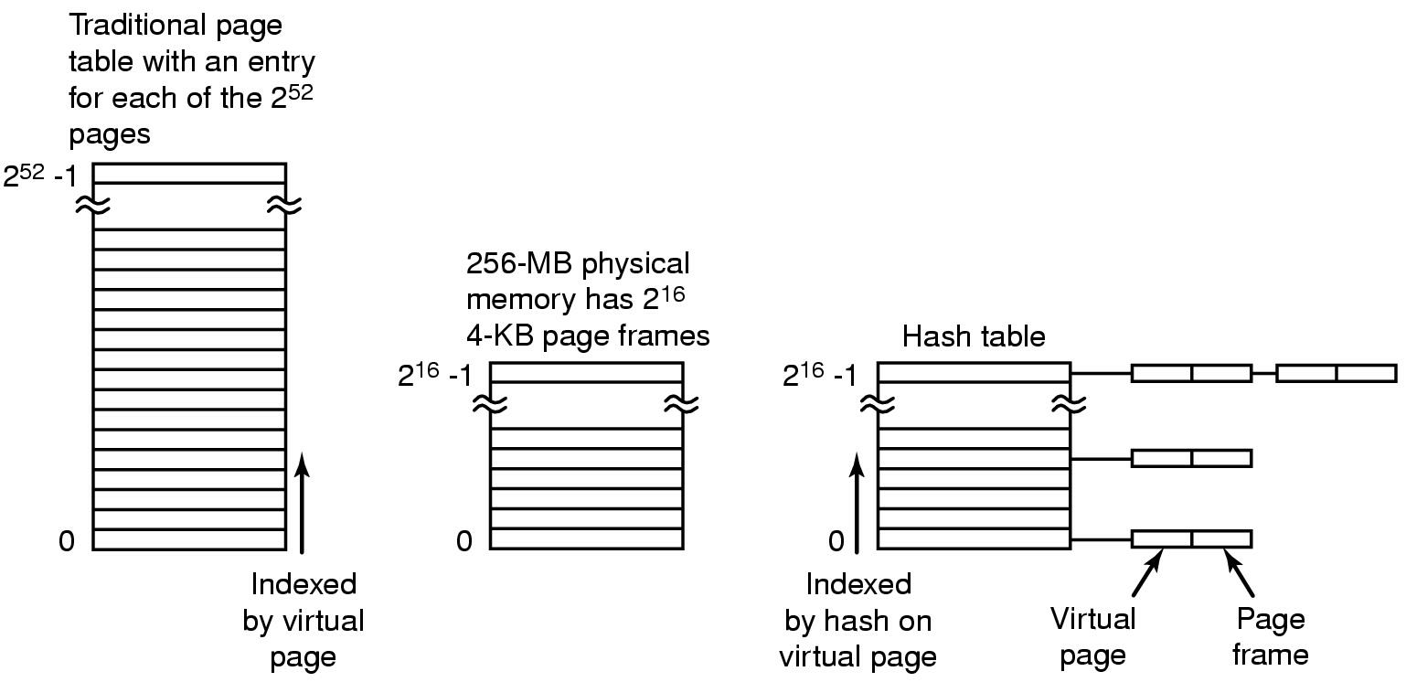
Inverted Page Tables
64-bit virtual space
4K page
32M RAM
Comparison of a traditional page table with an inverted page table

Slide 31
4.4 Page Replacement Algorithms
Page fault forces choice
  which page must be removed
  make room for incoming page
Modified page must first be saved
  unmodified just overwritten
Better not to choose an often used page
  will probably need to be brought back in soon

Slide 32
Optimal Page Replacement Algorithm
Replace page needed at the farthest point in future
  Optimal but unrealizable
Estimate by …
  logging page use on previous runs of process
  although this is impractical
specific to one program

Slide 33
Not Recently Used Page Replacement Algorithm
Each page has Referenced bit, Modified bit
  bits are set when page is referenced, modified, by hardware
Pages are classified
  not referenced, not modified
  not referenced, modified
  referenced, not modified
  referenced, modified
NRU removes page at random
  from lowest numbered non empty class

Slide 34
FIFO Page Replacement Algorithm
Maintain a linked list of all pages
  in order they came into memory
Page at beginning of list replaced
Disadvantage
  page in memory the longest may be often used

Slide 35
Second Chance Page Replacement Algorithm
a simple modification of FIFO
  inspect the R bit of the oldest page
  if it is 0, replace it immediately;
  if it is 1, the bit is cleared, the page is added, and its load time is updated. The search continues.

Slide 36
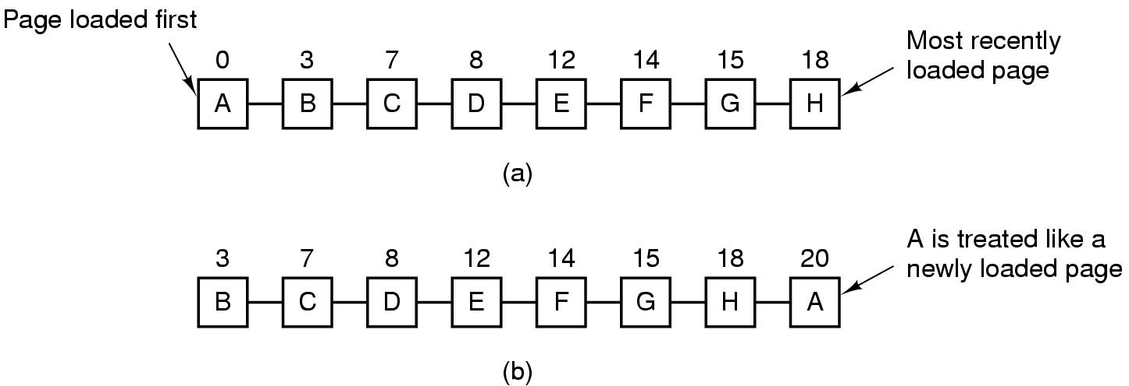
Second Chance Page Replacement Algorithm
Operation of a second chance
  pages sorted in FIFO order
  Page list if fault occurs at time 20, A has R bit set
  (numbers above pages are loading times)

Slide 37
The Clock Page Replacement Algorithm
to keep all pages on a circular list
  the page pointed to by the hand is inspected
  if its R bit is 0, the page is evicted, the new page is inserted, and the hand advances one position;
  if R is 1, it is cleared and the hand advances one position.

Slide 38
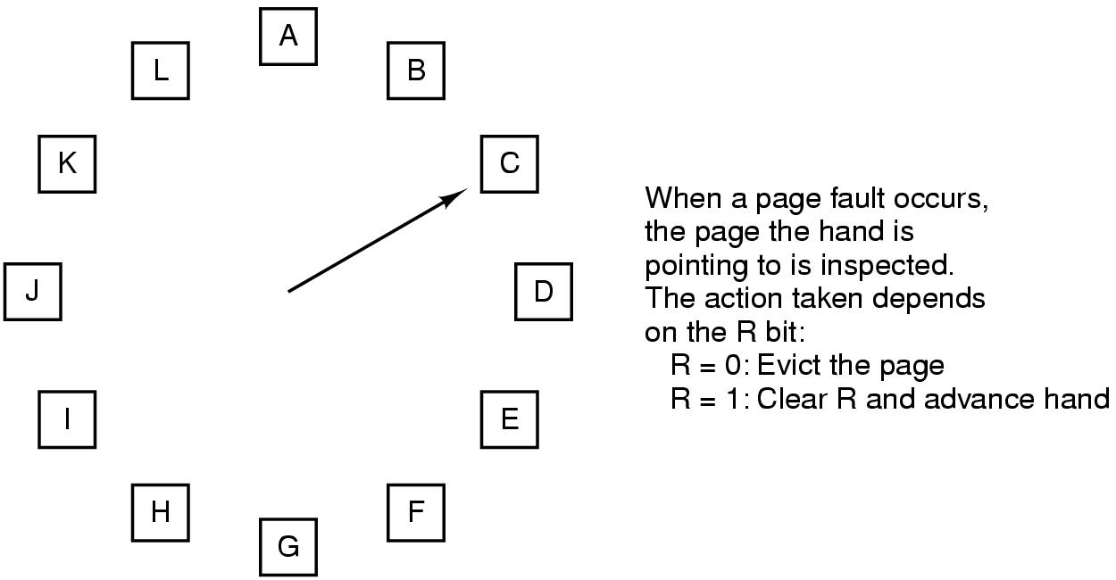
The Clock Page Replacement Algorithm

Slide 39
Least Recently Used (LRU)
Assume pages used recently will used again soon
  throw out page that has been unused for longest time
Must keep a linked list of pages
  most recently used at front, least at rear
  update this list every memory reference !!
Alternatively keep counter in each page table entry
  choose page with lowest value counter
  periodically zero the counter

Slide 40
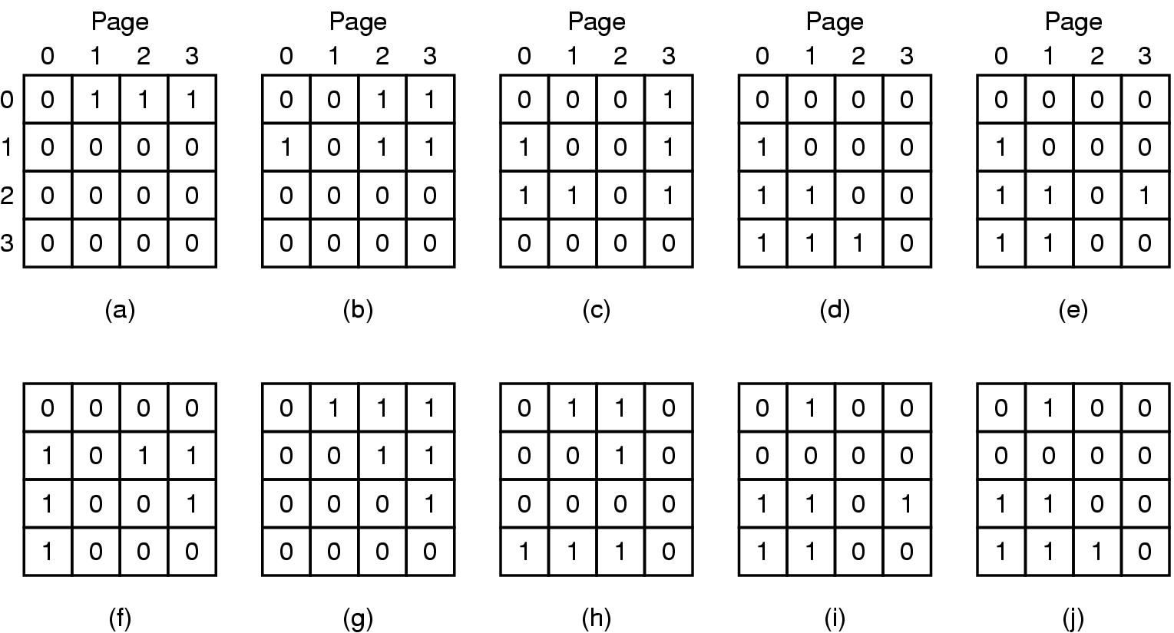
Least Recently Used (LRU)
LRU using a matrix – pages referenced in order 0,1,2,3,2,1,0,3,2,3

Slide 41
Simulating LRU in Software (1)
Not frequently used algorithm
  a software counter associated with each page, initially zero.
  at each clock interrupt, the operating system scans all pages in memory, adding each one’s R bit to the counter.
keeping track of how often each page has been referenced.
choose the lowest counter for replacement upon page fault

Slide 42
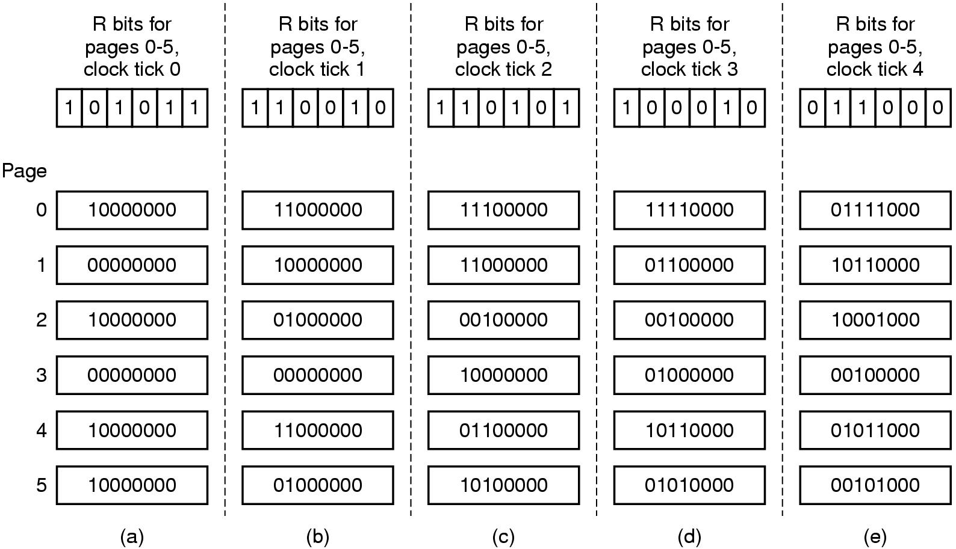
Simulating LRU in Software (2)
The aging algorithm simulates LRU in software
Note 6 pages for 5 clock ticks, (a) – (e)

Slide 43
Simulating LRU in Software (3)
differences between aging algorithm and the LRU
  aging algorithm keeps track of page reference in terms of clock tick.
  in aging the counters have a finite number of bits

Slide 44
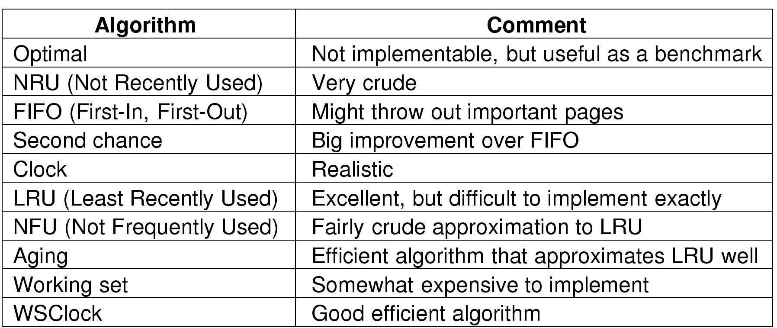
Review of Page Replacement Algorithms

Slide 45
Design Issues for Paging Systems
the working set model
  demand paging
  locality of references and working set
  page faults
    thrashing
    working set model – keeping track of each process‘ working set & prepaging

Slide 46
Design Issues for Paging Systems
implementation of the working set model
  using the aging algorithm – any page containing a 1 bit among the highest n bits of the counter is considered a member of the working set.
  n is determined experimentally for different systems.
wsclock algorithm

Slide 47
Design Issues for Paging Systems
Local versus global allocation policies
  local page replacement algorithm
  global page replacement algorithm

Slide 48
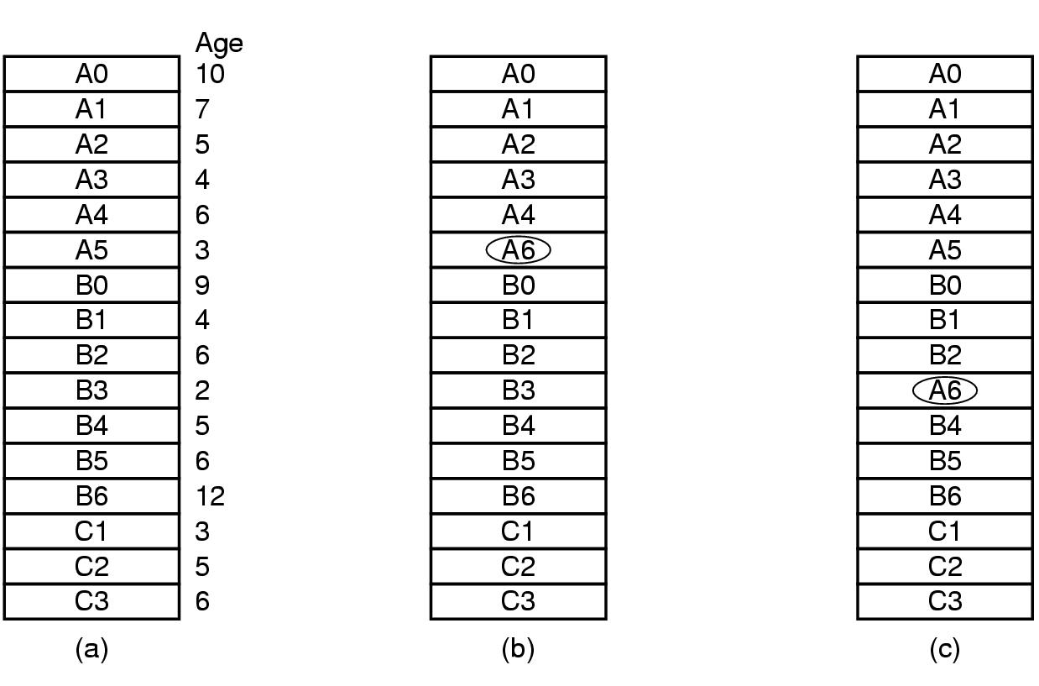
Design Issues for Paging Systems
Original configuration
Local page replacement
Global page replacement

Slide 49
Design Issues for Paging Systems
local algorithms
  allocating every process a fixed fraction of memory
global algorithms
  dynamically allocate page frames among runnable processes
  work better when working set vary over the process’ lifetime
  the operating system has to continually decide the number of page frames allocated to each process.

Slide 50
Design Issues for Paging Systems
algorithms for allocating page frames
  equal share allocation
  proportional allocation
  minimal allocation
  Page Fault Frequency allocation

Slide 51
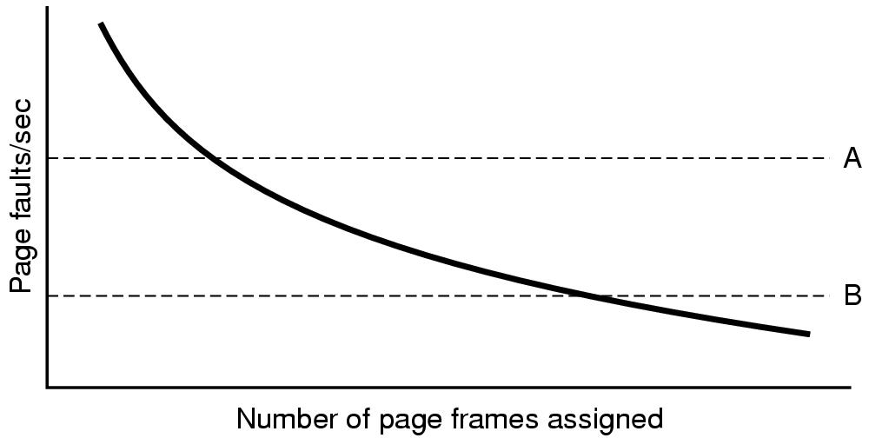
Design Issues for Paging Systems
Page fault rate as a function of the number of page frames assigned

Slide 52
Design Issues for Paging Systems
Load Control
  Despite good designs, system may still thrash
  When PFF algorithm indicates
    some processes need more memory
    but no processes need less
  Solution :
  Reduce number of processes competing for memory
    swap one or more to disk, divide up pages they held
    reconsider degree of multiprogramming

Slide 53
Page Size (1)
Small page size
Advantages
  less internal fragmentation
  better fit for various data structures, code sections
  less unused program in memory
Disadvantages
  programs need many pages, larger page tables

Slide 54
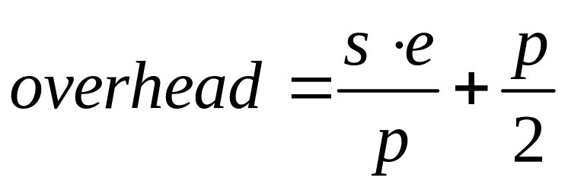
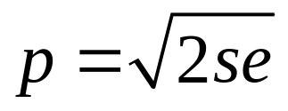
Page Size (2)
Overhead due to page table and internal fragmentation
Where
  s = average process size in bytes
  p = page size in bytes
  e = page entry size
page table space
internal fragmentation
Optimized when

Slide 55
Design Issues for Paging Systems
virtual memory interface – giving programmers control over their memory map
  share the same memory
  implement high-performance message passing system
  distributed shared memory

Slide 56
Virtual Memory
v. s. overlays
paging
  paging tables
  page replacement algorithms
  design issues for paging systems

Slide 57
Virtual memory - paging
A paging system can be characterized by three items
  The reference string of the executing process.
  The page replacement algorithm.
  The number of page frames available in memory, m.

Slide 58
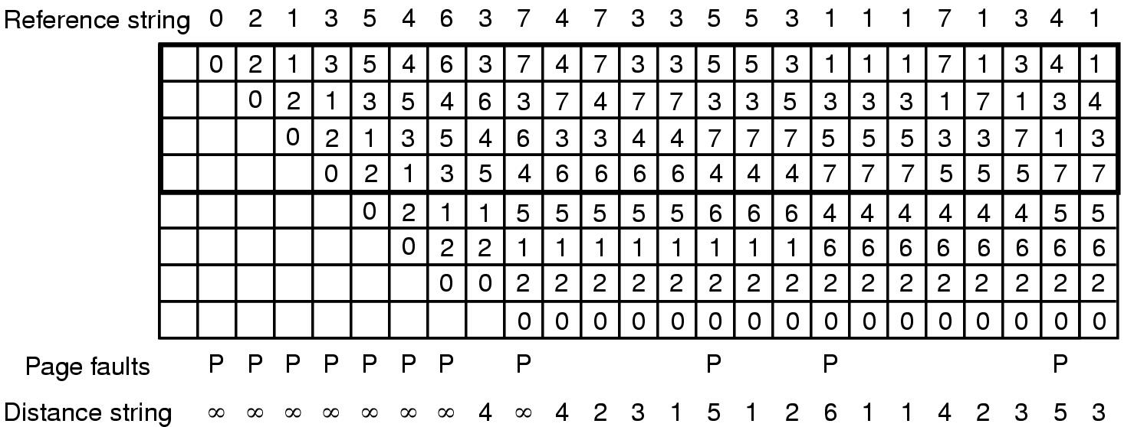
Virtual memory - paging
State of memory array, M, after each item in reference string is processed

Slide 59

4.6 Segmentation (1)
One-dimensional address space with growing tables
One table may bump into another

Slide 60
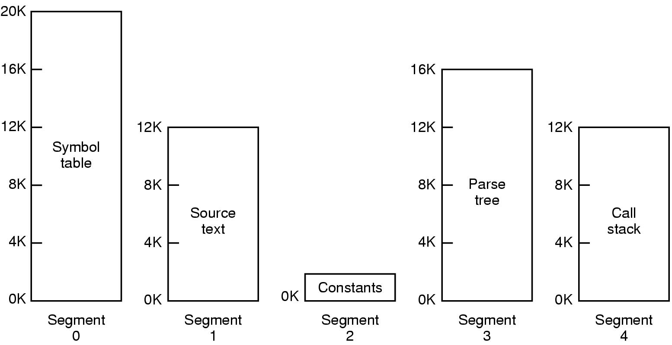
Segmentation (2)
Allows each table to grow or shrink, independently

Slide 61
Segmentation (3)
What are segments?
  independent address spaces consisting of a linear sequence of addresses.
  Different segments may have different lengths.
  Segment length may change during execution without affecting each other.

Slide 62
Segmentation (3)
To specify an address in segmented memory, the program must supply a two-part address
  a segment number
  an address within the segment

Slide 63
Segmentation (4)
segments are
  of single type(procedure, array or a stack).
  to simplify procedure calls when linking up procedures compiled separately.
  to facilitate sharing procedures or data between several processes
    shared library
  segments protection
  logical entities of which the programmer is aware

Slide 64

Segmentation (5)
Comparison of paging and segmentation

Slide 65
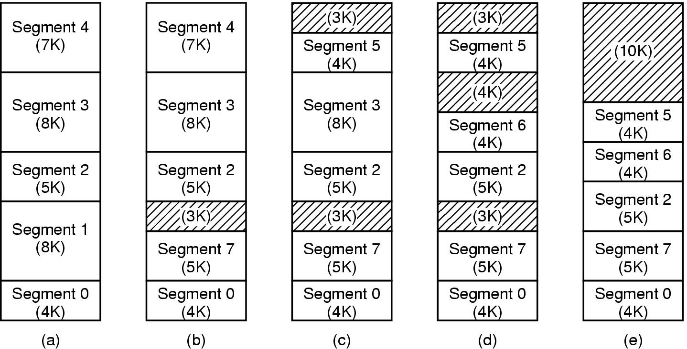
Implementation of Pure Segmentation
(a)-(d) Development of checkerboarding
(e) Removal of the checkerboarding by compaction

Slide 66
Segmentation with Paging: MULTICS (1)
MULTICS:
  Each program has a virtual memory of up to as many as 2¹⁸ segments.
  Each segment is as long as up to 65536 (36-bit) words.
  Each segment is a virtual memory with its own virtual pages’ space

Slide 67
Segmentation with Paging: MULTICS (2)
Each MULTICS program has a segment table, with one descriptor per segment.
The segment table itself is a segment and is paged.

Slide 68
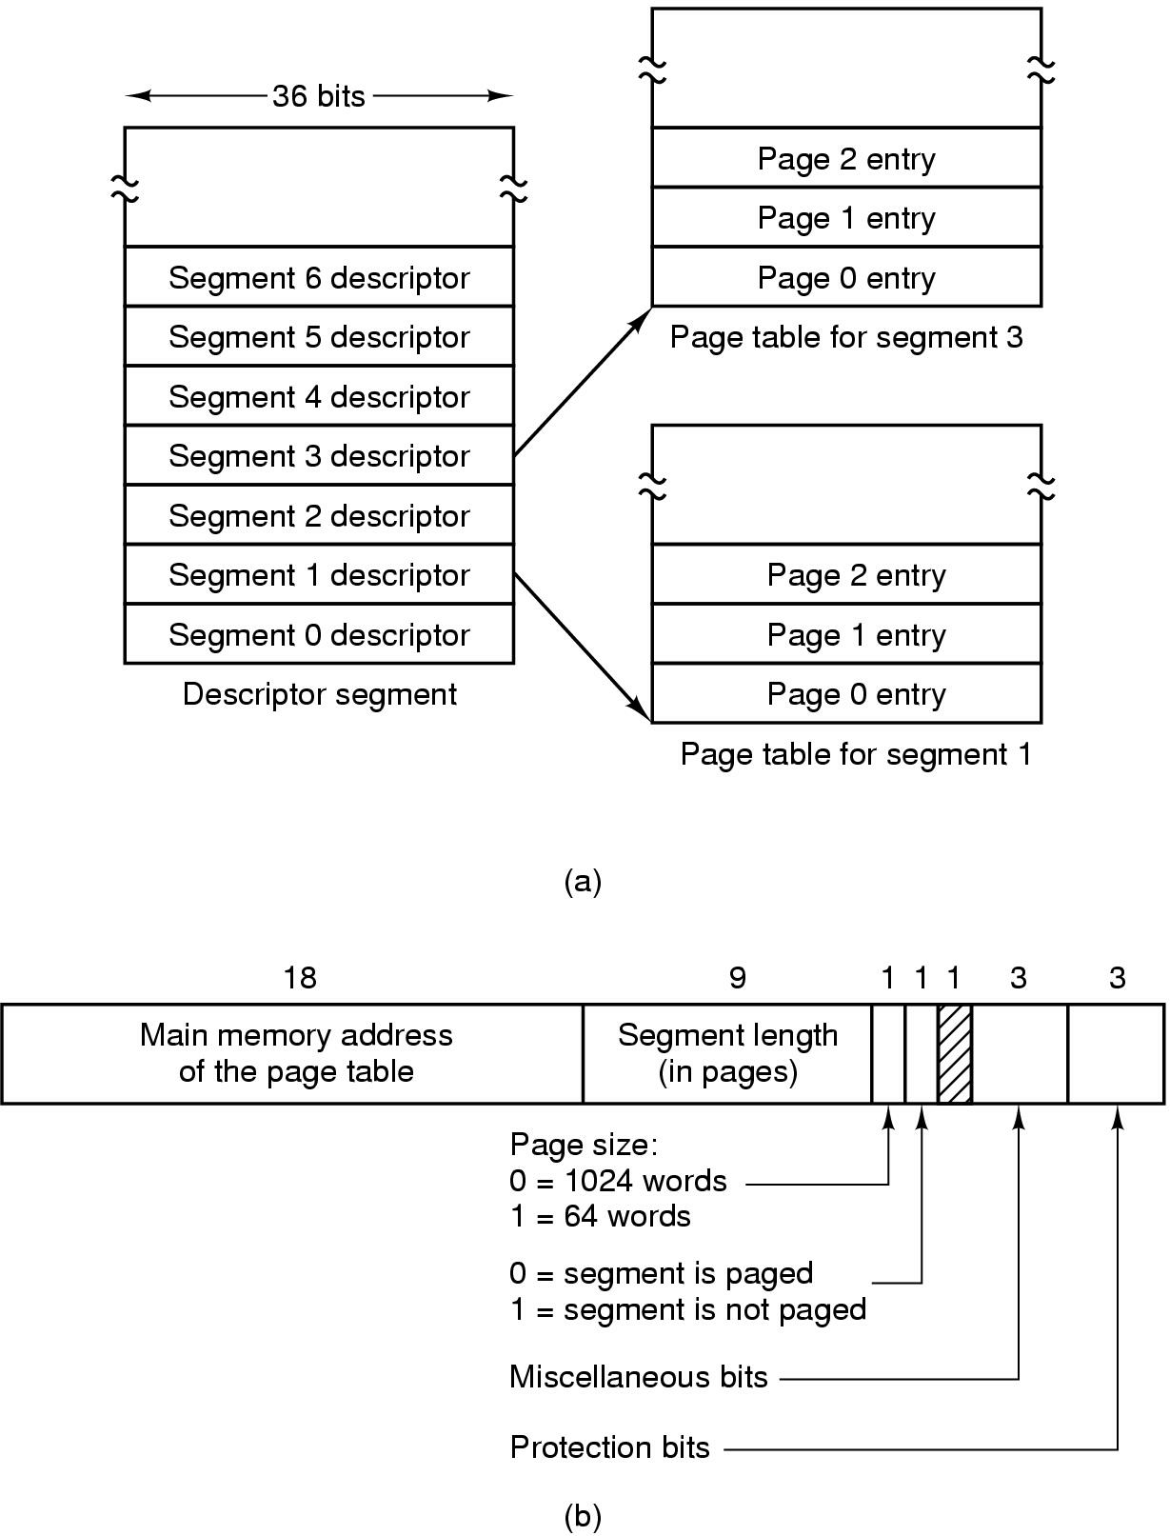
Segmentation with Paging: MULTICS (3)
Descriptor segment points to page tables
Segment descriptor – numbers are field lengths

Slide 69
Segmentation with Paging: MULTICS (4)
Each segment is an ordinary virtual paging space.
The normal page size is 1024 words.
So an address in MULTICS consists of two parts:
  the segment
  the address within the segment

Slide 70
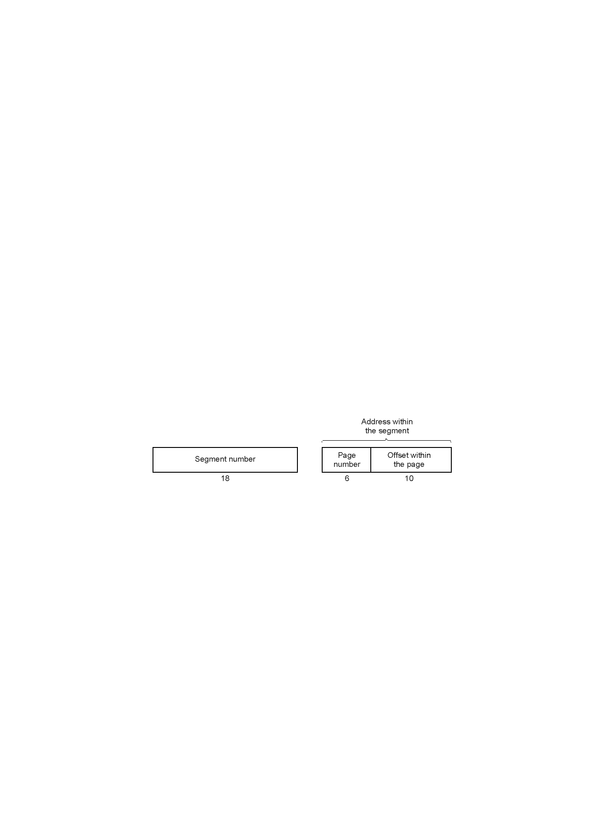
Segmentation with Paging: MULTICS (5)
A 34-bit MULTICS virtual address

Slide 71
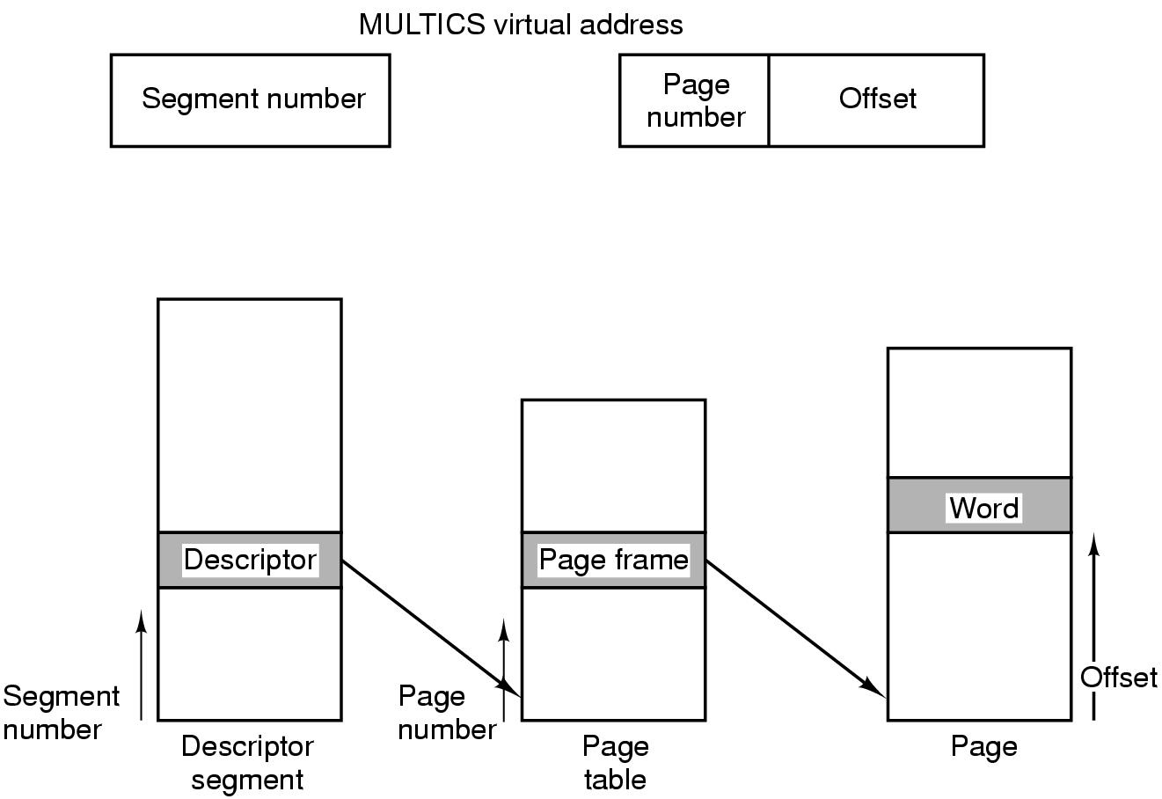
Segmentation with Paging: MULTICS (6)
Conversion of a 2-part MULTICS address into a main memory address

Slide 72
Segmentation with Paging: MULTICS (7)
memory reference algorithm
  use the segment number to find the segment descriptor.
  locate the segment’s page table in memory. A segment fault might occur. Protection needs to be checked.
  map the requested virtual page number to the physical address of the start of the page. A page fault might occur.
  the offset is added to the page origin.
  start referencing at the physical address.

Slide 73
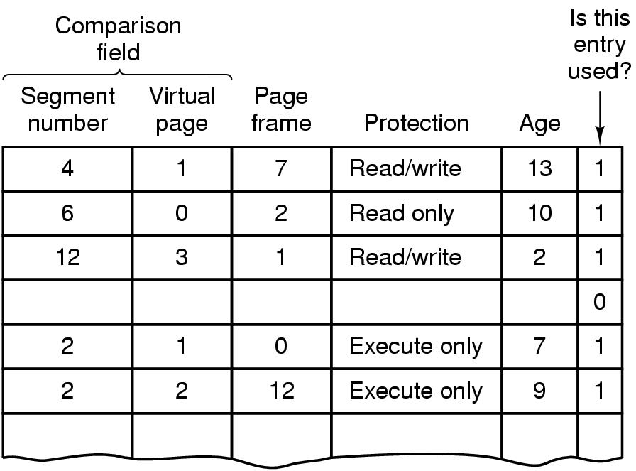
Segmentation with Paging: MULTICS (8)
Simplified version of the MULTICS TLB
Existence of 2 page sizes makes actual TLB more complicated

Slide 74
Segmentation with Paging: Pentium (1)
Pentium has as many as 16K independent segments, each as large as up to 1 billion 32 bit words.
LDT & GDT
  LDT – one per program describing segments local to it.
  GDT – only one single GDT describing the system segments.

Slide 75
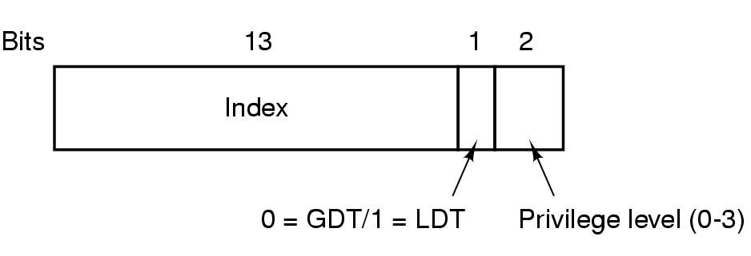
Segmentation with Paging: Pentium (2)
To access a segment,
  a selector for that segment is loaded into one of the machine’s segment registers.
A Pentium selector

Slide 76
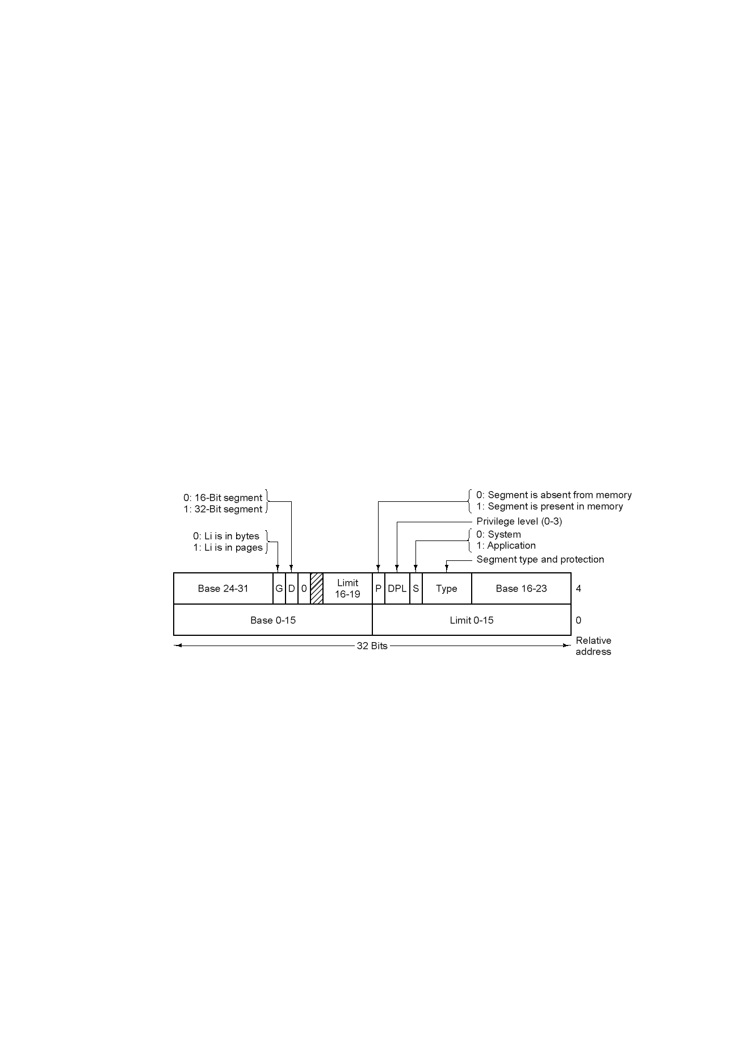
Segmentation with Paging: Pentium (3)
At the same time, the corresponding descriptor is loaded into microprogram registers.

Slide 77
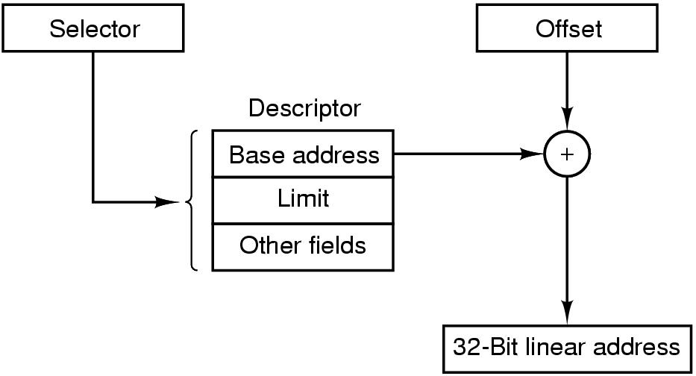
Segmentation with Paging: Pentium (4) – memory reference
Conversion of a (selector, offset) pair to a linear address

Slide 78
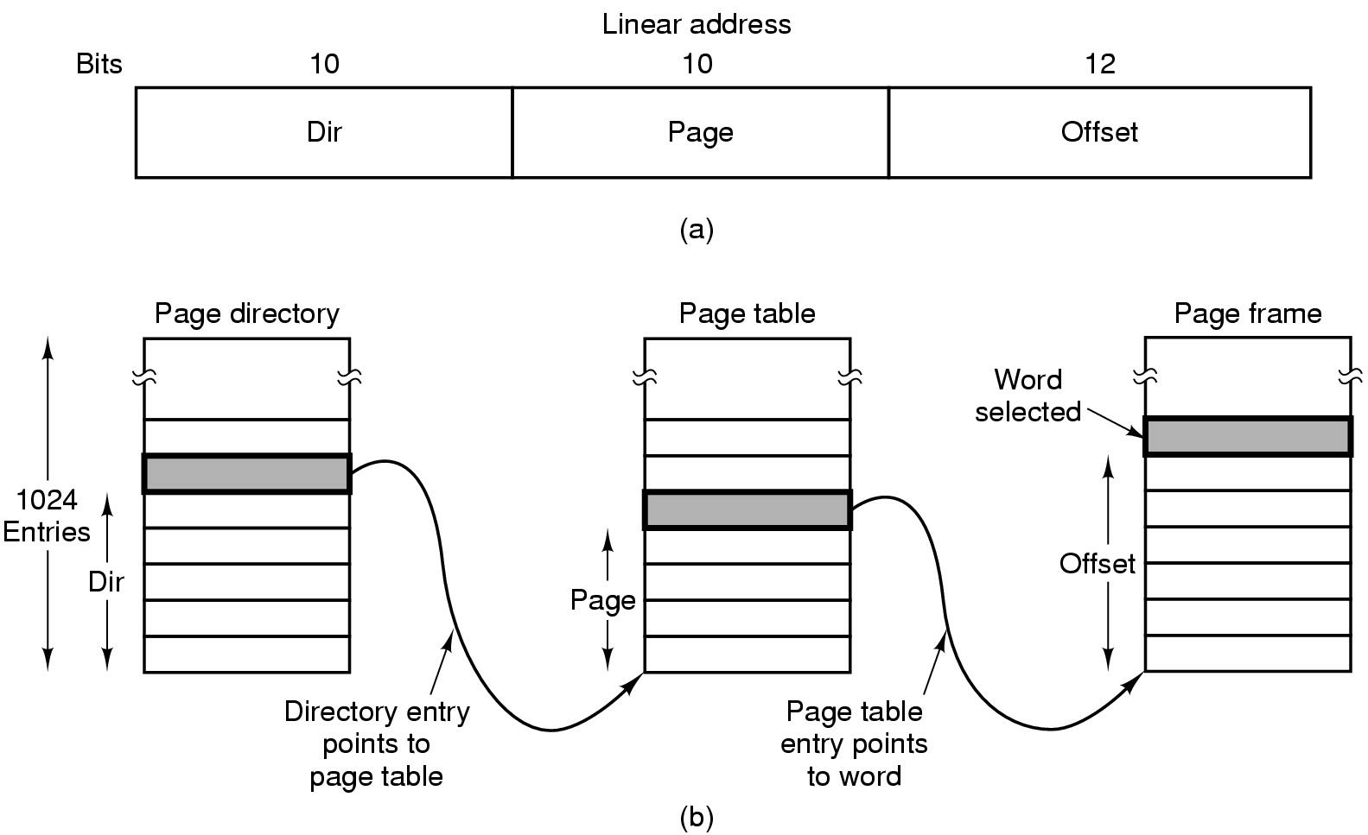
Segmentation with Paging: Pentium (4) – memory reference
Mapping of a linear address onto a physical address

Slide 79
Segmentation with Paging: Pentium (4)
TLB used in Pentium
The Pentium design supports pure segmentation, pure paging, paged segmentation, and compatibility with 286.
protection
  At each instant, a 2-bit field in the PSW indicates the protection level for the running program.
  Each segment has a protection level too.

Slide 80
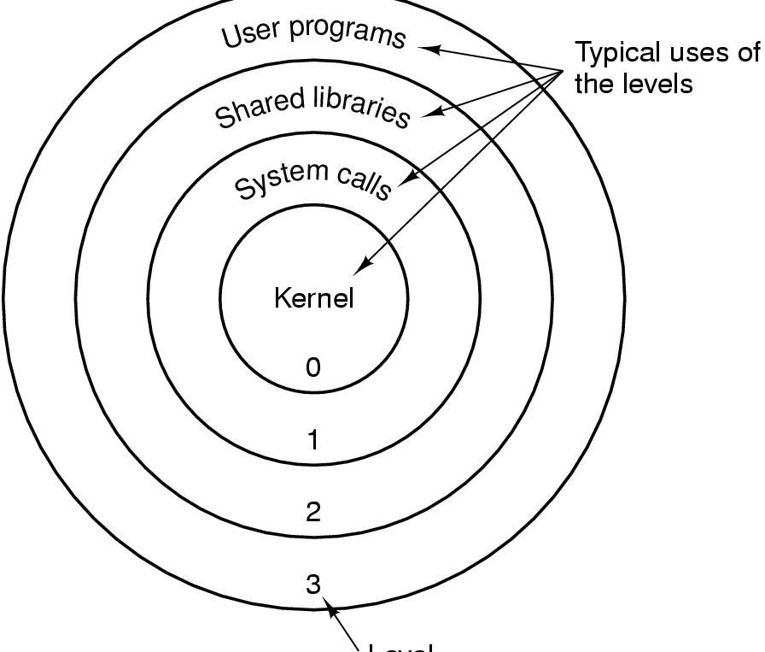
Segmentation with Paging: Pentium (5)
Protection on the Pentium

Slide 81
1 2 4 6 7 13 14 17

