Slide 1
Chapter 5 – File Systems
5.1 Files
5.2 Directories
5.3 File System Implementation
5.4 Security
5.5 Protection Mechanisms

Slide 2
Long-term Information Storage
Must store large amounts of data
Information stored must survive the termination of the process using it
Multiple processes must be able to access the information concurrently

Slide 3
Files
Files – persistent storage units on the disks and other external media, which can not be affected by process creation and termination.
File Systems – the part of the operating system dealing with files

Slide 4
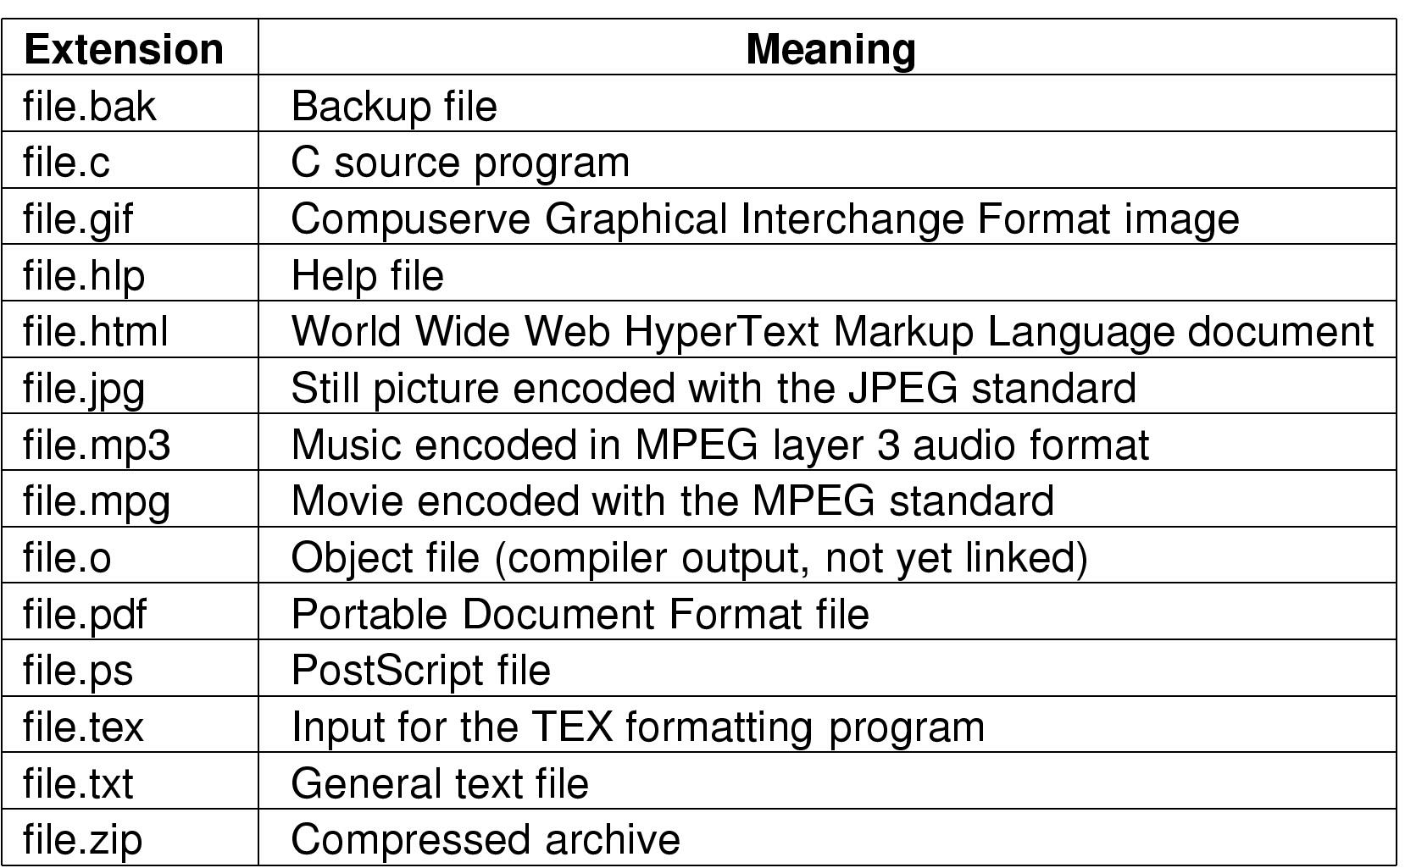
Files – File Naming
Typical file extensions.

Slide 5
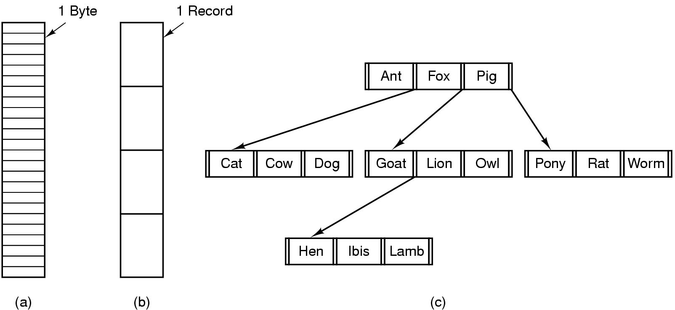
Files – File Structure
Three kinds of files
  byte sequence
  record sequence
  tree

Slide 6
Files – File Types
e.g.
  regular files v.s. directories
  character special files v.s. block special files
Regular files
  ASCII files v.s. binary files

Slide 7
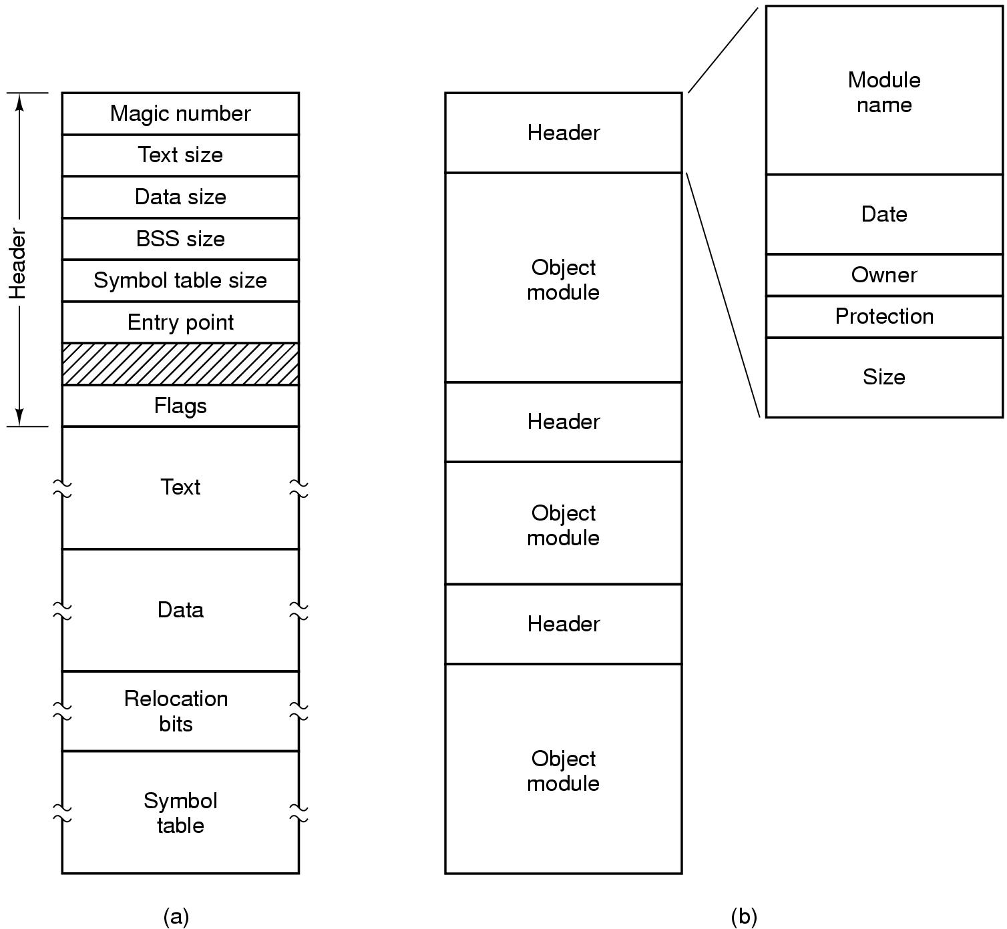
Files – File Types(Binary Files)
(a) An executable file (b) An archive

Slide 8
Files – File Access
Sequential access
  read all bytes/records from the beginning
  cannot jump around, could rewind or back up
  convenient when medium was mag tape
Random access
  bytes/records read in any order
  essential for data base systems
  read can be …
    move file marker (seek), then read or …
    read and then move file marker

Slide 9
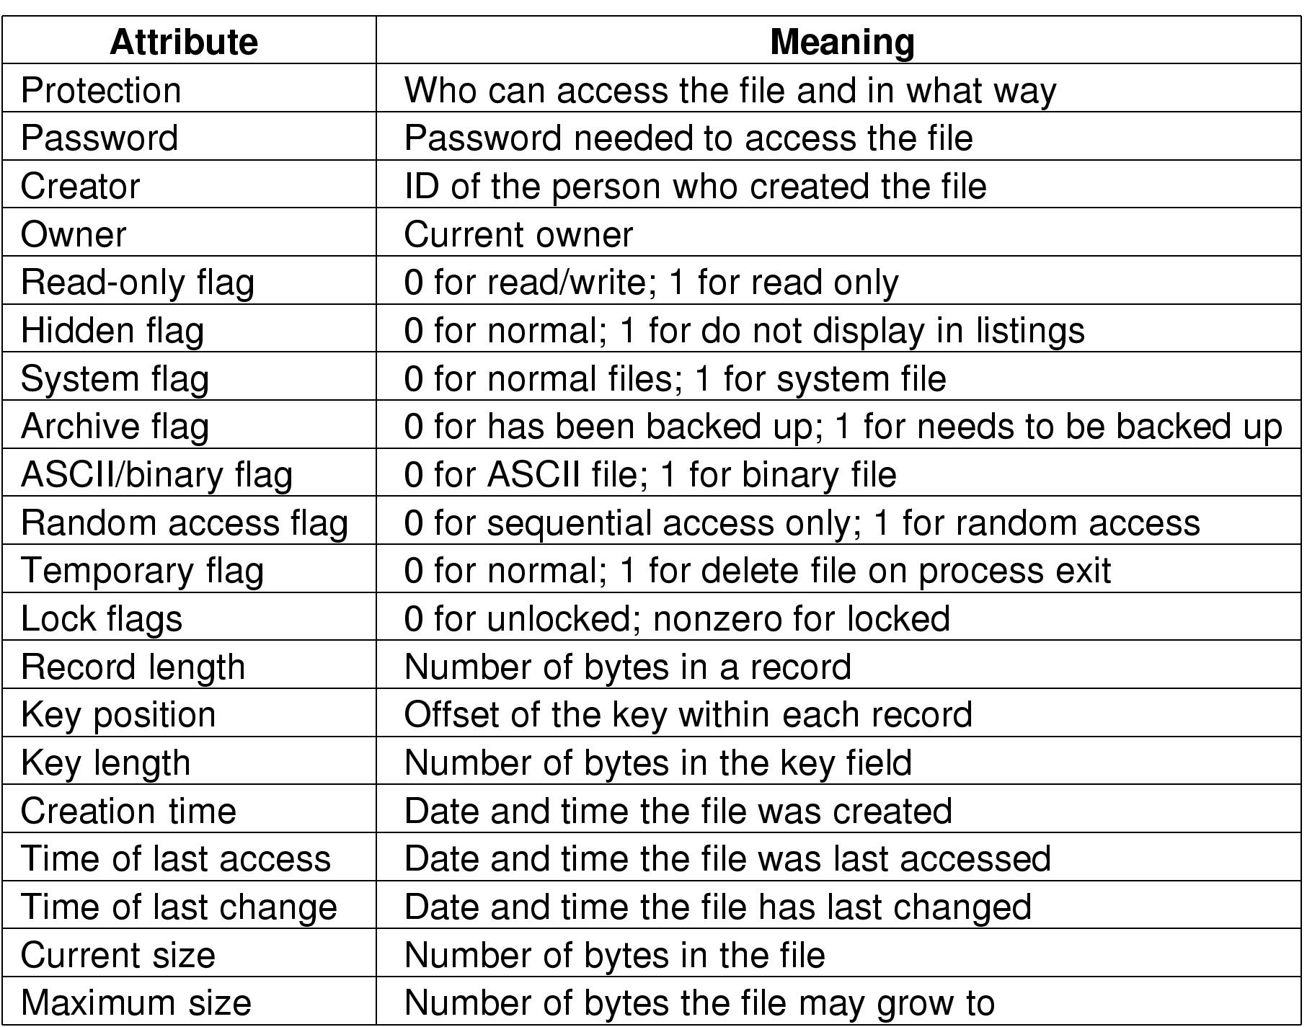
Files – File Attributes
Possible file attributes

Slide 10
Files – File Operations
  Create
  Delete
  Open
  Close
  Read
  Write
  Append
  Seek
  Get attributes
  Set Attributes
  Rename

Slide 11
Directories
Data structure containing the attributes
games | attributes
mail | attributes
news | attributes
work | attributes
games
mail
news
work
(a)
(b)
(a) attributes in the directory entry. (b) Attributes elsewhere.

Slide 12
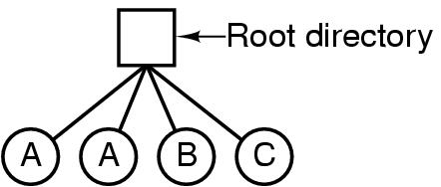
Directories
Single-Level Directory Systems
A single level directory system
  contains 4 files
  owned by 3 different people, A, B, and C

Slide 13
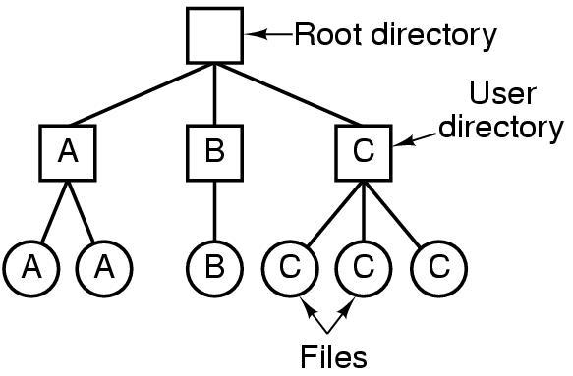
Two-level Directory Systems
Letters indicate owners of the directories and files

Slide 14
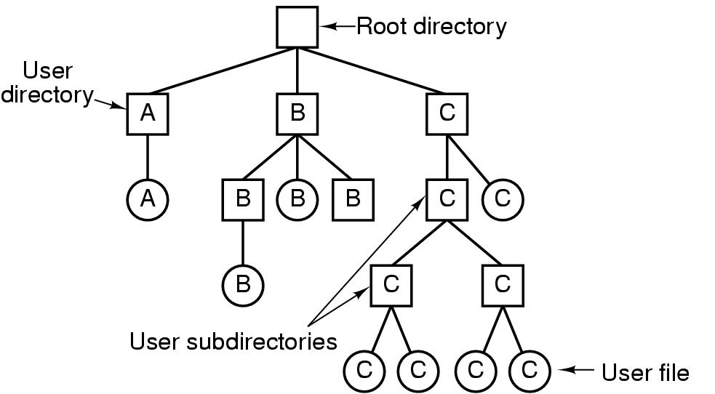
Hierarchical Directory Systems
A hierarchical directory system

Slide 15
Path Names
absolute path name
  e.g. /usr/ast/mailbox
relative path name
  working directory
  current directory - .
  parent directory - ..

Slide 16
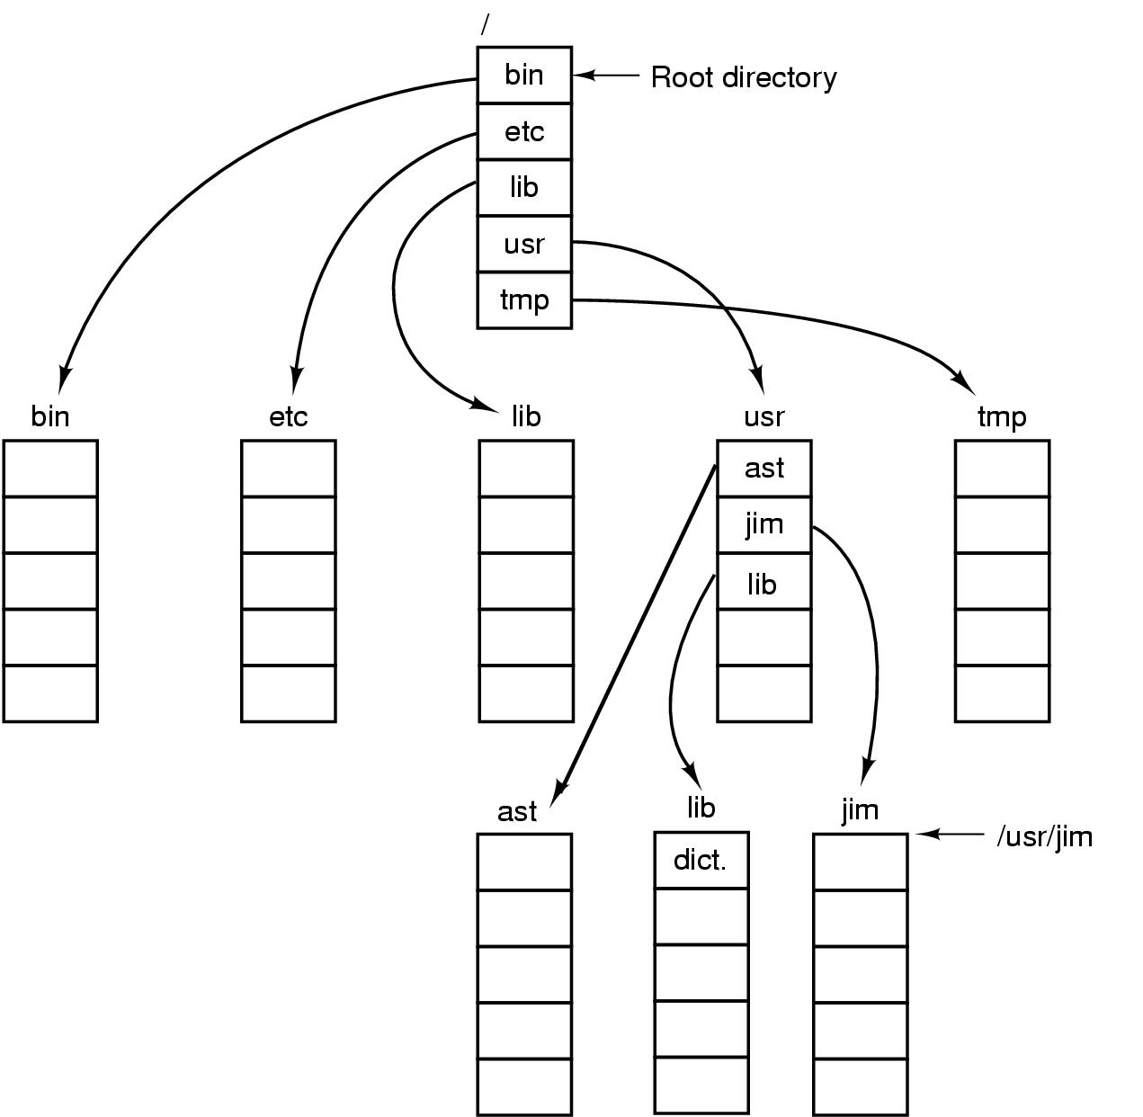
Path Names
A UNIX directory tree

Slide 17
Directory Operations
Create
Delete
Opendir
Closedir
Readdir
Rename
Link
Unlink

Slide 18
File System Implementation
Implementing Files
Implementing Directories
Disk Space Management
File System Reliability
File System Performance

Slide 19
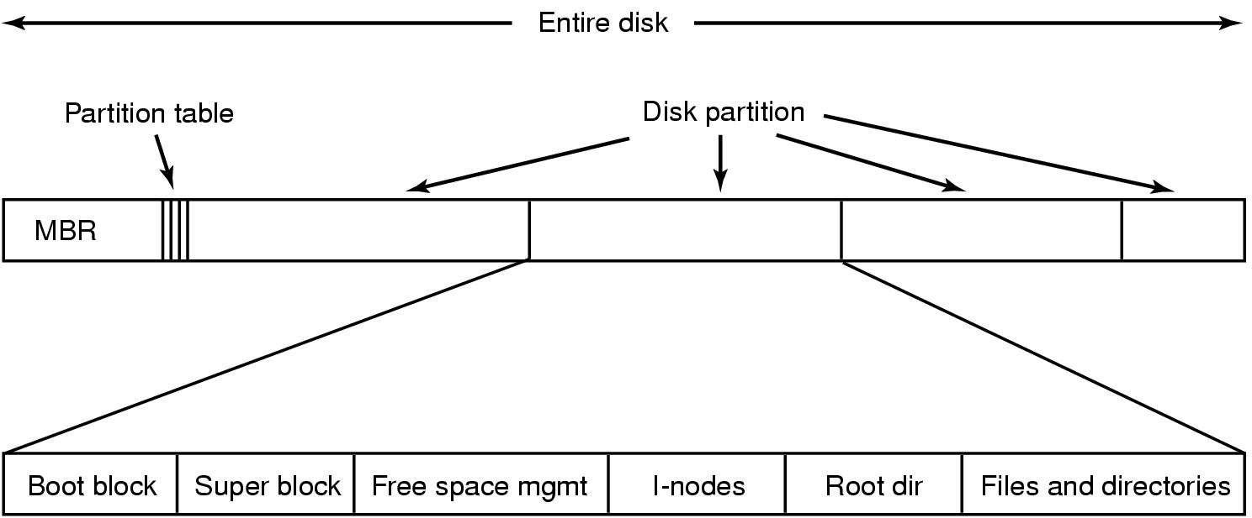
File System Implementation
A possible file system layout

Slide 20

Implementing Files
(a) Contiguous allocation of disk space for 7 files
(b) State of the disk after files D and E have been removed

Slide 21
Contiguous Allocation
Advantages
  simple to implement
  high performance
Disadvantages
  maximum file size must be given in advance
  fragmentation of the disk

Slide 22

Linked List Allocation
Storing a file as a linked list of disk blocks

Slide 23
Linked List Allocation
Advantages
  high disk space utility
  only the address of the first block needed
  sequential access is straightforward
Disadvantages
  random access is slow
  the amount of data storage in a block is not a power of 2

Slide 24
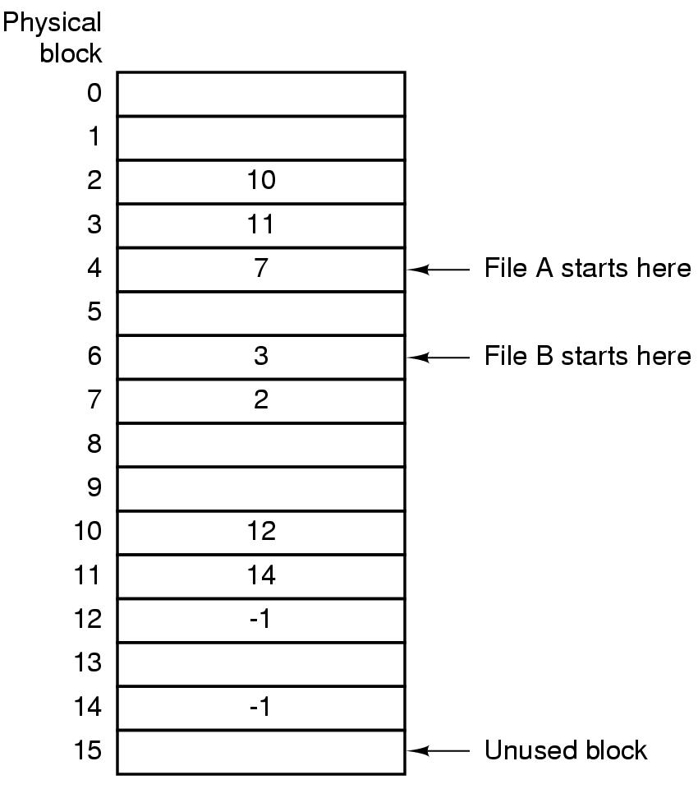
Linked List Allocation Using an Index
Linked list allocation using a file allocation table in RAM

Slide 25
Linked List Allocation Using an Index
Advantages
  the size of a block is a power of 2
  random access is easier
  simplify directory entries with a single integer per file
Disadvantages
  the whole table must be in main memory all the time

Slide 26
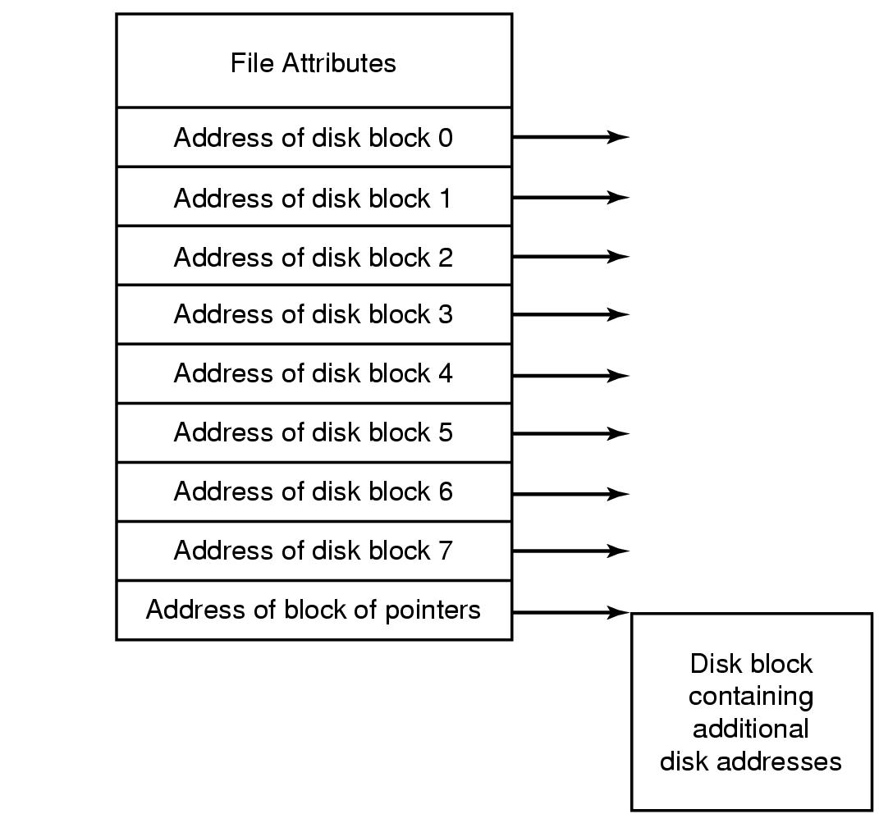
I-nodes
a little table per file listing the attributes and disk addresses of the file’s blocks
An example i-node

Slide 27
I-nodes
disk addresses within the i-nodes
single indirect block
double indirect block
triple indirect block

Slide 28
Implementing Directories
directory entries provide the information needed to find the disk blocks:
  disk addresses of the entire file, or
  the number of the first block, or
  the number of the i-node
file attributes
  stored directly in the directory entry, or
  stored in the i-node, if i-nodes are used.

Slide 29
Implementing Directories
directories in CP/M
  a single-level directory system
  file attributes and the disk block number are all stored in the 31-byte entry
  (see also the textbook)

Slide 30
Implementing Directories
directories in MS-DOS
  a hierarchical directory system
  a 32-byte directory entry contains file name, attributes, the number of the first disk block etc.

Slide 31
Implementing Directories
directories in UNIX
bytes 2 14
File name
I-node number
A UNIX directory entry

Slide 32
Implementing Directories
an example: to look up /usr/ast/mbox
block 406 for /usr/ast directory
root directory
block 132 for /usr directory
1
.
I-node 6 for /usr
I-node 26 for /usr/ast
1
..
6
.
26
.
Mode
size
times
Mode
size
times
4
bin
1
..
6
..
7
dev
19
dick
64
grants
14
lib
30
erik
92
books
132
406
9
etc
51
jim
60
mbox
6
usr
26
ast
81
minix
8
tmp
45
bal
17
src
looking up /usr/ast/mbox for its i-node number

Slide 33
Disk Space Management
Chopping files up into fixed-sized blocks prevails over storing a file as a contiguous sequence of bytes.
How big the block should be?

Slide 34
Disk Space Management
block size
  Big blocks sacrifice disk space efficiency.
  While small blocks might make reading a file to be slow.
  e. g. a disk with 32768 bytes per track, 16.67 msec of rotation time, 30 msec of average seeking time, blocks of k bytes each. The time to read a block is
30 + 16.67/2 + (k/32768)*16.67
time to read an n-byte file:
n/k * (30+16.67/2 + (k/32768)*16.67)

Slide 35
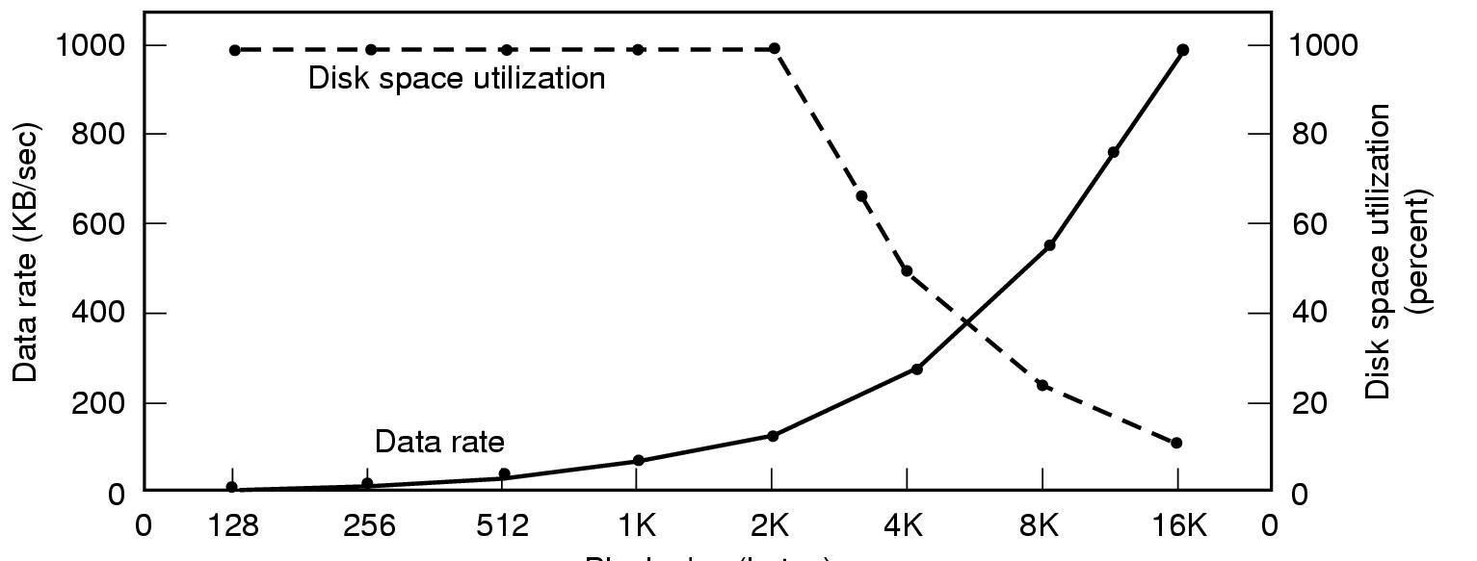
Disk Space Management
Block size
Dark line (left hand scale) gives data rate of a disk
Dotted line (right hand scale) gives disk space efficiency
All files 2KB

Slide 36
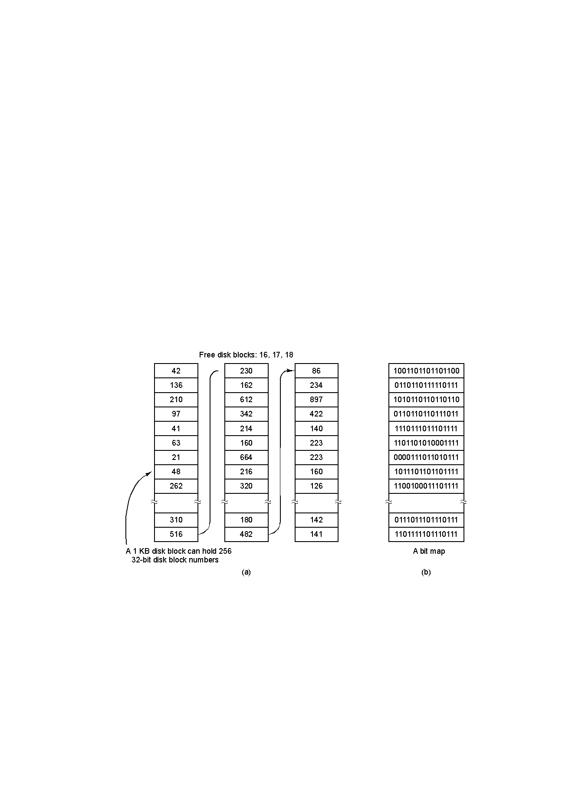
Disk Space Management
keeping track of free blocks
(a) Storing the free list on a linked list
(b) A bit map

Slide 37
Keeping Track of Free Blocks
Linked list method
  1K block, 32-bit disk block number, and 200M disk space need a free list of maximum 800 blocks.
Bit-map method
  200M disk requires 200K bits which is 25 blocks

Slide 38
File System Reliability
Aim: to protect the information of in the file system
review: how to deal with bad sectors

Slide 39
File System Reliability
Doing backups concerns
  backing up only specific directories v.s. backing up the entire file system
  incremental dumps v.s. full dumps
  compressed dumps v.s. uncompressed dumps
  static dumps v.s. dynamic dumps
  other nontechnical issues

Slide 40
File System Reliability
physical dumps
  back up blocks from block 0 to the last one
  no use to dump unused blocks
  avoid dumping bad blocks
  simple and speedy, but unable to customize dumping, such as skipping selected directories, incremental dumping, restoring individual files upon request etc.

Slide 41
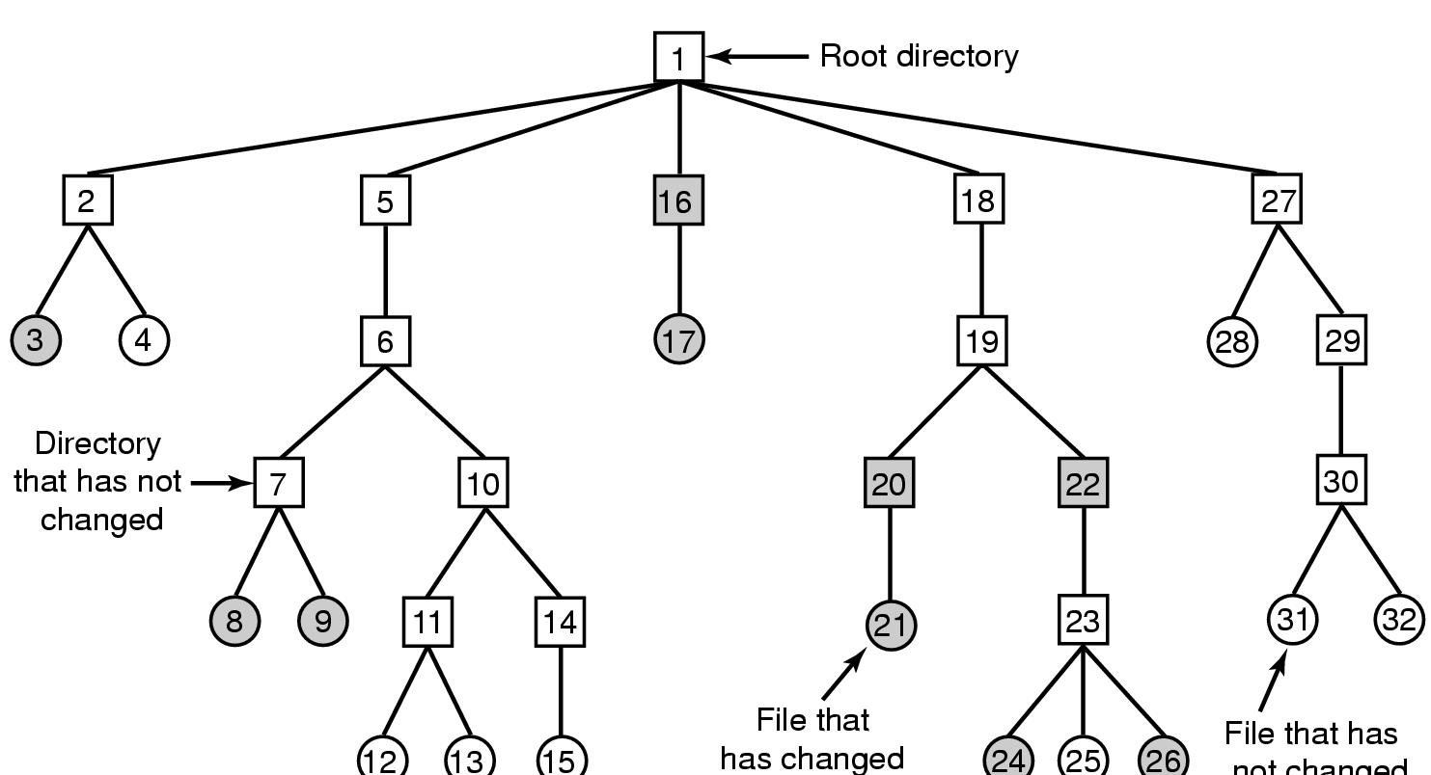
File System Reliability
logical dumps
A file system to be dumped
  squares are directories, circles are files
  shaded items, modified since last dump
  each directory & file labeled by i-node number

Slide 42
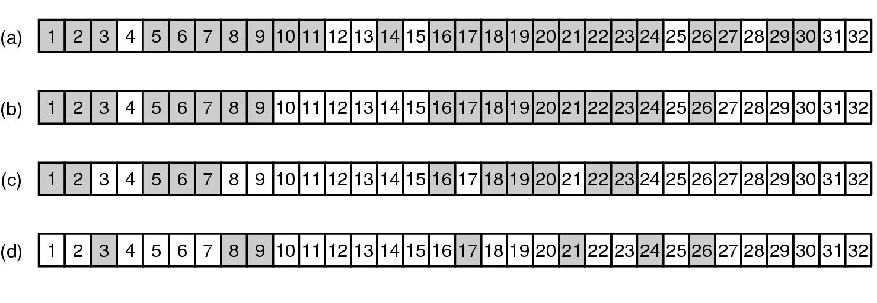
File System Reliability
Bit maps used by the logical dumping algorithm

Slide 43
File System Reliability
restoring a file system from the dump tapes
  create an empty file system on the disk
  restore the most recent full dump
    restore all the directories on the tape
    restore the files
  repeat this process with the incremental dumps henceforth.

Slide 44
File System Reliability
other issues with logical dumping
  free block list is to be reconstructed.
  a linked file should be restored only one time.
  holes in UNIX files should not be dumped and not be restored.
  special files, named pipes etc. should never be dumped.

Slide 45
File System Reliability
File System Consistency
  an inconsistent state
  usually, a utility program to check file system inconsistency
  two kinds of consistency checks
    blocks
    files

Slide 46
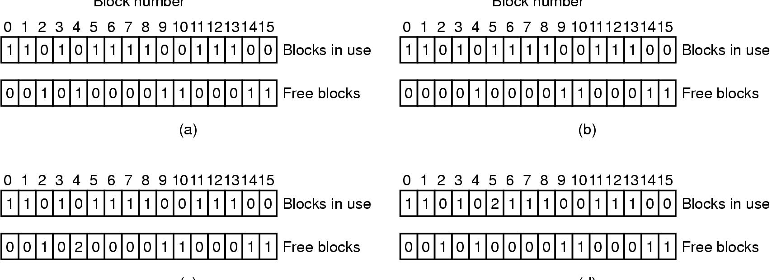
File System Reliability
File System Consistency
File system states
  (a) consistent
  (b) missing block
  (c) duplicate block in free list
  (d) duplicate data block

Slide 47
File System Reliability
solutions to blocks inconsistency
  missing block: added to the free list
  duplicate free block: rebuild the free list
  duplicate data block:
    copy the content the duplicate block to a new block
    insert the new one into one of these files
    report to the user

Slide 48
File System Reliability
File System Consistency
  checks for file inconsistency
  a table of counters for files indexed by i-node numbers
  compared the counter with the link count inside the i-node
    if the link count inside the i-node is higher, fix the i-node with correct value
    if the link count inside the i-node is lower, fix the i-node too.

Slide 49
File System Reliability
other consistency checks for
  inconsistent i-node number
  a strange i-node mode
  a suspiciously large directory
  other potential security problems

Slide 50
File System Performance
principal: reduce the number of disk access
  block cache or buffer cache: a collection of blocks that logically belong on the disk but are being kept in memory
  cache management
    replacement algorithm
    LRU in linked list is feasible

Slide 51
File System Performance
modifications to LRU algorithm
  divide blocks into categories such as i-node blocks, indirect blocks, directory blocks, full data blocks, and partly full data blocks.
  blocks needed soon are put in the rear of the LRU list, while the opposite, the front.
  modified blocks essential to the consistency should be written to disk immediately, regardless of its position in the list.

Slide 52
File System Performance
when to write the data blocks in cache to disk?
  periodically rewrite all modified blocks in cache to disk(Unix)
  write every modified block to disk as soon as it has been written(MS-DOS)

Slide 53
File System Performance
important: reduce the amount of disk arm motion
  putting blocks to be accessed in sequence
  allocating disk storage in units of 2 consecutive blocks
  512-byte sector 1K blocks 2 blocks
  format result system for allocation

Slide 54

File System Performance
other issue: i-node placement
I-nodes placed at the start of the disk
Disk divided into cylinder groups
  each with its own blocks, i-nodes and free list

Slide 55
Log-Structured File System
backgrounds
  changes in CPU, memories, and disks in price and capacity
  what is lagging behind the disk seek time.
  file systems are the main performance bottleneck.

Slide 56
Log-Structured File System
motive of the LFS
  disk caches can also be larger
  increasing number of read requests can come from cache
  thus, most disk accesses will be writes
  even worse, small writes waste much time in seeking and rotating
  for reason of consistency, i-nodes are written immediately.

Slide 57
Log-Structured File System
LFS Strategy structures entire disk as a log
  have all writes initially buffered in memory
  periodically write these to the end of the disk log
    a single contiguous segment
  when file opened, locate i-node, then find blocks
    a cached i-node map

Slide 58
Log-Structured File System
a cleaner in LFS in real disks
  scan the log circularly
    read the summary of the first segment to get the i-nodes and files there
    check the current i-node map to see if current and in use
    if not, the information is discarded
    or else, read in memory to be written out in the next segment
    the original segment is marked as free

Slide 59
Log-Structured File System
when a file block is written back to a new segment
  the i-node is to be located,
  updated,
  put into memory to be written out in the next segment

Slide 60
Security
security: the overall problem of making sure that files are not read or modified by unauthorized persons.
protection: specific operating system mechanisms used to provide security.

Slide 61
Security
two main suffering
  data loss
  intruders
causes of data loss – dealt with by backups
  natural catastrophe
  hardware or software errors
  human errors

Slide 62
Security
intruders
  passive intruders
  active intruders
categories of intrusion
  casual prying of nontechnical users
  snooping by insiders
  determined attempts to make money
  commercial or military espionage

Slide 63
Security
famous security flaws
  UNIX
    lpr
    core file
    mkdir

Slide 64
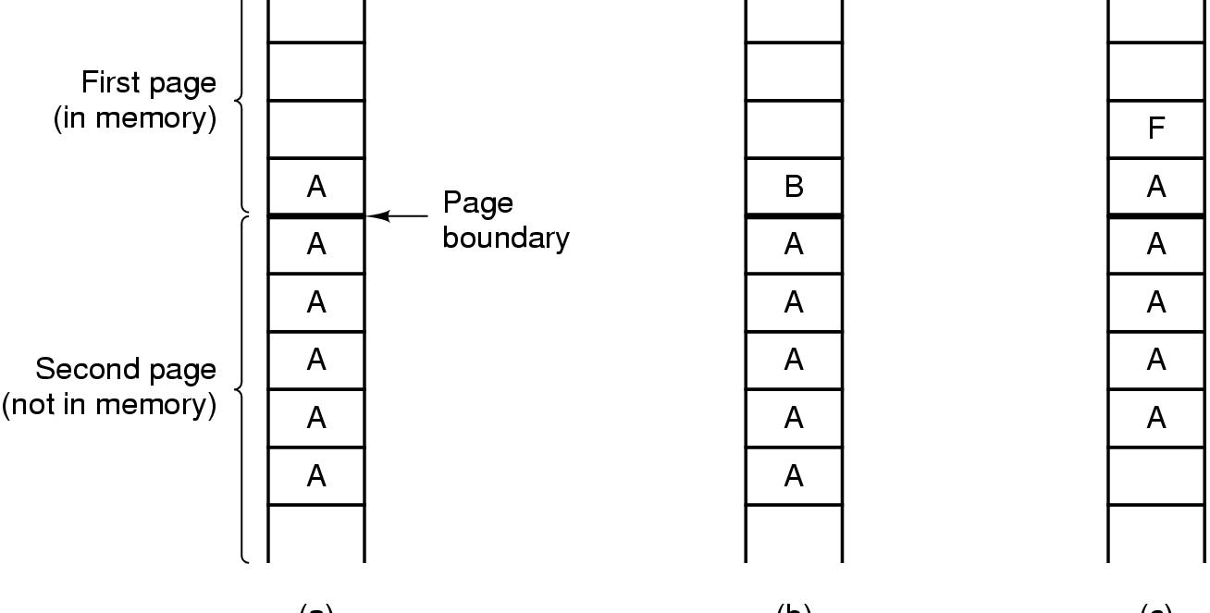
Famous security flaws - TENEX
allow to call a user function on each page fault
The TENEX – password problem

Slide 65
Famous security flaws
OS/360
  start a tape reading and then continue computing while reading into the user space.
  when “computing” is reading a file presenting the file name and the password
  checking for password and reading according to filename are separated.

Slide 66
Famous security flaws
Trojan horses
logic bomb
Morris’ worm program

Slide 67
Generic Security Attacks
Typical attacks
Request memory, disk space, tapes and just read
Try illegal system calls
Start a login and hit DEL, RUBOUT, or BREAK
Try modifying complex OS structures
Try to do specified DO NOTs
Convince a system programmer to add a trap door
Beg admin's sec’y to help a poor user who forgot password

Slide 68
Viruses
Virus: a program fragment attached to a legitimate program with the intention of infecting others.
Viruses | Worms
attached to an existing program | a complete program itself
need the infected program to run | automatically and actively attack
aim at the local programs or boot sector, LAN, emails | aim to the hosts on the Internet

Slide 69
Viruses
How viruses spread:
  copying
  downloading
  attaching to mails
How to prevent:
  buying legal copies
How to detect:
  secure (file, checksum) list v. s. all files’ checksum
How to cure:
  antivirus packages

Slide 70
Design Principles for Security
System design should be public
Default should be no access
Check for current authority
Give each process least privilege possible
Protection mechanism should be
  simple
  uniform
  in lowest layers of system
Scheme should be psychologically acceptable

Slide 71
User Authentication
identifying users when they log in on a system
based on something the user knows, something the user has, or something the user is.

Slide 72
User Authentication - passwords
Morris’ study
  unrestricted user-chosen passwords fall into the prepared encrypted list by a rate of 86 percent.
  require users to pick reasonable passwords
  salting the password file
    salt: a random n-bit number
    increase the size of search space by 2^{n}
  effectively select and change passwords, secure and keep them encrypted
  ask the user some questions stored in the computer
  challenge-response

Slide 73
User Authentication
physical identification
  smart-cards
  physical characteristic
    fingerprint or voiceprint or visual recognition
    signature analysis
    finger length
    other unacceptable measurements

Slide 74
User Authentication
countermeasures – daunting the intruders
  asking for specific place and time to log in
  recording all logins
  baited traps

Slide 75
Protection Mechanisms
policy v.s. mechanism
often implemented in a program - reference monitor

Slide 76
Protection Domains
objects: those that need to be protected, can be
  hardware
  software
each object has
  a unique name
  a finite set of operations allowed to perform on it

Slide 77
Protection Domains
protection mechanism should make it clear
  whether processes are authorized to access any objects, and if so
  what legal operations they are entitled to perform

Slide 78
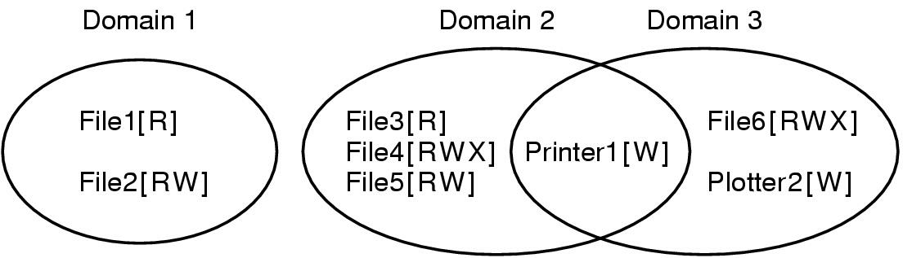
Protection Domains
a domain: a set of (object, right) pairs
Examples of three protection domains

Slide 79
Protection Domains
process – domain relation
domains in UNIX
  the domain of a process is defined by its uid and gid
  a system call causes a domain switch
  exec on a file with SETUID or SETGID, or running a program with SETUID or SETGID causes a domain switch

Slide 80
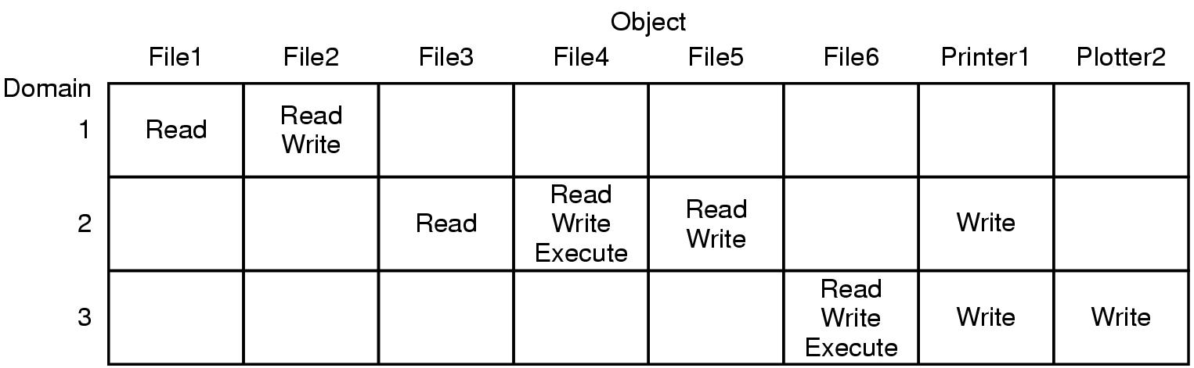
Protection Domains
A protection matrix

Slide 81
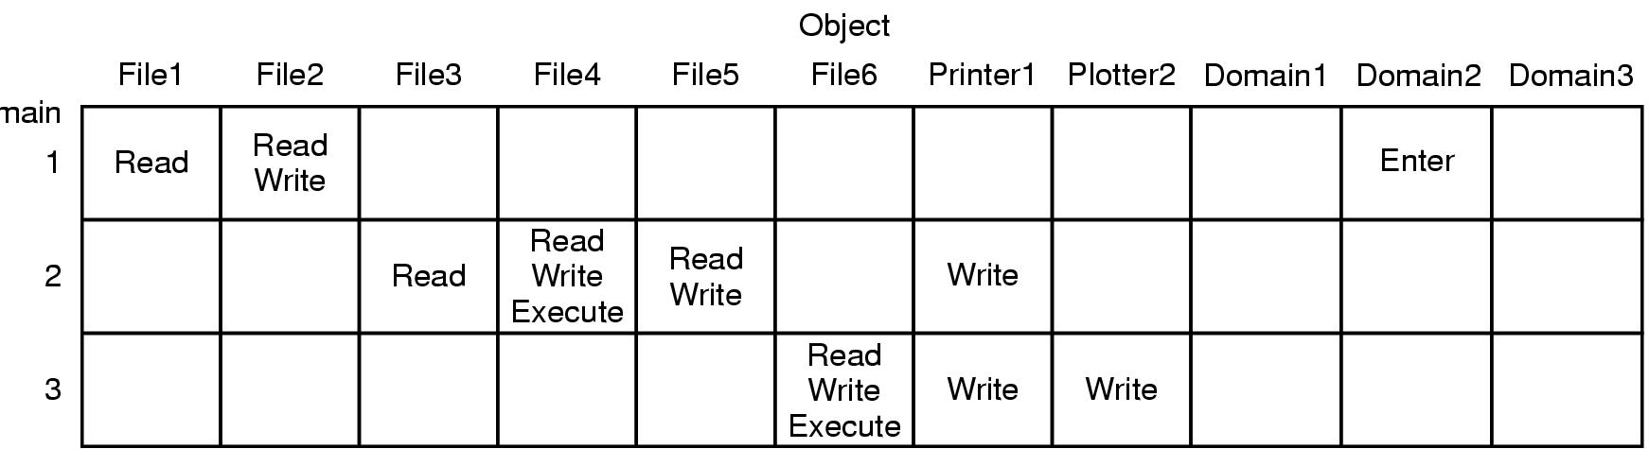
Protection Domains
A protection matrix with domains as objects

Slide 82
Access Control Lists
ACL: associating with each object an ordered list containing all the domains allowed on the object
when implemented, can be one of the file attributes

Slide 83
Access Control Lists(an example)
users(uid): Jan, Els, Jelle, Maaike
groups: system, staff, student, student
some ACLs:
  File0: (Jan, *, RWX)
  File1: (Jan, system, RWX)
  File2: (Jan, *, RW-), (Els, staff, R--), (Maaike, *, R--)
  File3: (*, student, R--)
  File4: (Jelle, *, ---), (*, student, R--)

Slide 84
Access Control Lists
implementation in UNIX is simpler and cheaper
the problem with ACL
  changing the ACL will probably not affect any users who are currently using the object.

Slide 85
Capabilities
capability list: associating with each process its domain
# | Type | Rights | Object
0 | File | R-- | Pointer to File3
1 | File | RWX | Pointer to File4
2 | File | RW- | Pointer to File5
3 | Pointer | -W- | Pointer to Printer1

Slide 86
Capabilities
protect the C-lists from user tampering
  tagged architecture
  keep the C-list inside the OS, processes refer to capabilities by their slot number
  keep the C-list in user space, but ENCRYPT each capability with a secret key unknown to the user

Slide 87
Capabilities
object-dependent rights
generic rights applicable to all objects
  copy capability
  copy object
  remove capability
  destroy object
how to revoke access from an object?

Slide 88
ACLs v.s. Capabilities
Capabilities are efficient.
ACLs often need to search a potentially long list to decide the legality of an access.
Encapsulation
ACLs allow selective revocation of rights.
Separation of capabilities and objects makes it troublesome to remove either side while not the other.

Slide 89
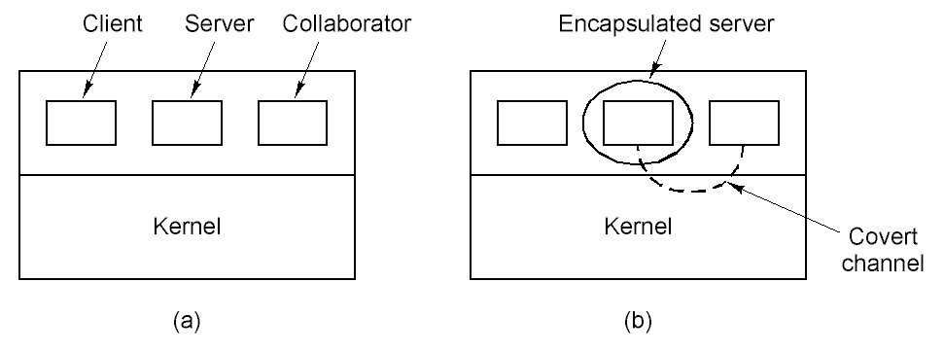
Covert Channels
Encapsulated server can still leak to collaborator via covert channels
Client, server and collaborator processes

Slide 90
Covert Channels
typical covert channels
  modulating the CPU usage
  modulating paging rate
  locking and unlocking some file
  acquiring and releasing dedicated resources
  creating and removing a file
leakage to the human owner of the server process.

