Slide 2
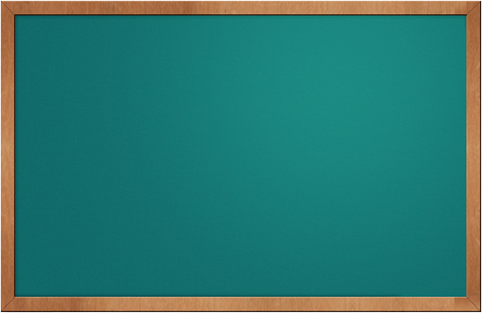










Welcome to my Villa!
Mouse LEFT CLICK on screen to enter navigation mode
Press “ESC” key to exit navigation mode
Use arrow keys or WSAD keys to move around
Now turn around and
Enjoy the Space!

Slide 3
欢迎来到我的别墅 !
在屏幕任意位置点击鼠标左键进入环游模式
按“ESC”键退出环游模式
按方向键或者WSAD键向前后左右移动
转身有惊喜
祝您游玩愉快!

