Slide 1
SAFETY PREDICTION IN VARIOUS DISTRICTS OF CHICAGO AT A GIVEN TIME
by
Sami Ahmad Khan, A20352677
Zeeshan Aamir Khavas, A20341778

Slide 2
Task
Given a dataset of reported incidents of crimes that occurred in the city of Chicago in the year 2016, we classify the districts as “Safe” and “Unsafe”.
Predict the safety of a particular district at a given time based on prediction model.

Slide 3
Dataset
The raw dataset was collected from “City of Chicago” data portal.
The original dataset contained millions of records for the year 2016. This was reduced to a size of 11,670 records by randomly choosing ~1000 entries from each month.
From the dataset we selected few features for the prediction model. Then manually added weightage to each crime on the basis of crime severity.
We created Target Labels on the basis of severity of crimes i.e. ‘Primary type’ and ‘Arrest’ and manually labelled them as ‘0’ for Safe and ‘1’ for Unsafe.
So, our dataset has 11,670 rows, 5 columns and 1 Label column.

Slide 4
Visualization of the Class
This is the Histogram for the target class depicting 0s and 1s for Safe and Unsafe respectively for all the districts.

Slide 5
Visualization of the Class
This Histogram depicts average Safe and Unsafe values per District.

Slide 6
Visualization of one feature
Below we can see a histogram for Danger Value associated with each District in Chicago. This Danger Value is used to calculate the target.

Slide 7
Model Selection Results
We used Accuracy as our baseline measure via Confusion Matrix.
First, we manually calculated the probability of 1s and 0s in our class for our baseline accuracy measure.
Model used: MLPClassifier
Parameters used:
activation = ‘relu’
learning_rate_init = 0.006
hidden_layer_sizes = {5, 5, 5}
alpha = 0.1
We used Accuracy because we had a balanced binary target class.
We performed 10-fold cross validation
Results are one the next slide

Slide 8
Model Selection Results
Model | Parameters | Performance
Baseline | majority class | 0.589
Logistic regression | C=2, max_iter=1000, random_state=0, solver=‘sag’ | 0.68058
 | C=1, max_iter=1000, random_state=0, solver=‘sag’ | 0.68058
 | C=0.1, max_iter=1000, random_state=0, solver=‘sag’ | 0.68132
 | C=0.01, max_iter=1000, random_state=0, solver=‘sag’ | 0.68169
 | C=0.001, max_iter=1000, random_state=0, solver=‘sag’ | 0.68132
 | C=0.002, max_iter=1000, random_state=0, solver=‘sag’ | 0.68144
 | C=0.0001, max_iter=1000, random_state=0, solver=‘sag’ | 0.68144
 | C=0.00001, max_iter=1000, random_state=0, solver=‘sag’ | 0.63100

Slide 9
Model Selection Results
Model | Parameters | Performance
Decision Tree | Default | 0.99963
Gaussian Naïve Bayes | Default | 0.69467
MLPClassifier | activation = 'relu’, learning_rate_init = 0.006, alpha = 0.1, hidden_layer = (5,5,5) (*Best Case) | 0.76984
 | P.S.
Support Vector Machines (SVM) | cache_size=1000, kernel=‘linear, C=0.1, degree=2 | 0.65855
 | cache_size=1000, kernel=‘linear, C=0.1, degree=3 | 0.65855
 | cache_size=1000, kernel=‘linear, C=1, degree=4 | 0.65855
 | cache_size=1000, kernel=‘linear, C=1, degree=2 | 0.65855

Slide 10
Model Selection Results
Model | Parameters | Performance
 | cache_size=1000, kernel=‘linear, C=1, degree=3 | 0.65855
 | cache_size=1000, kernel=‘linear, C=1, degree=4 | 0.65855
 | P.S. There is no difference the value
MLPClassifier | learning_rate_init = 0.006, alpha = 0.1, hidden_layer_sizes = (5, 5, 5), activation = 'relu' | 0.698
BEST MODEL AND PARAMETER SETTING WAS

Slide 11
Top Features
Based on our model the top features that affected our target were following:
Data
District
Primary Type
Arrest
Crime Weightage
On the basis of the above features, we have given weightage to each crime type and created a column ‘Danger Value’.
A threshold is set (T) = mean of Danger Value (DV)
The target values are set on the basis threshold value.
If DV < T, Label = 0
Else if DV >=T, Lable = 1

Slide 12
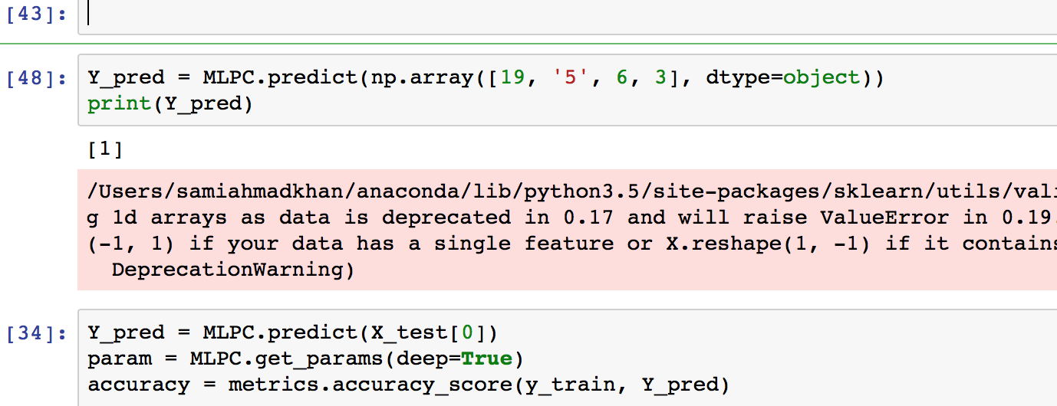
Interesting/unexpected cases
There are certain instances of features where you can directly tell by looking at the Primary Type and Arrest, whether that district is safe or unsafe.
For example,
When Primary Type = Homicide
And Arrest = False
Homicide has been given a weightage of ‘3’ on the severity.
So one can directly tell that for a district at particular time there is a severe crime committed and no arrest has been made i.e. the criminal is still a fugitive, making that district unsafe i.e. Label = 1.
And looking at the above screenshot I can see that my estimation is correct, the model also gave the same output.
The Accuracy for Decision Tree Classifier is 0.99976, which is almost 100%. Such high accuracy is due to the fact that the dataset is very large and the target has binary values. The target variable in our dataset has roughly 60% and 40% negative classes respectively, thus it is a balanced dataset. When we train a decision tree to classify this data, we get an overall accuracy of 99.97% (~100%). Hence we have ignored this classification model.

Slide 13
Interesting/unexpected cases
We have noticed that neural network and deep learning related models like MLPC and SVM takes a lot of time on huge datasets.
SVM solves an optimization problem of quadratic order.
Hence we have sampled our data uniformly, so as to reduce our dataset to a feasible size (~11,760 records).

