Slide 1



STUDYHUB
PRECILLAS,HAZEL
LABOSTRO, LEVY JEAN
ALMONIA, SHARANIE
CALABRIA, ANTWIN FERNANDEL
PAGARA, MEGO NENO
3RD PRESENTER
Designation

Slide 2

INTRODUCTION
Current online learning systems often fail to support effective communication and resource access, leading to student disengagement. StudyHub offers a solution: a user-friendly platform that centralizes information, fosters collaboration, and includes integrated note-taking. This study will evaluate StudyHub's impact on student learning and instructor experience.

Slide 3
OBJECTIVES
This study will:
1) Design & develop StudyHub (resource library, note-taking);
2) Evaluate its impact on student organization;
3) Identify areas for improvement.

Slide 4
SCOPE AND DELIMITATION OF THE STUDY
Course: Single undergraduate course (BSIT, 2nd year, USTP-Claveria)
Semester: First Semester, SY 2024-2025
Focus: Communication & resource sharing (primary); collaboration (secondary)
Exclusions: Comparison with other LMS; in-depth technical analysis

Slide 5
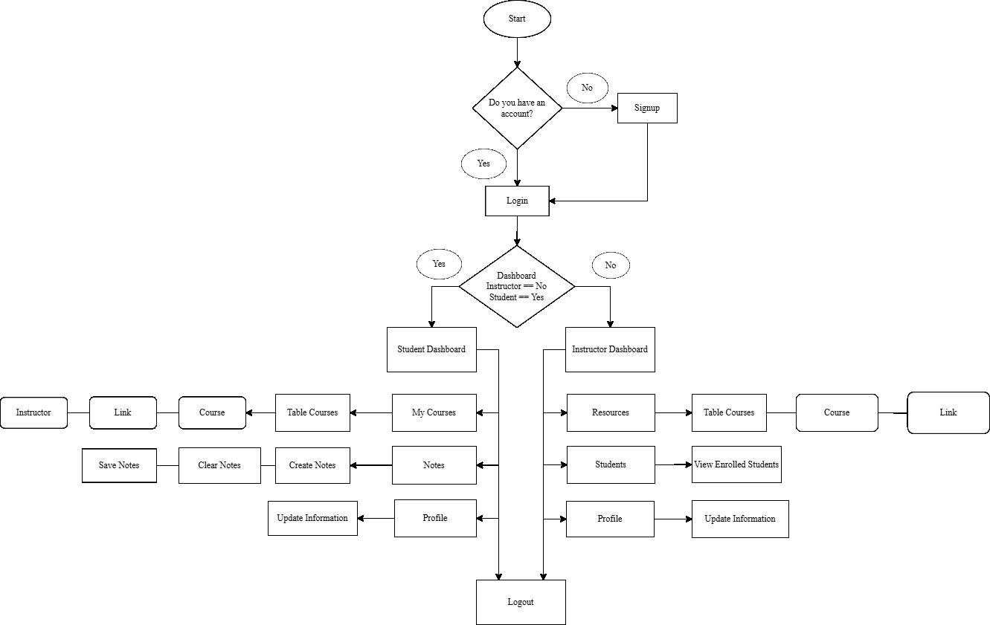
FLOWCHART

Slide 6
GANTT CHART
TASK | AUG | SEPT | OCT | NOV | DEC
Create login/Signup UI
Connecting Database & Debugging Error
Creating the Dashboard of Student and Instructor UI
Create Buttons and Icons for Student Dashboard
Connecting Database for Student Dashboard & Debugging Error
Add Functions to the Button
Connect to the Database & Debugging Error
Create Buttons and Icons in Instructor Dashboard

Slide 7
GANTT CHART
Add Functions to the Button,Connect Database, Debugging Error
Create Internal Panel, Button, Icon for Student & Debugging Error
Create Internal Panel,Button, Icon for Instructor & Debugging Error
Creating Functions for the Internal Panel of Student & Debugging Error
Creating Functions for the Internal Panel of Instructor & Debugging Error
Conversion of System

Slide 8
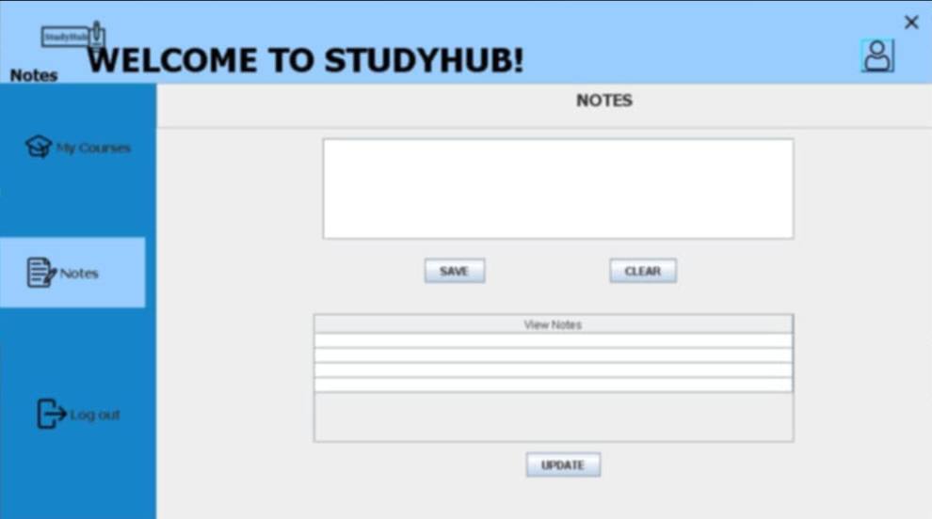
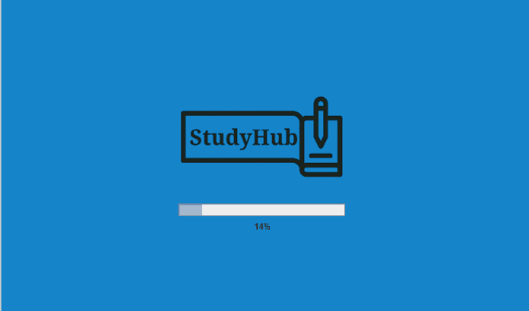
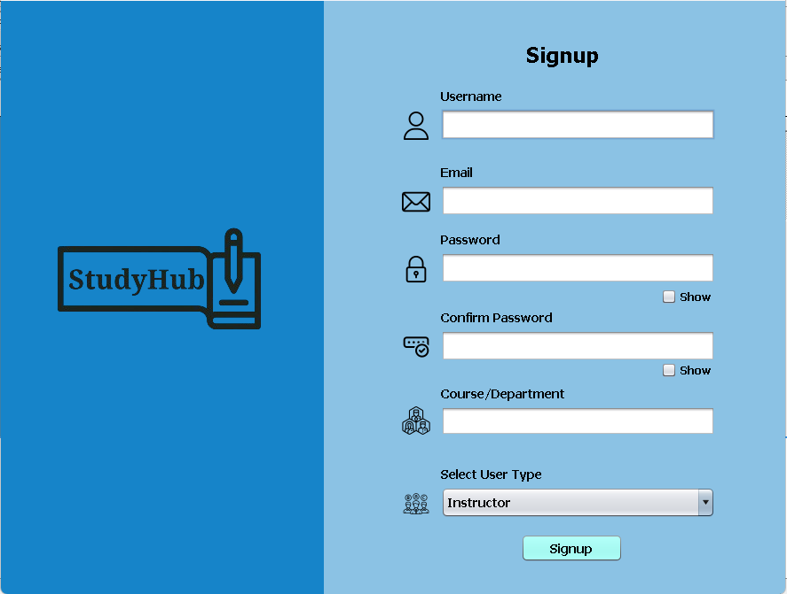
SYSTEM DESIGN
Open the application and wait until the loading process is done.
Signup first if you do not have an account yet.

Slide 9
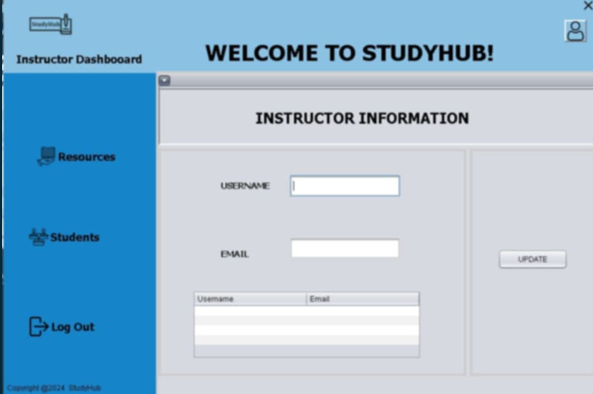
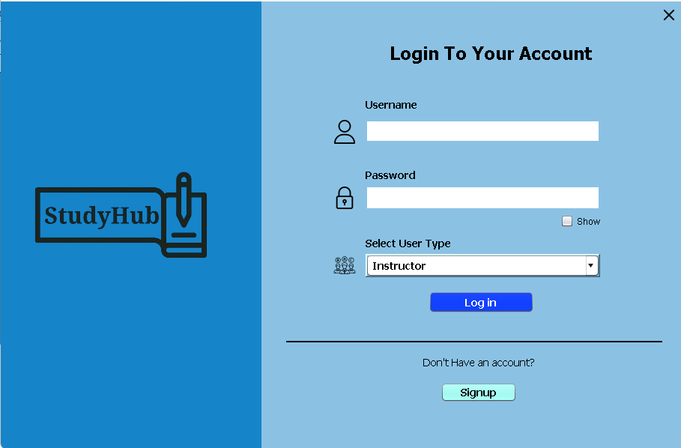
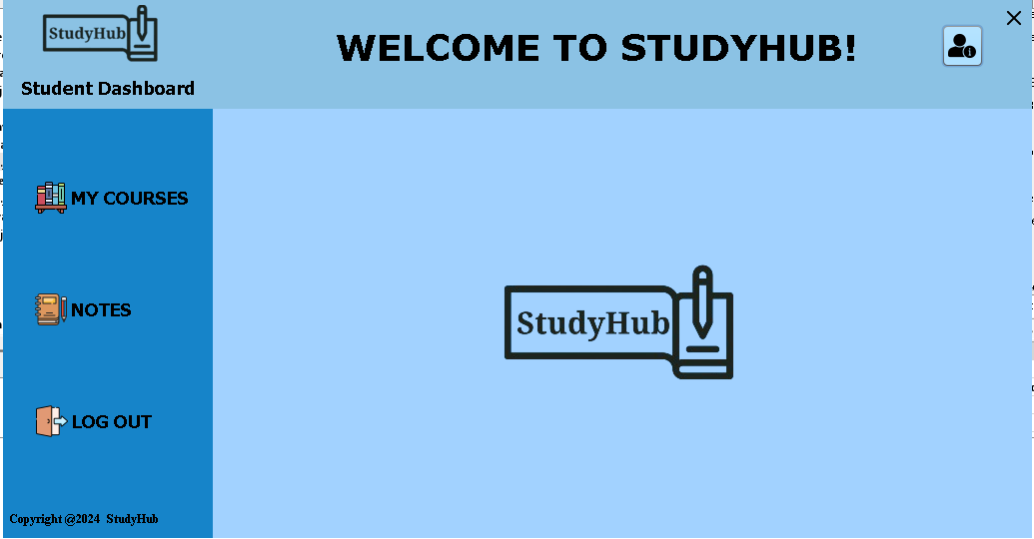
Go back to login page to access your account
You’re now on the student dashboard if you’re a student.

Slide 10
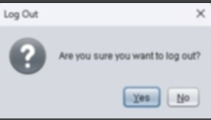
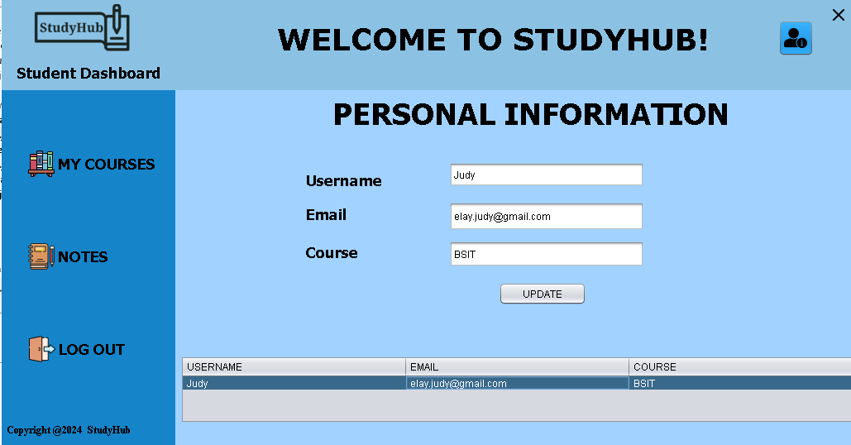
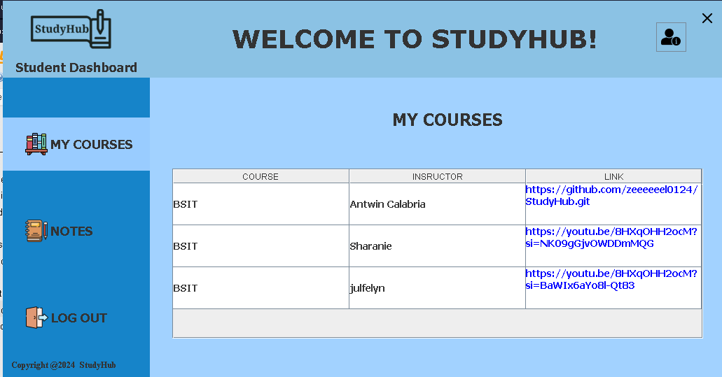
If you click My Courses, you’ll see the table courses wherein you can find your enrolled course, instructor and the link of the learning materials being posted by your instructor.
If you have something to update on your profile information, just click the icon located at the right side of the application. You can modify your information there anytime you like.

Slide 11
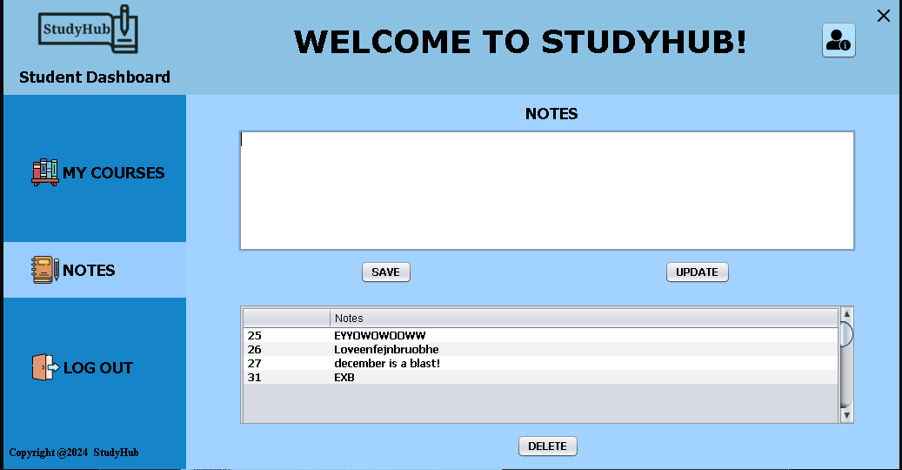
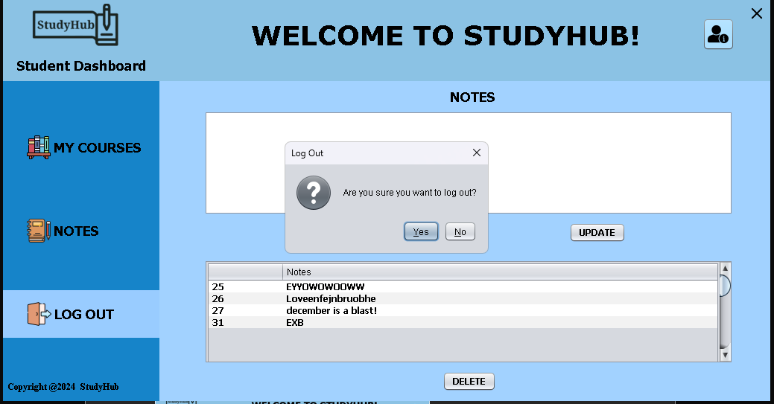
If you want to logout, you can quickly find it next to Notes feature. Then you can exit.
If you’ll likely to take notes just click the Notes feature. There, you can create, clear and save notes.

Slide 12
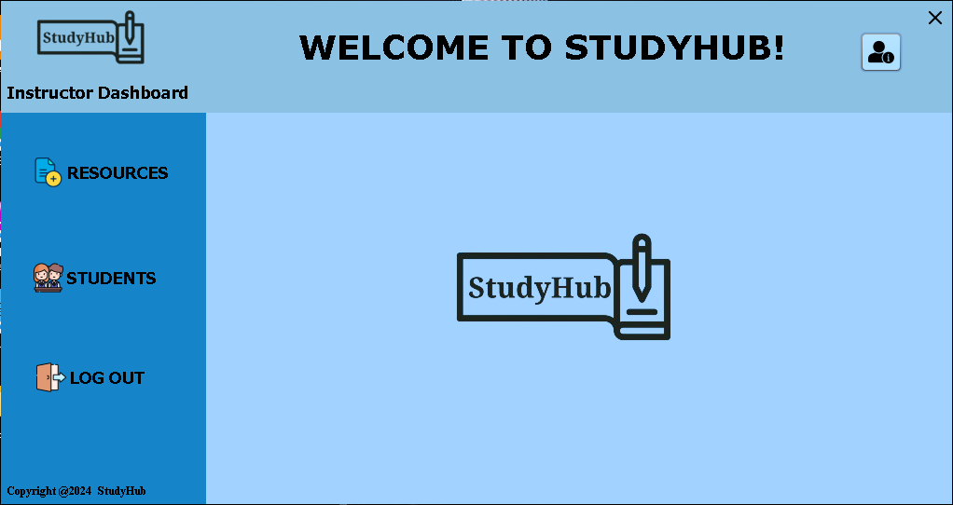
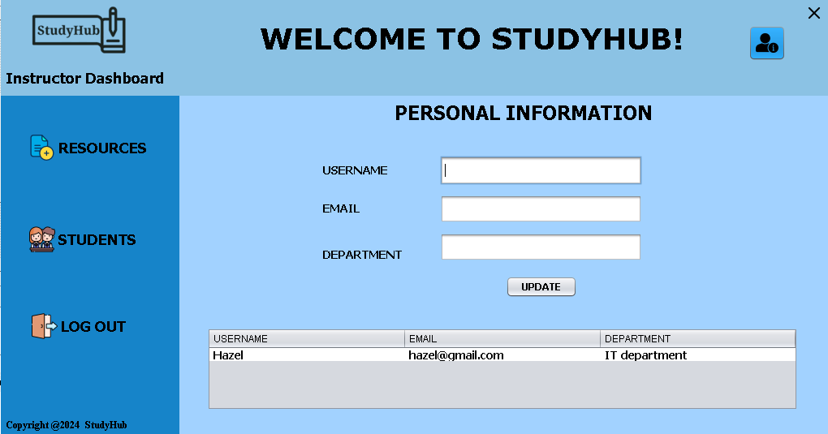
Same thing with the student dashboard, instructor also the profile icon wherein he/she can update his/her information.
If you’re an instructor, these will be your dashboard.

Slide 13
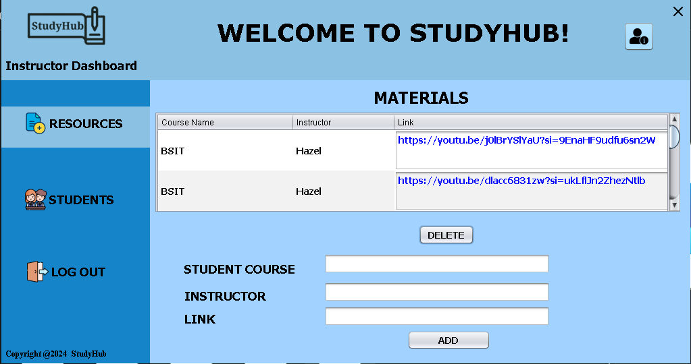
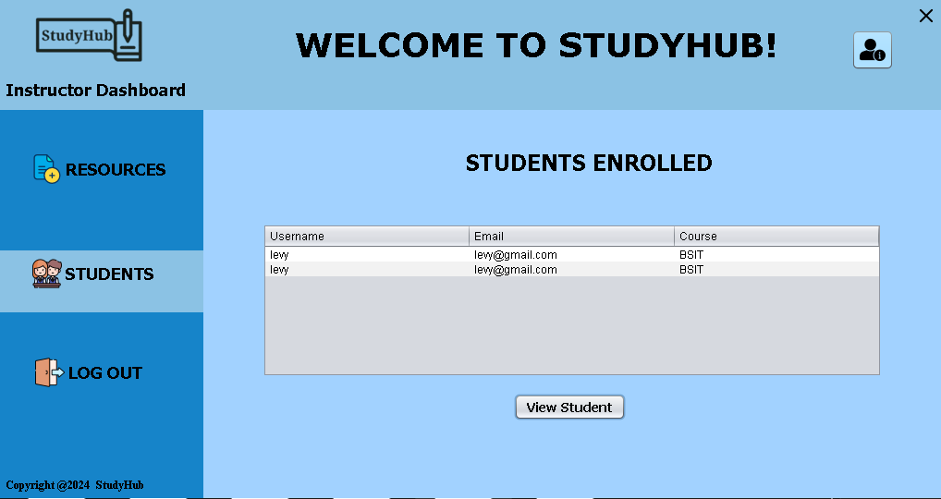
If the instructor wants to view his/her students, just click the Students feature. There, he/she can view the enrolled students he/she is handling.
If you click Resources, you can upload the resources on what course you prefer by putting the link on it for the student to access it.

Slide 14
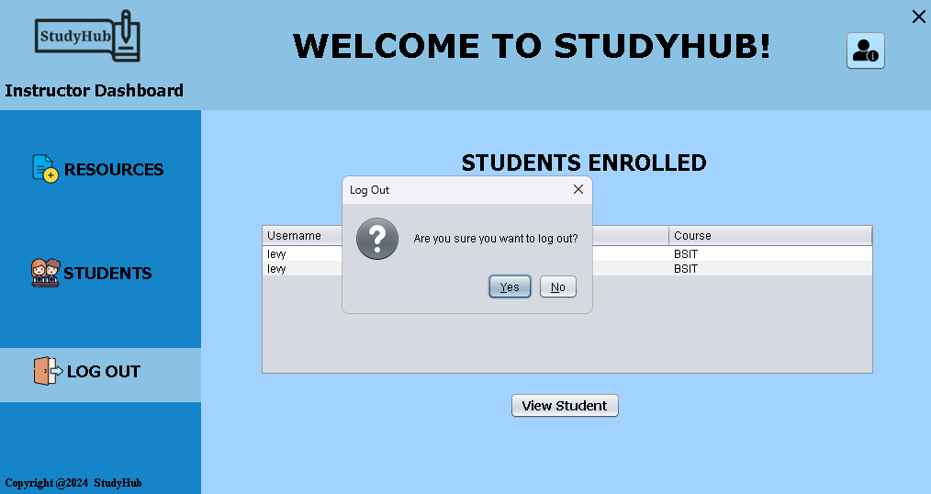
And lastly, there is a logout feature to exit the application same thing as the student dashboard.

Slide 15
CONCLUSION
StudyHub's innovative approach to online learning centralizes communication, resources, and note-taking, promoting collaboration and engagement. This research assesses its effectiveness in improving student and instructor satisfaction and academic performance, guiding future development to better serve the educational community.

Slide 16
RECOMMENDATION
Improve the StudyHub user experience by adding in-app notifications that proactively inform students about important updates from their instructors, such as assignment deadlines and newly available resources. This will help students stay organized and on track.

Slide 17


