Slide 1
Fais
A Priority-Based To-Do
and Routine Planner
Student Names: [Names]
Roll Numbers: [Roll Numbers]
Guide Name: [Guide Name]
Department: [Department]
College Name: [College Name]
FAIS / FULL STACK DEVELOPMENT
01
Notes:
Introduce Fais as a personal task and routine planner. Replace all bracketed academic identity fields with the team’s actual information before submission. The app name takes inspiration from the French verb faire, to do or make.

Slide 2
Introduction
Daily planning includes both one-time tasks and repeating habits.
01
Fais gives each user a private place to organize their day.
02
A playful routine board and calendar make progress visible.
03
FAIS / FULL STACK DEVELOPMENT
02
Notes:
Fais brings one-time work and repeating routines into one personal workspace. The demo uses a labeled fictional account; real accounts start empty.

Slide 3
Problem Statement
Scattered notes make it easy to lose track of small commitments.
01
Unclear priorities make the next task difficult to choose.
02
Repeated routines need date-specific tracking and a useful history.
03
A task list alone offers limited visibility into daily consistency.
04
FAIS / FULL STACK DEVELOPMENT
03
Notes:
Describe these as the problems our project addresses, not a claim that every existing application lacks the features.

Slide 4
Objectives of the Project
Organize tasks with clear priorities, deadlines, and status.
01
Track repeating routines without losing earlier completion records.
02
Restore saved data across refreshes and authenticated sessions.
03
Support desktop and mobile access with visible progress.
04
FAIS / FULL STACK DEVELOPMENT
04
Notes:
Explain that these objectives map to implemented modules. Priority is an explicit ordering rule. MongoDB persistence means a refresh restores confirmed data.

Slide 5
Scope of the Project
Implemented: personal accounts, task CRUD, priorities, and search.
01
Implemented: routines, calendars, statistics, activity, and settings.
02
Implemented: autosave, retries, and responsive web navigation.
03
Excluded: Android app, notifications, offline sync, teams, and mood journal.
04
FAIS / FULL STACK DEVELOPMENT
05
Notes:
The application has individual accounts, not a shared team model. Mood journaling was optional and remains future scope. There is no deployed production service in this deliverable.

Slide 6
Existing System
Paper lists provide a simple record, but updates and summaries are manual.
01
Basic digital lists organize items but vary in recurring-task support.
02
Modern planners already offer many advanced planning features.
03
Fais focuses on a coherent personal workflow and explainable MERN design.
04
FAIS / FULL STACK DEVELOPMENT
06
Notes:
Paper lists are useful but do not automatically synchronize or summarize data. Modern digital planners can already include advanced features. Fais is a focused full-stack implementation and learning project, not an unsupported novelty claim.

Slide 7
Proposed System
A user signs in to a MongoDB-backed session.
01
Tasks use High, Medium, and Low priority with deadline ordering.
02
Routine check-ins belong to one routine and one local calendar date.
03
Calendar, statistics, and activity read persisted records.
04
FAIS / FULL STACK DEVELOPMENT
07
Notes:
Walk through the app in order: register, plan tasks, check in to routines, inspect reports. All business data passes through Express, which applies ownership and validation rules.

Slide 8
Hardware and Software Requirements
Verified environment: Apple Silicon Mac, macOS 26.6.2, Node 24.14.0, npm 11.9.0.
01
Required software: MongoDB 8.0, Git, a modern browser, and project dependencies.
02
Practical recommendation: 8 GB RAM and several GB of free disk space.
03
Network: package installation and optional fonts or Atlas. Compass is optional.
04
FAIS / FULL STACK DEVELOPMENT
08
Notes:
This lists the actual software environment and practical hardware advice, not a benchmarked minimum. MongoDB 8.0 macOS support starts at macOS 14. Compass is optional and can be installed later. Sources: https://www.mongodb.com/docs/v8.0/tutorial/install-mongodb-on-os-x/ and https://vite.dev/guide/.

Slide 9
Technology Used
React + Vite: pages, reusable components, routing, and production builds.
01
Node.js + Express: REST endpoints, validation, and ownership checks.
02
MongoDB + Mongoose: records, indexes, persistence, and version checks.
03
bcrypt, sessions, and Luxon: password hashing, authentication, and local dates.
04
FAIS / FULL STACK DEVELOPMENT
09
Notes:
React renders the browser interface. Vite builds it. Express runs REST routes on Node. Mongoose connects the server to MongoDB. Supporting dependencies have specific jobs: bcrypt hashes, express-session and connect-mongo manage sessions, Luxon handles IANA timezone calculations. Official documentation links are on slide 15.

Slide 10
Block Diagram
Browser / React
Express / Node
MongoDB
Forms and pages
API fetch client
Session + CSRF
Validation + controllers
Users and planning data
Sessions and history
Requests / JSON responses
Queries / results
Ownership and business rules stay on the server.
FAIS / FULL STACK DEVELOPMENT
10
Notes:
The browser never connects directly to MongoDB. The forward arrows represent requests/queries and the reverse arrows represent JSON responses/results. Express middleware verifies the session, Origin, CSRF token and ownership. The same API can support a future native client with appropriate authentication integration.

Slide 11
Modules of the Project
Authentication
Tasks / Priority
Registration, login, session restoration
CRUD, filtering, status, and racing progress
Routines
Calendar / Statistics
Schedules, ordering, archive, and daily check-ins
Occurrence rates, daily counts, and streaks
Autosave / Activity
Settings
Serialized saves, retries, and action history
Name and IANA timezone
FAIS / FULL STACK DEVELOPMENT
11
Notes:
Explain how modules share a small centralized API helper and authentication context. Autosave serializes edits and retains unsaved text after a failed request. Activity is not a guaranteed transactional audit log: a failed activity write raises a visible warning after the core mutation is saved.

Slide 12
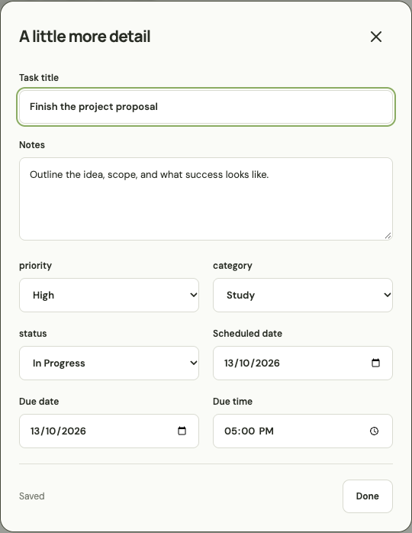
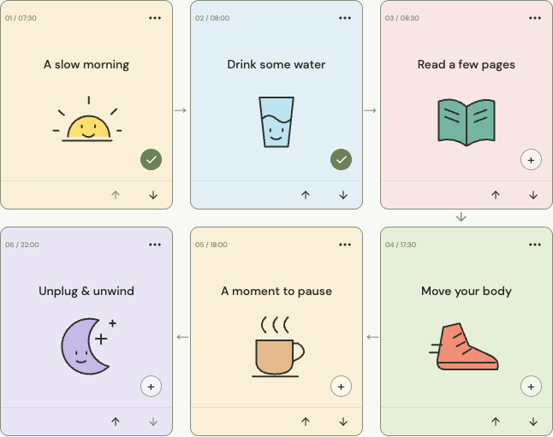
Screenshots / Output
Task details with confirmed autosave
Routine board with independent daily check-ins
FAIS / FULL STACK DEVELOPMENT
12
Notes:
These are actual screenshots from the running Fais application, using clearly labeled demo data. The screenshots show the implemented task editor and routine board, not the source reference screenshots.

Slide 13
Future Scope
A native Android client that reuses the Express API.
01
Reminders and notifications with user-controlled scheduling.
02
Offline synchronization with explicit conflict handling.
03
Shared planning, an optional mood journal, and native widgets.
04
FAIS / FULL STACK DEVELOPMENT
13
Notes:
These are future possibilities, not completed features. A native Android client would reuse Express. Offline support requires a conflict and synchronization design. A mood journal and native widgets were intentionally not included in the core deliverable.

Slide 14
Conclusion
Fais combines one-time tasks and repeating routines in a working MERN app.
01
Confirmed MongoDB data survives refreshes and session restoration.
02
Focused tests check isolation, date rules, ordering, and save reliability.
03
The project provides a foundation for further native and offline features.
04
FAIS / FULL STACK DEVELOPMENT
14
Notes:
Demonstrate the actual application before making claims. The tests cover ownership, priority order, routine dates/history, timezone boundaries and save failures. Avoid invented performance figures or claims of production readiness.

Slide 15
References
Design inspiration: MyTurn (myturn.kr) and its Google Play listing.
01
MERN documentation: mongodb.com/docs, expressjs.com, react.dev, nodejs.org.
02
Supporting tools: mongoosejs.com/docs, vite.dev/guide, moment.github.io/luxon.
03
Assets: original SVG illustrations; Lucide (ISC); DM Sans and Manrope (SIL OFL).
04
FAIS / FULL STACK DEVELOPMENT
15
Notes:
Design inspiration: https://myturn.kr/ and https://play.google.com/store/apps/details?id=kr.cheesebear.routineapptwo. The additional task-priority screenshot was supplied by the user. Original inline SVG art belongs to this project. Lucide: https://lucide.dev/license (ISC). Fonts: DM Sans and Manrope via https://fonts.google.com/ (SIL Open Font License). Official documentation: https://www.mongodb.com/docs/, https://mongoosejs.com/docs/, https://expressjs.com/, https://react.dev/, https://nodejs.org/docs/latest-v24.x/api/, https://vite.dev/guide/, https://moment.github.io/luxon/.

Slide 16
Thank You
Questions?
Fais
A little progress, every day.
FAIS / FULL STACK DEVELOPMENT
16
Notes:
Invite questions. Be ready to demonstrate one request flow from React through Express to MongoDB and explain the autosave failure and timezone tests.

