Slide 1
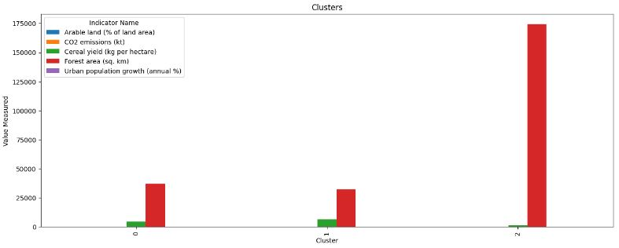
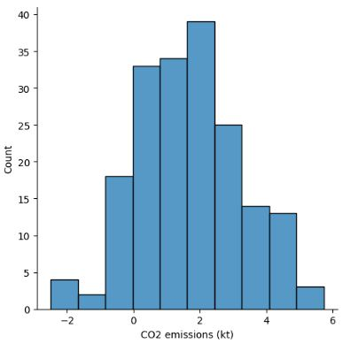
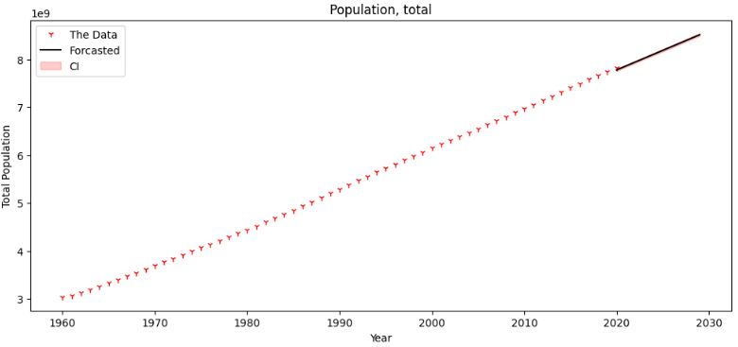
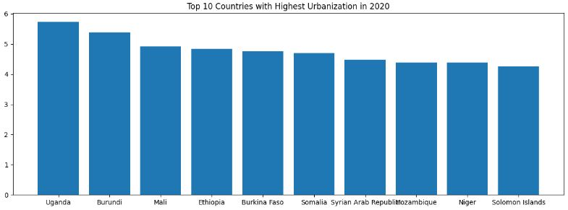
Climate Change Analysis Zarak Khan [22001928]
Introduction
We used these climate change indicators from the World Bank: CO2 emissions, Urban population growth, Cereal yield, Arable land, Forest area.
In the clustering analysis, it was observed that cluster 0 shows the highest level of Forest Area whose value is almost 47000km and lowest value of Cereal yield near to 5000kg.The Cluster 1 shows the highest value of Forest Area whose value is almost 32000km and the lowest value of Cereal yield is 10000kg. Then it comes to the Cluster 2 which represents the highest value of Forest Area whose value is almost 175000km and the lowest value of Cereal yield is 2000kg.
Cluster 0
Cluster 1
Forest Area whose value is almost 32000km
Cluster 2
Forest Area whose value is almost 175000km
Forest Area whose value is almost 47000km
Cereal yield value is 5000kg
Cereal yield value is 10000kg
Cereal yield value is 2000kg
Form this Histogram we can see maximum CO2 emissions is at 39 and we can also conclude that the minimum CO2 emissions are at 2, It tells use the maximum count and minimum count of CO2 emissions.
In this graph we are forcasting from 2020 to 2030 and we can see population is increasing continuously.
This graph is showing the top 10 countries with highest urbanization from which
Conclusion
The World Bank indicators highlight alarming environmental degradation, such as deforestation, biodiversity loss, and rising pollution levels. It is imperative to take immediate action to address these issues and prioritize sustainable development and environmental conservation. Effective international cooperation and policy interventions are vital in addressing global environmental challenges and fostering sustainable practices across various sectors.
We can see Uganda is the country which is at top in Urbanization and Solomon islands is the country which has minimum Urbanization.
Github Link: https://github.com/zeekokhan/ADS1-Assignment3-Clustering-and-fitting

