Slide 1
Secure data hiding in images using Steganography
CAPSTONE PROJECT
Presented By:
Student Name : Simejiya Zeel Rajenbhai
College Name & Department : Leelaben Dashrathbhai Ramdas Patel Institute Of Technology & Research

Slide 2
OUTLINE
Problem Statement
Technology used
Wow factor
End users
Result
Conclusion
Git-hub Link
Future scope

Slide 3
Problem Statement
Data security is a major concern in digital communication, as traditional methods are prone to interception. This project, "Secure Data Hiding in Images Using Steganography," embeds secret messages within image pixels, making them invisible to unauthorized users. The encoded data can only be retrieved using a passcode-based decryption system, ensuring confidentiality and secure transmission.

Slide 4
Technology used
Python : For implementing Steganography algorithm.
OpenCV : For image Processing and pixel manipulation.
OS Module : To handle file operations and open images.

Slide 5
Wow factors
Enhanced Security – The secret message remains hidden within image pixels, making it undetectable to unauthorized users. Passcode Protection – Decryption requires a password, adding an extra layer of security. Minimal Data Distortion – The image remains visually unchanged, ensuring stealthy communication. Lightweight & Efficient – Uses simple Python and OpenCV functions for fast and effective execution. Real-World Application – Can be used for confidential data transfer, digital watermarking, and secure messaging.

Slide 6
End users
🔹 Journalists & Whistleblowers – To securely transmit sensitive information without detection. 🔹 Government & Defense Agencies – For confidential communication and intelligence sharing. 🔹 Cybersecurity Professionals – To enhance data protection and prevent unauthorized access. 🔹 Corporate Organizations – For secure exchange of confidential business data. 🔹 General Users – Anyone who wants to protect private messages from prying eyes.

Slide 7
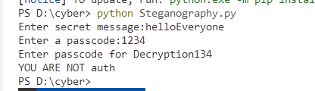
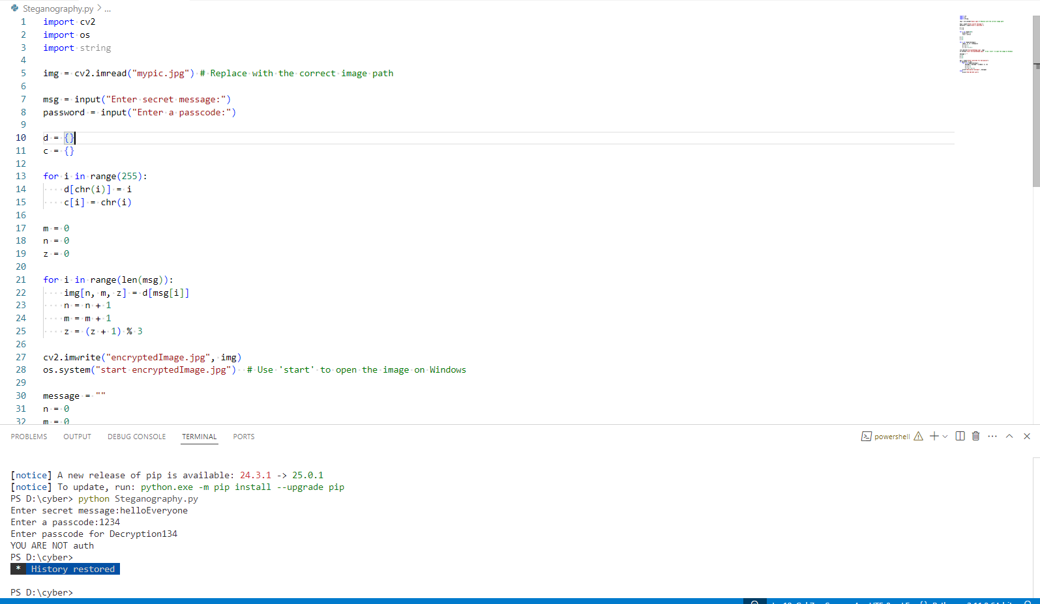
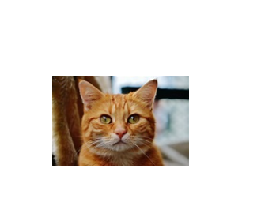
Results
Screenshot 2
Screenshot 3 (output image)
ScreenShot 1

Slide 8
Conclusion
This project ensures secure communication by embedding secret messages within images using steganography. With pixel manipulation and passcode-based decryption, it prevents unauthorized access while keeping the image visually unchanged. Its lightweight and efficient implementation makes it ideal for confidential data transmission in various fields.

Slide 9
GitHub Link
https://github.com/zeel-16/Steganography

Slide 10
Future scope(optional)
🔹 Enhanced Encryption – Integrating advanced cryptographic techniques for added security. 🔹 Increased Capacity – Optimizing algorithms to hide larger amounts of data without distortion. 🔹 AI-Powered Steganography – Using machine learning to improve data embedding and detection resistance. 🔹 Cross-Platform Compatibility – Expanding support for mobile and web applications. 🔹 Real-Time Secure Messaging – Implementing steganography for live, encrypted communication channels

Slide 11
THANK YOU

