Slide 1
What is Microsoft .Net Framework?
The .Net framework is a software development platform developed by Microsoft. The framework was meant to create applications, which would run on the Windows Platform. The first version of the .Net framework was released in the year 2002.
The version was called .Net framework 1.0. The .Net framework has come a long way since then, and the current version is 4.7.1.
The .Net framework can be used to create both - Form-based and Web-based applications. Web services can also be developed using the .Net framework.

Slide 2
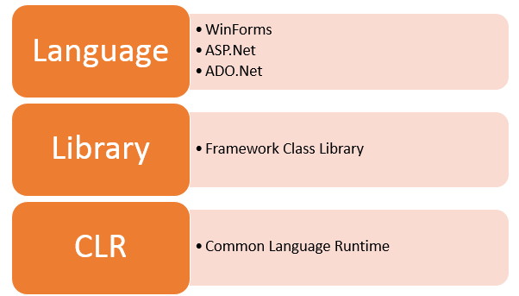
.Net Framework Architecture

Slide 3
.NET Components
Microsoft always ensures that .Net frameworks are in compliance with all the supported Windows operating systems.
The architecture of the .Net framework is based on the following key components;
1. Common Language Runtime
The "Common Language Infrastructure" or CLI is a platform on which the .Net programs are executed.
The CLI has the following key features:
  Exception Handling
  Garbage Collection

Slide 4
.NET Components
A developer can develop an application in a variety of .Net programming
languages.
Language - The first level is the programming language itself, the most
common ones are VB.Net and C#.
Compiler – There is a compiler which will be separate for each programming
language. So underlying the VB.Net language, there will be a separate VB.Net
compiler. Similarly, for C#, you will have another compiler.
Common Language Interpreter – This is the final layer in .Net which would be
used to run a .net program developed in any programming language. So the
subsequent compiler will send the program to the CLI layer to run the .Net
application.

Slide 5
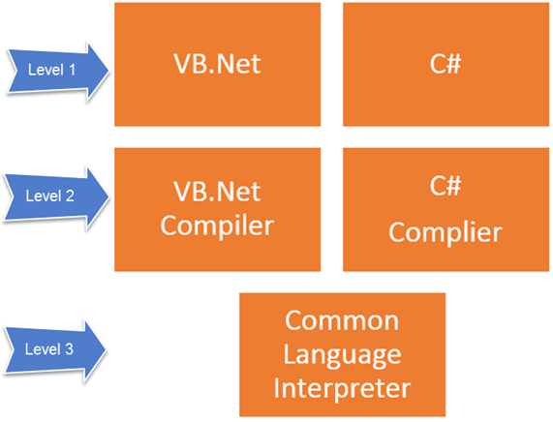
.NET Components

Slide 6
Class Library
The .NET Framework includes a set of standard class libraries. A class library is a collection of methods and functions that can be used for the core purpose.
For example, there is a class library with methods to handle all file-level operations. So there is a method which can be used to read the text from a file. Similarly, there is a method to write text to a file.
Most of the methods are split into either the System.* or Microsoft.* namespaces. (The asterisk * just means a reference to all of the methods that fall under the System or Microsoft namespace)
A namespace is a logical separation of methods. We will learn these namespaces more in detail in the subsequent chapters.

Slide 7
Languages
The types of applications that can be built in the .Net framework is classified broadly into the following categories.
WinForms – This is used for developing Forms-based applications, which would run on an end user machine. Notepad is an example of a client-based application.
ASP.Net – This is used for developing web-based applications, which are made to run on any browser such as Internet Explorer, Chrome or Firefox.
The Web application would be processed on a server, which would have Internet Information Services Installed.
Internet Information Services or IIS is a Microsoft component which is used to execute an Asp.Net application.
The result of the execution is then sent to the client machines, and the output is shown in the browser.
ADO.Net – This technology is used to develop applications to interact with Databases such as Oracle or Microsoft SQL Server.

