Slide 1
DRAWING UP OF DYNAMIC MODEL AND EXTRACTION OF BOUNDARY AND CONTROL CLASSES

Slide 2
ITERATION AND INCREMENTATION
The phrase “iterate and increment” also includes the possibility of having to decrement what has been developed to date
  A mistake may have been made, and backtracking is needed
  As a consequence of reorganizing the UML models, one or more artifacts may have become superfluous

Slide 3
INITIAL DYNAMIC MODEL: MSG FOUNDATION
The third step is dynamic modeling
  A statechart is drawn that reflects all the operations, showing the events that cause the transition from state to state
The major source of information regarding the relevant operations is the scenarios

Slide 4
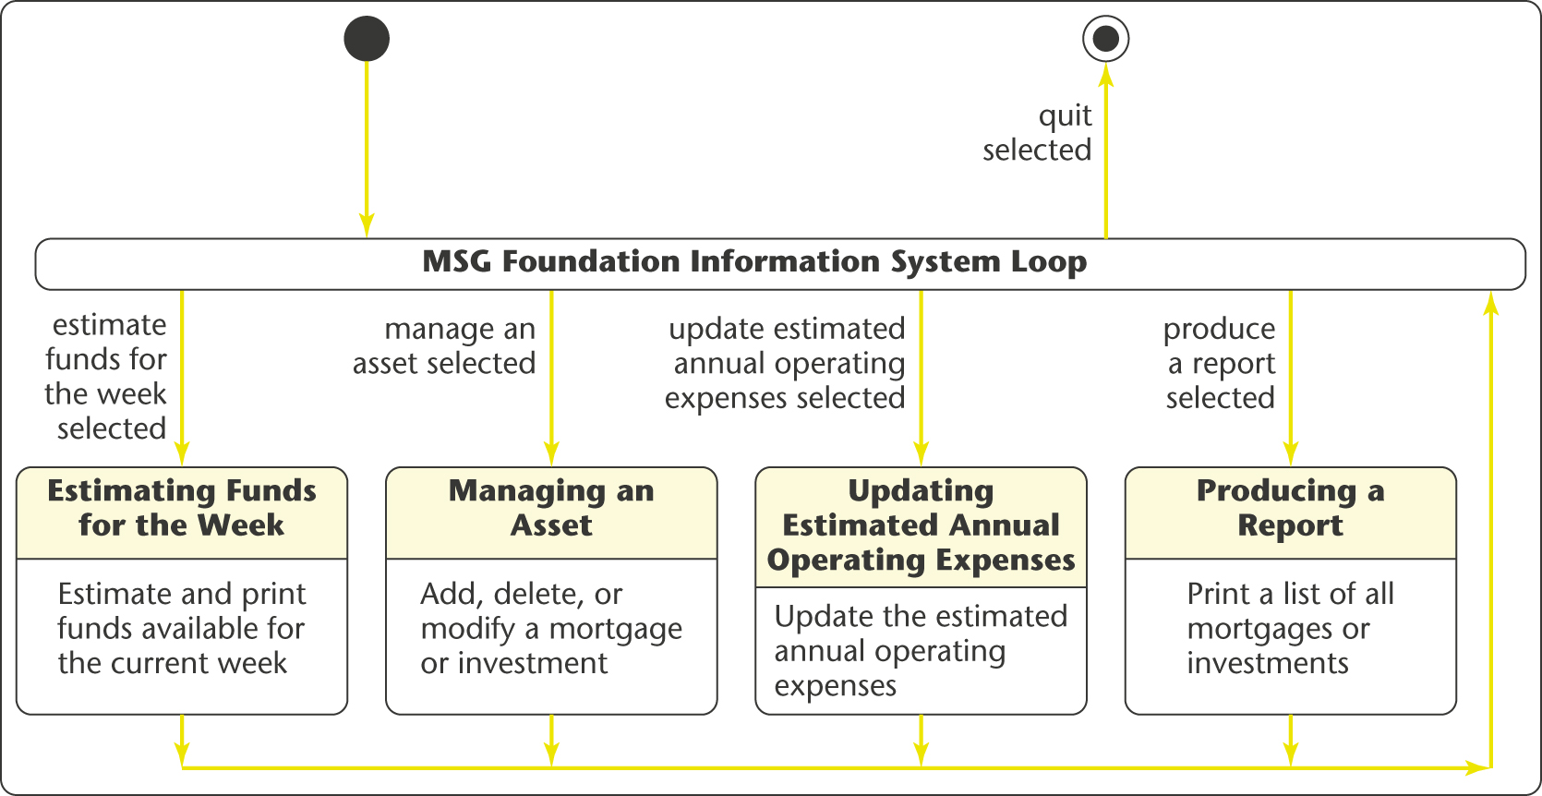
STATECHART: MSG FOUNDATION CASE STUDY

Slide 5
STATECHART: MSG FOUNDATION CASE STUDY (CONTD)
The statechart reflects the operations of the complete MSG Foundation information system
  The solid circle on the top left represents the initial state, the starting point of the statechart
  The white circle containing the small black circle on the top right represents the final state
  States other than the initial and final states are represented by rectangles with rounded corners
  The arrows represent possible transitions from state to state

Slide 6
STATECHART: MSG FOUNDATION CASE STUDY (CONTD)
In state MSG Foundation Information System Loop, one of five events can occur
An MSG staff member can issue one of five commands:
  estimate funds for the week
  manage an asset
  update estimated annual operating expenses
  produce a report, or
  quit

Slide 7
STATECHART: MSG FOUNDATION CASE STUDY (CONTD)
These possibilities are indicated by the five events
  estimate funds for the week selected
  manage an asset selected
  update estimated annual operating expenses selected
  produce a report selected, and
  quit selected
An event causes a transition between states

Slide 8
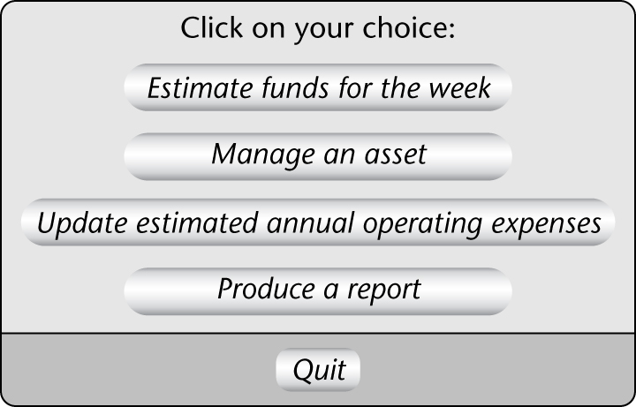
STATECHART: MSG FOUNDATION CASE STUDY (CONTD)
An MSG staff member selects an option by clicking on the menu
This graphical user interface (GUI) requires special software

Slide 9
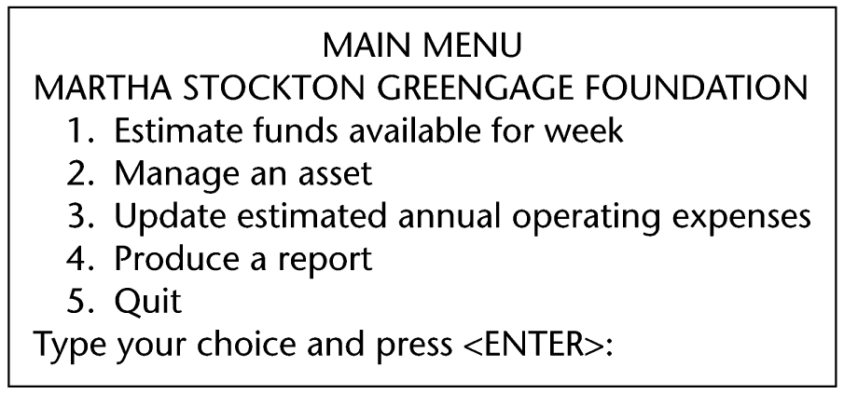
STATECHART: MSG FOUNDATION CASE STUDY (CONTD)
Here is an equivalent textual user interface that can run on any computer

Slide 10
STATECHART: MSG FOUNDATION CASE STUDY (CONTD)
Example:
  The MSG staff member clicks on the choice Manage an asset
  The event “manage an asset selected” has now occurred
  The system moves from its current state, MSG Foundation Information System Loop, to the state Managing an Asset
  The operations that the MSG staff member can perform in this state
    Add, delete, or modify a mortgage or investment
  appear below the line in the box with rounded corner

Slide 11
REVISING THE ENTITY CLASSES: MSG CASE STUDY
The initial functional model, the initial class diagram, and the initial dynamic model are completed
  Checking them reveals a fault
In the initial statechart, consider state Update Estimated Annual Operating Expenses with operation Update the estimated annual operating expenses
  This operation has to be performed on the current value of the estimated annual operating expense

Slide 12
REVISING THE ENTITY CLASSES: MSG (CONTD)
But where is the value of the estimated annual operating expenses to be found?
Currently there is only one class (Asset Class) and its two subclasses
  Neither is appropriate for storing the estimated annual operating expenses

Slide 13
REVISING THE ENTITY CLASSES: MSG (CONTD)
The only way a value can be stored on a long-term basis is as an attribute of an instance of that class or its subclasses
Another entity class is needed in which the estimated annual operating expenses can be stored
  MSG Application Class

Slide 14
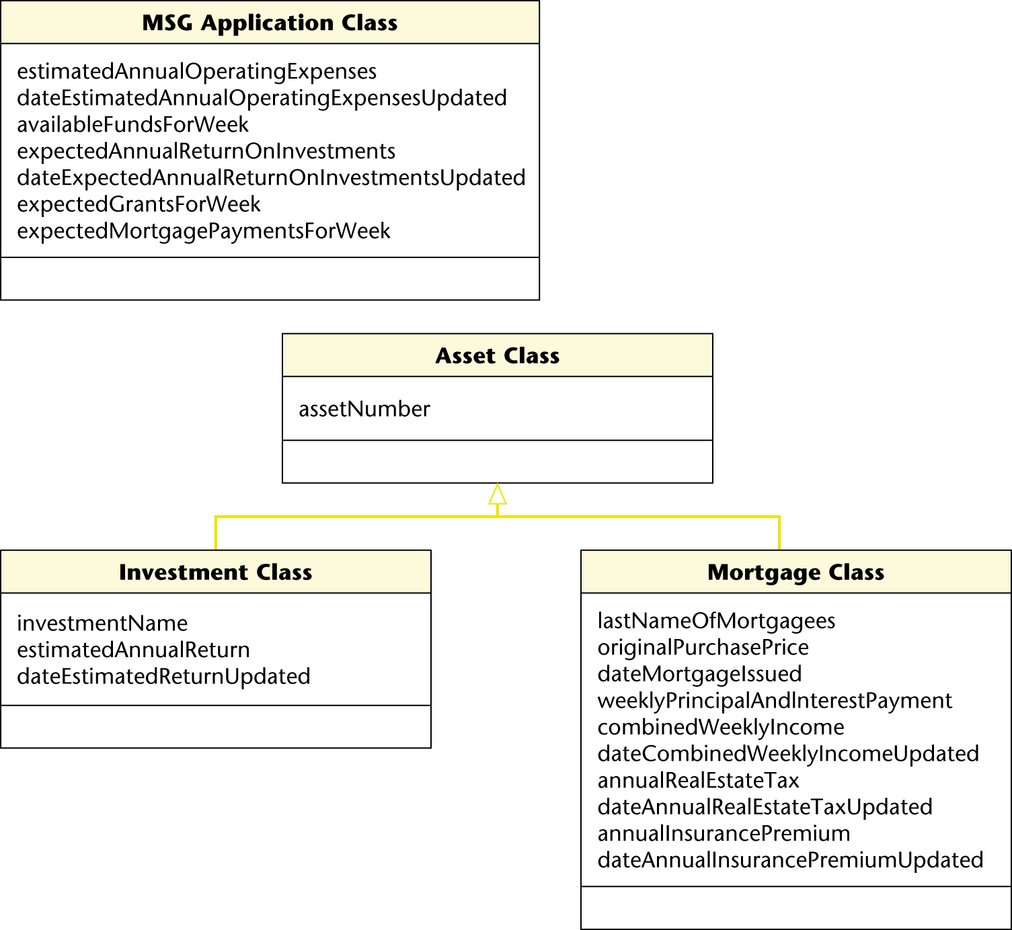
THIRD ITERATION OF THE INITIAL CLASS DIAGRAM: MSG
MSG Application Class has other attributes as well
  Attributes that do not appertain to the assets

Slide 15
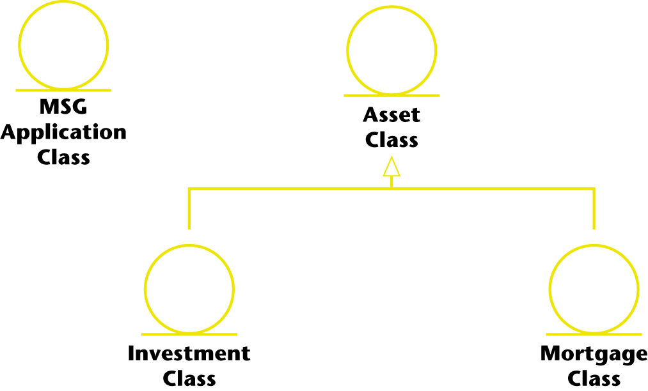
THIRD ITERATION OF THE INITIAL CLASS DIAGRAM: MSG
The class diagram redrawn to show the prototypes

Slide 16
EXTRACTING BOUNDARY CLASSES: MSG FOUNDATION
Each input screen, output screen, and report is usually modeled by a boundary class
The target MSG Foundation information system appears to be relatively straightforward
  Try to have just one screen for all four use cases:
    Estimate Funds Available for Week
    Manage an Asset
    Update Estimated Annual Operating Expenses
    Produce a Report

Slide 17
EXTRACTING BOUNDARY CLASSES: MSG FOUNDATION
There is one initial screen class
  User Interface Class

Slide 18
EXTRACTING BOUNDARY CLASSES: MSG (CONTD)
Three reports have to be printed
  The estimated funds for the week report
  The listing of all mortgages
  The listing of all investments
Each of these has to be modeled by a separate boundary class
  Estimated Funds Report Class
  Mortgages Report Class
  Investments Report Class

Slide 19
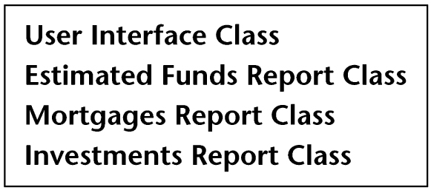
EXTRACTING BOUNDARY CLASSES: MSG (CONTD)
Here are the four initial boundary classes

Slide 20

EXTRACTING CONTROL CLASSES: MSG CASE STUDY
Each computation is usually modeled by a control class
The MSG Foundation case study has just one
  Estimate the funds available for the week
There is one initial control class

