Slide 1
USE CASE REALIZATION - I

Slide 2
USE-CASE REALIZATION: MSG CASE STUDY
Drawing up of class diagram that realizes the use case and drawing up of sequence and collaboration diagram.
Use-case realization
  A description of how a use case is performed in terms of its classes.
We determine what classes are needed to realize (achieve or accomplish) the use case.

Slide 3
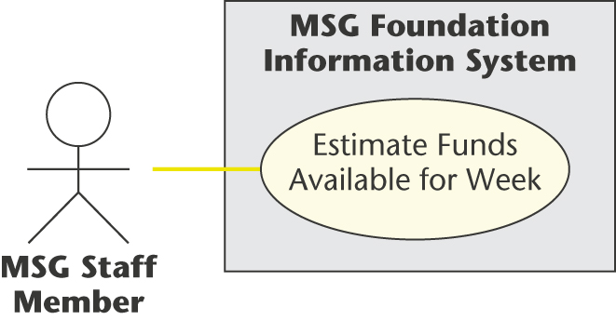
ESTIMATE FUNDS AVAILABLE FOR WEEK USE CASE
Use-case diagram

Slide 4
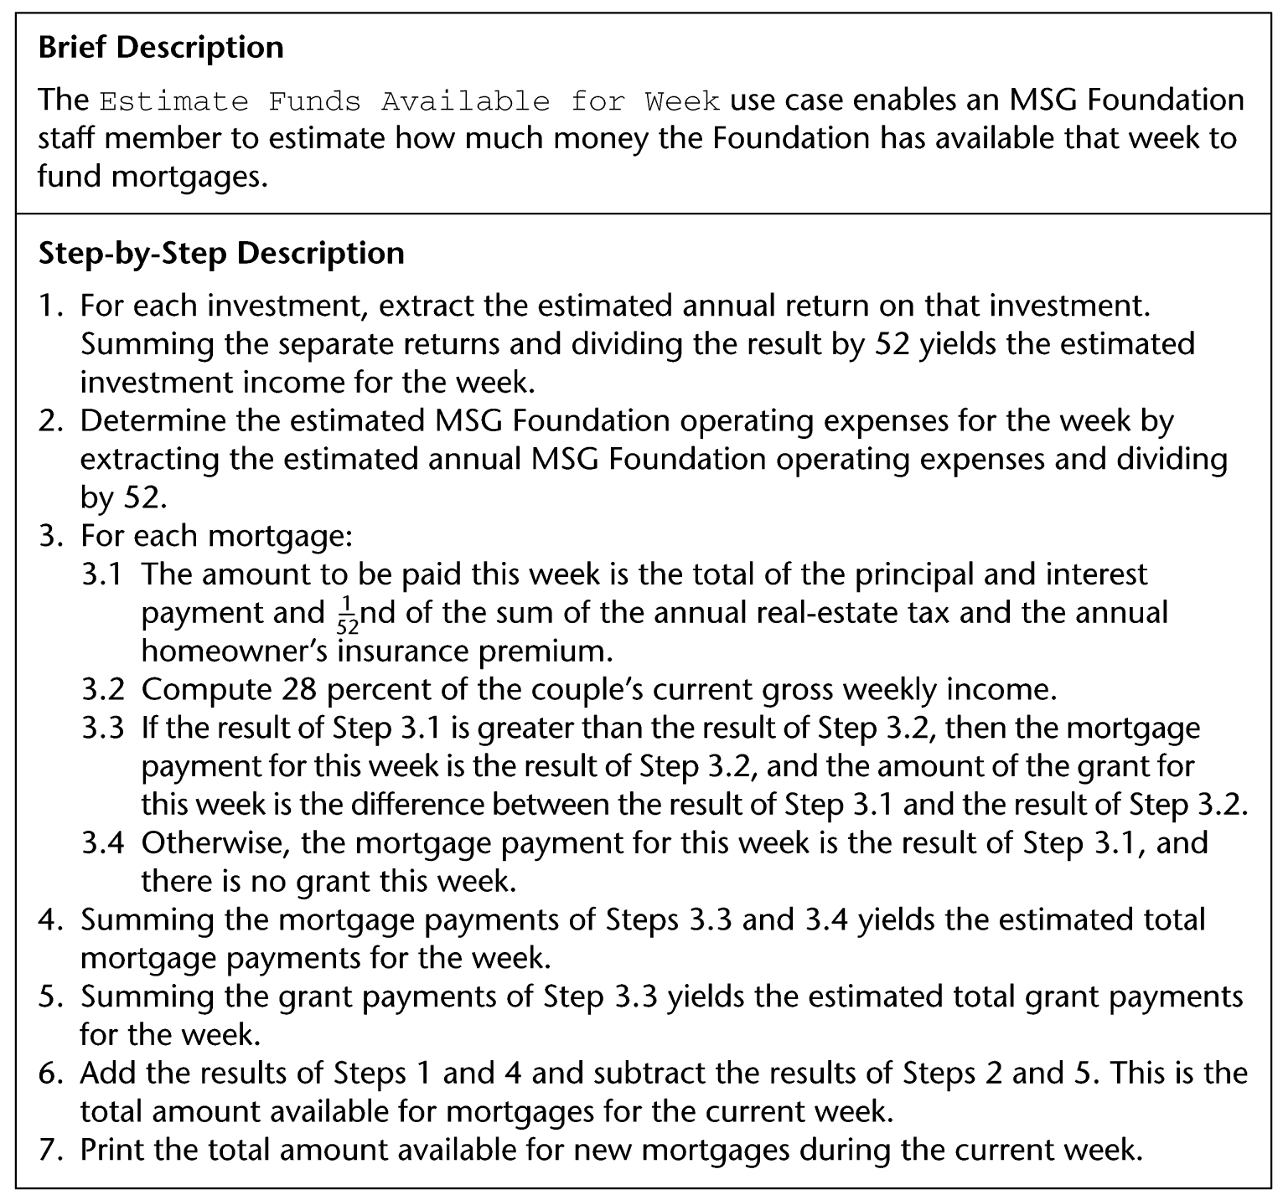
ESTIMATE FUNDS AVAILABLE FOR WEEK USE CASE
Description of use case

Slide 5
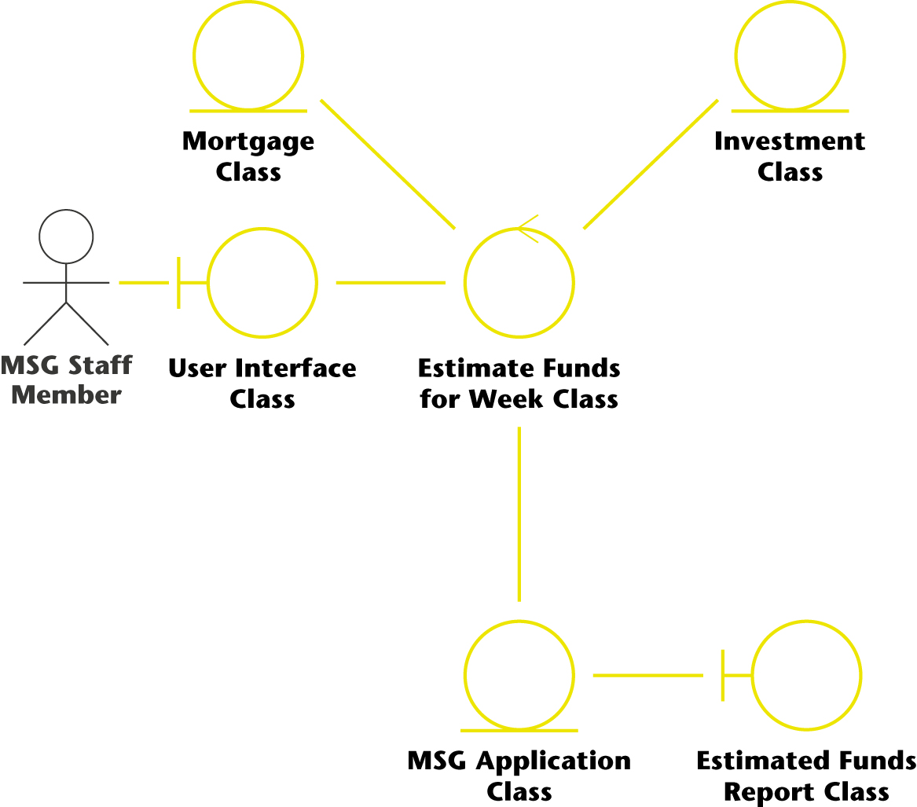
ESTIMATE FUNDS AVAILABLE FOR WEEK USE CASE
Class diagram (classes that enter into the use case)

Slide 6
ESTIMATE FUNDS AVAILABLE FOR WEEK USE CASE
The six classes that enter into this use case are:
  User Interface Class
    This class models the user interface.
  Estimate Funds for Week Class
    This control class models the computation of the estimate of the funds that are available to fund mortgages during that week.
  Mortgage Class
    This class models the estimated grants and payments for the week.
  Investment Class
    This class models the estimated return on investments for the week.
  MSG Application Class
    This class models the estimated operating expenses for the week.
  Estimated Funds Report Class
    This class models the printing of the report.

Slide 7

ESTIMATE FUNDS AVAILABLE FOR WEEK USE CASE
Scenario (one possible instance of the use case)

Slide 8
ESTIMATE FUNDS AVAILABLE FOR WEEK USE CASE
A working information system uses objects, not classes.
  Example: A specific mortgage cannot be represented by Mortgage Class but rather by an object, a specific instance of Mortgage Class.
Such an object is denoted by : Mortgage Class

Slide 9
ESTIMATE FUNDS AVAILABLE FOR WEEK USE CASE
A class diagram shows the classes in the use case and their relationships.
  It does not show the objects nor the sequence of messages as they are sent from object to object.
Something more is needed.

Slide 10
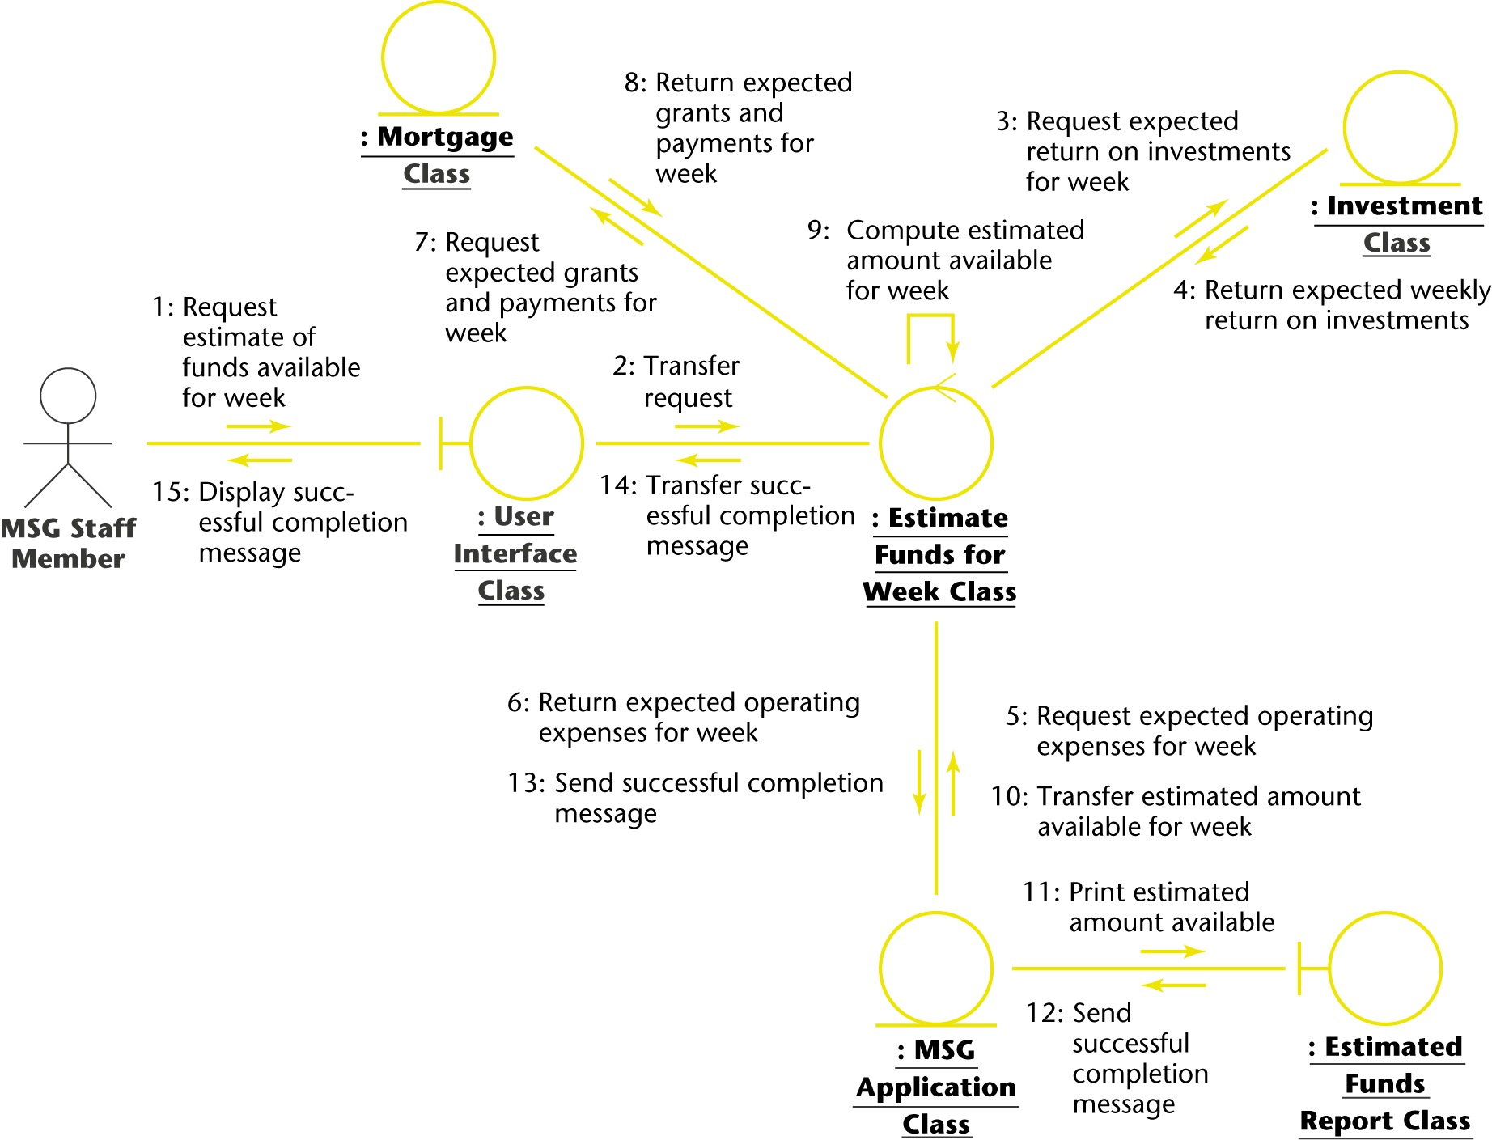
ESTIMATE FUNDS AVAILABLE FOR WEEK USE CASE
Collaboration diagram (of the realization of the scenario of the use case).

Slide 11
ESTIMATE FUNDS AVAILABLE FOR WEEK USE CASE
The collaboration diagram shows the objects as well as the messages, numbered in the order in which they are sent in the specific scenario.

Slide 12
ESTIMATE FUNDS AVAILABLE FOR WEEK USE CASE
Item 1:
  The staff member wants to compute the funds available for the week.
  In the collaboration diagram, this is modeled by message.
    1: Request estimate of funds available for week.
  from MSG Staff Member to : User Interface Class, an instance of User Interface Class.

Slide 13
ESTIMATE FUNDS AVAILABLE FOR WEEK USE CASE
Item 2
  This request is passed on to : Estimate Funds for Week Class, an instance of the control class that actually performs the calculation.
  This is modeled by message.
    2: Transfer request.
Four separate financial estimates are now determined by : Estimate Funds for Week Class.

Slide 14
ESTIMATE FUNDS AVAILABLE FOR WEEK USE CASE
Item 3
  In Step 1 of the scenario, the estimated annual return on investments is summed for each investment and the result divided by 52.
  This extraction of the estimated weekly return is modeled by message.
    3: Request estimated return on investments for week.
  from : Estimate Funds for Week Class to : Investment Class followed by message.
    4: Return estimated weekly return on investments
  in the other direction.

Slide 15
ESTIMATE FUNDS AVAILABLE FOR WEEK USE CASE
Item 4
  In Step 2 of the scenario, the weekly operating expenses are estimated by taking the estimated annual operating expenses and dividing by 52.
  This extraction of the weekly expenses is modeled by message.
    5: Request estimated operating expenses for week.
  from : Estimate Funds for Week Class to : MSG Application Class followed by message.
    6: Return estimated operating expenses for week
  in the other direction.

Slide 16
ESTIMATE FUNDS AVAILABLE FOR WEEK USE CASE
Item 5
  In Steps 3, 4, and 5 of the scenario, two estimates are determined.
    the estimated grants for the week, and
    the estimated payments for the week
  This is modeled by message
    7: Request estimated grants and payments for week.
  from : Estimate Funds for Week Class to : Mortgage Class, and by message.
    8: Return estimated grants and payments for week
  in the other direction.

Slide 17
ESTIMATE FUNDS AVAILABLE FOR WEEK USE CASE
Item 6
  Now the arithmetic computation of Step 6 of the scenario is performed.
  This is modeled by message.
    9: Compute estimated amount available for week.
  This is a self call.
  : Estimate Funds for Week Class tells itself to perform the calculation.
  The result of the computation is stored in : MSG Application Class by message.
    10: Transfer estimated amount available for week.

Slide 18
ESTIMATE FUNDS AVAILABLE FOR WEEK USE CASE
Item 7
  The result is printed in Step 7 of the scenario.
  This is modeled by message.
    11: Print estimated amount available.
  from : MSG Application Class to : Estimated Funds Report Class.

Slide 19
ESTIMATE FUNDS AVAILABLE FOR WEEK USE CASE
Item 8
  Finally, an acknowledgment is sent to the MSG staff member that the task has been successfully completed.
  This is modeled by messages
    12: Send successful completion message.
    13: Send successful completion message.
    14: Transfer successful completion message, and
    15: Display successful completion message.

Slide 20
ESTIMATE FUNDS AVAILABLE FOR WEEK USE CASE
No client will approve the specification document without understanding it.
Accordingly, a written description of the collaboration diagram is needed, the flow of events.

Slide 21
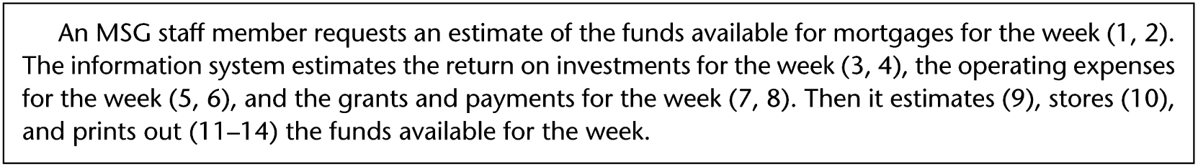
ESTIMATE FUNDS AVAILABLE FOR WEEK USE CASE
The flow of events of the collaboration diagram of the realization of the scenario of the use case.

Slide 22
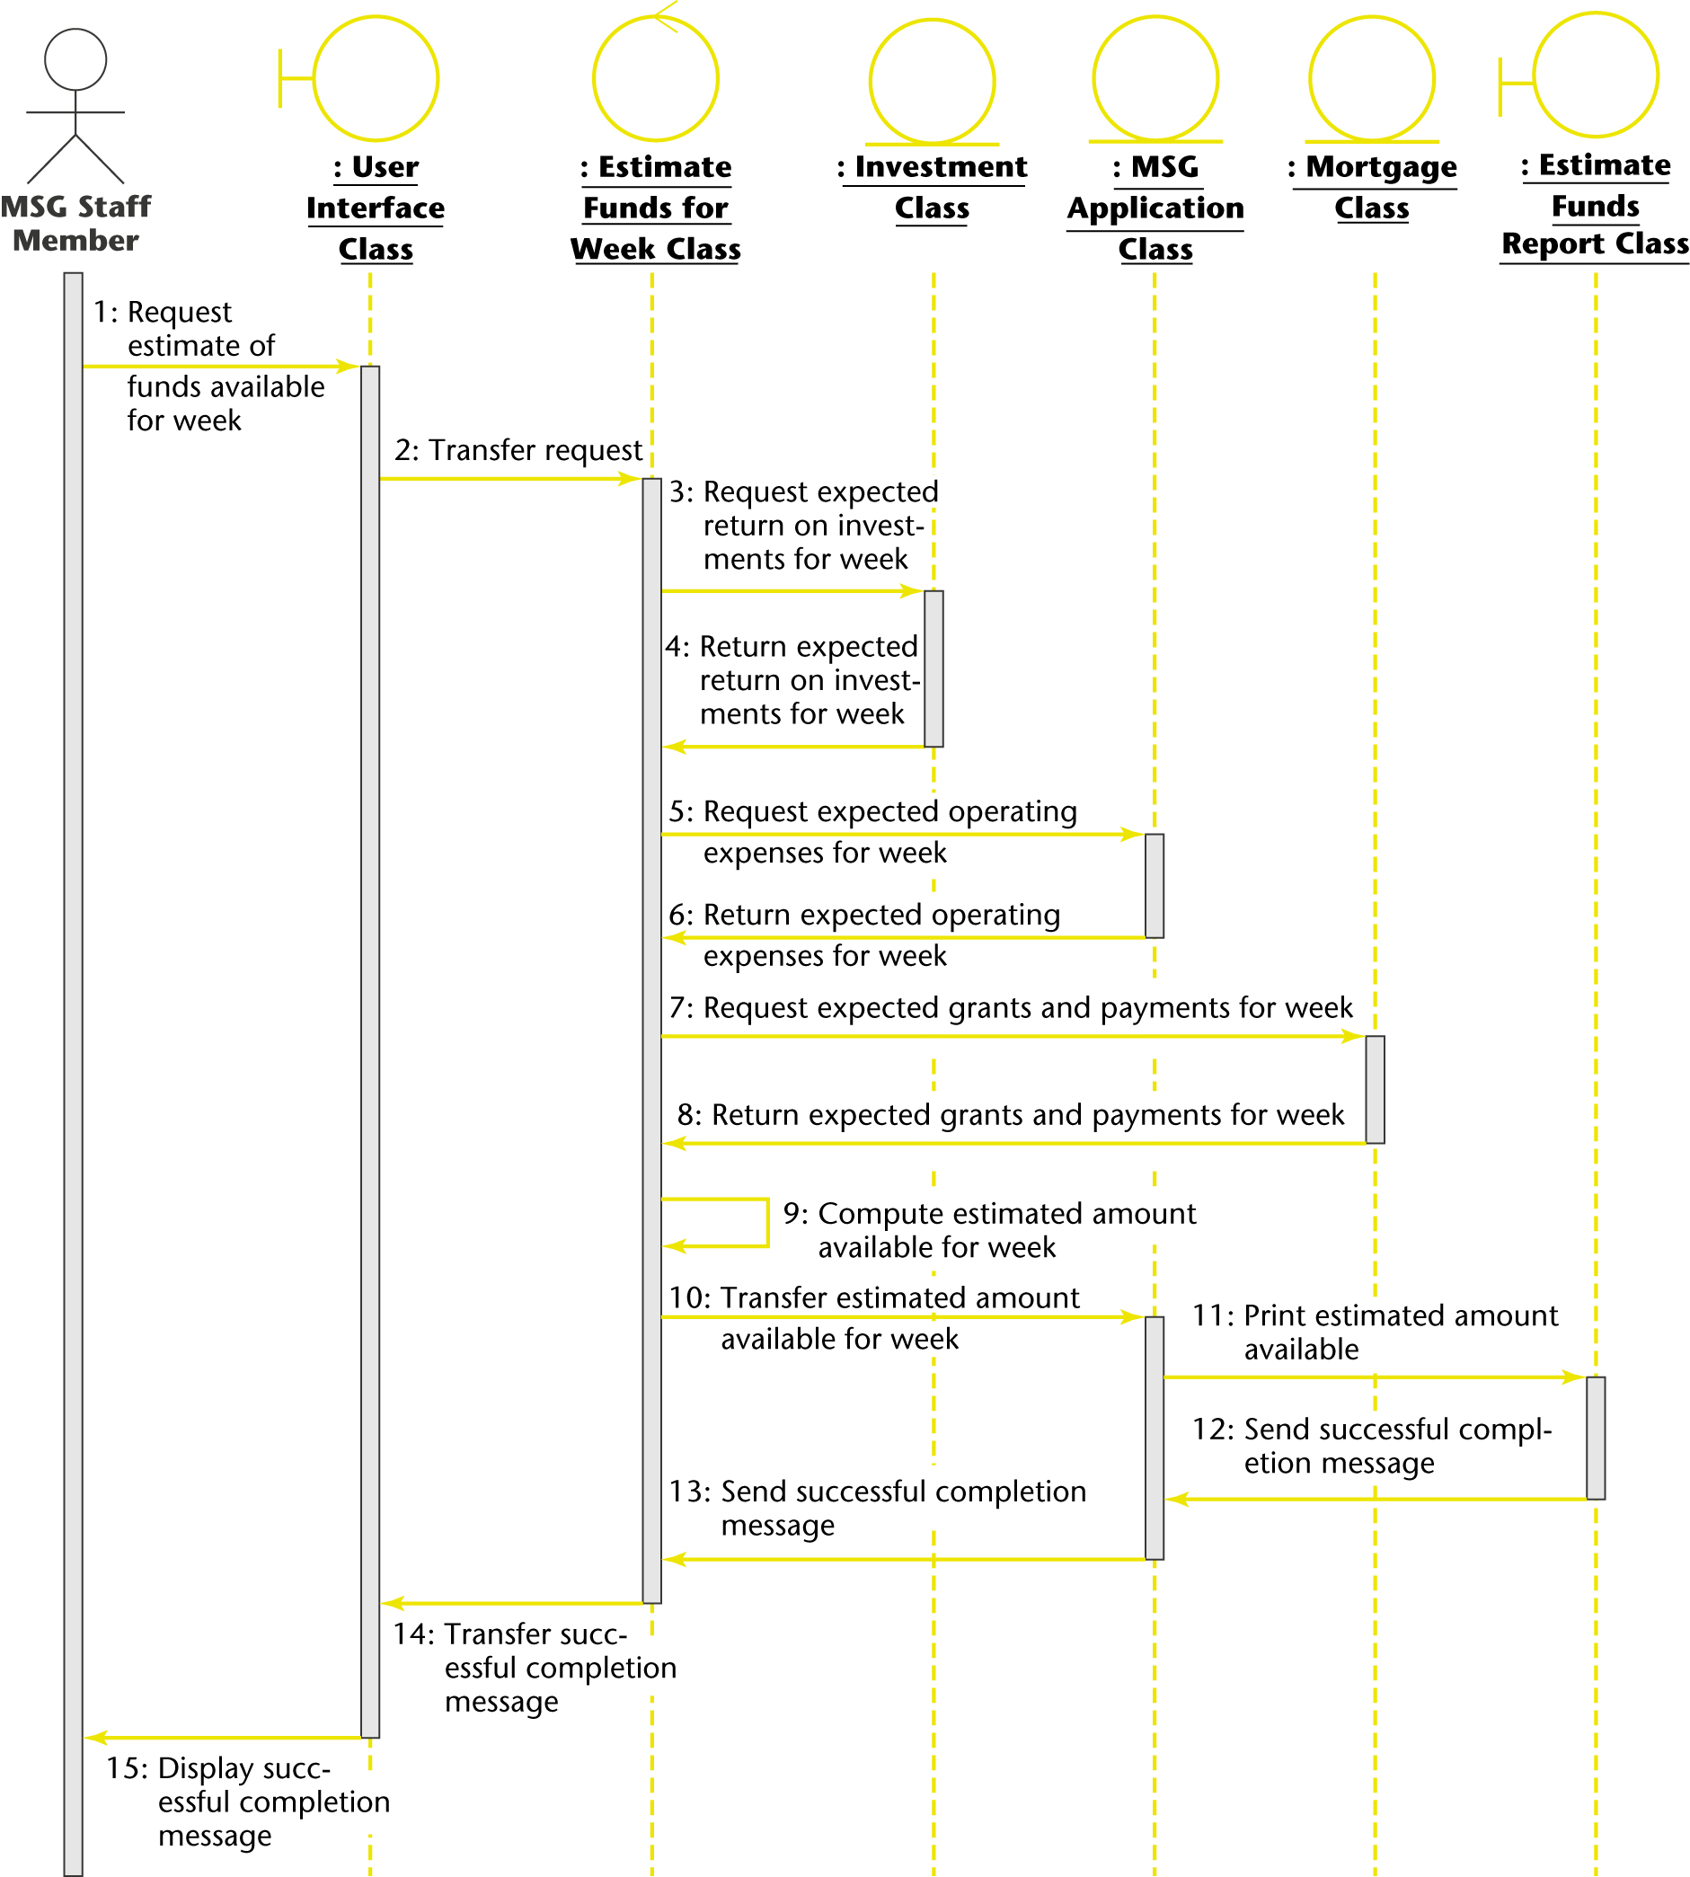
ESTIMATE FUNDS AVAILABLE FOR WEEK USE CASE
Sequence diagram equivalent to the collaboration diagram (of the realization of the scenario of the use case).

