Slide 1
Crop Disease detection using Image Processing and Deep Learning
-By Zeel Desai

Slide 2
Research paper:1

Slide 3
Objectives
The main objective is to identify the plant diseases using image processing. It also, after identification of the disease, suggest the name of pesticide to be used. It also identifies the insects and pests responsible for epidemic. The budget of the model is quite high for low scale farming purposes but will be value for money in large scale farming. It completes each of the process sequentially and hence achieving each of the output. Thus the main objectives are:
1) To design such system that can detect crop disease and pest accurately.
2) Create database of insecticides for respective pest and disease.
3) To provide remedy for the disease that is detected.

Slide 4
Social Impact and Applications In real world
In recent times, drastic climate changes and lack of immunity in crops has caused substantial increase in growth of crop diseases. This causes large scale demolition of crops, decreases cultivation and eventually leads to financial loss of farmers. Due to rapid growth in variety of diseases and adequate knowledge of farmer, identification and treatment of the disease has become a major challenge. Using AI, a model can be developed to identify the disesase and provide a remedy to it.

Slide 5
Advantages
The identification of plant disease is the premise of the prevention of plant disease efficiently and precisely in the complex environment.
The productivity of crops is increased.
There is increased efficiency of environmental factors or product resource, such as temperature, humidity, labour and electrical costs are important.

Slide 6
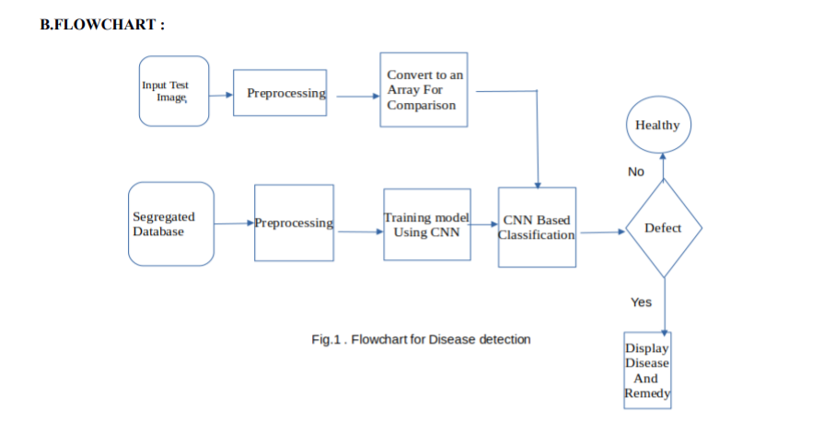
Methodology

Slide 7
Methodology:
Preprocessing and Training the model (CNN): The database is Preprocessed such as Image reshaping ,resizing and conversion to an array form. Similar processing is also done on the test image. A database consisting of about 32000 different plant species is obtained , out of which any image can be used as a test image for the software. The train database is used to train the model (CNN ) so that it can identify the test image and the disease it has .CNN has different layers that are Dense, Dropout, Activation, Flatten,Convolution2D, MaxPooling2D. After the model is trained successfully ,the software can identify the disease if the plant species iscontained in the database. After successful training and preprocessing ,comparison of the test image and trained model takes place to predict the disease.

Slide 8
Database collection: Initial step for any image processing based project is acquiring proper database which is valid . Most of the time the standard database is preferred but in certain circumstances we do not get proper database .So in such conditions we can collect the images and can form our own database. The database is accessed from crowdAI which is plant disease classification challenge . Data available here is not labeled .So the first task is to clean and label the database. There is a huge database so basically the images with better resolution and angle are selected . After selection of images we should have deep knowledge about the different leaves and the disease they have. Huge research is done from plant villlage organization repository. After Different types of plant images are studied in detail , labeling in done by segregating the images and with different diseases

Slide 9
Solutions
REMEDY:
After the disease is successfully predicted with a good confidence level , the corresponding remedy for the disease present is displayed that can be taken as a cure.
The proposed system was developed taking in mind the benefits of the farmers and agricultural sector .The developed system can detect disease in plant and also provide the remedy that can be taken against the disease. By proper knowledge of the disease and the remedy can be taken for improving the health of the plant .The proposed system is based on python and gives an accuracy of around 78%.

Slide 10
Research paper 2

Slide 11
Methodology
Image Segmentation
Feature Extraction
Disease Identification

Slide 12
Image Segmentation
In the complex environment, the most crucial task is how to segment the images while localizing and detecting diseased plant leaves, since the major aim of image segmentation is to set the symptom information apart from the background.

Slide 13
Feature Extraction
The feature extraction of plant disease faces many problems in identifying plant disease. The distinct image features include textures, shape, color, and motion-related attributes, which are the essential conditions for disease feature extraction

Slide 14
Disease Identification
As for the precise identification, so many techniques are developed and researched to get accurate results. The identification model focused on using class labels for training images and built a fine-grained image classification system

Slide 15
Modelling(Solution Framework)
localization of plant leaves
the segmentation of images and the extraction of plant disease
identification of disease

Slide 16
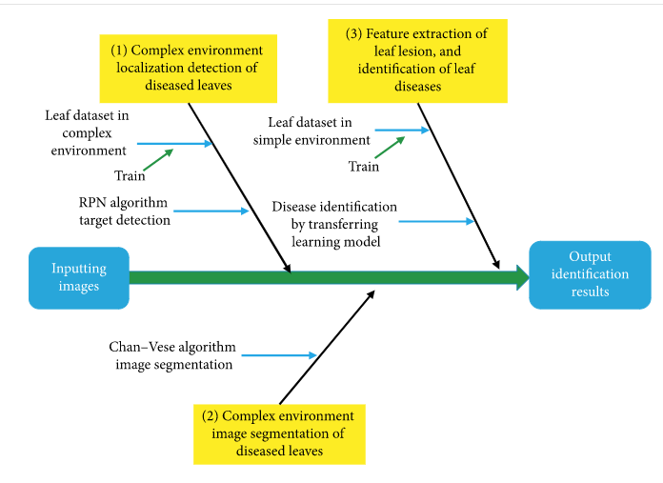

Slide 17
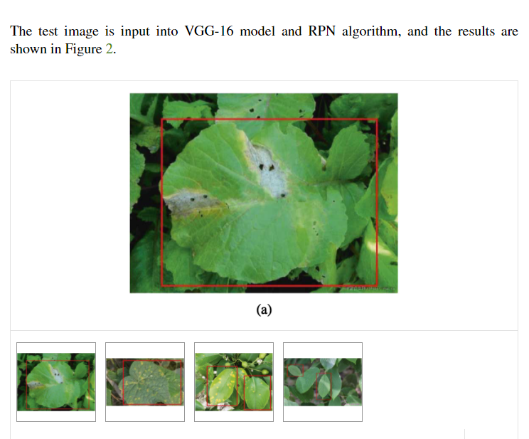
Results
1.

Slide 18
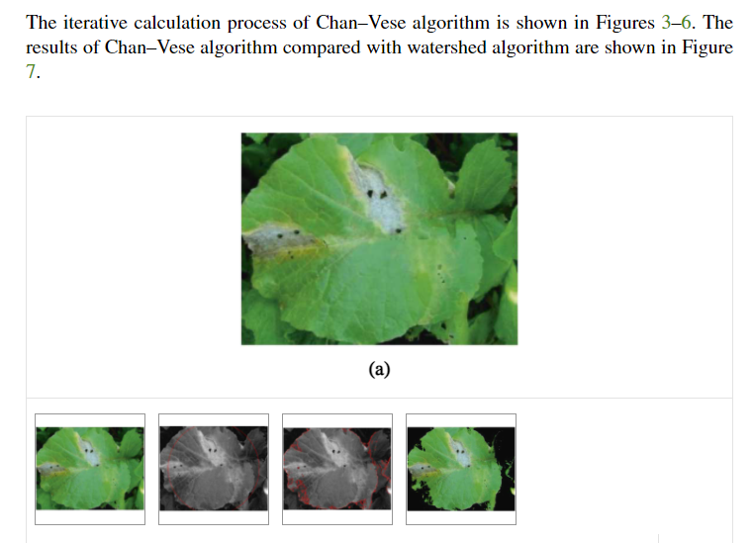

Slide 19
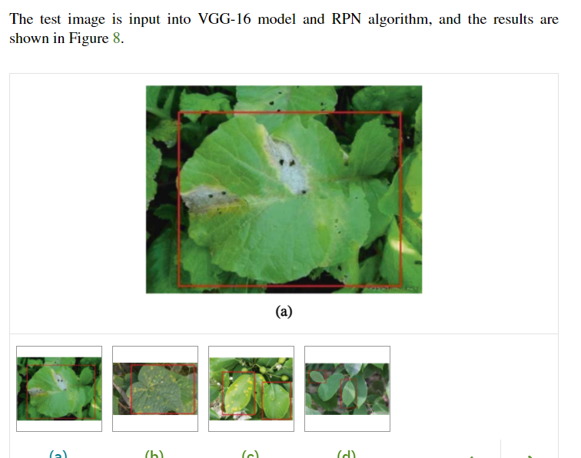

Slide 20
Conclusion
The average correct rate of the proposed method is 83.75%. which is better than the traditional method, thus reducing the influence of disease on agricultural production and being favorable to sustainable development of agriculture. Therefore, the deep learning algorithm proposed in the paper is of great significance in intelligent agriculture, ecological protection, and agricultural production.

Slide 21
Research Paper 3

Slide 22
Methodology

Slide 23
Dataset Description
We analyze 54,306 images of plant leaves, which have a spread of 38 class labels assigned to them. Each class label is a crop-disease pair, and we make an attempt to predict the crop-disease pair given just the image of the plant leaf..
We start with the PlantVillage dataset as it is, in color; then we experiment with a gray-scaled version of the PlantVillage dataset, and finally we run all the experiments on a version of the PlantVillage dataset where the leaves were segmented, hence removing all the extra background information which might have the potential to introduce some inherent bias in the dataset due to the regularized process of data collection in case of PlantVillage dataset. Segmentation was automated by the means of a script tuned to perform well on our particular dataset. We chose a technique based on a set of masks generated by analysis of the color, lightness and saturation components of different parts of the images in several color spaces .One of the steps of that processing also allowed us to easily fix color casts, which happened to be very strong in some of the subsets of the dataset, thus removing another potential bias.

Slide 24
Measurement of Performance
To get a sense of how our approaches will perform on new unseen data, and also to keep a track of if any of our approaches are overfitting, we run all our experiments across a whole range of train-test set splits, namely 80–20 (80% of the whole dataset used for training, and 20% for testing), 60–40 (60% of the whole dataset used for training, and 40% for testing), 50–50 (50% of the whole dataset used for training, and 50% for testing), 40–60 (40% of the whole dataset used for training, and 60% for testing) and finally 20–80 (20% of the whole dataset used for training, and 80% for testing). It must be noted that in many cases, the PlantVillage dataset has multiple images of the same leaf (taken from different orientations), and we have the mappings of such cases for 41,112 images out of the 54,306 images; and during all these test-train splits, we make sure all the images of the same leaf goes either in the training set or the testing set. Further, for every experiment, we compute the mean precision, mean recall, mean F₁ score, along with the overall accuracy over the whole period of training at regular intervals (at the end of every epoch). We use the final mean F₁ score for the comparison of results across all of the different experimental configurations.

Slide 25
Results
Across all our experimental configurations, which include three visual representations of the image data, the overall accuracy we obtained on the PlantVillage dataset varied from 85.53%

