Slide 1
Identifying Needs and Establishing Requirements
Chapter 7 - PRS
By – Hao and Raj

Slide 2
Why do we need Requirements?
When 38 IT professionals in the UK were asked about which project stages caused failure, respondents mentioned “requirements definition” more than any other phase.

Slide 3
What are requirements?
A requirement is a statement about an intended product that specifies what it should do or how it should perform.
Goal: To make as specific, unambigous, and clear as possible.

Slide 4
What kinds of specifications?
(broad category)
Functional: What the system should do
Non-Fictional: what constraints there are on the system its development. (For example that a work processor runs on different platforms)

Slide 5
What requirements should be gathered?
Functional: What the product should do.
Data requirements: Capture the type, volatility, size/amount, persistence, accuracy and the amounts of the required data.
Environmental requirements: a) context of use b) Social environment (eg. Collaboration and coordination) c) how good is user support likely to be d) what technologies will it run on
User Requirements: Capture the characteristics of the intended user group.
Usability Requirement: Usability goals associated measures for a particular product (More info on Chapter 6).

Slide 6
Data Gathering Techniques
Questionnaires: Series of questions designed to elicit specific information from us. The questions may require different kinds of answers: some require a simple Yes/No, others ask us to choose from a set of pre-supplied answers.
Interviews: Interviews involve asking someone a set of questions. Often interviews are face-to-face, but they don’t have to be (more on next page).

Slide 7
Data Gathering Techniques (continued)
Interviews:
  Forum for talking to people
  Structured, unstructured or semi-structured
  Props, e.g. sample scenarios of use,
  prototypes, can be used in interviews
  Good for exploring issues
  But are time consuming and may be
  infeasible to visit everyone

Slide 8
Data-gathering techniques
Focus groups and workshops: Interviews tend to be one on one, and elicit only one person’s perspective. It can be very revealing to get a group of stakeholders together to discuss issues and requirements.
Naturalistic Observation: It can be very difficult for humans to explain what they do or to even describe accurately how they achieve a task. (more on next page)

Slide 9
Data-gathering Techniques (continued)
Naturalistic observation:
  Spend time with stakeholders in their day-to-day tasks, observing work as it happens
  Gain insights into stakeholders’ tasks
  Good for understanding the nature and
  context of the tasks
  But, it requires time and commitment
  from a member of the design team, and
  it can result in a huge amount of data
  Ethnography is one form : entire class devoted to this.

Slide 10
Data-gathering
Studying documentation: Procedures and rules are often written down in a manual and these are a good source of data about the steps involved in an activity and any regulations governing a task.
Use All of the above In Combination : Constraints of Time and Money

Slide 11
Task Classification
Is the Task a set of sequential steps or is it a rapidly overlaying series of sub-tasks?
Does the task involve high information content : High information content or low --- is it complex or simple to interpret visual displays.
Is the task intended to be performed by a layman without much training or by a practitioner skilled in the task domain?

Slide 12
Data Gathering Guidelines
Focus on identifying the stakeholders
Involve all the stakeholder groups
Need more than on person from stakeholder group(s)
Use a combination of data gathering techniques
For example: use observation to understand the context, interviews to target specific user groups, questionnaires to reach a wider population, and focus groups to build a consensus view

Slide 13
Data Gathering Guidelines Cont.
Support the data-gathering sessions with suitable props, such as task descriptions and prototypes if available.
Run a pilot session if possible to ensure that your data-gathering session is likely to go as planned
In an ideal world, you would understand what you are looking for and what kinds of analysis you want to do, and design the data-capture exercise to collect the data you want. However, data gathering is expensive and often a tightly constrained resource.

Slide 14
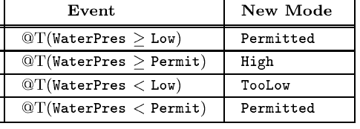
Software Cost Reduction Method (SCR)
The system behavior is described by a mathematical relation between monitored variables and controlled variables. Very mathematical…

Slide 15
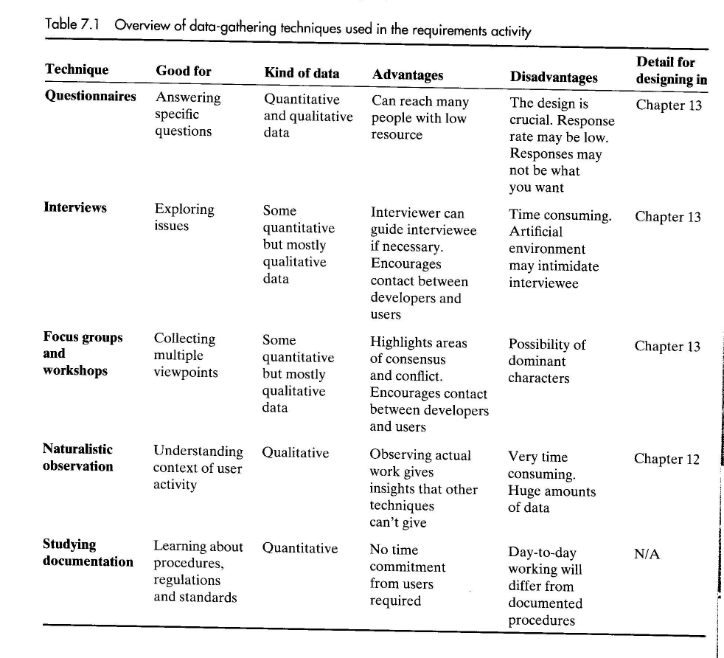

Slide 16
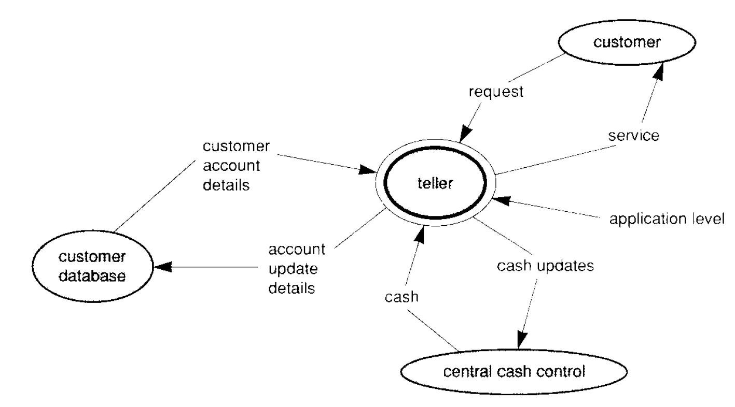
Viewpoints:

Slide 17
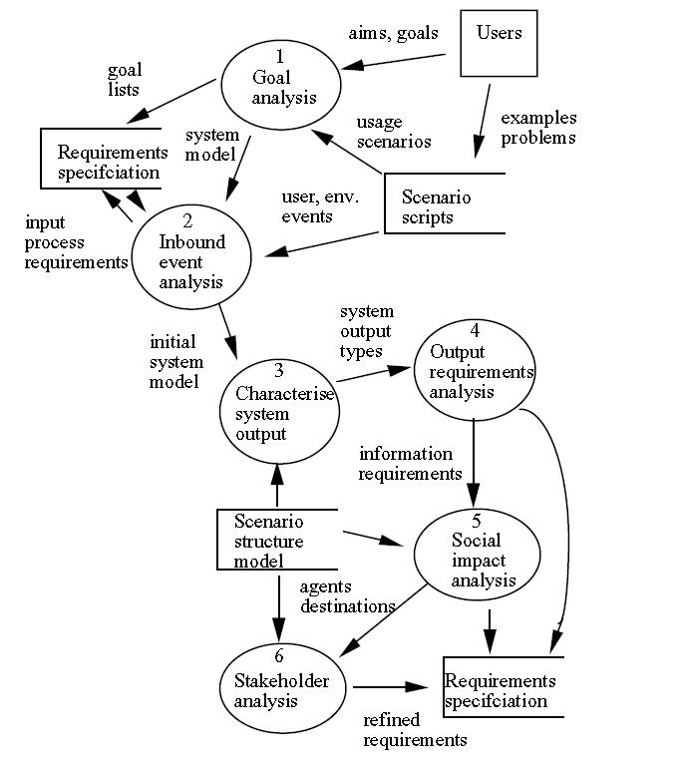
Scenarios used to create Requirements Specification (From Users → to Requirements)
We may follow this approach in our projects

Slide 18
Overview
Data interpretation and analysis
Task descriptions
Task analysis
Requirements management

Slide 19
Data interpretation and analysis
What: structure and record description of requirement
When: Start soon after data gathering session
Notes:
Start soon because experience will be fresh in mind

Slide 20
Data interpretation and analysis
Main Requirement analysis models in object-oriented systems
  Use cases diagrams:
  consists of actors and user cases, discussed later
  Class diagrams
  More…
How to develop those diagrams?
  UML tools( useful in practice)

Slide 21
What is UML
Stands for Unified Modeling Language
standard language
to specify, visualize, construct, and document the artifacts of software systems, as well as other non-software systems.
very important part of object oriented software development process.
uses graphical notations to express the design of software projects.
you can choose to use UML tool for establishing requirement Or just use paper and pen.
See details in references books about UML

Slide 22
Task descriptions

Slide 23
Task descriptions
Scenarios
  an informal narrative story of users
  Natural way to explain
Use cases
  show interaction with a system
  show detailed understanding of the interaction
Essential use cases
  Improvement of use cases
Often used in combination

Slide 24
Scenarios
Scenarios
  Usually the first step in establishing requirement
  an informal narrative story of users
  Describe
    what users are doing or
    How to achieve something
  An example
Notes:
Use the vocabulary and phrasing of users instead of describing how to achieve a task

Slide 25
Scenario for shared calendar
In an informal interview, one potential user answered the question
” How to arrange a meeting
between several people
in the shared-calendar system ?”
A simple scenario for this system:
“The user types in all the names of the meeting participants,
the length of the meeting, together with some constraints such as roughly when the meeting needs to take place, and possibly where it needs to take place. The system then checks against the individuals’ calendars and the central departmental calendar……”

Slide 26
Scenario for shared calendar
In an informal interview, one potential user answered the question
” How to arrange a meeting
between several people
in the shared-calendar system ?”
A simple scenario for this system:
  User :
  types in all the names of the meeting participants
  length of the meeting
  when is the meeting
  where is the meeting.
  System:
  checks against the individuals’ calendars and the central departmental calendar
  More…

Slide 27
Use cases
Use cases
  a special kind of scenario that breaks down system requirements into user functions
  use case is a sequence of events performed by a user
  Interaction between user and a system
  Example

Slide 28
Use case for shared calendar
A sequence of events to arrange a meeting:
1. The user chooses the option to arrange a meeting.
2. The system prompts user for the names of attendees.
3. The user types in a list of names.
4. The system checks that the list is valid.
5. The system prompts the user for meeting constraints.
More steps…
Note: Number indicates the steps,
shows how user and system will interact.

Slide 29
Use cases
How to avoid many words in the requirement description ?
Try graphical description!
Actors-------------use cases
  For example
  Administrator --------- Arrange a meeting

Slide 30
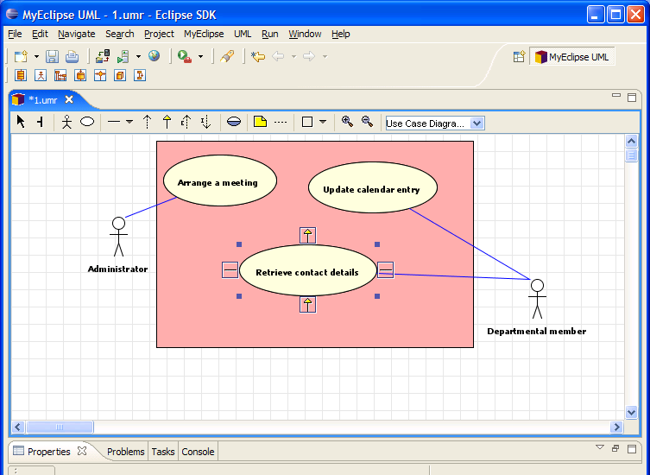
Use case diagram example
Use case diagram for the shared calendar system
3 use cases and 2 actors (Using the UML tool)

Slide 31
Essential use cases
Improvement of scenarios and use cases
structured
Consists of description of
  user intention
  system responsibility

Slide 32
Task analysis

Slide 33
Task analysis
Task descriptions versus Task analysis
  Task descriptions are often used to envision new systems or devices
  Task analysis is used mainly to investigate an existing situation
Many techniques, the most popular is Hierarchical Task Analysis (HTA)

Slide 34
Hierarchical Task Analysis
Idea is simple!
Involves breaking a task down into subtasks, then sub-sub-tasks and so on. These are grouped as plans which specify how the tasks might be performed in practice
Start with a user goal which is examined and the main tasks for achieving it are identified

Slide 35
Example Hierarchical Task Analysis
0. In order to borrow a book from the library
1. go to the library
2. find the required book
2.1 access library catalogue
2.2 access the search screen
2.3 enter search criteria
2.4 identify required book
2.5 note location
3. go to correct shelf and retrieve book
4. take book to checkout counter
plan 0: do 1-3-4. If book isn’t on the shelf expected, do 2-3-4.
plan 2: do 2.1-2.4-2.5. If book not identified do 2.2-2.3-2.4.
Note: start with a user goal
plan 2 shows subtasks order
no plan 1, step1 has no subtasks

Slide 36
Requirements management

Slide 37
Requirements management
What is it?
  a systematic approach to eliciting, organizing, and documenting the requirements of the system,
  a process that establishes and maintains changing requirements.
  Important and helpful for real projects
Common problems
  No.1: Can’t track change
  No.2: Difficult to write
  More…

Slide 38
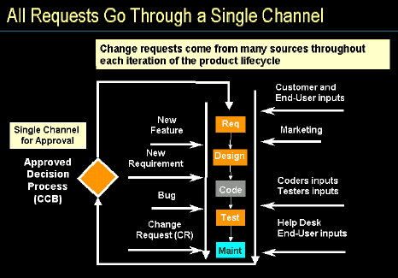
How to Manage changing requirements
Single channel of change control
Change Control Board (CCB).
Keep track history of requirements
Maintain version control
More…

Slide 39
How to document requirement?
Requirement of description documents
  Natural language and graphical
  Widely accepted, consistent format
Use tools to help
  Software<IBM Rational RequisitePro>
  automating effective tool, template

Slide 40
Further Info:
  See more details at
  http://www-306.ibm.com/software/awdtools/reqpro/
  Thank you for listening!

Slide 41
Works Cited
  Chapter 7 from J. Preece, Y. Rogers, H. Sharp: Interaction Design: Beyond Human-Computer Interaction.
  “Applying Requirements Management with Use Cases,” Roger Oberg (IBM Rational Software)
  Constance L. Heitmeyer. “Software cost reduction”. In John J. Marciniak, editor, Encyclopedia of Software Engineering. John Waley & Sons, 2nd edition, 2002
  Alistai Sutcliffe, "Scenario-based requirements analysis." Requirements Engineering Journal, London, UK, 1998.

