Slide 1


A BLOGGING PLATFORM
ConnectCo
IT314- Software Engineering
-Prof. Saurabh Tiwari

Slide 2



Lead by- Zeel Ghori
FRONTEND
BACKEND
TESTING
DOCUMENTATION
Zeel Ghori
Akshat Jindal
Pritish Nehal Desai
Aditya Iyer
Kashyap Gajera
Kritarth Joshi
Prachi Chaudhari
Chauhan Heman
Siddhant Gupta
Naisargi Patel
Akshat Jindal
Prachi Chaudhari
Chauhan Heman
Siddhant Gupta
Zeel Ghori
Naisargi Patel
Pritish Nehal Desai
Aditya Iyer
Kashyap Gajera
Kritarth Joshi
Prachi Chaudhari
Chauhan Heman
Siddhant Gupta
Zeel Ghori
Naisargi Patel
Akshat Jindal
Pritish Nehal Desai
Aditya Iyer
Kashyap Gajera
Kritarth Joshi

Slide 3



Objective
To Engage the Community
User Friendly Interface
Availability of Content
Exchange Thoughts and Ideas

Slide 4

Milestones
1.Project Planning
6. Frontend Development
2. Requirement Gathering
7. Feature Integration
3. Documentation
8. Testing
4. Raw UI/UX Design
9. Deployment
5. Backend Development
10. Presentation

Slide 5
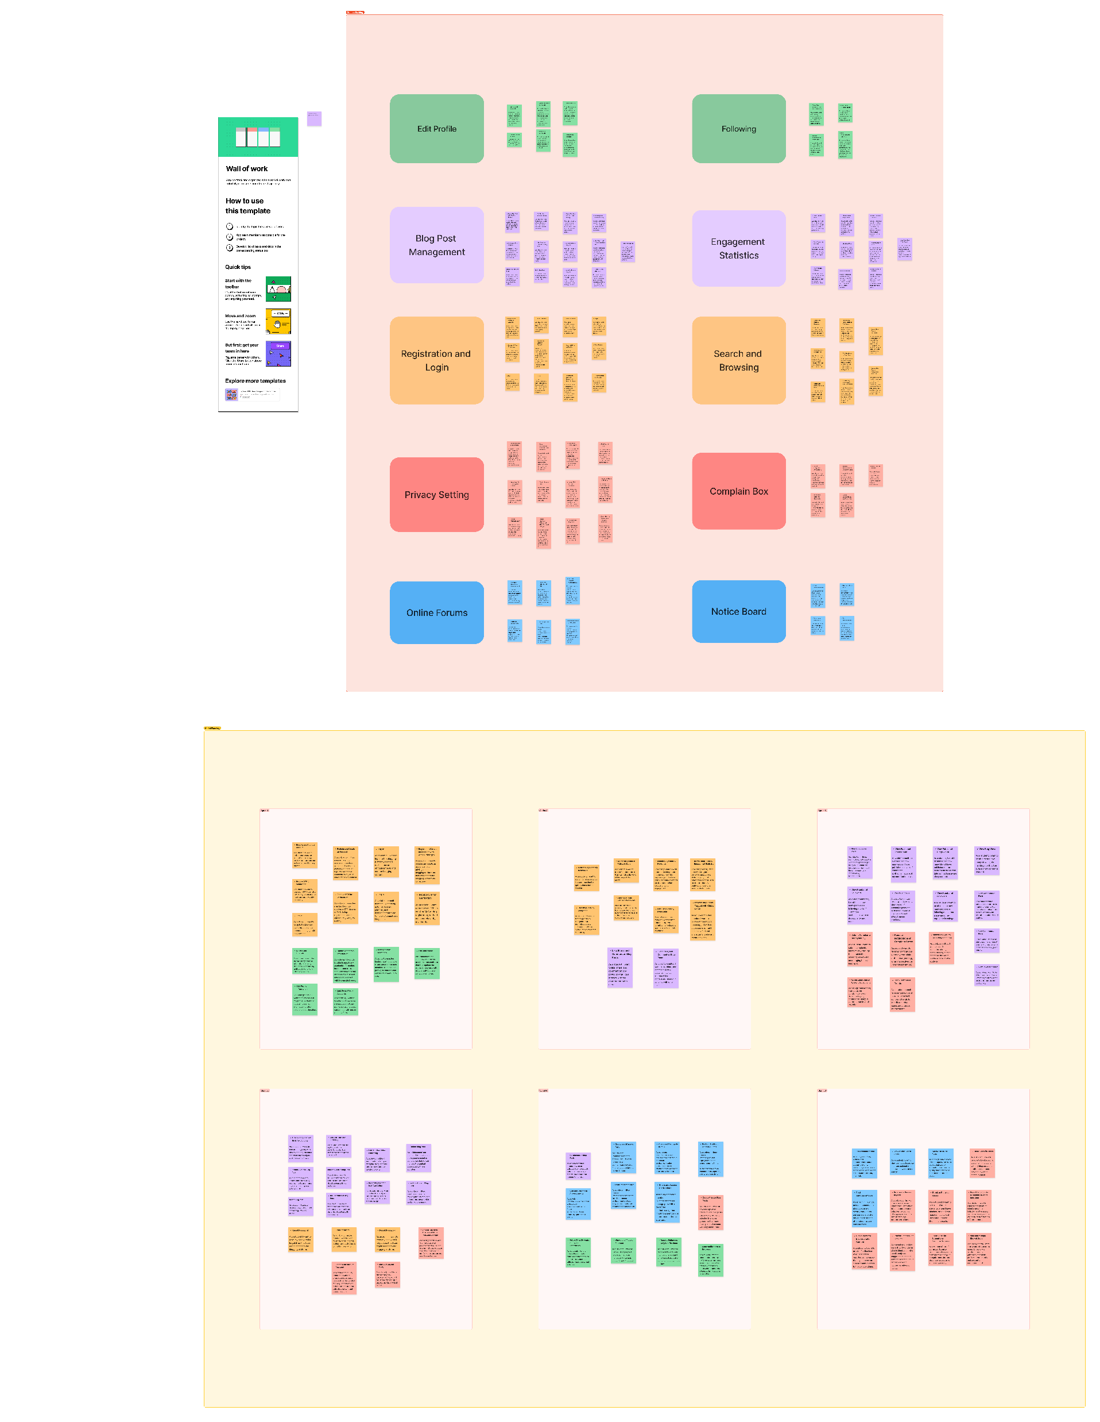
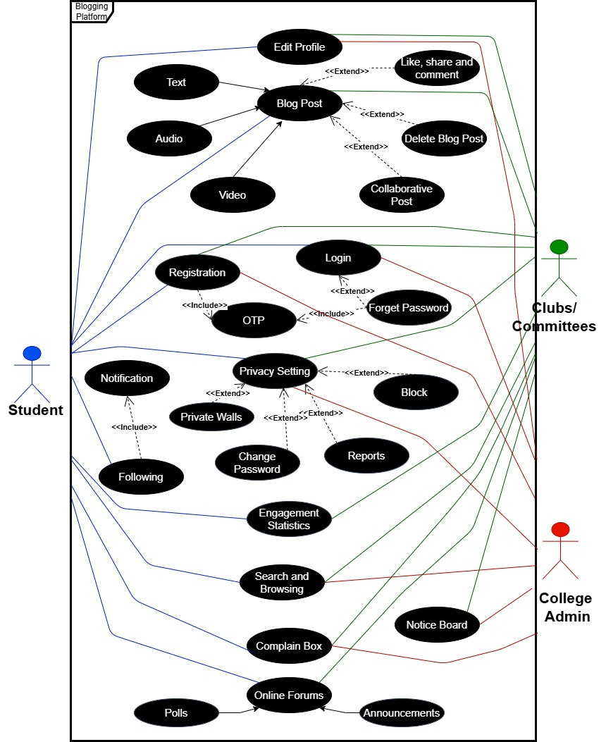
Product backlog/User Stories
Use Case Diagram
Link of Figma : https://www.figma.com/board/hEaccaR6QBGZa7DrWa7fwu/Scrum-Board-Template-(Community)?node-id=0-1&t=25YeGrNuN87VkFMt-1

Slide 6




Importance of Clear Requirements
Team Collaboration
Lesson
Learnt
Lessons learnt
Error Detection
Time Management
Problem-Solving Skills
Learning New Technologies

Slide 7
Achievements
Developed proficiency in utilizing GitHub and project management tools effectively.
Strengthened technical skills in the MERN stack through hands-on project development.
Enhanced teamwork and problem-solving abilities through collaborative efforts.
Gained expertise in integrating front-end and back-end technologies.
Learned how to plan and track work using project management tools.
Practiced sharing ideas and working with others to meet project goals.

Slide 8

Mistakes
Occurrence of blank screen multiple times due to error in routing and importing
Failure to execute drop down transition on clicking on profile page
Incorrect path causing "No blogs here" message despite blog existence.
Failure to address transition-related issues effectively.

Slide 9
Rating of your software artefacts (0-5)
5
4
4.25
3.75
Design & Documentation
Project Management
Coding Proficiency
Testing and Test Cases

Slide 10
8.5
/
Overall rating of your project
10

