Slide 1

IT - 462 Exploratory Data Analysis
Group – 4
Group members:
Ghori Zeel Jivrajbhai (202201287)
Aryankumar Panchasara (202201056)
Nischay Agrawal (202411031)
Professor: Gopinath Panda

Slide 2

Crime Against Women in India: Trends and Predictions
Data Analysis

Slide 3

Introduction
Objective:
This analysis aims to uncover patterns, trends, and insights that can help policymakers, law enforcement agencies, and researchers understand crime dynamics over time.
Scope:
Data includes state-wise crime records and multiple crime categories.
Topics
Overall Crime Trends
01
Trends by Crime Type
02
State-Wise Analysis
03
Predictive Analysis
04
Conclusions
05

Slide 4
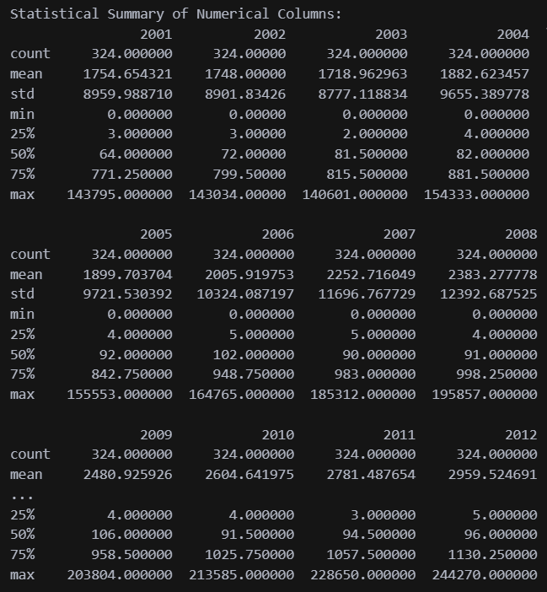
Overview of the Dataset used
Dataset link: https://www.data.gov.in/resource/crime-against-women-during-2001-2012
Total record: 324 rows, 14 columns
Numerical Columns: Crime counts for each year (2001–2012).
Categorical Columns: STATE/UT (Region) and CRIME HEAD (Crime Category).
Descriptive Statistics:
Maximum Total Crimes: 21,73,559.
Mean (Average) Total Crimes: 26,472.
Median Total Crimes: 1,066.
Large variation suggests significant disparities across states and crime categories.

Slide 5
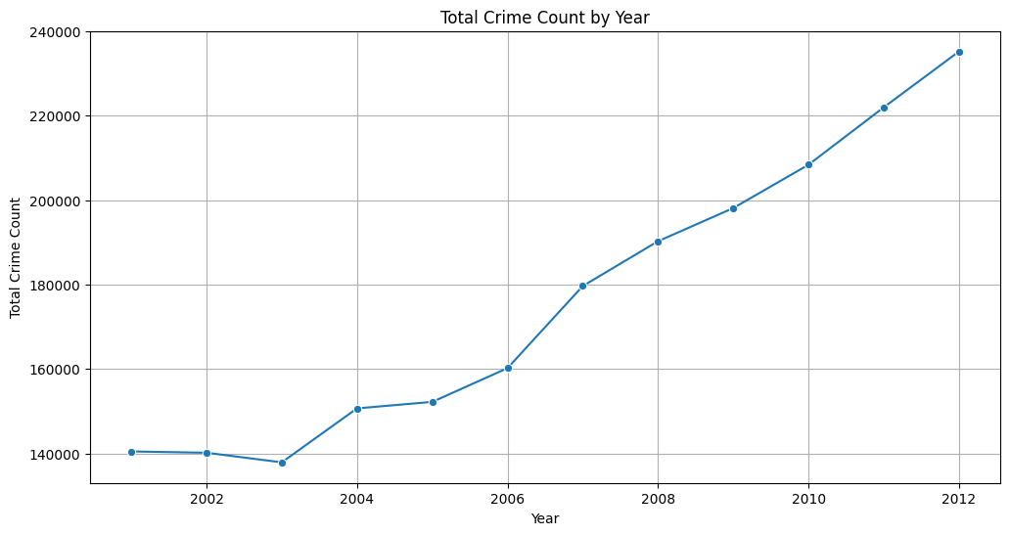
Overall Crime Trends
Total Crime Count by Year (2001–2012)
Inference of the graph:
The analysis of crimes against women in India from 2001 to 2012 shows an upward trend in the total crime count, indicating growing challenges in ensuring women's safety. A significant rise is also seen after 2005, indicating either an increase in crime rates or better reporting mechanisms.
Predictive analysis shows that crime trends will continue to rise if proactive measures are not put in place. This requires stronger law enforcement, public awareness campaigns, and investments in safety infrastructure to curb the menace.

Slide 6
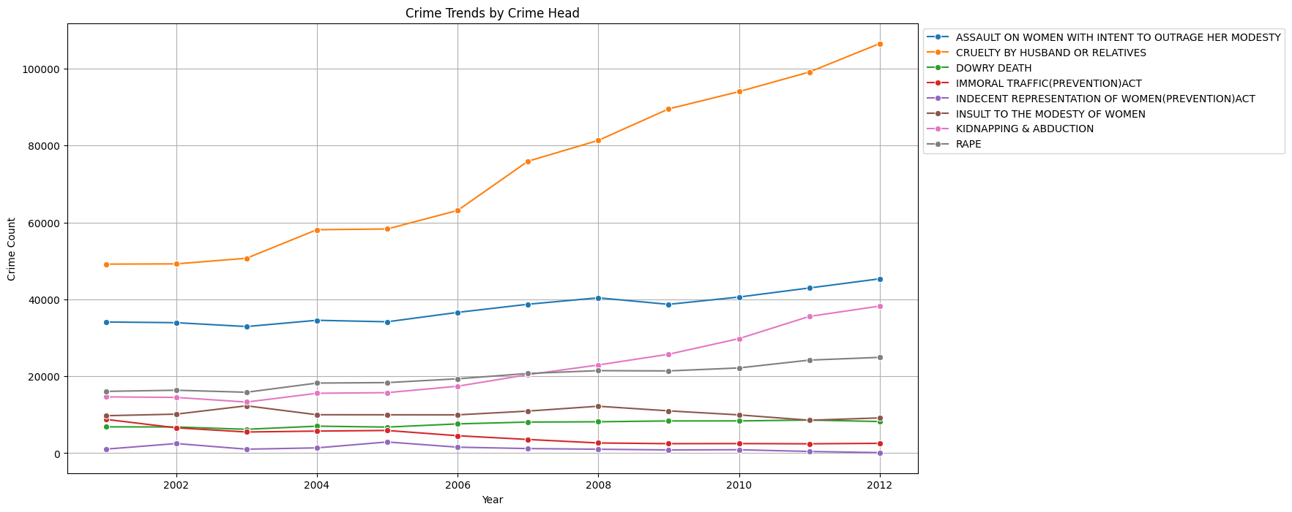
Trends by Crime Type
Crime Trends by Crime Category (2001–2012)

Slide 7
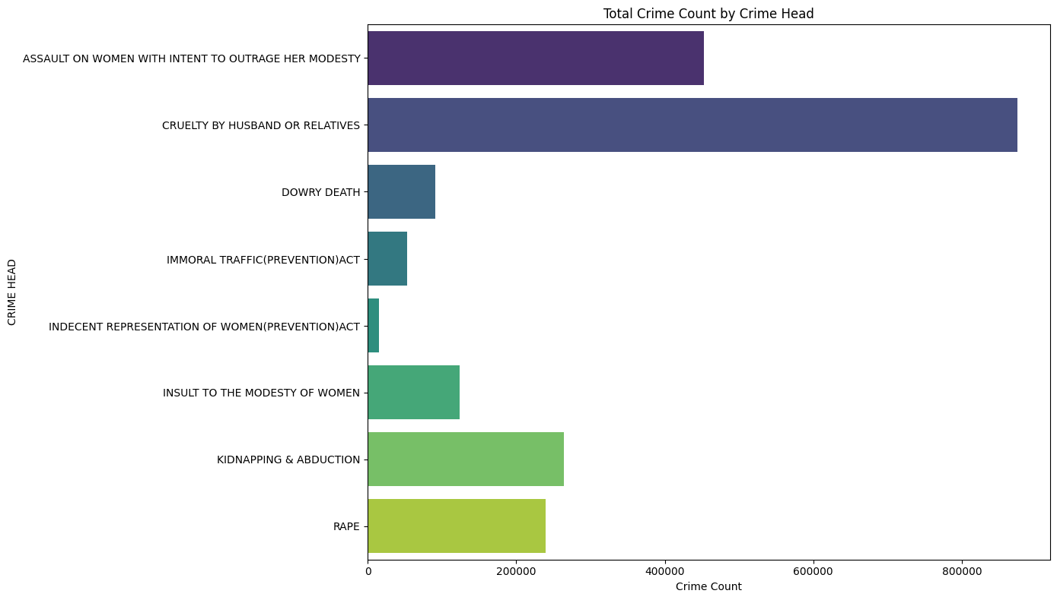
Total Crime Count by Crime Head

Slide 8
What do we conclude from the previous graphs:
The graph shows all the trends of different forms of crimes against women from the year 2001 to 2012. It throws light on the following features:
The overall crime categories are steadily increasing, which some categories, like the "Cruelty by Husband or Relatives", are significantly leading.
Other crimes, like "Rape" and "Kidnapping & Abduction," continually increase, reflecting worsening problems in these areas.
Some crimes, such as "Dowry Death," are relatively stable or decrease slightly, indicating that the effects of policy and social awareness are different.
Overall Insight: This chart reflects the complexity of crime dynamics, where some areas require urgent attention and others display progress.

Slide 9
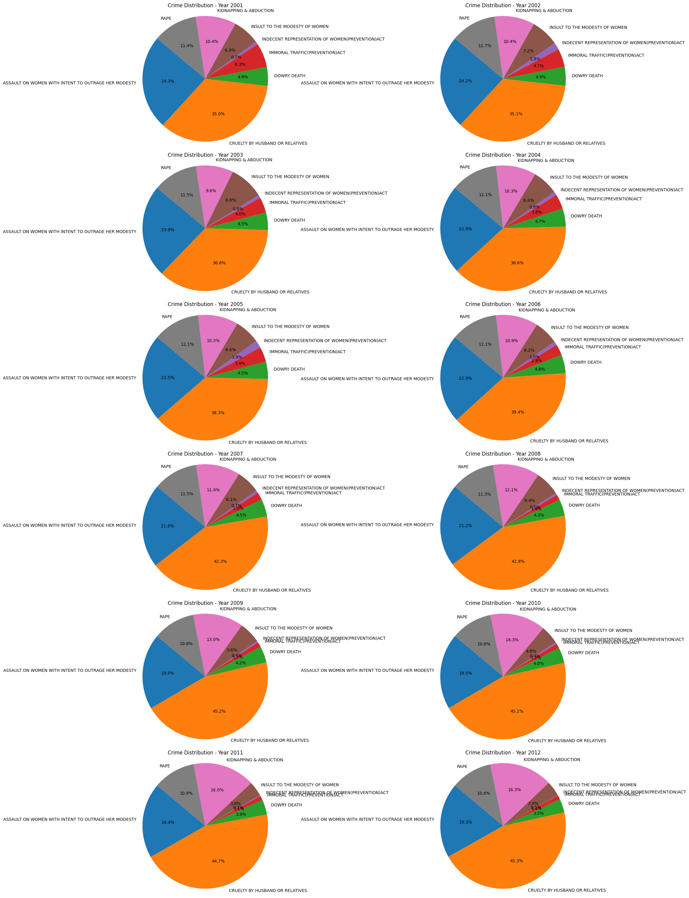
This pie chart represents the percentage distribution of various crime categories for each year from 2001 to 2012. Each segment of the pie corresponds to a specific type of crime, illustrating how its proportion contributes to the total reported crimes for that year. It highlights changes in the prevalence of different crime categories over time, providing insight into trends and shifts in criminal activity.
"This category consistently accounts for the largest share, ranging from 35% in 2001 to 45% in 2012
"Assault on Women with Intent to Outrage Her Modesty" The second most reported crime, contributing approximately 22%–25% of total cases.
"Rape" and "Kidnapping & Abduction" Together, they account for around 15%–20% of the total crimes.
Lesser-reported crimes, like "Dowry Death" and "Immoral Traffic", show minimal variations but remain consistent concerns.

Slide 10
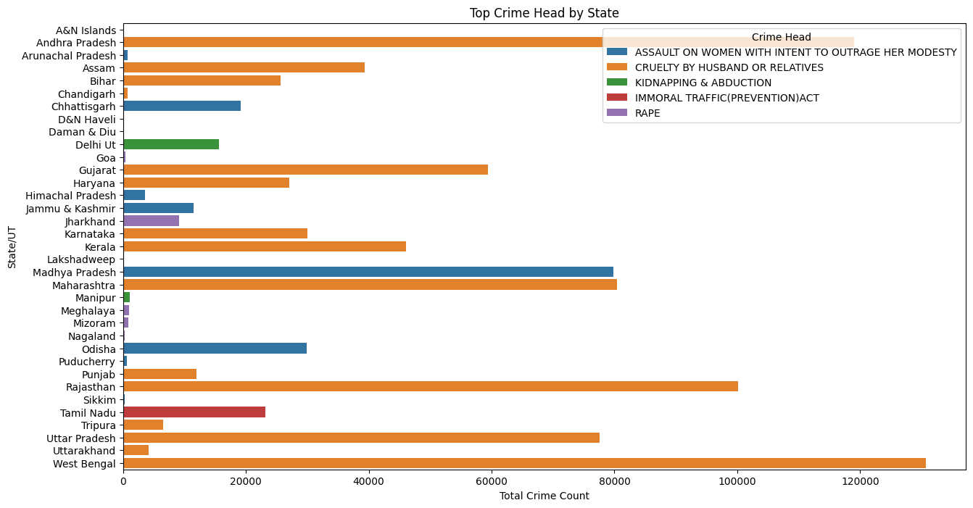
Top Crimes by each state/UT
"Cruelty by Husband or Relatives" has the highest crime counts in most states/UTs, including Uttar Pradesh, Rajasthan, and West Bengal, indicating it is a significant concern nationwide.
"Assault on Women with Intent to Outrage Her Modesty" is prevalent in states like Madhya Pradesh, Chhattisgarh, and Odisha, where it is among the most reported crimes.
"Rape" shows significant crime counts in Jharkhand, Meghalaya and Mizoram
"Kidnapping & Abduction" appears prominently in Delhi UT and Manipur, highlighting a specific challenge.
"Immoral Traffic (Prevention) Act" has relatively low crime counts compared to other categories but is noticeable in states like Tamil Nadu, possibly indicating regional trends or targeted crimes.
West Bengal stands out as having the highest overall crime counts in the category "Cruelty by Husband or Relatives," reflecting its dominance as a critical social issue in the state.
Smaller states and union territories, such as Lakshadweep, Andaman & Nicobar Islands, and Arunachal Pradesh, report lower crime counts, potentially due to their smaller populations.
Madhya Pradesh stands out as having the highest overall crime counts in the category " Assault on Women with Intent to Outrage”

Slide 11
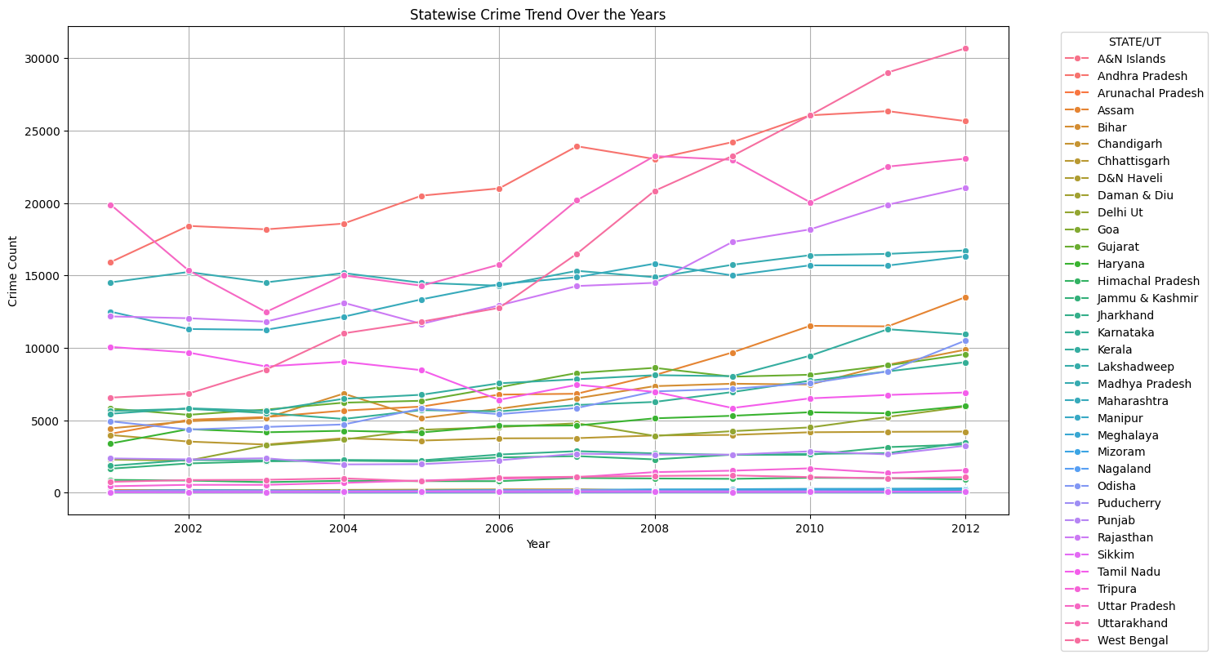
State-Wise Analysis
Line Chart: State wise Crime Trend Over the Years
This line chart depicts the yearly crime trends for various states and union territories (UTs) from 2001 to 2012.
Key Observations:
States like Andhra Pradesh, Uttar Pradesh, and West Bengal show a consistent increase in crime counts over the years.
Some regions like Bihar show fluctuations, reflecting possible shifts in reporting or interventions.
Smaller UTs like Daman & Diu and Lakshadweep have consistently low crime counts.

Slide 12
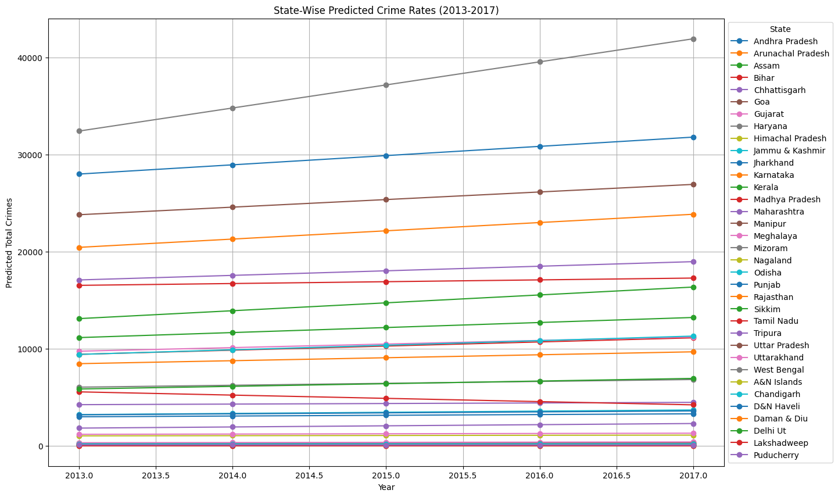
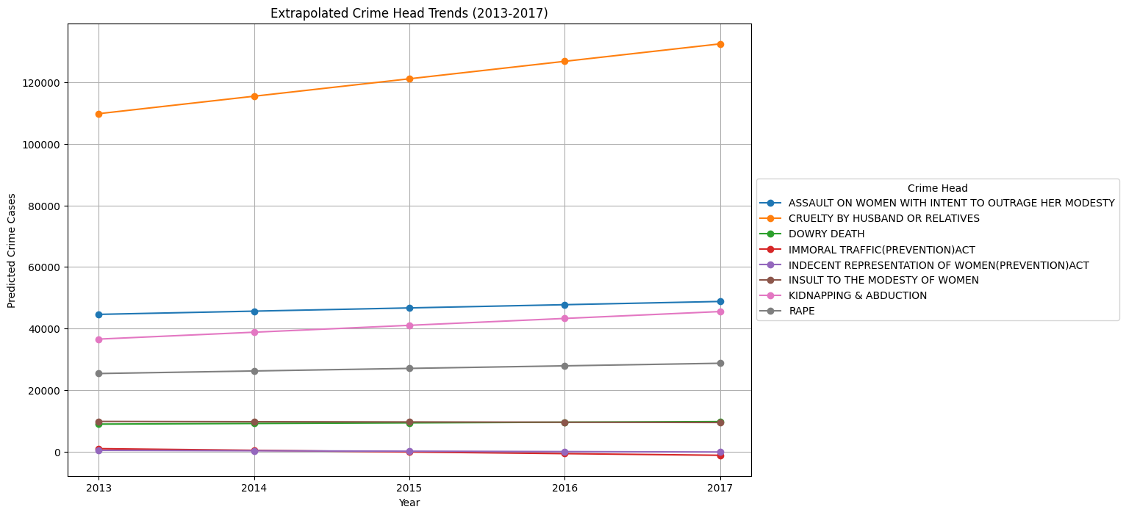
Predictive Analysis
Linear Extrapolation:
State Wise Predicted total Crime Rates from 2013 to 1017
Crime Wise Predicted total Crime Rates from 2013 to 1017

Slide 13
Inference of the previous graph:
This chart shows the predicted trends for different crime categories against women from 2013 to 2017 based on past data.
Key Observations:
"Cruelty by Husband or Relatives":
Continues to dominate with the highest predicted counts, exceeding 120,000 by 2017.
Reflects the systemic nature of domestic violence.
"Assault on Women with Intent to Outrage Her Modesty":
Predicted to maintain a stable but high count of around 45,000 cases annually.
"Kidnapping & Abduction" and "Rape":
Both show steady increases, reaching approximately 40,000 and 25,000 cases by 2017, respectively.
Other Crimes:
Categories like "Dowry Death" and "Immoral Traffic" show relatively smaller and stable predicted counts, reflecting lesser growth compared to major categories.

Slide 14
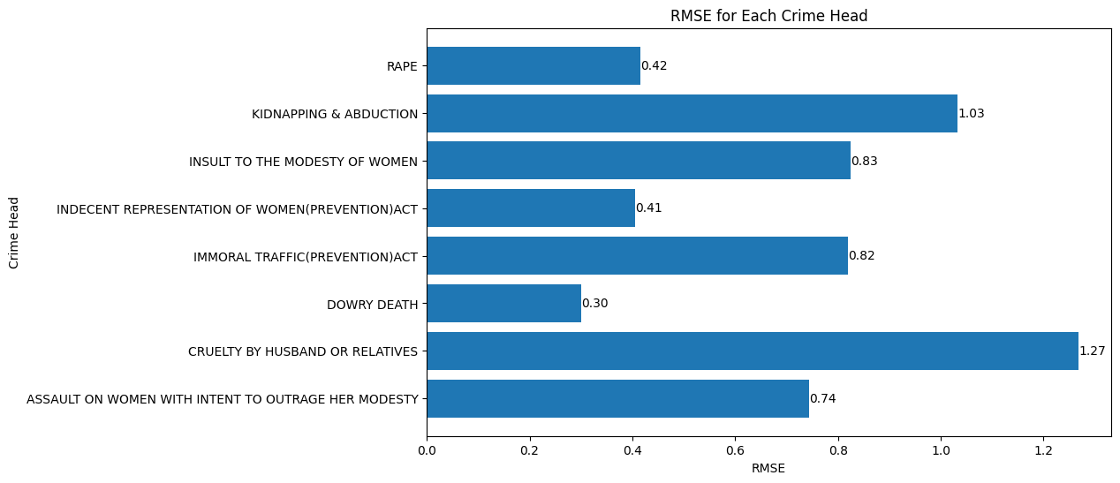
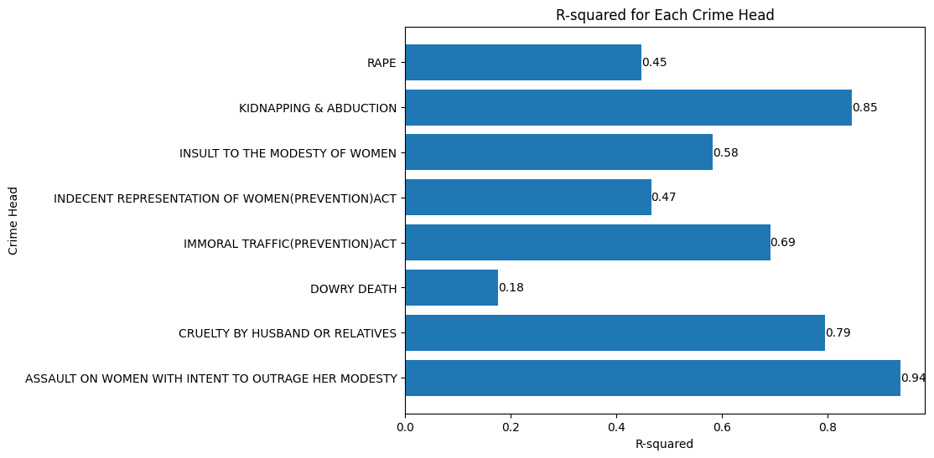
RMSE (Root Mean Square Error)
The RMSE chart measures the average prediction error for each crime head:
Lowest RMSE: "Dowry Death" (0.30), indicating the model predicts this category most accurately.
Highest RMSE: "Cruelty by Husband or Relatives" (1.27), reflecting greater prediction variability for this dominant crime.
Other notable errors include "Kidnapping & Abduction" (1.03) and "Insult to the Modesty of Women" (0.83).
R-squared
The R-squared chart shows how well the model explains the variance in the data for each crime head:
Best Fit: "Assault on Women with Intent to Outrage Her Modesty" (0.94), indicating the model explains 94% of the data variation.
Lowest Fit: "Dowry Death" (0.18), showing limited predictive accuracy for this category.
Categories like "Kidnapping & Abduction" (0.85) and "Cruelty by Husband or Relatives" (0.79) also show good model performance.

Slide 15
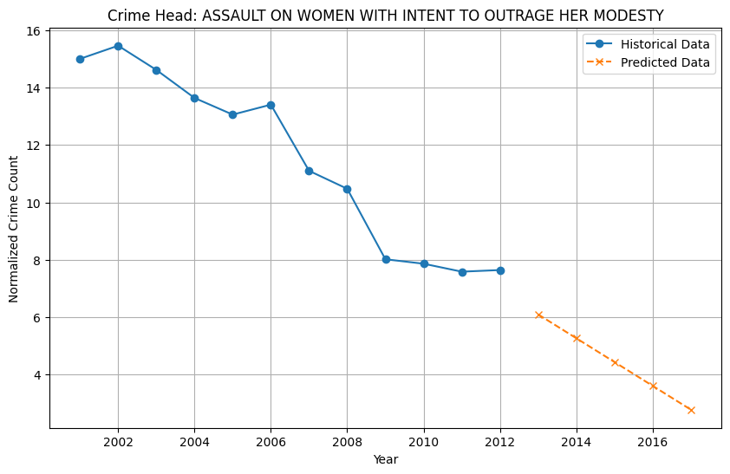
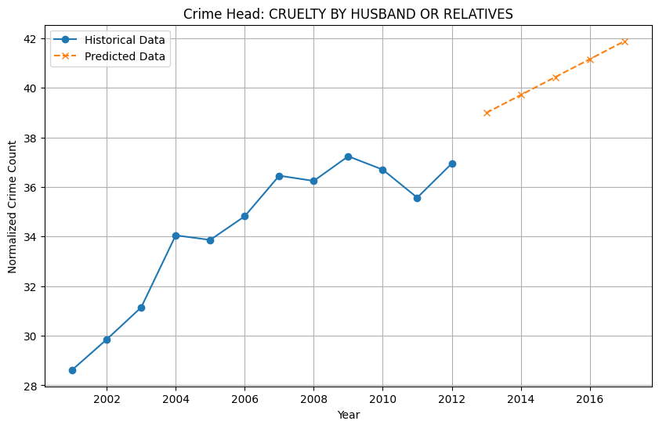
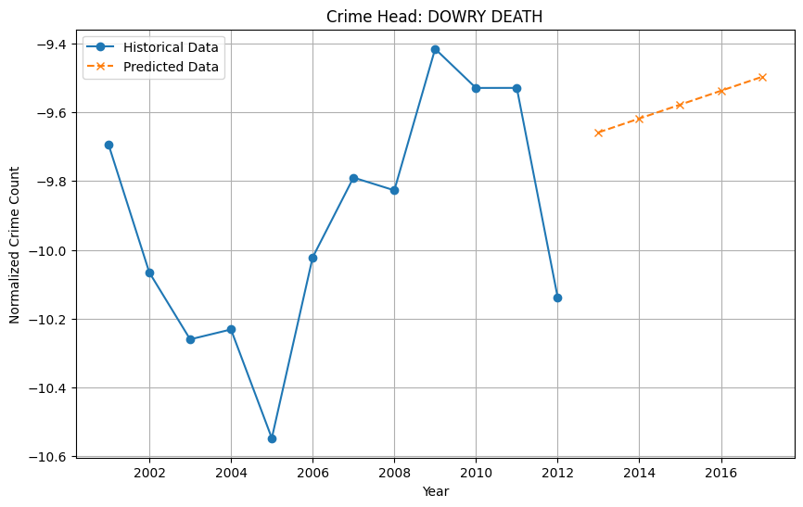
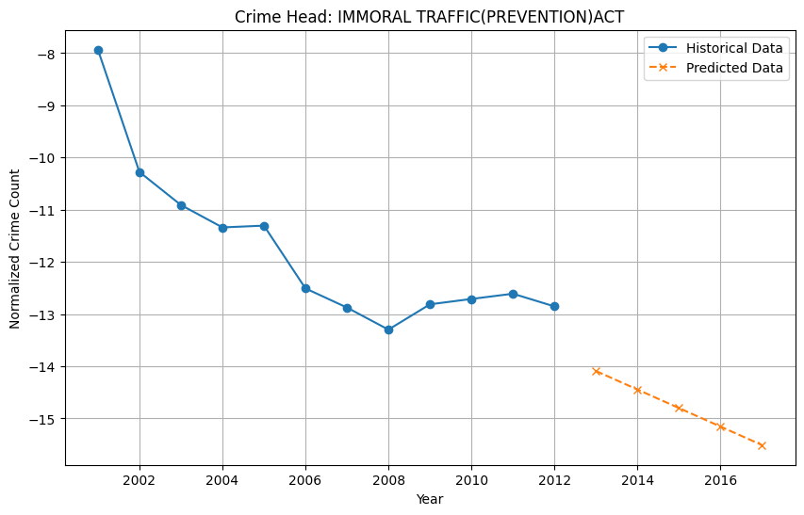
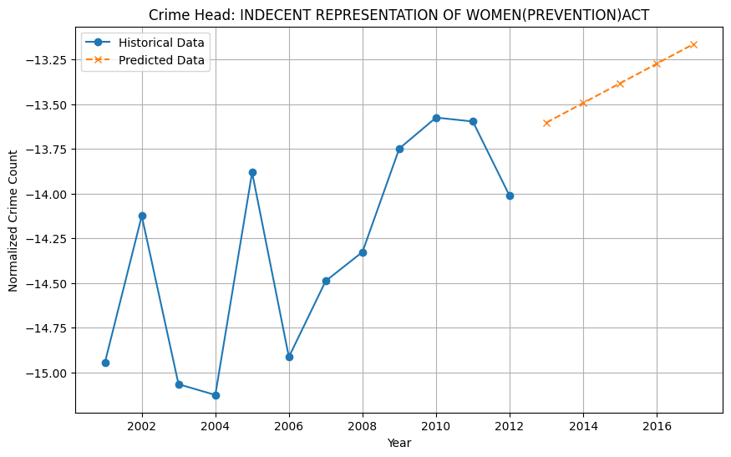
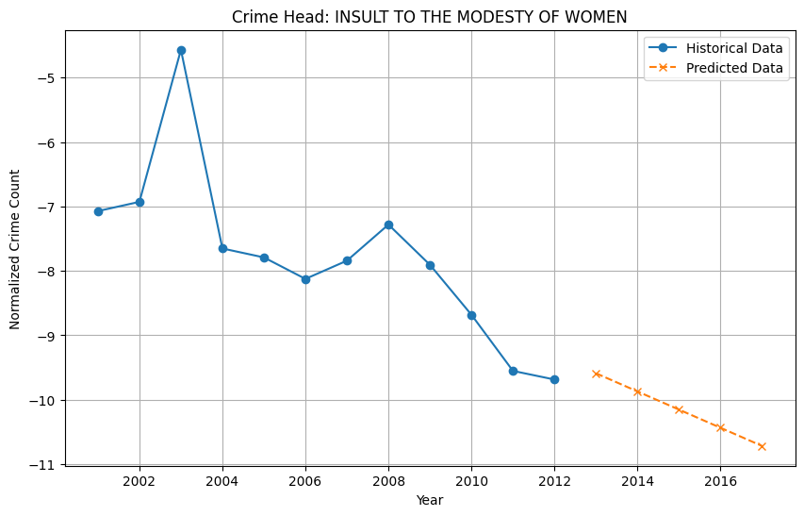
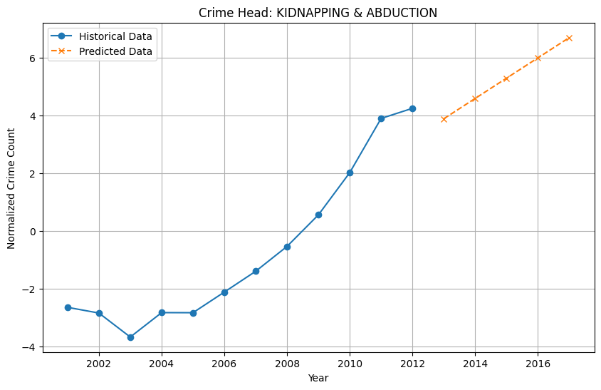
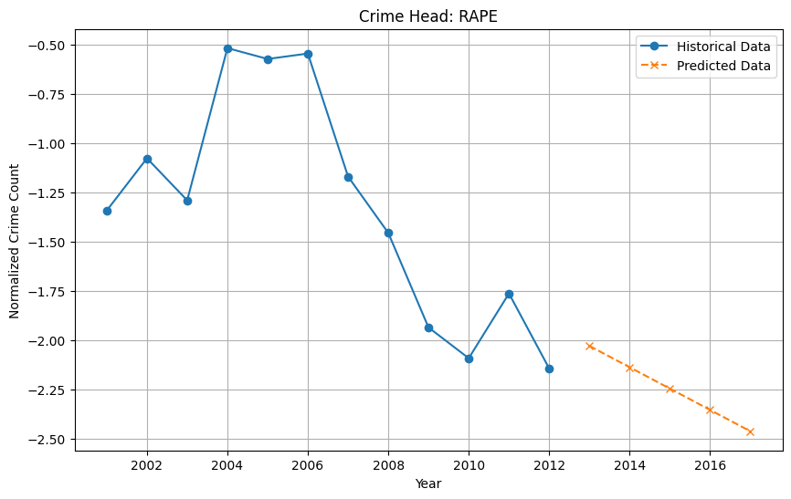
Historical Data with Predicted Data

Slide 16
Inference:
This visualization presents historical data (2001–2012) alongside polynomial extrapolated predictions (2013–2017) for each crime head. The trends are normalized to focus on relative changes.
Key Observations:
"Assault on Women with Intent to Outrage Her Modesty":
Historical data shows a gradual decline after 2005.
Predicted data suggests a continued but slower decline beyond 2013.
"Cruelty by Husband or Relatives":
A clear upward trend historically, with predictions showing a sharp rise post-2013, reaching new highs.
"Dowry Death":
Historical data shows fluctuations but stabilizes toward 2012.
Predictions indicate a gradual upward trend post-2013.
"Immoral Traffic (Prevention) Act":
Historical data reflects a consistent decline.
Predicted data indicates a continued downward trajectory.
"Indecent Representation of Women (Prevention) Act":
Historical data is erratic with no clear pattern.
Predictions suggest a slow increase beyond 2013.
"Insult to the Modesty of Women":
A declining trend historically, which is predicted to continue.
"Kidnapping & Abduction":
A sharp rise from 2006 to 2012.
Predicted data indicates continued growth at a similar rate.
"Rape":
Historical data shows fluctuations with a decline after 2010.
Predictions indicate a further slight decline.

Slide 17
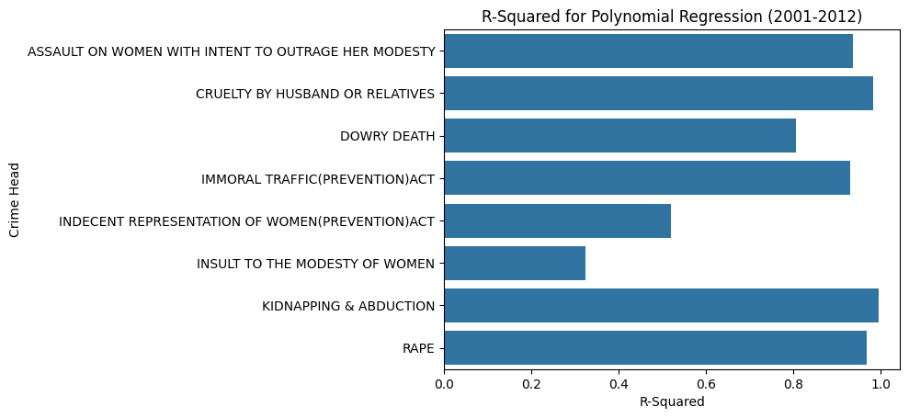
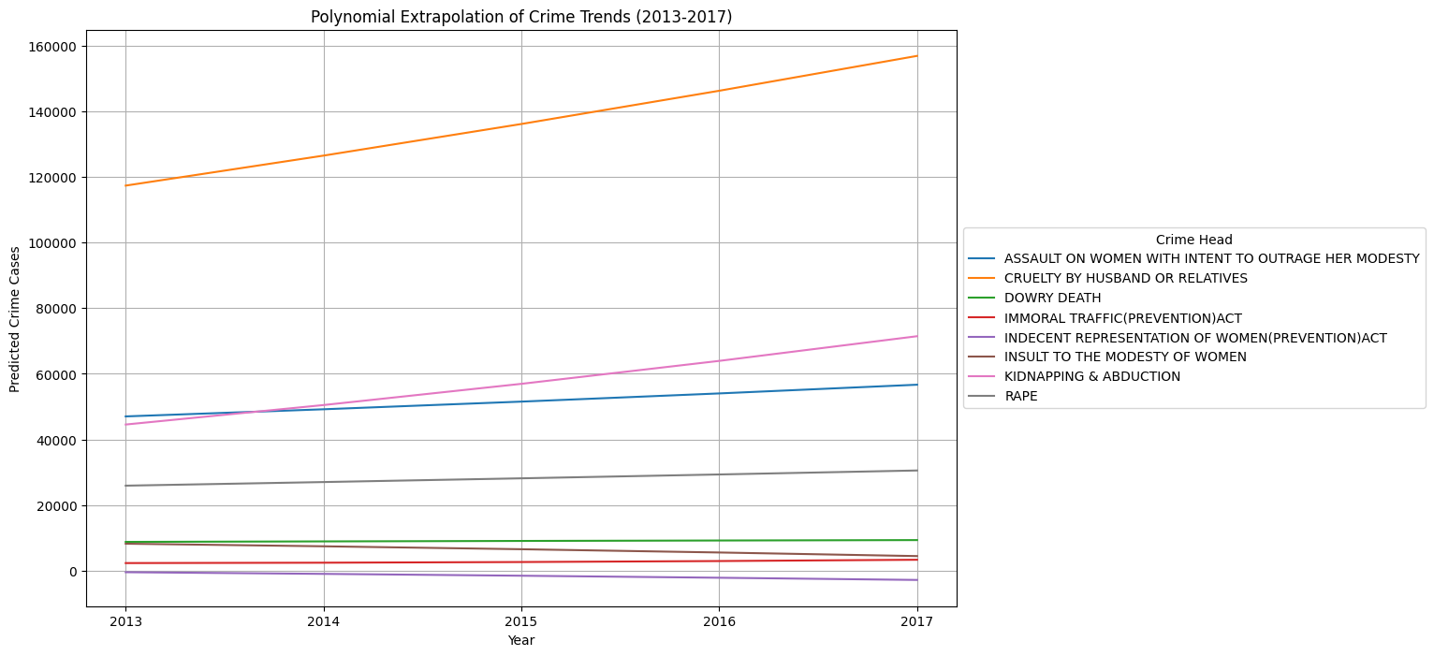
Polynomial Extrapolation:

Slide 18
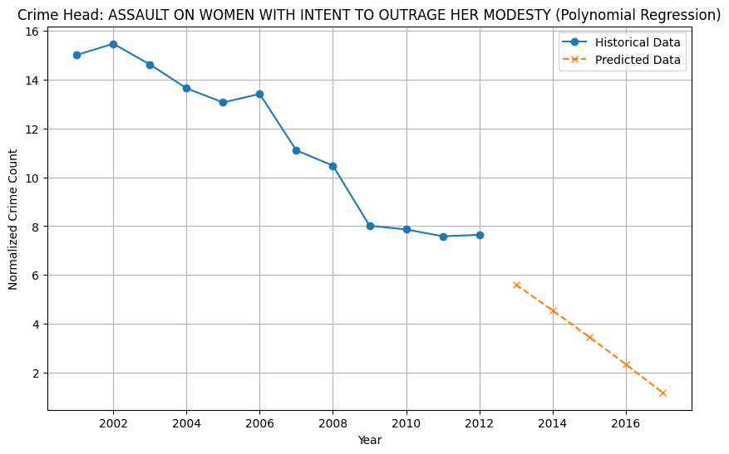
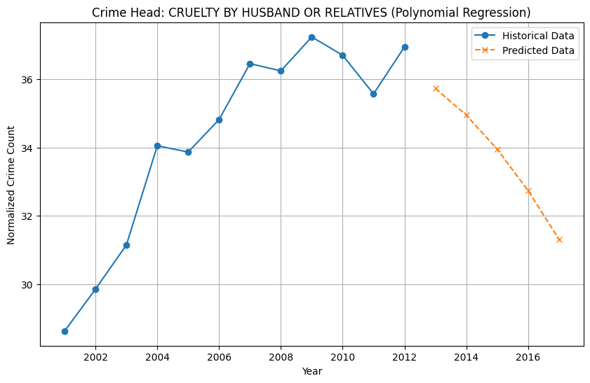
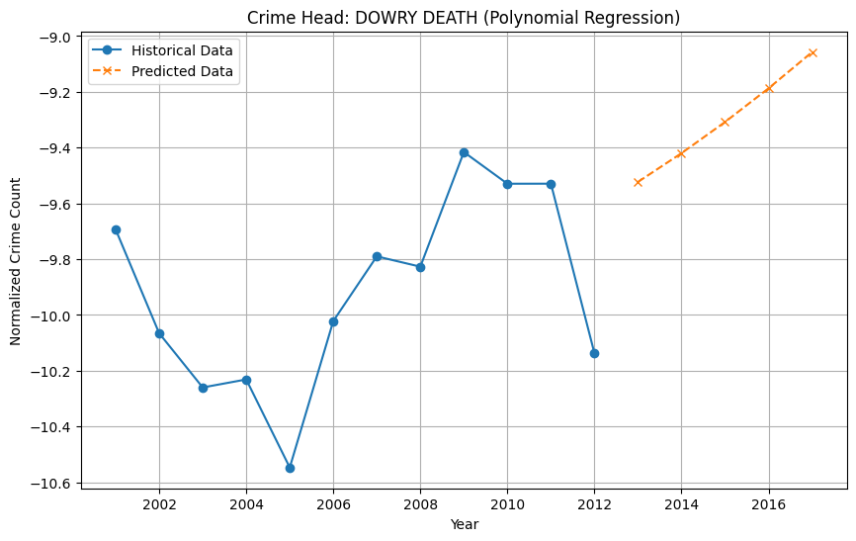
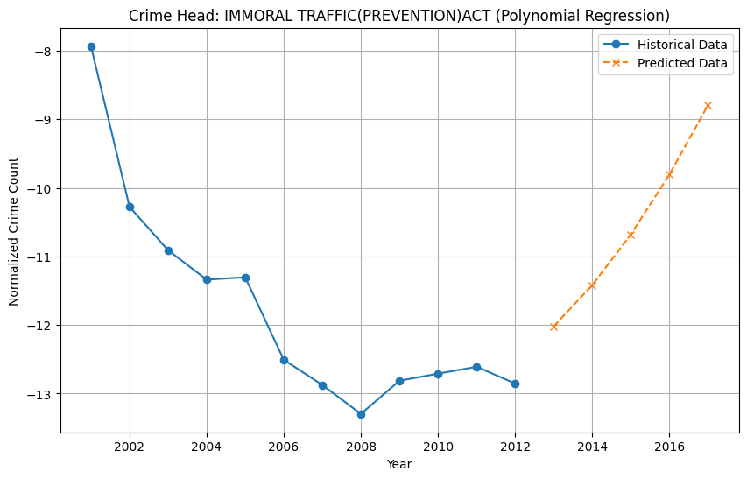
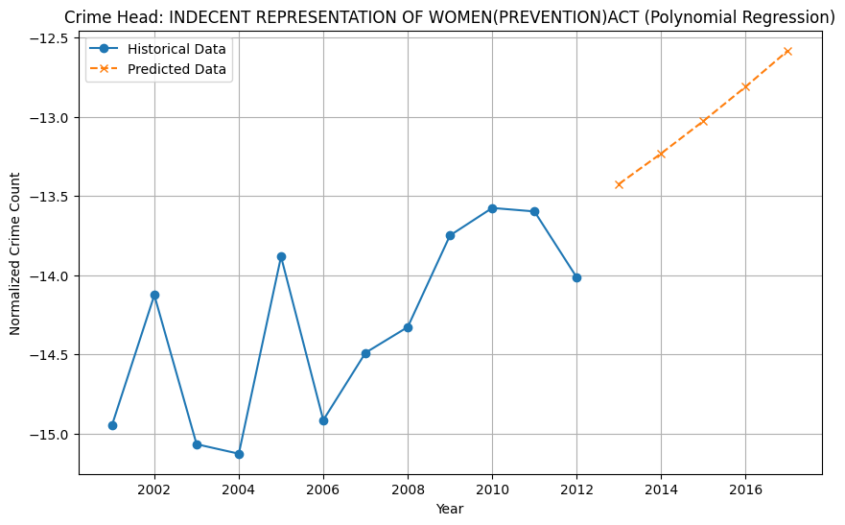
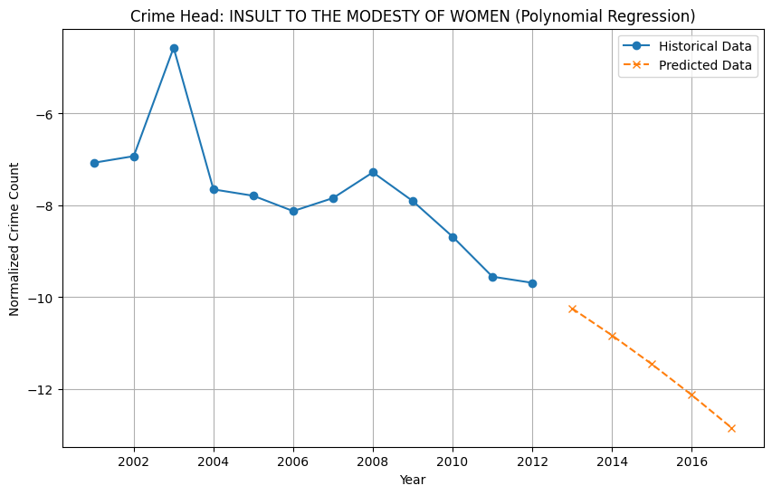
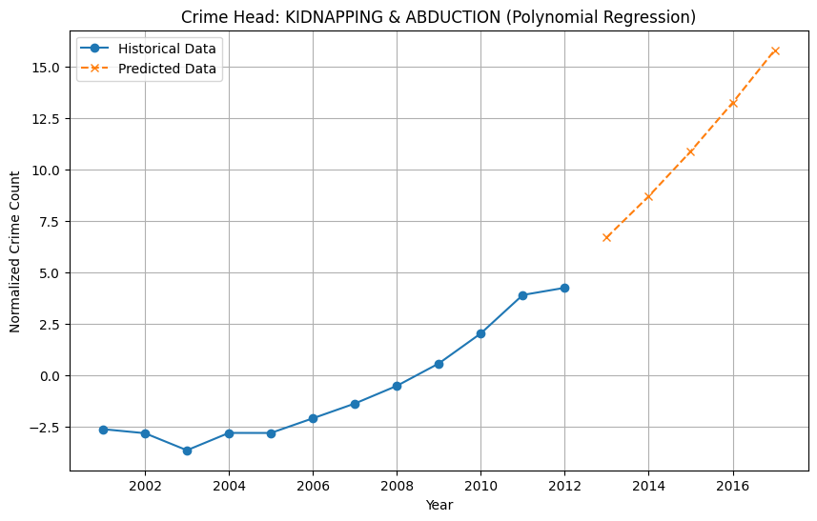
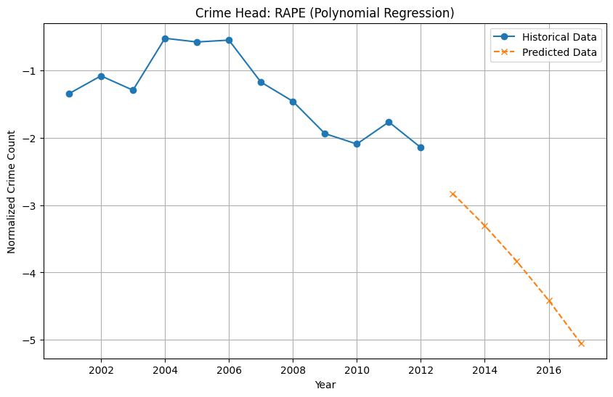
Historical Data with Predicted Data

Slide 19
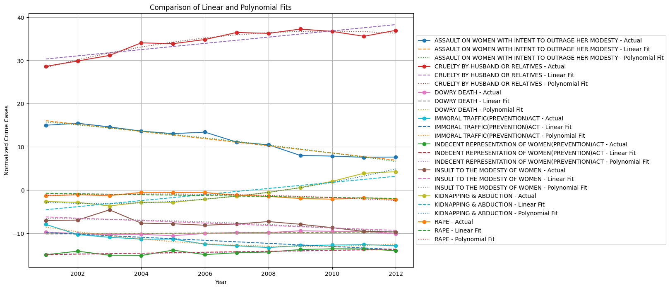
This chart compares the actual crime data (2001–2012) against the predictions made using linear regression and polynomial regression models for various crime categories.

Slide 20
Accuracy of Polynomial Fit:
For crimes like "Cruelty by Husband or Relatives" and "Kidnapping & Abduction", the polynomial fit closely aligns with the actual data, capturing non-linear patterns more effectively than linear regression.
Linear Regression Limitations:
Linear fits, such as for "Dowry Death" and "Indecent Representation of Women", fail to capture variations and are less aligned with the actual data trends.
Divergence in Trends:
For categories with fluctuating trends, like "Immoral Traffic", both models struggle, though polynomial regression slightly outperforms by capturing minor variations.
Consistent Trends:
In cases with steady trends, such as "Rape" and "Insult to the Modesty of Women", both models perform reasonably well, though polynomial fits provide a better long-term prediction.
Overall Insight: The comparison highlights that polynomial regression offers better flexibility for capturing complex patterns in crime trends compared to the simpler linear model. However, for steady trends or small datasets, linear regression remains a viable alternative due to its simplicity.
CONCLUSION: The trends in crime against women in India have remained strong and alarming. This shows that the statistics for category "Cruelty by Husband or Relatives" and "Assault on Women with Intent to Outrage Her Modesty" dominates the rest and throws lights on systemic issues to take immediate action. It could be observed that the remaining ones like "Immoral Traffic" and "Dowry Death" comprise only smaller shares, which constitute grave socio-cultural challenges though. Predictive models of crime rates suggest an increase further in more critical categories, and hence, proactive measures, targeted policies, and wider public awareness are recommended. This study speaks to the implementation of reform from legal, educational, and social spectrums into making India a more secure place for women.
THANK YOU

