Slide 1
DAB 103 Analytic Tools & Decision Making Team 5 - 002 Project – First Submission

Slide 2

Content of Report
01. Background/Motivation
02. Problem Statement
03. Project Proposal
04. Analysis Questions
05. Data Description
06. Exploratory Data Analysis (EDA)

Slide 3

Team Introduction
Avikumar Patel
Rahulkumar Nasit
Ramya Theegala
Sufyaan Junaidi
Zeelkumar Mendpara

Slide 4

Background/Motivation
There are many employees who get fired or they quit the jobs every month, and its difficult to maintain track of all employees who get fired and why they are fired for the big company’s HR.
For better retention and selecting new employees, it is important to know the characteristics and situations of the past ones, to make sure the company does not loose its employees.
This situation will give us motivation to take this as our project, in the end, we will try to provide useful insights and solutions to mitigate these issues so that the company can benefit.

Slide 5

Problem Statement
Any reputable company's HR department needs better insight into what types of employees were fired or resigned, and what characteristics to focus on in order to retain them.
Identifying the most significant reasons for experienced and young people dropping out, as they are more important for the company's development.

Slide 6

Project Proposal
Our project team will prepare a detailed analysis to examine the characteristics of the employees who were fired or who resigned to help organizations find the best employee for a certain position and retain them.
By using EDA, Understanding the employee's existing condition and taking action to address controllable elements that can avoid employee turnover would be the key to success.

Slide 7
Analysis Questions
What are the top most characterises of the employees who got fired?
What are the top most departments and job role of the employees who got fired?
What number of employees were promoted and still got fired?
What are the employee source who got fired?
Find how much years employee work at company who got fired?
What is the performance rating of rating who got fired?
What is the average pay rate of employee who got fired?
What is the business travel type of employee who got fired?
what are the issue with experienced employee to submit resignation or to get fired?

Slide 8
Data Description
This is an IBM data scientist-created fictitious dataset. The dataset (23436R X 37C) contains numeric and categorical data types defining each employee's background and attributes, and is labelled with whether they are still employed or have resigned.
Source : https://www.kaggle.com/rushikeshghate/capstone-projectibm-employee-attrition-prediction

Slide 9
Variable Name | Type | Description
ID | Numeric | Id an anonymous id given to an Employee
Age | Numeric | Age of an Employee
Attrition | Categorical | Did the Employee leave the company
BusinessTravel | Numeric | Travelling frequency of an Employee
DailyRate | Numeric | Daily Pay rate of employee
Department | Categorical | Work Department
DistanceFromHome | Numeric | Distance of office from home
Education | Numeric | Level of education they have
EducationField | Categorical | Field of Education
EmployeeNumber | Numeric | Number of Employees in the division of a given Employee
EnvironmentSatisfaction | Numeric | Work Environment Satisfaction
Gender | Categorical | Gender of Employee
HourlyRate | Numerical | Hourly Rate of employee
JobInvolvement | Numeric | Level of job involvement
JobLevel | Numeric | Level of job

Slide 10
Variable Name | Type | Description
JobRole | Categorical | Job Roll of employee
JobSatisfaction | Numeric | Job satisfaction level
MaritalStatus | Categorical | Martial Status of an employee
MonthlyIncome | Numeric | Monthly Income of Employee in USD
MonthlyRate | Numeric | Monthly Pay rate of employee
NumCompaniesWorked | Numeric | Number of Companies in which Employee has worked before joining this Company
Over18 | Categorical | Does The employee age over 18
OverTime | Categorical | Does The employee work overtime
PercentSalaryHike | Numeric | Average annual salary hike in percentages
PerformanceRating | Numeric | Performance rating
RelationshipSatisfaction | Categorical | Relationship satisfaction level
StandardHours | Categorical | Standard hours employee is working
StockOptionLevel | Numerical | Company stocks given to an Employee
TotalWorkingYears | Categorical | Total working experience of an employee
TrainingTimesLastYear | Categorical | No. of trainings an employee went through last year

Slide 11
Variable Name | Type | Description
WorkLifeBalance | Numeric | Rating of work life ba;ance
YearsAtCompany | Numeric | Number of years worked at this company
YearsInCurrentRole | Numeric | Number of years in current role
YearsSinceLastPromotion | Numeric | Number of years since last promotion
YearsWithCurrManager | Numeric | Number of years with the current manager
Employee Source | Categorical | Source of employee

Slide 12
Exploratory Data Analysis (EDA)
Does the data include missing values or incomplete data?
Does the data have outliers?
Is the selected data imbalanced?
How was the data collected?
Can you generate preliminary visualization?

Slide 13
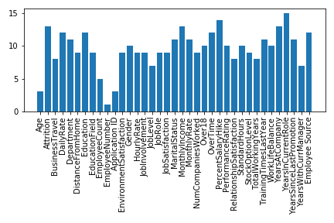
Does the data include missing value or incomplete data or invalid data?
Yes, there are lots of null or missing values in the dataset, like every column contains null values.
There is some invalid data like age. It’s never been a float, it should be an integer, so yes, there is some invalid data in the dataset.

Slide 14
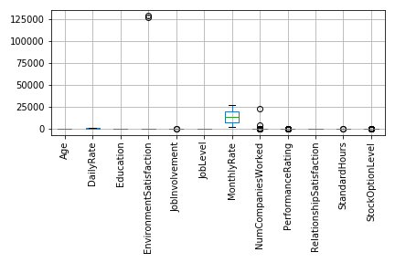
Does the data have outliers?
As you can see in the graph, there are lots of outliers contained within the data. The EnvironmentSatisfaction variable contains some invalid data, indicating that outliers are present in the data.

Slide 15
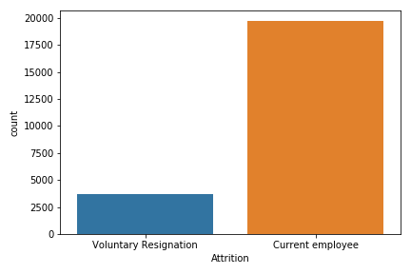
Is the selected data imbalance?
Attrition is the target column of dataset as per graph, it is clearly seen that data is imbalance.

Slide 16
How was the data collected?
We have use Kaggle.com for finding this dataset.
Link for dataset : https://www.kaggle.com/rushikeshghate/capstone-projectibm-employee-attrition-prediction
This dataset is created by IBM data scientists.

Slide 17
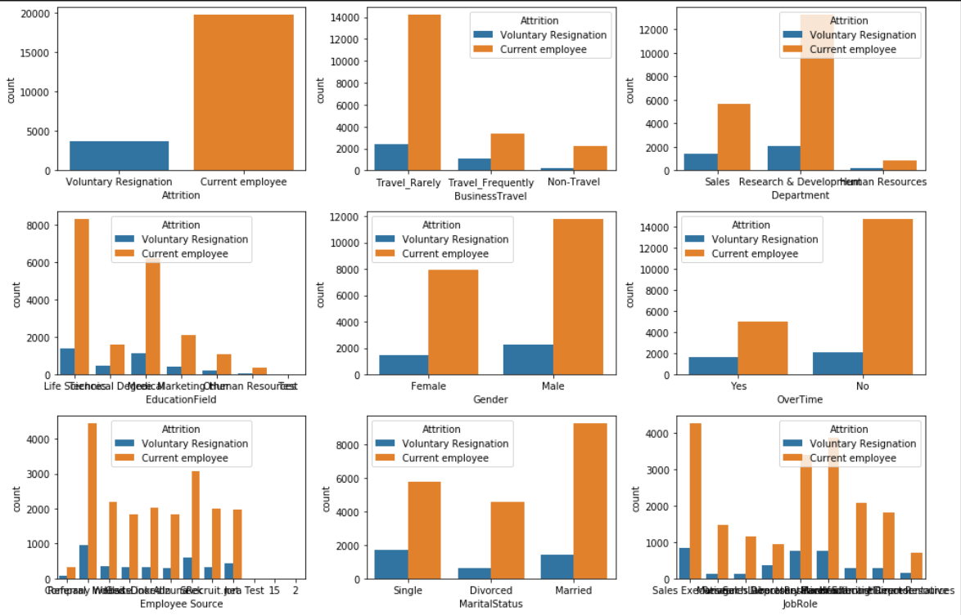
Can you generate preliminary visualization?
Here, a count plot is generated for every categorical data based on attrition type, which can give a glimpse of the data distribution of every data according to attrition type.

Slide 18
DAB 103 Analytic Tools & Decision Making Team 5 - 002 Project – Second Submission

Slide 19
Content of Report
01. Data Cleaning & Transformation
02. Data Analysis
03. Conclusion
04. Recommendations
05. References

Slide 20






Tools and libraries

Slide 21
01. Data Cleaning & Transformation
We have some outliers and missing value which can influence result so we did transformation and cleaning.
We drop some of the dataset.
We find mean or mode of respected column and replaces with missing value
For categorical data, we replace missing value with unknown.
We transform categorical data to numerical data using sklearn library.

Slide 22
02. Analysis Questions

Slide 23
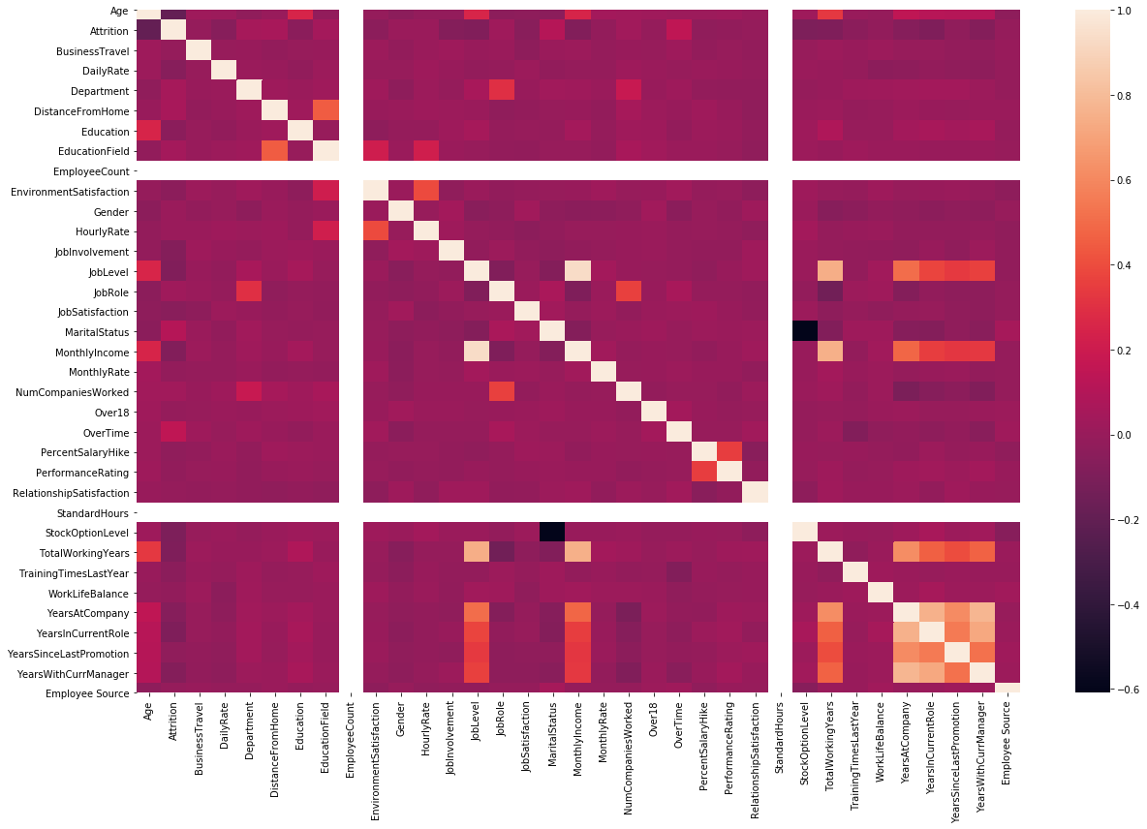
What are the top most characterizes of the employees who take volunteer resignation?

Slide 24
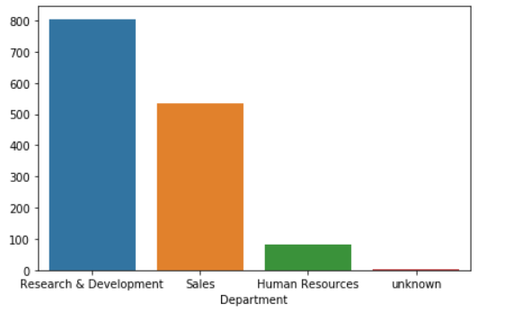
What are the top most departments of the employees who take volunteer resignation?

Slide 25
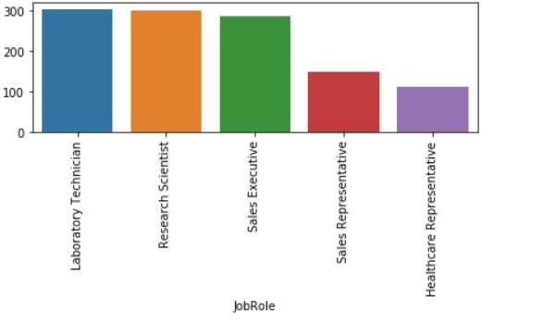
What are the top most job role of the employees who take volunteer resignation?

Slide 26
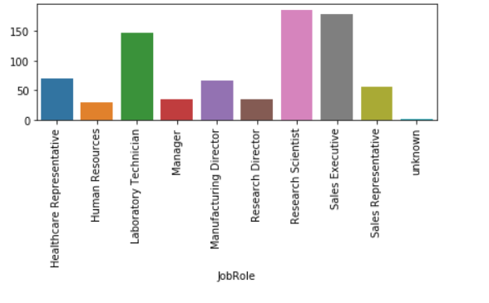
What number of employees were promoted and still take volunteer exit?

Slide 27
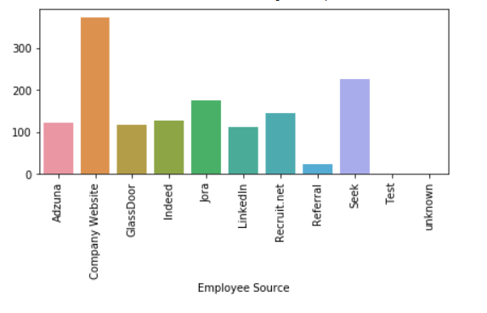
What are the employee source who have taken volunteer exit?

Slide 28
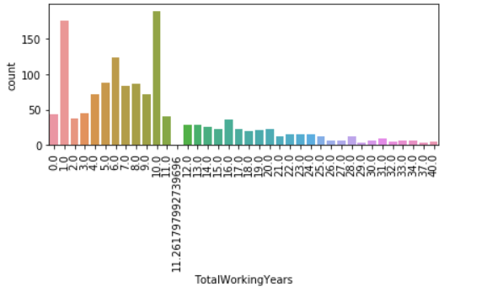
Find how much years employee work at company who have taken volunteer exit?

Slide 29
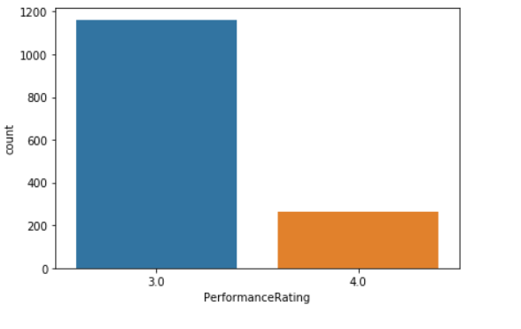
What is the performance rating of rating who got fired?

Slide 30
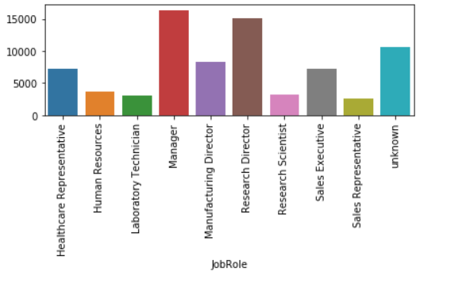
What is the average monthly income of employee who gave voluntary resignations?

Slide 31
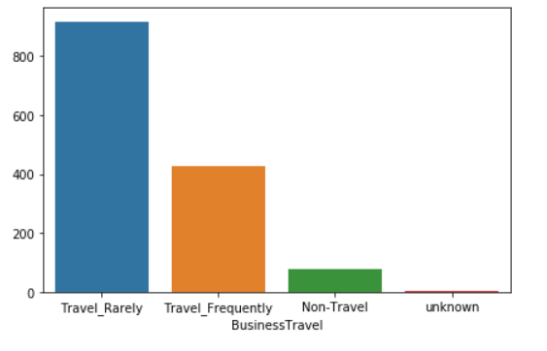
What is the business travel type of employee who gave voluntary resignations?

Slide 32
03.Conclusion
We have gone through different types of analysis, with different parameters. In conclusion, We would say that, the factors that affect most for the self resignation are Daily Rate, Education, Job involvement and level, Monthly Income, Stock option level and Total working experience.
Secondly, most of employee take resignation from Research and Development Department (These employees already got promotions) and whose main job role are Laboratory Technician, Research Scientist and Sales Executive.

Slide 33
04.Recommendations
We would like to recommend that while hiring employee for the any department below factors should be considered.
Daily Rate – Provide satisfactory so that employee can not leave.
Education – Employee education is suitable for the job.
Job involvement and level – How much employee need to involvement in his level of job
Monthly Income – Like daily rate
Total working experience – How much employee have experience for job. Does he/she will have enough experience.
By focusing these we can reduce the employee’s volunteer resignation.

Slide 34
05.References
https://matplotlib.org/stable/tutorials/introductory/pyplot.html
https://pandas.pydata.org/pandas-docs/stable/getting_started/tutorials.html
https://www.tutorialspoint.com/python/index.htm

Slide 35
Thank you !!

