Slide 1
DevOps Final Assessment
End-to-End DevOps Project using Docker, Kubernetes, Helm, Monitoring, Logging, Terraform & CI/CD
Presented By: Zeel Assan Tilwani
GIT
GITHUB
DOCKER
KUBERNETES
HELM
PROMETHEUS
GRAFANA
ELK STACK
TERRAFORM
AWS

Slide 2
Project Overview
Project Objective
Build and deploy a containerized web application using modern DevOps practices.
Key Goals
Containerize Application
Containerize application using Docker
Kubernetes Deploy
Deploy on Kubernetes
Helm Management
Implement Helm package management
Monitoring
Configure Monitoring with Prometheus & Grafana
Centralized Logging
Configure Centralized Logging using ELK Stack
Infrastructure as Code
Implement Infrastructure as Code using Terraform
CI/CD Pipeline
Automate deployment using CI/CD pipeline

Slide 3
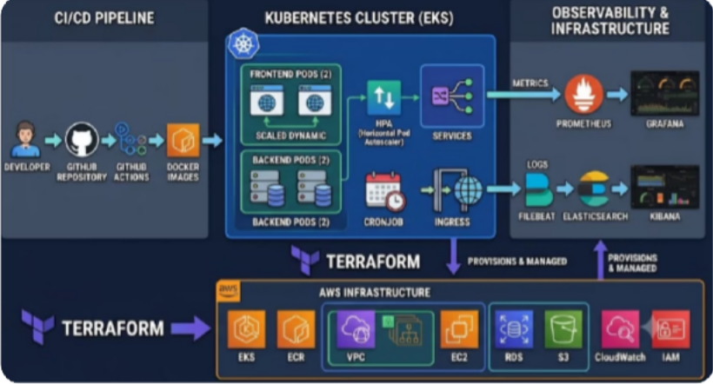
Project Architecture
High Level Architecture
This end-to-end DevOps pipeline flows from source code through containerization, orchestration, deployment, observability, and infrastructure provisioning — creating a fully automated, production-ready environment.
Components:
Frontend Application
Backend API
Kubernetes Services
Monitoring Stack
Logging Stack
Terraform Infrastructure

Slide 4
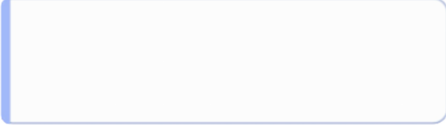

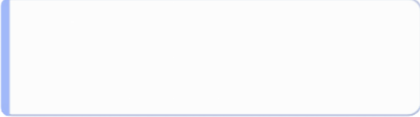
Docker Implementation
Containerization
Backend Container
Node.js API application
Dockerfile created
Image built successfully
Frontend Container
React/Frontend application
Dockerfile created
Image built successfully
Achievements
Reusable Docker Images
Created reusable Docker images
Verified Execution
Verified container execution
Image Management
Docker image management completed

Slide 5
Kubernetes Deployment
Kubernetes Orchestration
Resources Created
Features Implemented
Deployments
Services
ConfigMaps
Secrets
Multiple Pod Replicas
Load Balancing
Health Checks
Resource Requests & Limits
Result: Application successfully deployed and managed through Kubernetes cluster.

Slide 6



Advanced Kubernetes Features
Scalability & Reliability
Horizontal Pod Autoscaler (HPA)
Automatic scaling based on CPU usage
CronJob
Automated API health checks
Ingress Controller
NGINX Ingress installed
Min Replicas: 2
Max Replicas: 5
Scheduled execution every 5 minutes
Traffic routing configuration

Slide 7
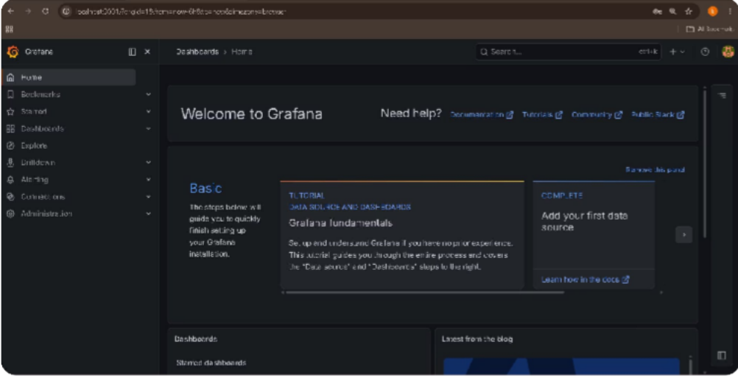
Monitoring with Prometheus & Grafana
Observability Setup
Prometheus
Metrics collection
Kubernetes monitoring
Resource tracking
Grafana
Dashboard visualization
Performance monitoring
Real-time insights
Benefits
Application visibility
Infrastructure monitoring
Performance analysis

Slide 8
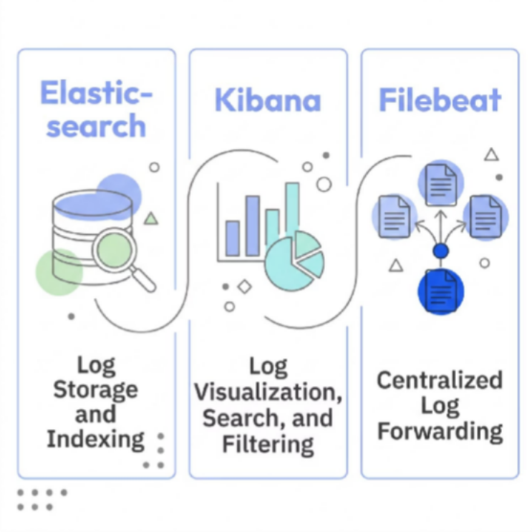
Centralized Logging with ELK Stack
Logging Solution
Elasticsearch
Log storage and indexing
Kibana
Log visualization, search and filtering
Filebeat / Log Collection
Centralized log forwarding
Benefits
•
•
•
Easier troubleshooting Centralized log management Faster issue identification

Slide 9
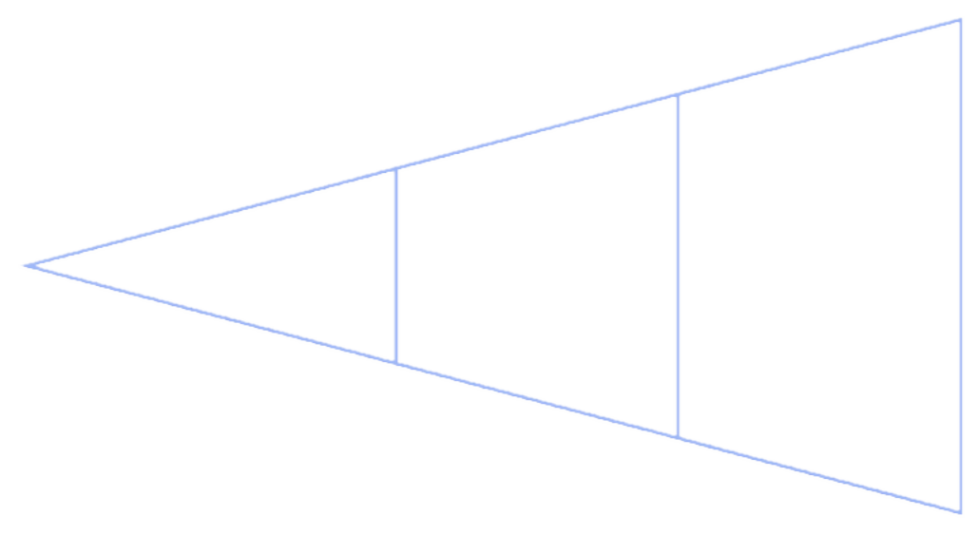
Terraform & CI/CD
Infrastructure Automation
Terraform
CI/CD Pipeline
•
•
•
Infrastructure as Code Modular VPC structure Reusable configurations
•
•
•
•
Source Code Management via GitHub Automated Build Process
Docker Image Creation Deployment Automation
Source Code
Deploy
Build
This pipeline automates the entire delivery workflow from code commit to Kubernetes deployment.
Benefits
Faster Deployments
Consistent Infrastructure
Reduced Manual Effort

Slide 10
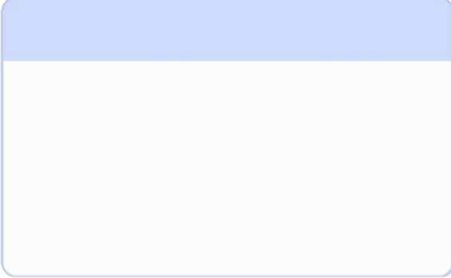


Challenges, Learnings & Conclusion
Challenges Faced
1 2
3
Docker Daemon Connection Issues
Docker daemon connection issues during image build.
Solution: Restarted Docker Desktop and verified Docker Engine status.
Prometheus Image Pull Failures
Prometheus image pull failures due to network interruption.
Solution: Restored internet connectivity and restarted affected pods.
ELK Stack Port Conflicts
Port conflicts while running ELK stack.
Solution: Identified existing containers and resolved port allocation conflicts.
Key Learnings
Conclusion
Successfully implemented an end-to-end DevOps project covering the complete software delivery lifecycle using industry-standard tools and practices.
Docker Containerization
Kubernetes Deployment & Scaling
Helm Package Management
Monitoring & Logging
Terraform Infrastructure Automation
CI/CD Best Practices

