Slide 1
Enhancing Security of Over-the-Air Updates in Connected & Autonomous Vehicles using Blockchain
MSc Thesis Defence by: Zeeman Memon
School of Computer Science, University of Windsor
10 September 2024
Notes:
Good morning everyone. My name is Zeeman, and I would like to thank everyone present for joining my thesis defense presentation on Enhancing Security of Over-the-Air Updates in Connected & Autonomous Vehicles Using Blockchain.

Slide 2
Thesis Committee
Chair: Dr. Prashanth Cheluvasai Ranga (School of Computer Science, University of Windsor)
External Reader: Dr. Balakumar Balasingam (Department of Electrical and Computer Engineering)
Internal Reader: Dr. Dan Wu (School of Computer Science, University of Windsor)
Advisor: Dr. Ikjot Saini (School of Computer Science, University of Windsor)
Notes:
I would especially like to thank the thesis committee members,
Dr. Ranga, Dr. Wu, and my advisor, Dr. Saini.

Slide 3
CONTENTS
Introduction
Background & Literature Review
Methodology
Results and Discussion
Conclusion and Future Work
References
Notes:
I would first like to get started with the contents of my presentation, which is as follow. We first go through the introduction, the background and literature review, the methodology, results and discussion, then the conclusion and future works.

Slide 4
INTRODUCTION
Notes:
Let us begin with introduction

Slide 5
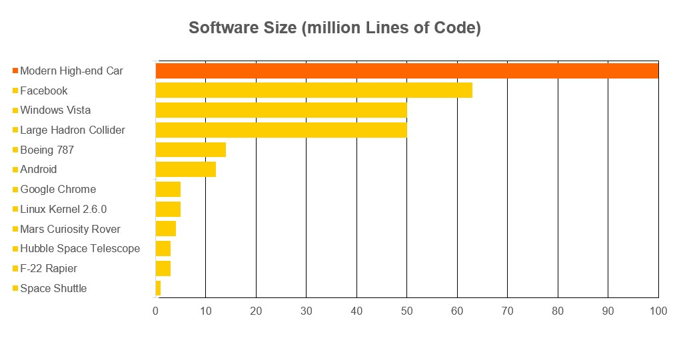
The Modern Day Vehicle
The modern-day vehicle (e.g., Tesla Model S, BMW iX, and Audi e-tron) are equipped with advanced connectivity features and autonomous driving capabilities, relying heavily on embedded Electronic Control Units (ECUs) for functions like engine management, braking, and infotainment.
The functionality of these ECUs is controlled by software running millions of lines of code [1], which includes a real-time operating system, software applications, and firmware.
Fig. 1: Software size of the Modern Day Vehicle [1]
Notes:
To understand my topic better, I would like to first talk about the evolution of vehicles. Vehicles are slowly becoming reliant on software as they become more connected and autonomous They consist of numerous ECUs for various functions. These ECUs are controlled by software. The functionality of these ECUs is controled by software running millions of lines of code, in which most of it is performance based code. The comparison can be seen in the figure.

Slide 6
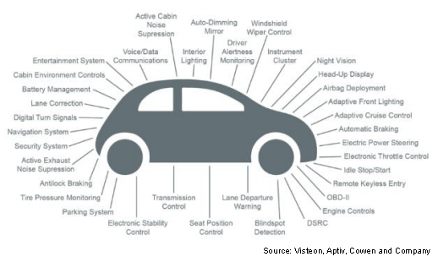
Vehicular Updates
Like smartphones, connected vehicles require frequent software updates which can be typically categorized into two types:
Safety-Critical Updates
Performance Updates
Examples include:
Engine Control Unit (ECU): Improve fuel efficiency, enhance performance, fix engine bugs.
Advanced Driver Assistance System (ADAS): Upgrade collision avoidance, improve lane-keeping accuracy.
Battery Management System (BMS): Optimize charging efficiency, extend battery life.
Camera and Sensor Systems: Enhance object detection, improve night vision, and update calibration.
Fig 2: The various ECUs in a Vehicle [2]
Notes:
Like smartphones, modern connected vehicles require frequent software updates to maintain and improve their functionality. These updates can be categorized into two types: safety-critical updates and performance updates.
Safety-critical updates involve components that are essential for the vehicle's safe operation, such as the Engine Control Unit (ECU), Advanced Driver Assistance Systems (ADAS), and Battery Management Systems (BMS). For example, the ECU updates can improve fuel efficiency, fix engine bugs, or enhance performance. ADAS updates improve collision avoidance and lane-keeping accuracy, while BMS updates optimize charging efficiency and extend battery life.
Performance updates, on the other hand, enhance features like camera and sensor systems, improving object detection, night vision, and overall system calibration.
As shown in the diagram, are the many Electronic Control Units (ECUs), which control various functions like navigation, steering, braking, and even entertainment systems. Most importantly, these ECUs need to stay updated to ensure that the vehicle operates efficiently and safely.

Slide 7
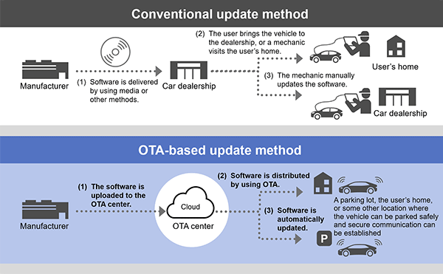
Over-The-Air Updates
Over-the-Air (OTA) updates fill in the gaps that comes with traditional methods of updating vehicles. It is a technology that refer to the process of wirelessly delivering software updates, which is commonly known to be used for smartphone related updates.​
​
This not only saves time, but also adds to the safety, security, and reliability of the car, while lowering the overall maintenance cost for the vehicle. ​
​
Fig. 3: OTA Update Method [3]
Notes:
Over-the-Air updates address the limitations of traditional methods used to update vehicles. Traditionally, software updates would require the vehicle owner to visit a dealership or mechanic, where the update is manually applied. As shown in the top part of Figure 3, this process can be time-consuming and inconvenient as it requires a physical trip to the dealership.
In contrast, OTA updates allow the software to be wirelessly delivered to vehicles, as illustrated in the bottom part of the diagram. The manufacturer uploads the software to the server, which is then distributed to the targeted fleets of vehicle via a secure network. The vehicle then receives the update while it is connected to the network infrastructure, however, updates usually are applied when the vehicle is parked.
Hence, OTA updates saves significant time and effort for both the manufacturer and the vehicle owner. More importantly, it enhances the safety, security, and reliability of the vehicle by ensuring that critical updates are delivered and installed promptly. Additionally, OTA updates also lowers the overall maintenance costs, as they eliminate the need for in-person dealership visits for routine software upgrades.

Slide 8
Motivation
While over-the-air (OTA) updates offer significant benefits such as convenience, cost reduction, and the ability to swiftly address reported vulnerabilities, they also introduce critical cybersecurity concerns, such as man-in-the-middle attacks, replay attacks, and rogue updates.
These issues can have severe implications for both consumers and original equipment manufacturers (OEMs), particularly when the updates target safety-critical systems.
Additionally, ensuring cybersecurity requirements such as integrity and authenticity of these updates is essential for maintaining the functionality of the vehicle, safety of the passenger, as well as for complying with cybersecurity standards and regulations set for OTA solution providers, such as ISO/SAE 21434 [4] and UNECE R155/R156 [5].
Notes:
Although Over-the-Air (OTA) updates provide significant advantages—such as convenience, reduced costs, and the ability to quickly address vulnerabilities—they also present serious cybersecurity risks. Some of the most concerning threats include man-in-the-middle attacks, replay attacks, and rogue updates, where malicious actors can potentially alter or intercept the updates.
These cybersecurity issues pose serious risks for both consumers and original equipment manufacturers (OEMs), particularly when safety-critical systems are involved. A compromised update targeting these systems could negatively impact the safety of the vehicle and its passengers.
Therefore, ensuring that OTA updates meet cybersecurity requirement, such as integrity and authenticity is crucial. Following these requirements also helps in complying with compliances and standards set for the OTA solution providers, such as the ISO/SAE 21434 and UNECE R155/R156.

Slide 9
Background & Literature Review

Slide 10
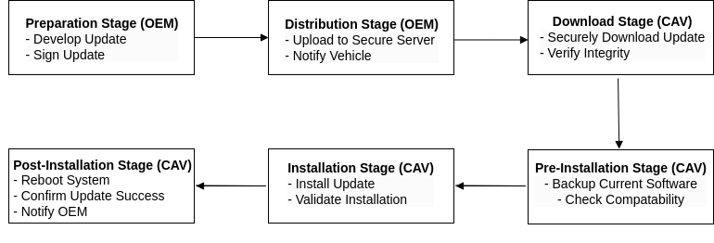
The OTA Update Lifecycle
Fig. 4: The OTA Update Lifecycle
Notes:
Before we proceed further, it is important to understand the OTA update lifecycle. It involves several stages, starting from preparation and ending with post-installation. This lifecycle ensures that updates are securely developed, distributed, installed, and verified.

Slide 11
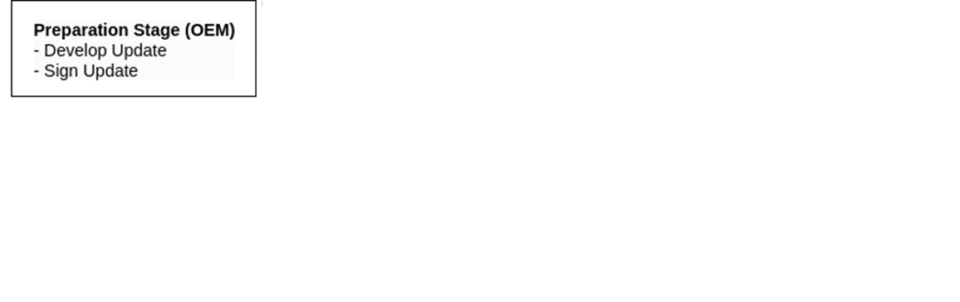
OTA Update Lifecycle
Notes:
In the preparation stage, the Original Equipment Manufacturer (OEM) is responsible for developing the software update. Once the update is ready, the OEM signs it with a cryptographic signature to ensure that the update is authentic and hasn’t been tampered with. Basically, tThis digital signature serves as a guarantee that the update originates from the trusted OEM and will be used later in the process to verify its integrity.

Slide 12
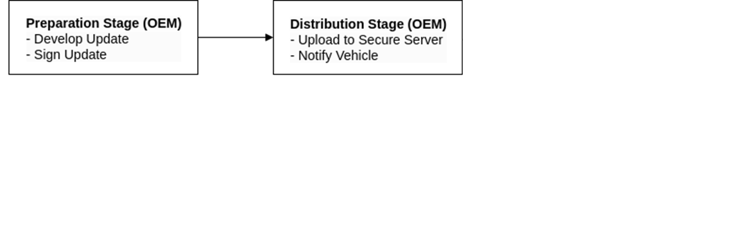
OTA Update Lifecycle
Notes:
Next is the distribution stage, where the OEM uploads the signed update to a secure server. This server acts as the central repository from which the vehicles can download the update. After the update is securely stored on the server, the OEM notifies the vehicle that a new update is available and ready for download.

Slide 13
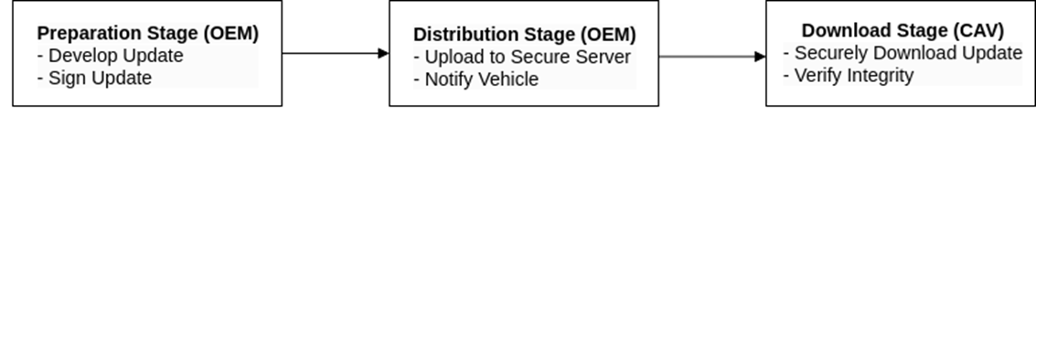
OTA Update Lifecycle
Notes:
Once the vehicle is notified, it enters the download stage. The vehicle securely downloads the update from the server. During this process, the vehicle will verify the integrity of the update by checking the OEM’s digital signature, ensuring that the update has not been altered during transmission.

Slide 14
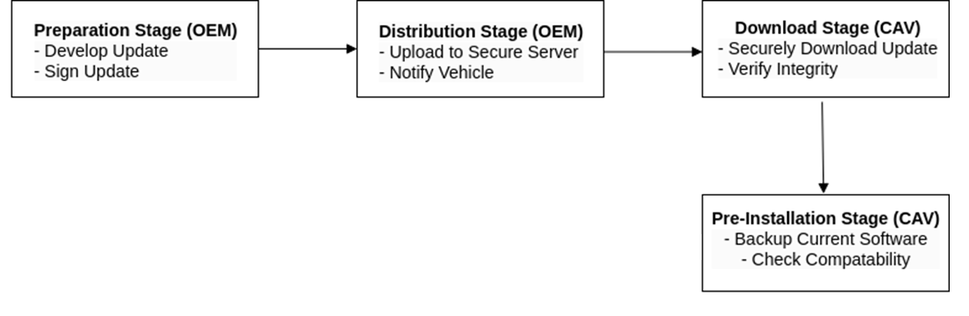
OTA Update Lifecycle
Notes:
Before the update is installed, the vehicle moves to the pre-installation stage. Here, it performs a backup of the current software to ensure that it can revert to the previous version if something goes wrong. The vehicle also checks the compatibility of the update with its existing systems, ensuring the new update won’t cause conflicts.

Slide 15
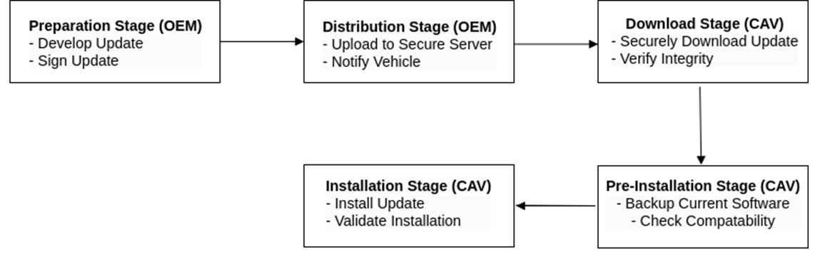
OTA Update Lifecycle
Notes:
Once the checks are complete, the vehicle moves into the installation stage. At this point, the update is installed on the vehicle’s systems. During this stage, the vehicle also validates the installation to ensure that the update has been applied correctly and is functioning as expected.

Slide 16
OTA Update Lifecycle
Notes:
Finally, in the post-installation stage, the vehicle reboots its system to apply the changes. After rebooting, the vehicle confirms that the update was successful and notifies the OEM. This notification allows the OEM to verify that the update process was completed without any issues.

Slide 17
OTA Update Cybersecurity
The security of OTA updates is important due to the critical risks associated with tampered updates that can affect an entire fleet of vehicles at once. Example cybersecurity attacks [6] include:
Man-in-the-middle attacks
Rogue updates
Replay attacks
Denial-of-Service attacks
Weak Access Controls
Social Engineering
Notes:
The security of OTA updates is critical because tampered updates can pose severe risks, not only to individual vehicles but potentially to an entire fleet that was targeted by the OEM. If vulnerabilities are exploited, they could result in negative consequences, such as vehicle malfunctions, compromised safety systems, or data breaches.
Some of the most common cybersecurity threats related to OTA updates include:
Man-in-the-middle attacks: In this type of attack, a malicious actor intercepts the communication between the vehicle and the server, potentially altering the update.
Rogue updates: Unauthorized updates that can be installed in the vehicle, leading to tampered or malicious software being run.
Replay attacks: In these attacks, an attacker captures legitimate update data and retransmits it later to cause disruption or trigger an undesired outcome.
Denial-of-Service (DoS) attacks: These attacks prevent legitimate update communications by overwhelming the network, delaying or blocking crucial updates from being applied.
Weak access controls: If there are insufficient security measures in place, attackers could gain unauthorized access to the vehicle's systems.
Social engineering: This method exploits the human element by tricking vehicle owners or OEM staff into performing actions that compromise the update process, such as connecting to malicious networks.
Given these risks, securing OTA updates is essential for maintaining the integrity and safety of vehicles on the road.

Slide 18
Notable Automotive Cyber Attacks
1) Researchers demonstrated a MitM attack on a Tesla Model S, intercepting and manipulating the software update communications. [7]
2) In 2015, Chrysler recalled 1.4 million vehicles after researchers discovered they could send rogue updates to the vehicle's infotainment system via a cellular network. [8]
3) In 2019, researchers demonstrated that the Nissan Leaf's telematics app allowed users to control vehicle functions with just the Vehicle Identification Number (VIN). Attackers could use social engineering techniques to obtain the VIN from unsuspecting vehicle owners or through public records, allowing them to initiate unauthorized OTA updates. [9]
Notes:
Now, let’s take a look at some real-world examples of notable automotive cyber attacks that happened in the automotive industry:
Man-in-the-middle attack on Tesla Model S: Researchers successfully demonstrated a MitM attack on a Tesla Model S. They intercepted and manipulated the vehicle’s software update communications, proving that OTA updates can be vulnerable to interception unless secured with strong cryptographic measures. This demonstration emphasizes the need for robust security in vehicle communication channels.
Chrysler rogue update attack in 2015: In 2015, Chrysler had to recall 1.4 million vehicles after researchers found that they could send rogue updates to the vehicle’s infotainment system via a cellular network. This vulnerability allowed attackers to take control of vehicle systems remotely, leading to one of the most significant automotive cybersecurity recalls in history. This incident underscores the dangers of weak OTA update security.
Nissan Leaf vulnerability in 2019: Researchers showed that the Nissan Leaf’s telematics app had a critical flaw, allowing attackers to control vehicle functions using just the Vehicle Identification Number (VIN). Attackers exploited social engineering techniques to obtain the VIN from vehicle owners or public records, which they then used to initiate unauthorized OTA updates. This example demonstrates how social engineering can bypass technical security measures.

Slide 19


Automotive Cybersecurity Standards and Regulation
Compliance with established cybersecurity standards and regulations is critical to achieving OTA update security requirements, such as confidentiality, integrity, authentication, access control, and audability,
Usually, for the OTA solution provider or the OEM to be in business, they need to comply with certain standards and regulations, which can vary geographically.
Two major standards: UNECE R155/R156 [5] and ISO/SAE 21434 [4].
Notes:
Ensuring the security of OTA updates requires strict compliance with established cybersecurity standards and regulations. These standards help to guarantee the security requirements that are crucial for OTA updates, such as integrity, authentication, and auditability.
For any OTA solution provider or OEM to remain in business and offer secure services, they need to comply with specific standards and regulations set in the region they are serving. Hence, these regulations can vary by region.
Two of the major standards that apply here are:
UNECE R155/R156: These are the United Nations Economic Commission for Europe’s regulations on vehicle cybersecurity and software updates. They focus on ensuring that manufacturers implement cybersecurity management systems and provide secure updates throughout a vehicle’s lifecycle.
ISO/SAE 21434: This standard provides guidelines for managing cybersecurity risks throughout a vehicle's development process. It ensures that cybersecurity considerations are integrated into vehicle systems from the design phase through to decommissioning.
Complying with these standards is not only essential for ensuring the security and safety of vehicles but is also a legal requirement for automakers and suppliers in the target region.

Slide 20
S.No. | Title & Author | Approach Used | Strengths | Weaknesses
1. | "A Multi-Factor Authenticated Blockchain-Based OTA Update Framework for Connected Autonomous Vehicles" by Sadia Yeasmin and Anwar Haque (2021) [10] "A Novel and Failsafe Blockchain Framework for Secure OTA Updates in Connected Autonomous Vehicles" by Sadia Yeasmin, Anwar Haque, and Amir Sayegh (2022) [11] | Blockchain-based Framework with multi-factor authentication for real-time OTA updates | - Provides increased security against OTA-related cyber threats due to multi-factor authentication mechanisms including salting-based hashing and ECC. - Low latency achieved through optimized network protocols. - No single point of failure, due to decentralized architecture. | - Requires comprehensive validation in real-world environments to better evaluate the framework. - Reliability and scalability can be further improved by addressing multiple node failures and diverse cyberattacks (e.g., DDoS, Sybil, brute force).
2. | "DDoS Attack Prevention in Autonomous Vehicle's OTA Updates: Combining PBFT Consensus and Distributed Firewall in Hyperledger Fabric Blockchain" by Sadia Yeasmin and Anwar Haque (2024) [12] | DDoS Attack Prevention using PBFT Consensus and Distributed Firewall using Hyperledger Fabric | - Designed to maintain service even when malicious nodes are present, ensuring continuation of system operations with minimum impact. - Maintains low transaction times, averaging around 20 milliseconds. | - May be challenging to set up and maintain in a production environment.
Notes:
Let’s now review some of the existing studies related to securing OTA updates using Blockchain.
A Multi-Factor Authenticated Blockchain-Based OTA Update Framework for Connected Autonomous Vehicles by Sadia Yeasmin and Anwar Haque (2021):
This paper proposes a Blockchain-based framework with multi-factor authentication to secure OTA updates in real-time. The strengths of this approach include increased security against various cyber threats, using mechanisms like salting-based hashing and Elliptic Curve Cryptography (ECC). Moreover, it achieves low latency through optimized network protocols and avoids a single point of failure due to its decentralized architecture. However, one of the key weaknesses is that it rhas not been evaluated against a wider range of cyberattacks such as DDoS, Sybil, and brute force attacks.
Based on the same work mentioned, the same researchers than published another paper which addresses DDos Attacks, titled 'DDoS Attack Prevention in Autonomous Vehicle's OTA Updates: Combining PBFT Consensus and Distributed Firewall by Sadia Yeasmin and Anwar Haque (2024)':
This study focuses on preventing Distributed Denial of Service (DDoS) attacks in OTA updates by combining Practical Byzantine Fault Tolerance (PBFT) Consensus and a Distributed Firewall using Hyperledger Fabric. One of its key strengths is the ability to maintain service continuity even when malicious nodes are present, ensuring that system operations remain unaffected even during attacks. Furthermore, the approach achieves low transaction times, averaging around 20 milliseconds. On the downside, the methodology may be challenging to set up and maintain in a production environment.

Slide 21
S.No. | Title & Author | Approach Used | Strengths | Weaknesses
3. | "BlockChain: A Distributed Solution to Automotive Security and Privacy" by Ali Dorri, Marco Steger, Salil S. Kanhere, and Raja Jurdak (2017) [13] | Blockchain-based architecture lever- aging Lightweight Scalable Blockchain (LSB) for IoT and large-scale net- works | - Enhanced privacy and security through decentralization of control and using cryptographic methods. - Reduced computational overhead and improved scalability due to the use of LSB, which uses a lightweight consensus algorithm that reduces computational overhead, making it suitable for IoT devices with limited resources. - Versatile application in various automotive domains including insurance and car sharing. | Real-world implementation and validation are needed to fully evaluate the system’s effectiveness and reliability. - Although Overlay Block Managers (OBMs) aid in scalability, they may introduce complexity in managing the network.
4. | "Secure Wireless Automotive Software Updates Using Blockchains: A Proof of Concept" by Marco Steger, Ali Dorri, Salil S. Kanhere, Kay Römer, Raja Jurdak, and Michael Karner (2018) [14] | Secure Wireless Automotive Soft- ware Updates Using Blockchain | - Provides a comprehensive security architecture - Proof-of-concept implementation demonstrates practical applicability. - Ensures secure and tamper-proof data exchange. | - Real-world validation needed to fully evaluate the Proof of Concept
Notes:
Now, let’s move on to two more key studies:
BlockChain: A Distributed Solution to Automotive Security and Privacy by Ali Dorri, Marco Steger, Salil S. Kanhere, and Raja Jurdak (2017):
This study presents a Blockchain-based architecture leveraging Lightweight Scalable Blockchain (LSB) for IoT and large-scale networks, hence, facilitating versatile applications in various automotive domains including OTA updates. The strengths of this approach include enhanced privacy and security through decentralization of control and the use of cryptography. LSB reduces computational overhead, making it more scalable, especially for IoT devices with limited resources. However, while Overlay Block Managers aid in scalability, they may introduce complexity in managing the network.
Secure Wireless Automotive Software Updates Using Blockchains: A Proof of Concept by Marco Steger, Ali Dorri, Salil S. Kanhere, Kay Römer, Raja Jurdak, and Michael Karner (2018):
This paper provides a proof-of-concept implementation demonstrates practical applicability, while ensuring secure and tamper-proof data exchange.

Slide 22
S.No. | Title & Author | Approach Used | Strengths | Weaknesses
5. | "Collaborative DDoS Attack Defense for OTA Updates in CAVs using Hyperledger Fabric Blockchain" by Sadia Yeasmin and Anwar Haque (2023) [15] | Collaborative DDoS Attack De- fense (CDAD) architecture using Hyperledger Fabric | - High resilience to DDoS attacks through collaborative defense mechanisms through the monitoring for attack anomalies - Low latency maintained even un- der heavy attack scenarios, while maximizing throughput. - Efficient resource optimization and load management | - Scalability challenges may occur as network size and complexity in- crease. - High resource requirements may be required in a production environment for implementing and maintaining the proposed defense architecture.
6. | Proposed Method | Permissioned Blockchain (Hyperledger Fabric) based approach, utilizing smart contract for automation and secondary point of trust for enhanced security of the OTA update package | It is a lightweight approach for verification and authentication of OTA updates, with a low computational power requirement to account for resource-constrained vehicular environments, reducing data load, and improving transaction processing times. Utilizes secondary point of trust, further enhancing the security Easily integrable with existing OTA update Infrastructure, and automation due to use of smart contract reducing manual intervention | Assumes that the CAVs have sufficient and reliable network connectivity and computational power for the downloading, and querying operations. Relies on consistent and collision-resistant update hash generation, which could introduce vulnerabilities if not properly implemented.
Notes:
Finally, the Collaborative DDoS Attack Defense (CDAD) architecture using Hyperledger Fabric paper involves a collaborative approach against mitigation of DDoS attacks. The system maintains low latency even during heavy attack scenarios, with optimized resource usage and load management. However, as the network grows in size and complexity, scalability challenges may arise. Additionally, the high resource requirements for implementing and maintaining the architecture could pose issues in production environments.
Finally, my method fits in the literature by enhancing the existing OTA update infrastructure, with smart contracts for automation of interacting with the Blockchain network.
The proposed approach is lightweight, with low computational requirements, making it suitable for resource-constrained environments. Additionally, the method reduces data load and improves transaction processing times by utilizing a secondary point of trust, ensuring better security. It is also easily integrable with existing OTA update infrastructures, and comes with minimal overhead for enhanced security.

Slide 23
Problem Statement
To secure automotive over-the-air updates against threats that compromise the authentication and integrity which have potential to negatively impact vehicle safety, performance, and compliance with mandated cybersecurity regulations and standards.
Research Objective
Using permissioned blockchain technology, to address security challenges related to the authentication and integrity of OTA updates for CAVs, in a lightweight and decentralized manner.
The findings of this research are expected to aid in the development of robust and secure OTA update infrastructure.
Notes:
Problem Statement: The primary problem we are addressing is the need to secure automotive over-the-air (OTA) updates. OTA updates are vulnerable to various threat mentioned earlier, such as tampering / unauthorized modifications, which can compromise the authentication and integrity of the update. These threats pose significant risks to vehicle safety, performance, and compliance with mandated cybersecurity regulations and standards. Therefore, ensuring the security of these updates is very important.
Research Objective: The objective of this research is to use permissioned Blockchain technology to overcome the security challenges related to OTA updates, specifically focusing on the authentication and integrity of the updates. The aim is to develop a lightweight, decentralized method that can be seamlessly integrated into existing vehicle infrastructures. Ultimately, the findings of this research are expected to contribute towards the development of a more robust and secure OTA update infrastructure for CAVs.

Slide 24
METHODOLOGY

Slide 25
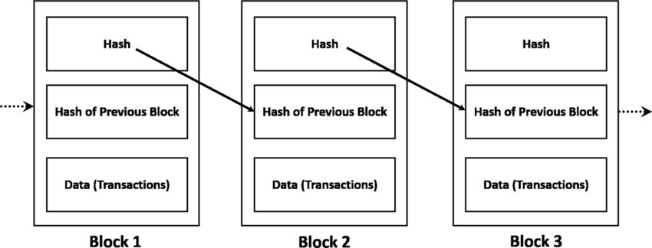
Blockchain Technology
Blockchain [16] is a decentralized ledger technology that records transactions in a secure, immutable chain of blocks. As the combination of words describes, Block-Chain, the blocks are linked together by each block containing a cryptographic hash (generated via hashing algorithms, such as SHA-256) of the previous block. Transactions are validated through consensus mechanisms like Proof of Work or Proof of Stake (public blockchains) or Solo, Kafka, and Raft (private blockchains).
Fig. 5: Diagram of Blockchain Technology [17]
Notes:
Before we go into the proposed methodology, it’s important to understand what Blockchain technology is.
Blockchain is a decentralized ledger technology that securely records transactions in an immutable chain of blocks. As the term 'Block-Chain' suggests, each block is linked to the previous one, forming a secure chain. Each block contains a cryptographic hash of the previous block, the data or transactions, and its own hash, which is generated using hashing algorithms like SHA-256.
If any block in the chain is altered, the hash of that block would change, breaking the chain and indicating tampering. This mechanism ensures the integrity of the Blockchain.
The first block in a Blockchain is called the genesis block. Blockchain’s security is reinforced by consensus mechanisms such as Proof of Work or Proof of Stake in public blockchains, or Raft and Kafka in private blockchains like Hyperledger Fabric, which (Raft) is used in my proposed solution.
In this way, Blockchain provides a secure, distributed way of storing and verifying data, which is highly applicable to ensuring the authenticity and integrity of OTA updates in CAVs

Slide 26
Blockchain Types
Blockchain technology can be categorized into public and private blockchains, each with distinct characteristics and use cases.
Table 1: Blockchain Types Comparison
Feature | Public Blockchain | Private Blockchain
Network Access | Open Network: Accessible to anyone. | Restricted Access: Limited to authorized participants.
Decentralization | Decentralized: No central authority. | Controlled by Organizations: Central entity or consortium.
Examples | Bitcoin, Ethereum | Hyperledger Fabric, Quorum
Use Case | Applications needing high transparency (e.g., cryptocurrency). | Enterprise applications needing privacy and control (e.g., OTA updates).
Advantages | High decentralization, broad participation. | Enhanced security, better performance, regulatory compliance.
Notes:
Main difference is public and private. Public use cases: finance (crypto), private uses: enterprise applications, e.g., OTA updates.

Slide 27
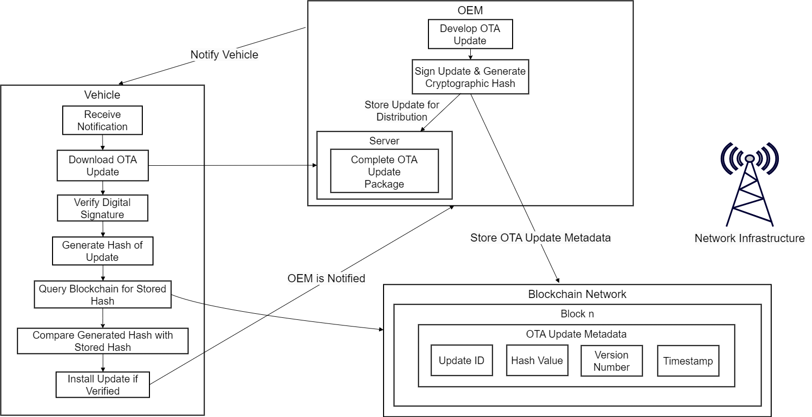
Proposed Architecture
Fig. 6: Proposed Architectue Diagram
Notes:
Workflow:
The OEM develops the OTA update and generates a cryptographic hash.
The update is signed to ensure authenticity.
The update package is stored on a central server.
Metadata such as the update ID, hash value, version number, and timestamp is stored on the Blockchain for verification purposes.
The vehicle is notified that a new OTA update is available.
The vehicle downloads the OTA update package from the server.
The vehicle verifies the digital signature to ensure the update’s authenticity.
The vehicle generates a hash of the downloaded update to compare with the one stored on the Blockchain.
The vehicle queries the Blockchain for the hash of the respective update.
The vehicle compares the generated hash with the stored Blockchain hash to ensure the update hasn't been tampered with.
If the hash matches, the update is verified and installed on the vehicle. If not, the update is not installed.
Once the update is installed, the vehicle sends a notification back to the OEM confirming successful installation.
Assumptions:
The CAVs have reliable network connectivity and sufficient computational power for downloading updates and querying the Blockchain.
The primary server and Blockchain network managed by the OEM are secure from unauthorized access and tampering.
The hash function used (e.g., SHA-256) is consistent and collision-resistant, ensuring unique and verifiable hashes.

Slide 28
Simulation Setup
Hyperledger Fabric (v2.5.9): We use this permissioned Blockchain network to store and manage the hashes of the OTA updates, with the help of smart contracts [18].
Smartcontract (chaincode): We have also developed a chaincode (smart contract) that automates storing and querying the OTA update metadata to the Blockchain server.
Veins Framework: OMNeT++ and SUMO}: The CAVs and the OTA update process is simulated using the open-source software OMNeT++ network simulation library and framework [20] integrated with the Veins framework [21] and SUMO (Simulation of Urban Mobility) [22].
Furthermore, the Blockchain network is exposed via REST API to allow interaction with OMNeT++.
Notes:
Hyperledger Fabric (v2.5.9): We use this permissioned Blockchain network to store and manage the hashes of the OTA updates, with the help of smart contracts. Moreover, to maintain the order of the blocks in the Blockchain and ensure all ledgers within the chain are updated, we are using the default consensus mechanism, Raft, which is the recommended ordering service by Hyperledger Fabric and is also production-ready.
Smartcontract (chaincode): We have also developed a chaincode (smart contract) that automates storing and querying the OTA update metadata to the Blockchain server.
Veins Framework: OMNeT++ and SUMO}: The CAVs and the OTA update process is simulated using the open-source software OMNeT++ network simulation library and framework integrated with the Veins framework and SUMO (Simulation of Urban Mobility).
Furthermore, the Blockchain network is exposed via REST API to allow interaction with OMNeT++. This setup allows us to simulate the OTA update download and query process while recording the communication between the vehicle and the OEM server through the various network infrastructures (i.e., RSU, WiFi, and Cellular).

Slide 29
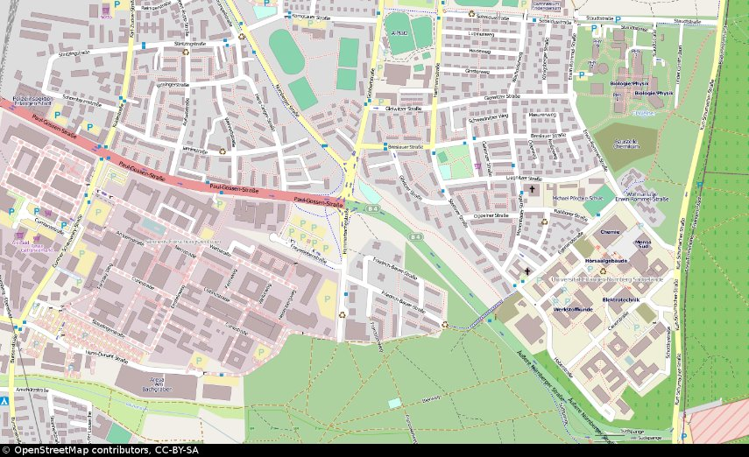
Simulation Setup
Fig. 7: Map of Simulation Scenario
Notes:
The simulation setup involved simulating 50 CAVs in transit in the map of simulation scenario illustrated in the map (fig. 7). After being notified about the update by the OEM, the vehicles interact with the OEM download server through the various network infrastructures described in Table 4. to download the OTA update package, calculate the hash of the downloaded update using hash function SHA-256, and then compare the retrieved hash of the respective update from the Blockchain network for comparison.

Slide 30
Experimental Setup & Simulation Parameters
Table 2: Experimental Setup
Experimental Setup
CPU | 12th Gen Intel(R) Core(TM) i5-12500H CPU
CPU-Cache | L1d: 480 KiB, L1i: 320 KiB, L2: 12.5 MiB, L3: 180 MiB
RAM | 9.6 GiB
Table 3: Simulation Parameters
Simulation Parameters
Simulation Time | 150s
No. of CAVs | 50
Ground area | 2500 m x 2500 m
Measured Parameters | CAV position, Distance from access point (RSU, WiFi, Cellular Tower), Bandwidth, Latency, Packet loss, Jitter, Download latency, Hash calculation time, Query latency, Hash comparison latency, Update status
Notes:
Here is the hardware setup for the virtual machine used, along with the simulation parameters for the vehicle simulation tool used.

Slide 31
Network Scenarios
Table 4: Details of Various Networks Under Observation
Network Type | Bandwidth (Mbps) | Latency (ms) | Packet Loss (%) | Jitter (ms)
RSU (Near) | 80 | 5 | 0.1 | 5
RSU (Far) | 15 | 40 | 5 | 2
Wi-Fi | 70 | 10 | 0.1 | 5
4G (LTE) | 100 | 30 | 0.5 | 5
Low-band 5G | 100 | 10 | 0.2 | 3
Notes:
Here is a list of the network scenarios defined for the simulations, namely RSU near, RSU far, WiFi, 4G LTE, and Low-band 5G.

Slide 32
Results and Discussion

Slide 33
Evaluation Metrics
The effectiveness of our proposed method was evaluated using the following metrics:
Network Latency
Computational Usage
Security Robustness
Notes:
The effectiveness of our proposed method was evaluated using the following metrics:
Network Latency: The total time taken from initiating the download process of the OTA update package and completing the download and verification process.
Computational Usage: The total computational processing time required to generate a hash for the downloaded OTA update and compare it against the hash retrieved from the Blockchain.
Security Robustness: To test our method's security robustness, we simulated a Man-in-the-Middle (MitM) attack by making the CAVs randomly download the tampered version of the update.

Slide 34
Results and Discussion
We evaluated our proposed method across five different network scenarios as described in Table 4. The averages obtained for each network scenario are further detailed in Table 5.
Table 5: Latency and Hash Calculation Time for Different Network Types
Network Type | Download Latency (s) | Hash Calculation Time (s) | Query Latency (s) | Hash Comparison Time (ms)
RSU (Near) | 6.0624 | 0.1343 | 0.0255 | 0.0004
RSU (Far) | 15.1702 | 0.1165 | 0.0556 | 0.0003
Wi-Fi | 3.4258 | 0.1383 | 0.0406 | 0.0004
4G (LTE) | 3.2861 | 0.2846 | 0.0176 | 0.0004
Low-band 5G | 16.4855 | 0.1398 | 0.0498 | 0.0003
Notes:
Here are the results which are the averages obtained from simulating 50 CAVs downloading an OTA update package of 40 MB consisting of a binary file and a metadata file are mentioned for each network scenario in Table.
We further go into the results one by one.

Slide 35
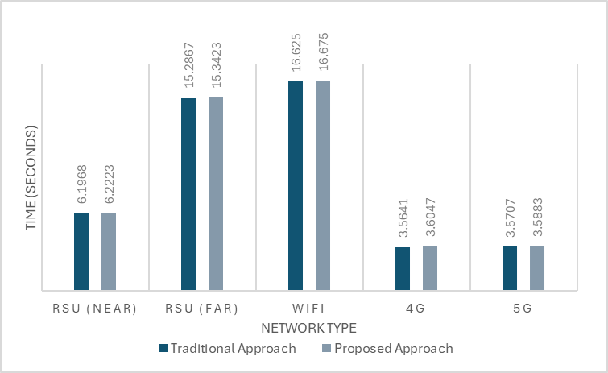
Fig. 8: Latency Comparison of Traditional and Proposed secure OTA Update approaches
Notes:
Here we have compared the performance of the traditional and proposed approach in the various network scenarios. Figure 9 shows the network overhead introduced by the Blockchain query process when comparing the traditional and proposed update approaches. The results indicate that the Blockchain query latency remains relatively low across all scenarios, with the 5G network demonstrating the best performance at around 0.018s. RSU (Near) and 4G networks also exhibit low latency, making them suitable for real-time operations.
However, the RSU (Far) and WiFi scenarios show slightly higher latency of around 0.055s and 0.05s, respectively, which can be attributed to distance from the infrastructure unit and potential network variability.

Slide 36
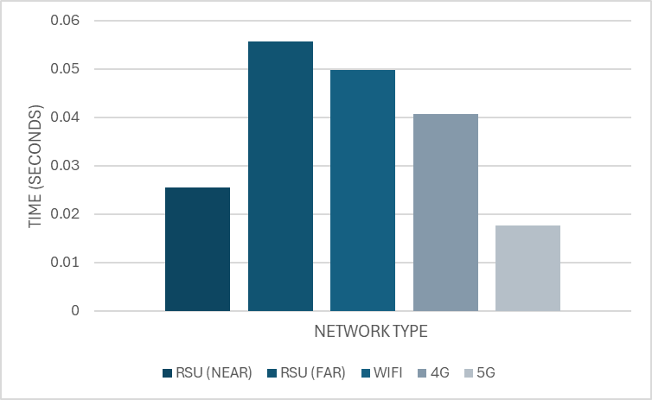
Fig. 9: Comparison of Query Latency indicating the difference between the traditional and
proposed approaches as shown in Fig. 8.
Notes:
This is the exact difference, as seen in the previous figure (figure 9).

Slide 37
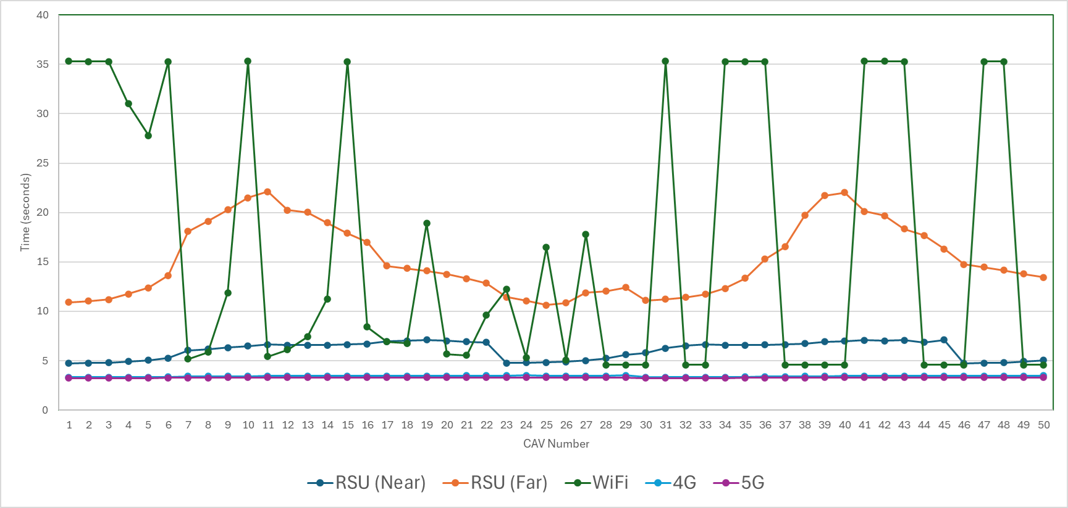
Fig. 10: Download Latency
Notes:
Here talk about the download latency, over the 50 CAVs. The trends observed as per each network scenario.
For the RSU scenario, we can see that the download latency remains consistently low across all CAVs, averaging around 6s, indicating stable performance when the vehicle is in close proximity to the RSU. However, as the distance from the RSU increases in the RSU (Far) scenario, the download latency makes a rise, with some CAVs experiencing latency peaks over 35s. The data shows significant variability in this scenario, likely due to weaker signal strength and increased distance.
The 4G network demonstrates a stable and low download latency, consistently below 4s for all CAVs, reflecting the reliability of 4G for data transmission in mobile environments. Similarly, the 5G network exhibits very low download latency, with values consistently around 3s, and shows the most stable performance with minimal variation across different CAVs. In contrast, the WiFi network scenario shows the highest variability and the longest download latency, with several CAVs experiencing latencies exceeding 30s. This suggests that WiFi may not provide the consistent performance needed for real-time OTA updates in every situation.

Slide 38
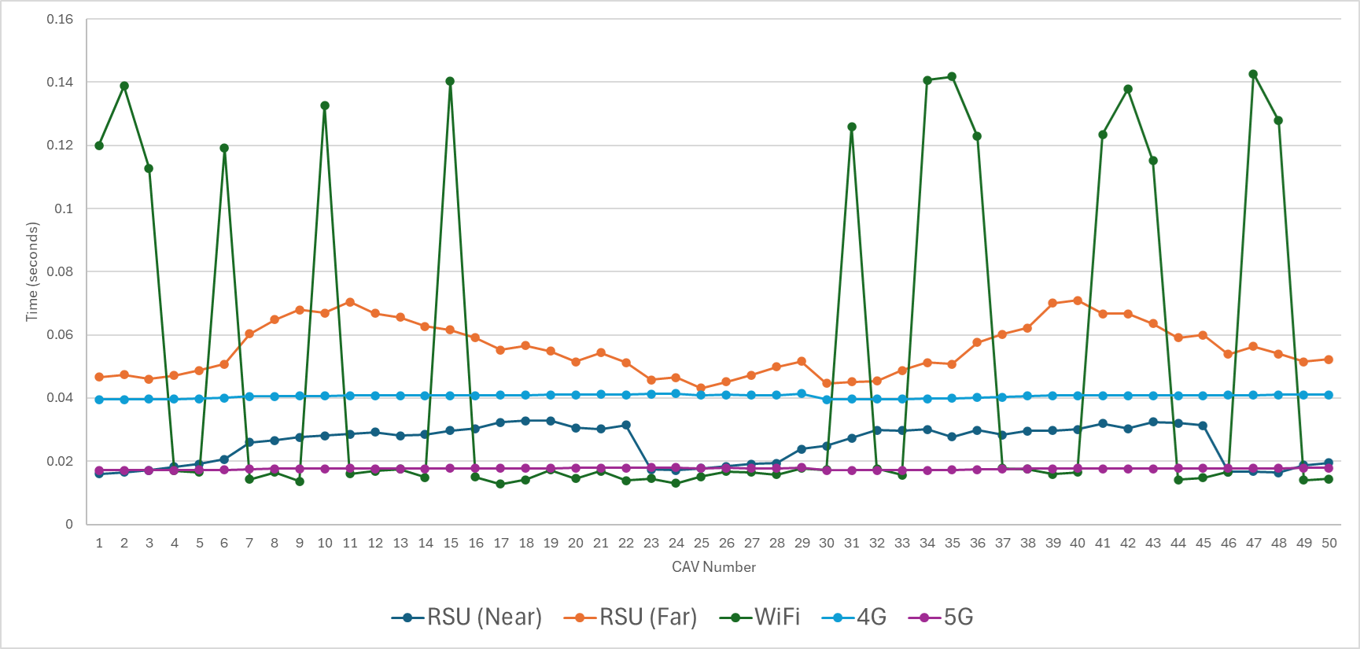
Fig. 11: Blockchain Query Latency
Notes:
Here talk about the query latency, over the 50 CAVs. The trends observed as per each network scenario.
Here we can see that in the RSU (Near) scenario, the Blockchain query latency remained consistently low, averaging around 0.025s, indicating efficient communication with the Blockchain server when close to the RSU. The RSU (Far) scenario showed higher and more variable latency, averaging 0.055s, due to increased distance and weaker signal strength.
The 4G network demonstrated stable performance with query latency consistently below 0.041s. The 5G network had the lowest and most consistent latency, around 0.018s, highlighting its superiority for real-time data verification. Where as, the WiFi scenario showed the most variability, with some CAVs experiencing latency over 0.14s.
Overall, 5G provided the best performance, followed by 4G and RSU (Near), while RSU (Far) and WiFi showed higher variability and latency.

Slide 39
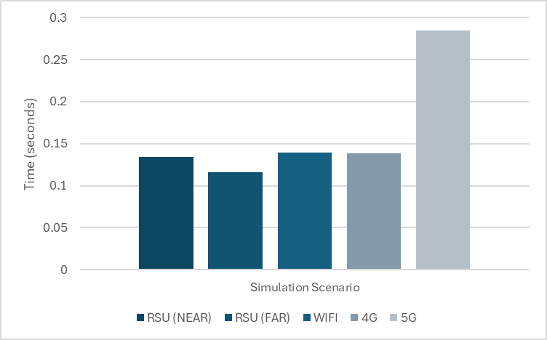
Fig. 12: Hash Calculation Computational Time
Notes:
Now we move onto the computational usage results, here it can be seen that the hash calculation time remains within the expected range for all network scenarios simulated using our experimental setup with the highest value being 0.2846 seconds for the 5G network scenario. Furthermore, our proposed approach introduces only a small increase in update time across all network scenarios, with the most notable difference observed in the RSU (Far) and WiFi scenarios. However, the increase is relatively minor and does not undermine the benefits of enhanced security provided by the Blockchain-based method.
Moreover, from our results, it can be interpreted that network scenarios with higher computational power requirements lead to increased calculation time; for example, 5G network scenarios demonstrated that although they are faster, they demand higher computational power, leading to increased calculation time. In scenarios such as the RSU (Near), a reduction in proximity leads to the CAV having more processing power to handle better the computational load required for cryptographic operations, such as SHA-256 hash calculations in our simulation scenarios.

Slide 40
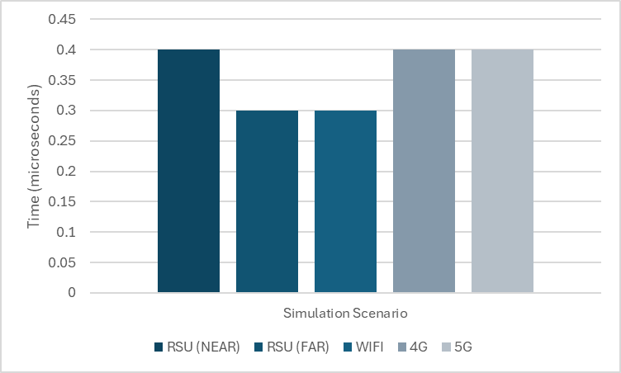
Fig. 13: Hash Comparison Computational Time
Notes:
Furthermore, here we can see in Figure 13 that the hash comparison also introduces very minor additional processing time, just like the query latency. However, this hash comparison is in microseconds (this is dependent on the hardware of the CAV).

Slide 41
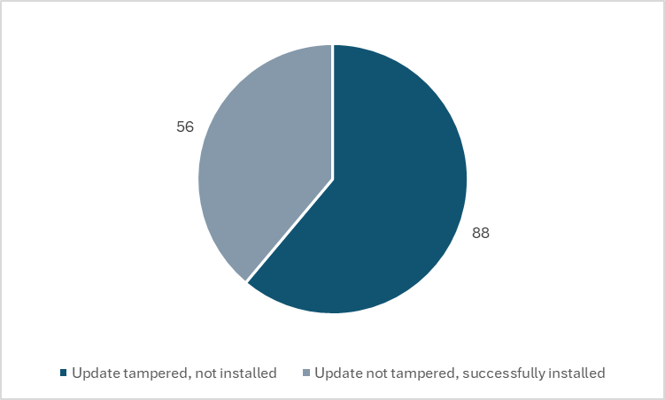
Fig. 14: Security Analysis (simulated MITM attack)
Notes:
The security robustness of our proposed Blockchain-based method was further validated by simulating a man-in-the-middle (MITM) attack, where a total of 250 CAVs across the 5 different network scenarios were randomly served a tampered OTA update package instead of the original update package to test the effectiveness of our method. Out of the 250 CAVs, 88 were served tampered OTA update packages, and the rest (162 CAVs) received untampered OTA update packages as illustrated in the FIg. 14.
The approach was successfully able to identify the tampered updates. Hence, it is safe to say that the our proposed permissioned Blockchain-based method demonstrate that the added security of Blockchain verification does not significantly decline the overall performance. Even in scenarios with slightly higher latency, such as RSU (Far) and WiFi, the trade-off between enhanced security and computational overhead (hash calculation and hash comparison computational time) can be considered justified, considering that the proposed architecture does not significantly burden the CAV’s computational resources with hash calculation and comparison times being minimal, and the network latency remains within acceptable limits for real-time operations.

Slide 42
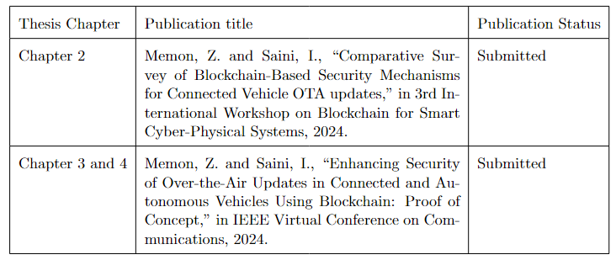
Notes:
The survey paper titled "Comparative Survey of Blockchain-Based Security Mechanisms for Connected Vehicle OTA Updates" was submitted to the 3rd International Workshop on Blockchain for Smart Cyber-Physical Systems, from which my Thesis's Chapter 2 is from.
A conference paper, "Enhancing Security of Over-the-Air Updates in Connected and Autonomous Vehicles Using Blockchain: Proof of Concept", was submitted to the IEEE Virtual Conference on Communications, from which my Thesis Chapter 3 and 4 is from.

Slide 43
Conclusion and Future Work

Slide 44
Conclusion
We introduced a novel method that leverages the security features of permissioned Blockchain technology for the verification and authentication of the OTA update before the CAV installs them. The system adds very minimal overhead, with low latency in the query and hash verification processes. This work lays the groundwork for future research to secure OTA updates without modifying the existing infrastructure, but by enhancing it.
Notes:
In conclusion, we introduced a novel method that leverages the security features of permissioned Blockchain technology for verifying and authenticating OTA updates before they are installed in Connected Autonomous Vehicles (CAVs).
Our system adds minimal overhead, with low latency during the query and hash verification processes, making it efficient for real-time applications. Importantly, this method does not require significant changes to existing infrastructure; instead, it enhances the current OTA update process by providing a more secure and trustworthy mechanism for verifying update integrity.
Our research lays the groundwork for future research to secure OTA updates without modifying the existing infrastructure, but by enhancing it.

Slide 45
Future Work
Future work can focus on real-world testing to validate the system's simulation results under real-world conditions, which would involve varying the network connectivity, traffic loads, and testing with different types of CAV models. Furthermore, advanced consensus mechanisms, such as Practical Byzantine Fault Tolerance (PBFT), can be further explored to enhance the efficiency and security of the Blockchain network.
Notes:
For future work, the next steps can be focused on validating the simulation results in real-world environments. This would involve testing the system under real-world conditions with different variables such as network connectivity, traffic loads, and different types of CAV models with different hardware setups. These real-world tests would provide a more comprehensive evaluation of the proposed system's scalability, performance, and security against the discussed cyber security attacks.
Additionally, exploring advanced consensus mechanisms, such as Practical Byzantine Fault Tolerance (PBFT), could further enhance the efficiency and security of the Blockchain network. As advanced consensus mechanisms like PBFT, are better designed to tolerate faulty nodes, which would improve the robustness of the Blockchain network, especially in dynamic environments like vehicular networks.
By addressing these areas, the work could be expanded to ensure the method is both scalable and adaptable to the increasing demands of connected and autonomous vehicle ecosystems.

Slide 46
REFERENCES
[1] K. Kainrath, "Cybersecurity in the Automotive Industry: New Challenges for Automotive Developers," Inside Automotive, Magna International, Oct. 23, 2023. [Online]. Available: https://www.magna.com/stories/inside-automotive/2023/cybersecurity-in-the-automotive-industry. [Accessed: Sep. 8, 2024].
[2] "Vehicle electronic control unit (ECU) consolidation targets the self-driving autonomous car," VentureOutsource.com, Oct. 2023. [Online]. Available: https://ventureoutsource.com/contract-manufacturing/vehicle-electronic-control-unit-consolidation-targets-the-self-driving-autonomous-car. [Accessed: Sep. 9, 2024].
[3] "Secure updating of in-vehicle software by using OTA technology," Hitachi, Sep. 30, 2021. [Online]. Available: https://www.hitachi.com/products/it/lumada/global/en/spcon/uc_00866s/index.html. [Accessed: Sep. 9, 2024].
[4] ISO/SAE 21434: Road vehicles – Cybersecurity engineering, ISO, 2021. [Online]. Available: https://www.iso.org/standard/70918.html. [Accessed: Sep. 9, 2024].
[5] United Nations Economic Commission for Europe, Addenda to the 1958 Agreement: Regulations 141-160, 2021. [Online]. Available: https://unece.org/transport/vehicle-regulations-wp29/standards/addenda-1958-agreement-regulations-141-160. [Accessed: Sep. 9, 2024].
[6] S. Kim and R. Shrestha, Automotive Cyber Security: Introduction, Challenges, and Standardization. Singapore: Springer Singapore, 2020. [Online]. Available: https://link.springer.com/10.1007/978-981-15-8053-6.
[7] A. Peterson, "Researchers remotely hack Tesla Model S," The Washington Post, Sep. 20, 2016. [Online]. Available: https://www.washingtonpost.com/news/the-switch/wp/2016/09/20/researchers-remotely-hack-tesla-model-s/. [Accessed: Sep. 9, 2024].
Notes:
Here are the slides used for my presentation. Sources for the data are all mentioned here.

Slide 47
[8] P. Paganini, "Jeep Cherokee hack leads Fiat Chrysler to recall 1.4M vehicles," Security Affairs, Jul. 24, 2015. [Online]. Available: https://securityaffairs.com/38844/hacking/jeep-cherokee-hack-fiat-recall.html. [Accessed: Sep. 9, 2024].
[9] "Nissan Leaf electric cars 'vulnerable to hack attack'," BBC News, Feb. 24, 2016. [Online]. Available: https://www.bbc.com/news/technology-35642749. [Accessed: Sep. 9, 2024].
[10] S. Yeasmin and A. Haque, "A Multi-Factor Authenticated Blockchain-Based OTA Update Framework for Connected Autonomous Vehicles," in Proc. 2021 IEEE 94th Vehicular Technology Conference (VTC2021-Fall), 2021, pp. 1-6. Doi: 10.1109/VTC2021-Fall52928.2021.9625372.
[11] S. Yeasmin, A. Haque, and A. Sayegh, "A Novel and Failsafe Blockchain Framework for Secure OTA Updates in Connected Autonomous Vehicles," SSRN Electronic Journal, 2022. doi: 10.2139/ssrn.4098797.
[12] S. Yeasmin and A. Haque, "DDoS Attack Prevention in Autonomous Vehicle’s OTA Updates: Combining PBFT Consensus and Distributed Firewall in Hyperledger Fabric Blockchain," in 2024 International Wireless Communications and Mobile Computing (IWCMC), Ayia Napa, Cyprus, 2024, pp. 1197-1202. doi: 10.1109/IWCMC61514.2024.10592450.
[13] A. Dorri, M. Steger, S. Kanhere, and R. Jurdak, "BlockChain: A Distributed Solution to Automotive Security and Privacy," IEEE Communications Magazine, vol. 55, 2017. doi: 10.1109/MCOM.2017.1700879.
[14] M. Steger, A. Dorri, S. S. Kanhere, K. Römer, R. Jurdak, and M. Karner, "Secure Wireless Automotive Software Updates Using Blockchains: A Proof of Concept," in Proc. 2017 IEEE International Conference on Blockchain (Blockchain 2017), 2017. [Online]. Available: https://api.semanticscholar.org/CorpusID:67306708.

Slide 48
[16] Z. Zheng, S. Xie, H. Dai, X. Chen, and H. Wang, "An Overview of Blockchain Technology: Architecture, Consensus, and Future Trends," in 2017 IEEE International Congress on Big Data (BigData Congress), 2017, pp. 557-564. doi: 10.1109/BigDataCongress.2017.85.
[17] Zheng, Zibin & Xie, Shaoan & Dai, Hong-Ning & Chen, Xiangping & Wang, Huaimin. (2018). Blockchain challenges and opportunities: A survey. International Journal of Web and Grid Services. 14. 352. 10.1504/IJWGS.2018.095647.
[18] The Linux Foundation, Smart Contracts in Hyperledger Fabric, Release 2.5, 2024. [Online]. Available: https://hyperledger-fabric.readthedocs.io/en/release-2.5/smartcontract/smartcontract.html. [Accessed: Sep. 9, 2024].
[19] The Linux Foundation, Hyperledger Fabric Documentation, Release 2.5, 2024. [Online]. Available: https://hyperledger-fabric.readthedocs.io/en/release-2.5/. [Accessed: Sep. 9, 2024].
[20] OMNeT++ Community, OMNeT++: Discrete Event Simulator, 2024. [Online]. Available: https://omnetpp.org/. [Accessed: Sep. 9, 2024].
[21] Veins Project, Veins: Vehicles in Network Simulation, 2024. [Online]. Available: https://veins.car2x.org/. [Accessed: Sep. 9, 2024].
[22] German Aerospace Center (DLR), SUMO Documentation, 2024. [Online]. Available: https://sumo.dlr.de/docs/index.html. [Accessed: Sep. 9, 2024].

Slide 49
THANK YOU!

