Slide 1

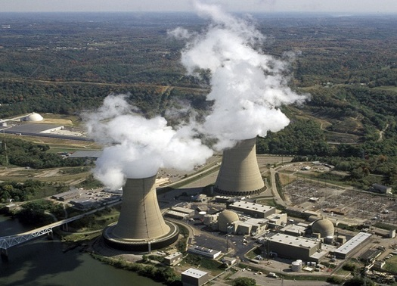
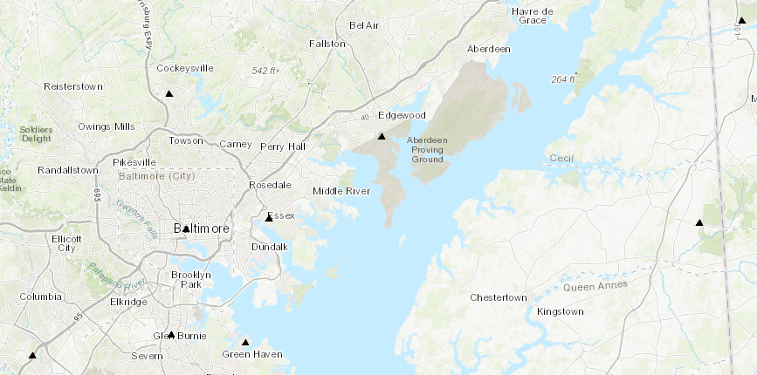
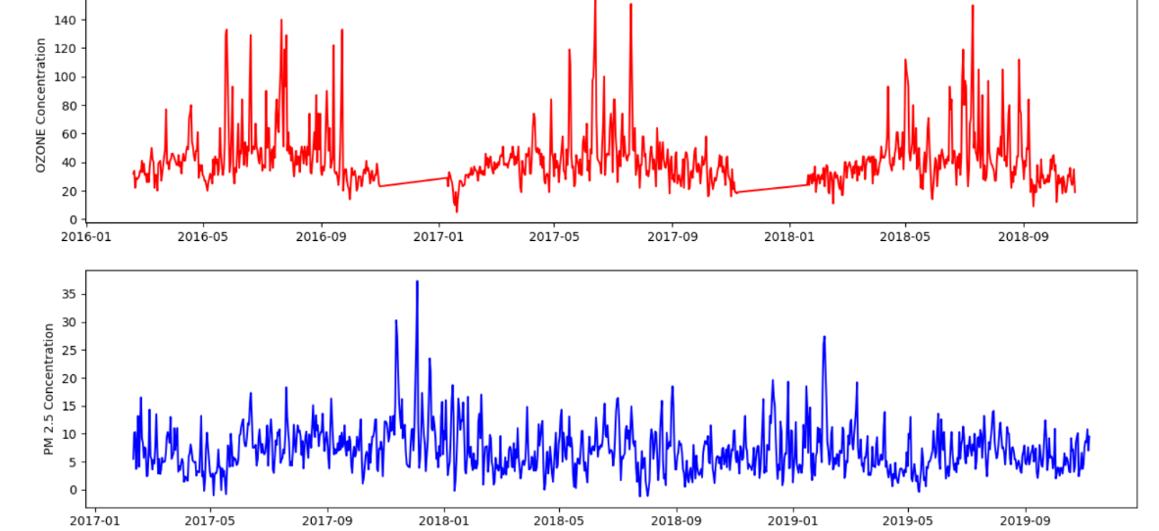

Environment Sustainability: Study of Impact of Air Pollution
CMSC 436/636: Data Visualization
Don Engel donengel@umbc.edu | Udit Choudhary uditc1@umbc.edu | Zeenat Ali zali2@umbc.edu
Motivation
Four sites of a state Maryland were considered based on the ones that have most impact on the overall study towards a better and more efficient data visualization. Percentage of pollutant PM2.5 was plotted over a period of about 2 years from Jan 2017 to Sep 2019 to compare the rise and fall of the pollution in those regions.
Figure 1: The Chalk Point Power Generating Plant located on the Patuxent River: the leading polluter in Prince George's County, Maryland, according to pollution research site Scorecard.org.[7] It produced 5,271,800 pounds (2,391 metric tons) of air pollution (not counting CO2).
Although many of us are aware of the most common pollution causing factors that is harming the air we breathe and the atmosphere, there is a room for identifying some of the new and uncommon pollutants and their level of impact on the mother nature. For example, CFCs and the methane gas produced by animal husbandry in various economies depleted the ozone layer considerably in past few decades. In this project such causes along with other common causes will be highlighted and the impact will be studied.
The study intends to help the user to visualize the increase and decrease of air pollution level and its causes at various sites of Maryland over a period of three years.
Figure 3: pollutant was kept fixed which was PM2.5 (Particulate matter of size less than 2.5 microns in diameter) and four sites of Maryland were considered for the same pollutant.

