Slide 1

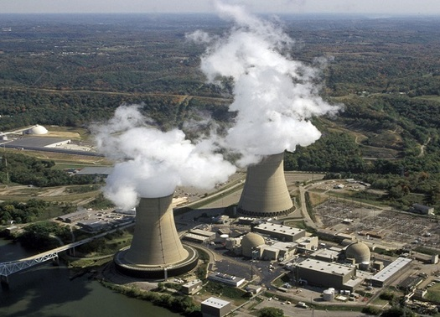
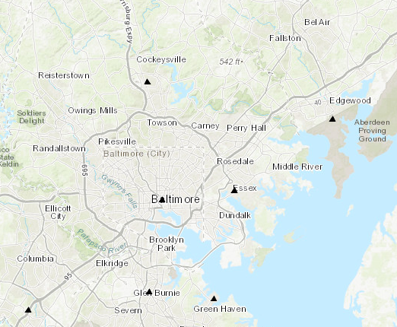
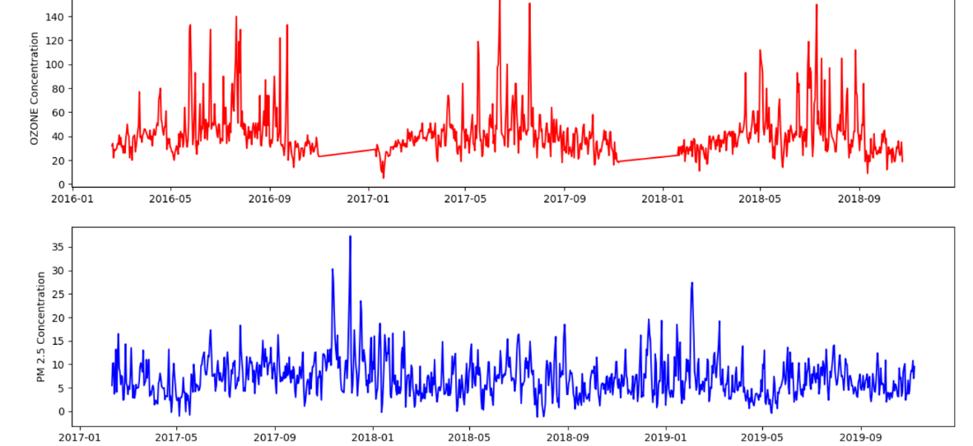

Environment Sustainability: Study of Impact of Air Pollution
CMSC 436/636: Data Visualization
Don Engel donengel@umbc.edu | Udit Choudhary uditc1@umbc.edu | Zeenat Ali zali2@umbc.edu
Motivation

