Slide 1
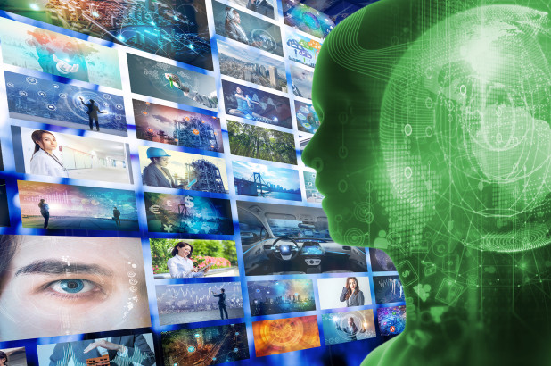
DeepFake Video Competition: Speech to Text
Team Members:
Zeenat Tariq
Sayed Khushal Shah
Vijaya Yeruva

Slide 2
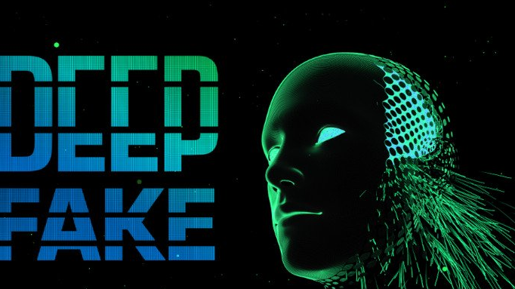
Deep Fake Detection
AI-based technology used to produce or alter video content
It presents something that didn't, in fact, occur
It changes the meaning of the picture

Slide 3
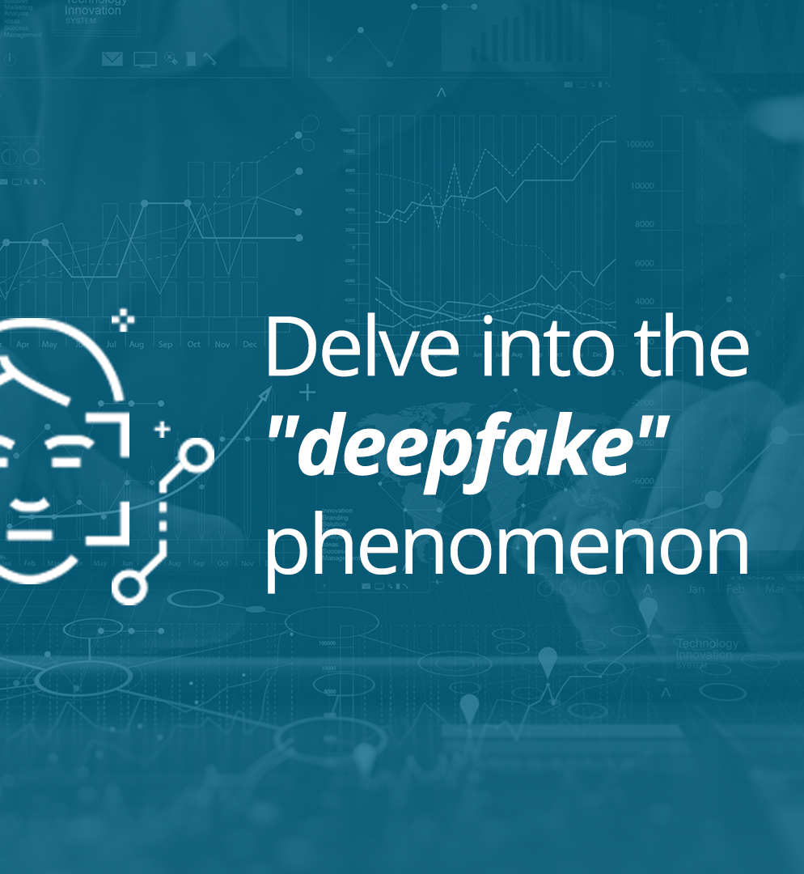
Objective
Get Fake Videos (with annotation about fake)
Audio extraction from video
Google talk or something similar speech-to-text conversion
Find out content about the fake (topic, words, sentence, etc)

Slide 4
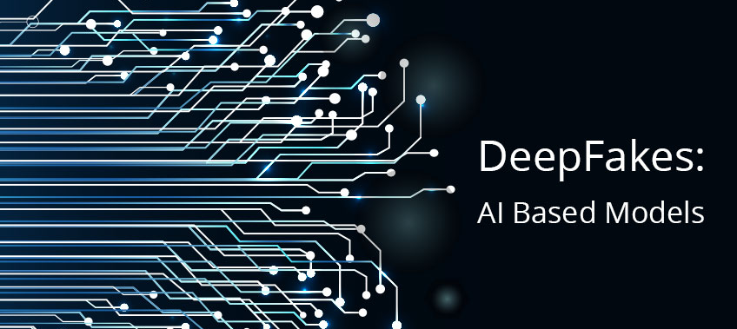
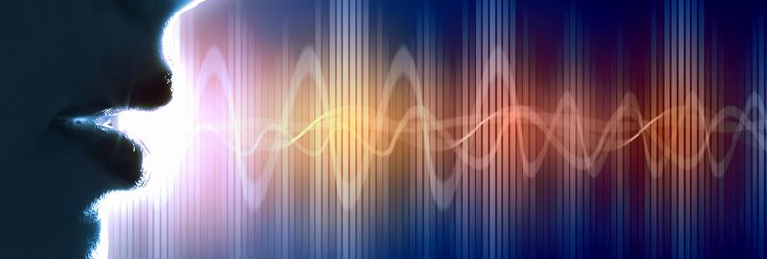
Proposed Solution
Identify any labelled fake audio/text data.
Convert audio/speech to text
Find any deep learning model to identify fake text data
Create our own model to identify fake text data

Slide 5
References
https://openai.com/blog/better-language-models/
https://ai.googleblog.com/2019/09/contributing-data-to-deepfake-detection.html
Radford, Alec, et al. "Language models are unsupervised multitask learners." OpenAI Blog 1.8 (2019).

