Slide 1
MediStop
Diksha Bhatia - 002175782
Virendra Rathore - Zeenia Singla -

Slide 2
03
01
02
Problem Statement
Object Diagram
Roles, UIs and Visualizations
04
Work Requests
05
06
Developer Insights
Future Scope

Slide 3

01
PROBLEM STATEMENT

Slide 4
PROBLEM STATEMENT
Developing a one stop solution that connects Hospitals, Patients, Blood Banks, Donors and Charities.
Ease of connecting with matching fund donors
Ease of adding slots of available appointments of Doctors for hospital staff.
Linking of donors from different charities to patients in need
Requesting and managing inventory from the blood bank
Summarizing data at admin level

Slide 5

02
OBJECT MODEL

Slide 6
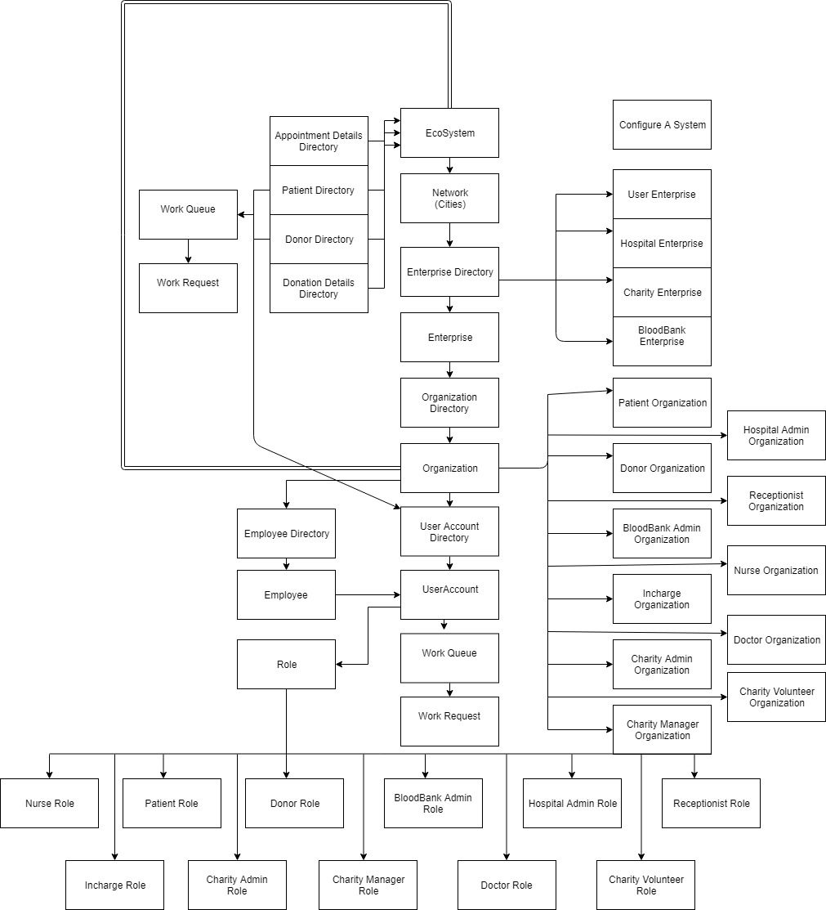

Slide 7

03
Enterprises, Roles, UI and Information analysis

Slide 8



Hospital Admin
Manage Doctors
Manage Assistants
Manage Attendants
Doctors provide diagnosis to patients and provide them necessary prescriptions.
Doctors also assess if the patient needs blood or funds
Add appointments for doctors
Accepts or rejects visit requests based on urgency
Raise Funding requests to charities for patients in need
Manages acknowledgements for patients that have successfully received funds.
Adds request for blood and blood type needed for a particular patient.
Check Status of raised requests.

Slide 9

Blood Bank Admin
Manages Inventory of the Blood bank
Accepts/Rejects requests made to blood bank based on variety of reasons

Slide 10


Funds Admin
Manages Volunteer
Publishes Newsletter to donors
Manages Admin
Views a list of donors and donations
Views a list of patients requesting funds
Manages funds received and donated

Slide 11

04
WORK REQUESTS

Slide 12
Donor & Patient User Requests
Authentication via OTP generated
Signup
1
2
3
4
User verification
Login to the donor/patient work area

Slide 13
Outline of Blood Order Request
STEP 2
STEP 4
STEP 1
STEP 3
Based on availability and urgency, blood supplies are allocated to different hospitals by the blood bank manager
Attendant would raise requests to blood banks for the required number of blood units required
Doctor enters the need of blood for a patient record
Order queued on the Blood banks’ work queue
based on priority

Slide 14
Outline of Funds Request
STEP 4
STEP 2
STEP 1
STEP 3
Based on availability and urgency, funds are allocated to different hospitals by the funds manager to the patients in need
Assistant would raise requests to charities for the required funds
Doctor enters the need of funds for a patient record
Order Rquests queued on the Fund Managers’ work queue
based on priority

Slide 15

05
Developer Insights

Slide 16
205
11
Commits to Master Branch
Branches
15
Closed Pull requests

Slide 17

06
Future Scope

Slide 18
Future Scope
1. Finding geographically eligible blood donors for the blood bank
2. Integrating with google maps API to find out nearest donors
Key Features
Integration with payments gateways
Global reach
Enhancing our system to manage organ donors.

Slide 19
Thank You

