Slide 1
INFO 7390 PROJECT AIR QUALITY INDEX PREDICTION
Aishwarya Mishra - 002127206
Sri Sai Amulya Nittala – 002194776
Zeenia Singla - 002980842

Slide 2
Problem statement - 1
With every increasing pollution by various pollutants, there is a serious need to understand how each pollutant contributes to pollution and predict it
In this project we aim to predict the levels of pollution using the 'India Air Quality' dataset
The independent variables are the different pollutants, i.e, Sulphur Dioxide (so2), Nitrogen Dioxide (no2), Respirable Suspended Particulate Matter (rspm), Suspended Particulate Matter (spm) and Suspended particulate matter with diameters less than 2.5 micrometers (pm2_5)

Slide 3
problem statement - ii
The focus of this project is learning about modeling of data using supervised algorithms and determine Air Quality Index (AQI) caused by factors that affects AQI i.e (so2, no2, spm, rspm, pm2_5).
Our independent variables are the pollutants, and the target variable is AQI.
Since we are predicting the values of AQI, it is a regression problem.

Slide 4
Regression models
The supervised machine learning algorithms we used are:
Linear Regression
Ridge Regression
Lasso Regression
Decision Tree Regressor
Random Forest Regressor
XGBoost

Slide 5
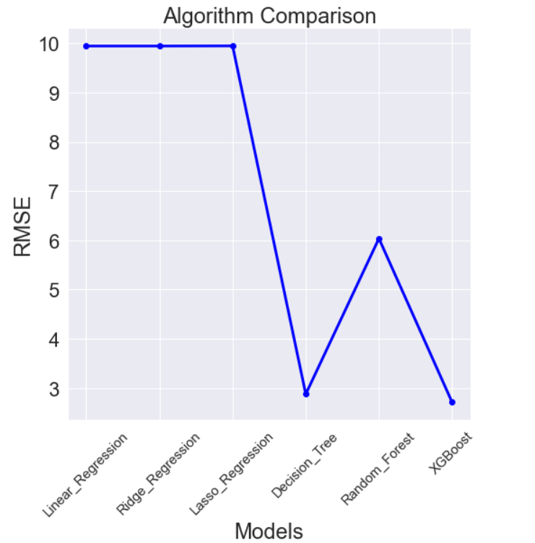
Performance evaluation
From the graph:
XGBoost performs best for our dataset.
Linear, Ridge, Lasso Regression are not the best models for our prediction and have higher RMSE as compared to XGBoost.
Decision Tree is also a good model at predicting AQI.

Slide 6
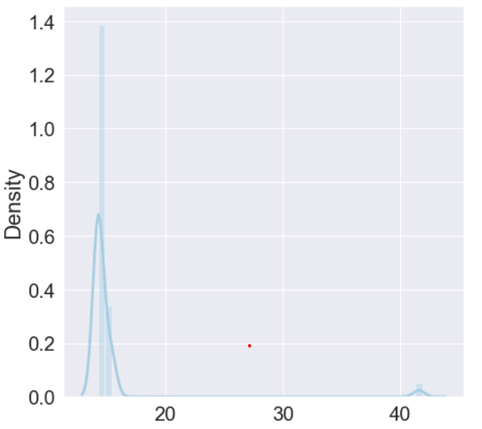
Testing our model
Running XGBoost on our test data and plotting the predicted values.

Slide 7
CITATIONS
https://scikit-learn.org/stable/modules/generated/sklearn.linear_model.LinearRegression.html
https://scikit-learn.org/stable/modules/generated/sklearn.linear_model.Ridge.html
https://scikit-learn.org/stable/modules/generated/sklearn.linear_model.Lasso.html
https://scikit-learn.org/stable/modules/tree.html
https://scikit-learn.org/stable/modules/generated/sklearn.ensemble.RandomForestRegressor.html
https://xgboost.readthedocs.io/en/stable/python/python_api.html

