Slide 1






NUEVA ECIJA UNIVERSITY OF SCIENCE AND TECHNOLOGY
PAPAYA OFF-CAMPUS
PROPONENTS
Aberin, John Cedrick G.
Martin, Edrick V.
Quijano Justine B.
Notes:
1

Slide 2

NUEVA ECIJA UNIVERSITY OF SCIENCE AND TECHNOLOGY
PAPAYA OFF-CAMPUS
“A Cirruculum-Aligned AI-Driven Learning Platform for Programming Instruction in Penaranda Senior High School”
Notes:
2

Slide 3
NUEVA ECIJA UNIVERSITY OF SCIENCE AND TECHNOLOGY
PAPAYA OFF-CAMPUS
Introduction
Artificial Intelligence (AI) is transforming education by providing personalized and interactive learning experiences. In programming education, many senior high school students struggle with complex concepts such as logic building, loops, and arrays, while teachers face challenges in giving individual support and monitoring student progress. Existing Learning Management Systems (LMS) mainly serve as storage platforms and lack features like real-time coding support, automated feedback, and intelligent tutoring
Notes:
2

Slide 4
NUEVA ECIJA UNIVERSITY OF SCIENCE AND TECHNOLOGY
PAPAYA OFF-CAMPUS
Introduction
To address these issues, this study proposes a curriculum-aligned AI-driven learning platform designed for programming instruction. The system integrates AI-powered tutoring, a built-in code editor, automated quiz generation, and performance analytics to provide students with real-time guidance and personalized learning support. At the same time, it helps teachers deliver instruction more efficiently and monitor student performance effectively. Overall, the study aims to improve programming education through a practical and interactive AI-based learning solution.
Notes:
2

Slide 5
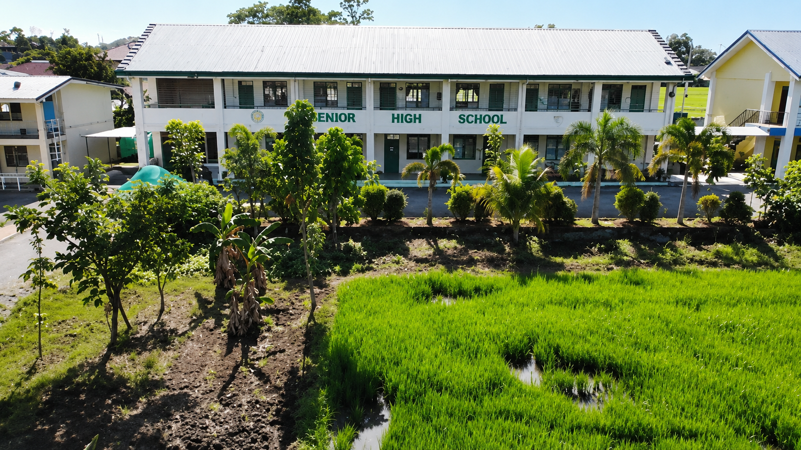
NUEVA ECIJA UNIVERSITY OF SCIENCE AND TECHNOLOGY
PAPAYA OFF-CAMPUS
Company Background
Notes:
2

Slide 6
NUEVA ECIJA UNIVERSITY OF SCIENCE AND TECHNOLOGY
PAPAYA OFF-CAMPUS
General Problem
How will the proponents design, develop, and implement A Curriculum-Aligned AI-Driven Learning Platform for Programming Instruction using the Agile software development approach to address the challenges faced in programming education, improve the delivery of programming lessons, provide real-time academic support and automated feedback, and enhance students’ learning experience through an integrated and curriculum-aligned coding platform?
Notes:
2

Slide 7
NUEVA ECIJA UNIVERSITY OF SCIENCE AND TECHNOLOGY
PAPAYA OFF-CAMPUS
Specific Problem
How can the proponents design and develop a curriculum-aligned AI-driven learning platform that will provide an integrated coding environment for Grade 12 ICT students at Peñaranda Senior High School?
Notes:
2

Slide 8
NUEVA ECIJA UNIVERSITY OF SCIENCE AND TECHNOLOGY
PAPAYA OFF-CAMPUS
Specific Problem
How can the proponents develop a system that will provide real-time academic support, guided assistance, and automated feedback to help students better understand programming concepts and improve their coding skills?
Notes:
2

Slide 9
NUEVA ECIJA UNIVERSITY OF SCIENCE AND TECHNOLOGY
PAPAYA OFF-CAMPUS
Specific Problem
How can the proponents implement a centralized learning platform that will allow teachers to manage lessons, generate quizzes, monitor student performance, and deliver programming instruction more effectively?
Notes:
2

Slide 10
NUEVA ECIJA UNIVERSITY OF SCIENCE AND TECHNOLOGY
PAPAYA OFF-CAMPUS
Specific Problem
How can the proponents evaluate the developed system in terms of functional suitability, performance efficiency, usability, reliability, maintainability, security, portability, and compatibility to ensure the quality and effectiveness of the platform?
Notes:
2

Slide 11
NUEVA ECIJA UNIVERSITY OF SCIENCE AND TECHNOLOGY
PAPAYA OFF-CAMPUS
General Objectives
The main objective of A Curriculum-Aligned AI-Driven Learning Platform for Programming Instruction is to design and develop a centralized AI-driven learning platform that will improve the delivery of programming education for Grade 12 ICT students at Peñaranda Senior High School. This study aims to create a platform that will provide an integrated coding environment, real-time academic support, and curriculum-aligned learning resources to make programming instruction more interactive, efficient, accurate, and accessible for both students and teachers.
Notes:
2

Slide 12
NUEVA ECIJA UNIVERSITY OF SCIENCE AND TECHNOLOGY
PAPAYA OFF-CAMPUS
Specific Objectives
• To develop a curriculum-aligned AI-driven learning platform that allows Grade 12 ICT students to write, compile, run, and submit Java programs within an integrated web-based code execution.
• To provide an AI-powered tutoring feature that can deliver real-time academic support, guided assistance, and automated feedback to help students improve their programming skills and problem-solving abilities.
• To create a centralized learning management module that allows teachers to upload curriculum-based materials, generate quizzes and lessons, monitor student progress, and manage programming courses effectively.
Notes:
2

Slide 13
NUEVA ECIJA UNIVERSITY OF SCIENCE AND TECHNOLOGY
PAPAYA OFF-CAMPUS
Scope and Limitation
Teacher Module
Enables teachers to create and manage classes
Allows building of structured courses composed of modules, lessons, and assessments
Supports uploading of curriculum documents (Daily Lesson Logs, learning guides) as knowledge base for AI features
Provides tools for managing student progress within courses
Student Learning Module
Delivers structured, sequential learning experience for programming instruction
Includes a built-in Java code editor for hands-on programming practice
Provides automated assessments for programming exercises
Allows students to view modules, lessons, and assessment results
Notes:
2

Slide 14
NUEVA ECIJA UNIVERSITY OF SCIENCE AND TECHNOLOGY
PAPAYA OFF-CAMPUS
Scope and Limitation
AI Tutor Module (Curriculum-Aligned)
Embeds an AI-powered tutor capable of answering programming-related questions
Uses retrieval-augmented generation (RAG) to ground responses specifically in teacher-uploaded curriculum materials
Provides hint-based guidance without directly supplying answers
Limits AI responses to class-taught content, avoiding general internet knowledge or curriculum deviations
Accessibility & Infrastructure Considerations
Designed with resource constraints of schools like Peñaranda Senior High School in mind
Favors accessibility and simplicity over feature complexity
Notes:
2

Slide 15
NUEVA ECIJA UNIVERSITY OF SCIENCE AND TECHNOLOGY
PAPAYA OFF-CAMPUS
Limitations
Scope of AI responses is intentionally restricted – The AI Tutor does not answer programming questions beyond the teacher's uploaded curriculum documents (DLLs, learning guides) to ensure alignment with class instruction.
Limited to Java programming (for now)– The built-in code editor and automated assessments are designed for Java instruction, as cited in the problem context of the study.
No real-time teacher-AI coordination – The AI Tutor functions as an on-demand support tool but does not replace or directly integrate with live teacher intervention during class hours.
No offline AI functionality – Given the RAG-based approach requiring access to uploaded curriculum documents, the AI Tutor requires internet connectivity; students in offline environments cannot access AI assistance.
Notes:
2

Slide 16
NUEVA ECIJA UNIVERSITY OF SCIENCE AND TECHNOLOGY
PAPAYA OFF-CAMPUS
Thank you!

