Slide 1
GUPnP
Past , Present and the Future
  Zeeshan Ali

Slide 2
In the beginning..
  Distributed multimedia (gstreamer) pipelines
  Libupnp
  Opened Hand (Jorn Baayen)
  Intel tools for UPnP

Slide 3
What do we offer?
  gssdp, gupnp, gupnp-ui and gupnp-av
  Clean and easy to use and learn API
  Bunch of GObjects
  GMainLoop integration
  Single-threaded
  Targeted for embedded systems
  Vala bindings

Slide 4
What do we offer? (continued)
  Developer tools:
      Universal Control Point
      Network Light
      AV Control Point
      Uploader
  Media Server
  Media Renderer

Slide 5
The future is bright
  Maemo
  Rygel
      gupnp-media-server
      GNOME (Mobile)
  DLNA
  Language bindings (gobject-introspection)

Slide 6
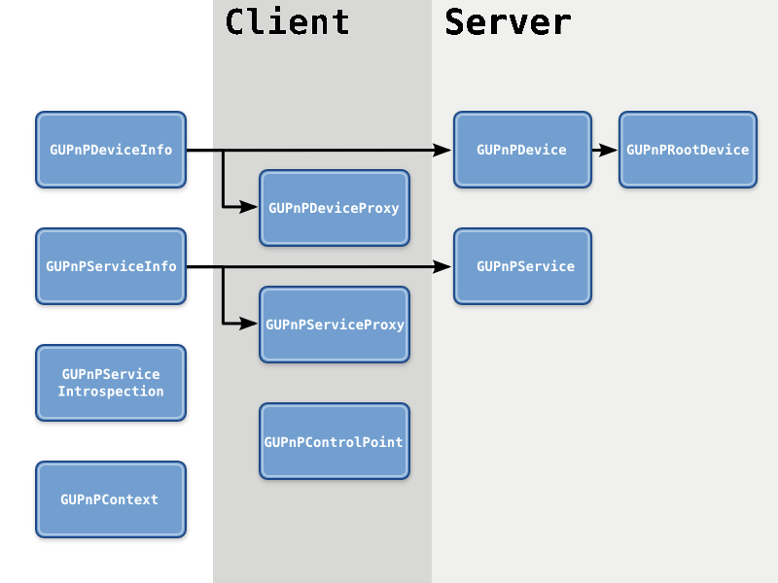
Object hierarchy

Slide 7
Implementing a Network Light
  Device description (~50 lines of XML)
      Basic info (friendly name, type, and icons etc)
      Vendor info (name, version and website etc)
  Service description (~100 lines of XML)
      Actions (name, argument names and types etc)
      State Variables (names and types etc)
  < 200 LOC in C and 120 LOC in Vala

Slide 8
Demo
Network Light
Media Server + Media Renderer +
      AV Control Point
      MediaStreamer

Slide 9
Thanks!
Jorn Baayen
Matthew Allum
Ross Burton
Jussi Kukkonen
Many other jolly good people

