Slide 1
GUPnP and Rygel
The UPnP/DLNA solution for Maemo
Zeeshan Ali (Khattak)

Slide 2
What is UPnP & DLNA?
Universal Plug n Play (UPnP)
  Discovery, description, control & event notification
  Device, Service & Control Point
  IGD, Printer & Lightening Control etc
  AV: Media Server, Media Renderer
Digital Living Network Alliance (DLNA)

Slide 3
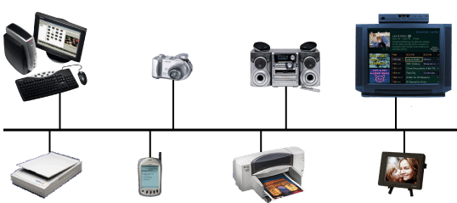
What is UPnP & DLNA? (continued)

Slide 4
Maemo's UPnP/DLNA needs
Profiles
  M-DMP (MediaPlayer & MAFW)
  IGD (farsight)
  M-DMS
  M-DMC
Resource constraints

Slide 5
Choice of a UPnP stack
ClinkC
Other C/C++ libraries
  libupnp
  MiniUPnP
Python libraries

Slide 6
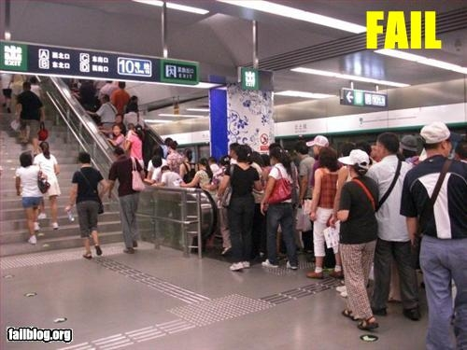
Laziness is not always a good thing

Slide 7
GUPnP
Completely OO
Single-threaded
Targeted for GNOME Mobile
Language Bindings
  Vala
  GObject-introspection (Python, Javascript, Scheme)
  PHP

Slide 8
Rygel
Dominar of the Hynerian Empire
Collection of DLNA (UPnP A/V) services
Targeted for GNOME Mobile
Written entirely in Vala
Plugin architecture

Slide 9
Rygel (continued)
Transcoding
Dynamic network support
Thumbnails

Slide 10
Future plans
Search
Upload
MediaRenderer
Album Art
Full DLNA-compliance
Better GObject-Introspection integration

