Slide 1

FSD
Pharma
Management System
Designed by FSD04 Team8

Slide 2
Background

Slide 3

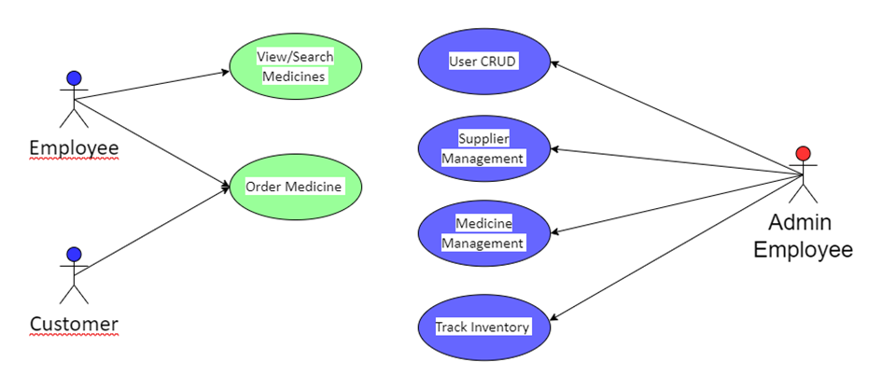
Solution Overview-Use Case Diagram

Slide 4
Solution Overview-Technologies
IDE: Visual Studio
Version Control: Git
Language: WPF C#
Framework: Entity Framework
Database: Azure SQL Database (database-first approach)
Library: Material Design
MVVM
LINQ
Unit Tests
StackPanel, GridSplitter
PDF-generation, export to Excel
Printing using WPF or additional library
Photo BLOB

Slide 5
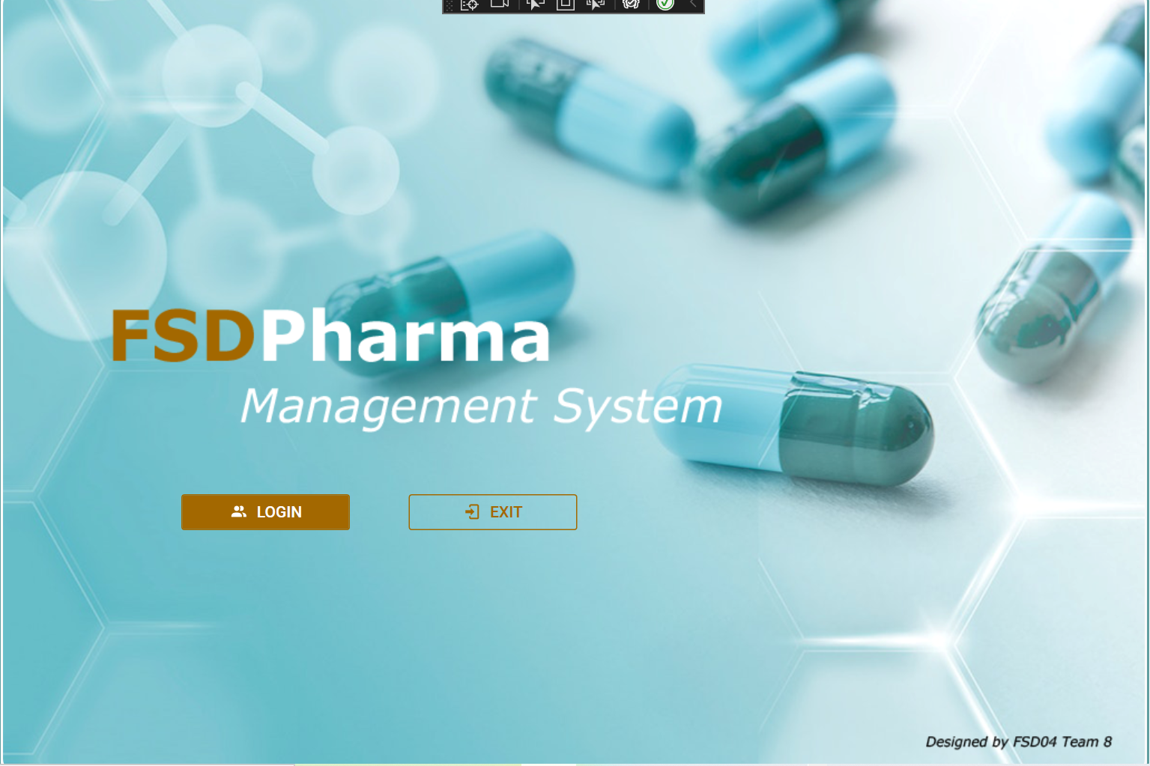
Display

Slide 6
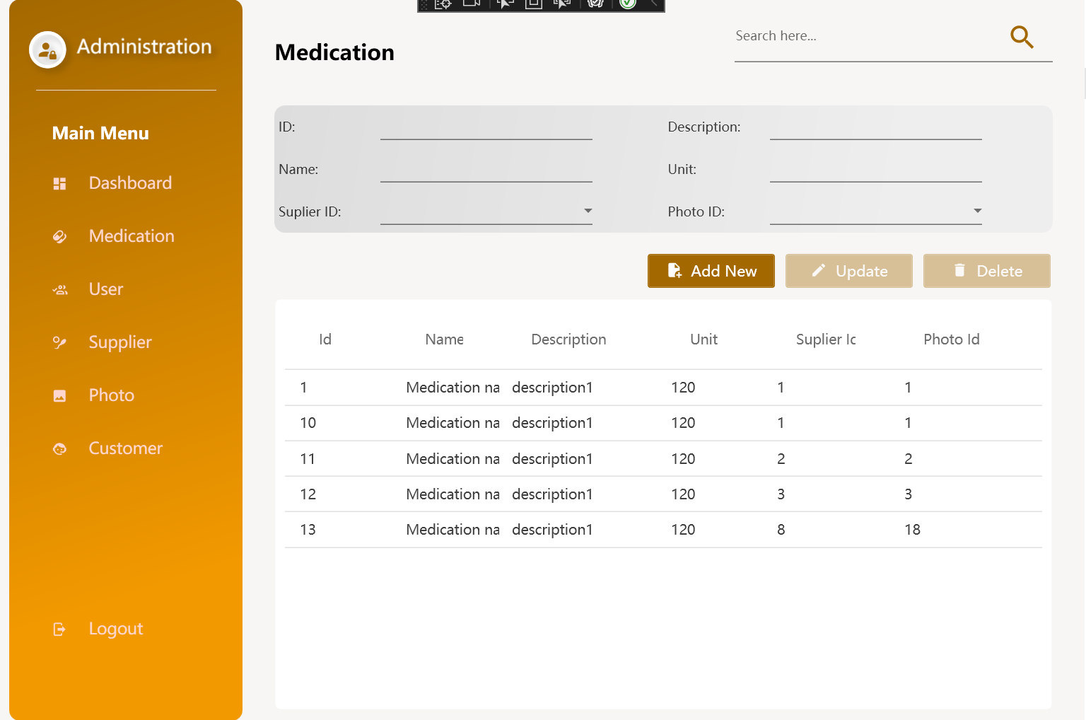
Display

Slide 7
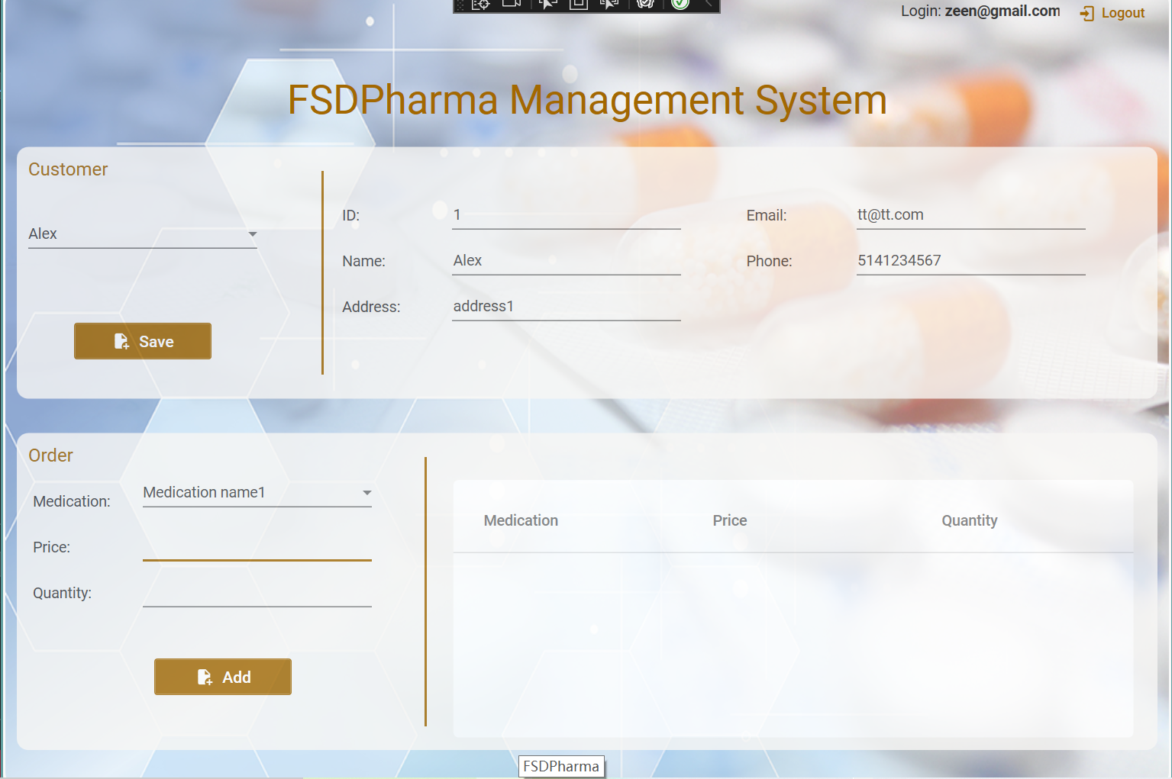
Display

Slide 8
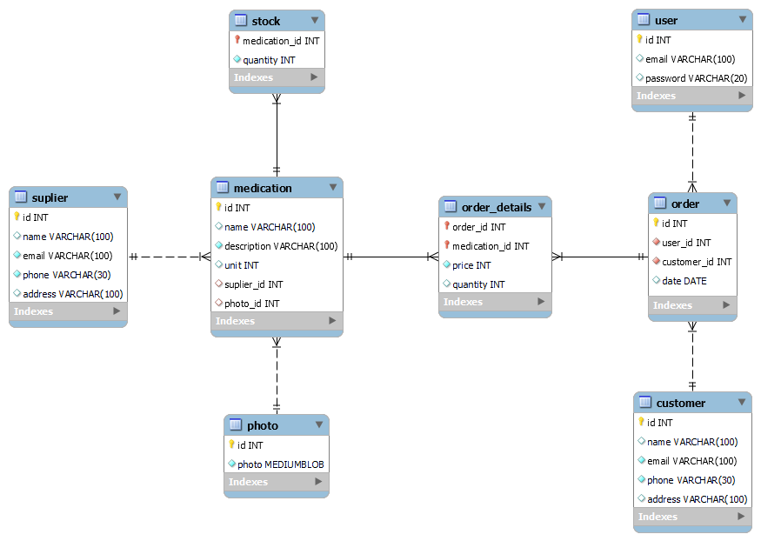
Challenges and Solutions-Database

Slide 9
Challenges and Solutions

Slide 10
Challenges and Solutions

Slide 11
Challenges and Solutions

Slide 12
What We Learned

Slide 13
What We Learned

Slide 14
What We Learned

Slide 15
Future Work

Slide 16
Summary

